Slide 1
Pulmonary Amyloidosis
Fellow 황지안

Slide 2
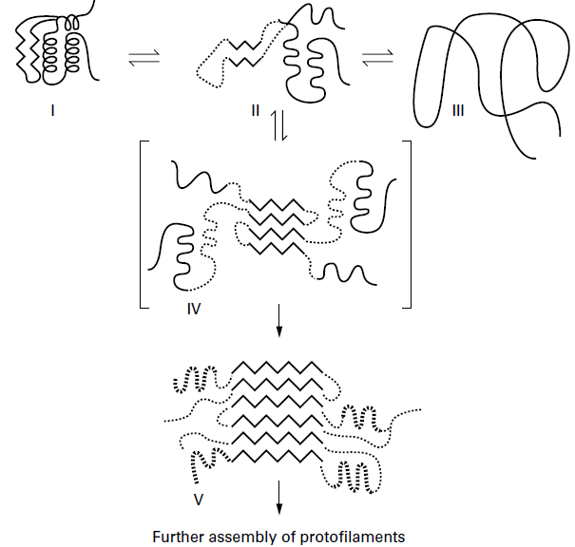
Definition
A collection of diseases in which different proteins are deposited as insoluble B-pleated sheets, disrupting organ function.
Thorax 1999;54:444–451
Notes:
predominantly antiparallel beta-pleated sheet configuration
Amyloidosis라는 질병은 특정한 종류의 단백질이, 용해되지 않는 B 주름의 형태로서 조직에 침착되는 질환을 통칭하는 용어.
이 때 fibril의 core structure를 이루는 B sheet는 매우 안정적인 구조를 이룬다 .
the development of the stable, mainly B-sheet, core structure of the fibril

Slide 3
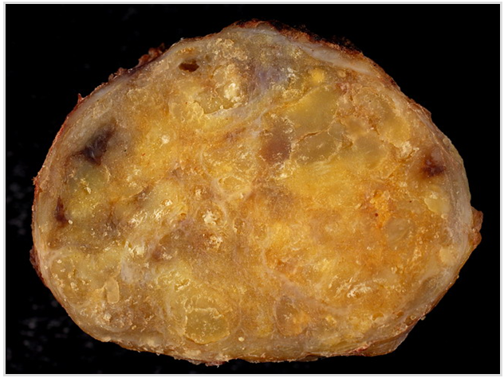
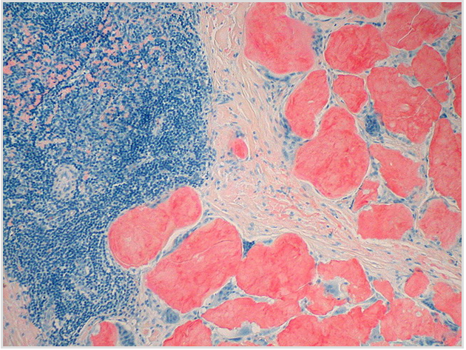
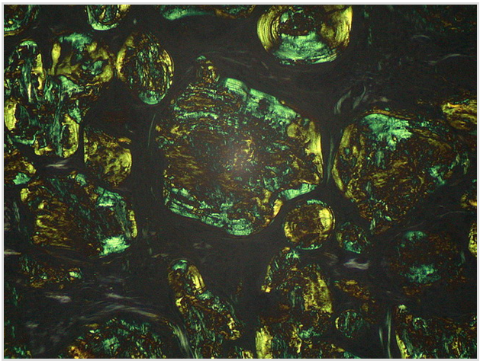
Notes:
이 때, amyloid는 특징적으로, 단단하고, waxy gross appearance를 보이고, 콩고 레드 염색을 시행했을 때, orange red color로 stain되면서 편광현미경에서는 apple green birefringence를 보이는 특징을 보인다.
Amyloid has a characteristic gross pathologic and microscopic appearance, demonstrating apple-green birefringence with polarized light microscopy of Congo red stained tissue
The lymph node was very firm and had a waxy consistency on cutting
Amyloid deposits stain orange-red with Congo Red stain
Amyloid has a characteristic apple-green birefringence with polarized light microscopy of Congo red stained tissue

Slide 4
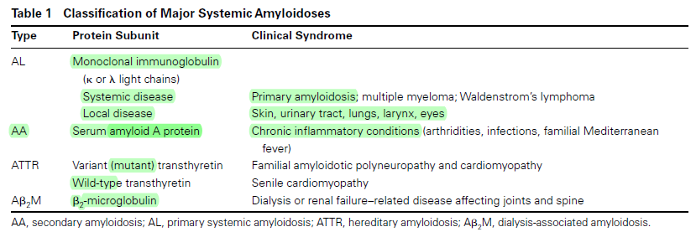
Classification
Seminars in Respiratory and Critical Care Medicine, volume 23, number 2, 2002
Notes:
이 때, 그 성분을 이루는 subunit protein에 따라서 organ involvement나 disease manifestation이 결정되는데, 첫글자 “A” 는 amyloid를 의미하고 다음 글자는 관련된 protein을 의미함.
Systemic amyloidosis는 크게 4가지 category로 구분됨.
(1) primary or immunoglobulin light-chain (AL) disease,
(2) secondary or amyloid protein A (AA) disease,
(3) hereditary or mutant transthyretin (ATTR) disease, and
(4) Dialysis associated or B2-microglobulin (B2M) disease
그외에도 관계된 protein의 종류에 따라 다양한 형태의 질환들이 존재한다. 여기서는 특이 pulmonary manifestation과 관련있는 systemic amyloidosis를 분류 해 본다.
Other less prevalent forms of amyloid disease exist,
locally affecting the pancreas (islet amyloid polypeptide,AIAPP)
brain (-amyloid precursor protein, A),
Genetically transmitted systemic disease (apolipoprotein AI, gelsolin, fibrinogen, lysozyme presuror proteins).

Slide 5
Secondary(AA) Amyloidosis

Slide 6
Demographics
Reactive amyloidosis (AA) results from excessive production and organ-deposition of an acute-phase reactant, serum amyloid A protein (SAA).
1% of patients with chronic inflammatory conditions (USA)
Rheumatic disease, infections, FMF, malignancies
Survival is determined by renal involvement. (11 vs 57 months)
Notes:
이것은 chronic inflammatory condition에서 reactive하게, acute phase reactant로서 serum amyloid A protein이 과도하게 생겨서 조직에 침착되는 질환.
여러 장기를 involve할 수 있지만 survival 과 관계 있는 것은 renal involvement인 것으로 알려져 있다.

Slide 7
LUNG INVOLVEMENT IN AA DISEASE
Autopsy finding
  Mild amyloid deposition in the airways and pulmonary vessels (3 cases)
  Absence of interstitial disease (alveolar–septal disease)
Clinical series
  Rarely identify patients with pulmonary manifestations
Exception
  Familial Mediterranean fever (FMF) rarely developing diffuse opacities, hilar adenopathy, and pulmonary hypertension
Notes:
Autopsy finding에서는 기존에 3 case에서 airway와 폐혈관에 경한 amyloid의 침착이 있었던 반면 interstitium 은 intact하였었는데,
Clinical 하게는 pulmonary manifestation은 매우 드문것으로 알려져 있다.
그렇지만 예외적으로 FMF는 diffuse하게 혹은 hilar adenopathy나 PH를 유발할 수 있는 것으로 알려져 있다.

Slide 8
Hereditary (ATTR) Amyloidosis

Slide 9
DEMOGRAPHICS
Precursor protein transthyretin (TTR):
Hereditary or familial amyloidosis, derived from mutant TTR
  - Rare AD disease, with a prevalence of less than 1 in 100,000 people (USA)
Senile systemic amyloidosis, caused by insoluble complexes of normal TTR
Untreated, survivorship is 7 to 15 years after diagnosis
Notes:
TTR을 precursor protein으로 하며, 크게 1. mutant TTR 에 의한 유전성과 2. normal TTR protein에 의한, 나이에 따라 증가하는 senile 의 두가 지 타입으로 나뉘고,
치료를 받지 않으면 진단 후 약 7-15년 정도 생존하는 것으로 알려짐.

Slide 10
PATHOGENESIS
Plasma TTR, a 55 kDa tetramer, is a transport protein principally synthesized by the liver
Single amino acid substitutions of TTR alter monomer folding and promote B-pleated sheet formation.
More than 60 variants have been described.
Peripheral neuropathy and cardiomyopathy are the most frequent findings - Lung involvement is rare.
Notes:
Plasma TTR은 간에서 합성되는 transport protein으로, 단일 아미노산의 치환이 일어나면서 protein folding에 변화가 일어나고, B-pleated sheet 를 형성하게 된다.
임상적으로는 peripheral neuropathy와 CM 가 가장 흔한 반면에, lung involvement는 드문것으로 알려져있다.

Slide 11
Immunoglobulin Light-Chain (AL) Amyloidosis

Slide 12
DEMOGRAPHICS
3200 new cases occur annually in the United States.
The incidence is 4.5 per 100,000.
Notes:
매년 미국에서 3200건의 새로운 case가 발생하고 있으며, incidence는 10만명당 4.5명인 것으로 알려져 있다.

Slide 13
PATHOGENESIS
Organ involvement results from the deposition of monoclonal or immunoglobulin (Ig) light chains.
Systemic disease - clonally expanded plasma cells residing in the BM secrete excessive quantities of monoclonal Ig which circulates in blood to target organs.
Localized disease arise from a small number of plasma cells surrounding the lesion.
Notes:
이것은 monoclonal 혹은 Ig light chain이 장기에 침착되서 생기는 것이고, systemic과 localized의 두가지 형태로 나뉜다.
이 때 systemic dz.는 BM에서 clonally expanded plasma cell이 monoclonal Ig을 과도하게 생성하고 이것이 혈액을 타고 target organ에 가서 생기는 형태이고, localized dz는 해당 lesion의 주변에 있는 plasma cell 이 이러한 Ig을 생성함으로써 생겨난다고 알려져 있다.

Slide 14
SYSTEMIC AL LUNG DISEASE
AL amyloid is found in the walls of most blood vessels, including the lung.
(1) Diffuse interstitial or alveolar-septal disease
(2) Nodular disease
(3) Intra and extrathoracic adenopathy
(4) Pleural disease
(5) Diaphragm deposition.
Notes:
먼저 systemic AL lung disease에 대해서 살펴보시면, AL amyloid는 lung을 비롯한 대부분의 혈관벽에 침착이 되는데,
5가지 형태의 extravascular lung involvement가 존재한다.

Slide 15
(1) Alveolar–Septal Disease
64% had no signs nor symptoms of lung disease.
Vital role of cardiac infiltration
  Histologic and clinical pulmonary disease were principally markers of severe cardiac infiltration, not the determinant of survivorship.
Clinical manifestations - kidney disease (28%), CHF (17%), and peripheral neuropathy (17%)
Complications - hemoptysis due to medial dissection of amyloid-infiltrated pulmonary arteries, massive pulmonary embolism related to extensive thrombosis of the IVC, chylous pleural effusions
Notes:
첫번째 alveolar septal disease의 경우는, Histolgic evidence가 저명함에도 불구하고, 64%에서는 증상이 저명하지 않다. 이 때,
임상적으로나 조직학적으로 pulmonary disease가 있는 경우, 이것은 이미 severe cardiac infiltration 이 존재함을 의미하는 marker이나, survival 을 결정하는 인자는 아니라고 한다.
Clinically는 kidney나 heart를 involve하는 경우가 가장 흔하며, complication으로는

Slide 16
(2)Nodular Disease
The presence of nodular amyloid deposits in systemic AL disease is controversial.
  - Rare to warrant biopsy identification
Notes:
두번째는 nodular disease인데, Systemic AL disease에서의 nodular disease의 존재는 controversial하기 때문에, 의심이 되면 확실히 하기 위해 bx. 가 필요하다.

Slide 17
(3)Adenopathy
8% of patients with systemic AL disease
Mediastinal or hilar adenopathy with or without accompanying pulmonary disease
Can mimic the glandular fever of sarcoidosis.
  Although longstanding sarcoidosis may induce secondary (AA) amyloidosis, no definite relationship with systemic AL has been established.
Notes:
세번째는 adenopathy인데, systemic AL disease의 약 8%가량에서 동반되는 것으로 알려져 있고, pulmonary disease를 동반 혹은 동반하지 않는 ~
이 때, sarcoidosis의 glandular fever를 mimic할 수 있다고 하는데,

Slide 18
(4)Pleural Disease
Large, recurrent effusions occur in the setting of significant cardiac dysfunction and pleural amyloid.
Left or right hemithorax and occasionally bilateral.
Transudate or exudate
Lymphocyte- predominant WBC counts range from 50 to 400/cm3.
Rarely, chylous effusions occur in patients with extensive amyloid burden.
Notes:
네 번째는 pleural disease의 경우인데, large, recurrent effusion은 대개는 significant한 cardiac dysfunction이나 pleural amyloid가 있는 경우 동반되며,
한쪽 hemithorax나 때때로 bilateral 하게도 생길 수 있으며, 성상은 transudate와 exudate모두 가능하고, lymphodominant하게 나타날 가능성이 크며, 드물게 amyloid burden이 extensive할 경우
Chylous effusion이 동반되는 것으로 알려져 있다.
Patients with nephrotic syndrome and serum albumin levels < 2.5 gm/dL do not frequently manifest pleural effusion in
the absence of congestive heart failure.

Slide 19
(5)Diaphragm Deposition
A case report of acute respiratory insufficiency and absent diaphragm excursion on sniff testing describes extensive amyloid infiltration of the diaphragm leaflets at autopsy
Phrenic nerves were spared of amyloid infiltration
Notes:
또한 드물지만 diaphragm을 involve할 수 있는 데 이와 관련하여서는, acute respiratory insufficiency를 유발하였던 증례가 있었고, sniff testing에서 diaphagm의 movement가 떨어져 있었던 경우이고, 부검에서 diaphragm에 extensive 한 amyloid 의 침착이 확인되었었다.
단, 이 때, phrenic nerve는 involve하지 않았었던 경우이다.

Slide 20
RADIOLOGY
Diffuse reticulonodular opacities
  - Almost exclusively manifest in systemic AL disease
Adenopathy
  - Noncalcified node enlargement
  - Frequently calcify in a popcorn pattern or, rarely, an eggshell conformation
  - Hilar nodes, the least involved site, typically enlarge bilaterally
Notes:
이 때, diffuse reticulonodular opacity를 보이는 경우는, 거의 대부분의 경우에 systemic AL disease에서 나타날 수 있는 소견이며,
Adenopathy의 경우 대개는 noncalcified LN의 enlargement를 동반하나, 팝콘 shape혹은 eggshell appearnce의 calcification을 동반하는 경우도 종종 관찰된다.
Hilar node는 잘 involve하지는 않지만, involve할 경우는 대개 bilateral 로 커지는 경향을 보인다.

Slide 21
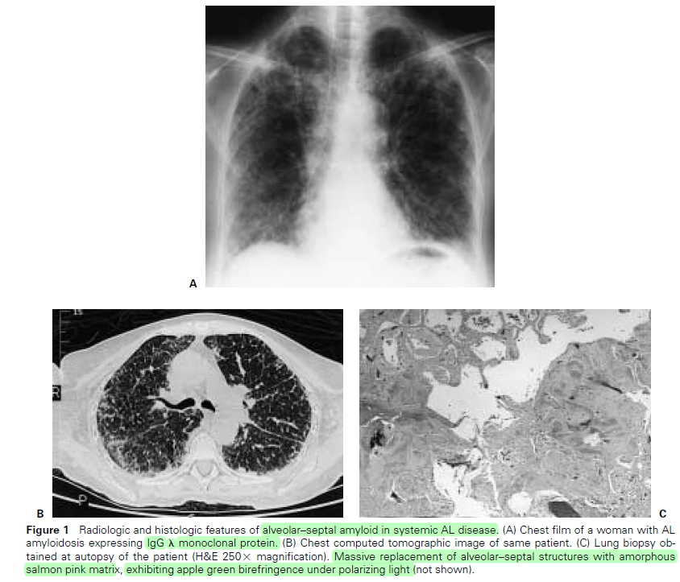
Seminars in Respiratory and Critical Care Medicine, volume 23, number 2, 2002
Notes:
이 사진은 systemic AL disease의 일환으로 alveolar septal disease pattern을 보였던 경우의 증례인데, CT에서 interstitum이 diffuse하게 두꺼워져 있는 모습이 관찰되고, 전자현미경에서는 alveolar septal structure에, amorphous한 salmon pink protein의 massive한 침착이 관찰된다. 환자는 Ig G 람다 타입의 monoclonal protein이 확인되었던 증례 이다.

Slide 22
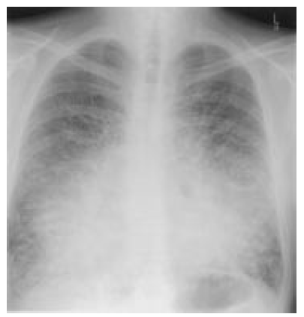
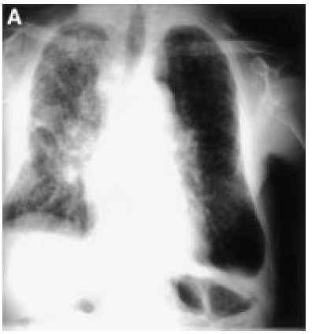
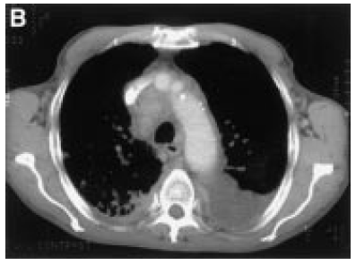
Thorax 1999;54:444–451
Notes:
Diffuse interstitial shadowing- 이후 BM Bx.서 monoclonal lymphoplasmacytoid population
Generalised lymphadenopathy associated with diffuse lung infiltration and pleural effusions.

Slide 23
LOCALIZED AL LUNG DISEASE
Nodular opacities (m/c)
Diffuse opacities
(3) Tracheobronchial disease

Slide 24
(1)Nodular Opacities
Diagnosed incidentally at open lung biopsy
Almost uniformly indicates localized disease.
Range in size from 0.6 to 9 cm (mean of 3 cm), present as multiple nodules of varying size and often appear peripherally in the lower lobes
Typically surrounded by plasma cells, lymphocytes, and giant cells; small amounts of amyloid can be found in contiguous blood vessels
Dystrophic calcification and bone formation in over 1/3
Grow slowly, and can cavitate.
Unless densely calcified, all nodules should expand at similar rates.
  Dyssynchronous growth of one lesion warrants investigation to rule out carcinoma
Typically does not impair lung function nor impact survivorship
Notes:
주로 open lung Bx.에서 incidental 하게 진단되는 경우들이고, 이 경우, 거의 항상 localized disease를 의미한다고 볼 수 있다.

Slide 25
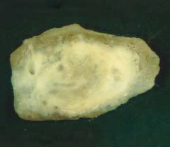
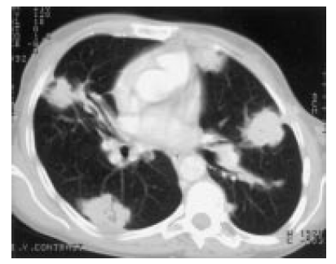
Am J Clin Pathol 2004;121:200-204
Thorax 1999;54:444–451
Notes:
Solitary 2.4-cm-diameter amyloid-like nodule from the right upper lobe of a 62-year-old woman

Slide 26
(2)Diffuse Opacities
The rarest form of localized AL lung disease
May be restricted to one lung
Over 55% of reported cases died of respiratory insufficiency
Notes:
두번째는 diffuse opacity를 보이는 경우이고, 이는 localized AL lung disease에서는 가장 rare한 형태이긴 한데 (13년동안 0, 90년동안 부검에서 0), 기존에 보고되었던 case들(3/5)에서는, 55%이상이 respiratory insufficiency로 사망하였다.
Diffuse parenchymal opacities is the rarest form of localized AL lung disease, with none seen over a 13-year period at the Mayo Clinic5 or over nearly 90 years of autopsies at Johns Hopkins Hospital.

Slide 27
(3)Tracheobronchial Disease(TBA)
0.5% of all symptomatic tracheobronchial lesions
Woman are affected earlier (52 vs 59 years), slightly more often (10:9 ratio), and more extensively than men
Bronchoscopic finding
  Nodular or unifocal disease
  Diffuse submucosal disease.
Composed of Ig light chains produced and secreted by small numbers of plasma cells surrounding the involved airway
Over time, TBA circumferentially infiltrates the tracheal wall
CT, serial PFT is most sensitive to progressive disease
Notes:
nodular or unifocal disease
- Mimics endobronchial carcinoma, obstructing airways and inducing hemoptysis.

Slide 28
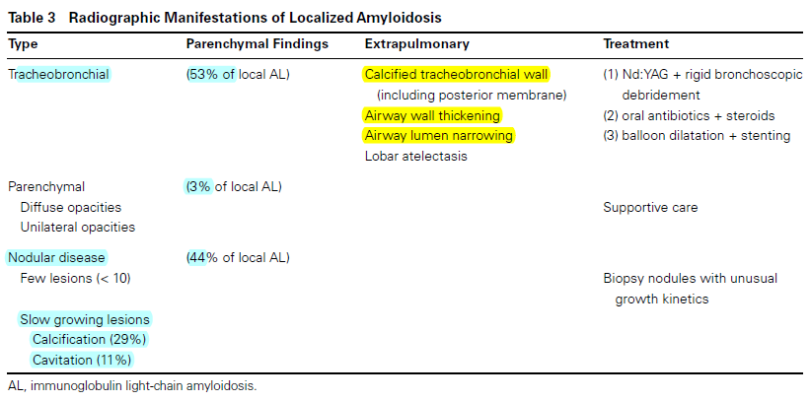
RADIOLOGY
Seminars in Respiratory and Critical Care Medicine, volume 23, number 2, 2002

Slide 29
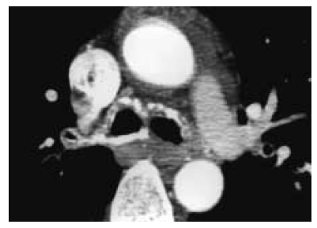
Seminars in Respiratory and Critical Care Medicine, volume 23, number 2, 2002
Notes:
1. Computed tomography of the main carina in TBA.
The walls of both main bronchi are thickened and densely calcified, particularly along the posterior wall
of the right main bronchus.

Slide 30
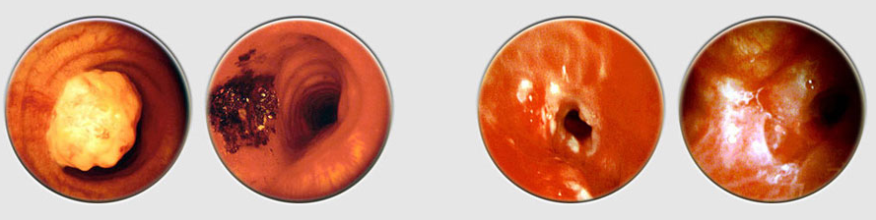
http://www.bronchotraining.org/spip.php?article78#
Notes:
TBD의 내시경 finding이고, 크게 첫번째 사진처럼 yellow color like appearance를 보이는 경우와, 마지막 두 사진처럼, diffuse하게 mucosa, submucosa를 involve하는 두가지 형태로 관찰된다.
a tumor-like appearance. Its yellow color is characteristic, and resection is straightforward.
patients with amyloidosis often present with mucosal infiltration of peripheral bronchi.

Slide 31
DIAGNOSIS
(1) Biopsy diagnosis of amyloidosis - apple-green birefringence conferred by congo red staining
(2) Determine the extent of disease
a fat pad aspiration and staining / alternative organ Bx. // EKG, TTE
(3) Define subunit proteins of amyloid
  1) Direct testing of tissue samples
    Treating amyloid tissue with potassium permanganate, which differentiates AA from AL, ATTR, or A2M
    IHC staining
    ATTR disease - sequencing or genotyping.
  2) Demonstrating a plasma cell dyscrasia or variant transthyretin

Slide 32
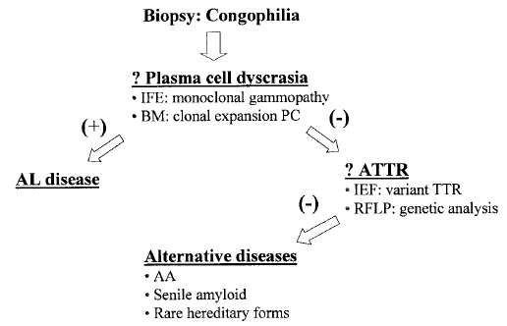
Seminars in Respiratory and Critical Care Medicine, volume 23, number 2, 2002
Notes:
Algorithm for diagnosing different types of amyloidosis. IFE, immunofixation electrophoresis; BM, bone marrow biopsy;
PC, plasma cells; IEF, isoelectric focusing; RFLP, restriction fragment length polymorphisms

Slide 33
PROGNOSIS AND TREATMENT OF SYSTEMIC AND
LOCALIZED AL DISEASE

Slide 34
Systemic AL Disease
The median survival for patients with untreated systemic AL disease is 13 months
  When complicated by heart failure, survival decreases to 16 weeks
Oral cyclic melphalan and glucocorticoids increase median survival to 17 months, but rarely induce hematologic cure or regression of organ dysfunction.
High-dose intravenous melphalan with autologous stem cell rescue to treat systemic AL disease
  Hematologic cure in 62% of these patients, with 65% experiencing improved organ function
Symptomatic pleural effusion - Serial drainage, pleurodesis
Notes:
Systemic AL disease가 치료를 받지 않으면, median survival은 ~.

Slide 35
Localized AL Disease
Nodular disease
  May slowly progress / Does not impact lung gas exchange nor survival
Diffuse parenchymal involvement
  Can impair lung physiology and lead to death
  Corticosteroids had no effect on the course of disease
Systemic chemotherapy is not advocated
  - Diffuse parenchymal involvement may warrant consideration of aggressive therapy
Tracheobronchial Disease
  Proximal and mid-bronchial TBA often progress to respiratory failure (7/15)
  Excisional therapy - (Nd:YAG) laser
  Diffuse form of TBA recurs after laser treatment / Scar stenosis
  Low dose external beam radiation - plasma cells are radiosensitive

Slide 36
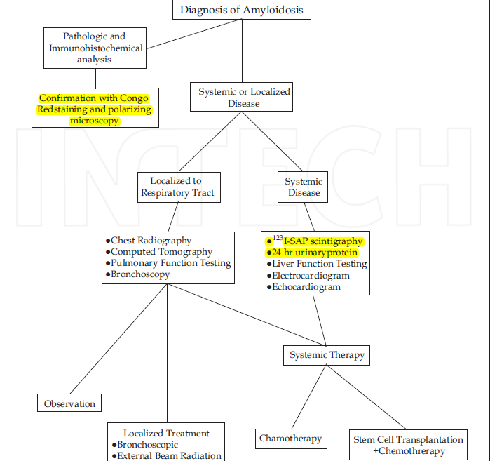

Slide 37
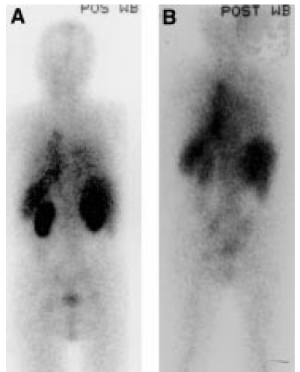
SAP Scintigraphy
SAP scintigraphs
Thorax 1999;54:444–451
Notes:
Serial SAP scintigraphs two years apart in a 66 year old man with systemic AL amyloidosis who presented
with advanced renal impairment (serum creatinine 260 μmol/l). The baseline posterior whole body scintigraph (A)
showed the renal amyloid deposits which regressed to almost undetectable levels following treatment with standard dose
vincristine, adnamycin, and dexamethasone chemotherapy (B). The patient’s renal function recovered completely.

Slide 38
경청해 주셔서 감사합니다.

