Slide 1
Pulmonary Cryptococcosis
Sung Woo Moon
Division of Pulmonology
Department of Internal Medicine
Yonsei University College of Medicine
Notes:
1. 정만기 8482322 F/70 pulmonary cryptococcosis
2. 김윤응 2380942 M/61 pulmonary cryptococcosis
3. 조재현 8475505 M/41 pulmonary cryptococcosis

Slide 2
Index
Cryptococcus
Epidemiology
Clinical presentation
Diagnosis
  Radiology
  Pathology
Treatment

Slide 3
Cryptococcosis
Emerged as a major opportunistic infection
less frequently reported but is almost certainly underdiagnosed*
*Wasser L, Talavera W. Pulmonary cryptococcosis in AIDS. Chest 1987;92:692–695

Slide 4
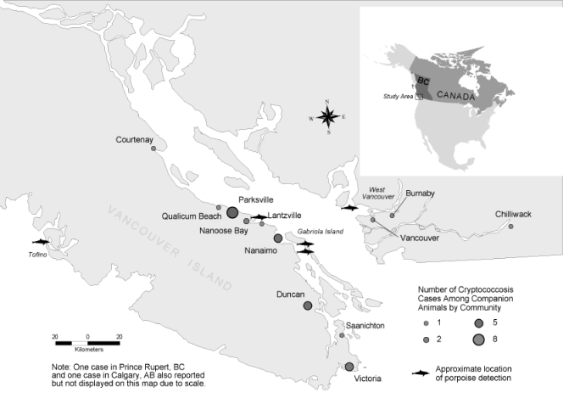
Notes:
흔히 크립토코코시스를 기회 감염으로만 생각하지만 평화로운 Canada 의 Vancouver 에서 1999`에는 다음과 같이 동물들에게 대규모 outbreak 가 생긴 이후 200명 이상의 정상 면역을 가진 사람도 Cryptococcosis 에 감염된 바가 있습니다. 이 중 167명이 Pulmonary cryptococcosis 를 보였습니다.
이 표는 우리나라의 cryptococcosis 숫자와 비용을 나타낸 것인데 생각보다 많은 비용이 필요한 병이라는 것도 알 수 있습니다.

Slide 5
Cryptococcus Infection
Over 70 Identified Spicies!
Cyptococcus neoformans var grubii (Serotype A)
Cryptococcus neoformans (Serotype D)
Cryptococcus gattii (C. neoformans, Serotype B & C)
Cryptococcus albidus
Cryptococcus laurentii
Notes:
3/4 는 pulmonary infection 은 rare 하다.

Slide 6
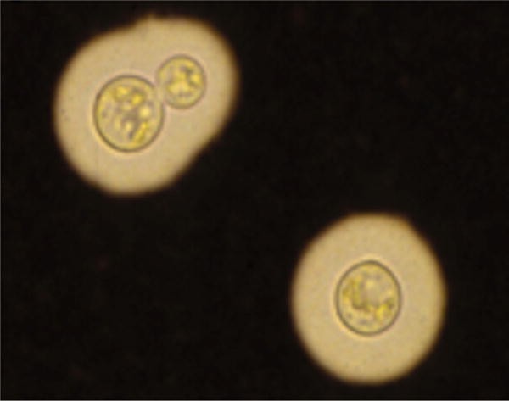
C. neoformans
budding, encapsulated yeast
ubiquitous environmental saprophyte
capsule is an important virulence factor, reducing phagocytosis*
*Casadevall A, Steenbergen JN, Nosanchuk JD. ‘‘Ready made’’ virulence and ‘‘dual use’’ virulence factors in pathogenic environmental fungi: the Cryptococcus neoformans paradigm. Curr Opin Microbiol 2003;6:332–337
Notes:
Indian ink stain

Slide 7
Severe or disseminated disease usually occurs in those who have defects in T-cell function ; cell-mediated immunity*
Protective pulmonary inflammatory responses are dependent on IFN-r, TNF-a ; Th1-weighted immunity. **
*Aberg JA, Mundy LM, Powderly WG. Pulmonary cryptococcosis in patients without HIV infection. Chest 1999;115: 734–740 / Ross JJ, Katz JD. Cryptococcal meningitis and sarcoidosis. Scand J Infect Dis 2002;34:937–939
**Chen GH, McDonald RA, Wells JC, Huffnagle GB, Lukacs NW, Toews GB. The gamma interferon receptor is required for the protective pulmonary inflammatory response to Cryptococcus neoformans. Infect Immun 2005; 73:1788–1796 / Herring AC, Lee J, McDonald RA, Toews GB, Huffnagle
GB. Induction of interleukin-12 and gamma interferon requires tumor necrosis factor alpha for protective T1-cellmediated immunity to pulmonary Cryptococcus neoformans infection. Infect Immun 2002;70:2959–2964

Slide 8
Pulmonary Cryptococcosis
The respiratory tract serves as the most important portal of entry for Cryptococcus
Isolated pulmonary infection can occur in about one-third of patients
Pulmonary involvement ranges from 10% to 55% of patients with AIDS-associated cryptococcal meningoencephalitis
Cryptococcosis, Eileen K. Maziarz, MD* and John R. Perfect, MD, Infect Dis Clin North Am. 2016 Mar; 30(1): 179–206

Slide 9
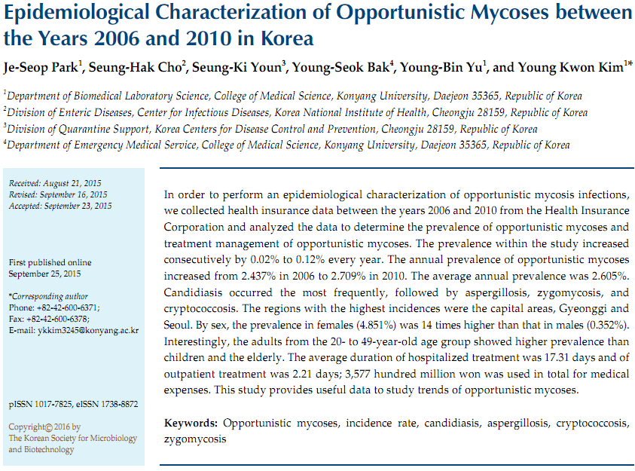
Notes:
벤쿠버에서 2002~4 년 사이에 C. neoformans 에 의한 162/142명의 정상 면역 환자 + 동물의 outbreak 가 발생한 경우가 있다.

Slide 10
Clinical presentations –
Immunocompetent
  present acutely with symptoms of pneumonia
Immunocompromised
  symptomatic and in some cases can progress rapidly to ARDS, even in the absence of CNS involvement

Slide 11
Diagnosis
Diagnosis is based on the isolation of Cryptococcus from a pulmonary specimen, coupled with appropriate clinical symptoms or radiological findings, and, ideally, histopathological evidence of tissue invasion.

Slide 12
Radiology
Immunocompetent
  pulmonary nodules, which may be solitary or multiple
  smooth and ill-defined edges, and no particular lobar predilection
  Areas of infiltration and consolidation are also commonly described
  pleural effusions, intrathoracic lymphadenopathy, cavitatory lesions, and diffuse reticulonodular lesions
Immunocompromised
  wider variaty of radiologic abnormalities

Slide 13
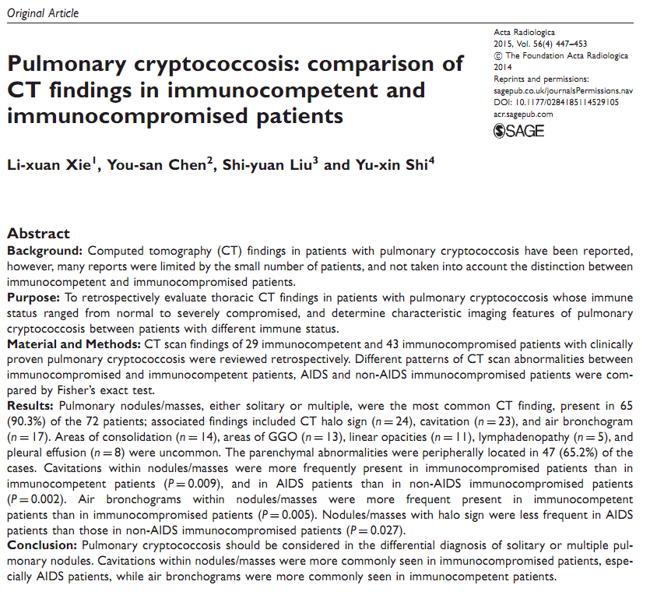
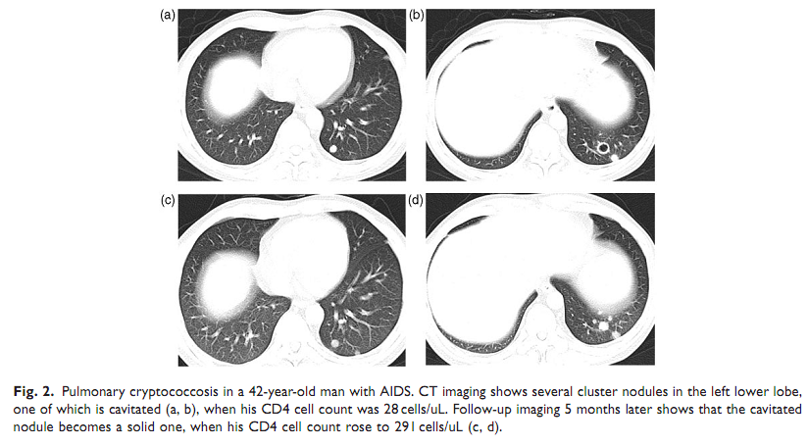

Slide 14
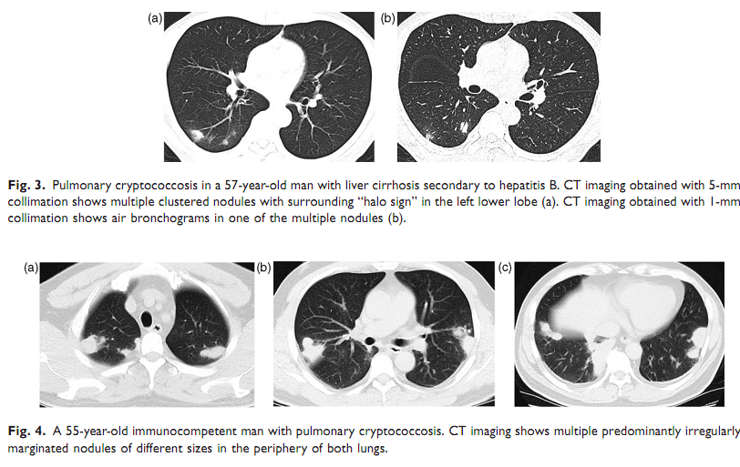

Slide 15
Diagnosis
Sputum
Bronchoscopy + BAL – cryptococcal Ag.
Transbronchial biopsy
Percutaneous or open-lung biopsies
Pleural aspirations
Serum Cryptococcal Ag
  Titers In Isolated pulmonary cryptococcosis are relatively low
Notes:
cryptococcal antigen (CRAG) titer of >1 in 8 being 100% sensitive and 98% specific for cryptococcal pneumonia. -> 우리 병원 오더에는 Serum, CSF 만+

Slide 16
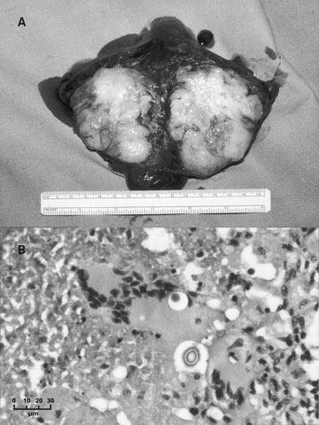
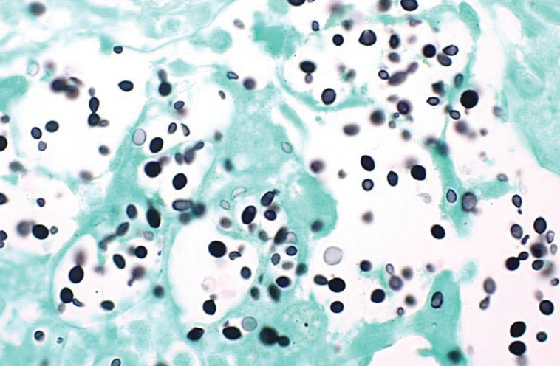
Pathology
Marked granuloma formation with extensive monocytic cell infiltrate and giant cells associated with cryptococci
immunocompromised patients often develop much more diffuse disease
  Zinck et al : foamy macrophages and numerous cryptococcal yeast with minimal interstitial mononuclear inflammatory response and no granuloma formation
  No inflammation
PAS and GMS(Methenamine silver)
Notes:
(A) Macroscopic specimen of a well-circumscribed cryptococcoma in the left lower lobe of 39-year-old Australian man with Cryptococcus gattii infection. (B) Highpower view of a granuloma from the excised cryptococcoma, showing giant cells containing cryptococci (hematoxylin and eosin)

Slide 17
Diagnosis
should be investigated for disseminated disease and for underlying immunodeficiency
Immunocompetent : Contentious about routine CSF study
Immunocompromised : CSF, cryptococcal serum Ag + concurrent diagnoses
  PCP(52%), mycobacterial (42%)

Slide 18
Treatment
The primary aims of treatment are to prevent dissemination and treat symptomatic infections.

Slide 19
Treatment; AJRCCM 2011
Asymptomatic, mild-mod
  400 mg fluconazole daily (then taper to 200 mg for 6 mo) Or Itraconazole for 6 mo
Diffuse pulmonary disease
  Amphotericin B 0.7–1.0 mg/kg/d plus flucytosine 100 mg/kg/d for 2 wk, then fluconazole or itraconazole 400 mg/d for 10 wk
  Amphotericin B 0.7–1.0 mg/kg/d plus flucytosine 100 mg/kg/d for 6–10 wk
***Extension if C. gatti or immunocompromised

Slide 20
Treatment; IDSA 2010
Asymptomatic, mild disease
  400 mg fluconazole daily 6–12 mo
Diffuse pulmonary disease
  HIV:
    Induction: Conventional amphotericin 0.7–1.0 mg/kg/d plus Flucytosine 100 mg/kg/d for 2 wk
    Consolidation: Fluconazole 400 mg daily for 8 wk
    Maintenance: Fluconazole 200 mg daily for 12 mo
  Transplant:
    Induction: [Liposomal amphotericin 3–4 mg/kg/d or ABLC 5 mg/kg/d] plus flucytosine (100 mg/kg/d) for 2 wk
    Consolidation: Fluconazole 400–800 mg daily for 8 wk
    Maintenance: Fluconazole 200–400 mg daily for 12 mo
  Non-HIV, nontransplant:
    Induction: Conventional amphotericin 0.7–1.0 mg/kg/d plus flucytosine 100 mg/kg/d for 4 wk
    Consolidation: Fluconazole 400–800 mg daily for 8 wk
    Maintenance: Fluconazole 200 mg daily for 12 mo
Notes:
Infectious Diseases Society of America

Slide 21
Treatment : Adjunctive
Surgical resection should be considered
  Persistent symptoms despite therapy
  large pulmonary cryptococcomas (> 5 cm), particularly in the presence of a mass effect

Slide 22
Summary
Cryptococcosis is a major invasive fungal infection that is capable of widespread disease outbreaks in both immunocompromised and apparently immunocompetent hosts.
A systematic approach is necessary to identify the cause and to institute appropriate treatment in a timely.
The diagnosis of Pulmonary cryptococcosis requires a high index of suspicion.

Slide 23
Thank you for your attention

