Slide 1
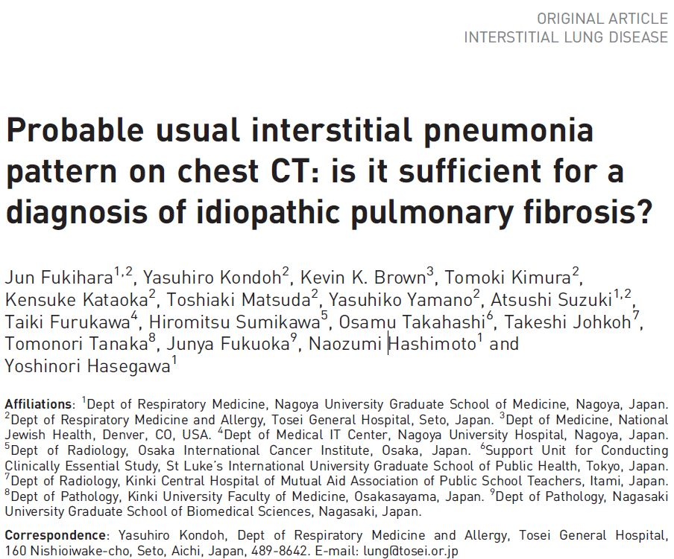
발표자: 내과 R2 신동환
Modulator: Prof. 김송이

Slide 2
Introduction
Introduction
“UIP pattern” on Computed tomography is sufficient to establish a diagnosis of IPF
without the need for a surgical lung biopsy.
“Probable UIP pattern” on CT require SLB for a definitive diagnosis.
However, a substantial number of patients will not undergo surgery for a variety reasons
and remain without a definitive diagnosis.
In the two INPULSIS trials, possible UIP pattern on CT were considered to have a
diagnosis without the need for SLB.
The INPULSIS trials recruited patients who were clinically suspected to have IPF by
physicians with expertise in the diagnosis of ILD.
Therefore, it is possible that the PPV of a probable UIP pattern and a diagnosis of IPF
was higher in the INPULSIS trials than would be seen in a real-world setting.
To estimated the validity of this approach, we compared survival time, acute exacerbation
(A/E) in IIP patients having a UIP pattern with that in patients having a probable UIP
pattern, in a real-world Setting.
Notes:
UIP pattern: Subpleural basal predominace, reticular abnormality and honeycomb.
SLB(Surgical Lung biopsy)
Probabable UIP pattern: Without honeycombing and with Traction bronchiectasis
INPULSIS trial은 IPF 진단받은 환자에서 nintedanib의 Safety 및 efficac를 확인하는 trial이며 이를 이용한 논문들에서는 CT에서 나타난 Possible UIP patter은 UIP pattern과 마찬가지로 IPF의 진단에 SLB가 필요 없다는 결론들이
있었습니다. 하지만 상기 Trial에서는 단순 CT 소견 뿐만 아니라 환자들의 진단에 전문가들이 임상양상 등을 모두 고려하여 진단을 한 상태에서 비교한 것이기 때문에 결국은 Possible UIP pattern을 가지고 있는 환자가 IPF를 진단할 수 있다는 주장은 좀 더 많은 PPV(Positive Possible Value)를 가질 수 밖에 없습니다.
따라서, 이 논문에서는 Real-world setting(i,.e Populations seen in routine clinical practice).에서 CT 상 Probable UIP patter과 UIP patter을 가진 IIP 환자에서의 Survival time, A/E를 비교한 논문입니다.

Slide 3
Patients and Methods
Study design and population
Approved by the institutional review board of Tosei General Hospital(Seto, Aichi, Japan)
Data were collected retrospectively and anonymously analysed
January 2008 to March 2013
Patients included wete those who underwent an initial workup for a suspected diagnosis of IIP and whose CT scans at initial workup were available.
Excluded
CTD(Connective tissue disease), CHP(Chronic hypersensitivity pneumonitis) or other identifiable causes of ILD, associated malignant diseases
Lost to F/U within 1year of the Initial workup for reasons other tham death and those who did not undergo a pulmonary function test(PFT) at the initial workup.
UIP pattern vs Probable UIP pattern on CT
Survival Time
First AE
Notes:
이 스터디는 Tosei General hospital에서 시행되었으며 Retrospectively 그리고 익명으로 진행되었습니다.
2008년 1월부터 2013년 3월까지의 자료를 수집하였으며
IIP가 의심되는 환자 중에서 Initial W/U에 CT를 진행한 환자를 대상으로 진행하였습니다.
CTD, CHP, ILD의 원인이 명확한 경우 1년 안에 F/U loss 된 경우 그리고 PFT 진행하지 않은 경우는 모두 배제하였습니다.
이후 CT 상에서 UIP pattern 및 Probable UIP pattern에서의 Survival time 및 First A/E에 대한 비교가 이 논문의 목표입니다.

Slide 4
Patients and Methods
Data collection
- Patient characteristics and test results were collected retrospectivley from Clinical charts.
Initial Work UP: ABGA, PFT, CT scans conducted within 1 months
Definition of an AE
An Acute respiratory deterioration characterised by evidence of new widespread alveolar abnomality
Acute worsening or development of dyspnea within 1 month;
CT Scan of the chest with new bilateral ground-glass opacity superimposed on a background pattern consistent with UIP;
Detorioration not fully explained by cardiac failure, fluid overload or infection.
Notes:
Data는 Clinical chart를 후향적으로 분석하여 얻었으며 Initial W/U은 ABGA, PFT, CT scan 1달 안에 진행한 것을 분석하였습니다.
여기서 AE랑
새롭게 생긴 전반적으로 퍼져 있는 Alveolar abnormality 및 Acute respiratory deterioration을 의미하며
이는 약 한 달 안에 급작스럽게 증상이 악화되어야 하며
CT scan에서 UIP에 더하여 bilateral GGO가 새롭게 생겨야 하며
이 악화소견은 Cardiac failure, fluid overload 또는 infection에서 기인되지 않는 것을 말합니다.

Slide 5
Patients and Methods
Radiological and histopathological evaluation
Two experienced thoracic radiologists and an experienced thoracic physician
Chosen at random and Fleiss’ k-Value was calculated
Each reivewer was blinded to the clinical and histopathological information. Given the k-value (0.66, 95% CI 0.52-0.79), Radiological interpretation of eligible cases was performed by one of the three reviewers.
All Lung biopsy specimens were anomymised for histopathological analysis, and reviewd by experienced pulmonary pathologists
Notes:
후향적으로 얻은 Radiological 그리고 Histopathological evaluation에 대해서는
두 명의 전문적인 Thoracic Radiologist 및 Throacic Physician들이 Random하게 진행하였으며
Lung biopsy 역시 Pulmonary Pathologist에 의하여 판독되었습니다.

Slide 6
Patients and Methods
Final diagnosis of ILDs
When Histopathological information was available,
MDD(Multidisciplinary discussion) by Clinicians, Radiologists with referenced to the published criteria of IPF and the classification for IIPs.
Chest imaging and histopathology(if available)
If Histopathological information was not available,
When the Clinical Context was that of an IIP and the CT showed a UIP pattern.
Probable UIP pattern on CT but no Histopathology were provisionally classified as IPF when the likelihood of the diagnosis was believed to be > 70%
CTD, CHP and other identifiable casese or associations were actively sought out at the time of initial W/U and during F/U.

Slide 7
Patients and Methods
Statistical analysis
The Mann-Whitney U-test used for continuous variables
The Pearson Chi-aquared test was used for categorical variables
Survival time and time to first AE were measured from the date of initial workup
The Kaplan-Meier method was applied to show unadjusted survival curves, and mortality rate and AE rate were shown per 100 person-years.
Cox Proportional hazards models were used to evaluate the associations between CT pattern on IPF diagnosis and Survival time.
The adjusted annual rate of change in FVC was analysed with the use of a random coefficient regression model that included sex, age and height as covariates.
All Statistical tests were two sided and p-values of less than 0.05 were considered statsticalliy significant .
Statistical analyses were carried out using SPSS version 25.0

Slide 8
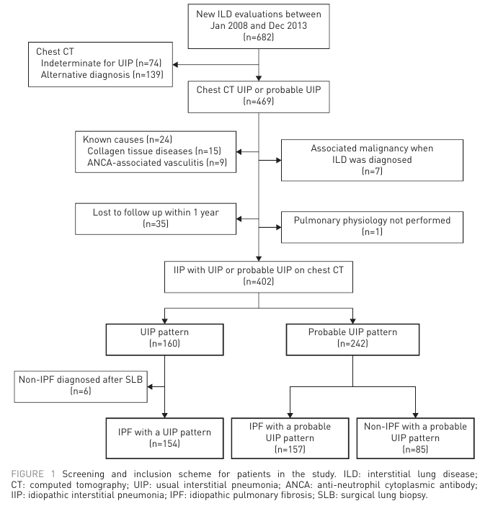
Results
Patient Characteristics
Notes:
총 682명이 IIP 의심 하 CT를 촬영하였으며
이 중 280명이 제외되었습니다. 따라서 총 UIP pattern은 160명, Probable UIP pattern은 242명으로 진단되었으며 Median F/U은 42.9개월 입니다.

Slide 9
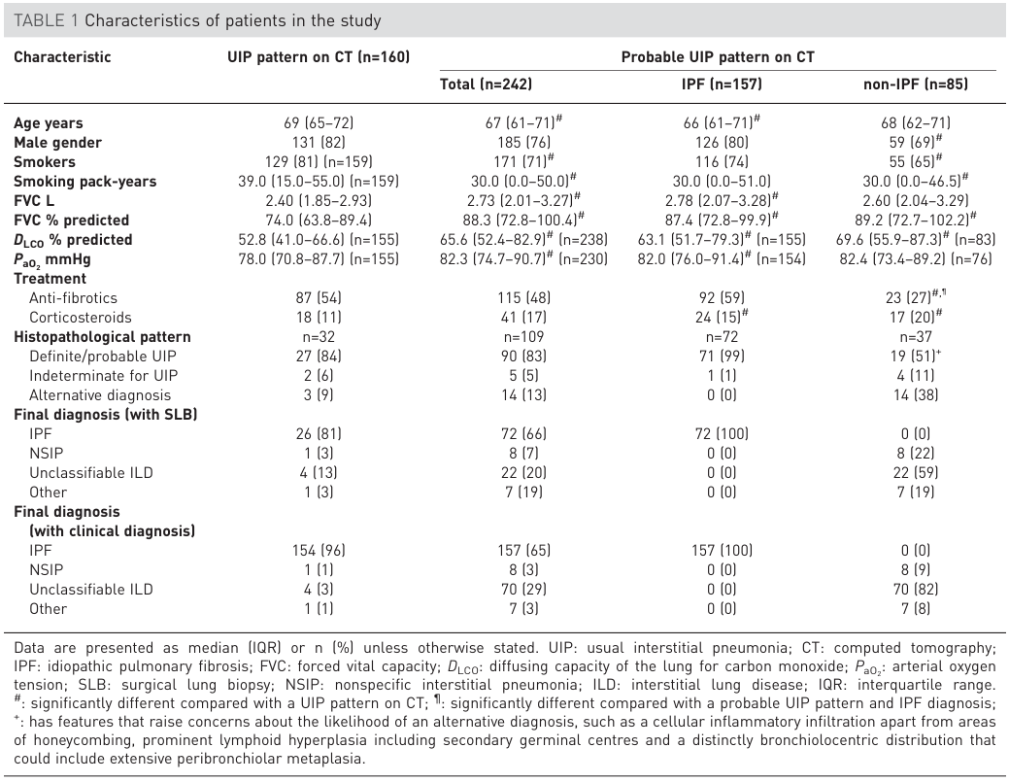
Results
Patient Characteristics
Notes:
상기 Table 1은 Clinical characteristics를 보여주고 있으며 Probable UIP pattern에서 Non-IPF의 경우 남성이 적고 또한 Smokers가 좀 더 적은 것을 볼 수 있습니다.
IPF환자에서 UIP pattern이 있는 환자는 FVC가 더욱 낮은 것을 볼 수 있습니다.
UIP pattern 및 Probable UIP pattern을 비교하였을 시

Slide 10
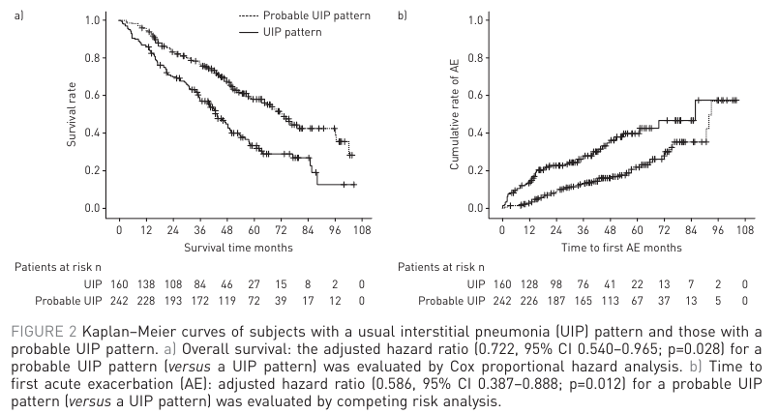
Results
Prognosis: UIP pattern versus Probable UIP pattern
Notes:
UIP pattern 및 Probable UIP pattern을 비교하였을 시
UIP pattern에서는 median survival은 43.5개월 probable UIP pattern의 경우 72.1개월이며
A/E까지의 Median time은 UIP pattern에서는 86.0개월, Probable UIP에서는 93.1개월로 확인됩니다.

Slide 11
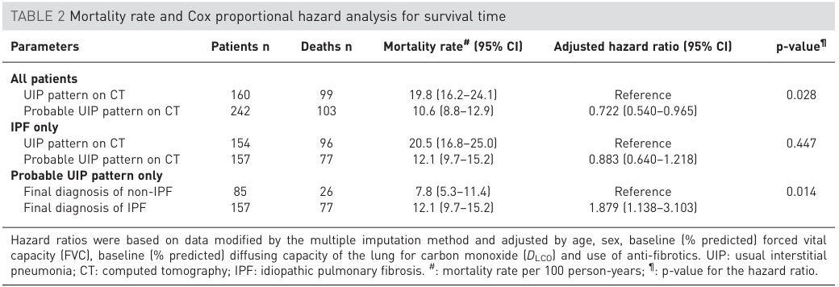
Results
Prognosis: UIP pattern versus Probable UIP pattern
Notes:
모든 환자에서는
UIP pattern을 가진 환자가 Probable UIP pattern을 가진 환자보다 Mortality가 더욱 높으며
IPF를 결국 진단받는 경우에는 UIP pattern 및 Probable UIP patter에서는 둘 사이의 차등은 없으며
Probable UIP pattern에서는 IPF 진단 받은 경우 사망률이 높았습니다.

Slide 12
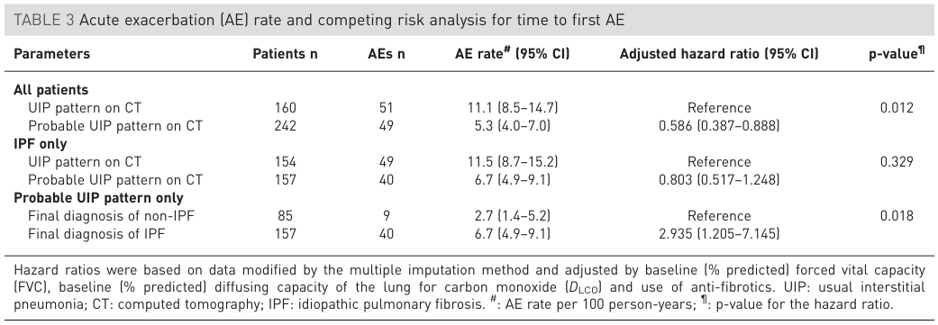
Results
Prognosis of IPF
Notes:
모든 환자들에서는
UIP pattern에서가 Probable UIP pattern보다 A/E까지의 시기가 짧은 것을 확인할 수 있으나
IPF 진단된 상태에서는 두 군의 CT 상 차이는 없었으며
Probable UIP patter에서 IPF가 Non-IPF보다는 A/E까지의 시기가 매우 짧은 것을 확인할 수 있습니다.

Slide 13
Discussion
The INPULSIS trials regarded the presence of an IIP and a probable UIP pattern as sufficient for diagnosing IPF without SLB
However, the validity of this finding in the real-world or from the perspective of survival time has never been tested.
Prognostically, we demonstrate that patients with a probable UIP pattern on CT generally have a longer survival time and longer time to first AE than those with a UIP pattern.
While recognizing that, in our study, the diagnosis of IPF was made with the combination of baseline and longitudinal follow-up data, making it not applicable for predicting prognosis at initial presentation.
The Probability of a histopathological UIP pattern in patients with a probable UIP pattern on CT remains controversial.
In 2011 guidelines etc.(=ignoring the existence of traction bronchiectasis) more than 90%
These studies have dealt with patients from randomized controlled trials for IPF(i.e. patients already diagnosed with IPF by expert ILD Physicians).
So, Selection bias
The inclusion of traction bronchiectasis in the definition of possible UIP pattern likely increases the PPV of histopathological UIP pattern(82.4%).
Notes:
전에 있던 논문들 그리고 INPULSIS trial에서는 IFP 진단 받은 환자들에서 Probable UIP pattern은 SLB 없이 충분히 IPF 진단을 할 수 있다는 결론을 가지고 있는 경우가 많았습니다만, 사실 이는 IPF 진단 받은 환자들에서의 결론이며
따라서 real-world에서는 이를 확인하기는 어려웠습니다.
상기 논문에서의 결과에서는 첫 Initial W/U에서의 Probable UIP patter이 CT에서 있을 시에는 Longer survival time 및 Longer time to First A/E가 UIP patter에서보다 빠른 것을 알 수 있습니다.
그 이후 문장의 의미??
Probable UIP pattern이 CT 상에서 보이는 것이 Histopathological UIP pattern의 가능성을 높인다는 것에는 Controversial issue가 있습니다.
IPF를 전문적인 Physician들에게 진단 받은 환자들을 대상으로 진행한 2011년 guidelines 및 논문들에서는 Traction bronchiectasis가 없는 Probable UIP patter에서 약 90%의 Positive Predictive Value를 보이나 이는 Selection bias를 가질 수 밖에 없습니다. 따라서 Traction bronchiectasis를 포함할 경우 상기 Histopathological UIP pattern의 PPV를 높인다는 논문들의 결론과 일치한다.

Slide 14
Discussion
Our real-world data shows longer survival in patients with a probable UIP pattern compared with a UIP pattern, even though the definition includes the presence of traction bronchiectasis.
In cohorts limited to subjects with a final diagnosis of IPF, No survival difference between pattern and probable UIP pattern
As IPF patients with a probable UIP pattern showed a risk for AE similar to those with as UIP pattern in our cohort, it should be noted that an IPF diagnosis is more important than the CT pattern in predicting time to AE.
Notes:
Probable UIP patter을 가진 IPF 환자들은 UIP pattern 환자들과 같은 정도의 AE의 위험성이 있으며 이는 IPF 진단이 CT patter보다 좀 더 AE를 진단하는데 중요함을 나타내는 것을 보여줍니다.

Slide 15
Limitation
Respective study from a large clinical practice and the baseline disease severity varied among the groups
Treatment was not standardized and all decisions regarding starting and ending treatment rested with the individual physician, making it difficult to evaluate the effect of treatment on outcomes
A single institute and all patients were Japanese, Making it difficult to generalize to other cohorts

Slide 16
Conclusion
In Conclusion, in our real-world IIP cohort patients with a probable UIP pattern had a generally better prognosis and lower risk of AE at any time point than those with a UIP pattern.
Moreover, probable UIP pattern was an independent prognostic factor and associated with time to first AE.
As probable UIP pattern did not predict survival in patients with a final diagnosis of IPF, diagnostic heterogeneity associated with a probable UIP pattern likely explains the difference between the two groups.

