Slide 1
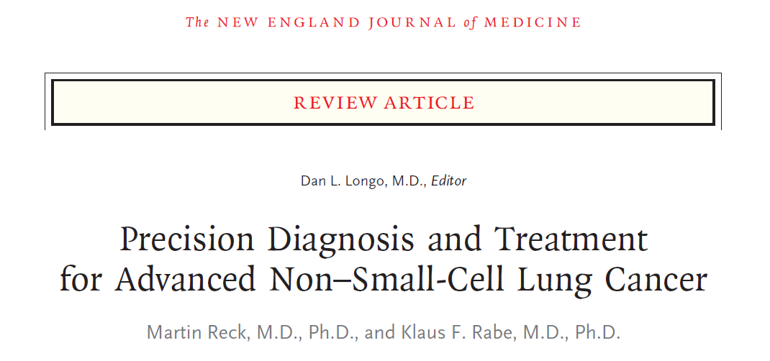
발표자 : R2 김지혜

Slide 2
Pathological Features
SCLC : 15%
NSCLC : 85%
- adenocarcinoma
- squamous-cell carcinoma
- NSCLC, not otherwise specified (NOS)
1) NSCLC favoring adenocarcinoma
2) NSCLC favoring squamous-cell carcinoma
3) NSCLC NOS
* squamous-cell cancer markers : p63, cytokeratin 5, cytokeratin 6
* adenocarcinoma markers : cytokeratin 7, thyroid transcription factor 1

Slide 3
Pathological Features
Molecular testing in the standard approach
- Mutations in the gene epidermal growth factor receptor
- BRAF V600E
- Translocations in the genes encoding anaplastic lymphoma kinase (ALK)
- Rat osteosarcoma (ROS1)
- Expression of programmed death ligand 1 (PD-L1)
▶ Genetic heterogeneity associated with several processes
(chromosomal instability, genome duplications, and additional subclonal mutations)

Slide 4
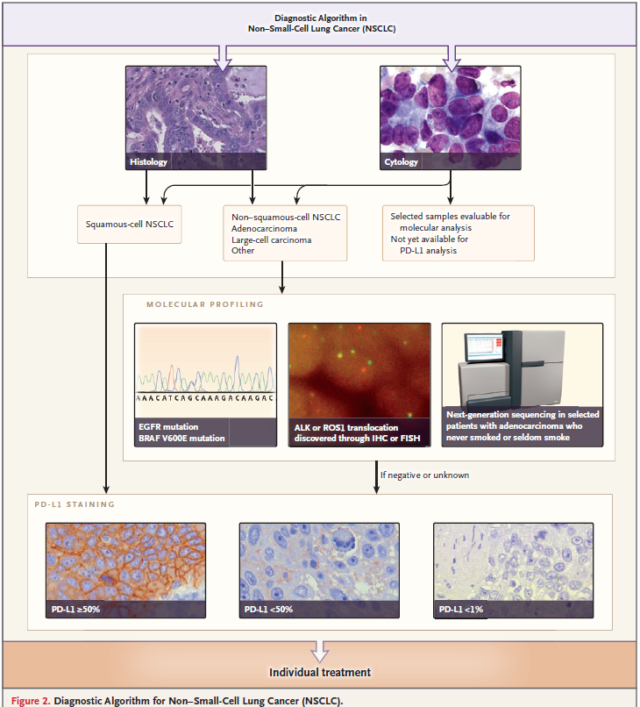

Slide 5
Staging of Lung Cancer
The 8th edition of the lung cancer stage classification
: Need for a correct tumor–node–metastasis (TNM)–based staging of lung cancer.
1) CT : Powerful tool for the staging of lung cancer
2) PET-CT : evaluating lymph nodes and other soft tissues
3) MRI : Visualizing brain and liver metastases
▶ Tissue diagnosis remains the standard essential element.
▶ Endosonography with needle aspiration :
Mediastinal or hilar lymph-node involvement

Slide 6
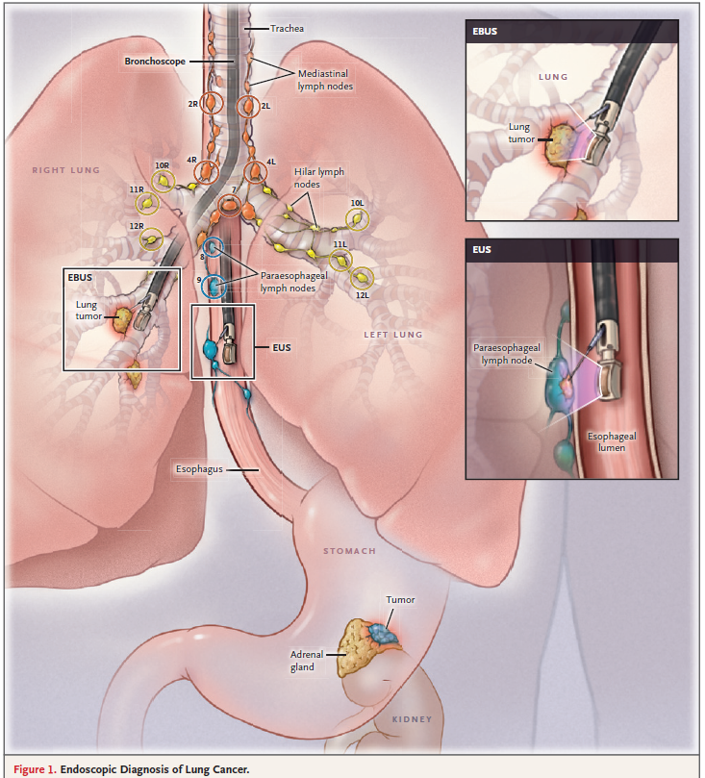

Slide 7
Current Landscape of Treatment
Advanced NSCLC without treatable oncogenic alterations :
platinum-based chemotherapy
- Rate of response (RECIST) : 25-30%
- Median survival : 8-12 months
- 1-year survival rate : 30-40%
Maintenance therapy and second-line chemotherapies have further improved outcomes in patients with advanced NSCLC.
Local treatment apporaches, Radiotherapy :
Pain and symptom management

Slide 8
Antiangiogenic Therapies and Treatment Based on Histologic Features
Bevacizumab (anti–vascular endothelial growth factor (VEGF) antibody)
Combination with platinum based chemotherapy (in non-squamous cell NSCLC)
→ Improve the response rate and progression-free survival
→ More frequency of adverse events (hypertension, proteinuria,
and thromboembolic and bleeding events)
Necitumumab (EGFR antibody)
Combination with cisplatin and gemcitabine (in EGFR - expressing squamous-cell NSCLC)
→ Median overall survival, 11.7 vs. 10.0 months
→ Hazard ratio for death, 0.79
→

Slide 9
Antiangiogenic Therapies and Treatment Based on Histologic Features
Ramucirumab (anti–VEGF receptor 2 antibody)
REVEL trial (ramucirumab + docetaxel VS docetaxel alone)
→ progression-free survival, 4.5 vs. 3.0 months
hazard ratio for progression or death, 0.76 (95% CI, 0.68 to 0.86; P<0.001)
overall survival, 10.5 vs. 9.1 months;
hazard ratio for death, 0.86 ; (95% CI, 0.75 to 0.98; P = 0.02)
Nintedanib (antiangiogenic tyrosine kinase inhibitor)
LUME–Lung 1 trial (nintedanib + docetaxel VS docetaxel alone)
→ progression-free survival, 3.4 vs. 2.7 months;
hazard ratio for progression or death, 0.79; (95% CI, 0.68 to 0.92; P = 0.002)
overall survival, 12.6 vs. 10.3 months;
hazard ratio for death, 0.83; (95% CI, 0.70 to 0.99; P = 0.04)
Efficacy of nintedanib and of ramucirumab was greater in rapidly
progressing tumors and nintedanib was greater in refractory tumors

Slide 10
Antiangiogenic Therapies and Treatment Based on Histologic Features
French ULTIMATE trial
- Bevacizumab and paclitaxel VS Paclitaxel
→ prolonged progression-free survival in previously treated patients → Median, 5.4 months vs. 3.9 months;
Hazard ratio for progression or death, 0.6; 95% CI, 0.44 to 0.86; P = 0.005
LUX–Lung 8 trial (previously treated squamouscell lung cancer)
- EGFR tyrosine kinase inhibitor afatinib VS erlotinib
→ median overall survival, 7.9 months vs. 6.8 months;
→ hazard ratio for death, 0.81; 95% CI, 0.69 to 0.95; P = 0.008

Slide 11
Treatment Based on Targetable
Oncogenic Alterations
An exploratory analysis involving 1007 patients with advanced adenocarcinoma
VS
→ median survival, 3.5 years vs. 2.4 years and 2.1 years
who received targeted therapies
who did not receive targeted therapies or patients without driver mutations

Slide 12
Treatment Based on Targetable
Oncogenic Alterations
Mutations in EGFR
Exon 19 (deletion) or Exon 21 (L858R point mutation)
White patients : 10-20%
East Asian origin : approximately 48%
  adenocarcinoma, no previous or current smoking, younger age, female

Slide 13
Treatment Based on Targetable
Oncogenic Alterations
Mutations in EGFR
Meta-analysis
(EGFR tyrosine kinase inhibitors VS First-line CTx)
→ median progression-free survival
9.6 to 13.1 months vs. 4.6 to 6.9 months;
hazard ratio for progression or death
0.37(95% CI, 0.32 to 0.41; P<0.001)
Activity of EGFR tyrosine kinase inhibitors
: exon 19 mutations (HR 0.24) > exon 21 mutations (HR 0.48)

Slide 14
Treatment Based on Targetable
Oncogenic Alterations
Mutations in EGFR
The disease progresses in most patients after 9 to 12 months of treatment
Most frequent alteration :secondary exon 20 T790M missense Mutation
Osimertinib : third-generation, irreversible EGFR tyrosine kinase inhibitor , targets the T790M mutation and the primary activating EGFR mutations
▶ Response rate of 61%, median progression free survival of 9.6 months
AURA3 Trial (osimertinib VS platinum-based chemotherapy)
Prolongation of median progression-free survival from 4.4 to 10.1 months (hazard ratio for progression or death, 0.30; P<0.001)
increase in the response rate from 31 to 71% (odds ratio for an objective response, 5.39; P<0.001)

Slide 15
Treatment Based on Targetable
Oncogenic Alterations
2) ALK and ROS1 Translocations
Translocations of ALK : 2-7% of NSCLC
Translocations of ROS1 : 1 - 2% of NSCLC
Crizotinib (tyrosine kinase inhibitor)
in patients NSCLC and ALK alterations : Crizotinib VS CTx
Previously treated patient : median progression-free survival, 7.7 months vs. 3.0 months
Previously untreated patients : median progression free survival, 10.9 months vs. 7.0 months
▶ Patients with ALK translocations acquire resistance to crizotinib during treatment

Slide 16
Treatment Based on Targetable
Oncogenic Alterations
2) ALK and ROS1 Translocations
Ceritinib or alectinib (second-generation ALK tyrosine kinase inhibitors)
response rates have been 38 to 56%,
median progression-free survival of 5.7 to 8.0 months
brain response rate, 33 to 57%
ASCEND-4 trial (untreated patients with ALK alterations)
- Ceritinib VS chemotherapy
→ median progression-free survival, 16.6 months vs. 8.1 months;
→ hazard ratio for progression or death, 0.55
J-ALEX trial & ALEX trial : Alectinib was superior to crizotinib

Slide 17
Treatment Based on Targetable
Oncogenic Alterations
2) ALK and ROS1 Translocations
Crizotinib
- response rate, 72%;
- median progression-free survival, 19.2 months
3) Other Targetable Alterations
Targeting KRAS : failed
Selumetinib (MEK (MAPK–ERK kinase) inhibitor) + Docetaxel VS Docetaxel
→ failed to improve the outcome
BRAF mutations
Dabrafenib(BRAF inhibitor) + Trametinib(MEK Inhibitor)
- Response rate was 63.2%
- median progression-free survival was 9.7 months.

Slide 18
Treatment Based on Targetable
Oncogenic Alterations
4) The Problem of Targeted Therapies in Squamous-Cell NSCLC
Fibroblast growth factor 1
phosphoinositide 3–kinase pathway modifications
Discoidin domain receptor 2 (DDR2)
ErB2 amplification

Slide 19
Immunotherapies for NSCLC
Specific antibodies interacting either with cytotoxic T-lymphocyte–associated antigen 4 or with programmed death 1 (PD-1) or PD-L1 have shown clinical activity and have opened a completely new treatment option.
Five randomized, phase 2–3 trials
Monotherapies with Ab against PD-1 or PD-L1 VS chemotherapy
→ Overall survival (9.2 to 13.8 months vs. 6.0 to 9.7 months)
→ Hazard ratio for death of 0.59 to 0.73
Specific adverse events : activation of the immune system

Slide 20
Immunotherapies for NSCLC
PD-L1 Expression as a Predictive Marker
FDA and European Medicines Agency labels
High PD-L1 expression (tumor proportion score ≥50%)
: required for initial treatment with pembrolizumab
PD-L1–negative tumors
: May receive immunotherapies such as nivolumab or
atezolizumab
(tumor burden, tumor growth rate, performance status may be taken into account for the selection of treatment.)

Slide 21
Immunotherapies for NSCLC
2) First-Line Monotherapy and Future Trials
KEYNOTE-024 trial
untreated patients with advanced NSCLC & high level of PD-L1 expression
Pembrolizumab (anti–PD-1 antibody) VS Platinum-based chemotherapy
Median survival, 10.3 months vs. 6.0 months; P<0.001
overall survival (hazard ratio for death, 0.60; P = 0.005
higher response rate (44.8% vs. 27.8%)
lower rate of treatment-related grade 3 or 4 adverse events (26.6% vs. 53.3%

Slide 22
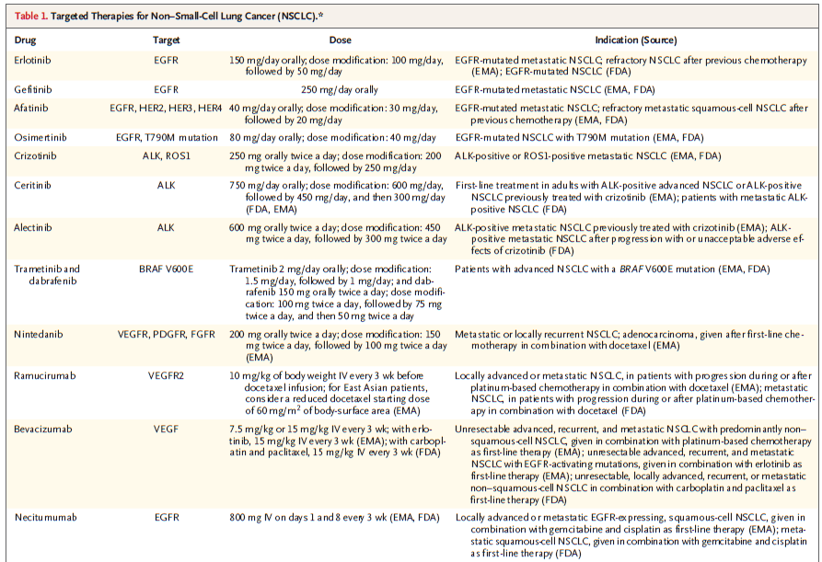
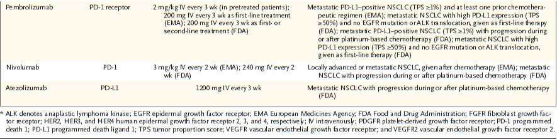

Slide 23
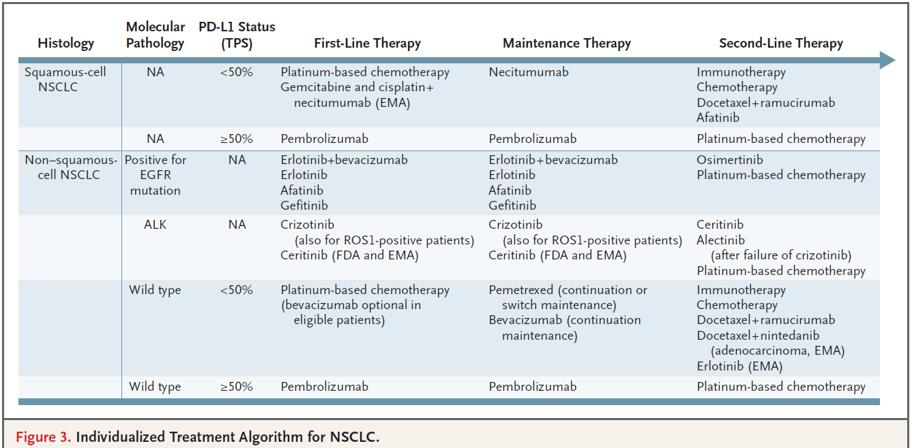

Slide 24
Summary
In addition to a precise description of histologic features, rational use of immunohistochemical markers is recommended.
non–squamous-cell NSCLC screened for treatable oncogenic alterations (EGFR mutations, BRAF V600E mutations, and ALK or ROS1 Translocations)
Adenocarcinoma who do not have a history of smoking
▶ Further molecular screening for rare treatable alterations
PD-L1 expression should be assessed in patients without known oncogenic alterations
Adequate tumor-biopsy samples obtained at the time of progression are crucial for the determination of the specific resistance mechanism

