Slide 1

79-10-15
Photodynamic therapy of
lung tumor
호흡기 내과 R4 이상훈
호흡기 내과 R4 이상훈

Slide 2
Contents
Introduction
Definition
Mechanism
Photosensitizer & light applicaton
Requirement
Conclusion
Complication
History
Classification
Patient education
Efficancy
Application
Dosimetry
Procedure

Slide 3
Introduction
Definition
Mechanism
Photosensitizer & light applicaton
Requirement
Conclusion
Complication
History
Classification
Patient education
Efficancy
Application
Dosimetry
Procedure

Slide 4
INTRODUCTION
Lung cancer is the leading cause of cancer deaths in the United States for both women and men.
Tobacco use, COPD
up to 10 percent of successfully resected patients with lung cancer subsequently develop a second primary lung neoplasm.

Slide 5
Non-surgical treatments
systemic
chemotherapy
external and internal
radiation
(brachytherapy)
photodynamic therapy (PDT)
endoscopic laser
therapy,
airway stenting,
cryotherapy

Slide 6
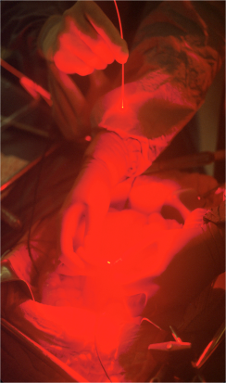

What is Photodynamic Therapy?
PDT is a directed, light-based method of damaging malignant or otherwise abnormal tissues.

Slide 7
INTRODUCTION

Slide 8
What is it used for?
FDA-Approved Indications (Oncology)
Obstructive esophageal cancer*
Obstructive endobronchial lung cancer*
Microinvasive endobronchial lung cancer
Actinic keratosis
Barrett’s esophagus/ high grade dysplasia
*for palliative intent
  Clinical Trials
Pleural spread of nonsmall cell lung cancer
Mesothelioma
Intraperitoneal malignant tumors
Head and Neck- pre-malignant through advanced disease
Brain tumors
Skin cancer
Prostate cancer
Notes:
Also FDA-approved for age-related macular degeneration, acne
Also in clinical trials for cardiovascular disease (atherosclerosis)

Slide 9
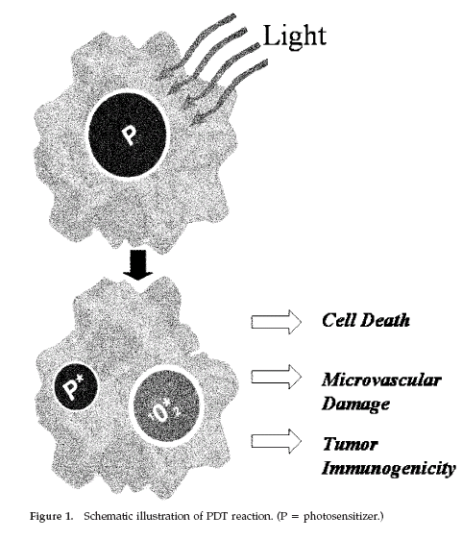
Mechanism of PDT
Singlet molecular oxygen

Slide 10
Mechanism 1
Direct Photodamage to Tumors by ROS
Problems:
  Non-homogenous distribution of photosensitizing agent within tumor
  Availability of O₂ within tumor cells
    Reduction of O₂ presence during PDT
Overcoming O₂ depletion:
  Lower light fluence rate
  Pulse light delivery – allow re-oxygenation

Slide 11
Mechanism 2
Vascular Damage
  Blood vessels supply nutrients to tumor cells
Effects:
  Microvascular collapse
  Tissue hypoxia and anoxia
  Thrombus formation
    Associated with halting tumor growth

Slide 12
Mechanism 3
Immune Response
  Movement of lymphocytes, leukocytes, macrophages into treated tissue
  Difference in reactions toward normal and tumor tissues
  Neutrophil – slows tumor growth
Required to purge remaining cells

Slide 13
Introduction
Definition
Mechanism
Photosensitizer & light applicaton
Requirement
Conclusion
Complication
History
Classification
Patient education
Efficancy
Application
Dosimetry
Procedure

Slide 14
Photosensitizing Agents:
Requirements
Selectivity to tumor cells
Photostability
Biological stability
Photochemical efficiency
No cytotoxicity in absence of light
Strong absorption – 600-800 nm
  Good tissue penetration

Slide 15
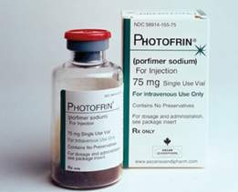
Photosensitizing Agents:
Classes
Porphyrin derivatives
*Most widely used
Chlorins
*Reduced porphyrins
*Derivatives from chlorophyll or porphyrins
Phthalocyanines
*2nd generation
*Contain diamagnetic metal ion
Porphycenes
*Synthetic porphyrins

Slide 16
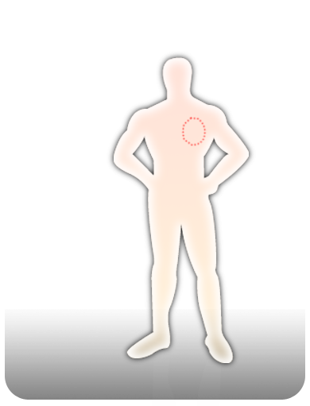
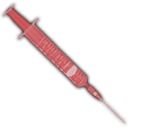


Principle of Photodynamic Thrapy
①
②
A patient comes to the
Clinic with a tumor.
After time the photosensitizer
concentrates in the tumor.
The photosensitizer is
given by injection
③
hυ
④
The Photosensitizer is activated by light.
The tumor is selectively
destroyed
Notes:
Currently, the most commonly used agents are a mixture of different porphyrin-based oligomers, such as porfimer (Photofrin).
A standard dose of 2 mg/kg is injected intravenously slowly over 5 to 10 minutes.
The drug is cleared from most organ systems within 72 hours, but is retained longer in tumors, skin (up to 30 days), liver, and spleen.

Slide 17
Tumor Death by PDT
Photosensitizer Excitation in tumor tissue
Release of active species
Vascular Sites
(EC, BM)
Direct cellular
toxicity
Immunologic
activation
Prostaglandin release
Organelle damage, apoptosis
Cytokine release (IL-1, IL-2, TNF)
Platelet aggregation
Vascular shutdown
Hypoxia
Tumor Death
Tumor Remission
Notes:
Due to its preferential retention in tumor cells and in vascular endothelium, the cytotoxic reaction of porfimer is somewhat selective for neoplastic cells [5].
After a set time interval (usually 48 hours), the tumor is exposed to light energy, which triggers the cytotoxic reaction.
This reaction seems to be dependent primarily upon a type II photo-oxidative process, in which molecular oxygen is transformed to a cytotoxic singlet oxygen species in the presence of the light-excited sensitizer [4,6].
The neovascular endothelium of tumors seems particularly susceptible to PDT, with loss of capillary integrity soon after treatment.

Slide 18
Photosensitizing Agents
Advancements
Increase specificity to tumor cells
Increase potency
Decrease time of sensitivity to sunlight

Slide 19
LIGHT APPLICATION
405 nm
absorption peak
630 nm
achieve more penetration
However, almost completely absorbed at the tissue surface
thus achieves only minimal and superficial tumor destruction.
used for therapeutic applications and results in tumor destruction to a depth of 5 to 10 mm
Notes:
The most commonly used light sources are argon-pumped or KTP (potassium-titanyl-phosphate)-pumped tunable dye lasers, which emit a nonthermal laser light.

Slide 20
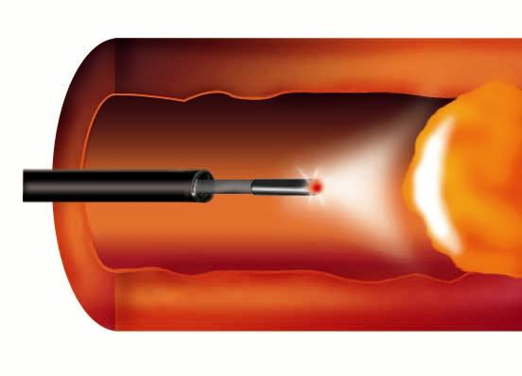


Choice of Optical fiber or diffuser
Cylindrical Type
Frontal Type
Balloon Type
Notes:
This light can be delivered through one of several types of fiber systems, which can be introduced via the working channel of a flexible bronchoscope.
The most commonly used design is a cylindrical diffuser which differs from conventional laser fibers by emitting the light laterally in a 360 degree arc near its tip.

Slide 21
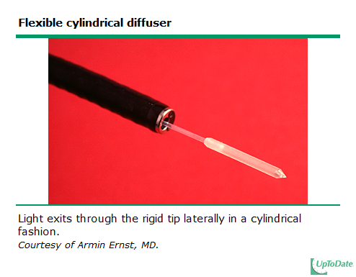

Slide 22
DOSIMETRY
Since the laser light is nonthermal, the effects of PDT are not immediate.
Total energy delivery depends upon
  the timing of treatment after injection of the sensitizing agent
  the energy delivered through the fiber.
48 hr
wash out of normal mucosa
minimizing damage to nonmalignant tissue.
200J
apply 200 Joules per cm treated
additional energy may be applied during a follow-up bronchoscopy 2 days later
Notes:
Obstructing Esophageal Cancer: 200-300 (400mW)
Obstructing Lung Cancer: 200-300 (400mW)
Cholangio Cancer: 180~200 (400mW)
Basal Cell Carcinoma : 200-500 (400mW)

Slide 23
PROCEDURE
presumed superficial carcinoma in-situ
EBUS
flexible bronchoscope
rigid bronchoscope
light application
200 J/cm generally requires 8 minutes
Adequate topical anesthesia
repeat bronchoscopy
planned in 48 hours
inflammatory response is particularly prominent

Slide 24
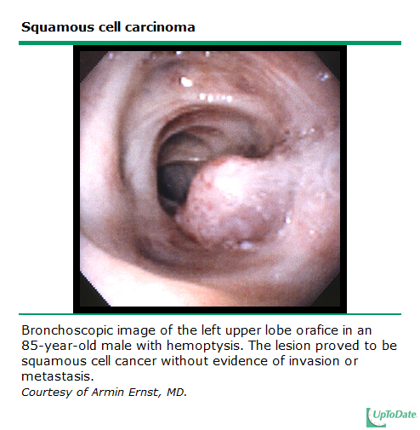
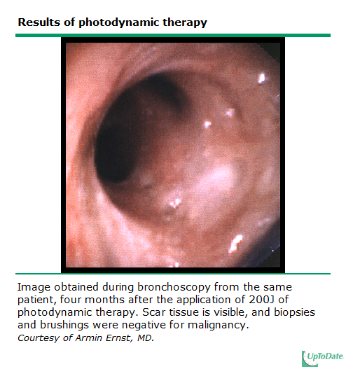
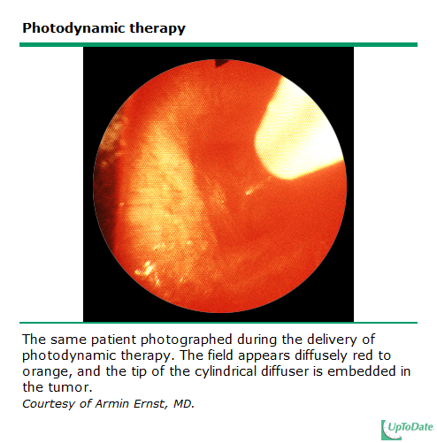
EXAMPLE

Slide 25
Contents
Introduction
Definition
Mechanism
Photosensitizer & light applicaton
Requirement
Conclusion
Complication
History
Classification
Patient education
Efficancy
Application
Dosimetry
Procedure

Slide 26
Complications
1. Photosensitivity of the skin
2. Cough with some blood-streaked sputum & chest discomfort
3. Airway compromise
The main adverse effect
not uncommon
worrisome if the procedure was performed in the trachea or with higher energy levels
Immediate therapeutic bronchoscopy must be available
intubation and mechanical ventilation may be required.
Patient education –> 4~6wks, cloth, suncream[], most artificial light sources[0]

Slide 27
EFFICACY
Curative PDT-early cancer & recurrent ca.
  Lung ca., esophagus, gastric, cervix, oral cavity, H&N, bladder
  Recurrent breast ca., Metastasized breast wall, skin ca.
Palliative PDT
  Obstructive bronchial ca. & esophagus, dysphagia.
Functional conserving PDT
  Vocal cord, cervical ca., rectal ca.
Intraoperative PDT(post-op)
  Intraperitonial Ca., Glioma, pituitary adenoma, colon ca.
Pre-OP PDT
  Lung, inoperable cholangio ca.

Slide 28
Curative PDT-early cancer
Phothdynamic therapy for early stage squamous cell carcinoma of the lung
21 patients
15 patients: CR
11 patients: 12months CR status
10 patients -> 5 patients lung cancer develop, ultimately surgical treatment
2 patients -> refused a surgical process
9 patients (43%)-> spared, (68 months f/u)
at least 22% of patients -> can be spared surgical resection
Mayo Clin Proc 1997; 72:595-602

Slide 29
Palliative PDT
The place of bronchoscopic photodynamic therapy in advanced unresectable lung cancer: experience of 100 cases
Stage IIIa-IV, 100 patients(M:68, F:32),
mean age: 62.5,
WHO performance status [II <=43, IV >54]
Treatment protocol :
2 mg/kg body weight of photofrin + 630 nm laser light 24–72 h later.
Follow-up was at 6–8 weeks for 1 year.
Then every 3–6 months if applicable. Repeat PDT as necessary.
43 patients with PS <= 2, 23 (53%) survived 2 years or more
two of the 54 patients (3.7%) with PS > 2 survived more than 2 years
->better performance status have added survival benefit.
European Journal of Cardio-thoracic Surgery 15 (1999) 16

Slide 30
PHOTODYNAMIC THERAPY FOR ENDOBRONCHIAL MALIGNANT DISEASE: A PROSPECTIVE FOURTEEN-YEAR STUDY
Sixteen patients with stage I disease had a 93% 5-year disease-related estimated survival.
Survival After Photodynamic Therapy to Non-Pulmonary Metastatic Endobronchial Tumors
PDT of endobronchial metastatic tumors effectively decreased the amount of endobronchial obstruction, and improved the quality of life.
J Thorac Cardiovasc Surg 1997;114:940-7)
Lasers Surg. Med. 24:194–201, 1999.
Notes:
85-> 13%
Dypsnea, cough, hemoptysis
Stage IV 4-> 14months

Slide 31
Photodynamic therapy for peripheral lung cancer
Lung Cancer (2004) 43, 77—82
PDT can play an important role for the treatment strateg for MPLC.
Management of Multiple Primary Lung Cancer in Patients
with Centrally Located Early Cancer Lesions
Journal of Thoracic Oncology • Volume 5, Number 1, January 2010

Slide 32
Conclusions
PDT of cancer regulated by:
  Type of photosensitizing agent
  Type of administration
  Dose of photosensitizer
  Light dose
  Fluence rate
  O₂ availability
  Time between administration of photosensitizer and light

Slide 33
Conclusions
Tumor cells show some selectivity for photosensitizing agent uptake
Limited damage to surrounding tissues
Less invasive approach
Outpatient procedure
Various application types
Cosmetic results
Photodynamic therapy
Chemotherapy
Radiotherapy

Slide 34
Case presentation

Slide 35
권O문 M/62
Current diagnosis
  96’-> Rectal ca stage III, Dukes'C2)
    s/p Low anterior resection (double stable tech.)
    s/p Adjuvant FL, picibanyl(weekly)
  05’-> Metastatic lung ca. Lt.
    s/p Wedge resection of LLL under VATS (2005/08/19)
  07’ -> LLL tumor regrowth
    s/p LLL lobectomy(2007/08/27)
    s/p 1st Avastin+FOLFOX (2007.10.15~2007.10.16)
  Rectal cancer, lung mets (09.8’)

Slide 36
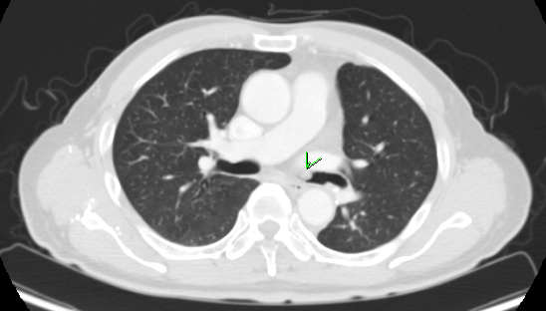
2009.08.20 PET-CT

Slide 37
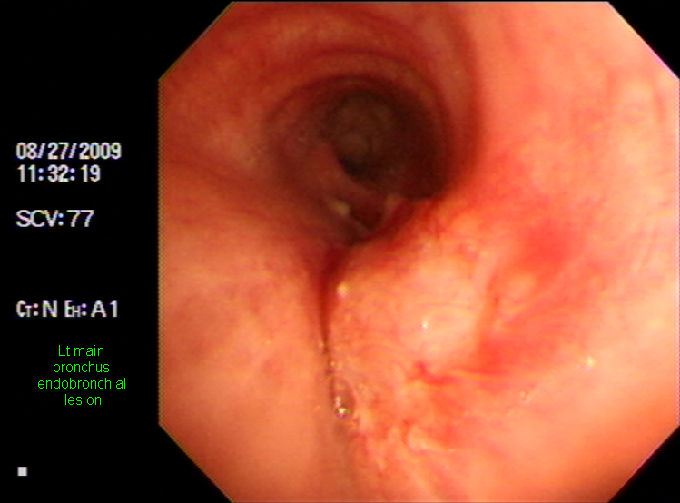
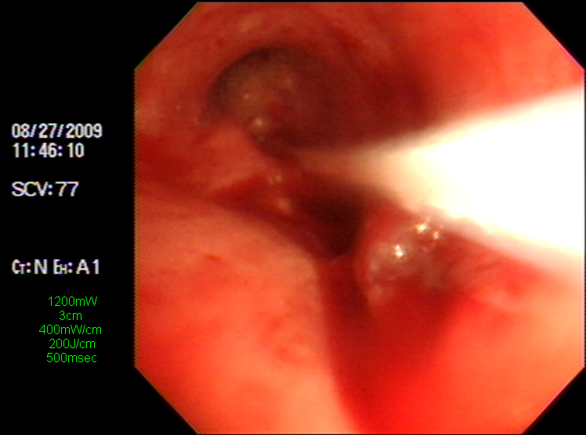
1st PDT Tx
2009.08.27
2009.08.27
Notes:
Rt : no endobronchial lesion, no mucosal change Lt : main carina 하방 2.5cm 부위 endobronchial lesion 확인됨. bronchus ridge를 타고 2.5cm~3cm 가량의 길이의 lesion확인되 었으며 bronchus가 직선을 이루지 않고 꺽여있어 최대한 probe를 길게하여 시술 하였음. 1200mW를 3cm의 lesion에 200J/cm apply하였음.(즉 400mW/cm) 시술중 bleeding등의 complication 없었으며 환자 tolerable 하였음.

Slide 38
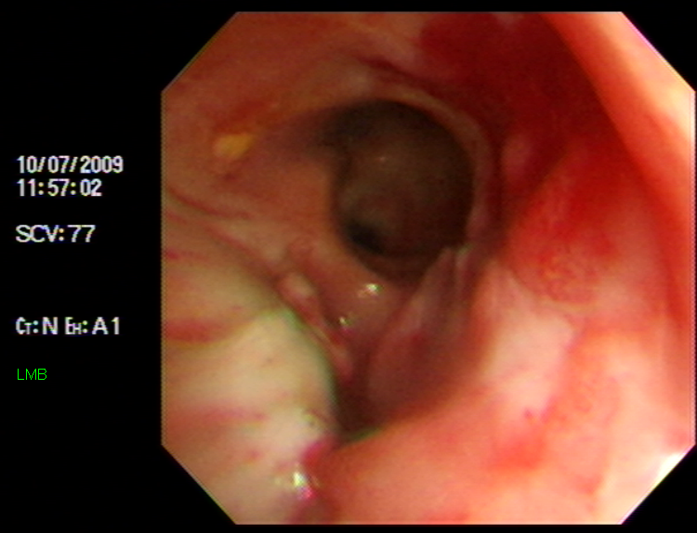
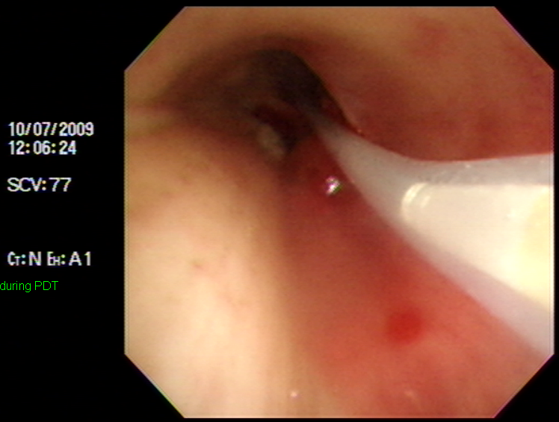
2nd PDT Tx
2009.10.07
2009.10.07
Notes:
Rt bronchus ; no endobronchial lesion, no mucosal change Lt bronchus ; LMB의 mass가 있던 부위는 주로 necrotic tissue로 덮여 있으나 distal portion 및 stump주위에 elevated lesion이 있고, mass의 proximal portion 약 0.5cm 상방에도 2-3개의 small nodular lesion이 있어 각각의 부위에서 forcep biopsy *4, *3회 시 행함 5cm probe를 이용해 PDT를 시행함 (200J/cm2, 총 1000J) 시술중 별다른 complication 없이 검사종료함

Slide 39
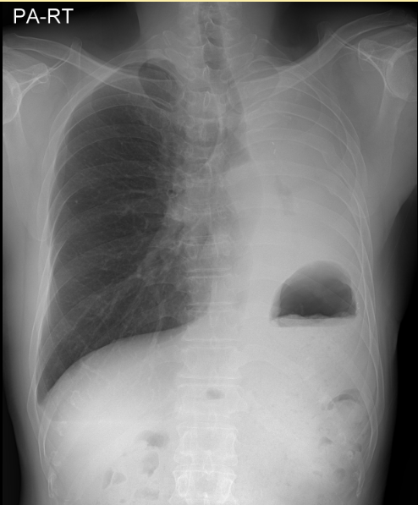
Pathology (09.11.16)
f/u chest x-ray
Erosion with acute inflammation with squamous metaplasia and detached a few fungal organism, morphologically Candida spp.

Slide 40

Thank you

