Slide 1
Pathology, lung
VAST conference
2015. 02. 26.

Slide 2
5257459 M/63

Slide 3
Accumulation of pigmented macrophages within the lumen of the respiratory bronchiole and the surrounding alveolar spaces, and relatively normal intervening parenchyma, consistent with respiratory bronchiolitis.

Slide 4
The spectrum of non-neoplastic lung disorders associated with smoking
Chronic obstructive pulmonary disease (COPD)
Smoking-related interstitial lung diseases
  Respiratory bronchiolitis (RB)
  Respiratory bronchiolitis-interstitial lung disease (RB-ILD)*
  Desquamative interstitial lung disease (DIP)*
  Pulmonary Langerhans cell histiocytosis (LCH)
  *the ATS/ ERS classification of idiopathic interstitial pneumonias

Slide 5
Histologic features of RB/RB-ILD
Key histological features
  Bronchiolocentric accumulation of alveolar macrophages
  Mild bronchiolar fibrosis and chronic inflammation may be seen
  Macrophages have fine brown cytoplasmic pigmentation (positive for iron stain)
Pertinent negative findings
  No diffuse accumulation of macrophages
  No interstitial fibrosis or honeycomb change

Slide 6
7621507 M/57

Slide 7
A. Lung, left upper lobe:
1. Consistent with desquamative interstitial pneumonia
2. Emphysema with interstitial fibrosis
B. Lung, left lower lobe: Consistent with desquamative interstitial pneumonia

Slide 8
Histological features of DIP
Key histological features
  Uniform involvement of lung parenchyma
  Intra-alveolar accumulation of lightly pigmented alveolar macrophages
  Mild-moderate interstitial fibrosis may be seen
  Mild chronic inflammation
Pertinent negative findings
  Inconspicuous or absent dense extensive fibrosis
  No honeycomb change
  Inconspicuous or absent fibroblastic foci and organizing pneumonia
  Rare or absent eosinophils
  Rare or absent smooth muscle proliferation

Slide 9
4033155 M/61

Slide 10
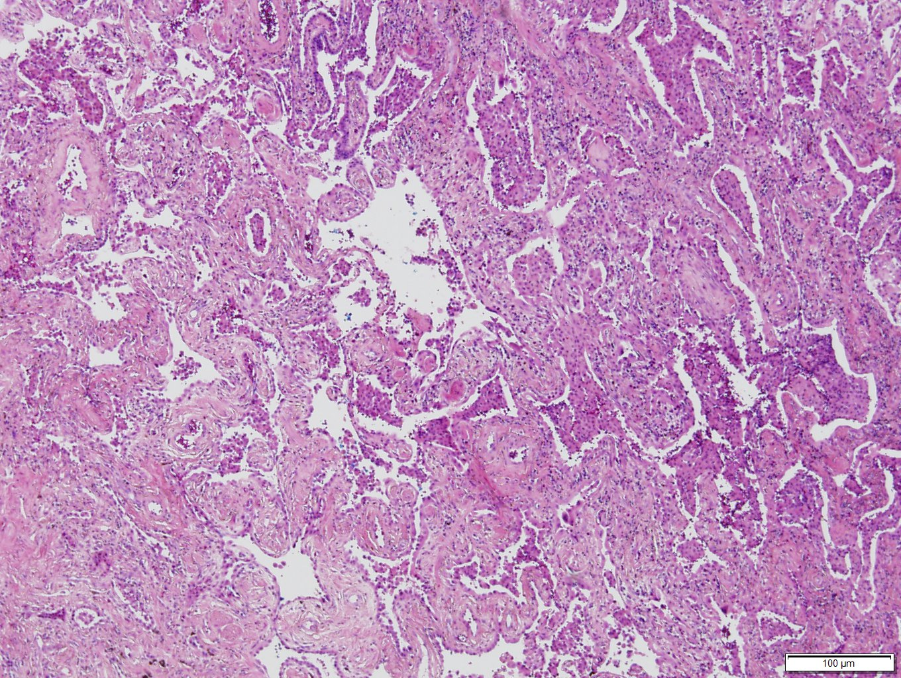

Slide 11
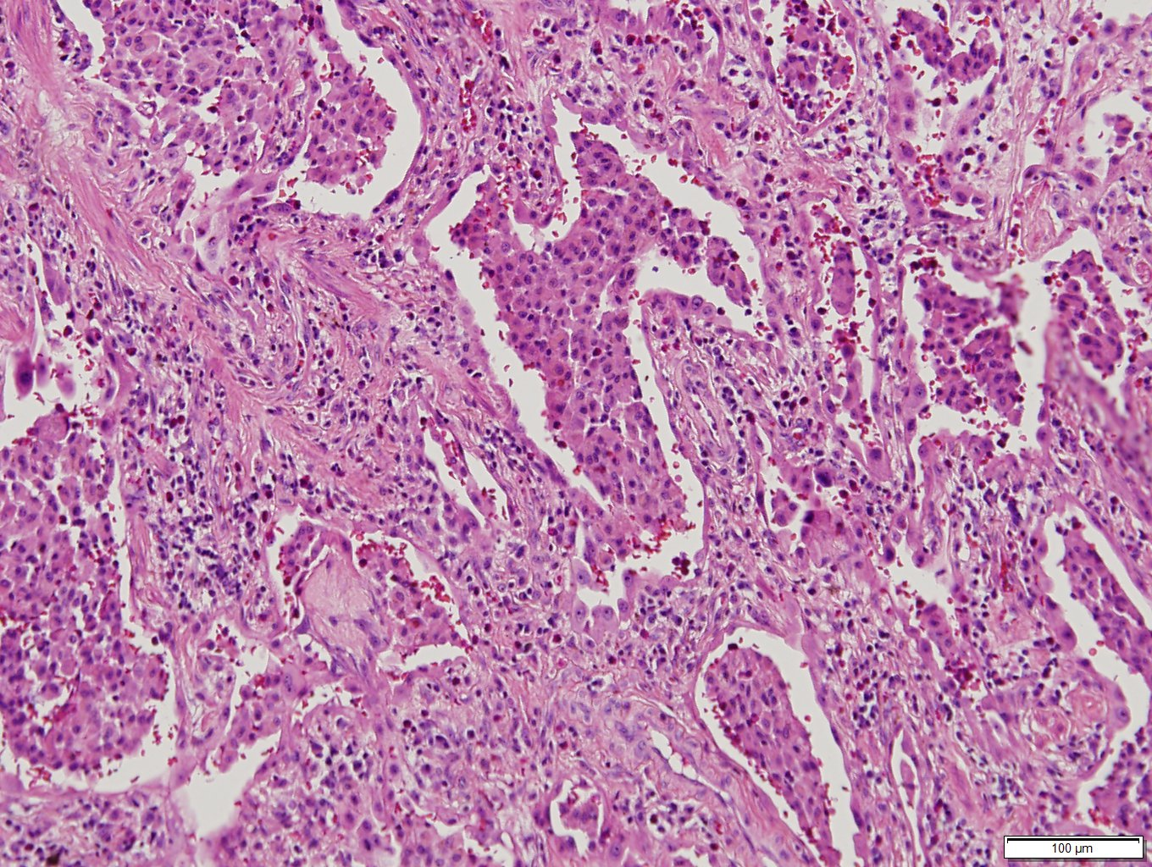

Slide 12
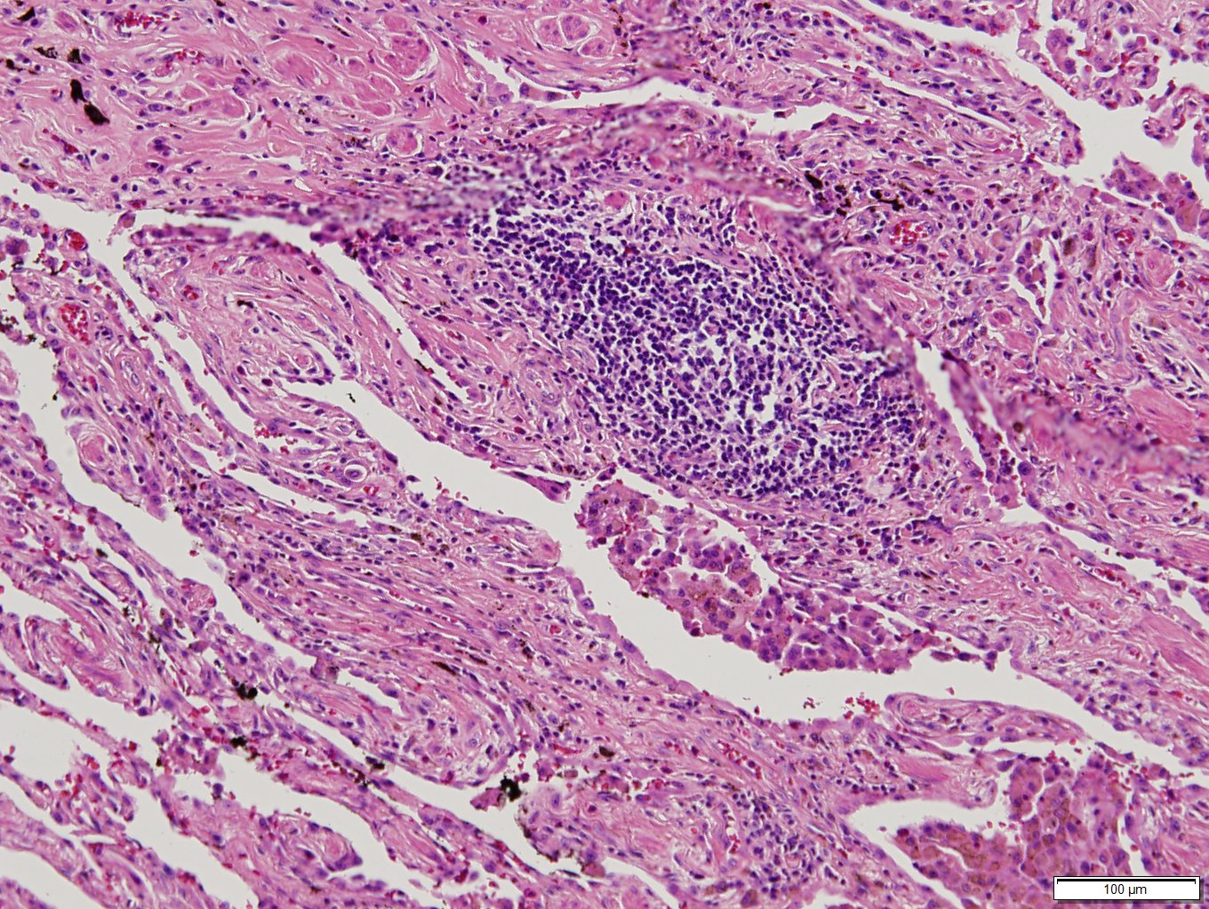

Slide 13
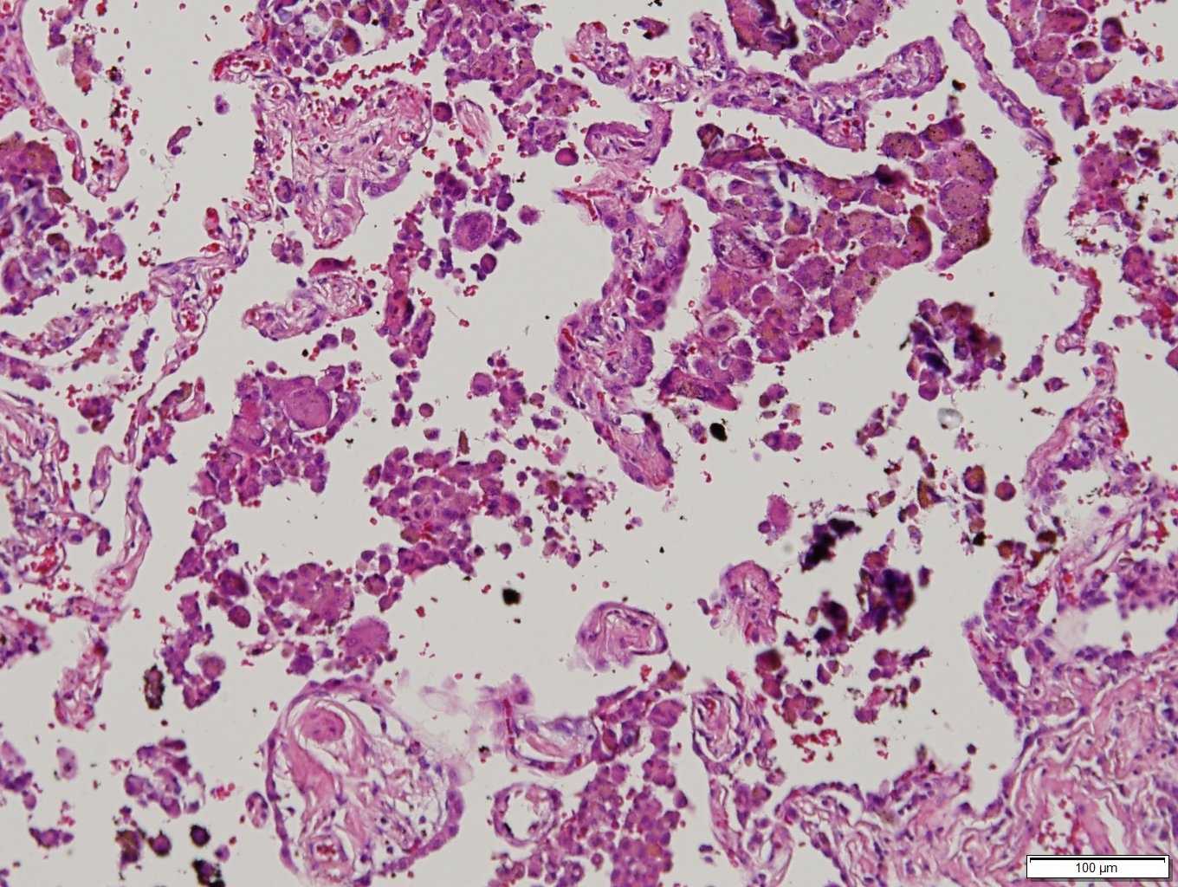

Slide 14
A. Lung, right upper lobe:
1. Consistent with desquamative interstitial pneumonia
2. Emphysematous change with a few multinucleated giant cells and microcalcification
B. Lung, right lower lobe:
1. Consistent with desquamative interstitial pneumonia
2. Emphysematous change

