Slide 1
Progressive pulmonary fibrosis
Toby Maher MB MSc PhD FRCP
Professor of Medicine and Director of ILD, Keck School of Medicine of USC
PC-KR-103303

Slide 2
Disclosures
Relations that could be relevant for this meeting | Company names
Personal financial relationships with commercial interests relevant to this presentation during the past 12 months | Consultant: Apellis, AstraZeneca, Bayer, Biogen Idec, Blade Therapeutics, BMS, Boehringer Ingelheim, F. Hoffmann-La Roche, Galápagos NV, Galecto, GlaxoSmithKline, Gossamer Bio, Indalo, NuMedii, ProMetic, Pliant, Redx, Respivant Sciences, Samumed, Theravance, Three Lakes Partners, UCB Speakers’ bureau: Boehringer Ingelheim and F. Hoffmann-La Roche
Relevant institutional financial interests | Research funding: AstraZeneca, GlaxoSmithKline, UCB

Slide 3
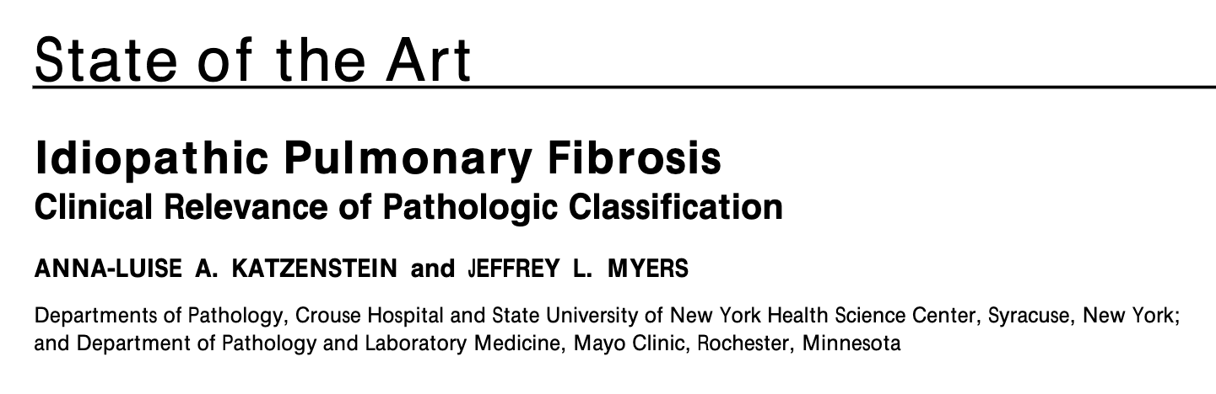
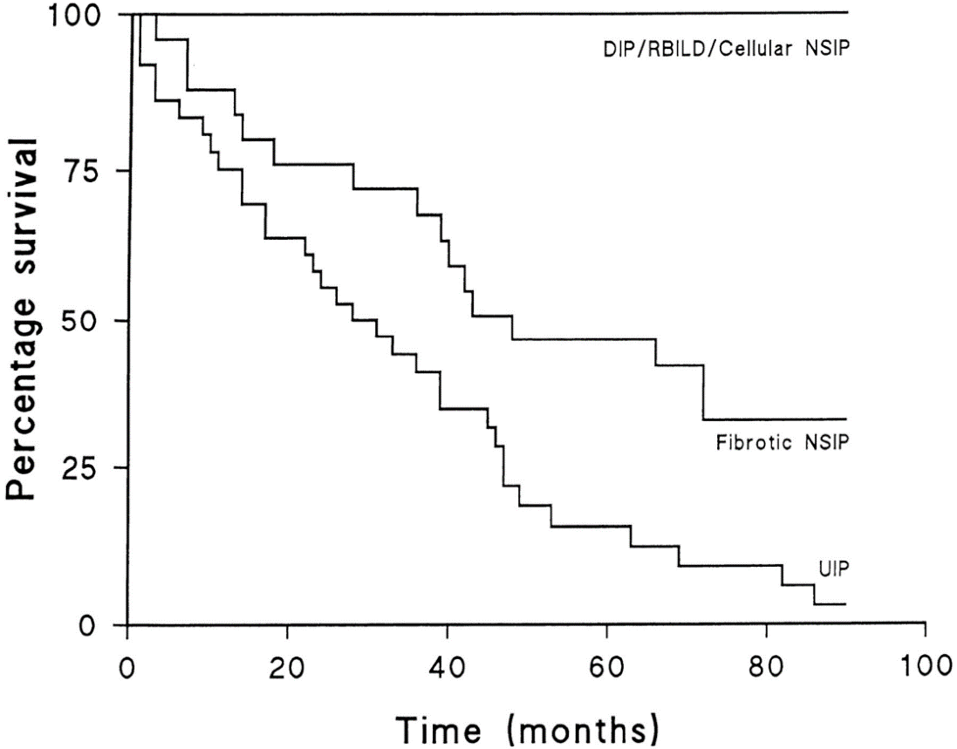
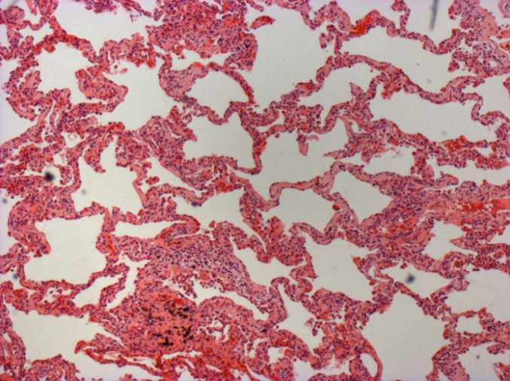
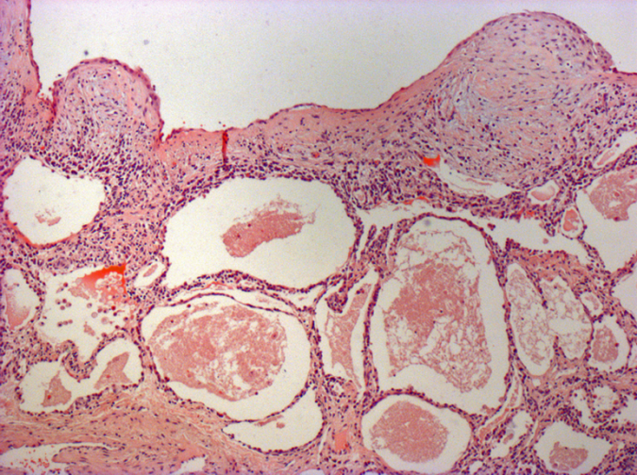
1
Survival with UIP vs fibrotic NSIP²:
NSIP*
UIP*
*Presenter’s own images
DIP, desquamative interstitial pneumonia; NSIP, non-specific interstitial pneumonia;
RB-ILD, respiratory bronchiolitis-associated interstitial lung disease;
UIP, usual interstitial pneumonia
Katzenstein AL, Myers JL. Am J Respir Crit Care Med. 1998;157:1301–1315;
2. Nicholson AG, et al. Am J Respir Crit Care Med. 2000:162;2213–2217

Slide 4
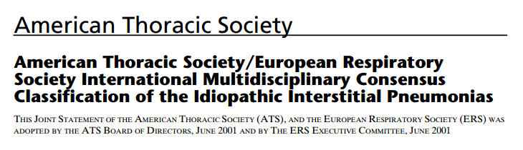
Interstitial lung disease (ILD)
Autoimmune ILDs
cHP
Sarcoidosis
Idiopathic interstitial pneumonias (IIPs)
Other ILDs
(known exposures, drugs)
RA-ILD
SSc-ILD
Other autoimmune ILDs
Major IIPs
Rare IIPs
uILD
Chronic fibrosing
Smoking-related
Acute/subacute
LIP
PPFE
1. Inadequate data
2. Major discordance between findings
IPF
NSIP
RB-ILD
DIP
COP
AIP
AIP, acute interstitial pneumonia; ATS, American Thoracic Society; COP, cryptogenic organising pneumonia; ERS, European Respiratory Society; IPF, idiopathic pulmonary fibrosis; LAM, lymphangioleiomyomatosis; LCH, Langerhans cell histiocytosis;
LIP, lymphocytic interstitial pneumonia; PPFE, pleuroparenchymal fibroelastosis
Adapted from: ATS/ERS. Am J Respir Crit Care Med. 2002;165:277–304;
Ryerson CJ, Collard HR. Curr Opin Pulm Med. 2013;19:453–459; Travis WD, et al. Am J Respir Crit Care Med. 2013;188:733–748; Cottin V, et al. Eur Respir Rev. 2018;27:pii180076

Slide 5
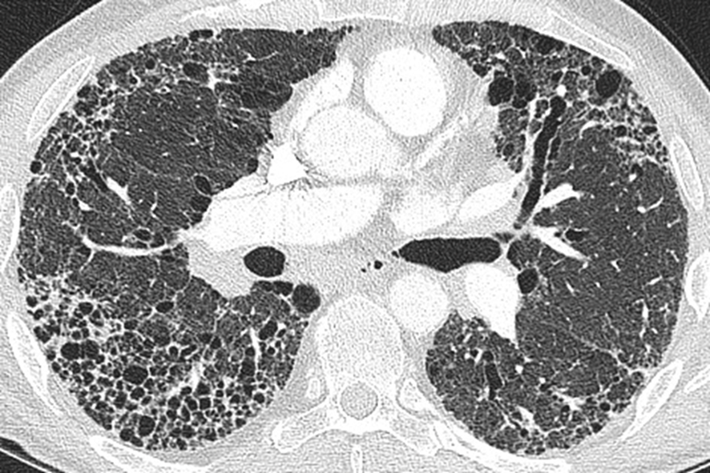
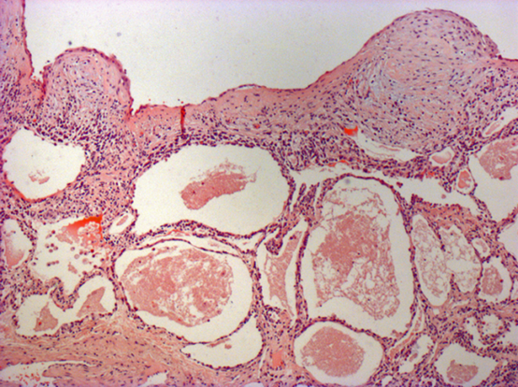
Not all UIP is IPF
IPF
Asbestosis
Rheumatoid Arthritis
Sarcoidosis
Scleroderma
Chronic hypersensitivity
pneumonitis

Slide 6
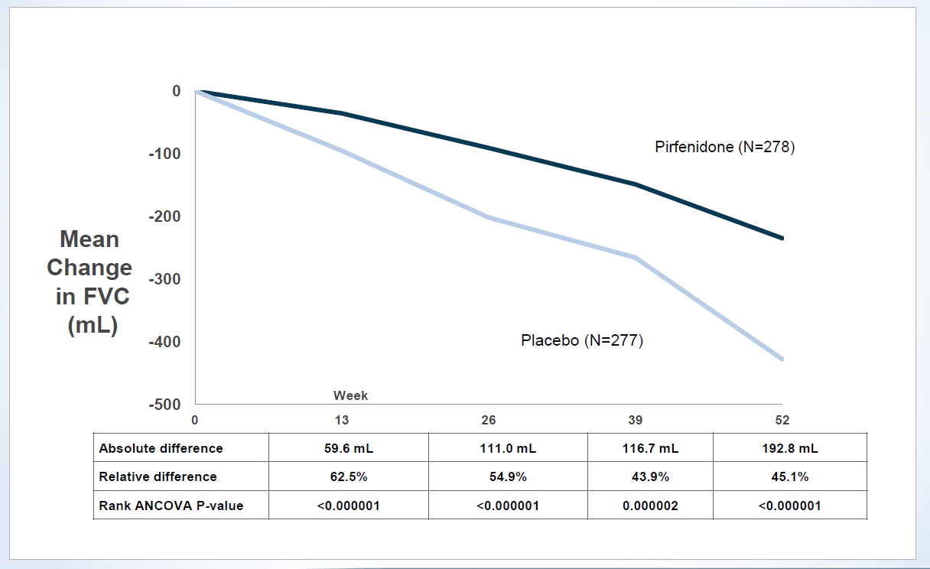
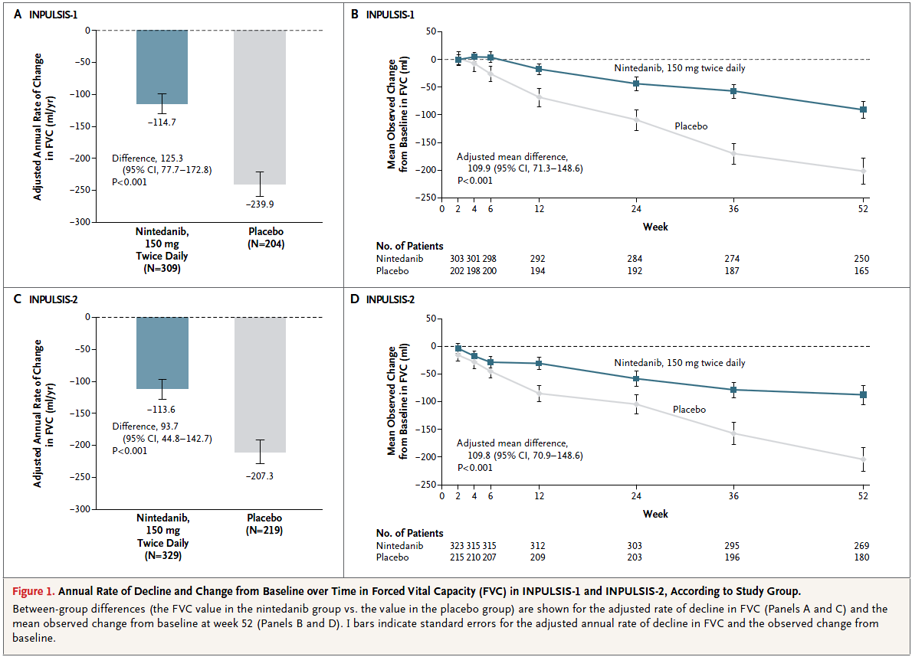
Antifibrotic-treatment for IPF
Pirfenidone: ASCEND study
Nintedanib: INPULSIS trials
King et al NEJM 2014
Richeldi et al NEJM 2014

Slide 7
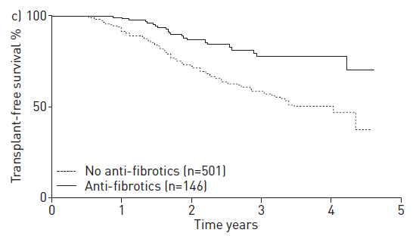
Survival benefits of antifibrotic therapy in IPF
Jo et al. ERJ 2017
1.0
0.8
Antifibrotic treatment
No antifibrotic treatment
0.6
Cumulative survival
0.4
Fisher M……Maher TM et al JMCSP 2017
0.2
0.0
0
50
100
150
200
250
Guenther et al Resp Res 2018

Slide 8
Diagnosis and treatment of ILD; 2012 - 2020
PROGRESSIVE FIBROSING
LUNG DISEASE
PRE - 2012
PROGRESSIVE FIBROSING
LUNG DISEASE
POST - 2012
IPAF
UIP
NSIP
Treat with
anti-fibrotic
Treat with steroid or immunosuppressant
AIP
IPF
Chronic HP
CTD-ILD
IPAF
Chronic
HP
CTD-ILD
Treat with steroid ± azathioprine

Slide 9
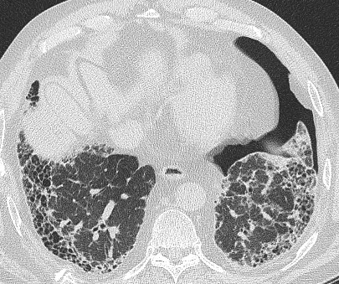
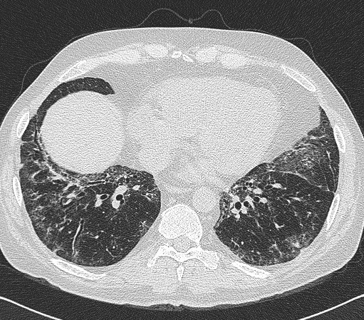
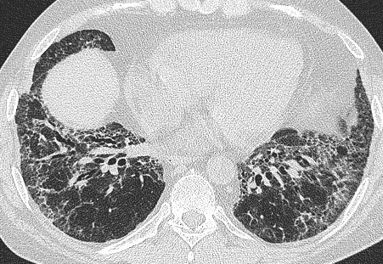
Progressive non-IPF pulmonary fibrosis
Rheumatoid arthritis
Systemic sclerosis

Slide 10
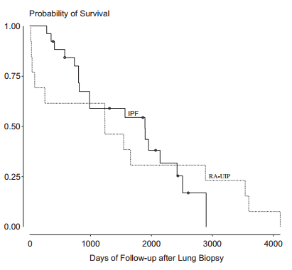
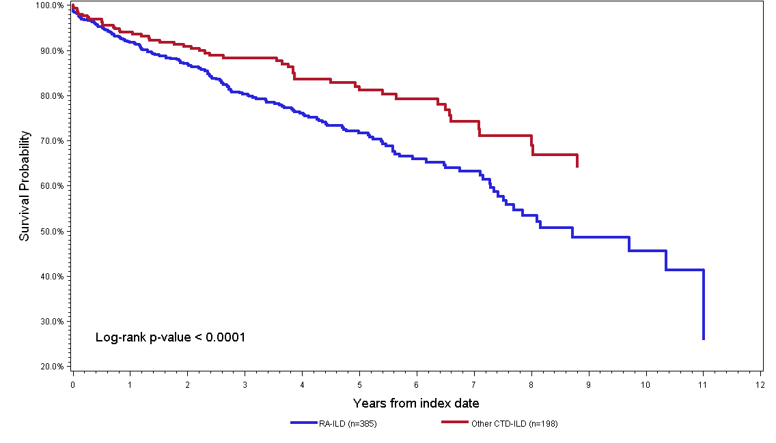
Poor outcomes in CTD-ILD
RA-UIP
CTD-ILD
Solomon et al Resp Med 2013
Amar, Maher et al (unpublished)

Slide 11
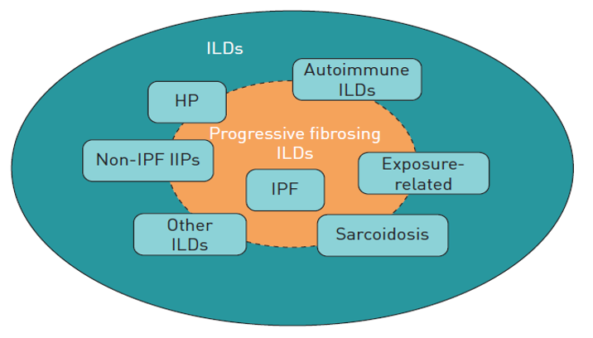
PF-ILD

Slide 12
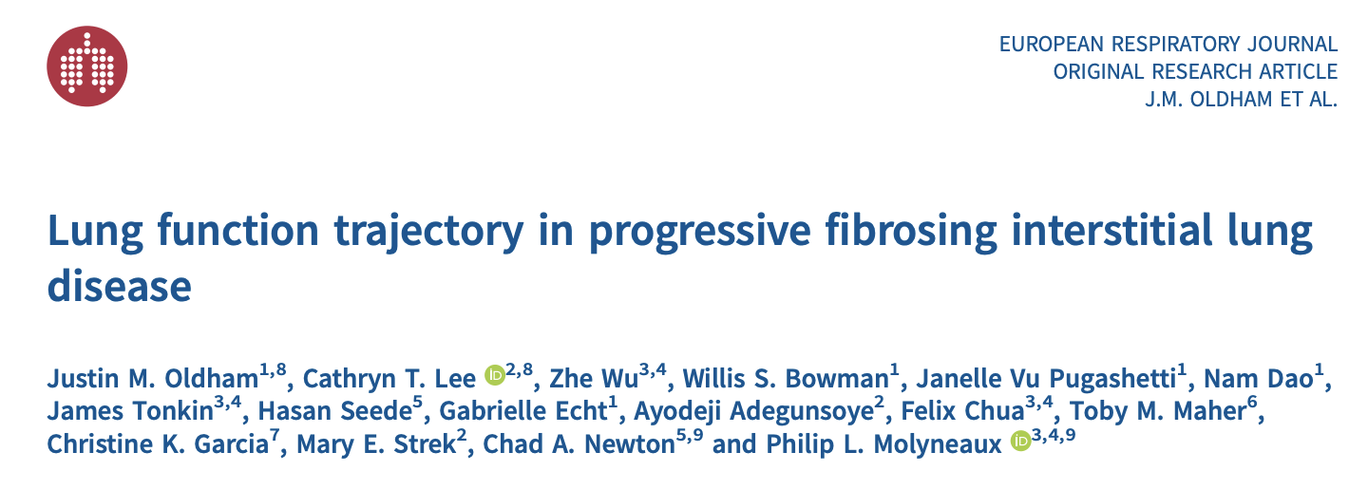
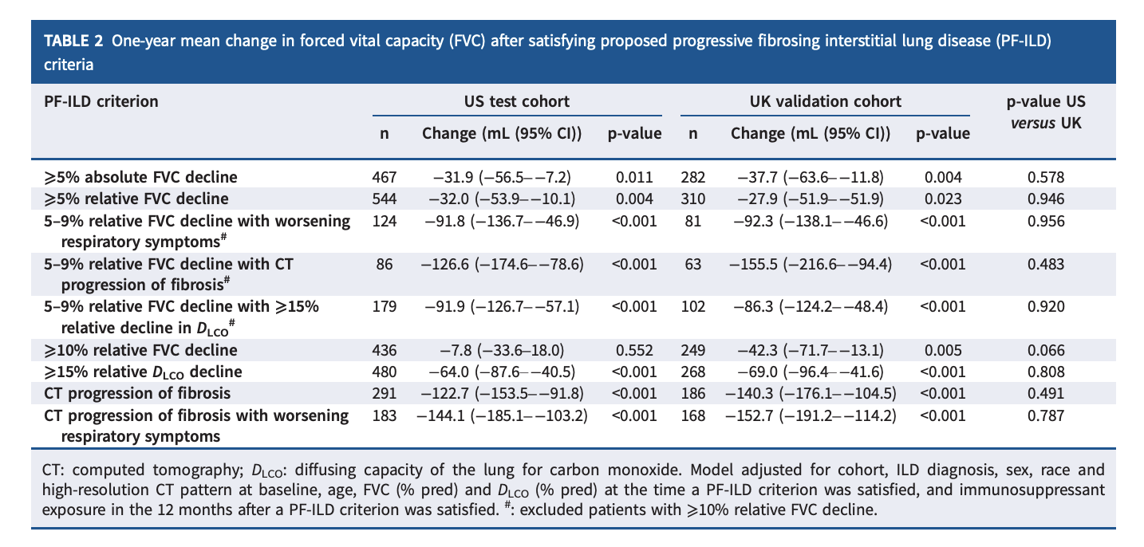

Slide 13
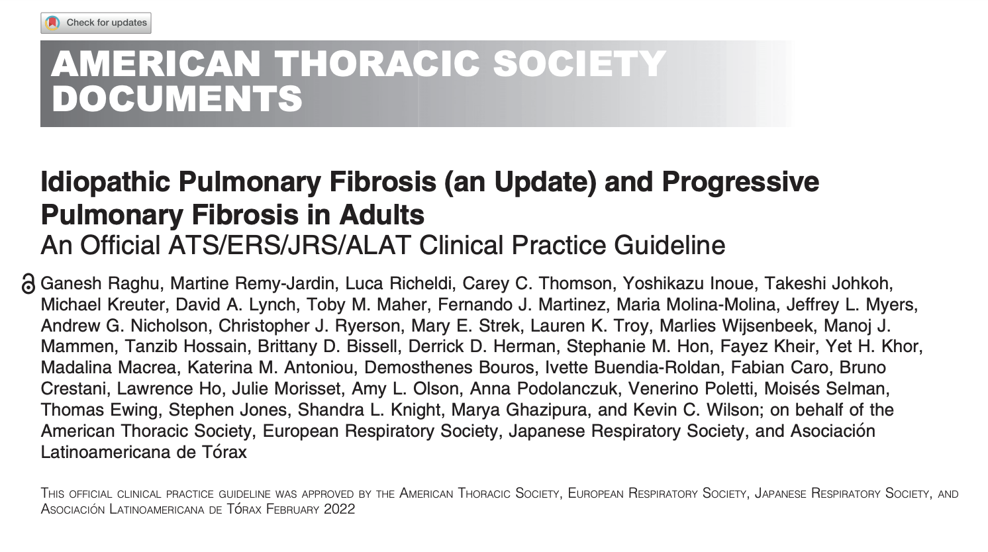
ATS Guidelines

Slide 14
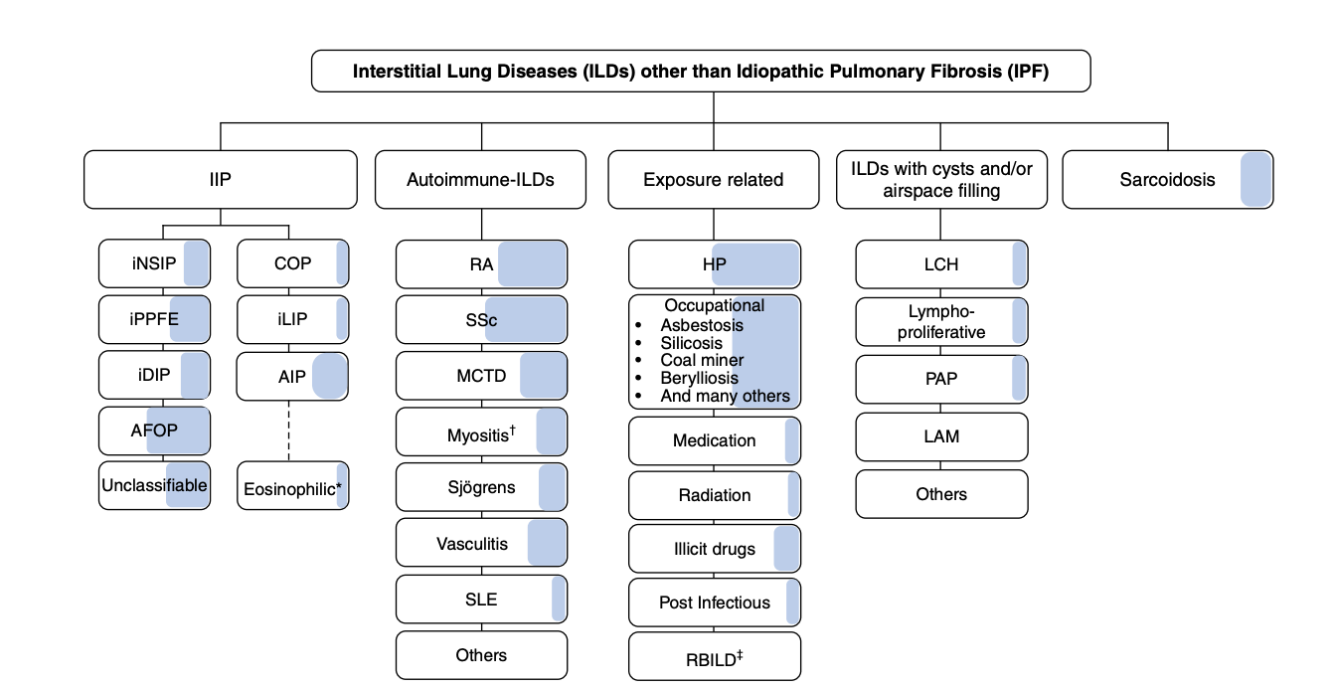
Which diseases cause PPF

Slide 15
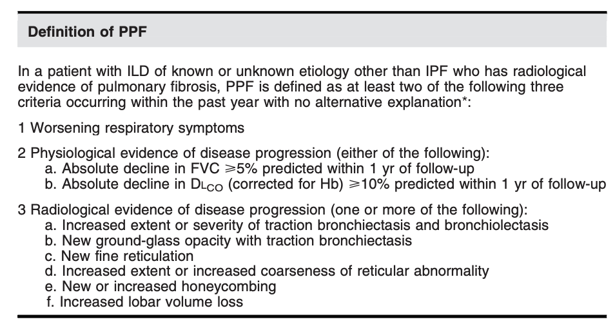
Definition of PFF

Slide 16
The INBUILD trial
Double-blind
Nintedanib 150 mg bid (n=332)
Nintedanib 150 mg bid
Open-label nintedanib (INBUILD-ON)
Screening
R
*
Placebo (n=331)
Placebo
Visit
1
2
3
4
5
6
7
8
9
Week
0
2
4
6
12
24
36
52
PART A
First database lock
PART B†
Primary endpoint assessed
*Randomisation was stratified by HRCT pattern (UIP-like fibrotic pattern only or other fibrotic patterns) based on central review.
†Visits occurred every 16 weeks until end of treatment.
bid, twice daily; R, randomisation; UIP, usual interstitial pneumonia.
Flaherty KR, et al. N Engl J Med 2019; doi: 10.1056/NEJMoa1908681.

Slide 17
Key eligibility criteria
  Physician-diagnosed ILD other than IPF
  Features of diffuse fibrosing lung disease (reticular abnormality with traction bronchiectasis, with or without honeycombing) of >10% extent on HRCT performed ≤12 months prior to screening, confirmed by central review
  FVC ≥45% predicted
  DLco ≥30%–<80% predicted
DLco, diffusing capacity of the lungs for carbon monoxide; FVC, forced vital capacity; HRCT, high-resolution computed tomography.
Flaherty KR, et al. N Engl J Med 2019; doi: 10.1056/NEJMoa1908681.

Slide 18
Inclusion criteria re: progressive phenotype
Patients were required to meet ≥1 of the following criteria for ILD progression in the 24 months before screening, despite management:
  Relative decline in FVC ≥10% predicted
  Relative decline in FVC ≥5–<10% predicted and worsened respiratory symptoms
  Relative decline in FVC ≥5–<10% predicted and increased extent of fibrosis on HRCT
  Worsened respiratory symptoms and increased extent of fibrosis on HRCT
Flaherty KR, et al. N Engl J Med 2019; doi: 10.1056/NEJMoa1908681.

Slide 19
Primary and main secondary endpoints¹
Primary endpoint:
  Annual rate of decline in FVC (mL/year) assessed over 52 weeks
Main secondary endpoints:
  Absolute change from baseline in K-BILD questionnaire² total score at
  week 52
  Time to first acute exacerbation of ILD or death over 52 weeks
  Time to death over 52 weeks
1. Flaherty KR, et al. N Engl J Med 2019; doi: 10.1056/NEJMoa1908681. 2. Patel AS, et al. Thorax 2012;67:804–10.
K-BILD, King’s Brief Interstitial Lung Disease. UIP, usual interstitial pneumonia.

Slide 20
Two co-primary analysis populations
  Overall population
  Patients with a UIP-like fibrotic pattern on HRCT
Overall population
Overall population
Patients with a UIP-like fibrotic pattern on HRCT
Patients with a UIP-like fibrotic pattern on HRCT
Flaherty KR, et al. N Engl J Med 2019; doi: 10.1056/NEJMoa1908681.
Notes:
.

Slide 21
Disposition of overall population over 52 weeks
Screened (n=1010)
Randomised (n=663)
Treated (n=663)
Nintedanib 150 mg bid (n=332)
Placebo (n=331)
Did not prematurely discontinue study drug (n=252)
Prematurely discontinued study drug (n=80)
Did not prematurely discontinue study drug (n=282)
Prematurely discontinued study drug (n=49)
Did not complete 52 weeks’ observation time (n=18)
Did not complete 52 weeks’ observation time (n=20)
Completed 52 weeks’ observation time (n=314)
Completed 52 weeks’ observation time (n=311)
Flaherty KR, et al. N Engl J Med 2019; doi: 10.1056/NEJMoa1908681.

Slide 22
Baseline characteristics of overall population¹ (1/2)
 | Nintedanib (n=332) | Placebo (n=331)
Age, years, mean (SD) | 65.2 (9.7) | 66.3 (9.8)
Male, n (%) | 179 (53.9) | 177 (53.5)
Body mass index, kg/m², mean (SD) | 28.1 (5.1) | 28.4 (5.5)
Current or former smoker, n (%) | 169 (50.9) | 169 (51.1)
Race², n (%)*
White | 242 (72.9) | 246 (74.3)
Asian | 83 (25.0) | 80 (24.2)
Black/African-American | 5 (1.5) | 5 (1.5)
American Indian/Alaska Native/Native Hawaiian/other Pacific Islander | 1 (0.3) | 0
*Data from patients who selected one race. One patient ticked two boxes.
Not all patients provided data for all variables.
1. Flaherty KR, et al. N Engl J Med 2019; doi: 10.1056/NEJMoa1908681. 2. Data on file.

Slide 23
Baseline characteristics of overall population (2/2)
 | Nintedanib (n=332) | Placebo (n=331)
UIP-like fibrotic pattern on HRCT, n (%) | 206 (62.0) | 206 (62.2)
FVC, mL, mean (SD) | 2340 (740) | 2321 (728)
FVC, % predicted, mean (SD) | 68.7 (16.0) | 69.3 (15.2)
DLco, % predicted, mean (SD)* | 44.4 (11.9) | 47.9 (15.0)
K-BILD questionnaire total score, mean (SD) | 52.5 (11.0) | 52.3 (9.8)
*Corrected for haemoglobin.
Not all patients provided data for all variables.
K-BILD, King’s Brief Interstitial Lung Disease.
Flaherty KR, et al. N Engl J Med 2019; doi: 10.1056/NEJMoa1908681.

Slide 24
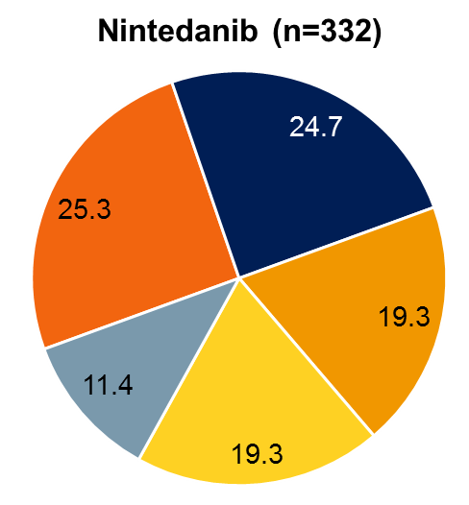
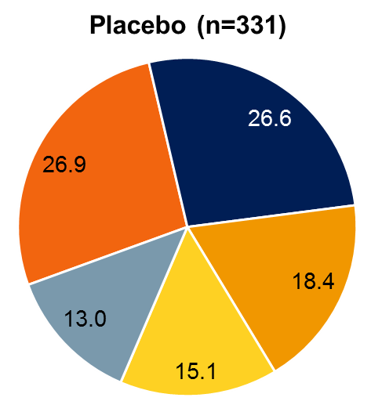
Clinical ILD diagnoses in overall population
Hypersensitivity
pneumonitis
Autoimmune ILDs*
Idiopathic non-specific
interstitial pneumonia
Unclassifiable IIP
Other ILDs†
*Included rheumatoid arthritis-associated ILD (nintedanib 12.7%; placebo 14.2%), systemic sclerosis-associated ILD (nintedanib 6.9%; placebo 4.8%), mixed connective tissue disease-ILD (nintedanib 2.1%; placebo 3.6%), and selected other terms in “Other fibrosing ILDs”.
†Included sarcoidosis, exposure-related ILDs and selected other terms in “Other fibrosing ILDs”. IIP, idiopathic interstitial pneumonia. Flaherty KR, et al. N Engl J Med 2019; doi: 10.1056/NEJMoa1908681.

Slide 25
Adjusted annual rate of decline in FVC (mL/year) over 52 weeks (primary endpoint)
Patients with UIP-like fibrotic
pattern on HRCT
Overall population
Nintedanib (n=332)
Placebo
(n=331)
Nintedanib (n=206)
Placebo
(n=206)
Adjusted mean (SE) annual rate of decline in FVC (mL/year)
Difference: 107.0 mL/year
(95% CI: 65.4, 148.5); p<0.001
Relative reduction: 57%
Difference: 128.2 mL/year
(95% CI: 70.8, 185.6); p<0.001
Relative reduction: 61%
Based on random coefficient regression with fixed effects for treatment, HRCT pattern (only for the overall population), and baseline FVC (mL), and terms for treatment-by-time and baseline-by-time interactions. Flaherty KR, et al. N Engl J Med 2019; doi: 10.1056/NEJMoa1908681.

Slide 26
Observed change from baseline in FVC (mL) over 52 weeks
Mean (SE) absolute change
from baseline in FVC (mL)
2
4
6
12
24
36
Week
No. of patients
Overall population
Nintedanib | 332 | 326 | 320 | 322 |  | 314 |  | 298 |  |  |  | 285 |  |  |  | 265
Placebo | 331 | 325 | 326 | 325 |  | 320 |  | 311 |  |  |  | 296 |  |  |  | 274
UIP-like fibrotic pattern on HRCT
Nintedanib | 206 | 203 | 200 | 199 |  | 193 |  | 180 |  |  |  | 171 |  |  |  | 160
Placebo | 206 | 202 | 202 | 201 |  | 197 |  | 190 |  |  |  | 176 |  |  |  | 162
Flaherty KR, et al. N Engl J Med 2019; doi: 10.1056/NEJMoa1908681.

Slide 27
Annual rate of decline in FVC (mL/year) over 52 weeks by HRCT pattern
 | N analysed |  |  | Adjusted difference (95% CI) | Treatment-by-subgroup-by-time interaction
Overall population | 332 | 331 |  | 107.0 (65.4, 148.5)
UIP-like fibrotic pattern | 206 | 206 |  | 127.8 (74.3, 181.2) | p=0.23
Other fibrotic patterns | 126 | 125 |  | 75.4 (9.5, 141.4)
Nintedanib
Placebo
Favours placebo
Favours nintedanib
Flaherty KR, et al. N Engl J Med 2019; doi: 10.1056/NEJMoa1908681.

Slide 28
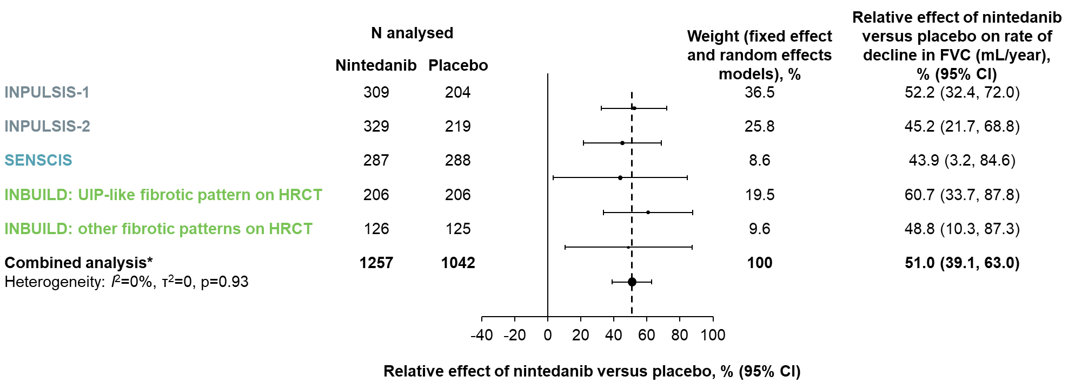
Consistent effect of nintedanib on reducing FVC decline across ILDs
1. Bonella F et al. Poster presented at ERS 2020 virtual congress: Presentation no. 739; 2. Richeldi L et al. N Engl J Med 2014;370:2071–82; 3. Distler O et al. N Engl J Med 2019;380:2518–28; 4. Flaherty KR et al. NEJM 2019;381:1718–27

Slide 29
Most frequently reported adverse events (irrespective of causality) in overall population
 | Nintedanib (n=332) | Placebo (n=331)
Diarrhoea | 222 (66.9) | 79 (23.9)
Nausea | 96 (28.9) | 31 (9.4)
Bronchitis | 41 (12.3) | 47 (14.2)
Nasopharyngitis | 44 (13.3) | 40 (12.1)
Dyspnoea | 36 (10.8) | 44 (13.3)
Vomiting | 61 (18.4) | 17 (5.1)
Cough | 33 (9.9) | 44 (13.3)
Decreased appetite | 48 (14.5) | 17 (5.1)
Alanine aminotransferase increased | 43 (13.0) | 12 (3.6)
Progression of ILD | 16 (4.8) | 39 (11.8)
Weight decreased | 41 (12.3) | 11 (3.3)
Aspartate aminotransferase increased | 38 (11.4) | 12 (3.6)
Data are n (%) of patients with ≥1 such adverse event reported over 52 weeks (or until 28 days after last trial drug intake for patients who discontinued trial drug before week 52). Adverse events based on MedDRA preferred terms that were reported in >11% of patients in either treatment group are shown. Flaherty KR, et al. N Engl J Med 2019; doi: 10.1056/NEJMoa1908681.

Slide 30
Change from baseline in K-BILD questionnaire total score at week 52¹
 | Overall population |  | Patients with a UIP-like fibrotic pattern on HRCT
 | Nintedanib (n=332) | Placebo (n=330) | Nintedanib (n=206) | Placebo (n=205)
Adjusted mean (SE) absolute change from baseline in K-BILD questionnaire total score at week 52 | 0.55 (0.60) | -0.79 (0.59) | 0.75 (0.80) | -0.78 (0.79)
Difference (95% CI) | 1.34 (-0.31, 2.98) |  | 1.53 (-0.68, 3.74)
Nominal p-value² | 0.11 |  | 0.17
Scores range from 0 to 100. Higher scores represent better health status.
K-BILD, King’s Brief Interstitial Lung Disease. 1. Flaherty KR, et al. N Engl J Med 2019; doi: 10.1056/NEJMoa1908681. 2. Data on file.

Slide 31
Time to first acute exacerbation of ILD or death and time to death over 52 weeks¹
 | Overall population |  | Patients with a UIP-like fibrotic pattern on HRCT
 | Nintedanib (n=332) | Placebo (n=331) | Nintedanib (n=206) | Placebo (n=206)
Acute exacerbation of ILD or death, n (%) | 26 (7.8) | 32 (9.7) | 17 (8.3) | 25 (12.1)
Hazard ratio (95% CI) | 0.80 (0.48, 1.34) |  | 0.67 (0.36, 1.24)
Nominal p-value² | 0.39 |  | 0.20
Death, n (%) | 16 (4.8) | 17 (5.1) | 11 (5.3) | 16 (7.8)
Hazard ratio (95% CI) | 0.94 (0.47, 1.86) |  | 0.68 (0.32, 1.47)
Nominal p-value² | 0.85 |  | 0.33
1. Flaherty KR, et al. N Engl J Med 2019; doi: 10.1056/NEJMoa1908681. 2. Data on file.

Slide 32
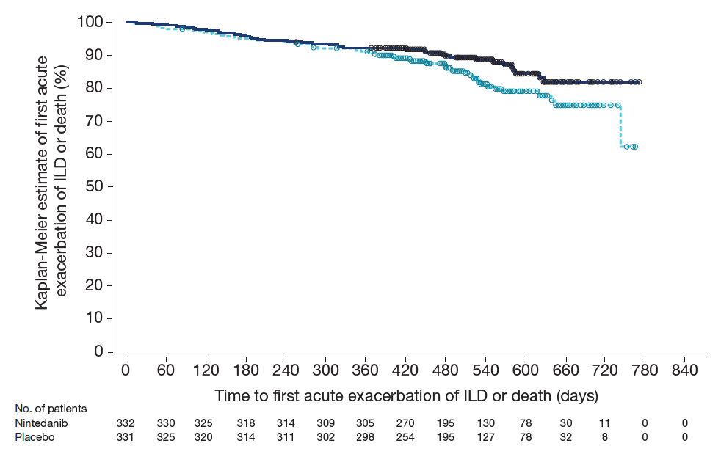
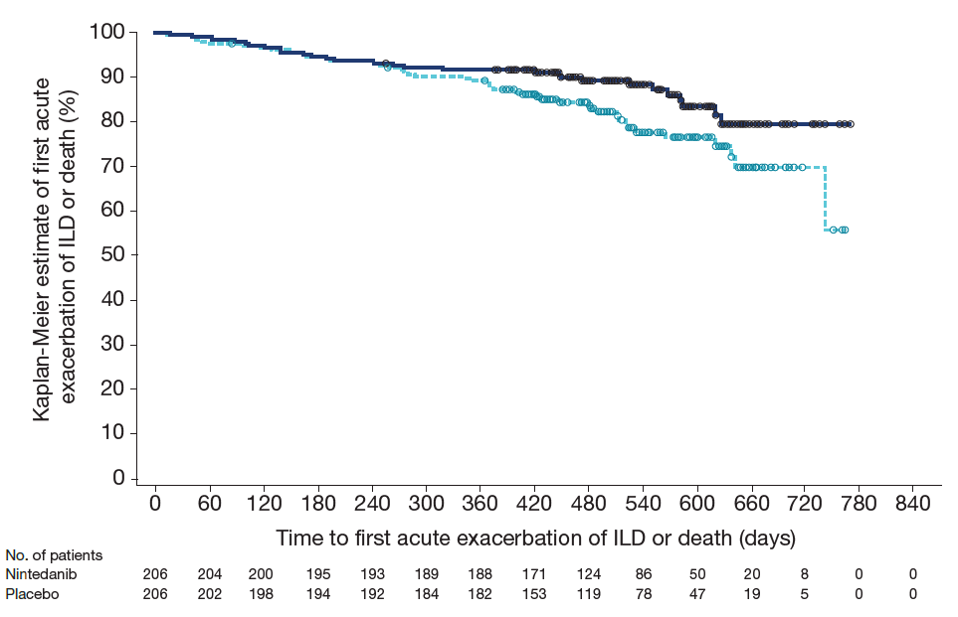
Time to first acute exacerbation of ILD or death using data up to first database lock
Overall population
Patients with a UIP-like fibrotic pattern on HRCT
Nintedanib
Nintedanib
Placebo
Placebo
Hazard ratio: 0.68 (95% CI 0.46, 1.01)
Nominal p=0.06
Hazard ratio: 0.61 (95% CI 0.38, 0.98)
Nominal p=0.04
Flaherty KR, et al. N Engl J Med 2019; doi: 10.1056/NEJMoa1908681.

Slide 33
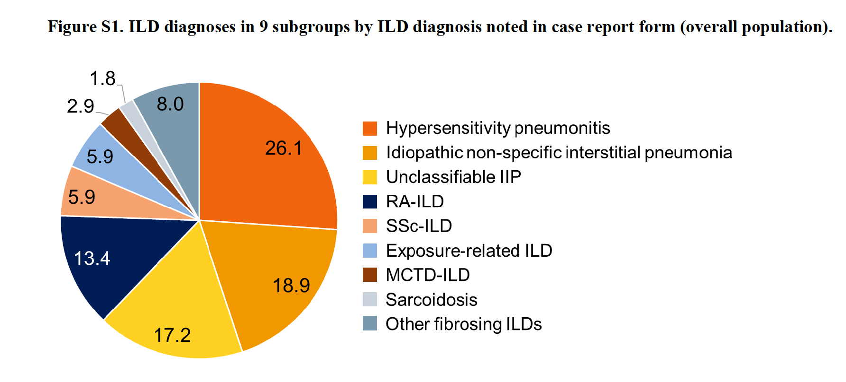
Breakdown of INBUILD population by diagnosis
Wells AU et al Lancet Respir Med 2020

Slide 34
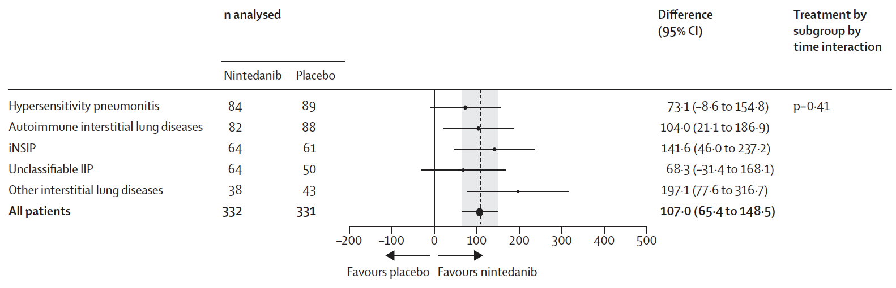
Post hoc analysis of effect of nintedanib by diagnosis
Wells AU et al Lancet Respir Med 2020

Slide 35
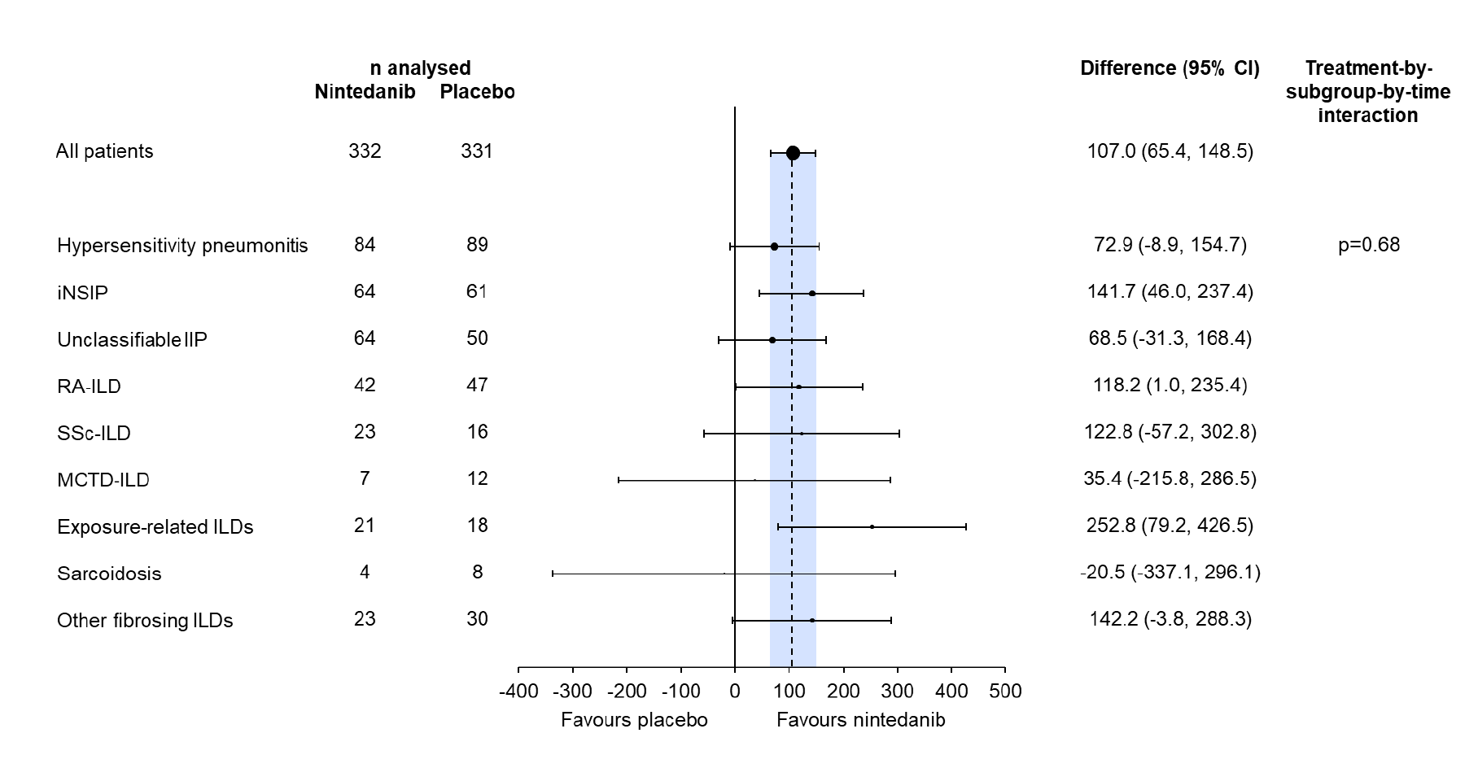
Absolute difference in FVC between groups in INBUILD.
Wells AU et al Lancet Respir Med 2020

Slide 36
Can we predict who will develop PPF?
UIP of any cause
  Rheumatoid-UIP
  Asbestosis
  HP with UIP
cHP lacking BAL lymphocytosis
Advanced fibrotic disease

Slide 37
Case history (2013)
57 year old man
6 month history of progressive exertional dyspnoea
At presentation was breathless climbing one flight of stairs
Minor cough
No extrathoracic symptoms of note
No exposure history
On examination – no clubbing
Bilateral basal crepitations
Serology - weakly positive ANA and RhF
Rheumatology assessment – no definable CTD or RA

Slide 38
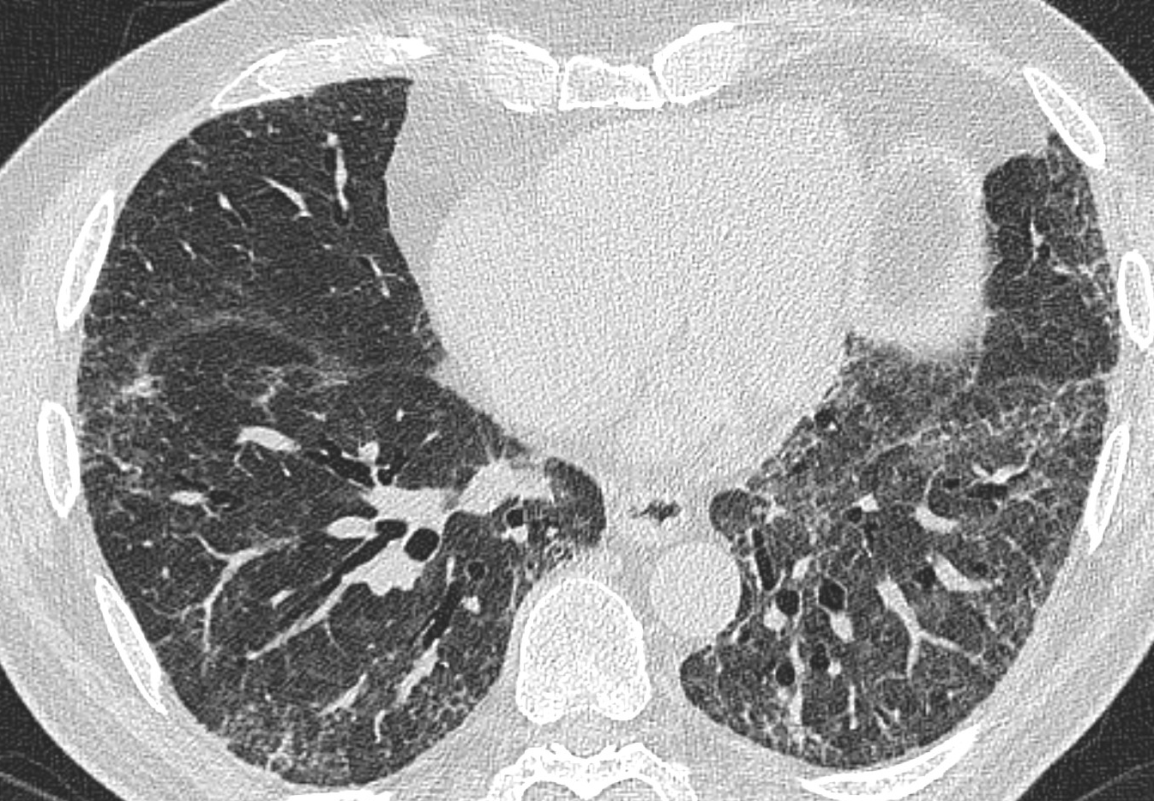
CT scan (2013)

Slide 39
Further investigations
FVC – 76% predicted
Tlco 44% predicted
Bronchoscopy – BAL 43% lymphocytosis
Patient declined biopsy

Slide 40
MDT assessment
Likely IPAF with mixed cellular and fibrotic NSIP
Treated with reducing dose of oral corticosteroids and intravenous cyclophosphamide

Slide 41
Follow up
Excellent response to treatment
Exertional dyspnoea improved and returned to unrestricted activity
Weaned and discontinued corticosteroids after 12 months. Attended follow up for three years (until 2016) remained stable with minimal residual fibrosis on CT

Slide 42
Represented 2021
In 2019 diagnosed with RA after presenting with classic joint symptoms and elevated anti CCP antibodies and raised Rh-F
Had been initiated on treatment with methotrexate and then rituximab
Between 2019 and 2021 developed progressive exertional dyspnoea
Exercise tolerance approximately 2 flights of stairs
FVC was 81% predicted in 2019 and dropped to 73% predicted by 2021

Slide 43
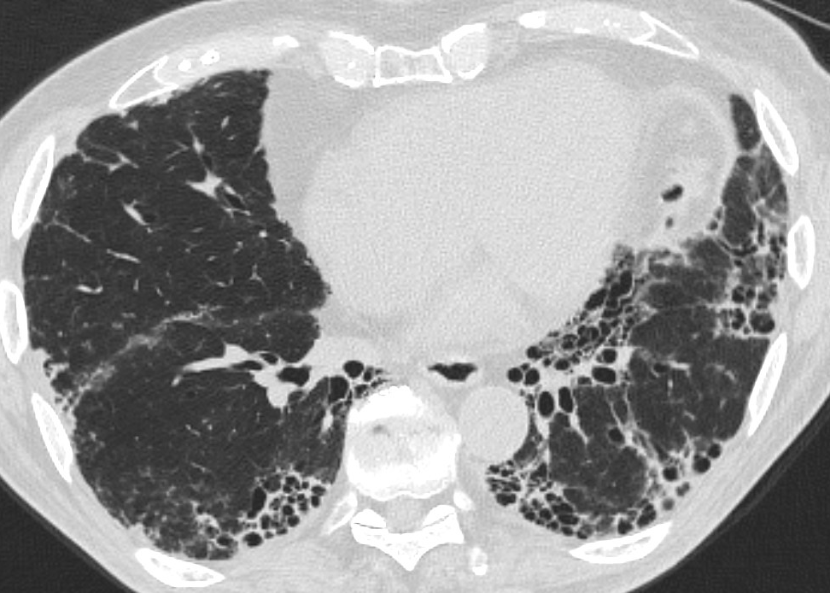
Repeat CT 2021

Slide 44
Follow up and treatment
Diagnosed with progressive pulmonary fibrosis (in context of RA-UIP and despite high quality DMARD therapy)
Started on nintedanib 150 mg twice daily

Slide 45
Challenges in clinical practice
Pulmonary hypertension
Infection
Worsening symptoms
and/or
Worsening FVC/DLCO
Loss of conditioning
Cardiovascular disease
Malignancy
Acute exacerbation
Progressive ILD

Slide 46
Current treatment of ILD
IPF
Nintedanib
Pirfenidone
SSc - ILD
(Cyclophosphamide)
(Mycophenolate mofetil)
(Rituximab)
Nintedanib
Tocilizumab
Other ILDs
(Immunosuppression but lack of evidence base)
Progressive pulmonary fibrosis
Nintedanib
Disease complications
Pulmonary hypertension – inhaled treprostinil
Respiratory failure – Oxygen
End stage disease – Lung transplant

Slide 47
Summary and conclusions
Fibrotic lung disease is a major cause of morbidity and mortality
Anti-fibrotic drugs have transformed outcomes for individuals with IPF
2022 guidelines have formalized identification of progressive pulmonary fibrosis
Nintedanib is an effective therapy for PPF

