Slide 1




Diagnosis of pneumocystis pneumonia (PCP)
; Polymerase chain reaction (PCR)
R4 김영재
Division of Pulmonology
Department of Internal Medicine
Yonsei University College of Medicine

Slide 2
Contents
Nomenclature
Risk factors
Clinical manifestations
Radiographic findings
Diagnostic tool
- Microscopy with staining
- Polymerase chain reaction (PCR)
- Serum markers

Slide 3
Nomenclature
Pneumocystis carinii
VS
Pneumocystis jirovecii

Slide 4
Nomenclature
Pneumocystis as a genus of protozoan organisms was questioned for several years
Now they are recognized as fungi based on ribosomal RNA
Edman JC, Kovacs JA, Masur H, et al. Ribosomal RNA sequence shows Pneumocystis carinii to be a member of the fungi. Nature 1988; 334:519.

Slide 5
Nomenclature
Four species have been described
: These include 2 species that infect rats, Pneumocystis carinii and Pneumocystis wakefieldiae ; 1 species that infects mice, Pneumocystis murina ; and Pneumocystis jirovecii, which infects humans
Cushion MT, Stringer JR. Has the name really been changed? It has for most researchers. Clin Infect Dis 2005; 41:1756.

Slide 6
Nomenclature
P. jirovecii has been designated as the species name to use in future publications and references to human infections
Abbreviation of “PCP” is still used to refer to the clinical entity of “PneumoCystis Pneumonia”

Slide 7
Risk factors
HIV infection
Non-HIV infected conditions
- Hematologic malignancy
- Organ transplantation
- Inflammatory conditions, such as Wegener’s
granulomatosis and polymyositis/dermatomyositis
- Solid tumors
- Glucocorticoid use
- Other immunosuppressive drugs

Slide 8
Clinical manifestations
In HIV-infected patients, PCP is generally gradual in onset and characterized by fever (79 to 100 percent), cough (95 percent), and progressive dyspnea (95 percent). The cough is generally nonproductive, but as many as 30 percent of patients may have some sputum production
In patients without HIV infection, PCP typically presents as fulminant respiratory failure associated with fever and dry cough

Slide 9
Radiographic findings
Chest radiographs are initially normal in up to one-fourth of patients with PCP in HIV infected patients.
The most common radiographic abnormalities are diffuse, bilateral, interstitial, or alveolar infiltrates
Other, less common presentations include pneumothorax, lobar or segmental infiltrates, cysts, nodules, pleural effusions

Slide 10
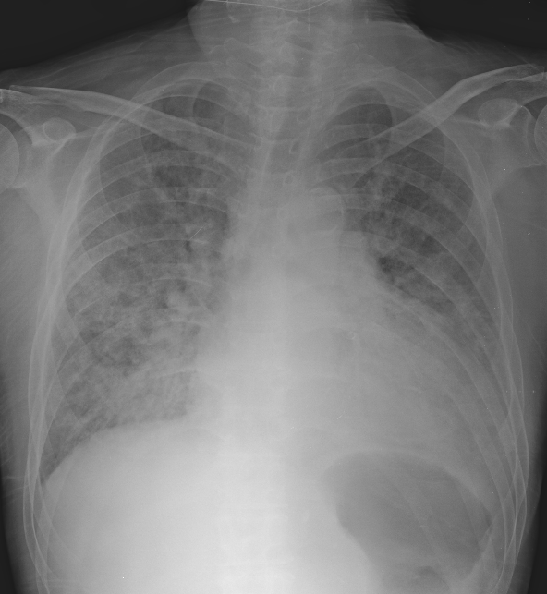

Slide 11
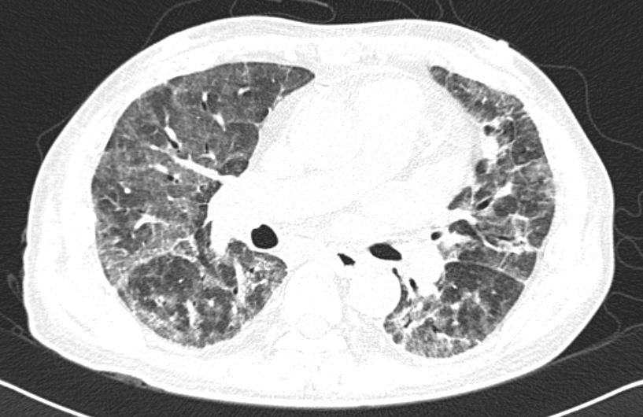
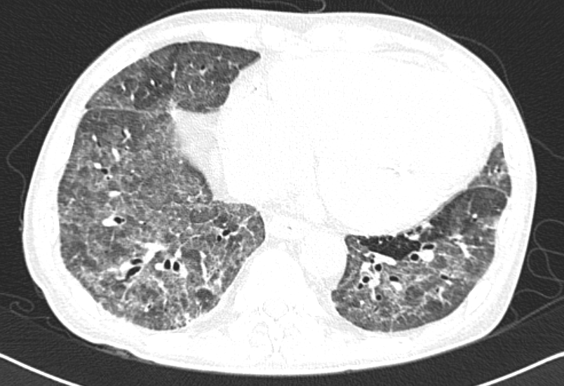
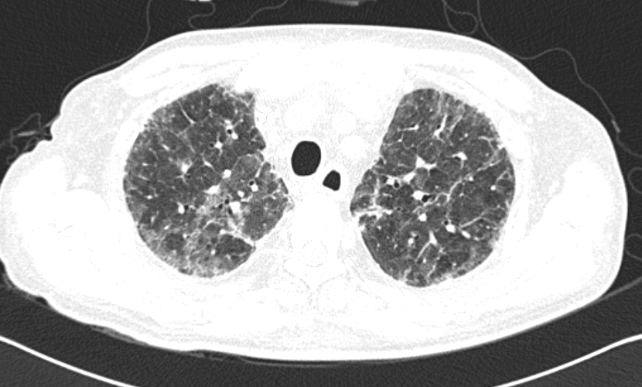

Slide 12
Diagnostic tool
Microscopy with staining
- Sputum
- Bronchoalveolar lavage (BAL) fluid
- Lung biopsy
Polymerase chain reaction (PCR)
- Sputum
- Bronchoalveolar lavage (BAL) fluid
Serum markers
- ex) Beta-D-glucan assay

Slide 13
Microscopy with staining
Diagnosis of PCP requires documentation of the organism in respiratory specimens, which is most commonly achieved by microscopy with staining of an induced sputum specimen or bronchoalveolar lavage fluid
Staining is necessary because Pneumocystis cannot be cultured.

Slide 14
Microscopy with staining
Calcofluor white
Cresyl echt violet
Gomori methenamine silver (GMS)
Toluidine blue
Gram-Weigert
Wright-Giemsa
Modified Papanicolaou stains
Periodic acid-Schiff (PAS)

Slide 15
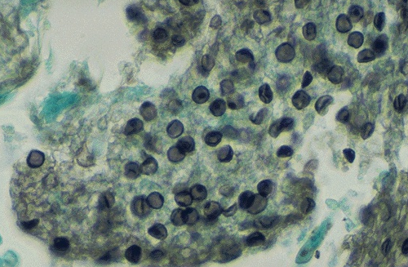
Microscopy with staining

Slide 16
Microscopy with staining
The most rapid and least invasive method of diagnosing PCP is by analysis of sputum induced by the inhalation of hypertonic saline (Induced sputum)
If PCP is not identified by this modality, then bronchoscopy with bronchoalveolar lavage (BAL) should be performed.
Lung biopsy is rarely required to establish the diagnosis.

Slide 17
Microscopy with staining
The diagnostic yield of microscopy with staining of induced sputum is 50 to 90 percent in patients with HIV infection and PCP but is thought to be lower in those non-HIV-infected patients due to a decreased organism burden
A similar difference has been noted with BAL. The diagnostic yield is over 90 percent in HIV-positive patients, but may be lower in HIV-negative patients

Slide 18
Polymerase chain reaction (PCR)
Study for HIV infected patients
- Forty-seven patients were enrolled in the study, including 18 with proven PCP and 29 with other conditions.
- PCR was positive for all 18 patients with PCP (100% sensitivity), and for 4 of the 29 control patients (specificity of 86.2%).
- Our findings confirm that PCR is a sensitive and reproducible test for detection of PCP.
Torres J, Goldman M, Wheat LJ, et al. Diagnosis of Pneumocystis carinii pneumonia in human immunodeficiency virus-infected patients with polymerase chain reaction: a blinded comparison to standard methods.
Clin Infect Dis 2000; 30:141..

Slide 19
Polymerase chain reaction (PCR)
Study for non-HIV infected patients
- From January 2002 to October 2005, 448 immunocompromised patients without AIDS underwent respiratory specimen collection to evaluate pulmonary infiltrates.
Azoulay E, Bergeron A, Chevret S, et al. Polymerase chain reaction for diagnosing pneumocystis pneumonia in non-HIV immunocompromised patients with pulmonary infiltrates. Chest 2009; 135:655.

Slide 20
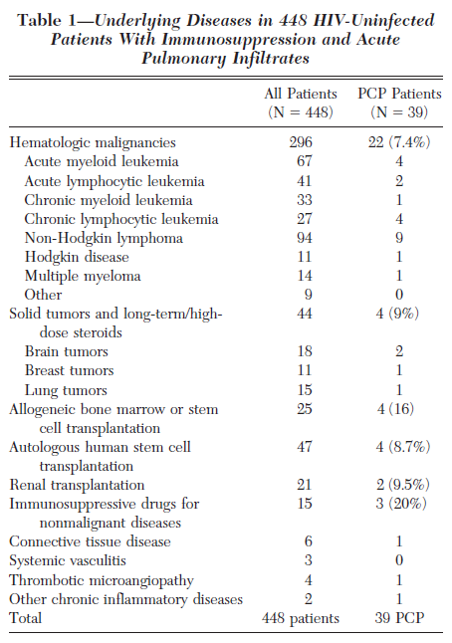
Azoulay E, Bergeron A, Chevret S, et al.
Polymerase chain reaction for diagnosing pneumocystis pneumonia in non-HIV immunocompromised patients with pulmonary infiltrates.
Chest 2009; 135:655.

Slide 21
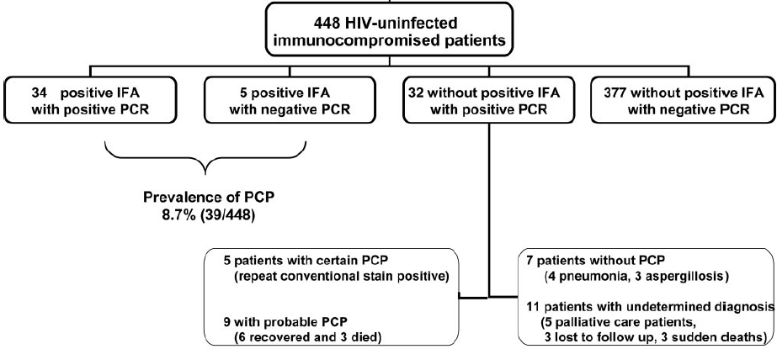
Polymerase chain reaction (PCR)
Azoulay E, Bergeron A, Chevret S, et al. Polymerase chain reaction for diagnosing pneumocystis pneumonia in non-HIV immunocompromised patients with pulmonary infiltrates. Chest 2009; 135:655.

Slide 22
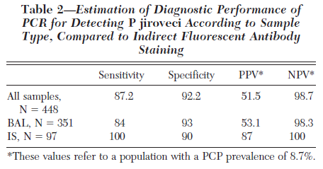
Polymerase chain reaction (PCR)
Azoulay E, Bergeron A, Chevret S, et al. Polymerase chain reaction for diagnosing pneumocystis pneumonia in non-HIV immunocompromised patients with pulmonary infiltrates. Chest 2009; 135:655.

Slide 23
Polymerase chain reaction (PCR)
“ Pneumocystis jirovecii PCR”
From October 2012 to June 2013
Total : 517 case
- Sputum : 417 case
- BAL : 100 case

Slide 24
Polymerase chain reaction (PCR)
Definition of PCP diagnosis
- Definite : Staining (+)
- Probable : Staining (-),
But, Clinical presentation and radiological
finding was compatible with PCP

Slide 25
Polymerase chain reaction (PCR)
PCR result
- PCR positive : 90 (17.4%)
- PCR negative : 427 (82.6%)
Definition of PCP diagnosis
- Definite : 5 (1.0%)
- Probable : 80 (15.5%)
- Negative : 432 (83.5%)

Slide 26
Polymerase chain reaction (PCR)
Total group (N = 517)
 | PCP diagnosis
PCR |  | Definite and Probable | Negative | Total
 | Positive | 63 | 27 | 90
 | Negative | 22 | 405 | 427
 | Total | 85 | 432 | 517
Sensitivity : 74% Positive predictive value : 70%
Specificity : 94% Negative predictive value : 95%

Slide 27
Polymerase chain reaction (PCR)
Sputum specimen group (N = 417)
 | PCP diagnosis
PCR |  | Definite and Probable | Negative | Total
 | Positive | 48 | 26 | 74
 | Negative | 19 | 324 | 343
 | Total | 67 | 350 | 417
Sensitivity : 72% Positive predictive value : 65%
Specificity : 93% Negative predictive value : 94%

Slide 28
Polymerase chain reaction (PCR)
BAL specimen group (N = 100)
 | PCP diagnosis
PCR |  | Definite and Probable | Negative | Total
 | Positive | 15 | 1 | 16
 | Negative | 3 | 81 | 84
 | Total | 18 | 82 | 100
Sensitivity : 83% Positive predictive value : 94%
Specificity : 99% Negative predictive value : 96%

Slide 29
Beta-D-glucan assay
Beta-D-glucan is a cell wall component of all fungi, including Pneumocystis.
The potential utility of this assay was illustrated in a retrospective case-control study of 295 patients with suspected PCP who had microscopy of bronchoalveolar lavage fluid for PCP and serum testing with beta-D-glucan and other serum markers (LDH, KL-6, CRP)
Tasaka S, Hasegawa N, Kobayashi S, et al. Serum indicators for the diagnosis of pneumocystis pneumonia. Chest 2007; 131:1173.

Slide 30
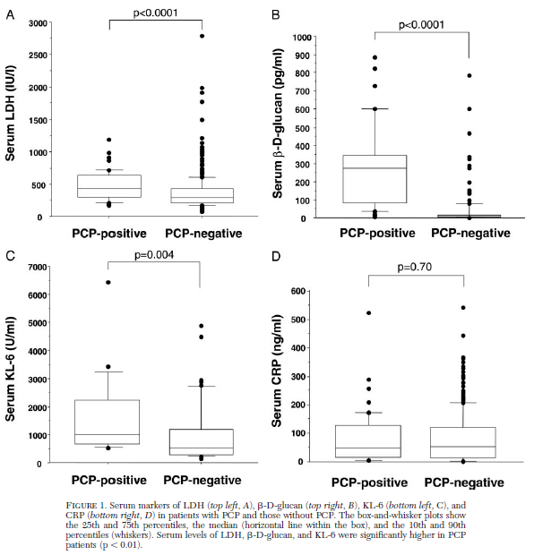
Tasaka S, Hasegawa N, Kobayashi S, et al. Serum indicators for the diagnosis of pneumocystis pneumonia. Chest 2007; 131:1173.

Slide 31
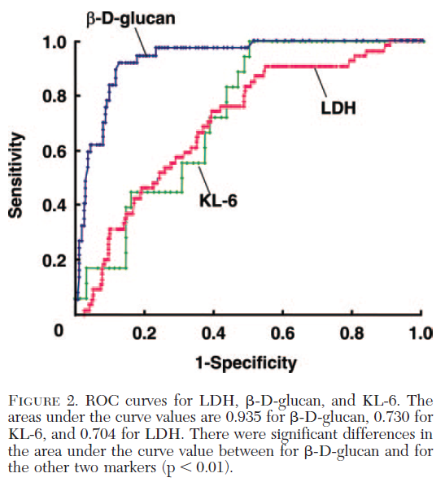
Tasaka S, Hasegawa N, Kobayashi S, et al. Serum indicators for the diagnosis of pneumocystis pneumonia. Chest 2007; 131:1173.

Slide 32
Beta-D-glucan assay
The beta-D-glucan assay had a sensitivity of 92 percent and a specificity of 86 percent for detecting PCP. The positive predictive value (PPV) and negative predictive value (NPV) of beta-D-glucan were 0.610 and 0.980, respectively.
Serum beta-D-glucan is a reliable marker for the diagnosis of PCP.
Tasaka S, Hasegawa N, Kobayashi S, et al. Serum indicators for the diagnosis of pneumocystis pneumonia. Chest 2007; 131:1173.

Slide 33
Take home message
Staining should be performed
Use of sputum induction ?
Type of specimen (Sputum VS BAL)
Serum markers (Beta-D-glucan assay)

