Slide 1


Pulmonary Capillary Hemangiomatosis
Nam Eun Kim,
Division of Pulmonology, Department of Internal Medicine
Severance Hospital

Slide 2
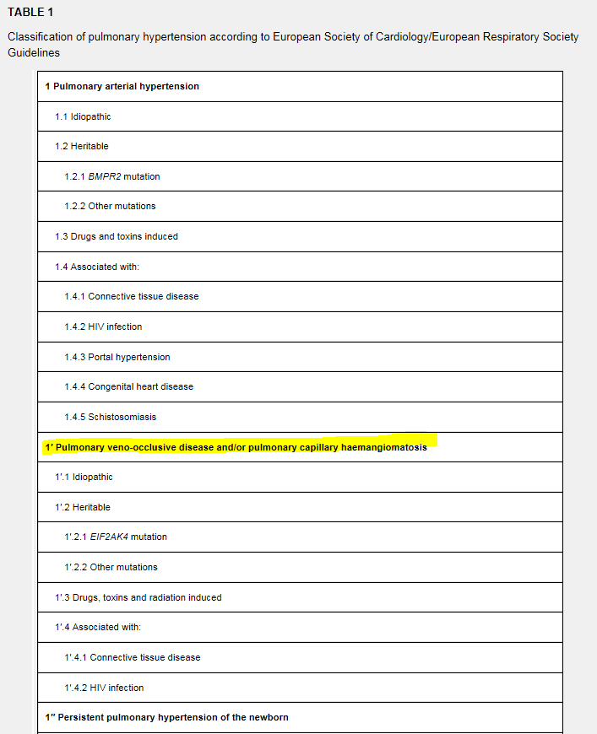
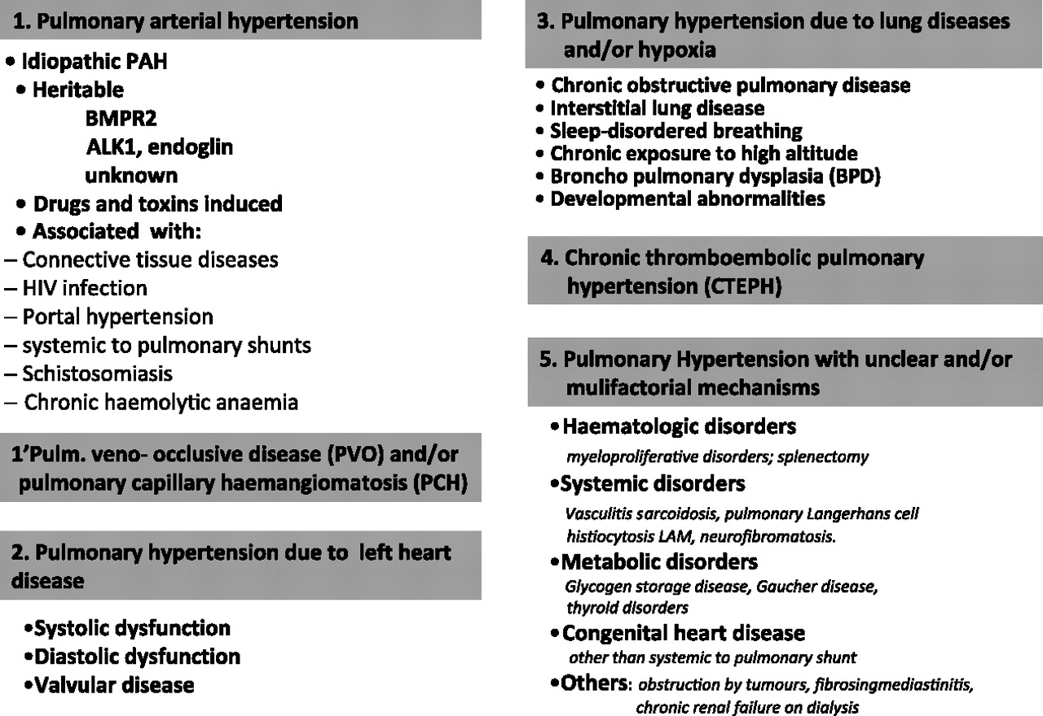
Pulmonary Capillary Hemangiomatosis
PCH
  Proliferation of benign appearing capillaries in alveolar septa
  vessel intimal thickening -> progressive vascular resistance ↑
  rare cause of pulmonary hypertension (Group 1’)
Notes:
1안

Slide 3
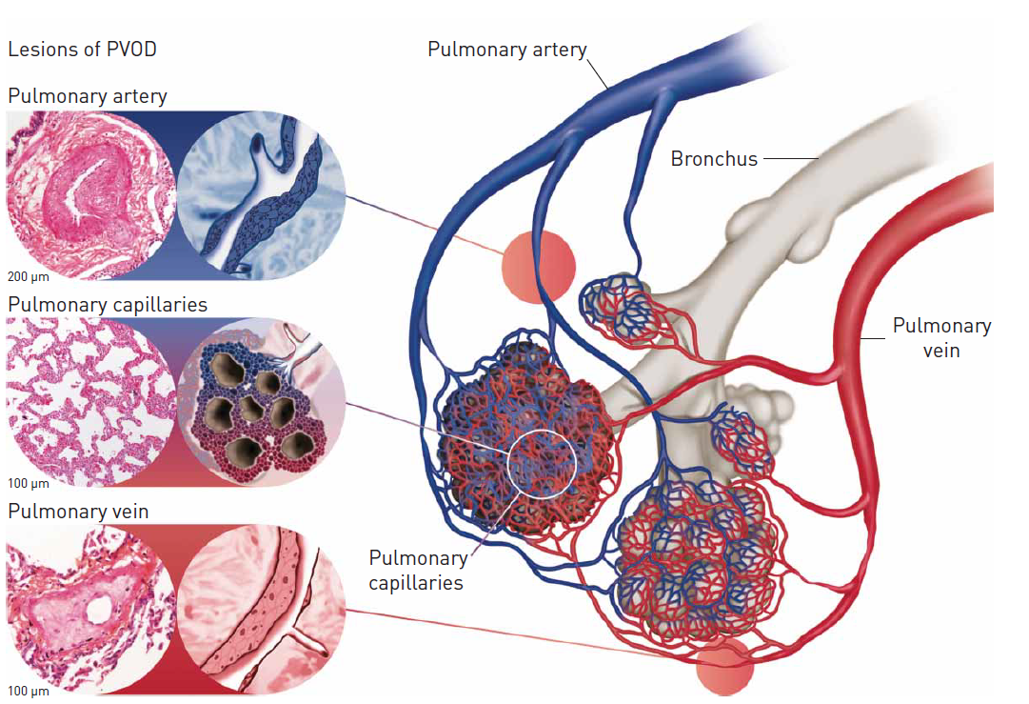
Pulmonary Capillary Hemangiomatosis
Incidence
  first reported in 1978, 100 by 2011
  general population incidence : unknown
  In autopsy series, 6%
  7 cases : CTD with PHTN unexpectedly found to have PCH after lung transplantation , autopsy
  (Annals of Dia pathology :V19(2015);149-153)
Clinical feature
  Progressive dyspnea
  hemoptysis
  Cough, fatigue
  Chest pain
Notes:
1안

Slide 4
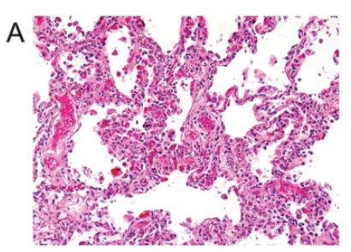
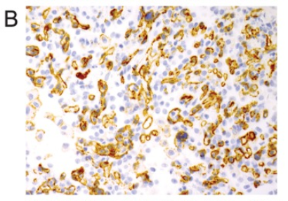
Pulmonary Capillary Hemangiomatosis
histologic feature
  proliferation of pulmonary capillaries
    Interstitial, bronchial(alveolar walls and alveolar space) , vascular structures of the lung(pulmonary veins, arteries)
  CD31, CD34 immunohistochemistry can help distinguish capillary proliferation from congestion
Pulm Circ. 2015 Sep;
5(3): 580-586
Notes:
1안

Slide 5
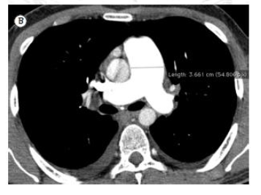
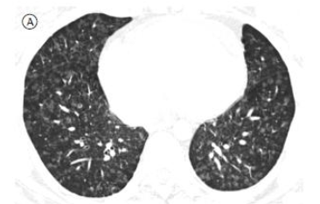
Pulmonary Capillary Hemangiomatosis
Radiologic feature
  Non-specific
  CXR : diffuse reticulonodular opacity
  Chest CT: Enlarged pulmonary arteries (main PA>3cm) + centrilobular GGO
J. Bras.pneumol; June 2013 : V(39) 203~204
Notes:
1안

Slide 6
Pulmonary Capillary Hemangiomatosis
Diagnosis
  lung biopsy is essential (risky in patients with severe pulmonary arterial hypertension)
  after lung transplantation
  autopsy, after death
Different diagnosis
  idiopathic pulmonary arterial hypertension
  pulmonary veno-occlusive disease
  atypical interstitial lung disease
Notes:
1안

Slide 7
Differential diagnosis
PCH vs Pulmonary hypertension
  PCH (group 1` ) is linked to but not PAH (group 1)
  Different histologic abnormalities
    PCH -capillary proliferation
    PAH- affects small arteries
PVOD vs PCH
  Share clinical, genetic, hemodynamic background with PCH
  EIF2AK4 represents a clear link between PCH and PVOD
    eukaryotic translation initiation factor
  PVOD-post capillary venous pulmonary vessel
Notes:
1안

Slide 8
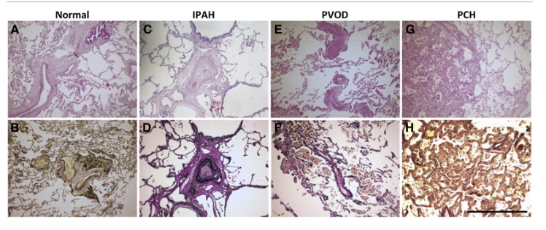
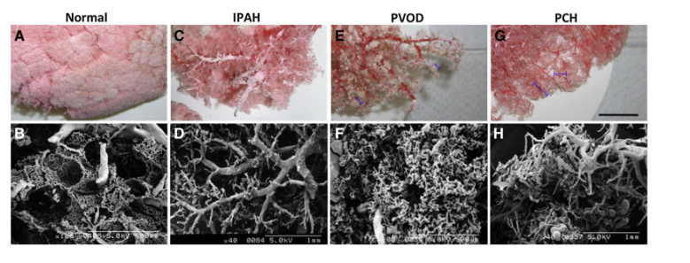
IPAH : intimal, medial hypertrophy , pulmonary artery stenosis, capillary defecient
PVOD: narrow pulmonary vein, obliteration venous vessel, capillary swallen
PCH : capillary proliferation, resemble tumorous clustere
Cardiovascular pathology : Aug 2013; 22(4); 287-293

Slide 9
Pulmonary Capillary Hemangiomatosis
Treatment
  Lung transplantation (curative treatment)
  Recombinant interferon alpha-2 (ex. Imatinib, case-report, bridging treatment)
  Doxycycline (case report, angiogenetic therapy)
  Pulmonary vasodilator -> contraindication
    Worsening pulmonary edema, death have been report
Prognosis
  symptoms appear, course is fulminant and fatal
  Median survival after diagnosis is usually 3 yrs
Notes:
1안

Slide 10

Notes:
의과대학 1-B

