Slide 1




Clinical Practice Guidelines for the Management of Pain, Agitation, and Delirium in Adult Patients in the Intensive Care Unit
Barr J, et al. Crit Care Med. 2013 Jan.
호흡기내과
박선철

Slide 2
Outline
Methods
Pain and Analgesia
Agitation and Sedation
Delirium
Strategies for Managing Pain, Agitation, and Delirium to improve ICU Outcomes

Slide 3
Methods
The American College of Critical Care Medicine
20-person, multidisciplinary, multi-institutional task force
4 subcommittees
  Pain and analgesia
  Agitation and sedation
  Delirium
  Related ICU outcomes

Slide 4
Methods
Web based electronic database of over 19,000 references
Group consensus
  The nominal group technique and the modified Delphi method, with anonymous voting by all task force members using E-Survey
  Completed in December 2010

Slide 5
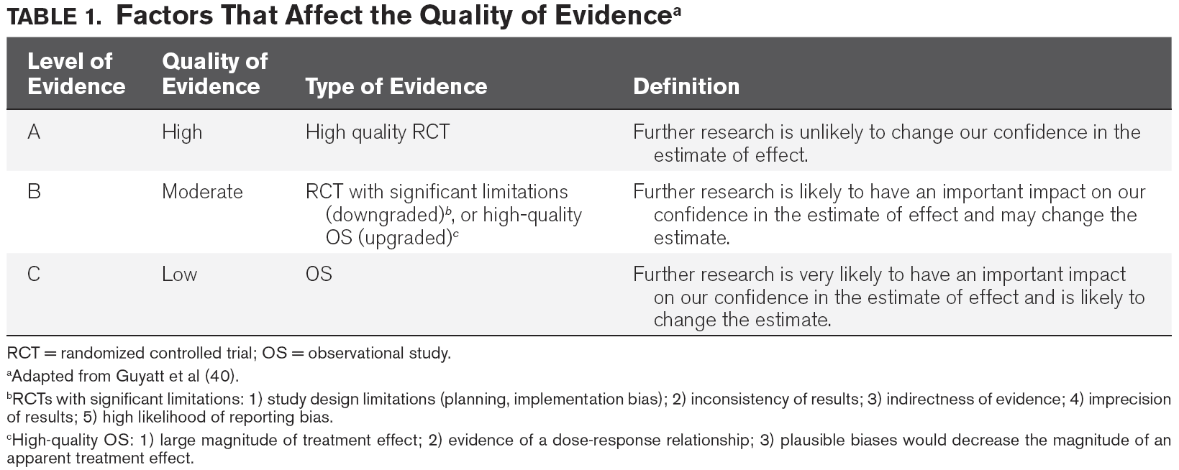
Methods
1. The quality of evidence

Slide 6
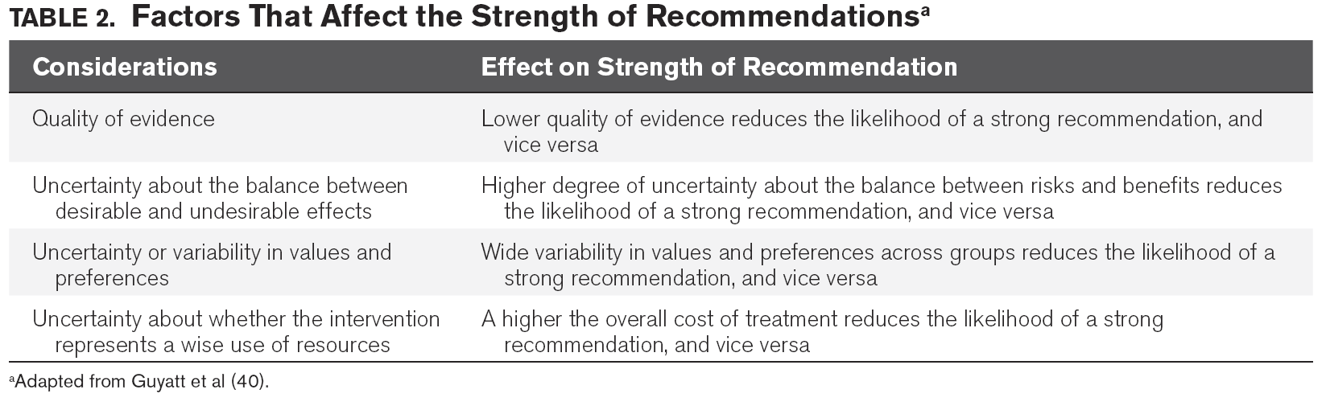
Methods
2. The strength of recommendations

Slide 7
Methods
The strength of recommendations
  Strong (1) or weak (2), or no (0)
  Favor of (+) or against (-) in intervention
Strong recommendation
  (+1) or (-1) → “We recommend …”
Weak recommenddation
  (+2) or (-2) → “We suggest …”

Slide 8
Methods
Psychometric analyses
  To evaluate and compare pain, agitation/sedation, and delirium assessment tools
    Ex) pain (BPS,..), agitation (RASS,..), delirium (CAM-ICU,…)
    Reliability, validity, feasibility, …
  0 to 25 for pain, 0 to 18 for sedation, 0 to 21 for delirium → total weighted score 0 to 20 for all three domains
  Very good (15-20), Moderate (12-14.9), Some acceptable (10-11.9), Very few (0-9.9)

Slide 9
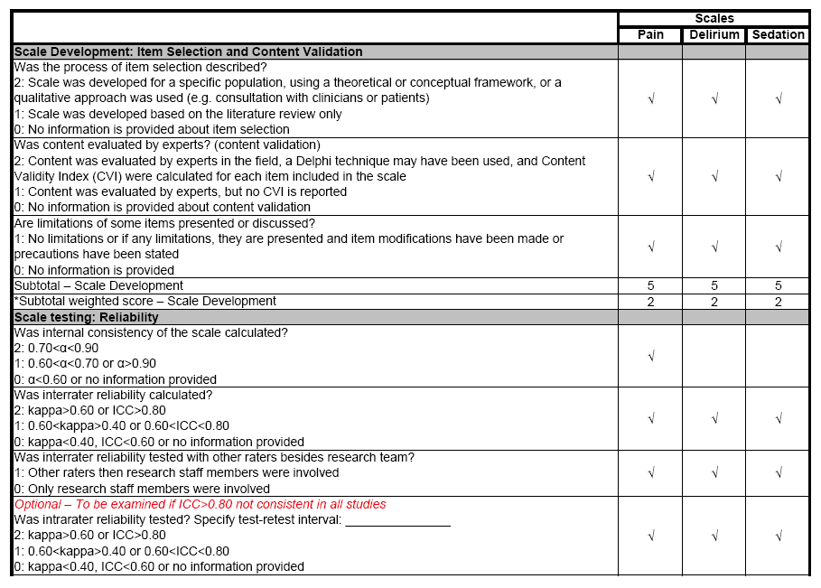

Slide 10
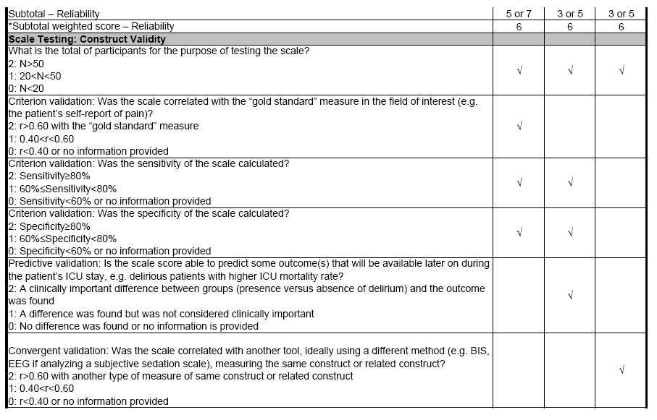

Slide 11
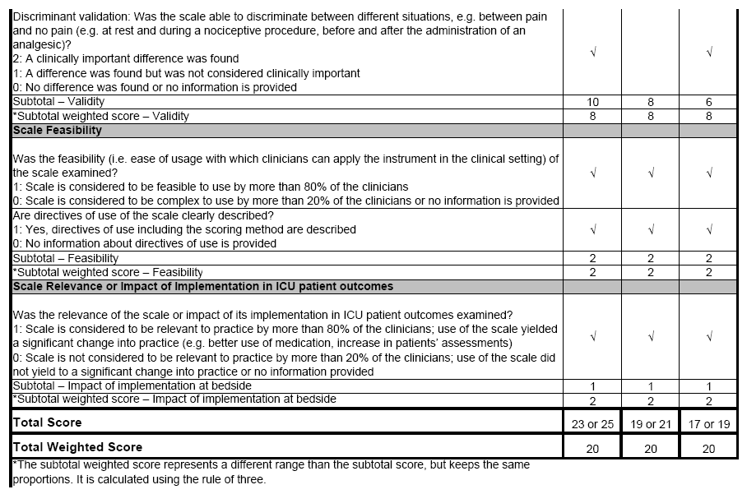

Slide 12
Outline
Methods
Pain and Analgesia
Agitation and Sedation
Delirium
Strategies for Managing Pain, Agitation, and Delirium to improve ICU Outcomes

Slide 13
Pain and Analgesia
Incidence of pain
Pain assessment
Treatment of pain

Slide 14
Incidence of pain
Adult medical, surgical, and trauma ICU patients routinely experience pain, both at rest and with routine ICU care (B).
  Still 50% or higher
  Subjective nature of pain, but many critically ill patients : unable to self-report their pain
  Most common traumatic memory, PTSD, chronic pain, low quality of life, …

Slide 15
Incidence of pain
Pain in adult cardiac surgery patients is common and poorly treated; women experience more pain than men after cardiac surgery (B).
Procedural pain is common in adult ICU patients (B).
  Nonsurgical procedure, ex) chest tube removal or wound care
  Less than 25%, receive analgesics before procedures

Slide 16
Pain assessment
We recommend that pain be routinely monitored in all adult ICU patients (+1B).
  Improved pain management and clinical outcomes
  Analgesics ↓, ICU LOS ↓, MV duration ↓
Self report is preferred over the use of behavioral pain scales to assess pain in ICU patients who are able to communicate (B).

Slide 17
Pain assessment
The Behavioral Pain Scale (BPS) and the Critical-Care Pain Observation Tool (CPOT) are the most valid and reliable behavioral pain scales for monitoring pain in medical, postoperative, or trauma (except for brain injury) adult ICU patients who are unable to self-report and in whom motor function is intact and behaviors are observable. Using these scales in other ICU patient populations and translating them into foreign languages other than French or English require further validation testing (B).

Slide 18
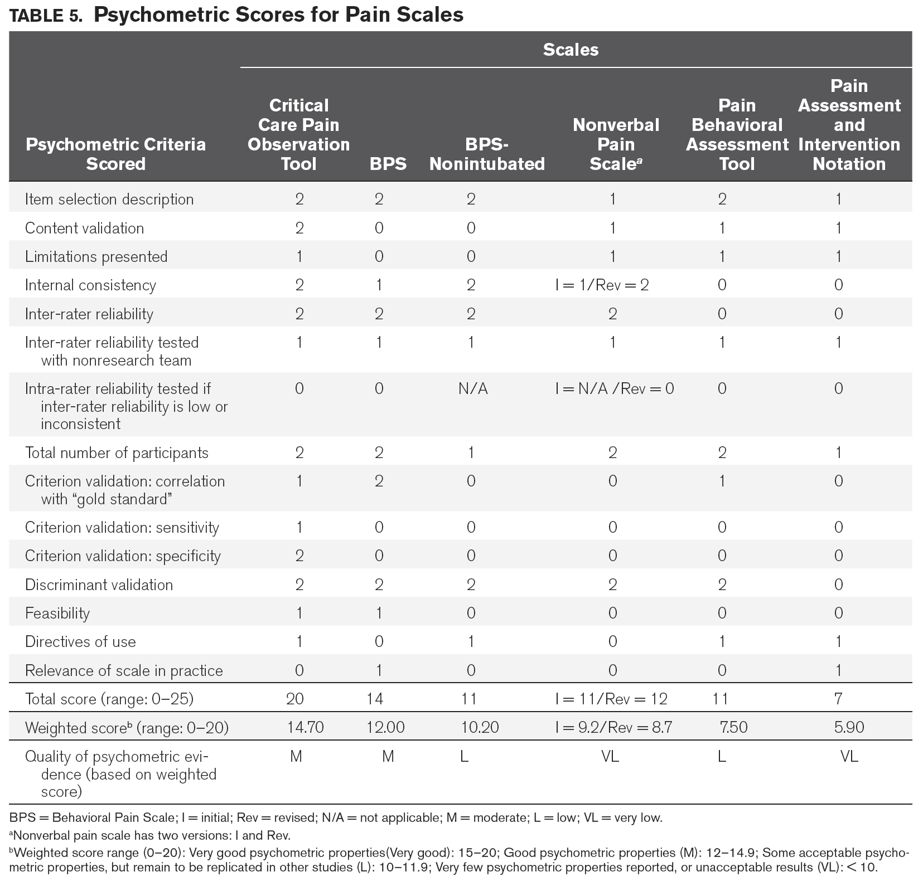

Slide 19
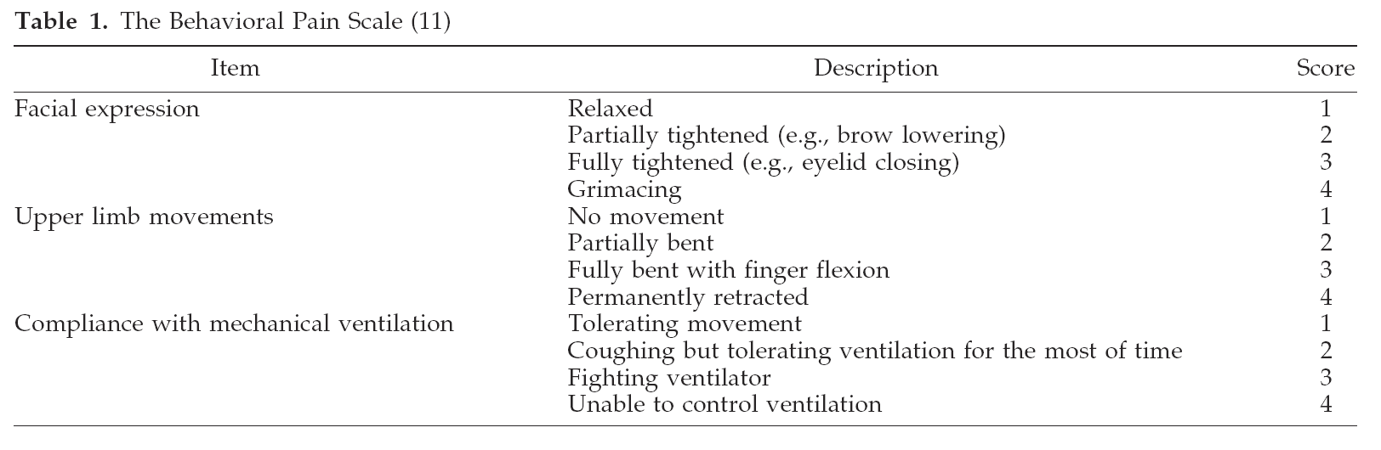

Slide 20
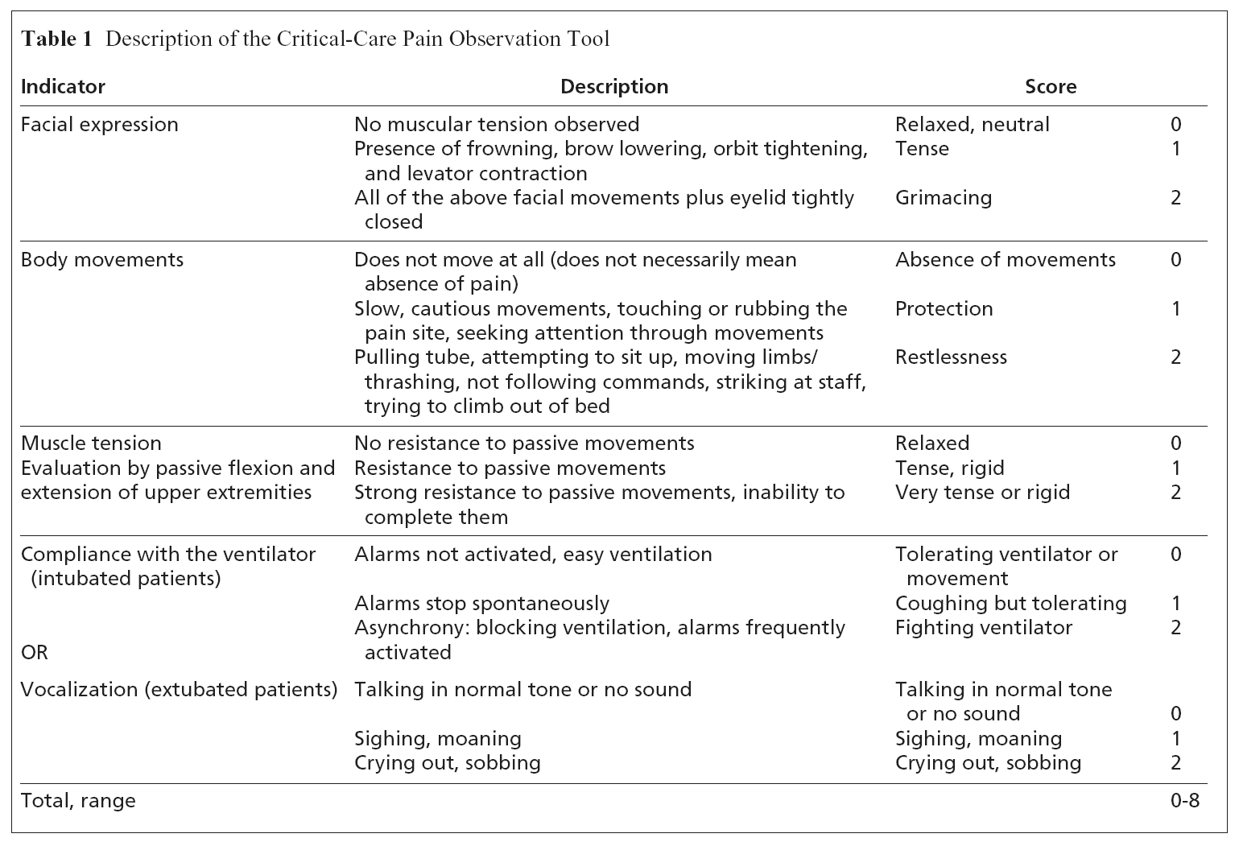

Slide 21
Pain assessment
We do not suggest that vital signs (or observational pain scales that include vital signs) be used alone for pain assessment in adult ICU patients (–2C).
  Not correlate with self-report pain or BPS
  May change with pain, distress, or other factors
We suggest that vital signs may be used as a cue to begin further assessment of pain in these patients, however (+2C).

Slide 22
Treatment of pain
We recommend that preemptive analgesia and/or nonpharmacologic interventions (e.g., relaxation) be administered to alleviate pain in adult ICU patients prior to chest tube removal (+1C).
We suggest that for other types of invasive and potentially painful procedures in adult ICU patients, preemptive analgesic therapy and/or nonpharmacologic interventions may also be administered to alleviate pain (+2C).

Slide 23
Treatment of pain
We recommend that intravenous (IV) opioids be considered as the first-line drug class of choice to treat non-neuropathic pain in critically ill patients (+1C).
All available IV opioids, when titrated to similar pain intensity endpoints, are equally effective (C).

Slide 24
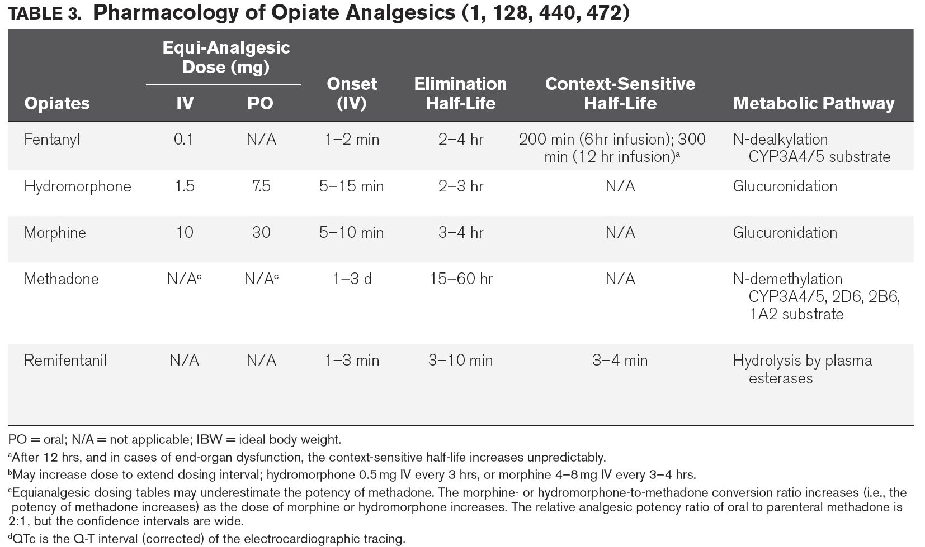

Slide 25
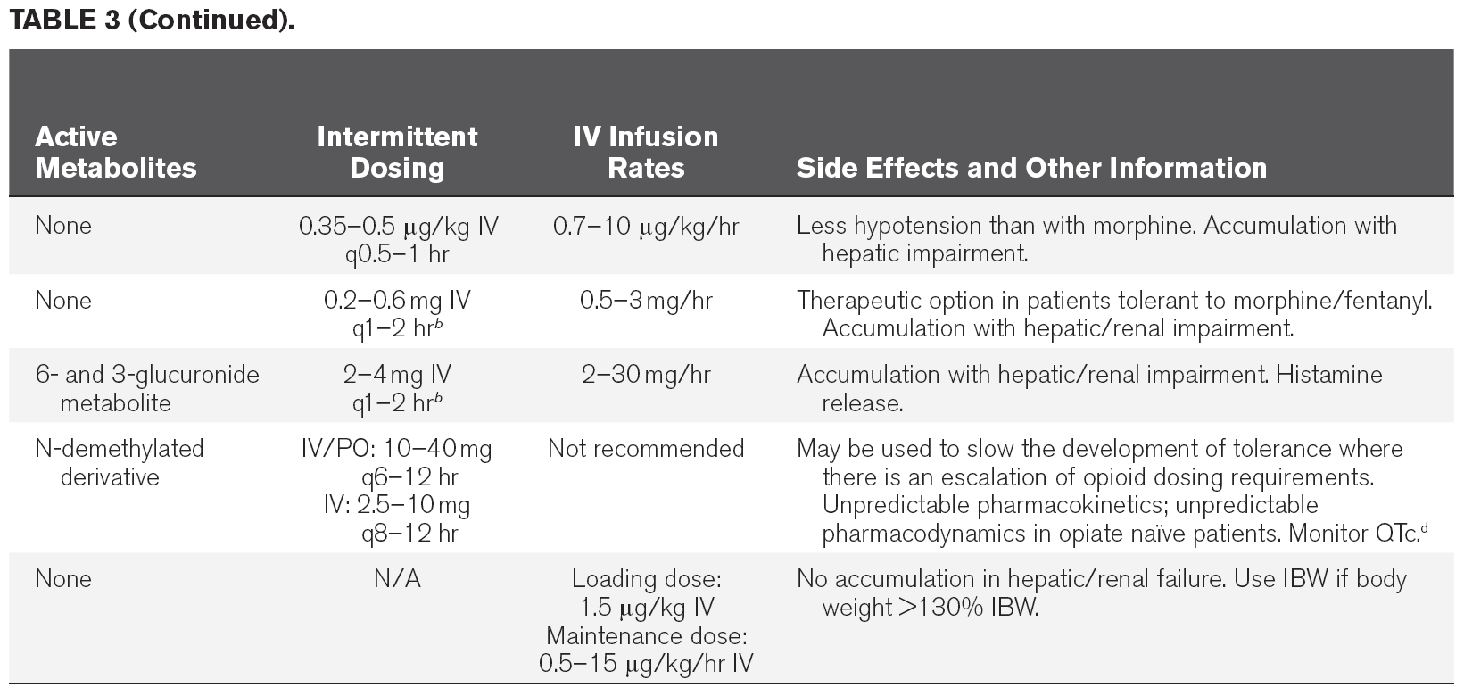
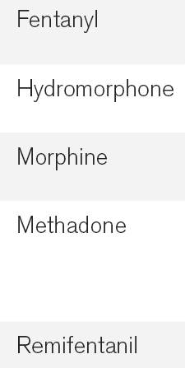

Slide 26
Treatment of pain
We suggest that nonopioid analgesics be considered to decrease the amount of opioids administered (or to eliminate the need for IV opioids altogether) and to decrease opioid-related side effects (+2C).
We recommend that either enterally administered gabapentin or carbamazepine, in addition to IV opioids, be considered for treatment of neuropathic pain (+1A).

Slide 27
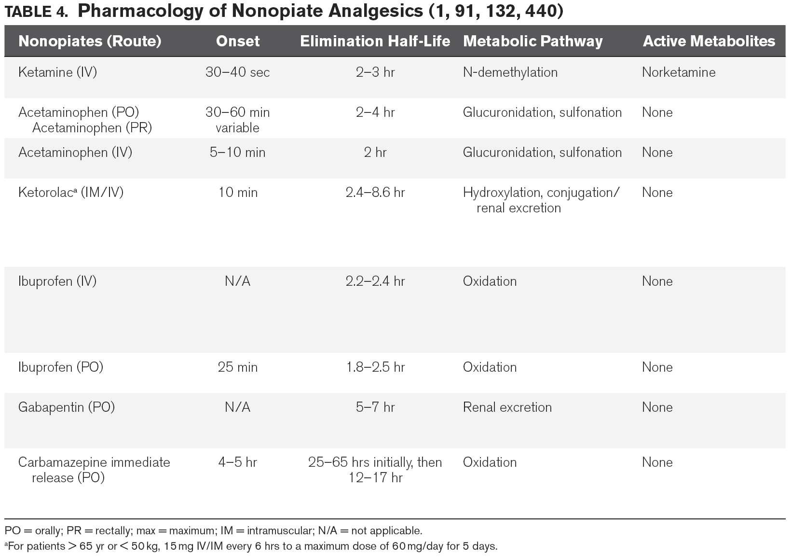

Slide 28
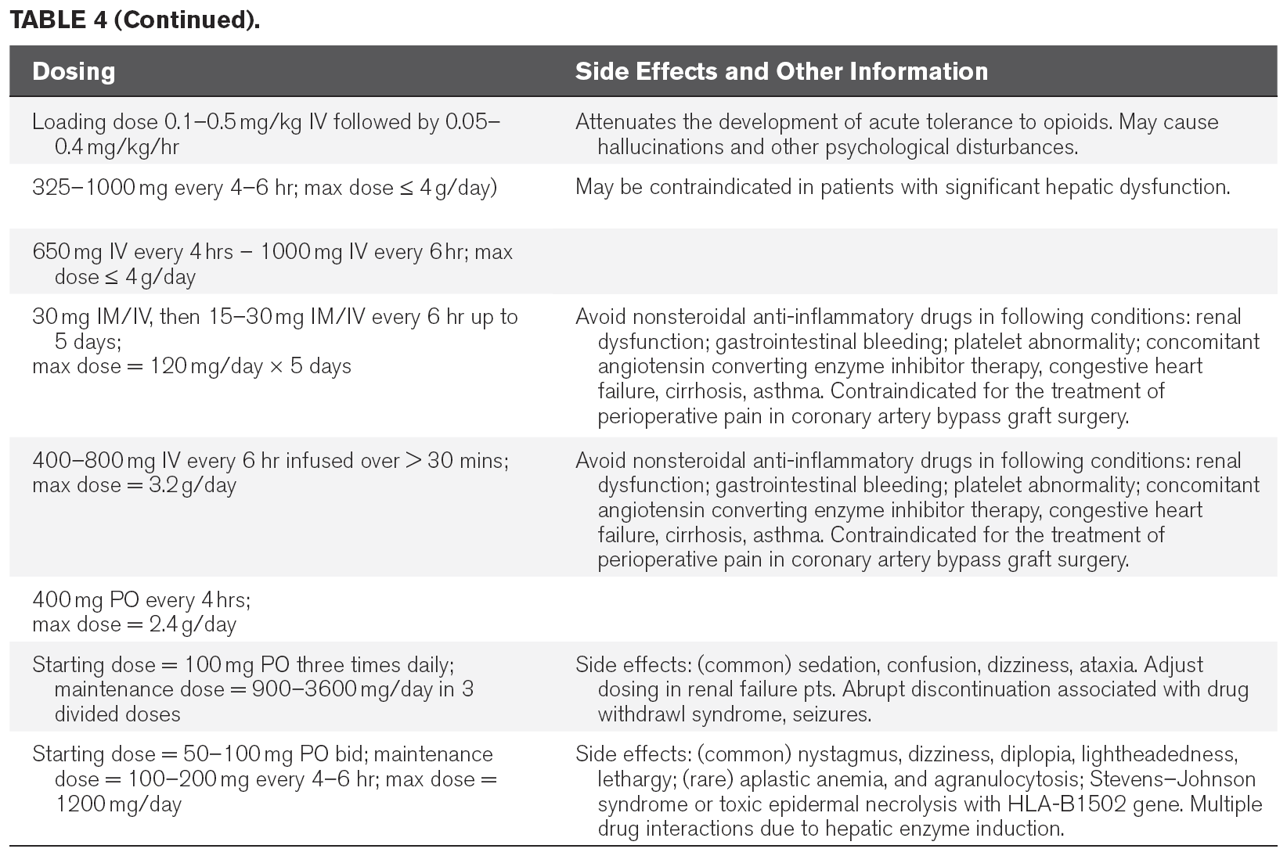
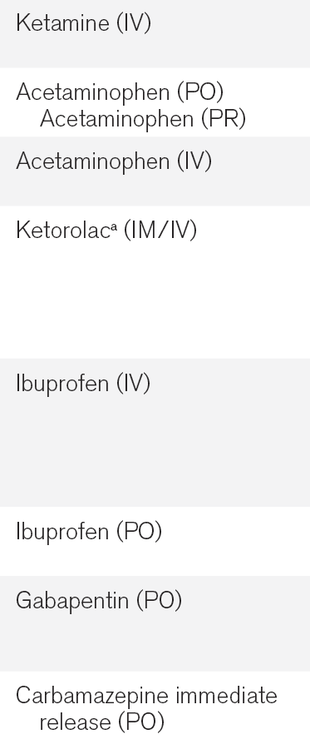

Slide 29
Treatment of pain
We recommend that thoracic epidural anesthesia/analgesia be considered for postoperative analgesia in patients undergoing abdominal aortic aneurysm surgery (+1B).
We provide no recommendation for the use of thoracic epidural analgesia in patients undergoing either intrathoracic or nonvascular abdominal surgical procedures, due to insufficient and conflicting evidence for this mode of analgesic delivery in these patients (0,B).
We suggest that thoracic epidural analgesia be considered for patients with traumatic rib fractures (+2B).

Slide 30
Treatment of pain
We provide no recommendation for using a lumbar epidural over parenteral opioids for postoperative analgesia in patients undergoing abdominal aortic aneurysm surgery, due to a lack of benefit of epidural over parenteral opioids in this patient population (0,A).
We provide no recommendation for neuraxial (surrounding a major nerve) /regional analgesia over systemic analgesia in medical ICU patients, due to lack of evidence in this patient population (0, No Evidence).

Slide 31
Outline
Methods
Pain and Analgesia
Agitation and Sedation
Delirium
Strategies for Managing Pain, Agitation, and Delirium to improve ICU Outcomes

Slide 32
Agitation and Sedation
Depth of sedation vs. clinical outcomes
Monitoring depth of sedation and brain function
Choice of sedative

Slide 33
Depth of sedation vs. clinical outcomes
Depth and quality of sedation should be routinely assessed in all ICU patients (1B).
  Effort to reduce anxiety and agitation
Maintaining light levels of sedation in adult ICU patients is associated with improved clinical outcomes (B).
  MV duration ↓, ICU and hospital LOS ↓, delirium and long-term cognitive dysfunction ↓

Slide 34
Depth of sedation vs. clinical outcomes
Maintaining light levels of sedation increases the physiologic stress response, but is not associated with an increased incidence of myocardial ischemia (B).
The association between depth of sedation and psychological stress in these patients remains unclear (C).

Slide 35
Depth of sedation vs. clinical outcomes
We recommend that sedative medications be titrated to maintain a light rather than a deep level of sedation in adult ICU patients, unless clinically contraindicated (+1B).

Slide 36
Monitoring depth of sedation and brain function
The Richmond Agitation-Sedation Scale (RASS) and Sedation-Agitation Scale (SAS) are the most valid and reliable sedation assessment tools for measuring quality and depth of sedation in adult ICU patients (B).

Slide 37
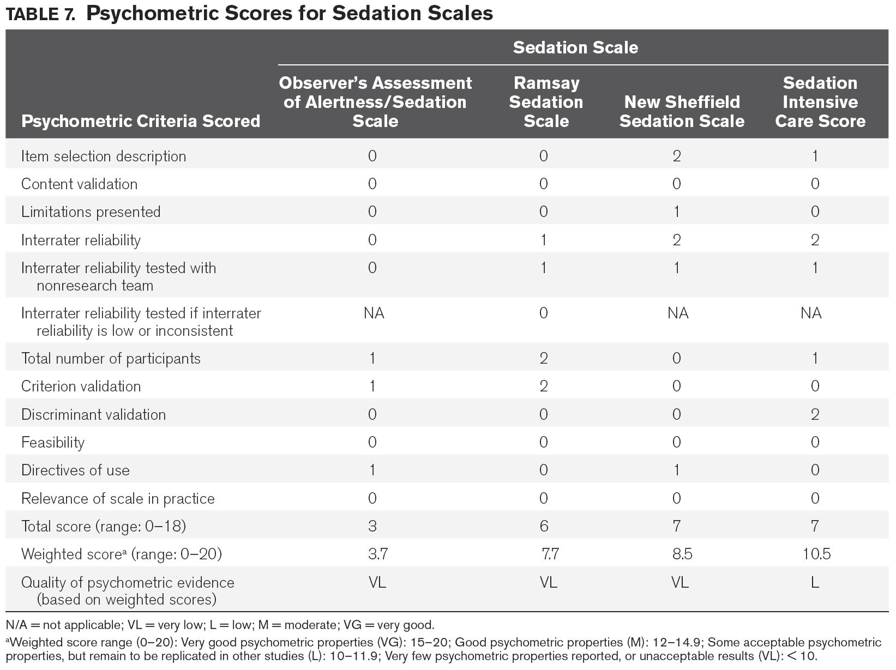

Slide 38
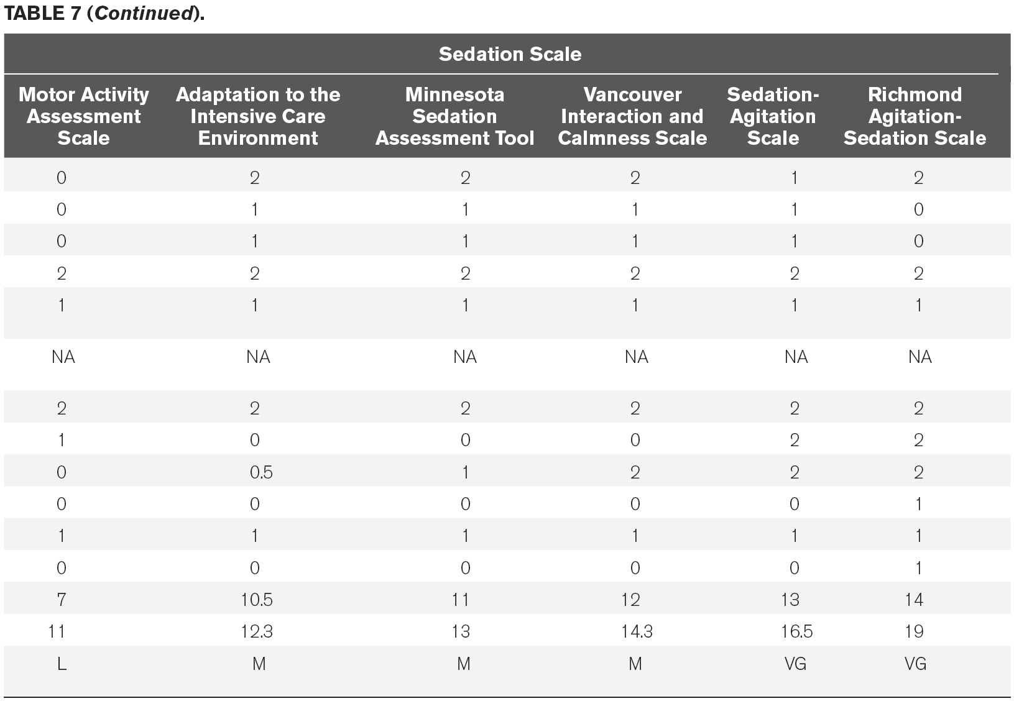

Slide 39
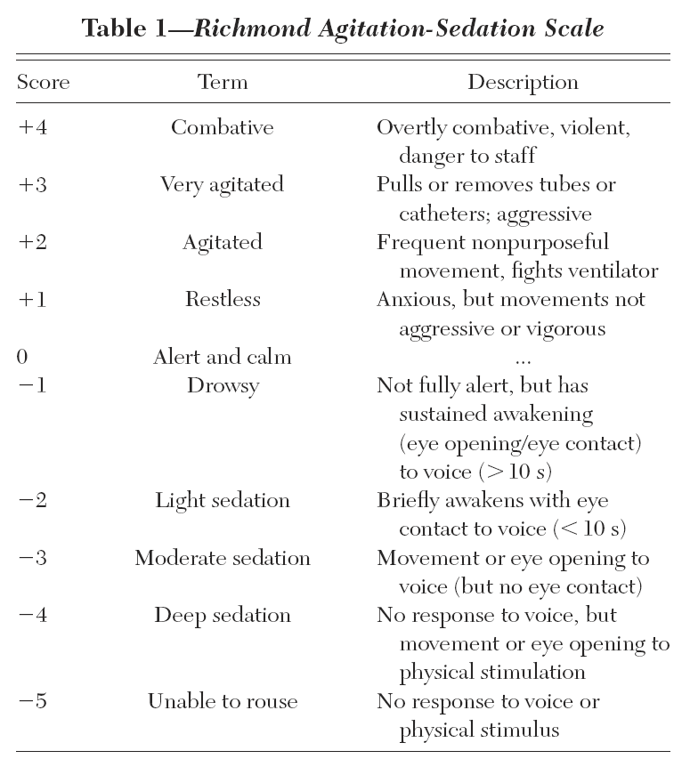

Slide 40
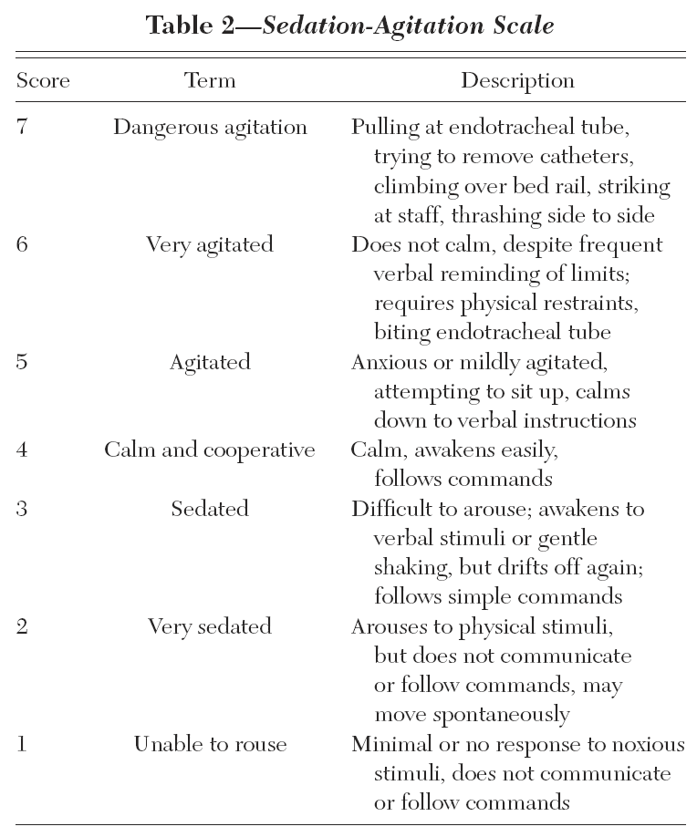

Slide 41
Monitoring depth of sedation and brain function
We do not recommend that objective measures of brain function (e.g., auditory evoked potentials [AEPs], Bispectral Index [BIS], Narcotrend Index [NI], Patient State Index [PSI], or state entropy [SE]) be used as the primary method to monitor depth of sedation in noncomatose, nonparalyzed critically ill adult patients, as these monitors are inadequate substitutes for subjective sedation scoring systems (–1B).

Slide 42
Monitoring depth of sedation and brain function
We suggest that objective measures of brain function (e.g., AEPs, BIS, NI, PSI, or SE) be used as an adjunct to subjective sedation assessments in adult ICU patients who are receiving neuromuscular blocking agents, as subjective sedation assessments may be unobtainable in these patients (+2B).

Slide 43
Monitoring depth of sedation and brain function
We recommend that EEG monitoring be used to monitor nonconvulsive seizure activity in adult ICU patients with either known or suspected seizures, or to titrate electrosuppressive medication to achieve burst suppression in adult ICU patients with elevated intracranial pressure (+1A).

Slide 44
Choice of sedative
Benzodiazepines
  Activate γ-aminobutyric acid A (GABA_{A}) neuronal receptors in the brain
  Anxiolytic, amnestic, sedating, hypnotic, and anticonvulsant effects, but no analgesic activity
  Tolerance with long-term administration
  Prolonged administration of benzodiazepines (due to saturation of peripheral tissues), advanced age, hepatic dysfunction, or renal insufficiency → Delayed emergence

Slide 45
Choice of sedative
Propofol
  Binds to multiple receptors in the central nervous system to interrupt neural transmission, including GABA_{A}, glycine, nicotinic, and M₁ muscarinic receptors
  Sedative, hypnotic, anxiolytic, amnestic, antiemetic, and anticonvulsant properties, but no analgesic effects
  Highly lipid soluble, BBB, rapid onset, short duration
  Long-term administration → Prolonged emergence

Slide 46
Choice of sedative
Dexmedetomidine
  Selective α₂-receptor agonist
  Sedative, analgesic/opioid sparing, and sympatholytic properties, but with no anticonvulsant properties
  More easily arousable and interactive, with minimal respiratory depression
  Most common S/E: Hypotension and bradycardia
  Lower prevalence of delirium than midazolam

Slide 47
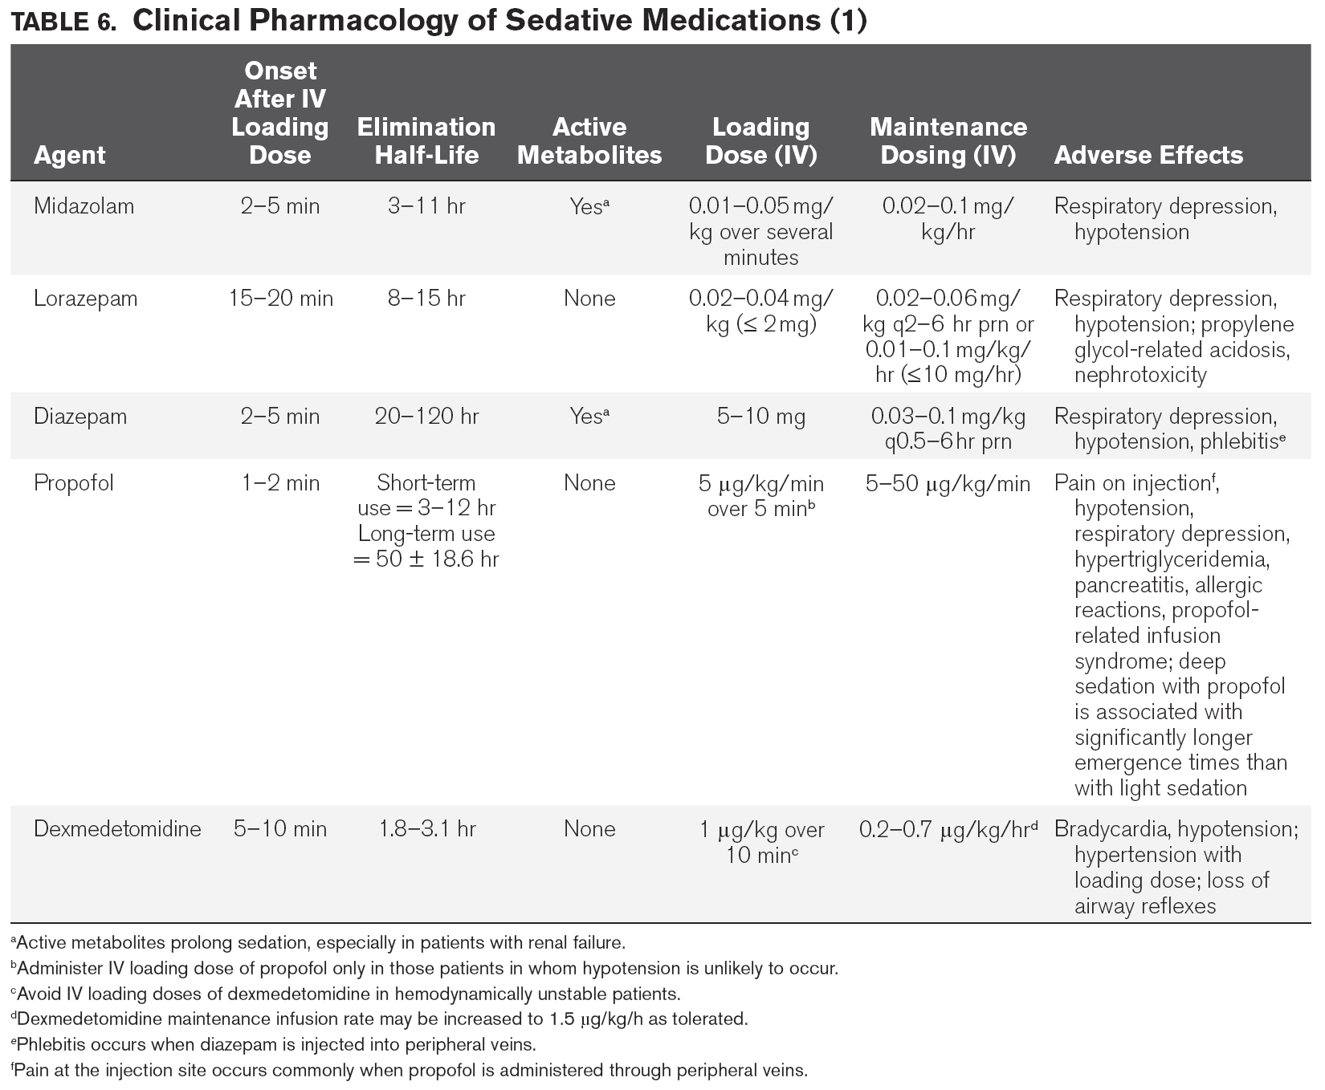

Slide 48
Choice of sedative
We suggest that sedation strategies using nonbenzodiazepine sedatives (either propofol or dexmedetomidine) may be preferred over sedation with benzodiazepines (either midazolam or lorazepam) to improve clinical outcomes in mechanically ventilated adult ICU patients (+2B).

Slide 49
Choice of sedative
BZD vs. non-BZD
  Modest differences in outcomes with BZD vs. non-BZD
  BZD (over non-BZD) : ICU LOS ↑, MV duration ↑ (limited data), mortality -
  Propofol (over midazolam or lorazepam), Dexmedetomidine (over midazolam) : Duration of MV ↓
  Delirium : BZD > Dexmedetomidine
  Transferring patients out of ICU : Dexmedetomidine > BZD
  Benzodiazepines remain important for treating anxiety, seizures, and alcohol or benzodiazepine withdrawal, and also important when deep sedation, amnesia, or combination therapy

Slide 50
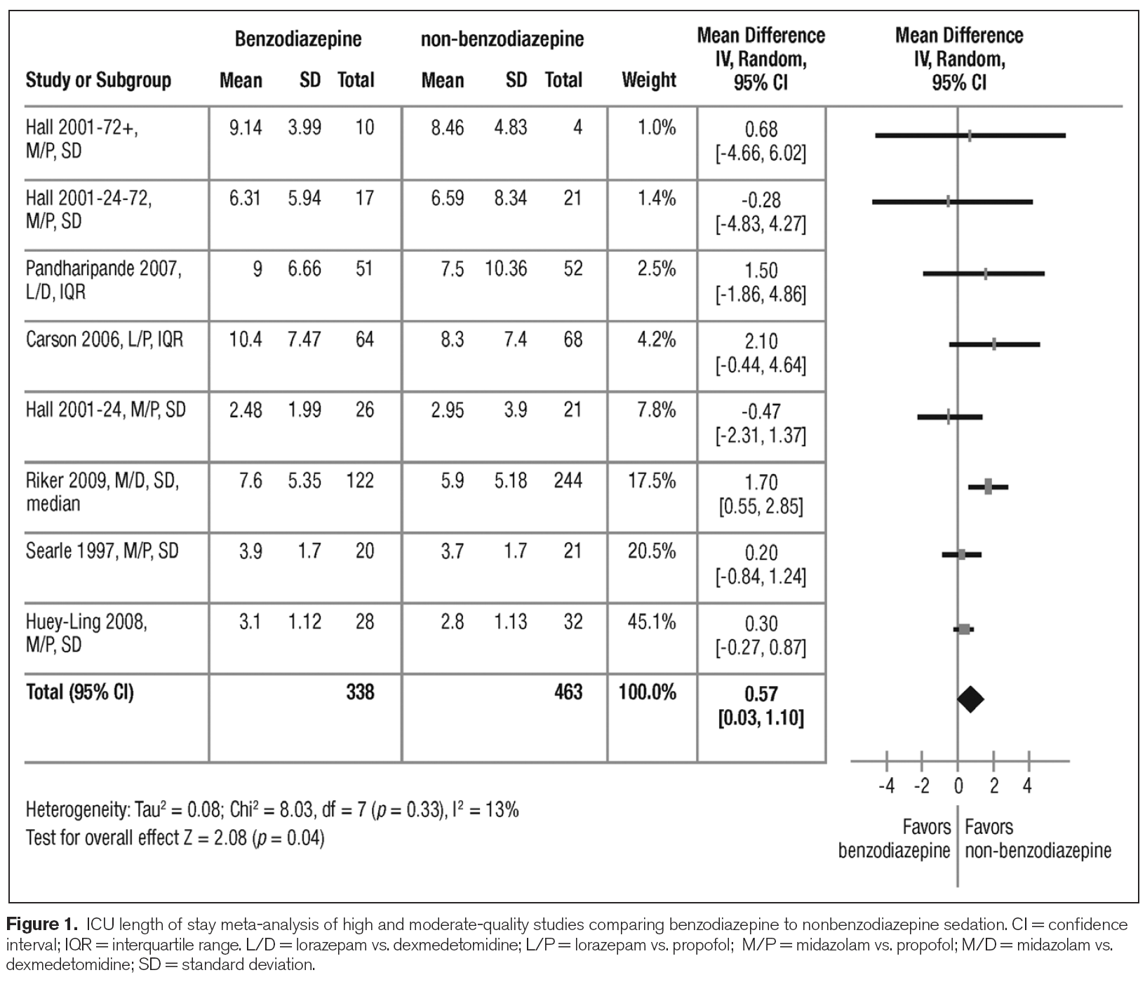

Slide 51
Outline
Methods
Pain and Analgesia
Agitation and Sedation
Delirium
Strategies for Managing Pain, Agitation, and Delirium to improve ICU Outcomes

Slide 52
Delirium
Outcomes associated with delirium
Detecting and monitoring delirium
Delirium risk factors
Delirium prevention
Delirium treatment

Slide 53
Outcomes associated with delirium
Delirium is associated with increased mortality in adult ICU patients (A).
Delirium is associated with prolonged ICU and hospital LOS in adult ICU patients (A).
Delirium is associated with the development of post-ICU cognitive impairment in adult ICU patients (B).

Slide 54
Detecting and monitoring delirium
We recommend routine monitoring of delirium in adult ICU patients (+1B).
  Most informed patients want to be monitored
  High delirium “miss rates” in the absence of monitoring
  Clinicians have successfully implemented ICU delirium monitoring programs
  Policy makers can adopt delirium assessment as part of routine, high-quality care in most ICUs

Slide 55
Detecting and monitoring delirium
Routine monitoring of delirium in adult ICU patients is feasible in clinical practice (B).
  Numerous implementation studies including over 2,000 patients across multiple institutions showed delirium monitoring compliance rates in excess of 90%

Slide 56
Detecting and monitoring delirium
The Confusion Assessment Method for the ICU (CAM-ICU) and the Intensive Care Delirium Screening Checklist (ICDSC) are the most valid and reliable delirium monitoring tools in adult ICU patients (A).

Slide 57
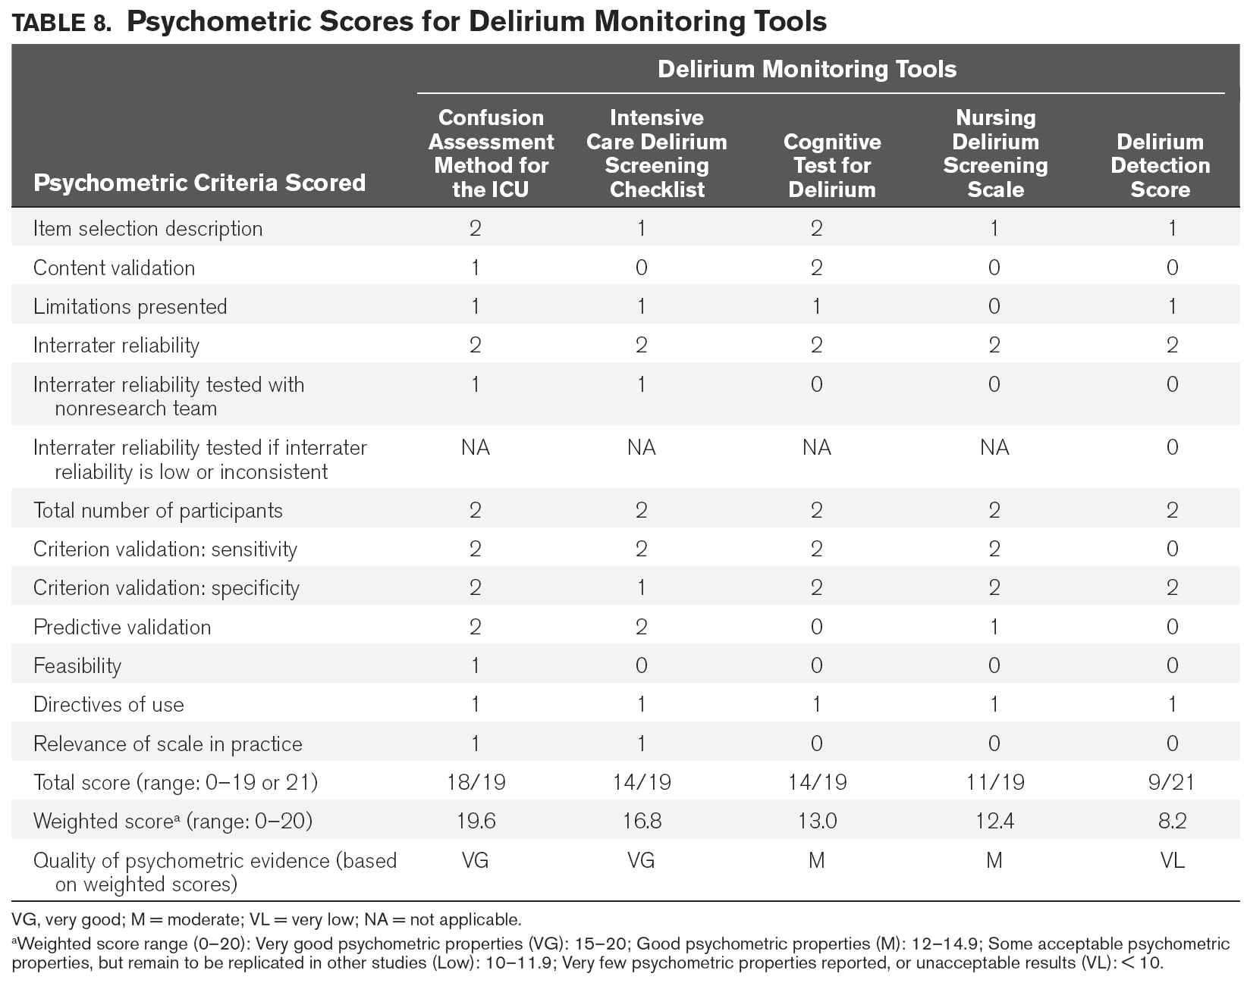

Slide 58
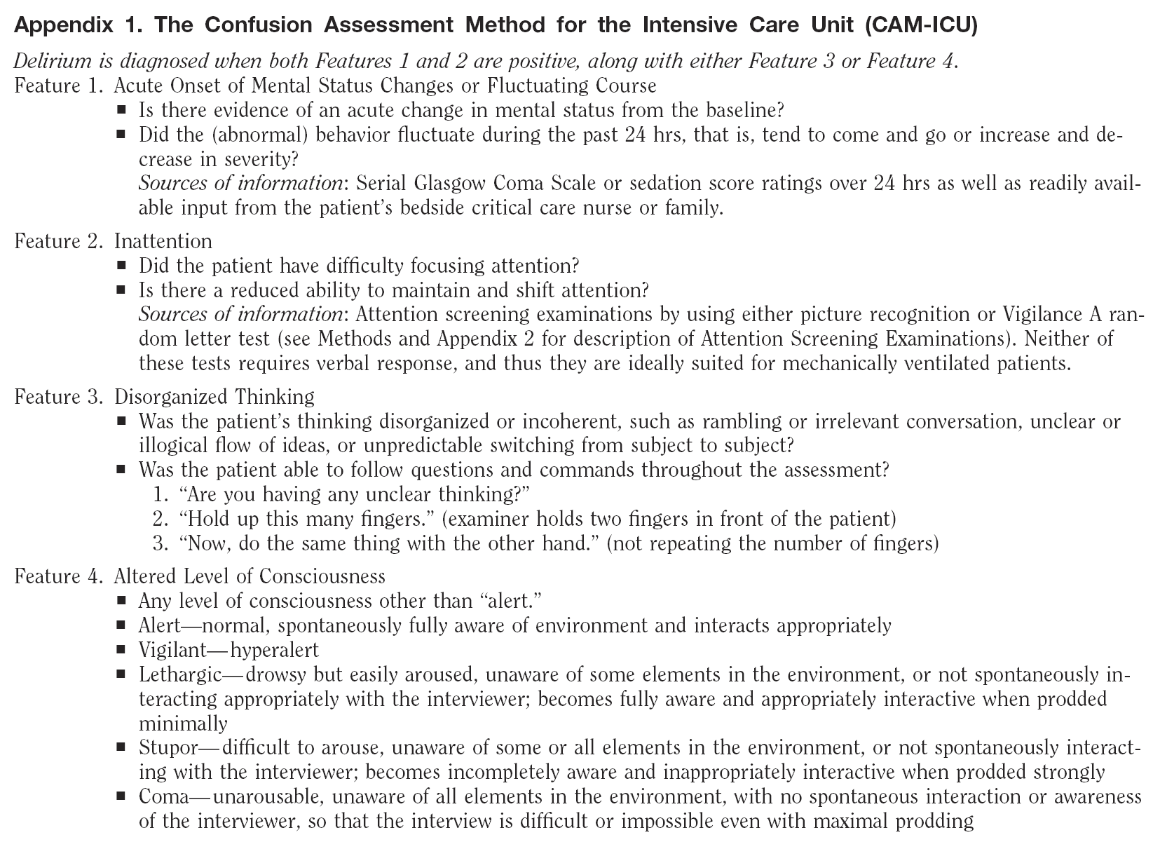

Slide 59
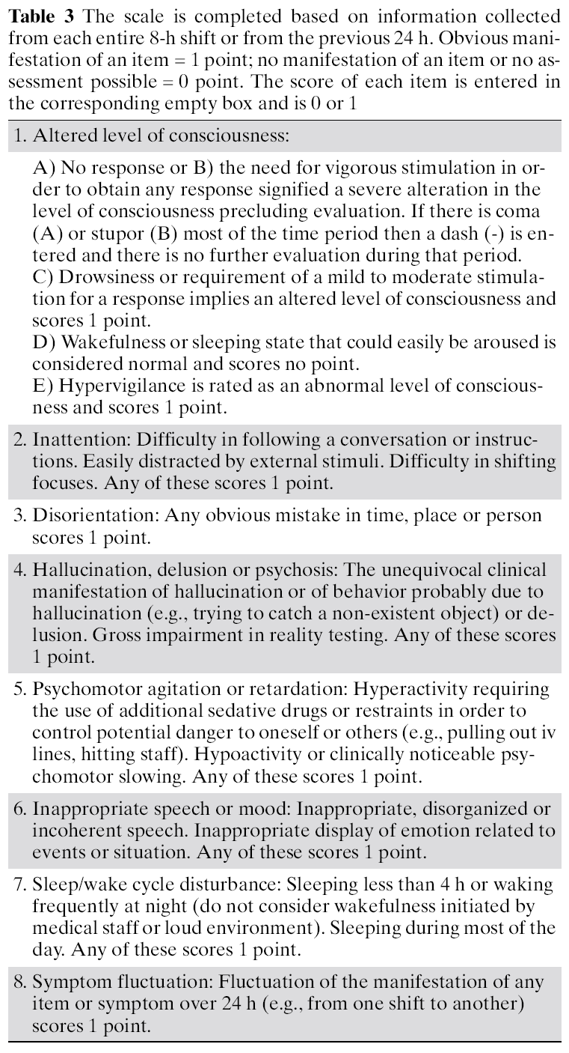
Intensive Care Delirium Screening Checklist
(≥ 4 points : Delirium)

Slide 60
Delirium risk factors
Four baseline risk factors are positively and significantly associated with the development of delirium in the ICU: preexisting dementia, history of hypertension and/or alcoholism, and a high severity of illness at admission (B).
  Age (risk factor outside the ICU) : not included in ICU

Slide 61
Delirium risk factors
Coma is an independent risk factor for the development of delirium in ICU patients (B).
Benzodiazepine use may be a risk factor for the development of delirium in adult ICU patients (B).

Slide 62
Delirium risk factors
Conflicting data surround the relationship between opioid use and the development of delirium in adult ICU patients (B).
There are insufficient data to determine the relationship between propofol use and the development of delirium in adult ICU patients (C).
In mechanically ventilated adult ICU patients at risk of developing delirium, dexmedetomidine infusions administered for sedation may be associated with a lower prevalence of delirium compared to benzodiazepine infusions (B).

Slide 63
Delirium prevention
We recommend performing early mobilization of adult ICU patients whenever feasible to reduce the incidence and duration of delirium (+1B).
  Delirium ↓, ICU and hospital LOS ↓, Hospital cost ↓

Slide 64
Delirium prevention
We provide no recommendation for using a pharmacologic delirium prevention protocol in adult ICU patients, as no compelling data demonstrate that this reduces the incidence or duration of delirium in these patients (0,C).
We provide no recommendation for using a combined nonpharmacologic and pharmacologic delirium prevention protocol in adult ICU patients, as this has not been shown to reduce the incidence of delirium in these patients (0,C).

Slide 65
Delirium prevention
We do not suggest that either haloperidol or atypical antipsychotics be administered to prevent delirium in adult ICU patients (–2C).
We provide no recommendation for the use of dexmedetomidine to prevent delirium in adult ICU patients, as there is no compelling evidence regarding its effectiveness in these patients (0,C).

Slide 66
Delirium treatment
There is no published evidence that treatment with haloperidol reduces the duration of delirium in adult ICU patients (No Evidence).
Atypical antipsychotics may reduce the duration of delirium in adult ICU patients (C).
We do not recommend administering rivastigmine (a cholinesterase inhibitor) to reduce the duration of delirium in ICU patients (–1B).

Slide 67
Delirium treatment
We do not suggest using antipsychotics in patients at significant risk for torsades de pointes (i.e., patients with baseline prolongation of QTc interval, patients receiving concomitant medications known to prolong the QTc interval, or patients with a history of this arrhythmia) (–2C).

Slide 68
Delirium treatment
We suggest that in adult ICU patients with delirium unrelated to alcohol or benzodiazepine withdrawal, continuous IV infusions of dexmedetomidine rather than benzodiazepine infusions be administered for sedation to reduce the duration of delirium in these patients (+2B).

Slide 69
Outline
Methods
Pain and Analgesia
Agitation and Sedation
Delirium
Strategies for Managing Pain, Agitation, and Delirium to improve ICU Outcomes

Slide 70
Sedation Strategies to Improve Clinical Outcomes
We recommend either daily sedation interruption or a light target level of sedation be routinely used in mechanically ventilated adult ICU patients (+1B).
We suggest that analgesia-first sedation be used in mechanically ventilated adult ICU patients (+2B).
  Clinical benefits (MV duration ↓, ICU LOS ↓)

Slide 71
Sedation Strategies to Improve Clinical Outcomes
We recommend promoting sleep in adult ICU patients by optimizing patients’ environments, using strategies to control light and noise, clustering patient care activities, and decreasing stimuli at night to protect patients’ sleep cycles (+1C).
We provide no recommendation for using specific modes of mechanical ventilation to promote sleep in mechanically ventilated adult ICU patients, as insufficient evidence exists for the efficacy of these interventions (0, No Evidence).

Slide 72
Strategies to Facilitate Implementation of ICU Analgesia, Sedation, and Delirium Guidelines
We recommend using an interdisciplinary ICU team approach that includes provider education, preprinted and/or computerized protocols and order forms, and quality ICU rounds checklists to facilitate the use of pain, agitation, and delirium management guidelines or protocols in adult ICUs (+1B).

Slide 73
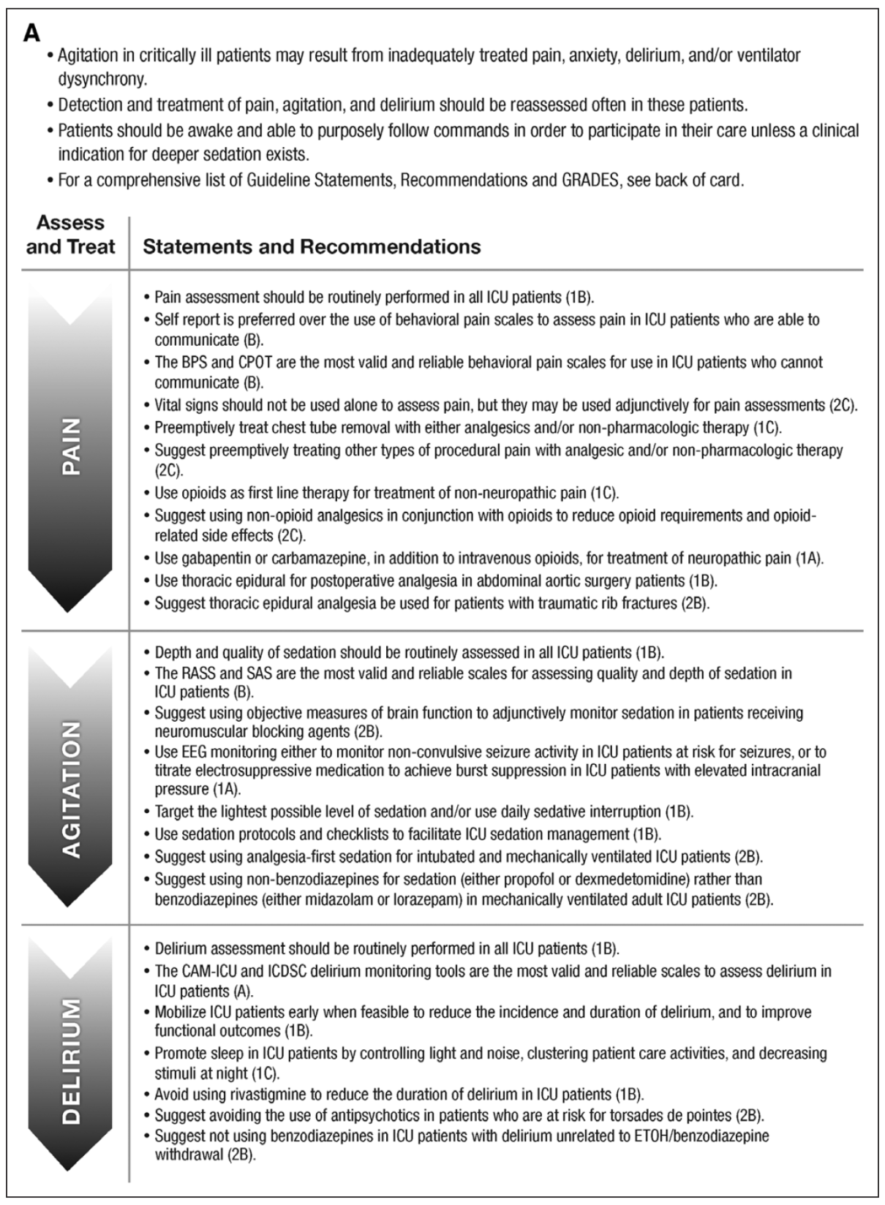

Slide 74
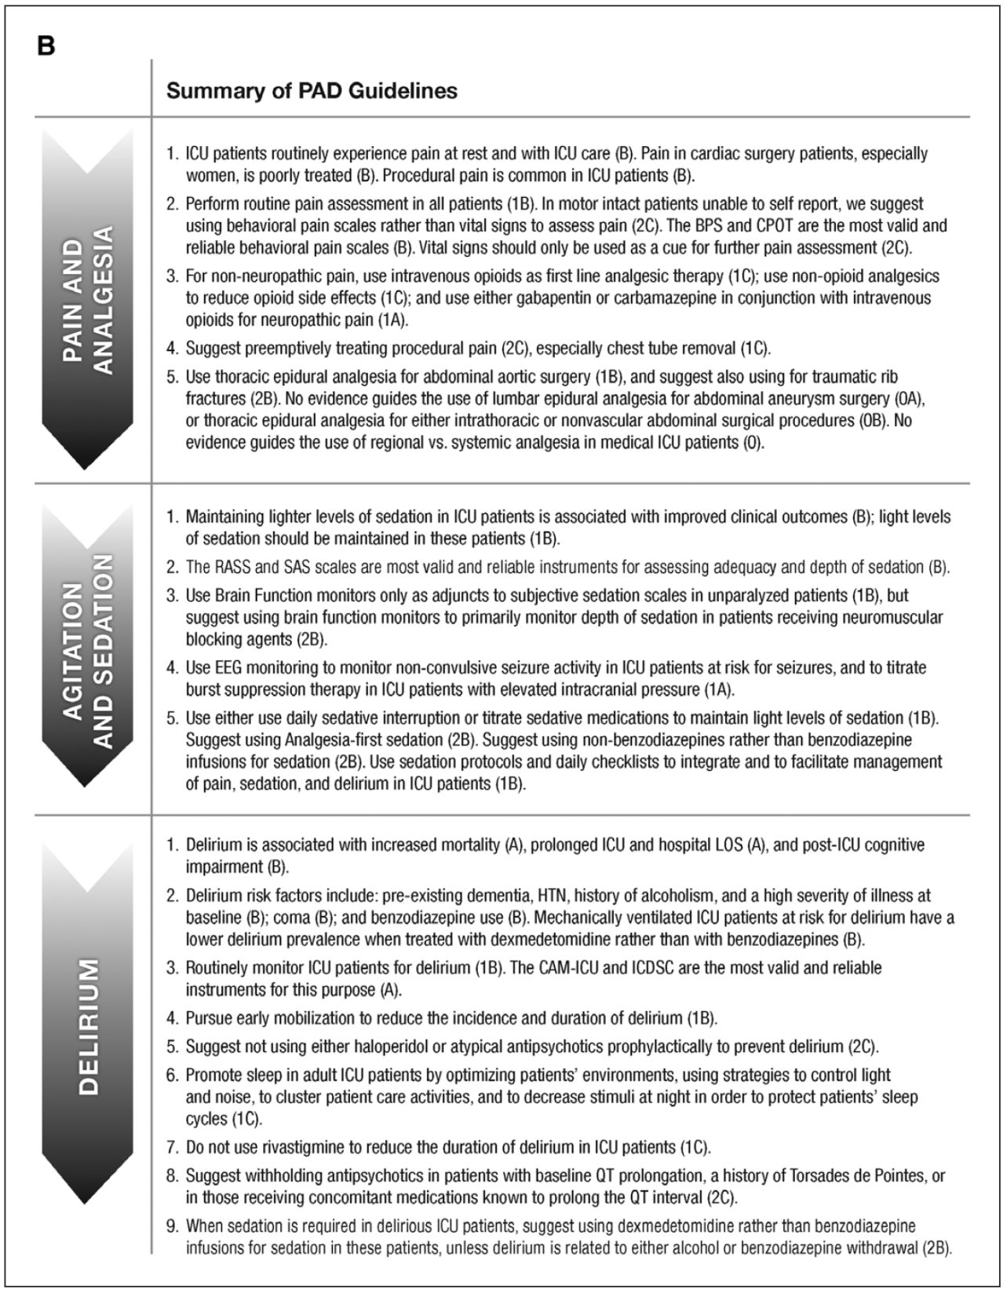

Slide 75
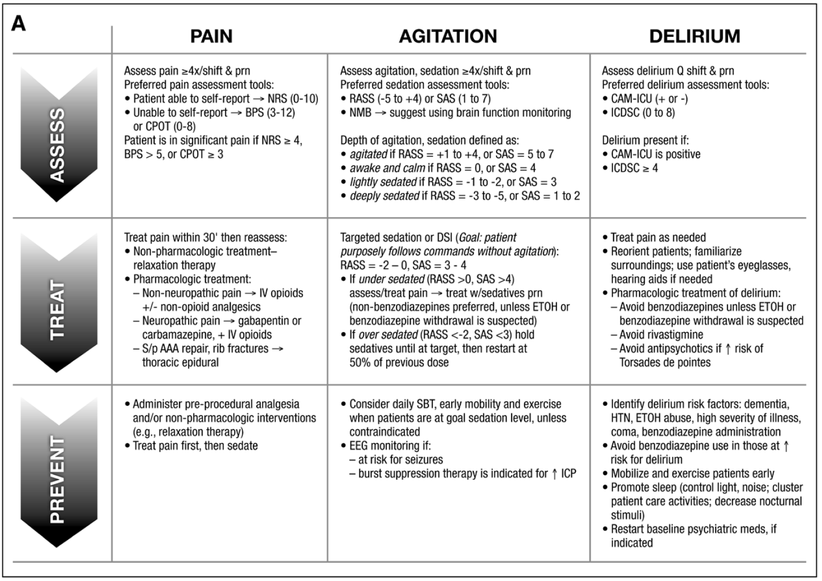

Slide 76
