Slide 1
NSIP vs UIP/IPF
S. H. Lee,
Division of Pulmonology
Department Of internal medicine
Yonsei University College of Medicine
Notes:
안녕하세요. 호흡기 내과 강사 이상훈 입니다. Pleural effusion 에 대해서 review 를 준비하였습니다.

Slide 2
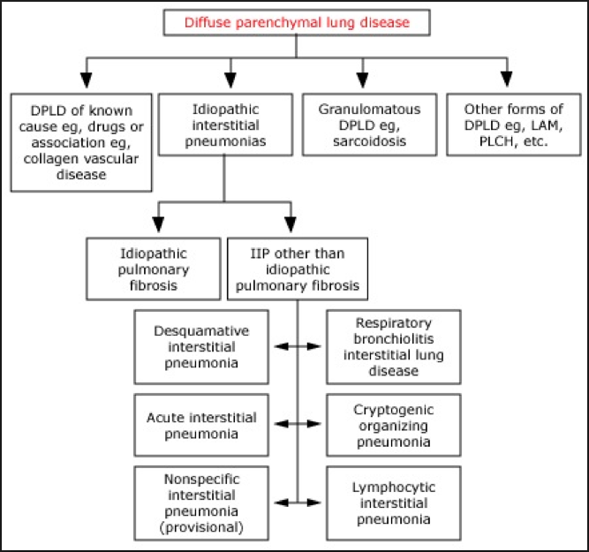
Classification
Notes:
Diffuse parenchymal lung diseases consist of disorders of known causes (rheumatic disease, environmental or drug related
The interstitial pneumonias are further categorized as chronic fibrosing, acute or subacute fibrosing, or smoking related.

Slide 4
CASE
75/F
P.I: DM(+)/ 2014.5 cough, sputum으로 개인병원 내원, 폐섬유화라고 들음 -> 14.12월 본원 내원
숨차거나 하진 않아요.
담배- none
입마름: (+), 관절: (-), 눈건조: (+/-), 농사일, 주부

Slide 5
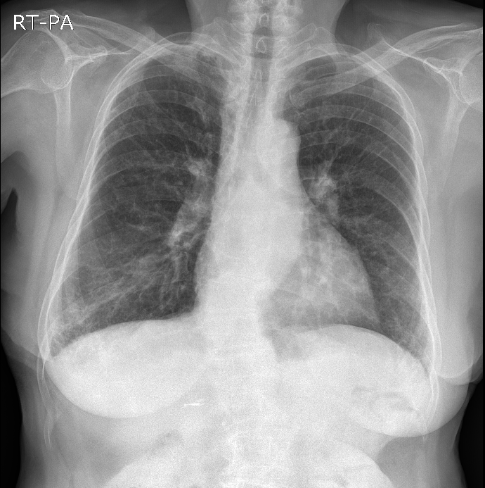

Slide 6
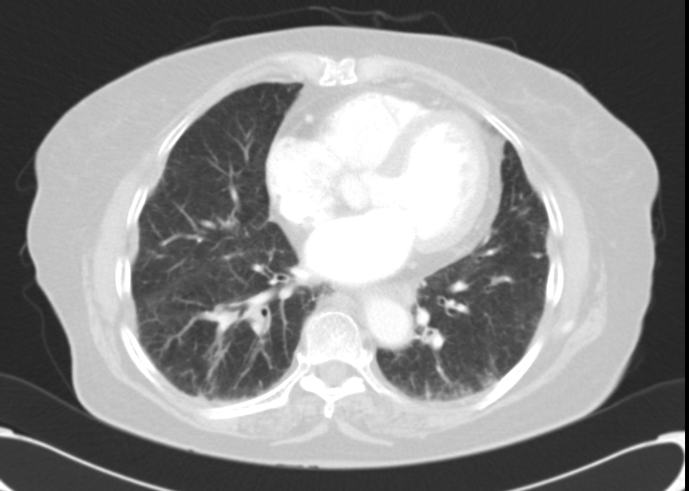
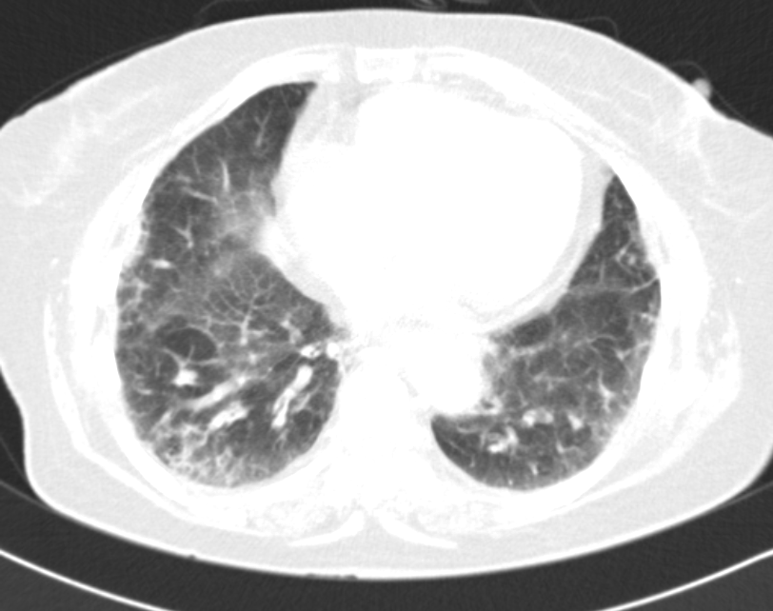
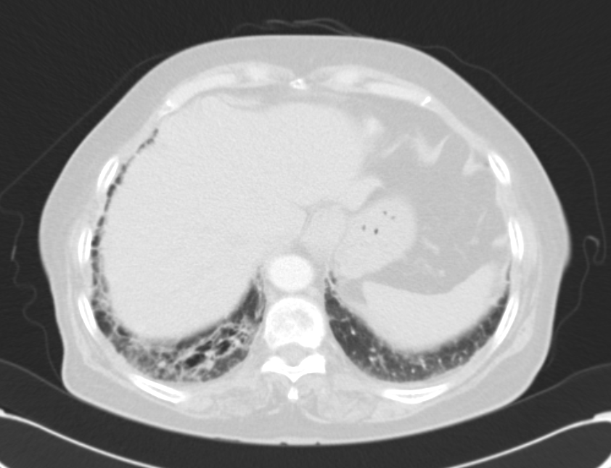
Notes:
Honeycomb : 0-16% NSIP에서 볼 수 있음

Slide 7
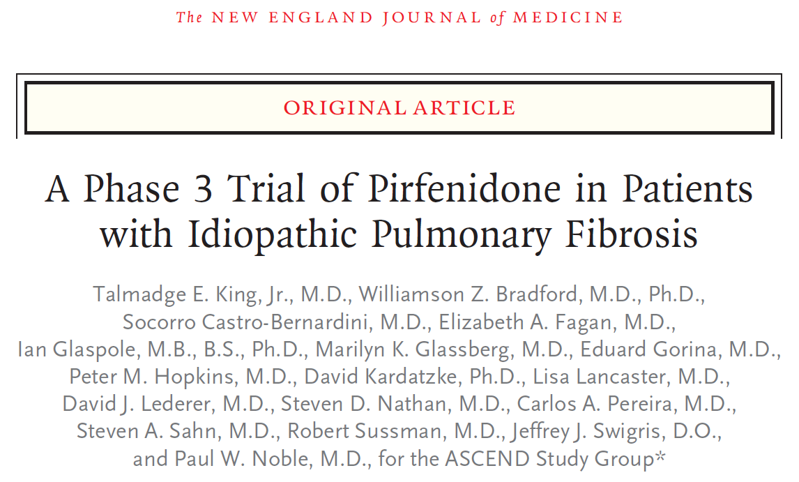
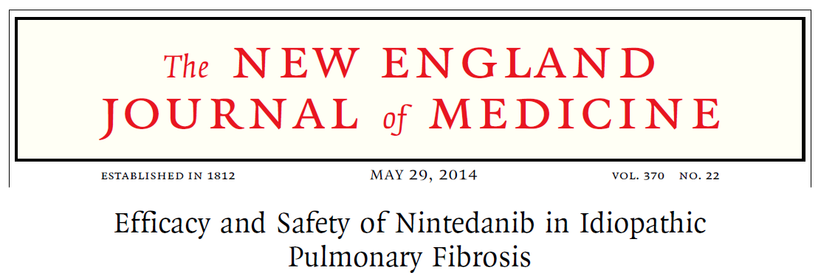
NSIP vs IPF
Treatment
Prognosis
Difficulty of identification
Notes:
NSIP had a significantly better prognosis than UIP [67-69]. Nearly 75 percent of patients with NSIP improved or recovered, versus none of the patients with UIP. All of the patients with NSIP who suffered a more aggressive course were in the fibrotic subset.
Recently, two promising drugs are reported for IPF patients. Pirferidone was beneficial in exercise-tolerance, reducing disease progression, and lung function decline. It also showed longer progression-free survival as compared with placebo [30]. The other drug, nintedanib was effective in reducing FVC decline over time and slowing of disease progression

Slide 8
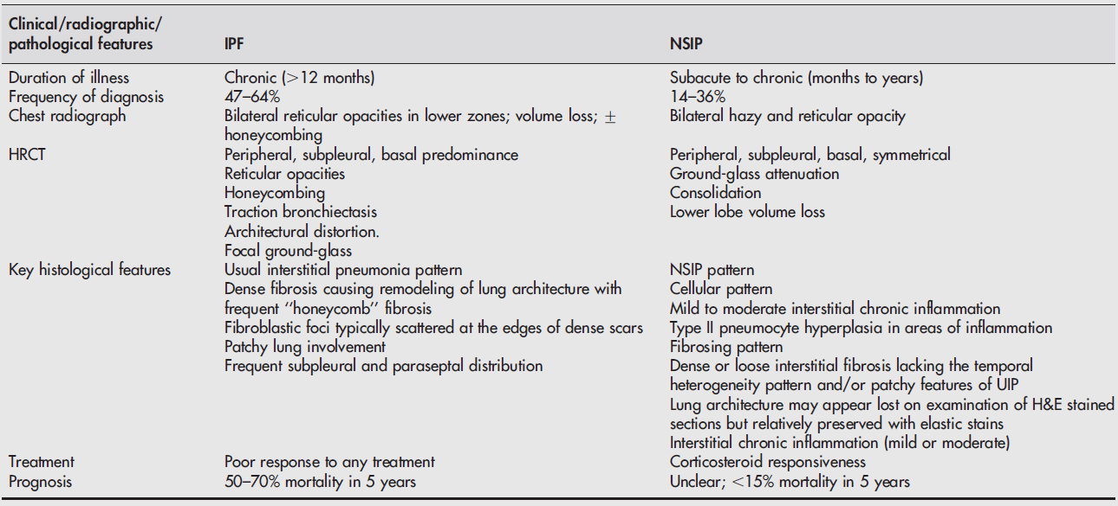

Slide 9
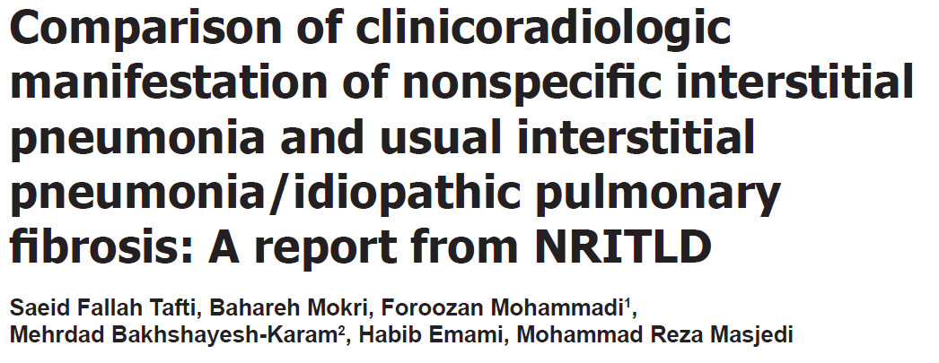
Clinical presentation

Slide 10
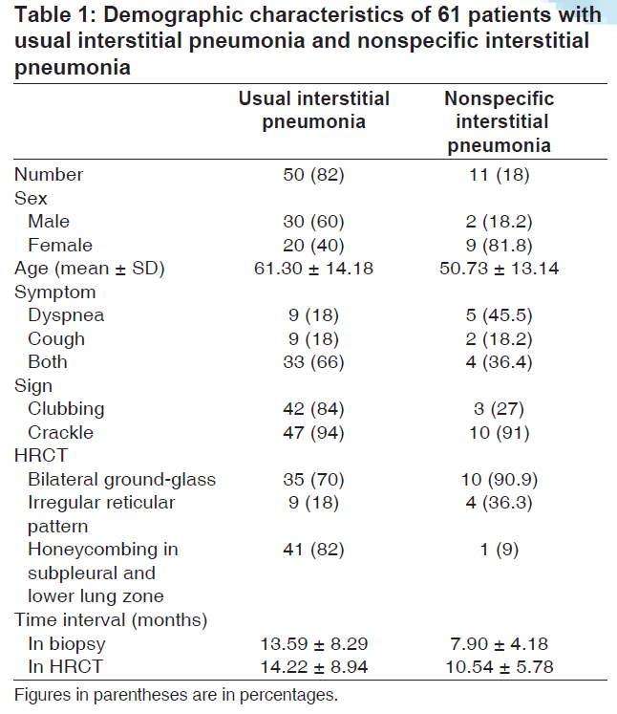
Notes:
Symptom duration (onset – diagnosis 까지 걸리는 시간)

Slide 11
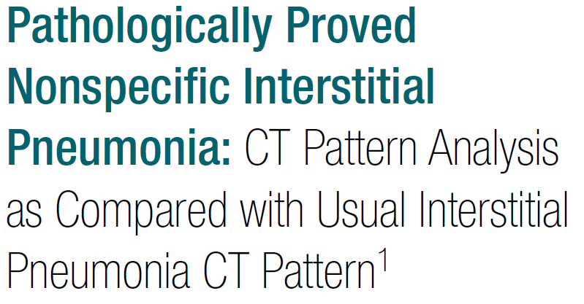
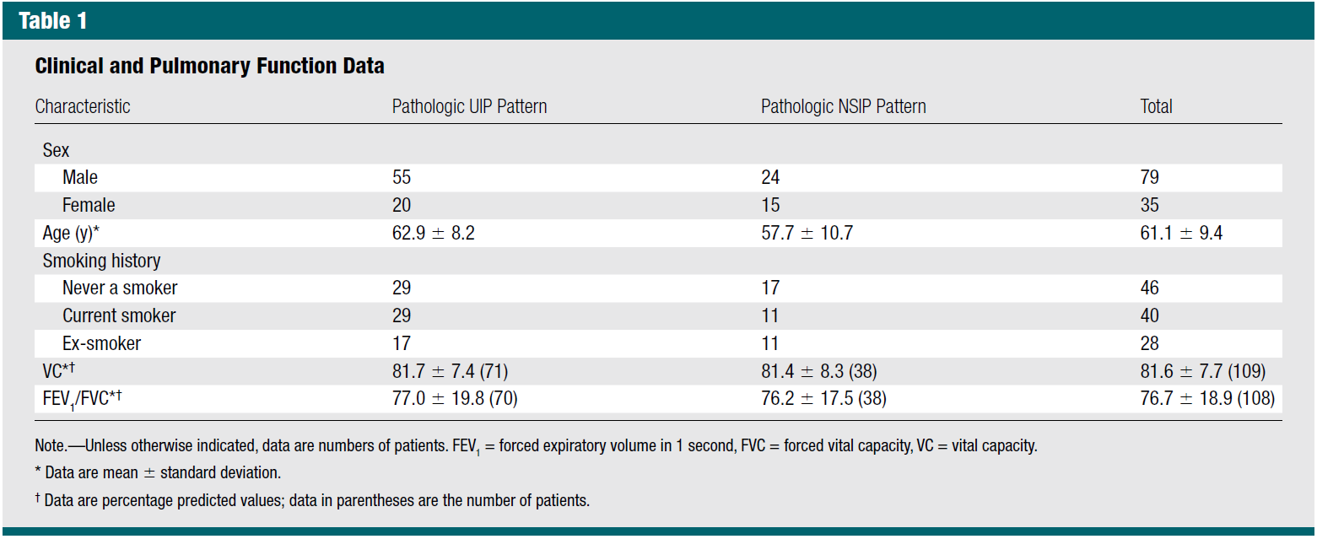

Slide 12
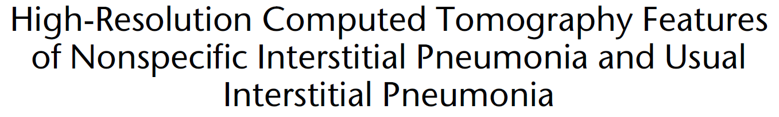
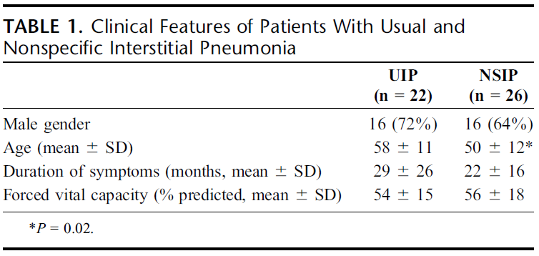
Notes:
결론적으로 UIP에서 나이, male. Smoker, clubing, 증상의 기간이 김
Rhematic dz 와 연관 - NSIP

Slide 13
NSIP and rheumatic dz
110 pts: AIDS and ILD, NSIP was detected in 38%.
Several connective tissue disorders
  70 patients with polymyositis-dermatomyositis (PD) and ILD: 18 NSIP/22 Bx
  16 pts with RA and ILD, 7 : most consistent with NSIP
  80 pts with ILD associated with systemic sclerosis, NSIP was identified in 62 (77.5%)
Notes:
결론적으로 UIP에서 나이, male. Smoker, clubing, 증상의 기간이 김
Rhematic dz 와 연관 - NSIP

Slide 14
Difficulty of identification
Radiology vs pathology

Slide 15
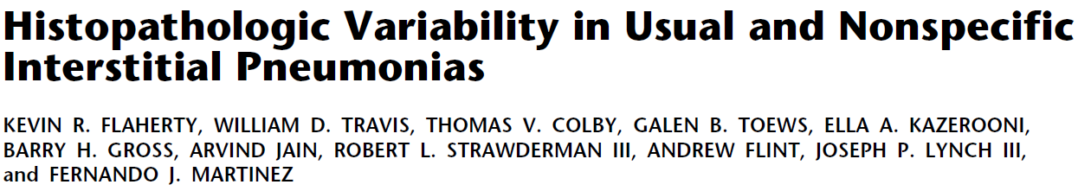
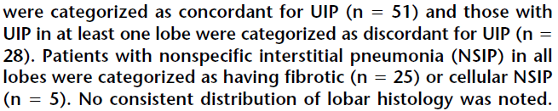
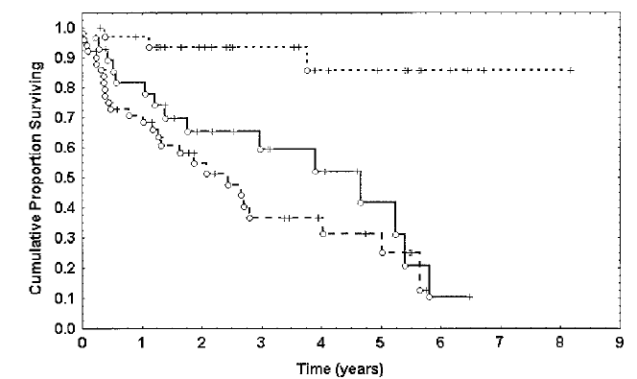
Notes:
109명 168개 Bx -> 3명의 병리학자

Slide 16
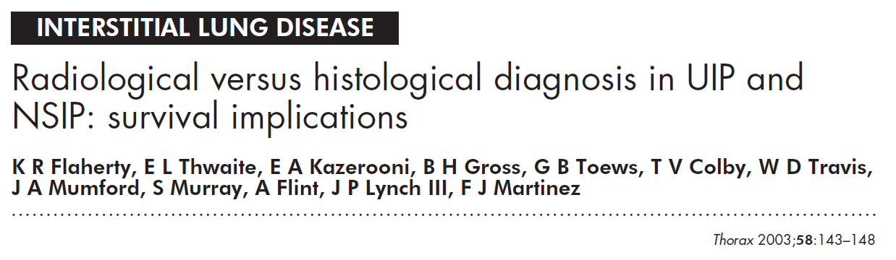
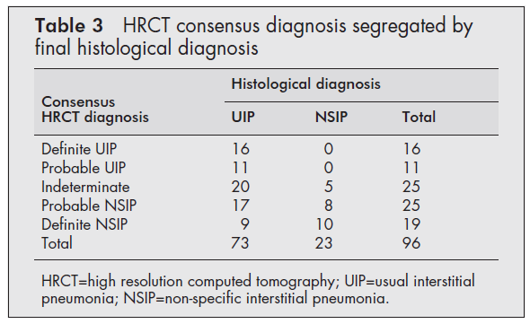

Slide 17
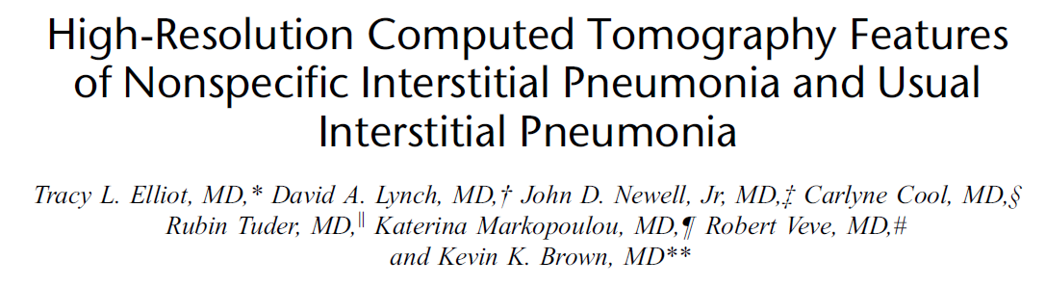

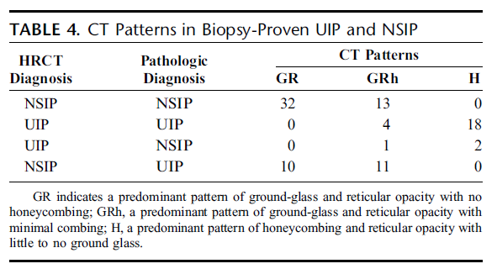

Slide 18
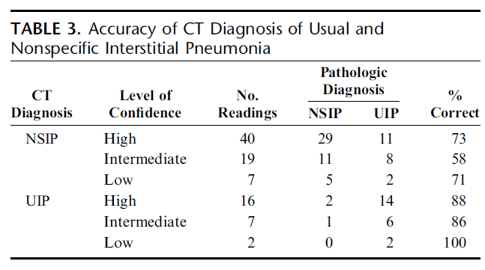
Notes:
The overall diagnostic accuracy of CT for UIP and NSIP
was 70%. The diagnosis of NSIP (at all levels of confidence)
was made in 66 readings and was correct in 45 (68%). Usual
interstitial pneumonia was correctly diagnosed in 22 (88%) of
25 readings.

Slide 19
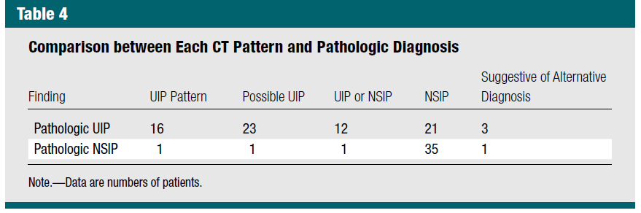

Slide 20
Difficulty of identification
Cohort of patients with IPF, the diagnosis would be missed in 30–40% using indices that do not include a biopsy.
In the same vein, a diagnosis of NSIP without a biopsy is highly inaccurate with roughly 50% being missed. Common conditions that may be confused with idiopathic NSIP include HP, LIP, RB-ILD, DIP.

Slide 21
Radiologic characteristics

Slide 22
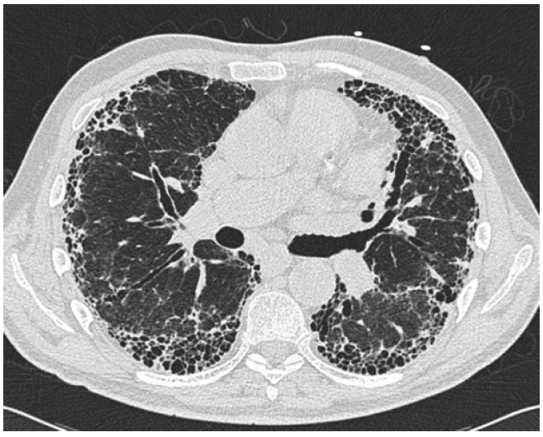
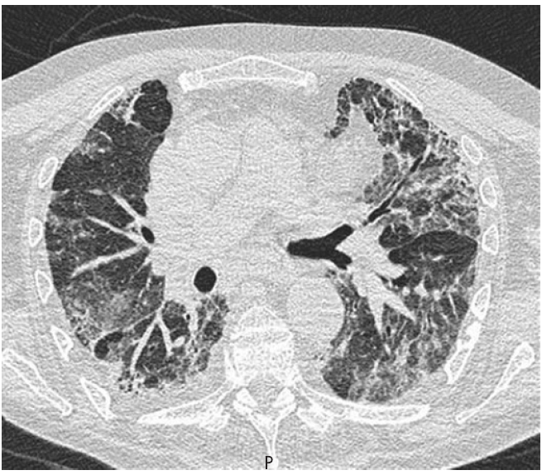
Notes:
Typical CT scan from a patient with non-specific interstitial pneumonia. Note the less peripheral distribution of disease than in idiopathic pulmonary fibrosis and the widespread ground-glass change,
but with clear evidence of traction of the airways indicating that at least some, but not necessarily all, of this ground change is due to fine fibrosis

Slide 23
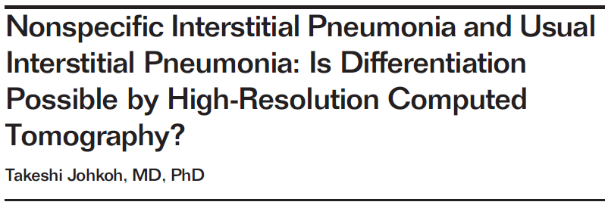
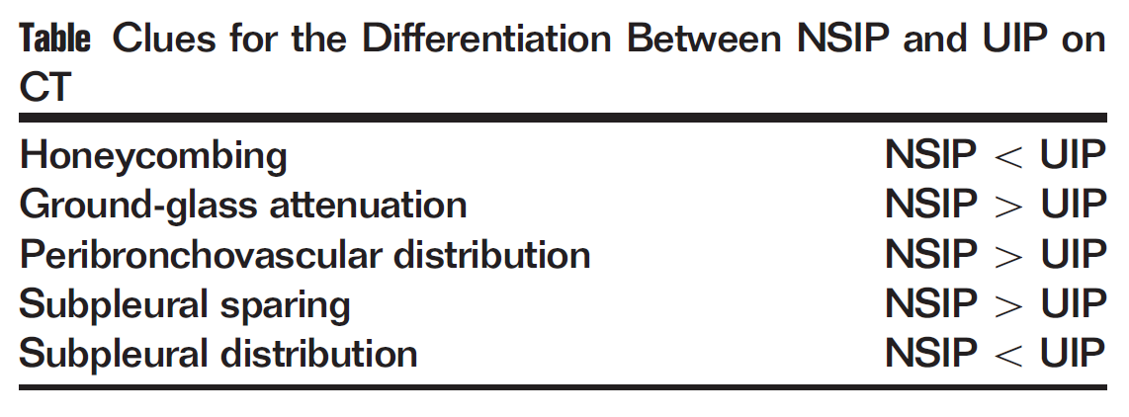

Slide 24
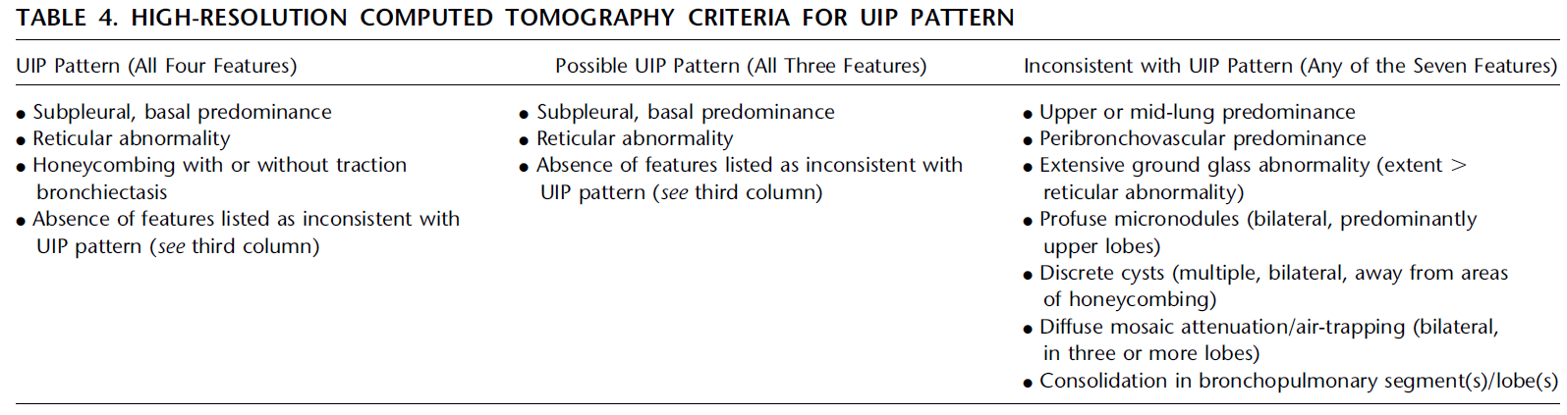
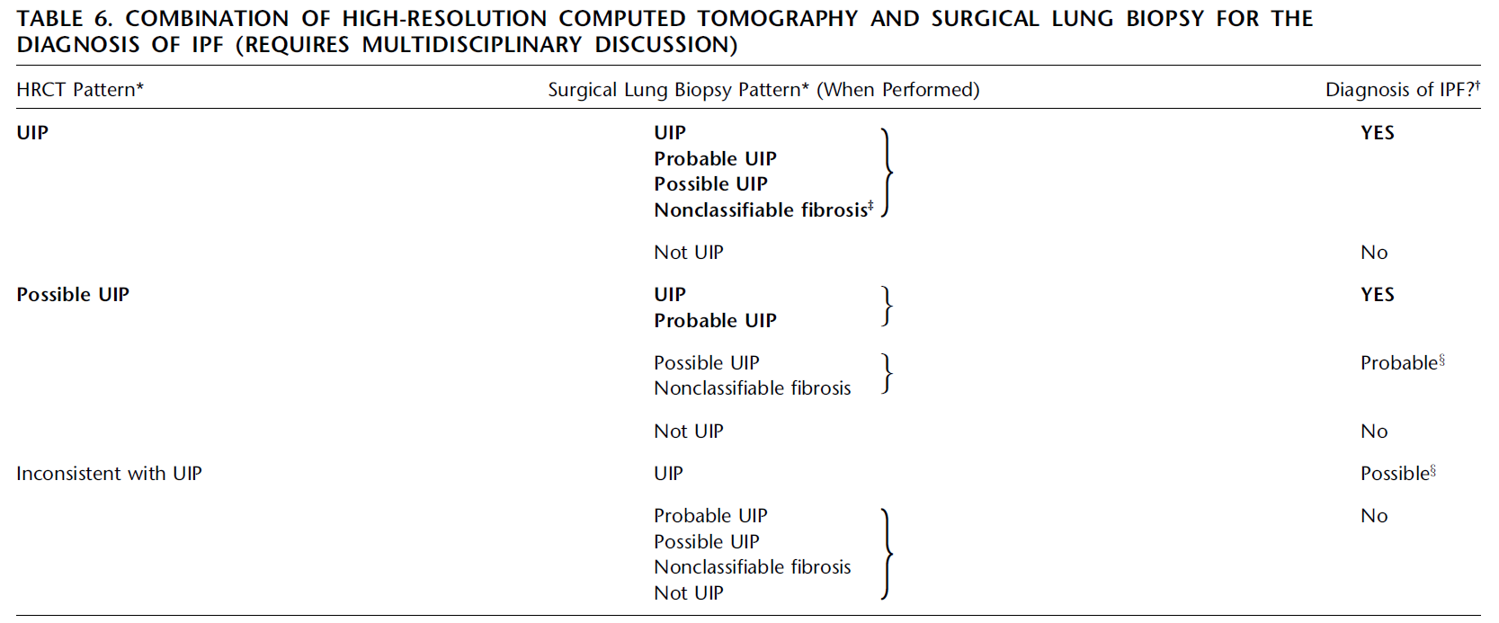

Slide 25
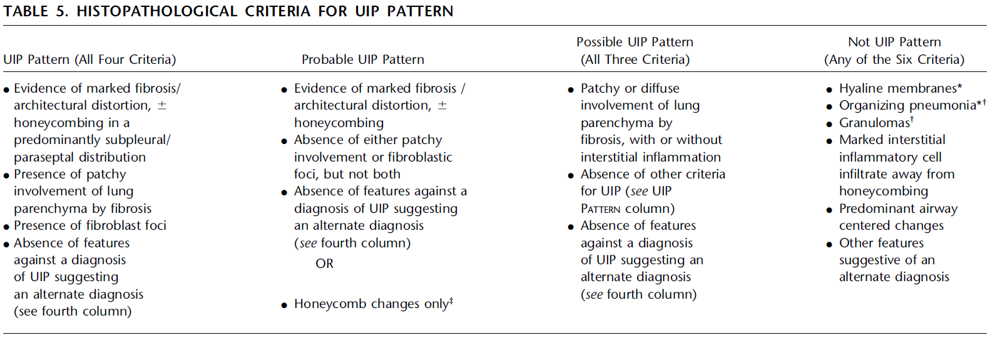
Pathologic characteristics

Slide 26
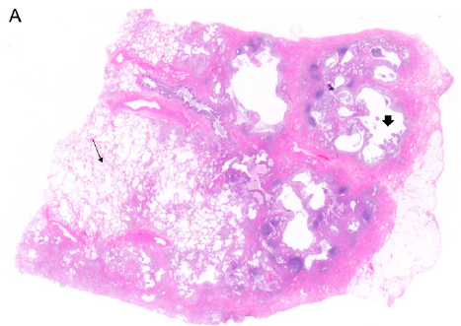
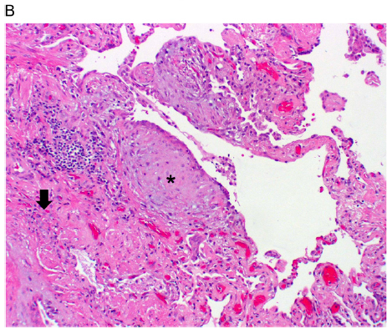
UIP
Notes:
(A) Scanning power microscopy showing a patchy process with honeycomb
spaces (thick arrow), some preserved lung tissue regions (thin arrow), and
fibrosis extending into the lung from the subpleural regions.
(B) Adjacent to the regions of more chronic fibrosis (thick arrow) is a fibroblast focus
(asterisk), recognized by its convex shape and composition of edematous
fibroblastic tissue, suggestive of recent lung injury.

Slide 27
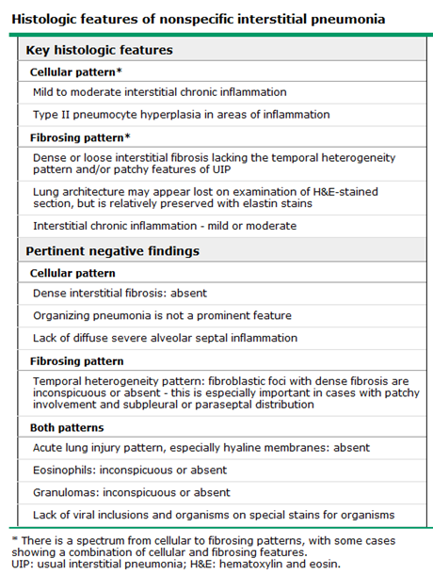

Slide 28
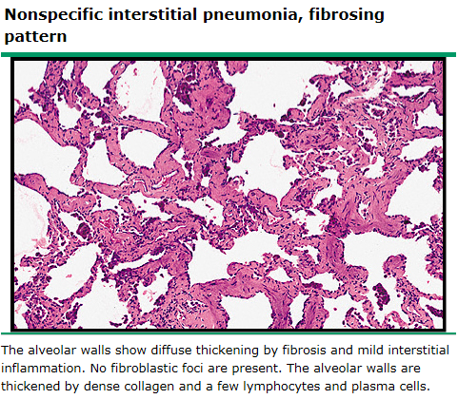
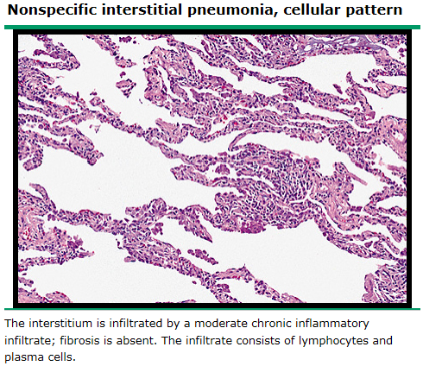
NSIP
Notes:
The histopathology of nonspecific interstitial pneumonia (NSIP) is characterized by varied degrees of alveolar wall inflammation and fibrosis in a pattern that suggests temporal homogeneity
The histopathologic features do not fit the patterns of other IIPs such as usual interstitial pneumonia (UIP), desquamative interstitial pneumonia, respiratory bronchiolitis interstitial lung disease, cryptogenic organizing pneumonia, acute interstitial pneumonia, or lymphocytic interstitial pneumonia.
Although the histopathologic features of NSIP are well defined, the differentiation of NSIP from other IIPs, particularly IPF/UIP, is difficult and even expert pathologists may disagree on a particular biopsy [51,52]. Three separate groups within NSIP have been described: Group I has primarily interstitial inflammation (picture 1), Group II has both inflammation and fibrosis, and Group III has primarily fibrosis (picture 2). Group III is distinguished from UIP by the absence of fibroblast foci and the presence of temporal homogeneity

Slide 29
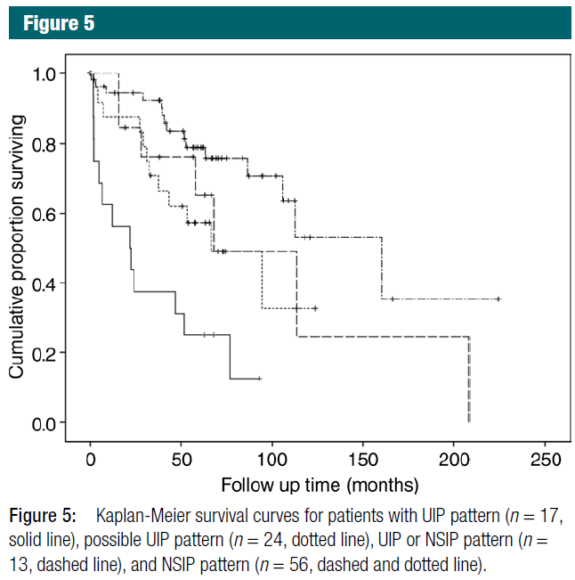
Prognosis

Slide 30
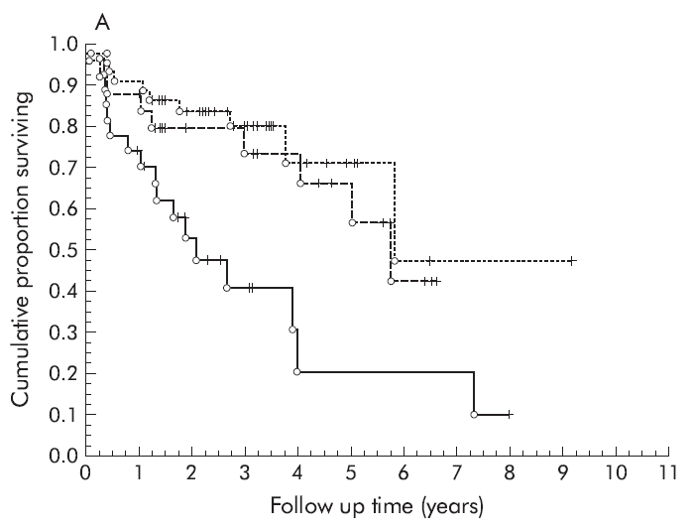
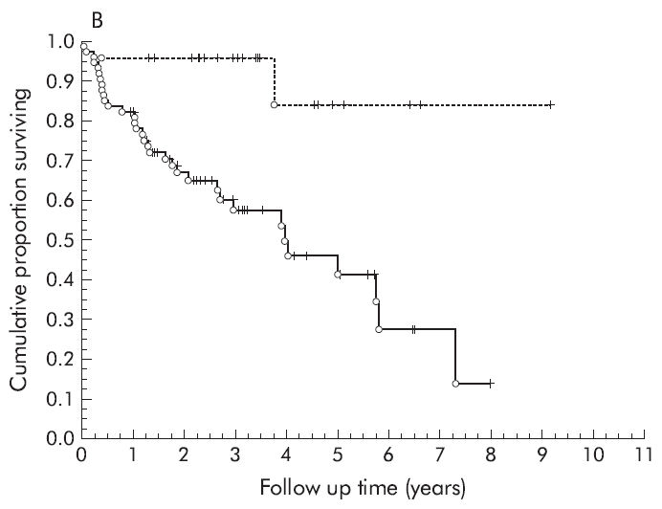
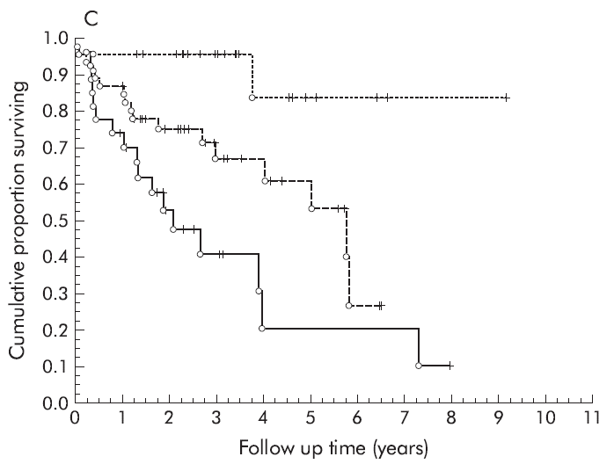

HRCT NSIP (n=44), indeterminate (n=25), and UIP (n=27)
(B) hNSIP (n=23) and UIP (n=73)
hNSIP and CT as indeterminate or NSIP (n=23), hUIP and CT indeterminate or NSIP (n=46), and hUIP and CT UIP (n=27)

Slide 31
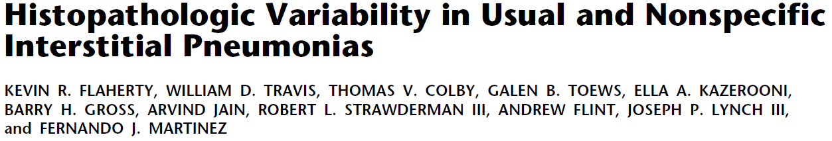
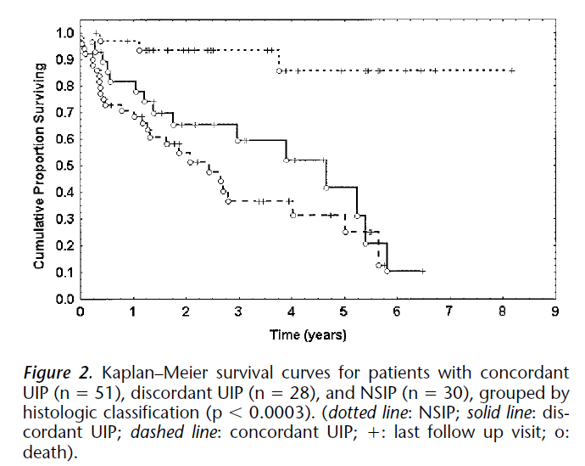

Slide 32
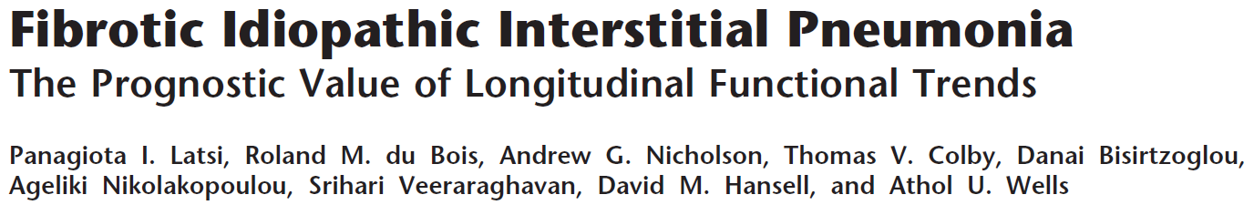
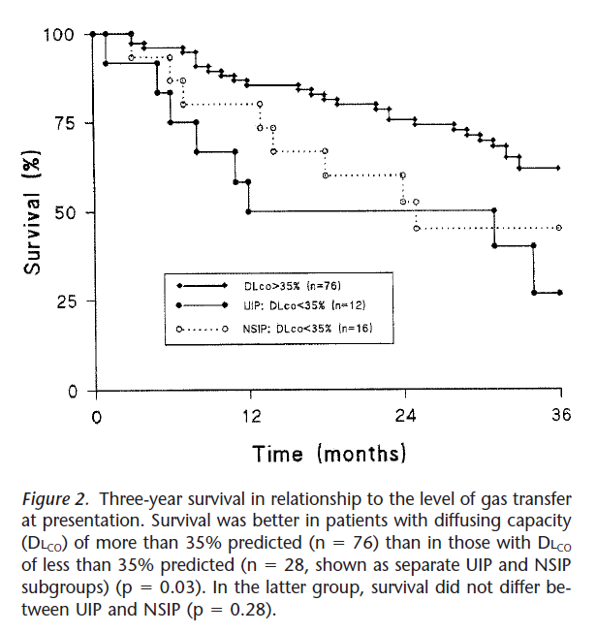

Slide 33
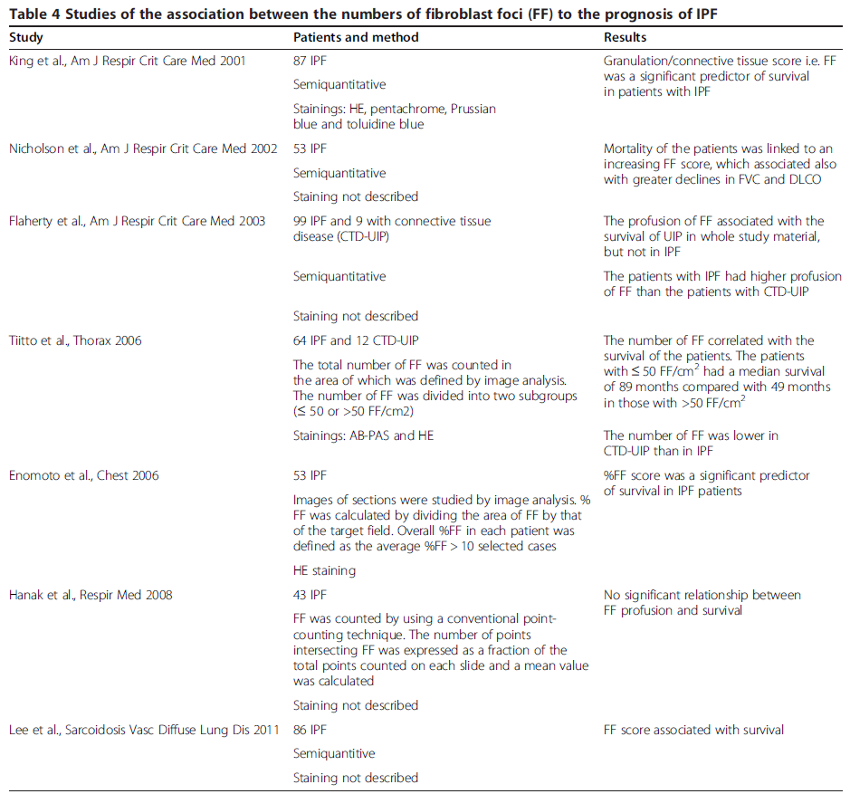
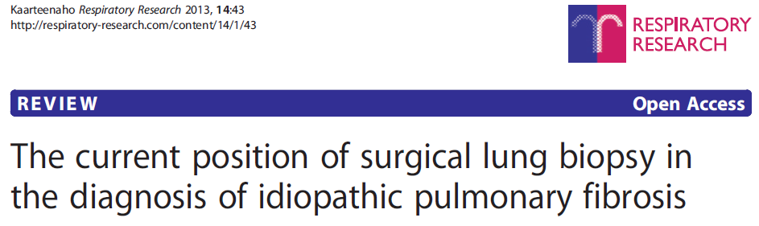

Slide 34
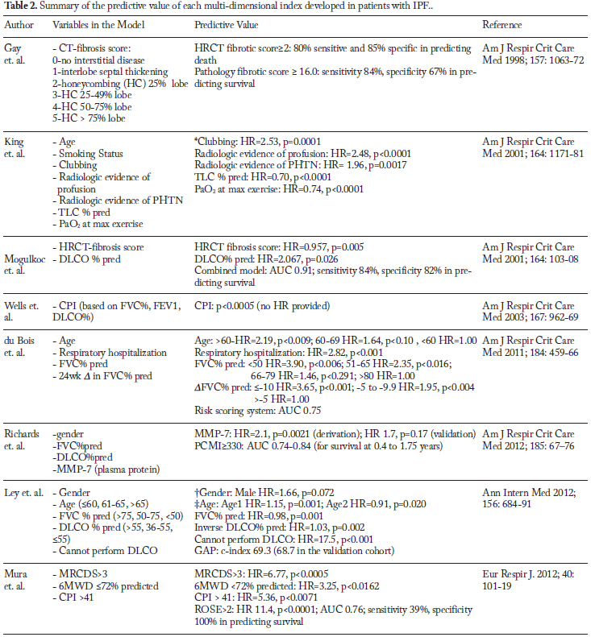

Slide 35
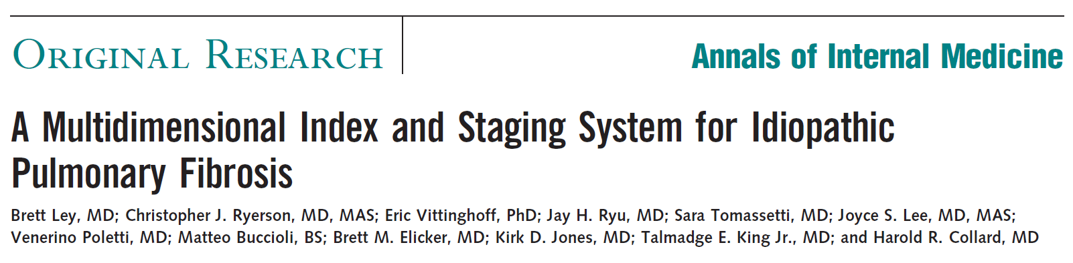
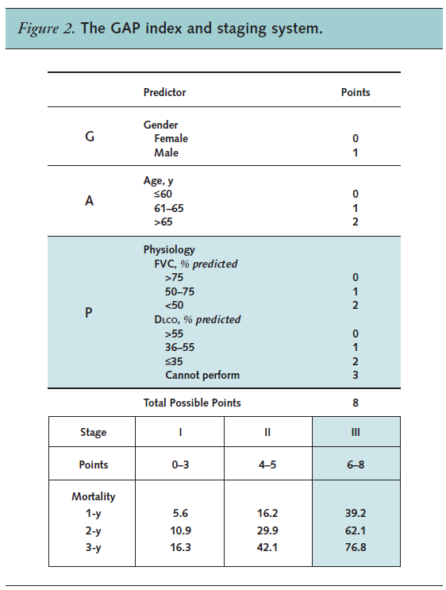

Slide 36
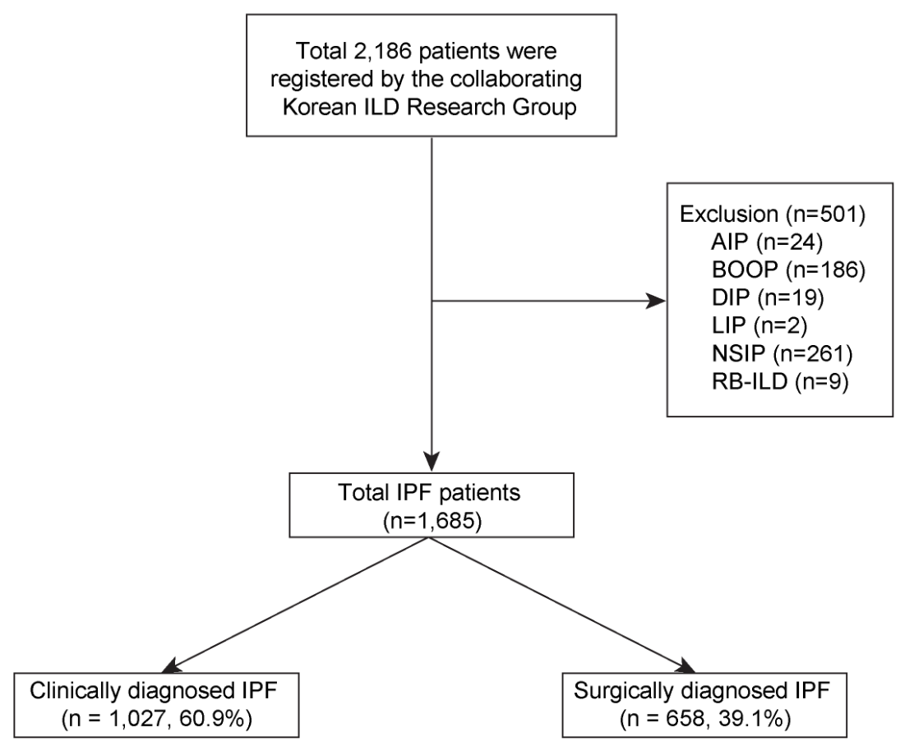

Slide 37
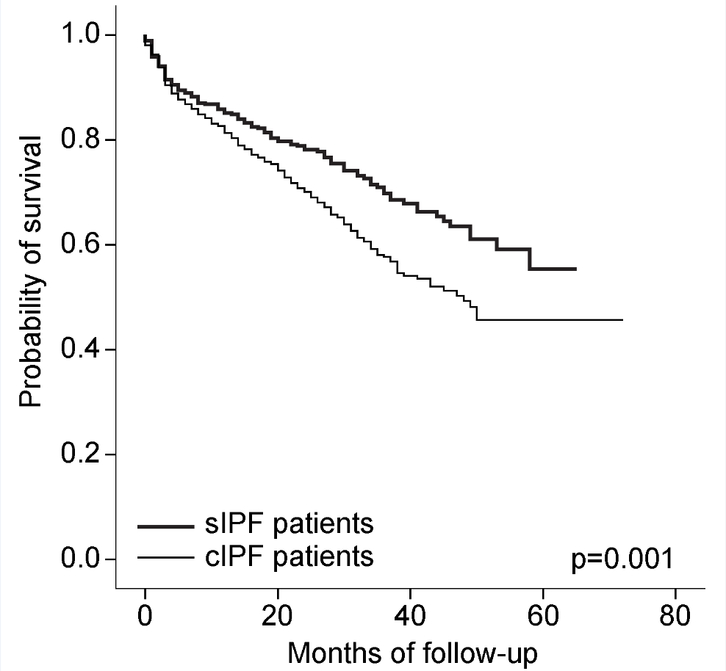

Slide 38


Slide 39


Slide 40

Notes:
경청해주셔서 감사합니다.

