Slide 1




Lung Cancer Screening
- NCCN Guidelines 2013
R4 임아영

Slide 2
Overview
Most lung cancer is diagnosed clinically when patients present with symptoms
  Usually have advanced lung cancer
Early detection of lung cancer is an important opportunity for decreasing mortality
  Recent data support using spiral (helical) low-dose computed tomography (LDCT) of the chest to screen select patients who are at high risk for lung cancer
The NCCN Lung Cancer Screening Panel developed this screening guideline based on the current body of evidence
Notes:
최근, 대다수의 lung cancer 는 환자에게서 symptom 을 동반하면서 진단되는 경우에서 진단
이러한 경우 진행된 stage 의 lung cancer
lung cancer 의 early detection 은 mortality 를 줄이는 데 중요
Lung cancer 의 high risk 환자에서 screening 에 spiral low-dose CT 를 사용하는 것이 도움이 된다는 최근의 연구들
NCCN lung cancer screening panel 은 2011년에

Slide 3
Overview
Screening for Non–Small Cell Lung Cancer
  Non–small cell lung cancer (NSCLC) : 85%
  Small cell lung cancer : 13% to 15%
CT as Part of a Screening Program
  Screening with CT should be part of a program of care and should not be performed in isolation as a free-standing test
Randomized Trials
  Essential for determining whether cancer screening decreases disease-specific mortality
Notes:
NSCLC 85%, SCLC 13-15% 라는 것을 고려해 볼 때 이 guideline 은 NSCLC 의 screening 에 중요
이 guideline 에서 CT 를 이용함.
Cancer screening 이 disease-specific motality 를 감소시키는 지를 알아보기 위한 RCT

Slide 4
Overview
  Multiple ongoing randomized trials are assessing LDCT screening for lung cancer among high-risk groups
    National Lung Screening Trial (NLST)
      Results from the NLST suggested that LDCT screening decreases disease-specific mortality
    Dutch Belgian randomized lung cancer screening trial (NELSON)
Notes:
lung cancer 의 high risk group 에서의 LDCT 를 이용한 lung cancer screening 에 대한 여러 개의 randomized trial 들이 수행되고 있다.

Slide 5
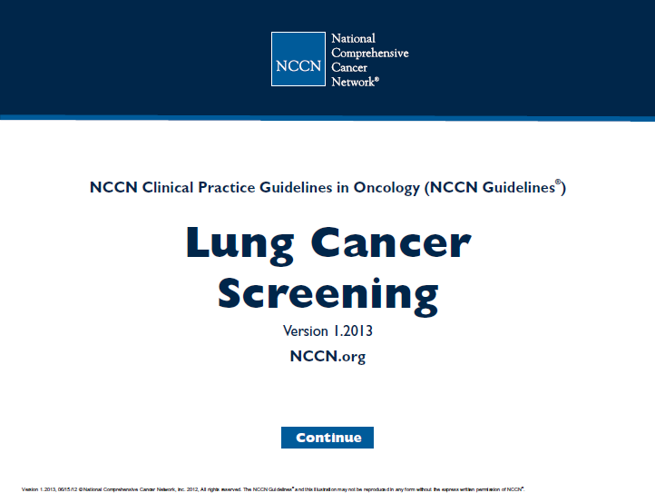

Slide 6
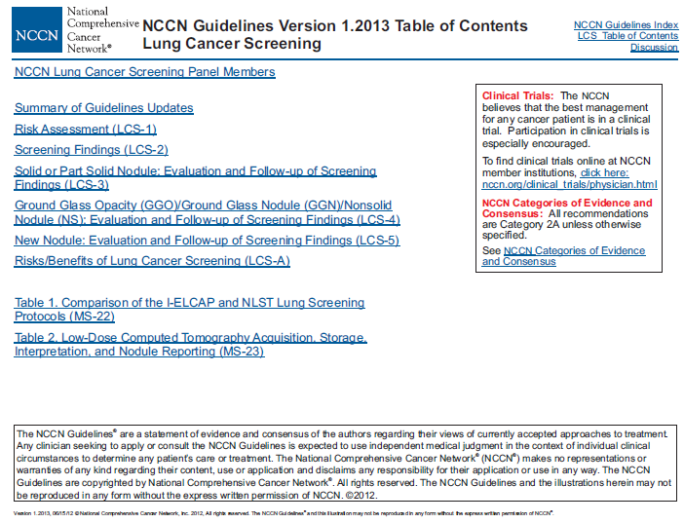

Slide 7
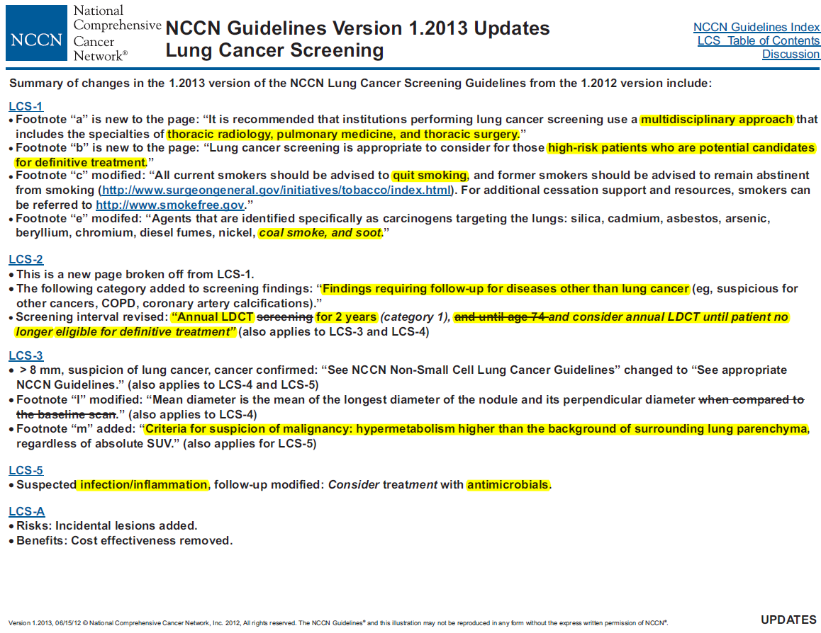

Slide 8
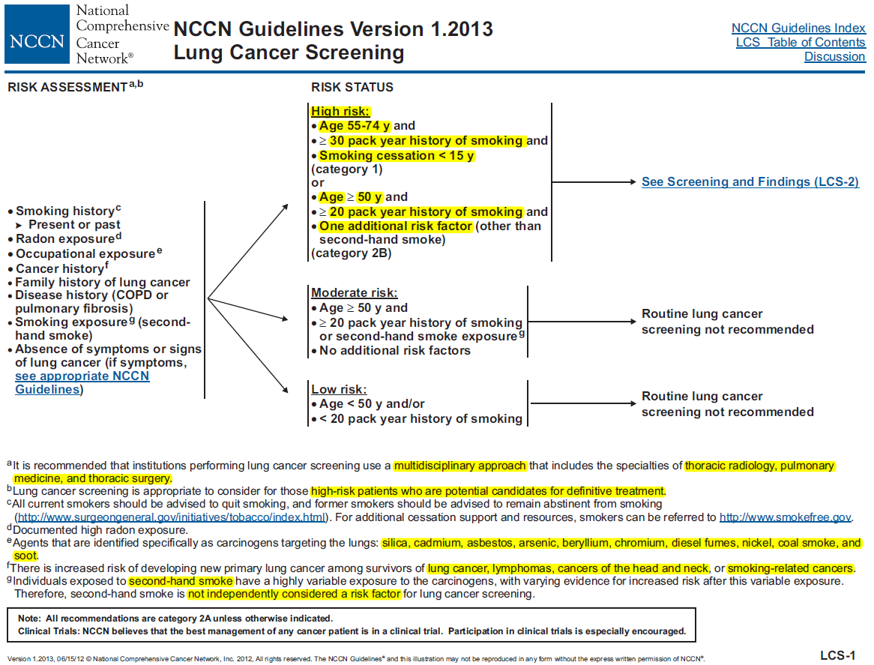
Added
Modified
Notes:
Risk assessment 에 대한 내용
Risk assessment 시에는 multidisciplinary approach 가 중요, 호흡기내과, 흉부외과, thoracic radiology 를 포함.
Difinitive treatment 의 대상이 될 수 있는 high risk patients 에게 적합
Smoking history -> 모든 current smoker 는 금연 권고, , former smoker 에 대해서는 금연 상태를 지속
Radon exposure 직업적 노출

Slide 9
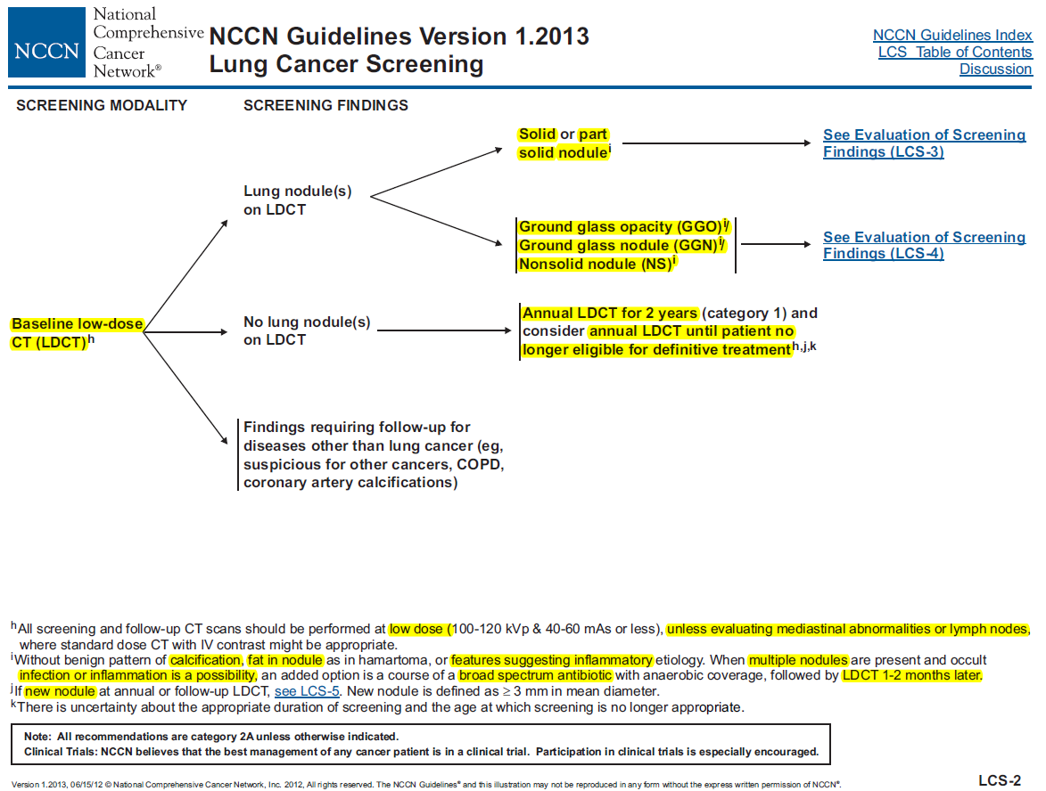
Modified from “until age 74”
until age 74
Added
Notes:
High risk patient 에서 Baseline LDCT 를 시행하는 것을 권고
-> 이 때 mediastinal abnormality 혹은 LN evaluation 이 필요한 경우라면 standard dose CT 가 적합.
(lung cancer 환자의 28”% 가 75-84세에 진단)

Slide 10
Image findings
Solid nodules
  Completely obscure the lung parenchyma
Part-solid nodules
  Present both ground-glass and solid components
GGO
  Focal nodular areas of increased lung attenuation through which normal parenchymal structures such as airways, vessels, and interlobular septa can be defined
GGN (synonym, nonsolid nodule)
  Hazy increased attenuation in the lung that does not obliterate the bronchial and vascular margins

Slide 11
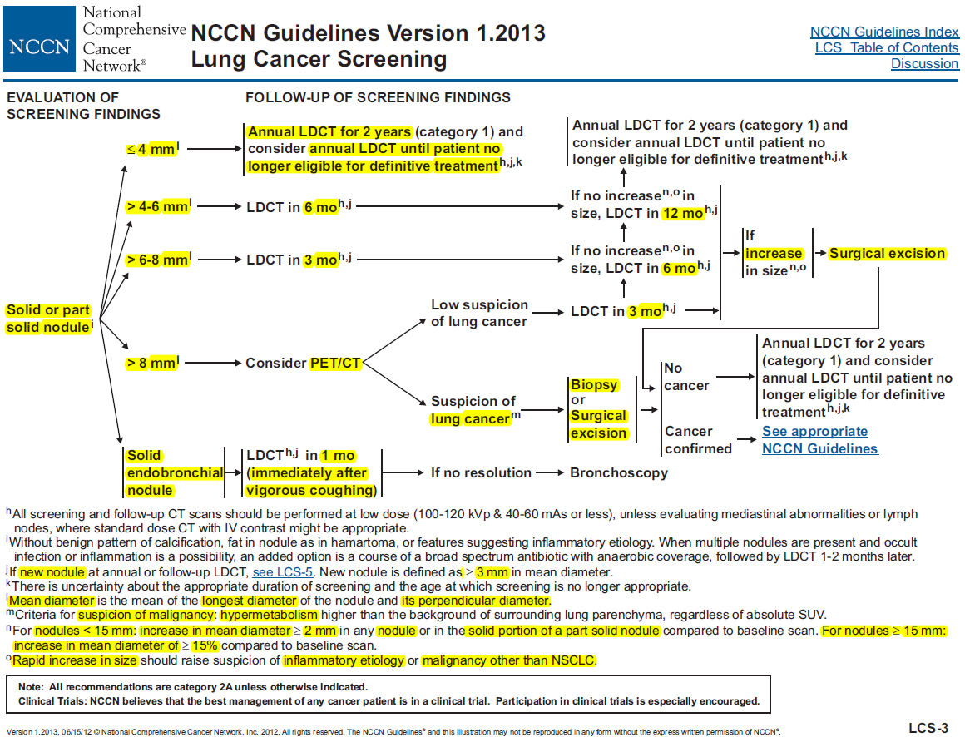
Added

Slide 12
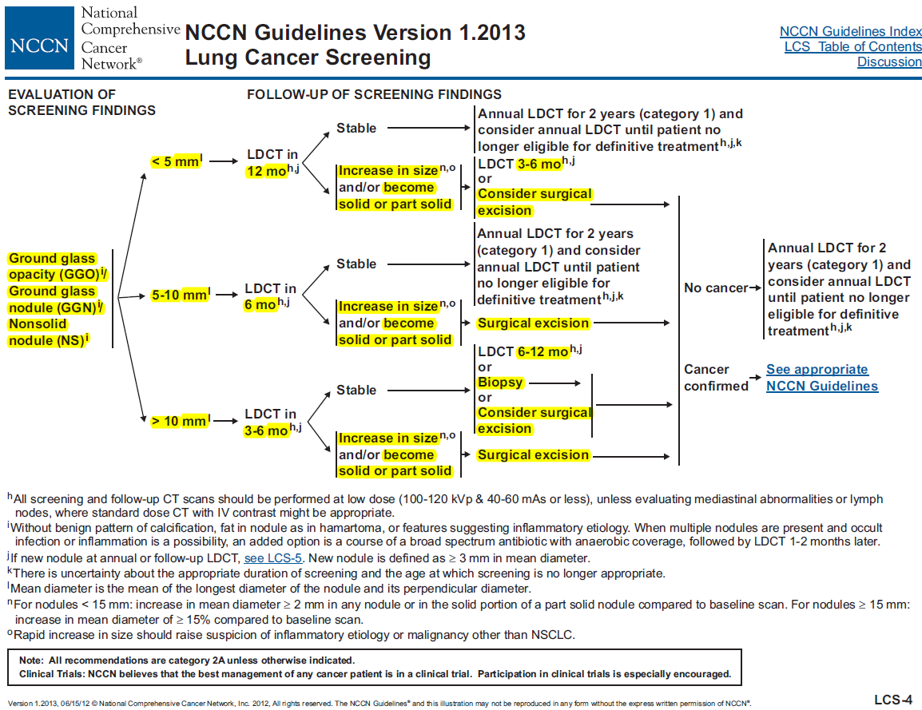

Slide 13
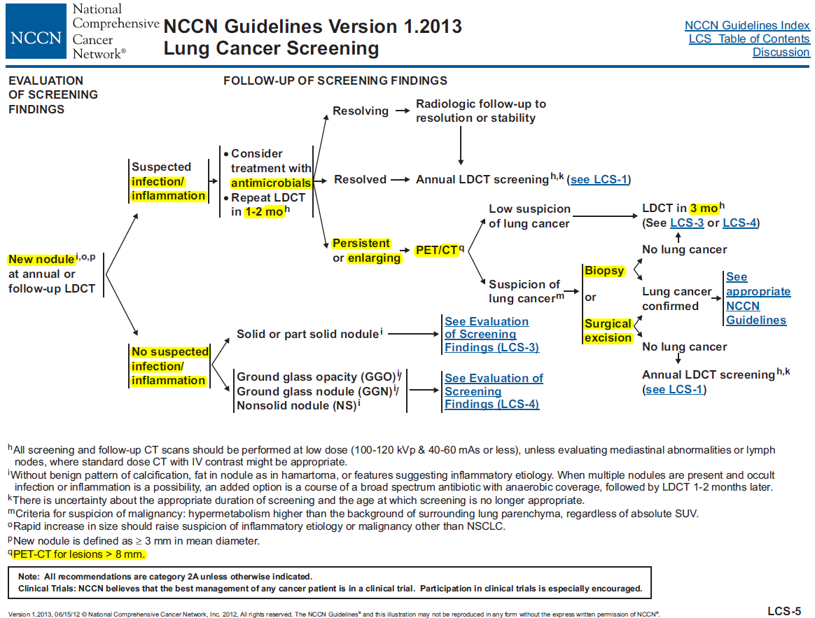

Slide 14
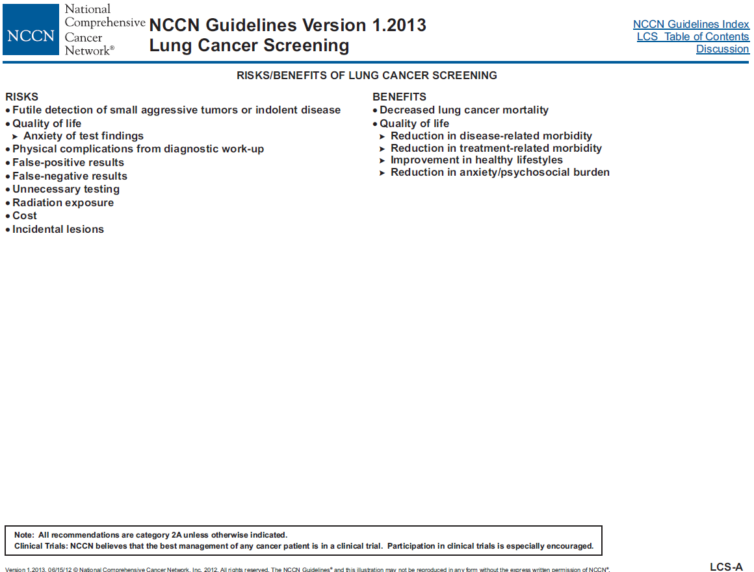

Slide 15
Benefits of Lung Cancer Screening
Oncology Outcomes
  After a clinical diagnosis of NSCLC, survival is directly related to stage at diagnosis
  Nonrandomized Trials
    I-ELCAP study
      Screened with baseline and annual LDCT scans
      High percentage of stage I cancers (85%) were detected using LDCT
      Annual helical LDCT screening can detect lung cancer that is curable

Slide 16
Benefits of Lung Cancer Screening
  Randomized Trials
    National Lung Screening Trial (NLST)
      Prospective, randomized lung cancer screening trial comparing annual LDCT scan with annual chest radiograph for 2 years
      Enrolled 53,454 high-risk participants aged 55 to 74 years who had smoking history of at least 30 pack-years. If subjects were no longer smoking tobacco, they had to have quit within the previous 15 years
      Annual LDCT decreased the relative risk of death from lung cancer by 20%
      The first randomized study showing an improvement in either disease-specific or overall mortality when using a lung cancer screening program

Slide 17
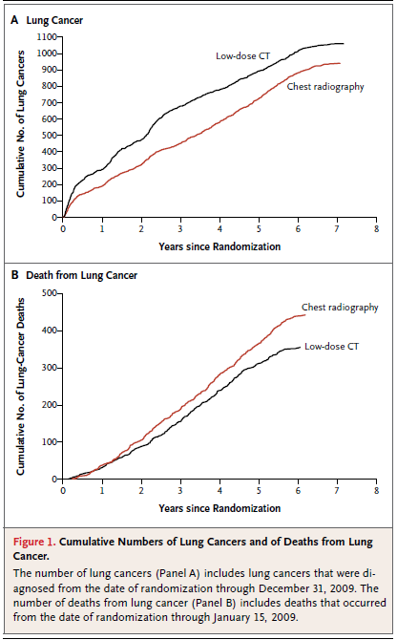
Benefits of Lung Cancer Screening
Relative reduction in the rate of death from lung cancer with lowdose CT screening of 20.0% (95% CI, 6.8 to 26.7; P = 0.004)
The National Lung Screening Trial Research Team, NEJM, 2011
Notes:
There were 247 deaths from lung cancer per 100,000 person-years in the low-dose
CT group and 309 deaths per 100,000 person-years in the radiography group,
representing a relative reduction in mortality from lung cancer with low-dose CT
screening of 20.0% (95% CI, 6.8 to 26.7; P = 0.004).

Slide 18
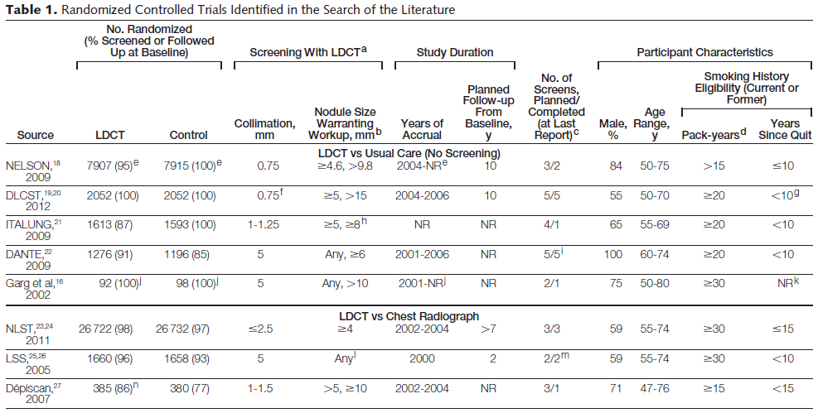
Benefits of Lung Cancer Screening
Peter B. et al. JAMA, 2012
Notes:
Abbreviations: DLCST, Danish Lung Cancer Screening Trial; LDCT, low-dose computed tomography; LSS, Lung Screening Study; NELSON, Dutch Belgian Randomised Lung Cancer
Screening Trial; NLST, National Lung Screening Trial; NR, not reported.
aAll studies had a protocol in place except LSS. Studies by NELSON, DANTE, and Garg et al had a protocol reported; however, specific details on adherence or deviation from the protocol
or actual procedures used were not reported. For NLST, “ . . . trial radiologists developed guidelines for diagnostic follow-up, but no specific evaluation approach was mandated.”23
bIndicates first the largest-size nodule warranting additional imaging and, second, the largest-size nodule warranting diagnostic testing.
cAll studies had screening conducted annually except the study by NELSON, which had planned screening at years 1, 2, and 4.
dDefined as the number of cigarette packs (20 cigarettes per pack) smoked per day multiplied by the number of years smoked.
eRandomization is ongoing with a target accrual of 16 000 participants.
f Collimation=160.75 mm.
gFormer smokers had to have quit after the age of 50 years and less than 10 years ago.
hDiagnostic workup was a referral to a positron emission tomography scan.
iThe median follow-up was 33.7 months and only 161 participants (6.5% of those screened or followed up at baseline) had 5 or more years of follow-up. Baseline data are mainly reported.
jTarget accrual of 400 participants in total was planned.
kStudy does not specify a maximum time since quitting.
lThe size of the noncalcified nodule to warrant further imaging was increased to 4 mm at year 1 to reflect evolving practice.
mIn the original design, 1 screen was planned; however, it was later amended to 2 screens (baseline and 1 repeat).
nSix patients randomized to chest radiography crossed over to receive LDCT at baseline.

Slide 19
Benefits of Lung Cancer Screening
Quality of Life
  Reduction in Disease-Related Morbidity
    Disease-related symptom burden would be decreased in patients whose lung cancer is detected early
    Identify other clinical conditions unrelated to lung cancer that require follow-up -> decrease the overall disease burden
  Reduction in Treatment-Related Morbidity
    LDCT screening decreases the number of cases of advanced lung cancer, and therefore may decrease treatment-related morbidity

Slide 20
Benefits of Lung Cancer Screening
  Alterations in Health That Affect Lifestyles
    Increase smoking cessation rates
  Reduction in Anxiety and Psychological Burden
Risks of Lung Cancer Screening
  False-Positive Results
    False-positive rates ranging from 10% to 43%
    Leading to unnecessary testing, unnecessary invasive procedures (including surgery), increased cost
  False-negative results
    Delay or prevent diagnosis and treatment because of a false sense of good health

Slide 21
Benefits of Lung Cancer Screening
  Futile detection of small aggressive tumors
    Which have already metastasized, preventing meaningful survival benefit from screening
  Futile detection of indolent disease
    Would never have harmed the patient who subsequently undergoes unnecessary therapy
  Indeterminate results
    leading to additional testing
  Radiation exposure
  Physical complications from diagnostic workup

Slide 22
Summary
Lung cancer screening with LDCT is a complex and controversial topic, with inherent risks and benefits
Results from the large, prospective, randomized NLST showed that screening with LDCT decreased the relative risk of death from lung cancer by 20% in a select group of high-risk individuals
The NCCN Lung Cancer Screening Panel recommends helical LDCT screening for select individuals at high risk for lung cancer based on the NLST results,
-> Recommendations for evaluating and following-up nodules detected on LDCT screening (e.g., solid and part-solid nodules)
>8mm : PET-CT

Slide 23
References
Lung cancer screening, Version I.2013 ; NCCN guidelines
Aberle DR et al. Reduced lung-cancer mortality with low-dose computed tomographic screening. N Engl J Med. 2011;365:395-409
Peter B. Bach et al. Benefits and Harms of CT Screening for Lung Cancer. JAMA. 2012; 307(22):2418-2429

