Slide 1

Mechanical Ventilation Management During
Extracorporeal Membrane Oxygenation for Acute
Respiratory Distress Syndrome: A Retrospective
International Multicenter Study
Matthieu Schmidt
Critical Care Medicine, March 2015
R2 이세주

Slide 2
Introduction
Mechanical ventilation – cornerstone of management for ARDS patients
ECMO – derives from conventional cardiopulmonary bypass circuits
-technological advances, promising outcomes duing H1N1 pandemic
ECMO -> ultraprotective ventilation strategies(minimizing ventilation induced lung injury

Slide 3
Introduction
Ventilation strategies during ECMO – little attention, little consensus regarding optimal ventilator support
To describe MV settings for ARDS with ECMO

Slide 4
PATIENTS AND METHODS
3 university hospital (45-bed ICU in Melbourne, Australia (The Alfred Hospital), a 49-bed ICU in Sydney, Australia(Royal Prince Alfred Hospital), and a 26-bed ICU in Paris, France (La Pitie-Salpetriere Hospital).

Slide 5
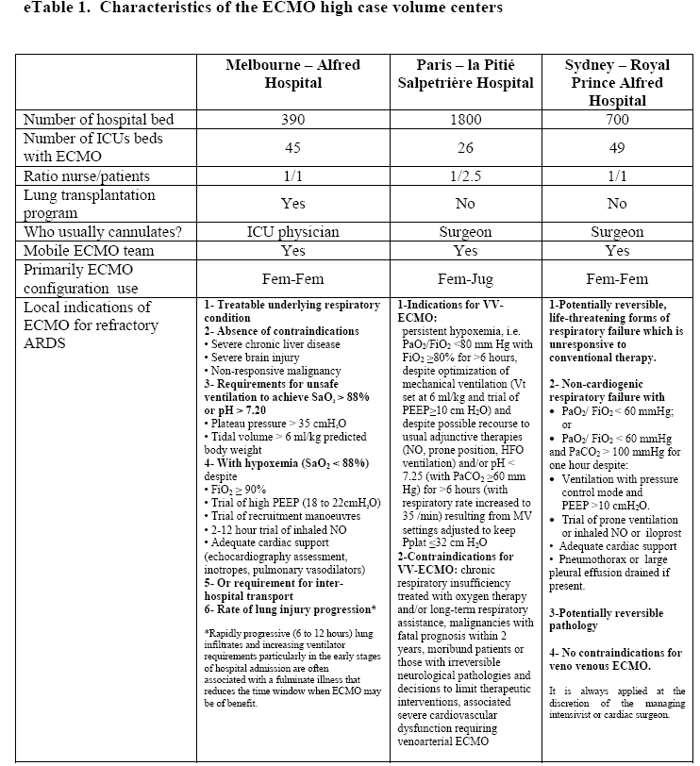

Slide 6
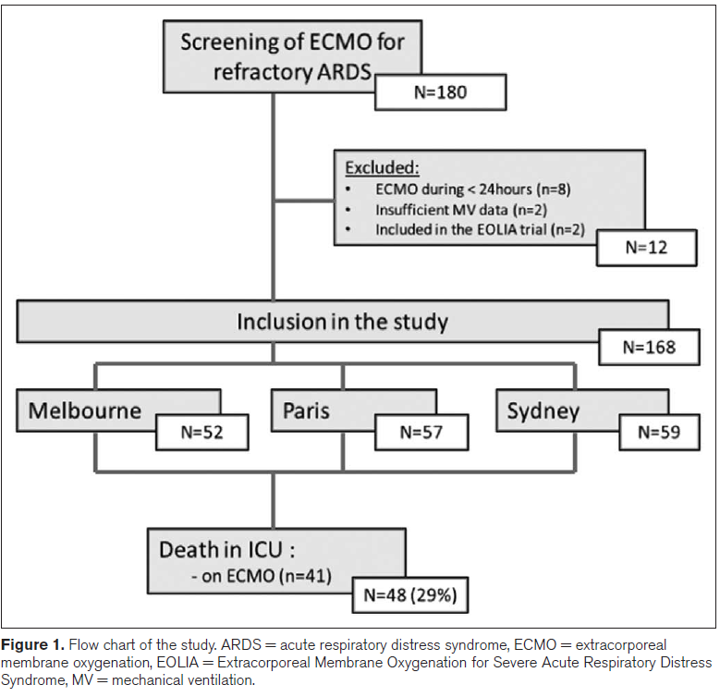

Slide 7
PATIENTS AND METHODS
Demographic data, APACHE II ,SOFA : at the time of ECMO initiation
RASS, ventilator settings, ECMO settings, blood gas, Hb, complication, tracheostomy
Status at ICU discharge, duration of MV, ECMO

Slide 8
PATIENTS AND METHODS
primary endpoint : management of
MV during ECMO, including mode, VT, plateau pressure, and PEEP.
  “pre-ECMO,” “day 1–3,” “day 4–7,” “day 8–14,” “day 15–21,” and “day 22–28.”
Secondary endpoint : whether any MV variables either before or during early ECMO support were associated with ICU mortality.

Slide 9
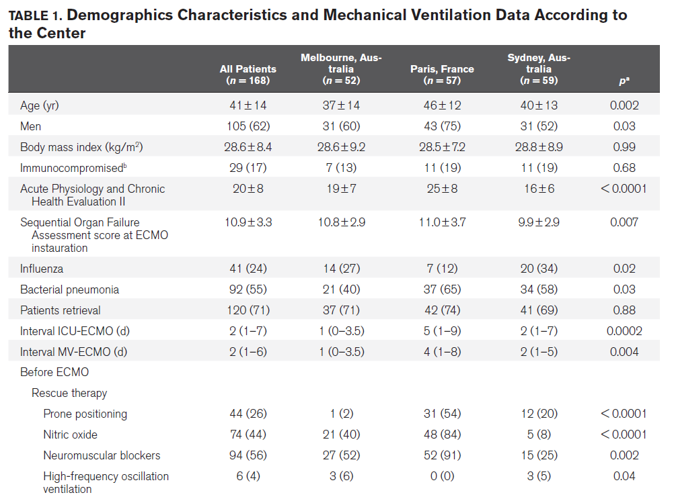
Result

Slide 10
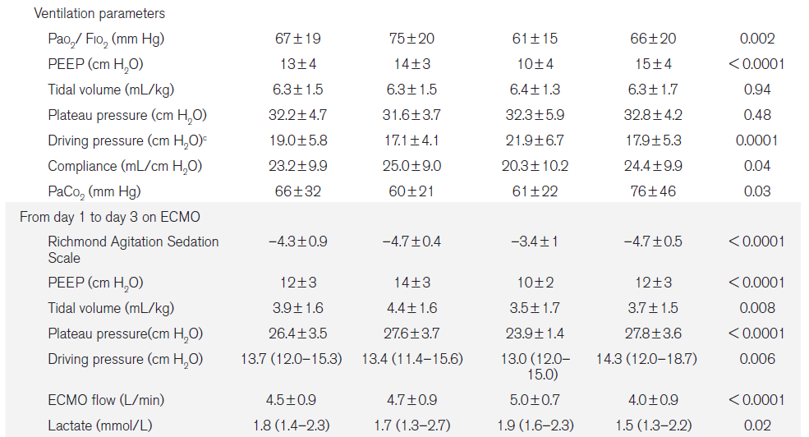

Slide 11
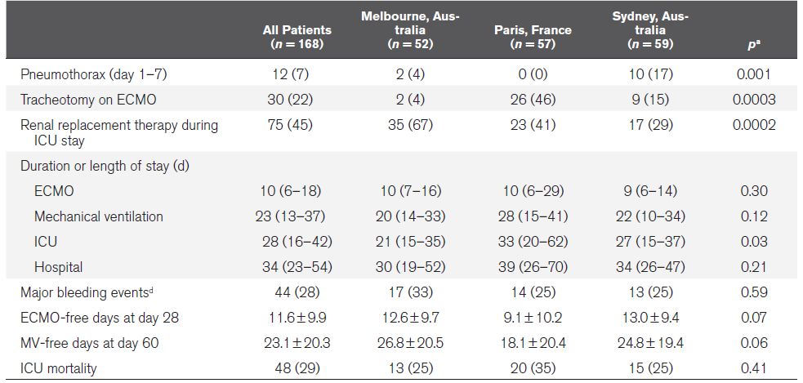
RESULT

Slide 12
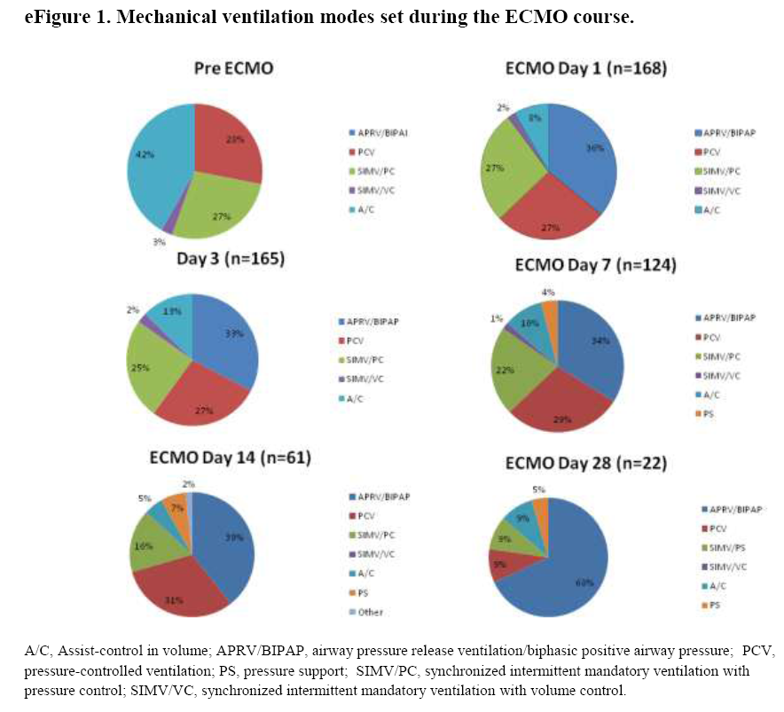

Slide 13
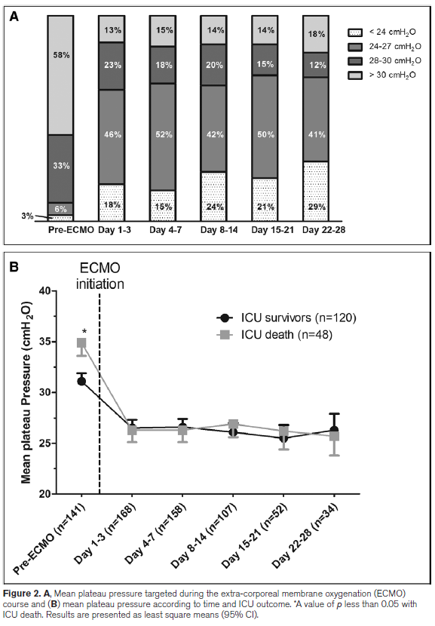
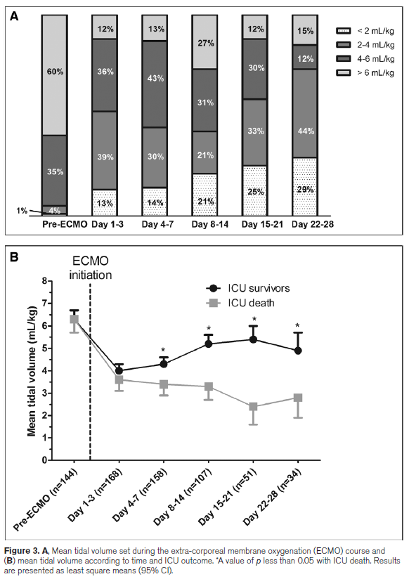

Slide 14
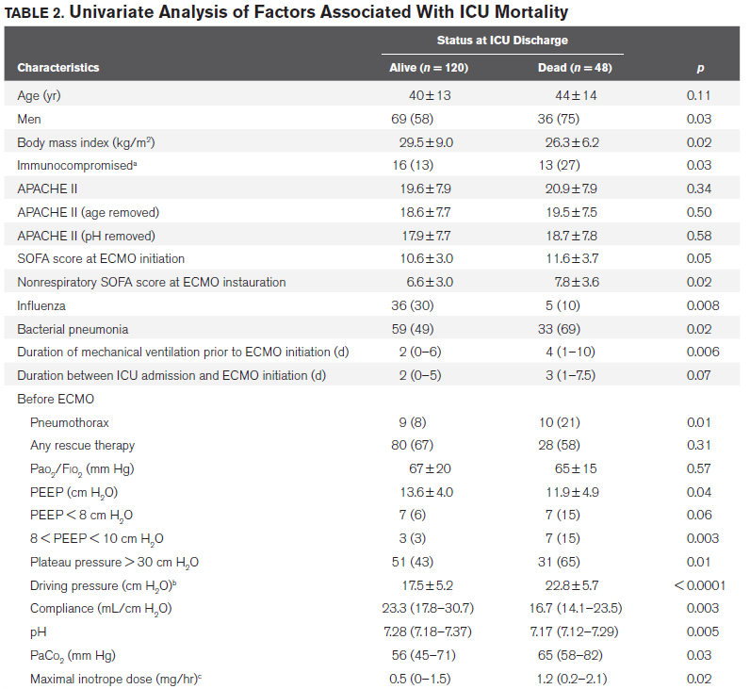

Slide 15
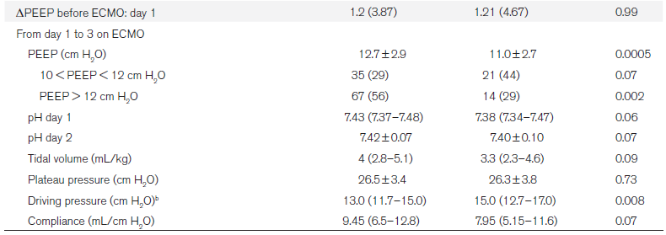
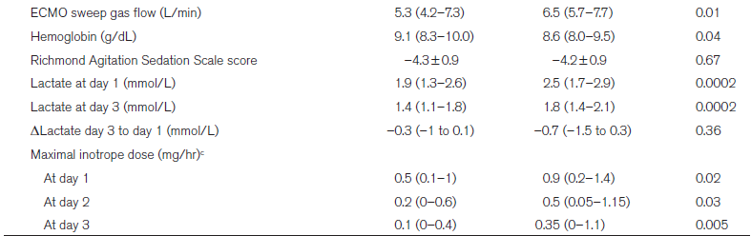
RESULT

Slide 16
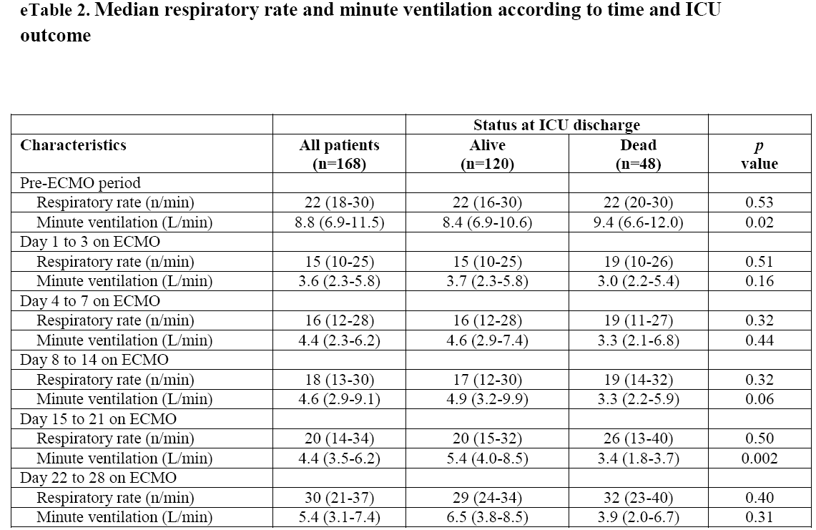

Slide 17
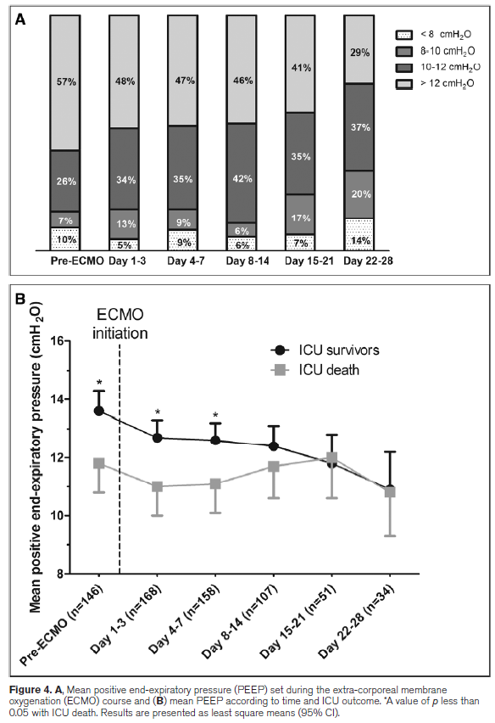

Slide 18
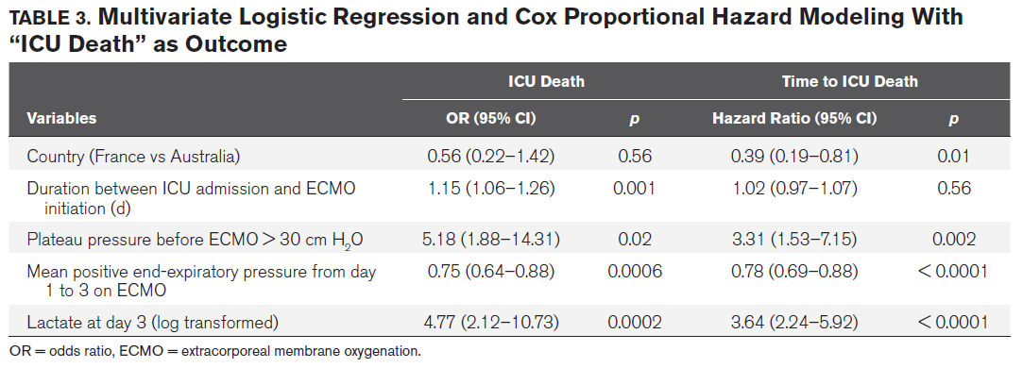

Slide 19
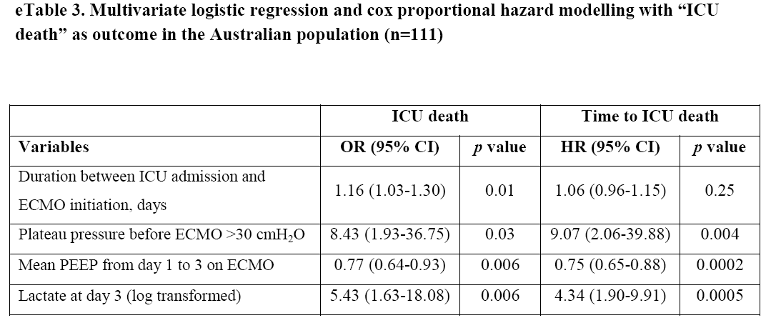

Slide 20
Discussion
ECMO -> Provision of “ultraprotective” MV, but ideal MV strategy on ECMO : unknown
MV settings varied significantly among 3 ECMO centers
high plateau pressure prior to ECMO, Lower PEEP during first 3 days on ECMO -> ICU mortality ↑
Assist volume control ventilation : most common MV mode for ARDS
PCV used in nearly all cases during 1st week(monitoring recovery of lung compliance)

Slide 21
Discussion
Limiting plateau pressure after ECMO by decreasing VT on day 1 to 3 to less than 4 mL/kg ideal body weight(ultraprotective ventilation)
Extracorporeal Life Support Organization : 10cm H2O PEEP during ECMO
Median PEEP during first 3 days: 12+_3cm H2O

Slide 22
Discussion
High PEEP
early high PEEP level and reduced mortality
Reduced atelectasis, improved V/Q matching, especially <4mL/kg
Very low VT(<2ml/kg) : higher PEEP maintain convective ventilation -> preventing atelectasis
Association between Higher VT(<6mL/kg) after day 4 & ICU survival -> support impact of the respiratory compliance on outcome

Slide 23
Other prognostic factors
Duration of MV prior to ECMO initiation, mortality(within 7 days?)
Further trials on the use and optimal timing ECMO support in ARDS, value & timing of other rescue therapies before cannulation
Shorter time to ICU death in Australia than France – hard to explain only by MV differences

Slide 24
Discussion
Limitation
  MV settings were collected as point data once a day although MV is continuous, dynamic function of practice
Data of First 3 days of ECMO support -> mortality analysis by reduced cohort size for accurate multivariate analysis

Slide 25
Conclusion
MV strategies after day 3 on ECMO : yet to be determined
Early higher PEEP during ECMO support -> decreased mortality

Slide 26


