Slide 1

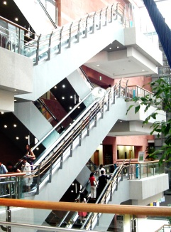


Pulmonary thromboembolism
2013.5.3 MGR
호흡기 내과 이 인 선

Slide 2
Contents
Clinical Course
Diagnosis of VTE
Treatment of VTE (ACCP 9th Guideline)
New anticoagulants

Slide 3
Incidence
VTE = DVT and/or PE
> 80% of PE originates in deep vein of leg
    Iliofemoral veins are the source of most clinically recognized PE
Incidence : VTE=143, DVT= 93, PE=50 per 100,000 population
  ( Norway, between 1995 and 2001 )
In 26 to 67% of untreated proximal DVTs → Clinical PE
Mortality : 11% to 23%
If treated, PE and mortality are 5% and 1%, respectively
Notes:
Acute PTE는 흔하고 때로는 fatal 할수 있는 질환으로서 즉각적인 진단과 치료를 통해 mortalit 를 낮출수 도 있는 질환입니다.

Slide 4
Risk factors
Acquired disoders
Pregnancy
Oral contraceptives
Hormone replacement therapy
Tamoxifen, Thalidomide, Lenalidomide
Immobilization
Congestive failure
Antiphospholipid antibody syndrome
Myeloproliferative disorders
Polycythemia vera
Essential thrombocythemia
Paroxysmal nocturnal hemoglobinuria
Inflammatory bowel disease
Nephrotic syndrome
Malignancy
Presence of a central venous catheter
Surgery, especially orthopedic
Trauma
Inherited thrombophilia
Factor V Leiden mutation
Prothrombin gene mutation
Protein S deficiency
Protein C deficiency
Antithrombin (AT) deficiency
Rare disorders (Dysfibrinogenemia)

Slide 5
Risk factors
The six most prevalent pre-existing medical characteristics
  More than 48 hours of immobility in the preceding month — 45 percent
  Hospital admission in the past three months — 39 percent
  Surgery in the past three months — 34 percent
  Malignancy in the past three months — 34 percent
  Infection in the past three months — 34 percent
  Current hospitalization — 26 percent
Only 11 % of the 587 episodes of VTE had none of these six characteristics present, while 36 and 53 percent had 1 to 2 and ≥3 risk factors, respectively.

Slide 6
Diagnosis of Pulmonary Embolism
Pulmonary embolism CT
D-dimer level < 500ng/mL : helpful in exclusion
  false negative in >15% of pt with high probability
Echocardiography
  Only 30 to 40 % of pts with PE have echo abnormalities suggestive of acute PE
    Increased right ventricular (RV) size
    Decreased RV function
    Tricuspid regurgitation
Pulmonary Angiography
  Definitive “gold standard’

Slide 7
Wells criteria
Wells criteria :
  high >6, moderate 2~6 , low < 2
Modified Wells criteria
  unlikely (score ≤4) or likely (score > 4 )
  Clinical symptoms of DVT (3 points)
  Other diagnoses less likely than PE (3 points)
  Heart rate >100 (1.5 points)
  Immobilization ≥3 days or surgery in previous four weeks (1.5 points)
  Previous DVT/PE (1.5 points)
  Hemoptysis (1 point)
  Malignancy(receiving tx, in the last 6 m or palliative) (1 point)
Notes:
DVT sx( minimum leg swelling and pain with palpation of the deep veins

Slide 8
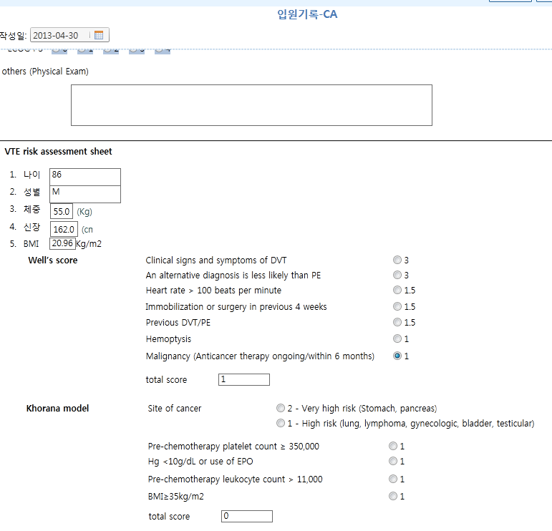
종양내과
입원 기록

Slide 9
Diagnosis of DVT
Clinical assessment of pretest probability
low pretest probability
  Moderately or highly sensitive D-dimer
    (-) → no further evaluation
    (+) → CUS > whole leg US
  Compression US of proximal veins
    (-) → no further evaluation
    (+) → treatment
Moderate pretest probability
  Highly sensitive D-dimer
    (-) → no further evaluation
    (+) → CUS or whole leg US
  proximal CUS or whole-leg US
    (-) → repeat CUS in 1 week or moderate or highly sensitive D-dimer
    (+) → treatment
Notes:
rather than by performing the same diagnostic tests in all patients (Grade 2B)

Slide 10
Diagnosis of DVT
High pretest probability
  moderately or highly sensitive D-dimer assays should not be used as stand alone tests to rule out DVT
  single proximal CUS (-) + D-dimer (-)
  → repeat proximal CUS in 1 week or whole-leg US
Suspected first lower extremity DVT
  Against the routine use of CT venography or MRI
Negative serial proximal CUS
Negative D-dimer + Negative initial proximal CUS
  no further testing
proximal US is positive for DVT→ treatment

Slide 11
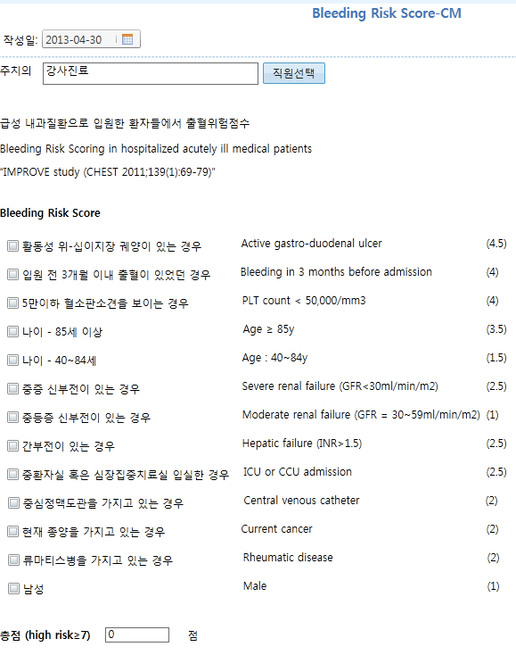
Bleeding Risk Scoring in hospitalized acutely ill medical patients
“ IMPROVE “ study ( CHEST 2011;139(1);69~79)
Risk score
> 7.0 points.

Slide 12
Risk Benefit ratio
High-risk condition with high risk of bleeding
  –AF and high risk of ischemic stroke
  –Recurrent intracranial bleeding on anticoagulation
Low-risk condition with high risk of bleeding
  –Proximal, unprovoked DVT
  - 10% recurrence rate of VTE one year after stopping
  –Recurrent, transfusion-required, lower GI bleeds
  –GI bleeding: 2/3 of major bleeding on anticoagulants

Slide 13
Risk Benefit ratio
Low-risk condition with low risk of bleeding
  –First unprovoked DVT
  –After 3 months of treatment
  –Risk of fatal PE : between 0.19 and 0.49% per year
  –Risk of recurrence : 10% the first year after stopping
  –Bleeding risk during extended Tx with warfarin 0.9 to 1.4% / yr
Very low-risk condition
  Distal DVT and a transient and removable risk factors
  Surgery
  Risk of recurrence : 1% per year during 6 years of F/U

Slide 14
Risk of Bleeding
Risk Indicators
  –Old age
  –Renal dysfunction
  –Recent history of major bleeding
  –Previous stroke
  –Anemia
  –Ethanol abuse

Slide 15
Anticoagulation treatment
High clinical suspicion of acute VTE
  Parenteral anticoagulation while awaiting the results of diagnostic tests
Intermediate clinical suspicion of acute VTE
  Parenteral anticoagulation ( the results of test - delayed for more than 4 hour)
Low clinical suspicion of acute VTE
  Awaiting the results of diagnostic test( expected within 24 hour)
Acute PTE with hypotension (SBP <90mmHg) without bleeding risk
  Systemic thrombolytic therapy (short infusion: 2 hour infusion > 24 hour)

Slide 16
Anticoagulation treatment
Initial treatment
  Parenteral anticoagulation (LMWH, fondaparinux > IV UFH, SC UFH)
  LMWH once daily > twice –daily administration
  Early initiation of VKA ( same day as parenteral therapy is started)
  parenteral therapy for a minimum of 5 days, until the INR > 2.0, at least 24 hour
VKA therapy
  Healthy as out patient
    VKA 10mg initial 1~2day → INR
    Stable INR-> every 12 weeks f/u (rather than 4weeks f/u )
    INR target 2~3 → f/u INR± 0.5 → same dose
  VKA toxicity
    INR 4.5~10 + bleeding evidence(-)→ Against routine vit K
    INR > 10 + bleeding evidence(-) → VKA po
    Bleeding (+) → FFP + vit K 5~10mg IV slowly

Slide 17
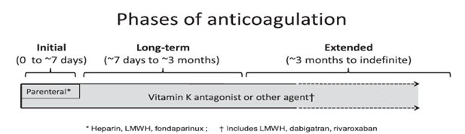
Duration of anticoagulation therapy
Long term therapy
  DVT of leg without cancer → VKA therapy > LMWH > dabigatran or rivaroxaban
  DVT of leg with cancer → LMWH > VKA
Extended therapy
  Same anticoagulant chosen for the first 3months

Slide 18
Optimal Duration of Anticoagulants
Diagnosis | Duration if available
PE & Proximal DVT of leg provoked by surgery or nonsurgical risk factor | 3 mo
Isolated distal DVT of leg provoked by surgery or nonsurgical risk factor | 3 mo
DVT of leg with active cancer + Bleeding risk is not high | Extended anticoagulation
+ Bleeding risk is high | Extended anticoagulation

Slide 19
Optimal Duration of Anticoagulants
Diagnosis | Duration if available
Unprovoked PE & DVT of the Leg (isolated distal or proximal) | At least 3 mo and reassess
First VTE (unprovoked PE & proximal DVT of leg) + Low or moderate bleeding risk | Extended (> 3mo) & reassess at periodic interval (risk-benefit ratio)
+ High bleeding risk | 3 mo
First VTE (unprovoked distal DVT of leg) + Low or moderate bleeding risk | 3 mo
+ High bleeding risk | 3 mo
Second unprovoked VTE + Low or moderate risk of bleeding | Extended (> 3mo)
+ High risk of bleeding | 3 mo

Slide 20
New oral anticoagulant agents (NOACS)
A Brief history of anticoagulant therapy
1899 : Aspirin
• 1930s : UFH (1936)
  antithrombin-dependent inhibition of factor Xa and IIa
• 1940s : VKA (Warfarin 1954)
  indirectly affect synthesis of multiple coagulation factors
• 1980s : LMWH
  AT-dependent inhibition of factor Xa
• 2000s :
Direct factor IIa inhibitors : Dabigatran (PRADAXA®)
Direct factor Xa inhibitors :Rivaroxaban (XARELTO ®)
Direct factor Xa inhibitors : Apixaban (ELIQUIS® 2011)
Indirect factor Xa inhibitor: Fondaparinux
Notes:
overcome some limitations of VKA
- drug interaction, injection and for dose adjustments by INR
directed against factor Xa or against thrombin
Dabigatran (Pradax)
Apixaban
Rivaroxaban (Xarelto)
Fondaparinux

Slide 21
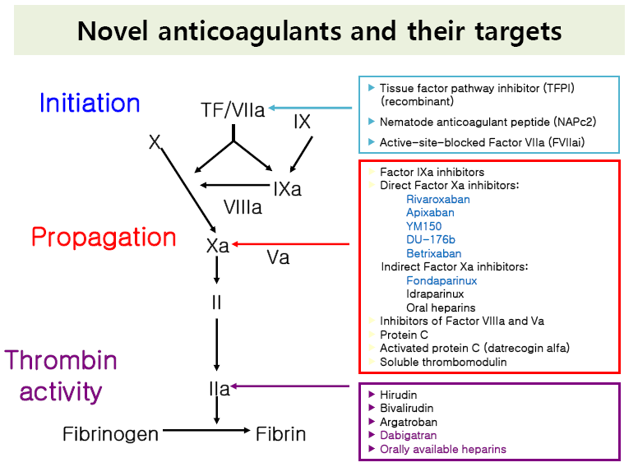
Notes:
Coagulation의 initication 과 propagation 을 억제 시키는 anticoagulants.
Targeting thrombin , attenuate fibrin formation.
Direct 와 Indirect
Direct factor Xa inhibitor : Small molecules , reversibly block the active site of factor Xa

Slide 22
Warfarin vs New Agent
 | Warfarin | Dabigatran
Onset | Slow | Rapid
Monitoring | INR | No
Drug interaction | Codarone, Rifampin, Antibiotics | No major interaction
Dietary interaction | Vitamin K | No
Antidote | Vitamin K | NO
Is there no remaining role for warfarin?
  Severe renal impairment (e.g. CrCl <30 ml/min)
  Patients who require treatment with a drug that is contraindicated
  Another indication for warfarin (e.g., mechanical heart valve)
  Cannot afford one of the new oral anticoagulants
  Antidote
Notes:
적절한 해독제가 없다는 단점
Dabigartan 은 아직 해독제가 없지만, 1/3만 단백결합되어있어 나머지는 투석으로 제거 될수 있으며 2~3시간 charcoal hemofiltration 시 60% 제거 가능
Rivaroxaban 90%, Apixaban 87% 가 단백 결합되어있어 투석으로 잘 제거되지 않는다.

Slide 23
Insurance
Dabigatran (PRADAX ®)
  110MG/C( 1,705원/C) , 150MG/C( 1,758원/C)
  비판막성 심방세동 환자에서 뇌졸중 및 전신 색전증의 위험 감소 (와파린에 과민반응, 금기, INR 조절 실패 등)로 소견서를 첨부토록 함.
Rivaroxaban (XARELTO ®) insurance in Korea
  10mg/T ( 3,563원/T) , 15mg/T ( 3,563원/T) , 20mg/T (3,563원/T)
  하지의 주요 정형외과 수술(슬관절 또는 고관절 치환술)을 받은 성인 환자의 정맥혈전색전증 예방
  비판막성 심방세동 환자에서 뇌졸중 및 전신 색전증의 위험 감소
  (와파린에 과민반응, 금기, INR 조절 실패 등)로서 소견서를 첨부토록 함)
  3. 심재성 정맥혈전증 및 폐색전증의 치료
  4. 심재성 정맥혈전증 및 폐색전증의 재발 위험 감소
Notes:
시판은 되고 있으나 보험 적용이 안되고 있다.
Apixaban 은 유럽에서 수술후 환자의 DVT 예방으로 승인되었다. 아직 시판되고 있지 않다.

Slide 24
Recurrence of VTE with anticoagulation
“DASH” rule
  After Tx with VKA for at least 3 m (1880 Pts with unprovoked VTE)
  Predict recurrence risk : score <=1, low risk
  Life-long anticoagulation can be avoided in half of patients.
Characteristic | Score
D-dimer abnormal 30 d after stopping anticoagulant therapy | +2
Age <= 50 | +1
Sex: male | +1
Hormone-use provoked VTE | - 2
Final score | Annual risk (95% CI)
<= 1 | 3.1% (2.3–3.9)
2 | 6.4% (4.8–7.9)
>=3 | 12.3% (9.9–14.7)

Slide 25
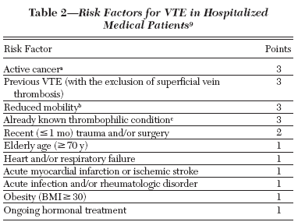
Padua Prediction Score
High risk of score >= 4
VTE risk in 1180 consecutive medical patients
  “Low risk” pts (n=711): 0.3 %
  “High risk” pts receiving adequate in-hospital thromboprophylaxis (n=186): 2.2 %
  “High risk” pts not receiving adequate in-hospital thromboprophylaxis (n=283): 11.0 %

Slide 26
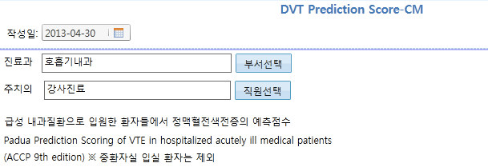
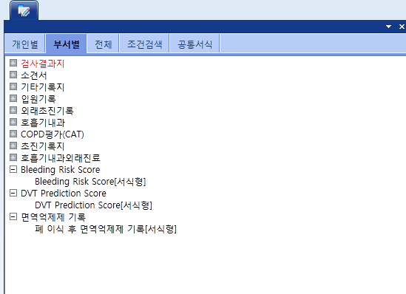
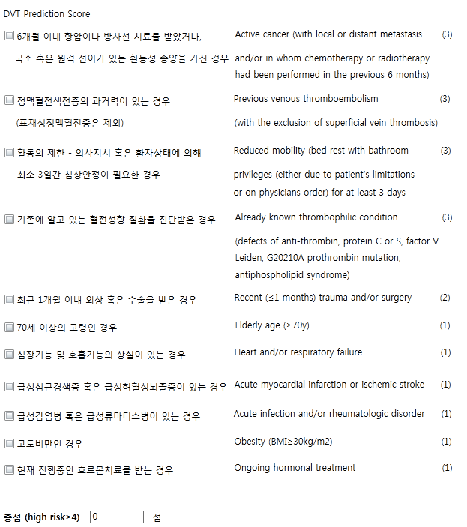
Padua Prediction Scoring of VTE in hospitalized acutely ill medical patients
(ACCP 9th edition)
중환자실 입실 환자는 제외

Slide 27
Prevention of VTE in medical patients
 | Clinical risk assessment | treatment
Acute ill patients | Increased risk for thrombosis | LMWH or LDUH BID or TID, Fondaparinux
 | Low risk for thrombosis | Against routine use of thromboprophylaxis
 | Bleeding or high risk bleeding | Against routine use of thromboprophylaxis
 | Increased risk for thrombosis + high risk for bleeding | Mechanical thromboprophylaxis (GCS or IPC)
Critically ill Patients |  | Against routine screening
 | Bleeding or high risk bleeding | GCS or IPC
Outpatient Cancer | (-) risk factor for thrombosis | Against routine use of thromboprophylaxis
 | (+) risk factor for thrombosis | LMWH or LDUH
Chronic ill patient | at nursing home or at home | Against routine use of thromboprophylaxis
Notes:
Long distance 여행자
C-line 넣은 사람

Slide 28
Prevention of VTE in surgical patients
 | Clinical risk assessment | Treatment
General & abdominal –pelvic surgery | Very low risk for thrombosis | Early ambulation
 | Low risk for thrombosis | Mechanical thromboprophylaxis (IPC)
 | Moderate risk for thrombosis (-) high risk for bleeding (+) high risk for bleeding | LMWH , LDUH or mechanical (IPC) Mechanical (IPC)
 | High risk for thrombosis (-) high risk for bleeding with cancer (+) high risk for bleeding | LMWH, LDUH + IPC or elastic stocking Extended-duration (4wks) LMWH Mechanical thromboprophylaxis (IPC)
 | contraindication to LMWH | Low dose aspirin, fondaparinux, IPC
 | Bleeding or high risk bleeding | GCS or IPC
Cardiac surgery | Uncomplicated postop course | Optimally applied IPC
 | >1 non-hemorrhagic surgical complication | IPC + LDUH or LMWH

Slide 29
Prevention of VTE in surgical patients
 | Clinical risk assessment | Treatment
Thoracic surgery | Moderate risk for thrombosis (-) high risk for bleeding (+) high risk for bleeding | LMWH, LDUH or mechanical (IPC) Mechanical thromboprophylaxis (IPC)
 | High risk for thrombosis (-) high risk for bleeding (+) high risk for bleeding | LMWH , LDUH or mechanical (IPC) Mechanical thromboprophylaxis (IPC)
Orthopedic surgery (Major) | THA, TKA, HFS | At least 10~14days LMWH, LDUH, fondaparinux, apixaban, dabigatran, rivaroxaban, VKA, Aspirin , IPC
 | Receiving LMWH as thromboprophylaxis | >12 hour preoperatively >12 hour postoperatively
 | Extending thromboprophylaxis | outpatient period for up to 35 days from surgery
 | During the hospital stay | antithrombotic agent + IPC
Notes:
rather than within 4 h or less preoperatively or 4 h or less postoperatively

Slide 30
Take “ward” message
Acute DVT & PE - initial treatment
Underlying risk factor & other causes
NOACs
Prophylaxis of VTE in Hospital

