Slide 1
Lymphoproliferative disease in lung
호흡기내과 강사 이수환

Slide 2
Lymphoid tissue in lung
Normal component
  Hilar and intrapulmonary lymph node
  Bronchus associated lymphoid tissue
Sparse numbers of bronchial and bronchiolar lymphocytes
  More abundant at bronchial bifurcations and near distal respiratory bronchioles

Slide 3
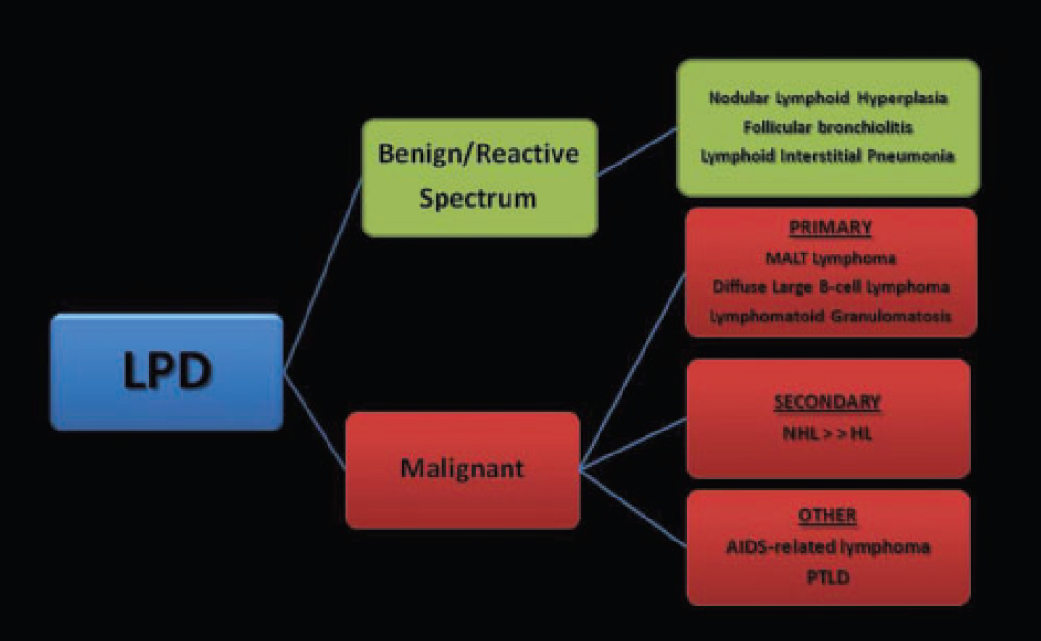
Classification

Slide 4
Benign/reactive
Nodular lymphoid hyperplasia
Lymphocytic interstitial pneumonia (LIP)
Follicular bronchiolitis
Angiofollicular hyperplasia(Castleman dz)
Intrapulmonary lymph nodes

Slide 5
Malignant
Primary pulmonary lymphoma
  B-cell non-Hodgkin's lymphoma(esp: MALToma )
  T-cell lymphoma Hodgkin's lymphoma
  Lymphomatoid granulomatosis
  Angioimmunoblastic lymphadenopathy
Secondary pulmonary involvement by systemic lymphoma and leukemia
Posttransplantation lymphoproliferative disorder

Slide 6
Nodular Lymphoid Hyperplasia
Benign, localized, reactive polyclonal lymphoproliferative lesion
Pathogenesis : unclear, secondary reactions to focal inflammatory conditions
Median age: 65, even sex distribution
Usually asymptomatic and found incidentally on imaging studies (70%)
Surgical resection

Slide 7
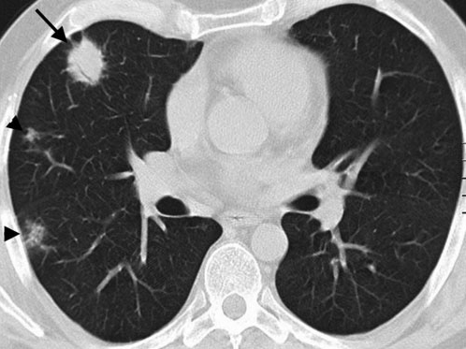
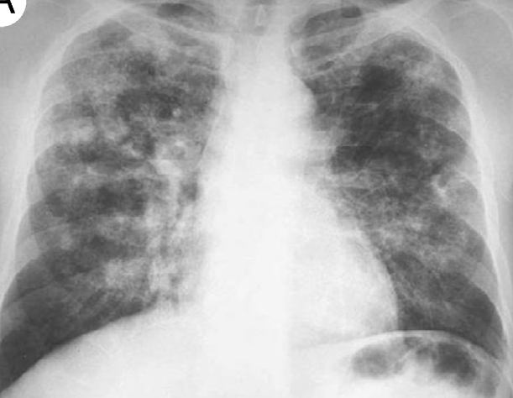
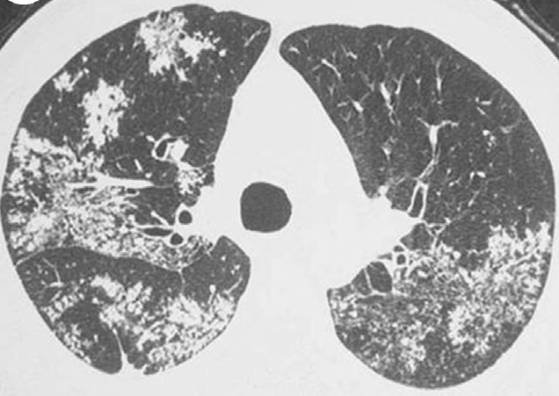
Discrete nodular mass (usually 2–3 cm in diameter)
Occasionally 2–3 nodules coalesce to form a discrete mass, multiple(36%)
Mild focal lymphangitic extension
Notes:
Figure: well-circumscibed pulmonary nodule (arrow) with an air bronchogram in the periphery of the right upper lobe.
mild surrounding linear opacities indicating focal lymphangitic extension. In addition two smaller nodules (arrowheads) are seen in the right lung
PA chest radiograph demonstrates bilateral patchy nodular opacities and consolidations.
multifocal bilateral scattered ground-glass opacities, patchy consolidations, and tree-in-bud opacities

Slide 8
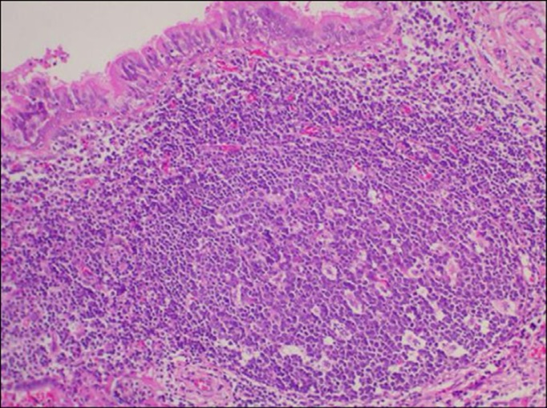
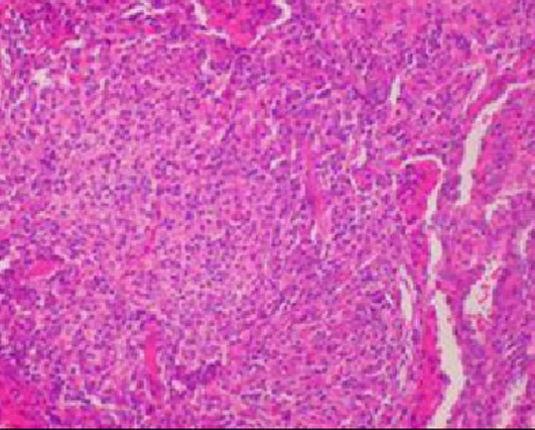
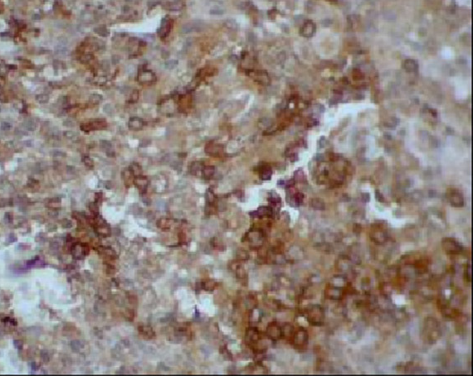
Well-defined lymphoid tissue masses with numerous reactive germinal centers and interfollicular lymphocytes and plasma cells, obliterating the underlying lung architecture
immunohistochemical stains: mixture of T and B cells CD20 , interfollicular lymphocytes CD3, CD43, and CD5
Notes:
Bronchial wall.Intermediate-power microphotograph(H&E stain; originalmagnification10) demonstrates reactive lymphoid follicles located beneath the bronchial (or bronchiolar) mucosa. Note the pseudostratified ciliated epithelium that lines the bronchial lumen. (Color versionof figure is available on line.)
Intermediate- power microphotograph(H&Estain;originalmagnification10) shows a dense lymphoid and plasma cell infiltrate.
(D) High-power microphotograph( immuno histochemical stain; originalmagnification40) demonstrates reactivity for T-cellantigenswithCD3.(Colorversionof figure is available online.)
→ Immunoglobulin light chain reacite 이 polyclonal reactivity 을 보이는 것으로 알려져 있고 이는 MALToma 와 다른점임

Slide 9
Lymphocytic Interstitial Pneumonia
Diffuse, lymphoid hyperplasia and an interstitial polyclonal inflammatory infiltrate
Pathogenesis: unknown, almost invariably associated with systemic immunological disturbances (EBV, HIV, HHV8, connective tissue dz)
Age : 40-60, female dominant
Progressive dyspnea
A progression from LIP to lymphoma has been described (rare)
Steroid based Tx
Notes:
Pathogenesis : Deoxyribonucleicacid from Epstein-Barrvirushas been identified in patients with or without retroviral infection.
LIP defines acquired immunedeficiency syndrome (AIDS) in children who are seropositive for the human immunodeficiency virus(HIV);
→ The dysregulation of T lymphocytes caused by the HIV may promote lymphoid hyperplasia in this group of patients.
The histopathologic pattern seen in cases of LIP has been described in patients with Sjögren syndrome, juvenile rheumatoid arthritis, systemic lupus erythematosus, autoimmune hemolytic anemia, myasthenia gravis, Hashimoto thyroditis, primary biliary cirrhosis, and celiac disease

Slide 10
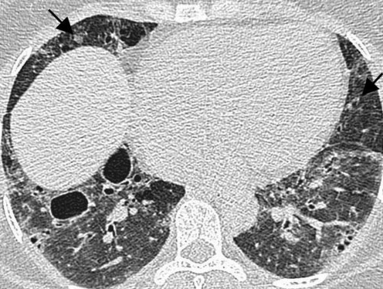
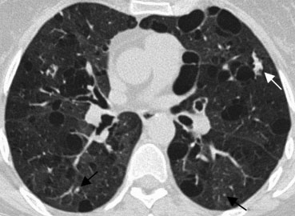
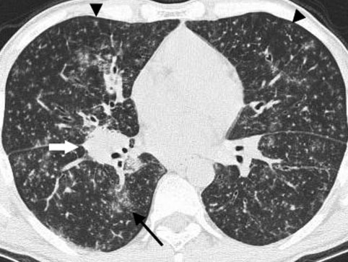
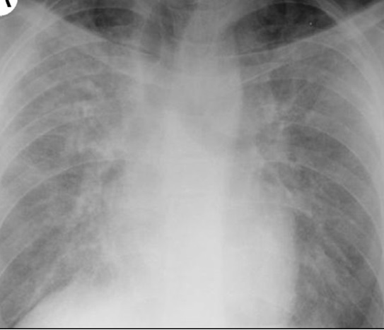
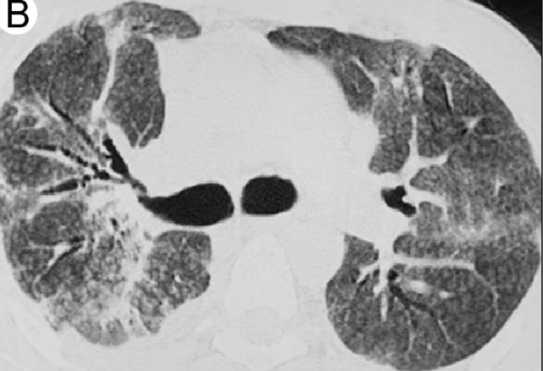
Diffuse interstitial involvement
Ground-glass opacity
Nodules-poorly defined, centrilobular and subpleural
Cystic airspaces
Peribronchovascular thickening
Notes:
Sjogren syndrome→bilateral diffuse ground-glass opacity, cystic airspaces and small nodules (arrows)
mixed connective tissue Disease→ extensive ground-glass opacity with small centrilobular nodules (black arrows) and lung cysts
HIV→innumerable small bilateral centrilobular nodules (arrowheads) and patchy ground-glass opacities (arrow) with no lung cysts seen
Demonstrates bilateral poorly defined centrilobular nodules and ground-glassopacities

Slide 11
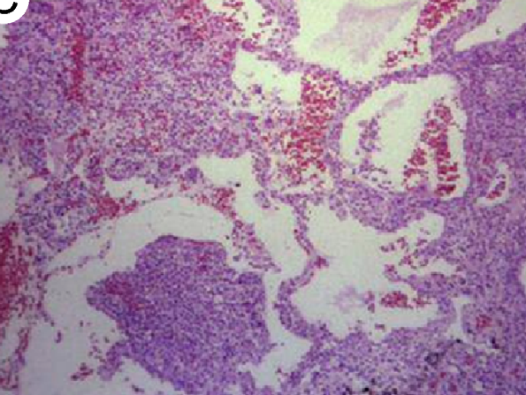
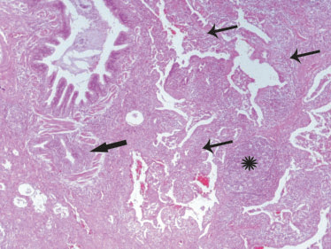
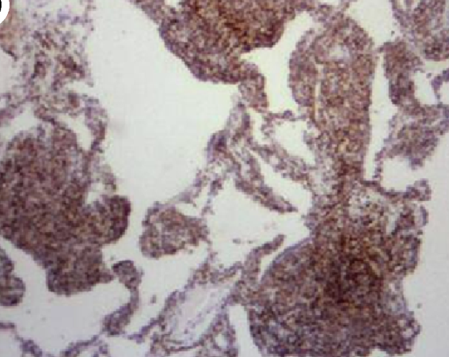
Diffuse inflammatory infiltrate within the alveolar interstitium that comprises mainly T lymphocytes, plasma cells and histiocytes
The B-cells are limited to the frequent reactive lymphoid follicles
Loosely formed epithelioid granulomas are commonly seen
Immunohistochemical stains using CD20 show that reactive B cells are located mainly in germinal centers
Notes:
demonstrates alveolar septal thickening by a lymphoid aggregate containing reactive germinal centers.
Low-powe rmicrophotograph(immuno- histochemicalstain;originalmagnification4) demonstrates that the interstitial lymphoid cells areT cells that stain positive for CD3
there is a prominent and diffuse lymphocytic interstitial infiltrate, involving both the airways (thick
arrow) and the alveolar septa (thin arrows), which are remarkably thickened. A reactive lymphoid follicle with germinal centre is
also noted (asterisk

Slide 12
Follicular Bronchiolitis
Polyclonal bronchial MALT hyperplasia in and around the bronchioles
Pathogenesis: hypersensitivity phenomenon related to an unidentified antigen or as a response to a treated infection
Primary: Usually associated with collagen vascular diseases(esp: RA, sjogren)
Secondary: chronic bronchial inflammation (bronchiectasis)
Mean age : 44 (collagen vascular dz) or 16 (immunocompromised), 55( hypersentivity symdrome)
Progressive dyspnea
Treatment: steroid based

Slide 13
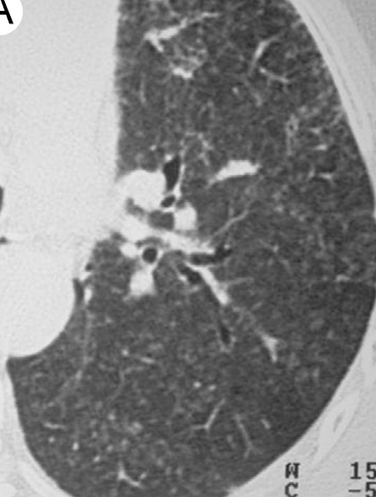
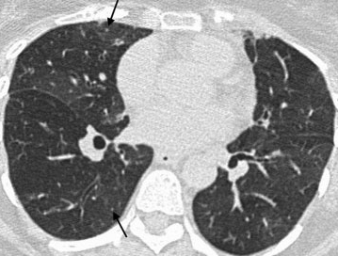
Diffuse small airways involvement
Nodules 1–3 mm in diameter
centrilobular or peribronchial nodules, GGO (75%)
Nodules which can mimic ‘‘tree-in-bud’’
Bronchial dilatation
Notes:
tiny parenchymal nodules (arrows) and subtle mosaic attenuation in a 56-year-old female with rheumatoid arthritis
Down to the left lung demonstrates poorly defined centri lobular nodules and tree- in-bud opacities.

Slide 14
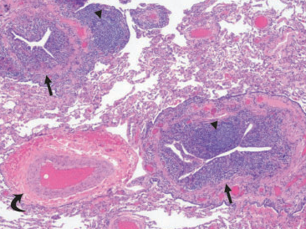
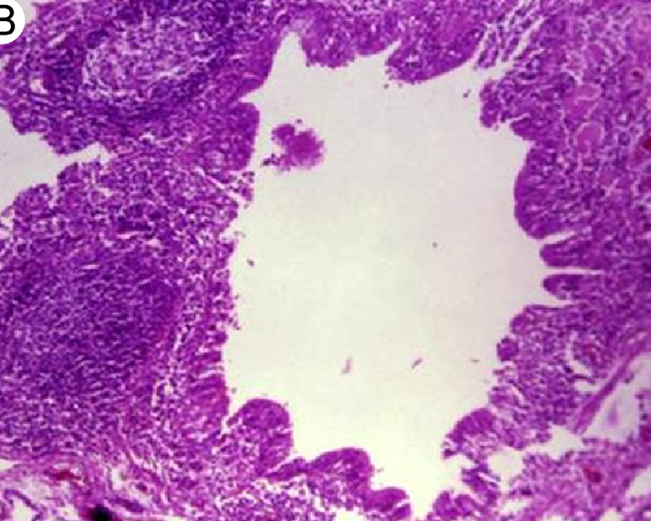
Lymphoid follicular hyperplasia in the walls of bronchioles with narrowing of the lumen is the defining feature
Reactive follicles may also be seen along interlobular septae and subpleural regions
Notes:
chronic inflammation of membranous bronchioles (arrows) with reactive lymphoid follicles (arrowheads)
demonstrates peribroncho- vascular hyperplastic lymphoid follicles with reactive germinal centers

Slide 15
Angiofollicular Lymphoid Hyperplasia
Also known as Castleman disease or benign giant lymph node hyperplasia
lymphoid follicular hyperplasia with or without germinal centers and marked small vessel proliferation with endothelial hyperplasia
Excessive release of interleukin (IL)-6 or related polypeptides(homolog of IL-6)
Localized , disseminated
Associated with development of malignancies, such as non-Hodgkin lymphoma

Slide 16
Localized ALH
Hyaline vascular type (90%)
At any age, peak in the fourth decade
Female to male ratio of 4:1
Common site: chest (24 %), neck (20%), abdomen (18%), and retroperitoneum (14%)
Commonly asymptomatic
Associated with autoimmune diseases
Surgical resection, debulking + other drug (IL-6 antibody, rituximab)
Notes:
including autoimmune hemolytic anemia, immune thrombocytopenia, and acquired factor VIII deficiency.

Slide 17
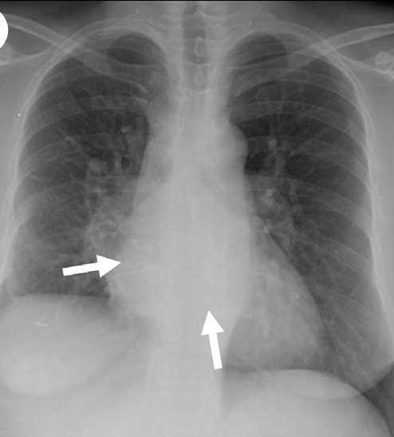
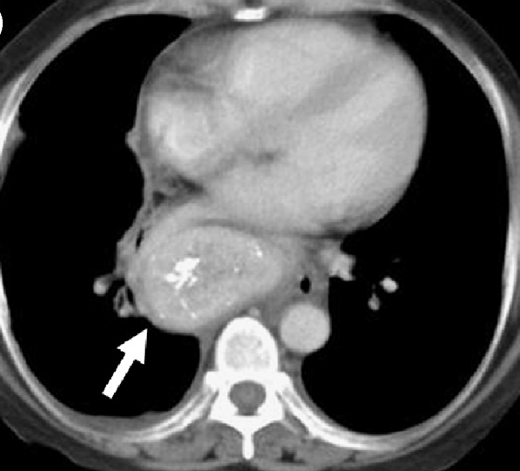
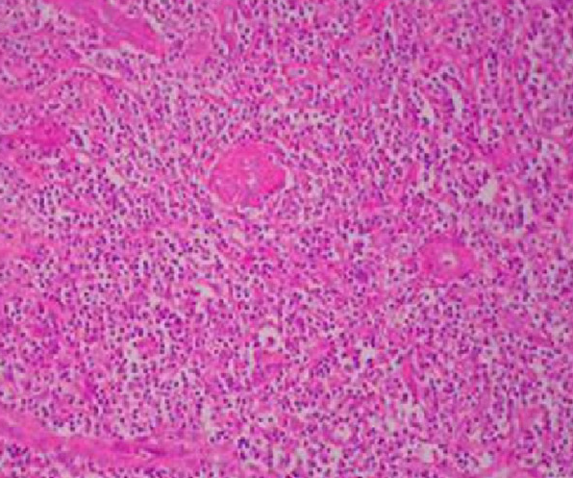
Localized ALH
Well-circumscribed mass of soft tissue attenuation (significant enhancement after intra-venous administration of contrast material)
Calcification is infrequent
Notes:
CT: demonstrate san ovoid retrocardiac mediastinal mass with intense contrast enhancement and central foci of coarse calcification(arrow)
Low-power microphotograph(H&Estain; originalmagnification4) demonstrates a lymph node that consists of lymphoid tissue with penetration by hyalinized vessels

Slide 18
Disseminated ALH
Median age: 50-65, male (50-65%)
Associated with POEMS syndrome, Kaposi sarcoma, and HIV
IL-6, HHV8
Symptom: involved area, production & level of IL-6 and VEGE, asymtomatic (10%)
Fever, night sweets, wt loss, weakness
IL-6 inhibition, rituximab, cytocxic chemo Tx
Prognosis: variable, untreated MCD is poor
Notes:
Prognosis :
An indolent form of MCD sometimes persists for months to a few years without worsening.
An episodic relapsing form may be aggressive for a short period and then remit spontaneously or in response to treatment, only to recur at a later time.
A rapidly progressive form that can lead to death within weeks may be more common in HIV-infected patients. Initiation of anti-retroviral therapy in patients who are positive for both HIV and HHV-8 may increase the likelihood of developing acute, fulminant MCD , but this remains to be confirmed

Slide 19
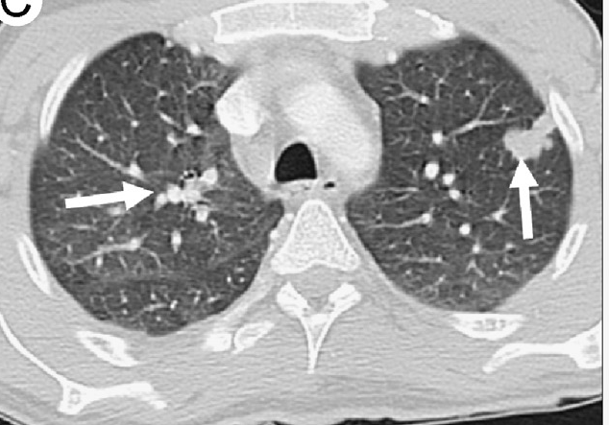
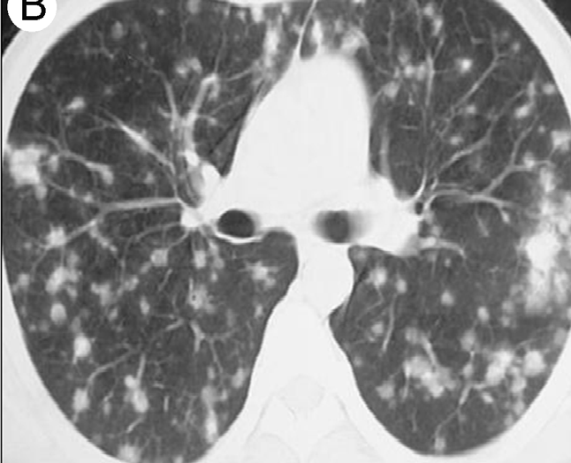
Diffuse mediastinal lymphadenopathy that affects multiple compartments, LN 1-6cm, ill-defined centrilobular nodules, thin- walled cysts, bronchovascular thickening
Notes:
Lung window axial image demonstrates peribronchovascular and subpleural lung nodules (arrows).
Unenhanced chest CT (lungwindow) demonstratesmultiple bilateral small nodules. These are closely associated with pulmonary vessels, have variable sizes, and exhibit rounded and irregular morphologies, some with surrounding ground-glass opacity

Slide 20
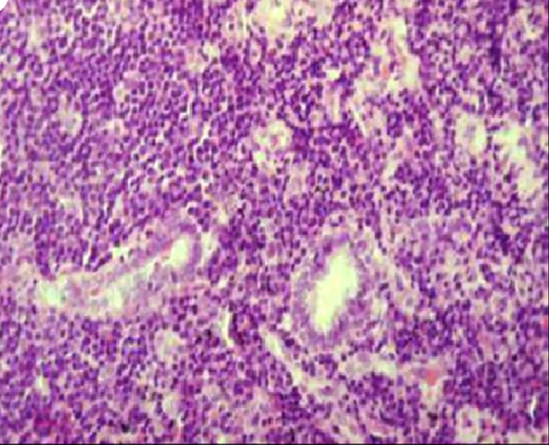
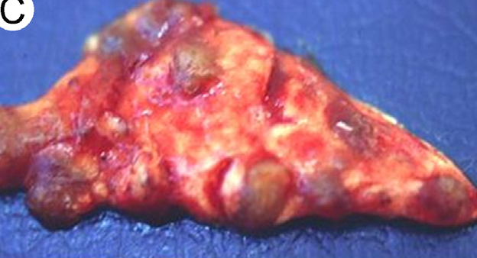
B cells and plasma cells are polyclonal, and T cells show no evidence of an aberrant immunophenotype
plasma cell variants are more common than the hyaline vascular varian
Notes:
Gross specimen photograph of an open lung biopsy demonstrates multifocal nodular lesions in the lung parenchyma
demonstrates aggregates of plasma cells and small lymphoid cells in the pulmonary interstitium

Slide 21
Primary pulmonary lymphoma
No detectable extrathoracic lymphoma for at least 3 months after the initial diagnosis
Relatively indolent MALT lymphoma to more aggressive forms of DLBCL
3%-4% of extranodal lymphomas
0.5%-1% of primary lung malignancies

Slide 22
Mucosa-associated lymphoid tissue lymphoma
Most common in PPL (58~90%)
Caused by chronic inflammation, occasionally related to chronic immune-mediated diseases(sjogren, RA, HIV, H.pylori, MAC, HCV)
Sixth decade, female predominance
Asymptomatic(50%), incidentally discovered
Cough, dyspnea, wt loss, fever, sweat
Limited stage- local Tx (RTx , limited surgery)
Advanced stage – immuno Tx or CTx

Slide 23
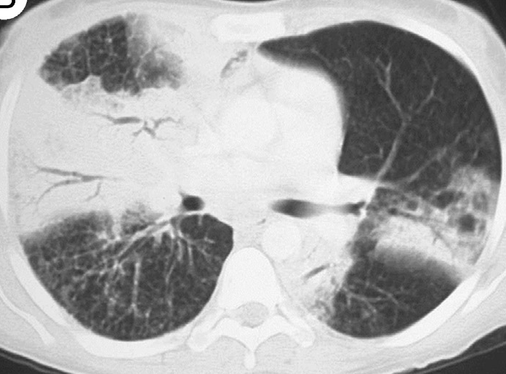
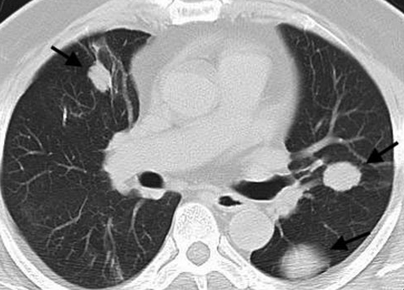
Solitary or multifocal and comprised ill-defined nodules containing air bronchograms
Cavitation is rare
Mediastinal lymphadenopathy and pleural reaction are uncommon
Notes:
bilateral opacities with more extensive air-space consolidation in the right upper lobe.
large bilateral lung nodules (arrows)

Slide 24
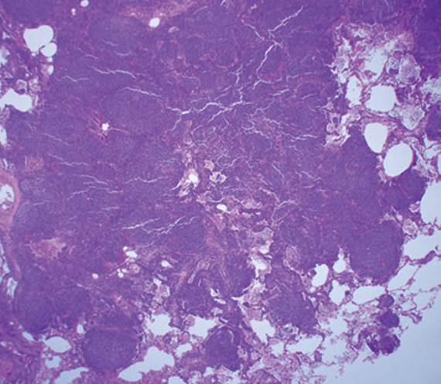
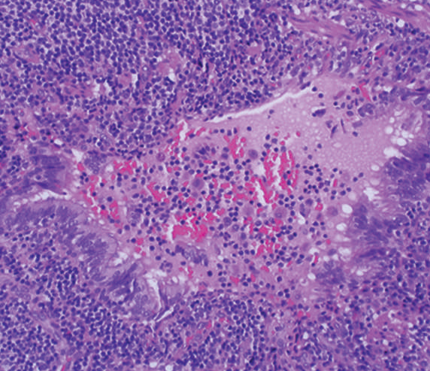
Massive interstitial infiltrate of small lymphocytes forming a mass-like lesion
Variable number of admixed plasma cells and histiocytes, and occasional small germinal centres
Immunohistochemical: coexpression of CD20 (cluster of differentation 20) and CD43
Notes:
relatively discrete mass extending into adjacent lung parenchyma
diffuse infiltrate of small lymphoid cells permeating through the bronchiolar epithelium, the so-called lymphoepithelial lesion

Slide 25
Extranodal NK/T-cell lymphoma, nasal type
Most common in Asia, accounts for 5-10% of all NHL
Rare cases with isolated lung
Median age: 52, male predominance
Pathogenesis: poorly understood, associated EBV infection
Symptom: involved site, B Sx (10-30%)
Combined CTx and RTx
Worst prognosis
Notes:
Pathogenesis: Curiously, the cyclin dependent kinase inhibitor p21, which is a downstream target of p53, is overexpressed in these tumors independent of p53 mutational status . In most other tumor types, p21 overexpression is linked to wild-type p53 expression, but in this tumor it has been found even with mutant p53 or low p53 expression; it is hypothesized that p21 overexpression may be related to EBV infection.
The p73 gene, which shares structural and functional homology with p53 and is thought to be a tumor suppressor gene, has been found to be highly methylated in these tumors, with the p15 and p16 genes also methylated but less often [21]. Other tumor suppressor genes that have been implicated in the pathogenesis of extranodal NK/T cell lymphoma include PRDM1 (also known as Blimp-1) and FOXO3. In one study, both PRDM1 and FOXO3 frequently demonstrated nonsense and missense mutations resulting in the down-regulation of these tumor suppressor genes in a majority of clinical samples [22]. Re-expression of PRDM1 and FOXO3 in NK cells with genetic lesions leading to loss of these factors inhibited proliferation suggesting that the down-regulation of these genes plays a role in lymphomagenesis.

Slide 26
Lymphomatoid Granulomatosis
bl
Rare EBV associated lymphoproliferative disorder with a propensity for blood vessel destruction
NHL as a neoplasm of mature B-cells
Most common primary site (>90%)
Systemic multiorgan disease(skin, CNS)
Age: 30-50 , usually affecting males
poor prognosis and a median survival of less than 2 years

Slide 27
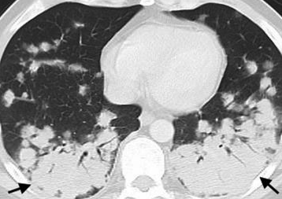
Bilateral, round, poorly marginated nodules 0.5–8 cm in diameter.
Basal predominance.
Peribronchovascular distribution.
Can coalesce and cavitate.
‘‘Reversed halo sign’’.
‘‘Migratory’’ nodules due to ‘‘waxing and waning’’.
Notes:
multiple pulmonary nodules coalescing in the lower lobes to form larger masses (arrows)

Slide 28
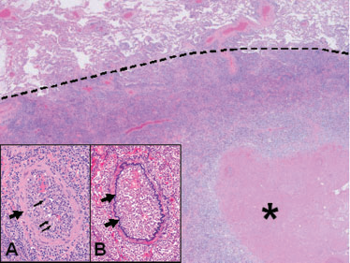
Angiocentric polymorphous mononuclear infiltrate composed of numerous small lymphocytes, plasma cells, histiocytes and large atypical EBV-positive B-cells, which resemble immunoblasts
Notes:
Lymphomatoid granulomatosis histopathological specimen in
the same patient: well-demarcated cellular nodule with a central area of necrosis (asterisk). The preserved alveolar parenchyma
is shown in the upper part of the image, above the dashed line. Inset shows the angiocentric nature of the lesion. Inset A:
infiltration of the intima by lymphoid cells. The muscular wall of the artery is indicated by the arrow. Most of the lymphocytes
are small reactive T-cells and atypical B-cells are rare (thin arrows). Haematoxylin–eosin stain; original magnification 6200. Inset
B: elastin stain shows the elastic lamina of the artery (arrows). Elastin stain; original magnification 6200

Slide 29
Posttransplantation Lymphoproliferative Disorders
lymphoid/plasmacytic proliferation that occurs following solid organ or hematopoietic stem cell transplantation
Polyclonal benign proliferations to monoclonal and monomorphic aggressive lymphomas
Associated with EBV infection
less than 2% of all transplant
highest incidence in lung transplantation (6–9%)

Slide 30
occur within 2 years of transplantation
fever, lymphadenopathy, abdominal pain with diarrhea, mononucleosis-like syndrome, upper respiratory tract, CNS Sx, Wt loss
Up to 25% of patients will present with allograft failure, and this can mimic primary allograft rejection

Slide 31
Nodules: more single than multiple, diameter range 0.3–5 cm.
More well-defined than ill-defined nodules.
‘‘Halo sign’’ around nodules.
Patchy/focal consolidation or ground-glass opacity.
More peribronchial/subpleural than diffuse distribution of nodules.
Lymphadenopathy (30–60%).

Slide 32
Benign LPDs and primary pulmonary lymphoma of the lung are relatively rare
Radiological appearance of the LPDs is not pathognomonic
Multidisciplinary approach to diagnosis is important

Slide 33
Reference
1. Carrillo J, Restrepo CS, Rosado de Christenson M, Ojeda Leon P, Lucia Rivera A, Koss MN: Lymphoproliferative lung disorders: a radiologic-pathologic overview. Part I: Reactive disorders. Semin Ultrasound CT MR 2013, 34(6):525-534.
2. Hare SS, Souza CA, Bain G, Seely JM, Frcpc, Gomes MM, Quigley M: The radiological spectrum of pulmonary lymphoproliferative disease. Br J Radiol 2012, 85(1015):848-864.
3. Lee BH, Kim SY, Kim MY, Hwang YJ, Han YH, Seo JW, Kim YH, Cha SJ, Hur G: CT of nasal-type T/NK cell lymphoma in the lung. Journal of thoracic imaging 2006, 21(1):37-39.
4. Morovic A, Aurer I, Dotlic S, Weisenburger DD, Nola M: NK cell lymphoma, nasal type, with massive lung involvement: a case report. J Hematop 2010, 3(1):19-22.
5. Poletti V, Ravaglia C, Tomassetti S, Gurioli C, Casoni G, Asioli S, Dubini A, Piciucchi S, Chilosi M: Lymphoproliferative lung disorders: clinicopathological aspects. Eur Respir Rev 2013, 22(130):427-436.
6. Restrepo CS, Carrillo J, Rosado de Christenson M, Ojeda Leon P, Lucia Rivera A, Koss MN: Lymphoproliferative lung disorders: a radiologic-pathologic overview. Part II: Neoplastic disorders. Semin Ultrasound CT MR 2013, 34(6):535-549.

