Slide 1

Lung Cancer updated guideline ( NCCN 2014, ACCP 2013)
Division of Pulmonology,
Department of Internal Medicine,
Institute of Chest Diseases,
Severance hospital, Yonsei University College of Medicine

Slide 2


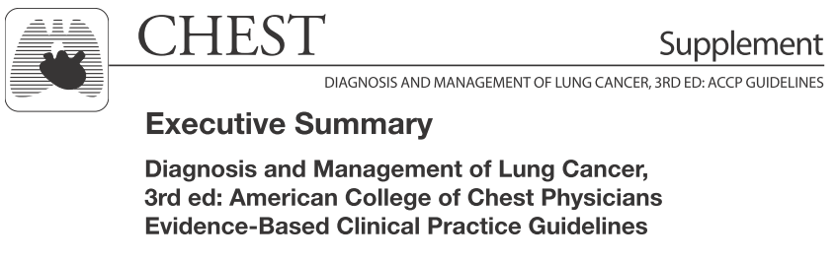

Slide 3
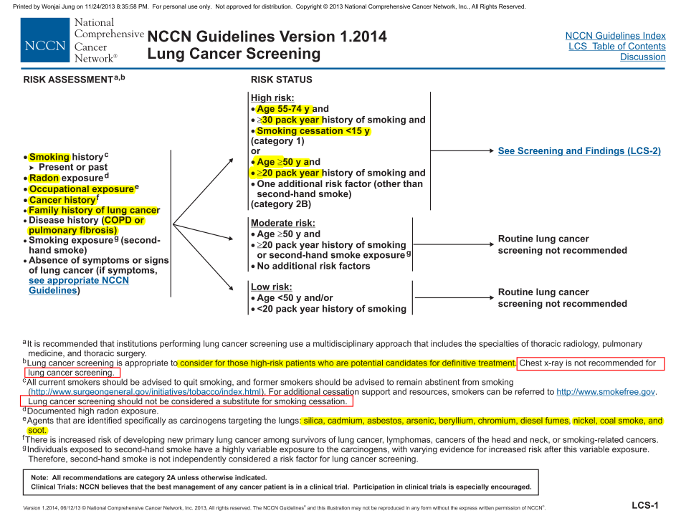

Slide 4
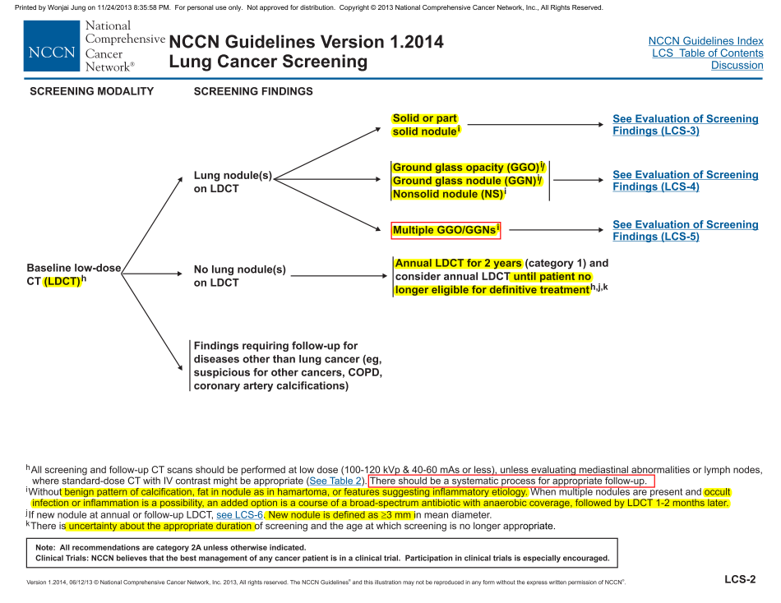

Slide 5
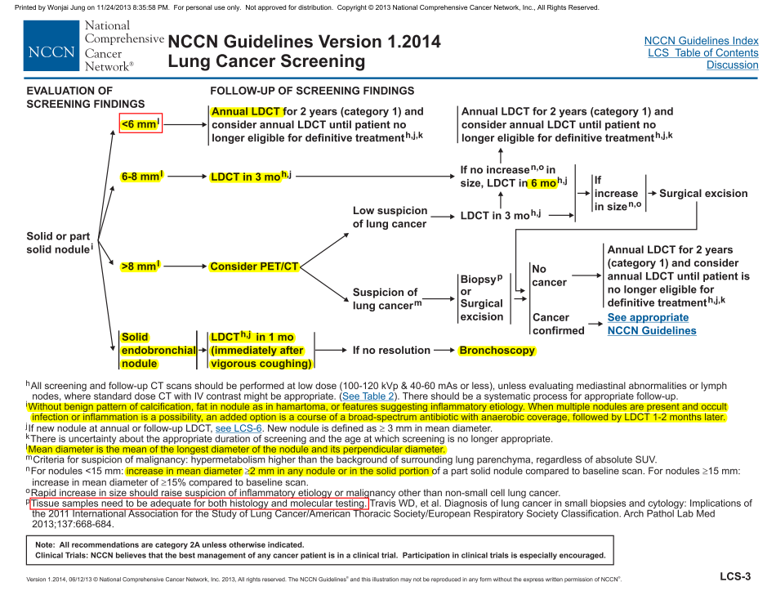

Slide 6
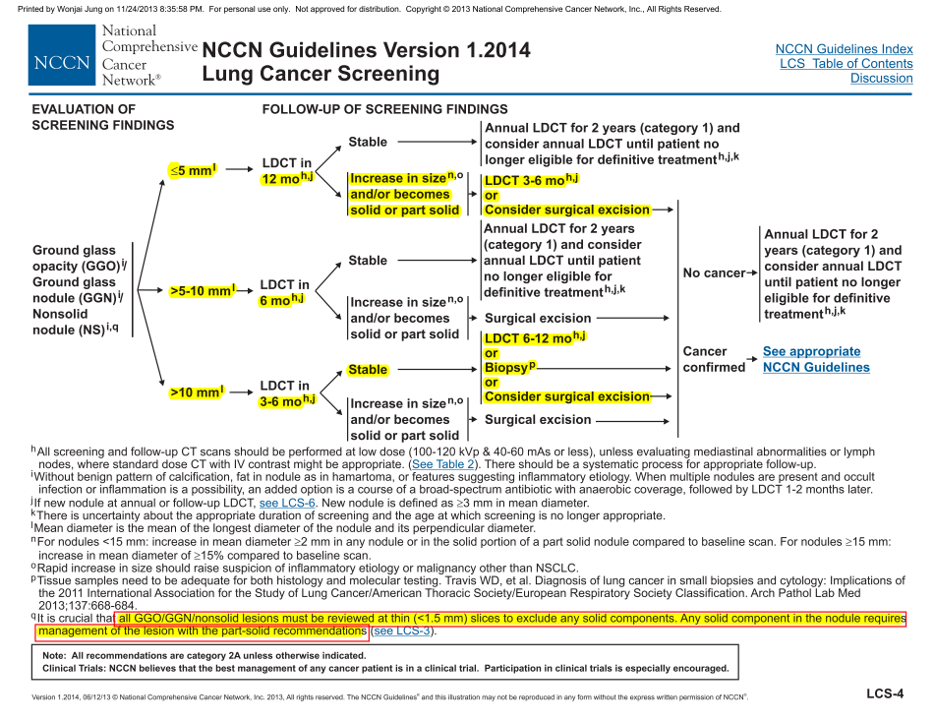

Slide 7
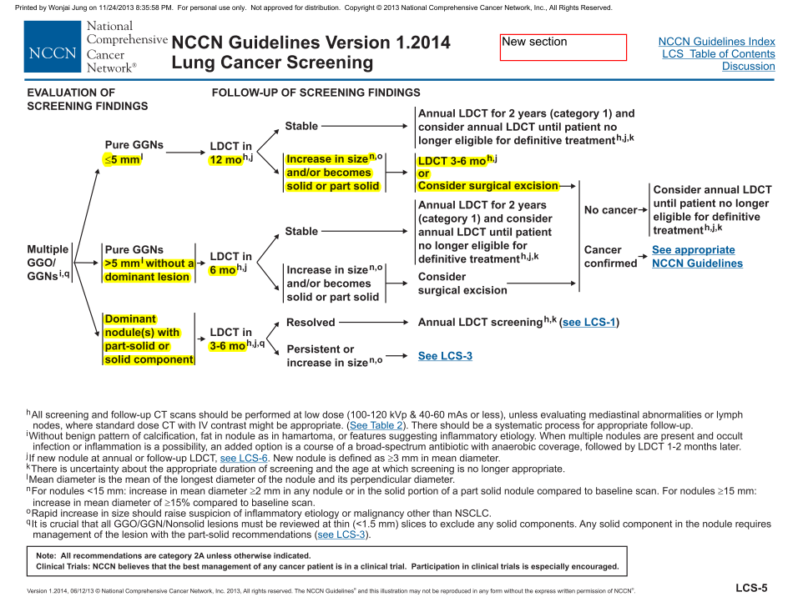

Slide 8
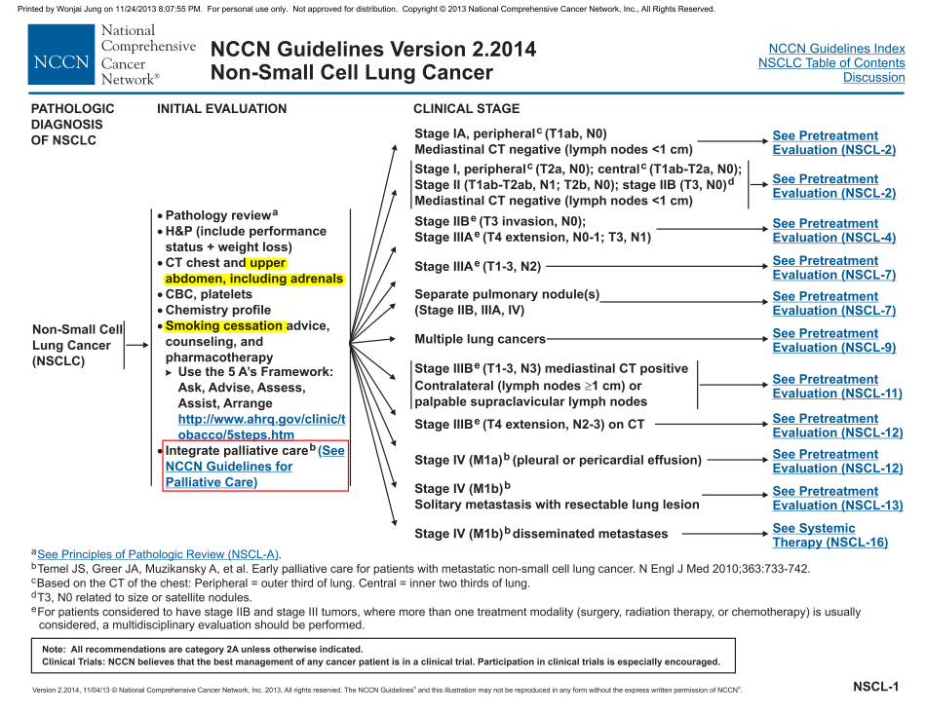

Slide 9
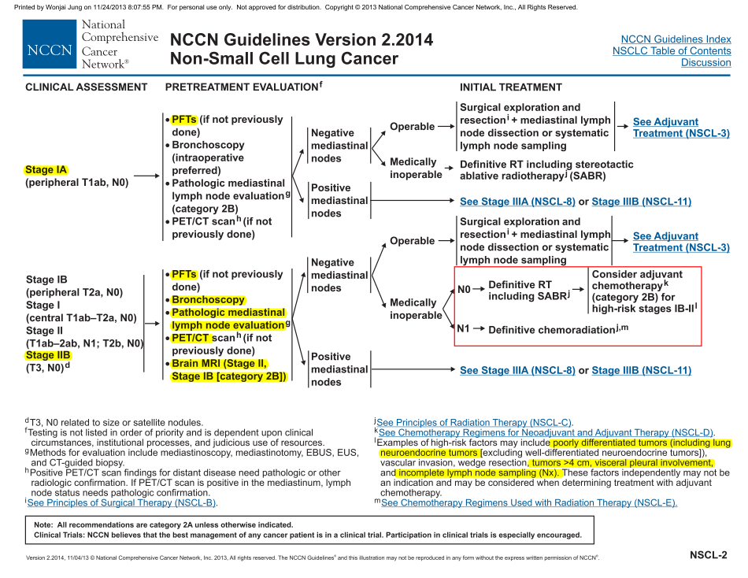

Slide 10
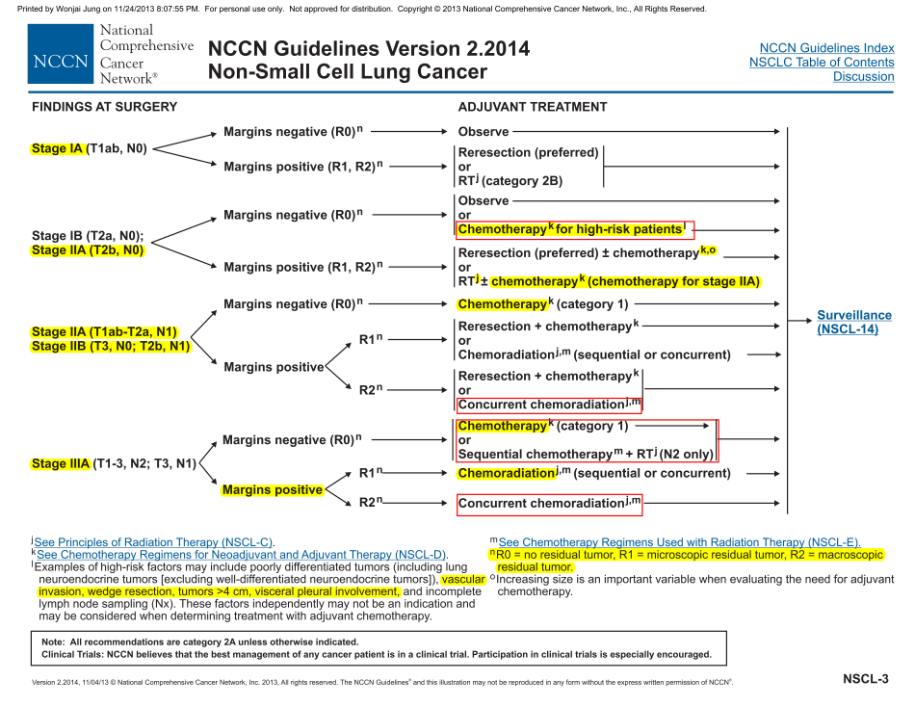

Slide 11
Postop RTx
Margin +
N2이상
Adjuvant CTx
- N1 + IIA이상. category I.
- Margin +인 IIA
HIgh risk인 Margin negative IB, IIA(N0)
(high risk: wedge resection, vascular invasion, visceral pluera involvement, 4cm이상)

Slide 12
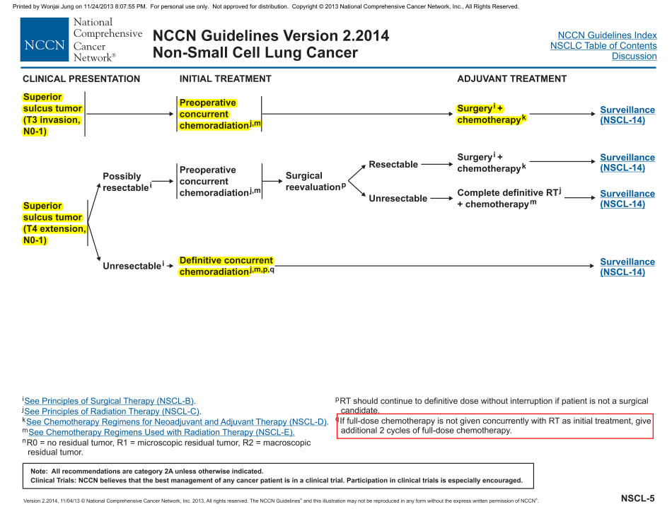

Slide 13
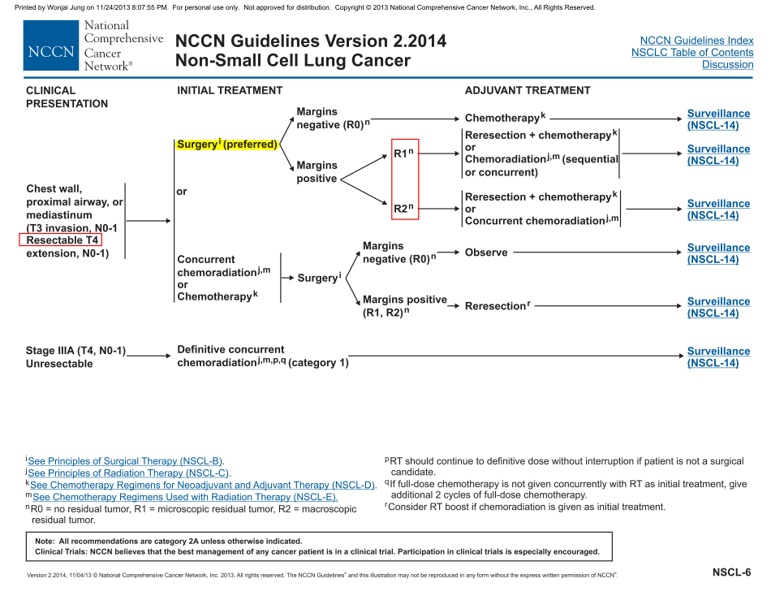

Slide 14
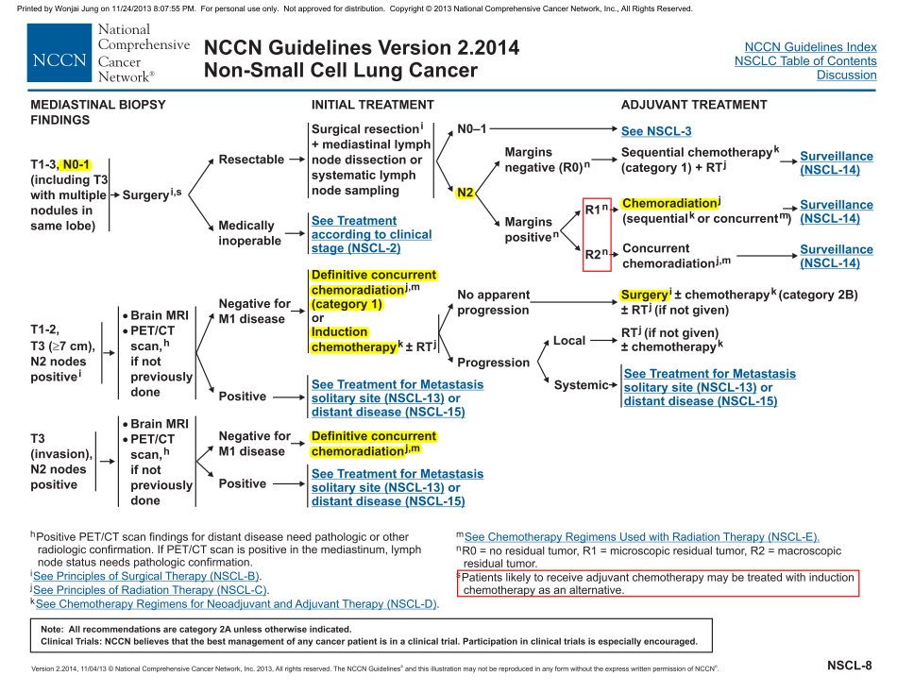

Slide 15
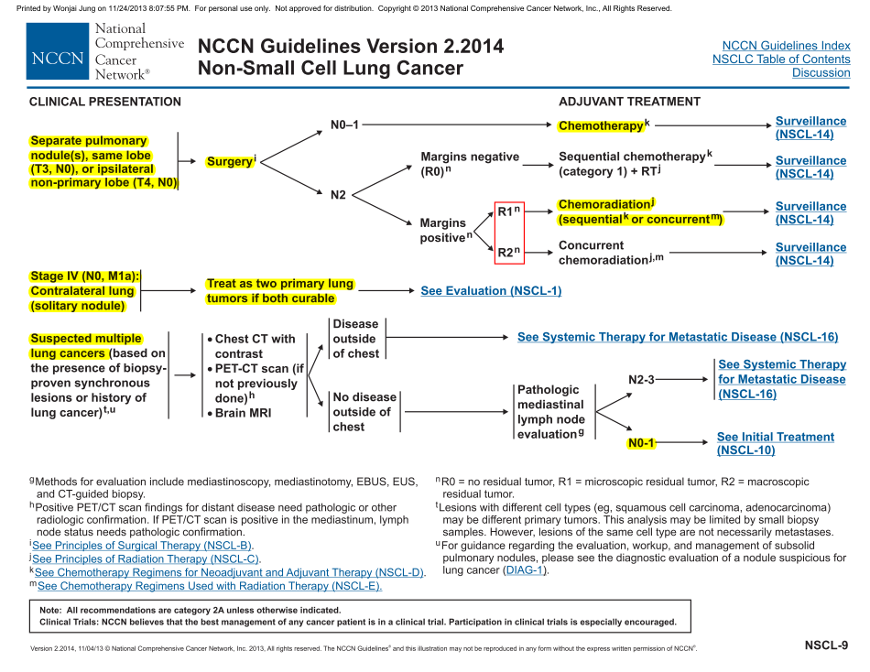

Slide 16
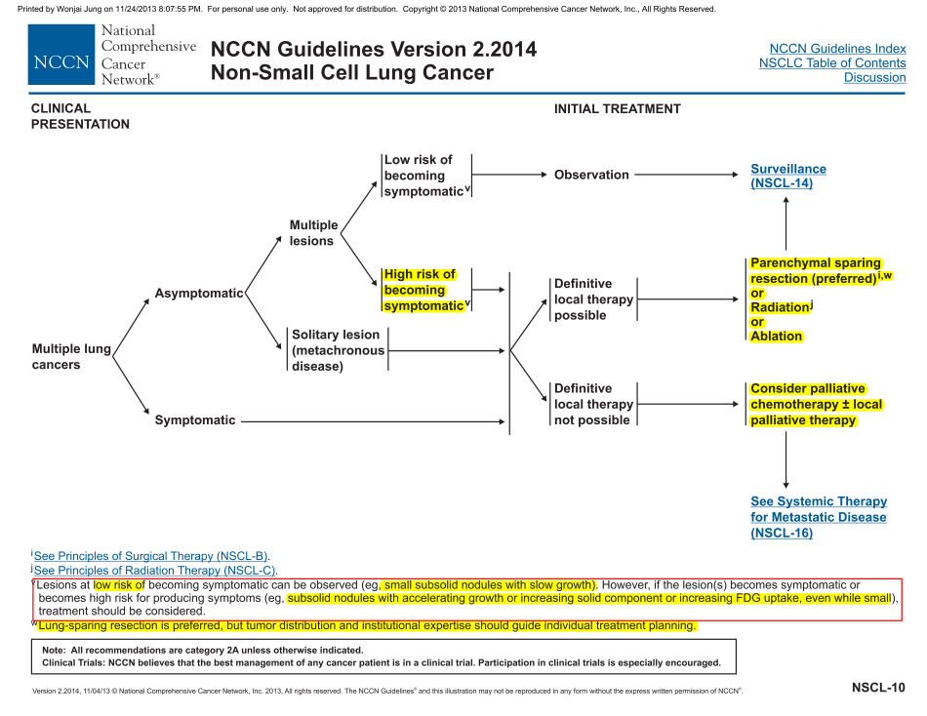

Slide 17
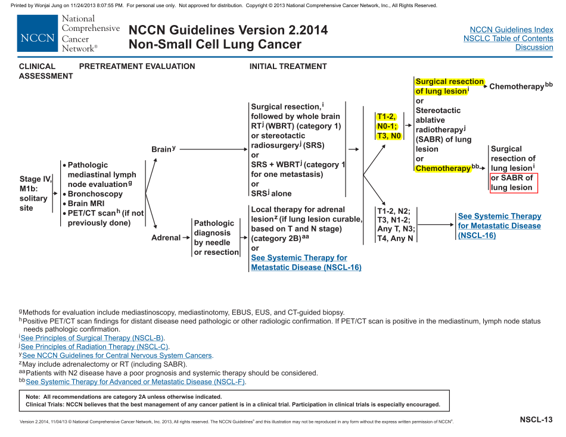

Slide 18
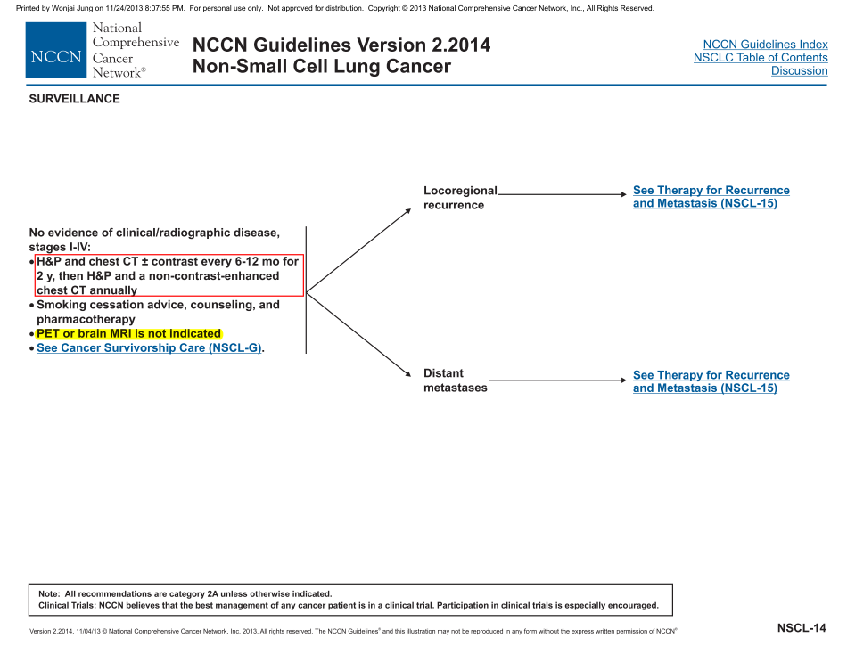

Slide 19
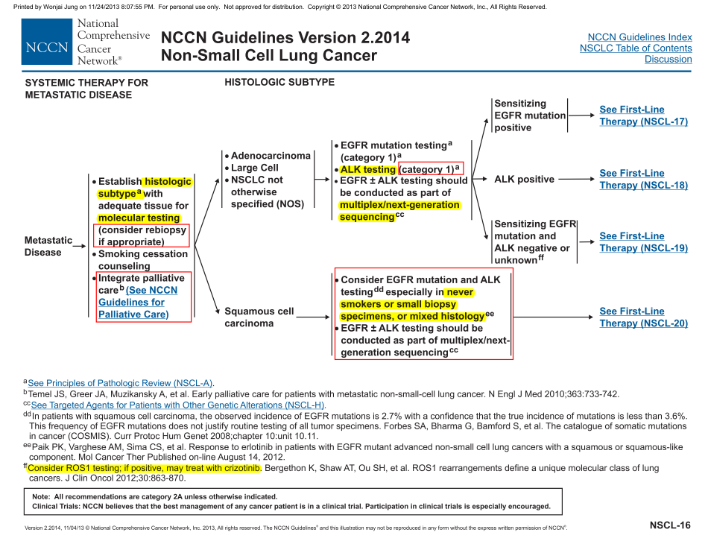
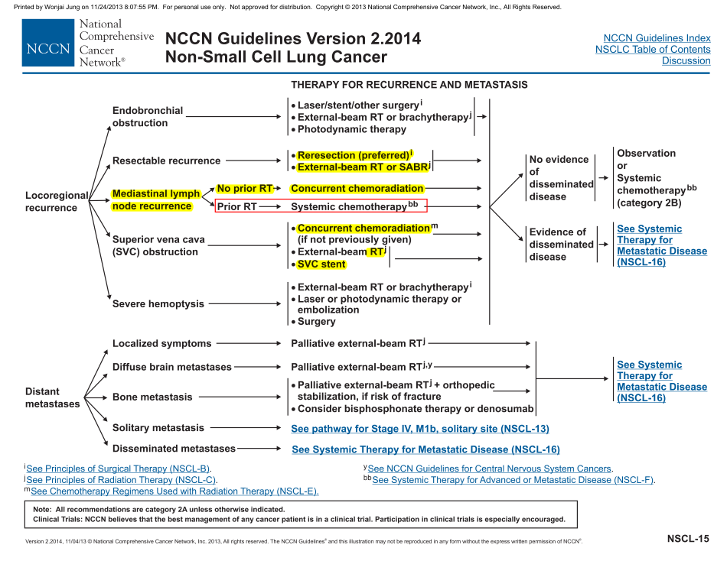

Slide 20
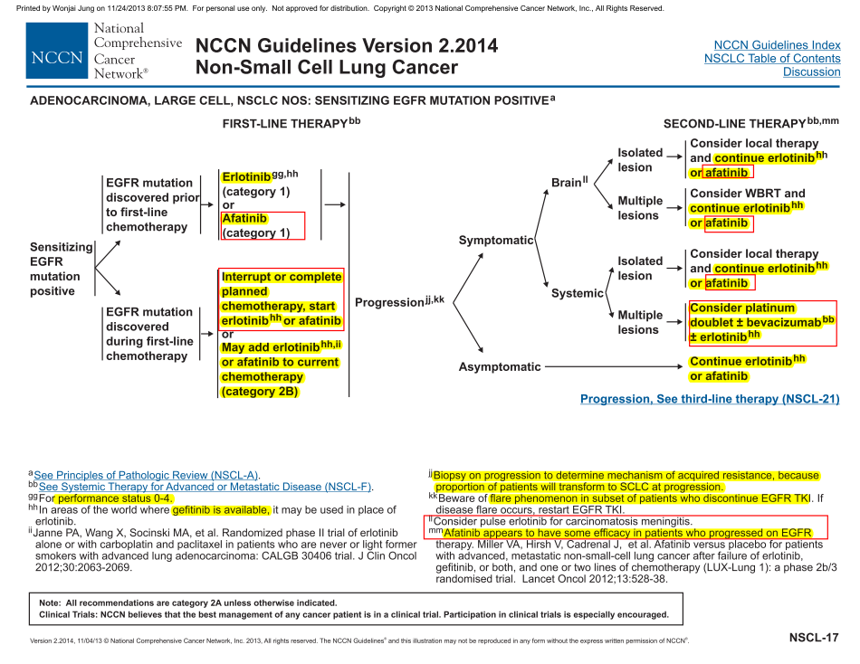

Slide 21
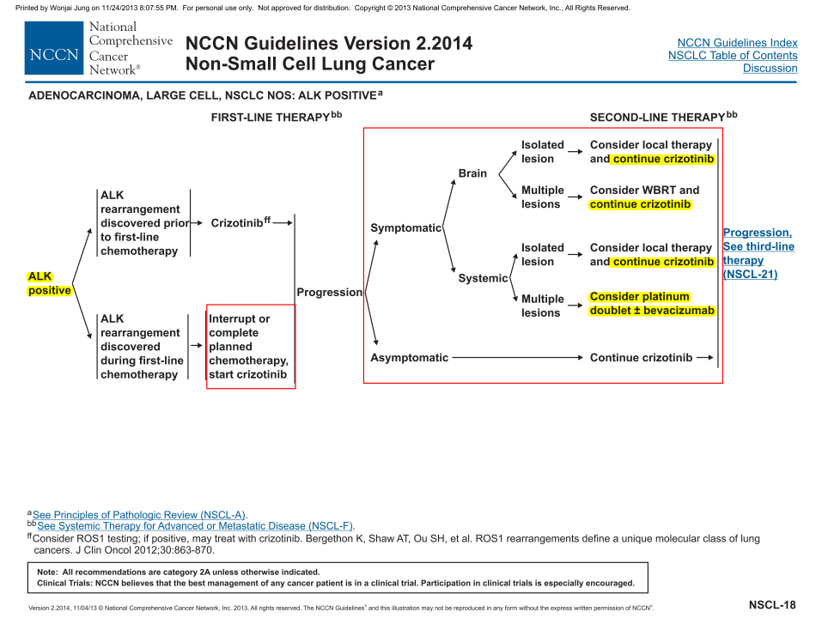

Slide 22
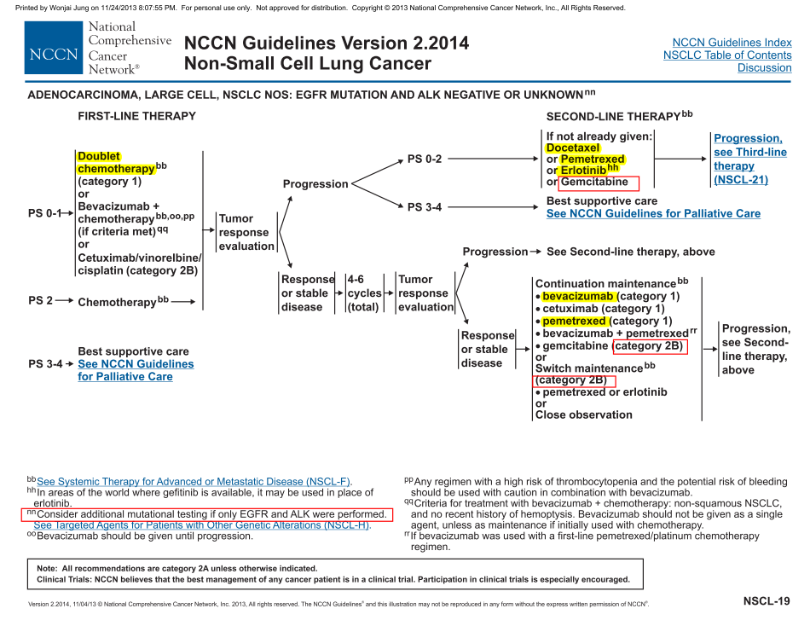

Slide 23
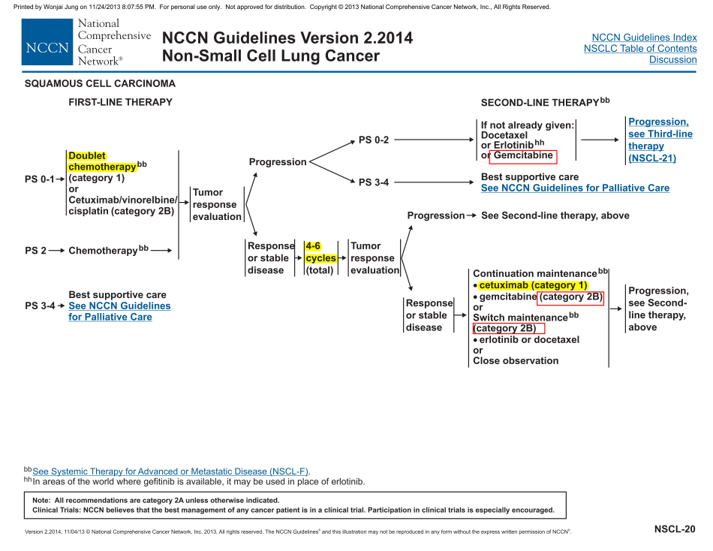

Slide 24
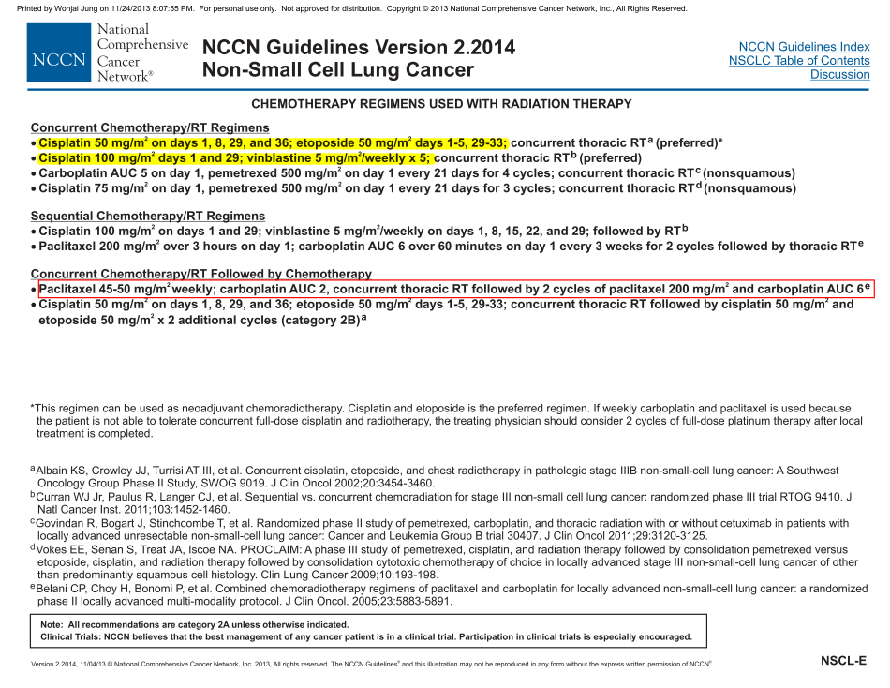

Slide 25
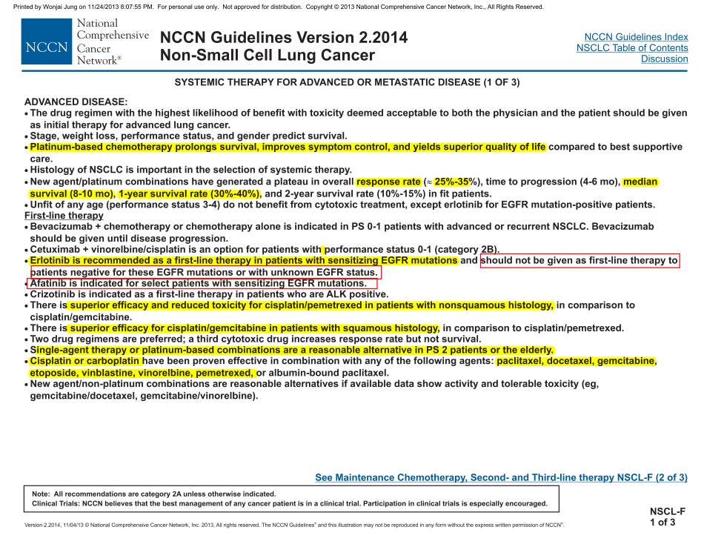

Slide 26
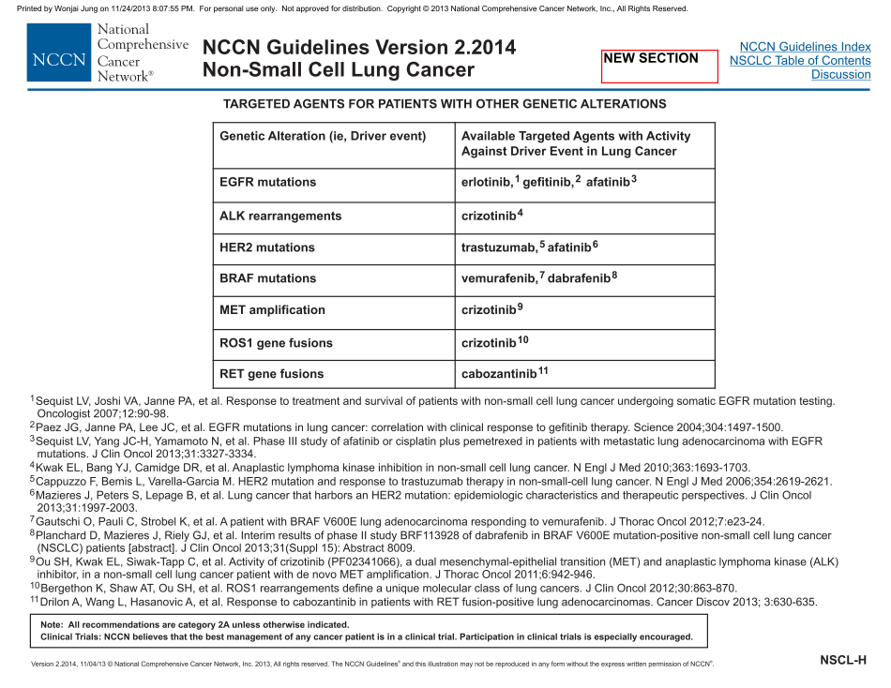
Notes:
Smoking시 4주 기다릴 수 있다는 부분은 삭제됨

Slide 27
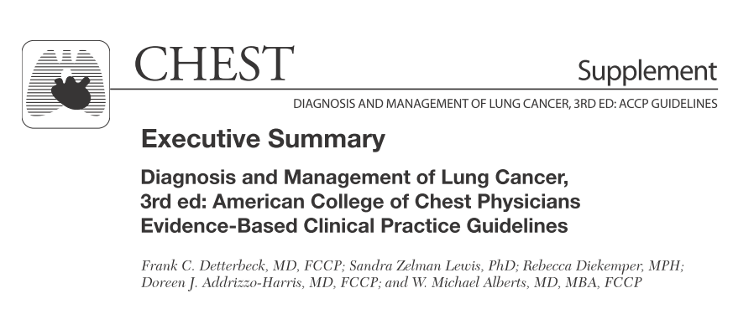

Slide 28
Chemoprevention of Lung Cancer
β-carotene supplementation, Vitamin E, retinoids, N-acetylcysteine, isotretinoin, aspirin, selenium, prostacyclin analogs, COX-2 inhibitor, inhaled steroids, pioglitazone are not recommended (Grade I A-B)

Slide 29
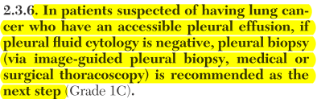
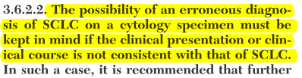
General approach

Slide 30
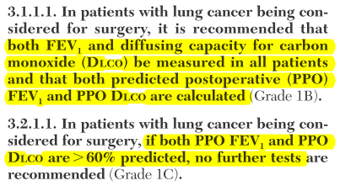
Physiologic evaluation prior to Surgery

Slide 31
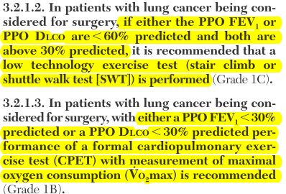
Physiologic evaluation prior to Surgery

Slide 32
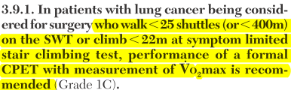
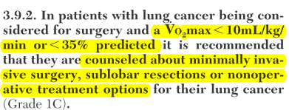
Physiologic evaluation prior to Surgery

Slide 33
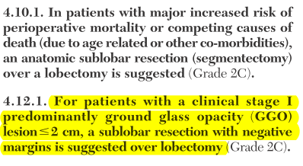
Sublobar Resection

Slide 34
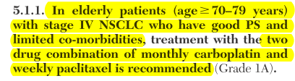

Speicial Populations and Consideration

Slide 35



Multifocal Lung Cancer

Slide 36
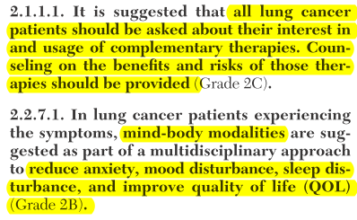

Complementary Therapies and Integrative Medicine
Meditation, stress reduction, yoga, tai chi, qigong, hypnosis, relaxation techniques, massage

Slide 37




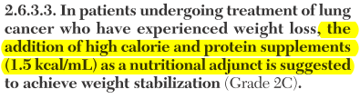
Complementary Therapies and Integrative Medicine

Slide 38
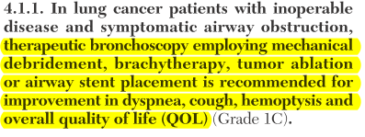



Symptom management

Slide 39
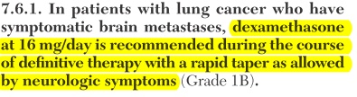
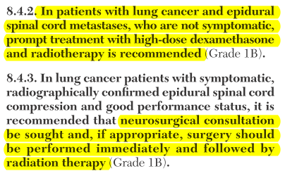
Symptom management

Slide 40

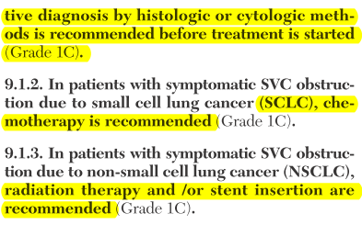
Symptom management

Slide 41
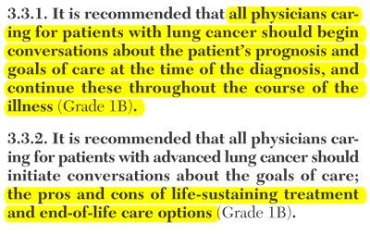
End of Life care

Slide 42


Slide 43
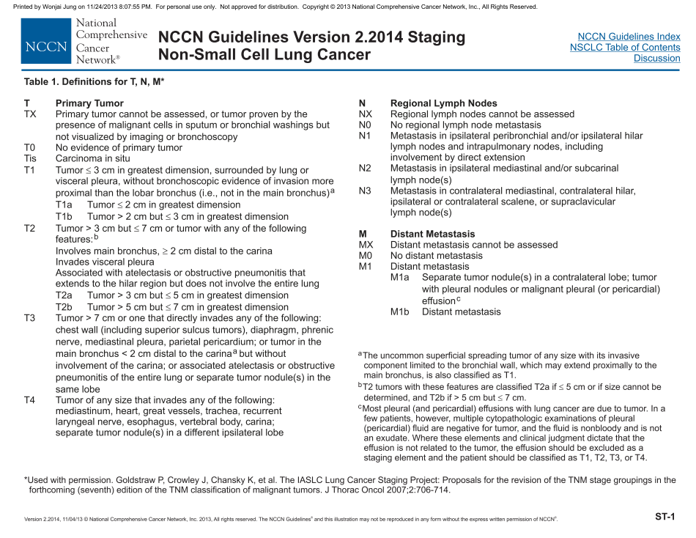

Slide 44
