Slide 1




Lung Transplantation
(Current status and recipient selection)
박선철
호흡기내과

Slide 2
History
First human lung transplantation (1963)
  The recipient survived 18 days
Successful heart-lung transplantation (1981)
Successful single lung transplantation (1983)
Successful double lung transplantation (1986)
→ Improved surgical techniques and advent of cyclosporine

Slide 3

NUMBER OF LUNG TRANSPLANTS REPORTED
BY YEAR AND PROCEDURE TYPE
NOTE: This figure includes only the lung transplants that are reported to the ISHLT Transplant Registry. As such, this should not be construed as representing changes in the number of lung transplants performed worldwide.
ISHLT
2012
J Heart Lung Transplant. 2012 Oct; 31(10): 1045-1095

Slide 4
국내 폐 이식 현황
36
(15)
28
18
(11)
9
(5)
7
(5)
3
(4)

Slide 5
Barriers to successful lung transplantation
Donor lung shortage : major limiting factor
Harvested from only 15% of all cadaveric donors
Lung’s vulnerability : thoracic trauma, aspiration, ventilator associated lung injury, pneumonia, neurogenic pulmonary edema
Decreased long-term survival d/t BOS : 50% of transplantation within 5 yrs, 3 yrs survival 50% and 5 yrs survival 30~40%

Slide 6
ADULT LUNG TRANSPLANTS
Kaplan-Meier Survival
(Transplants: January 1994 - June 2010)
p < 0.0001
ISHLT
2012
J Heart Lung Transplant. 2012 Oct; 31(10): 1045-1095
Notes:
Survival was calculated using the Kaplan-Meier method, which incorporates information from all transplants for whom any follow-up has been provided. Since many patients are still alive and some patients have been lost to follow-up, the survival rates are estimates rather than exact rates because the time of death is not known for all patients.
The half-life is the estimated time point at which 50% of all of the recipients have died. The conditional half-life is the estimated time point at which 50% of the recipients who survive to at least 1 year have died. Because the decline in survival is greatest during the first year following transplantation, the conditional survival provides a more realistic expectation of survival time for recipients who survive the early post-transplant period.
Survival rates were compared using the log-rank test statistic. A significant p-value means that at least one of the groups is different than the others but it doesn’t identify which group it is.

Slide 7
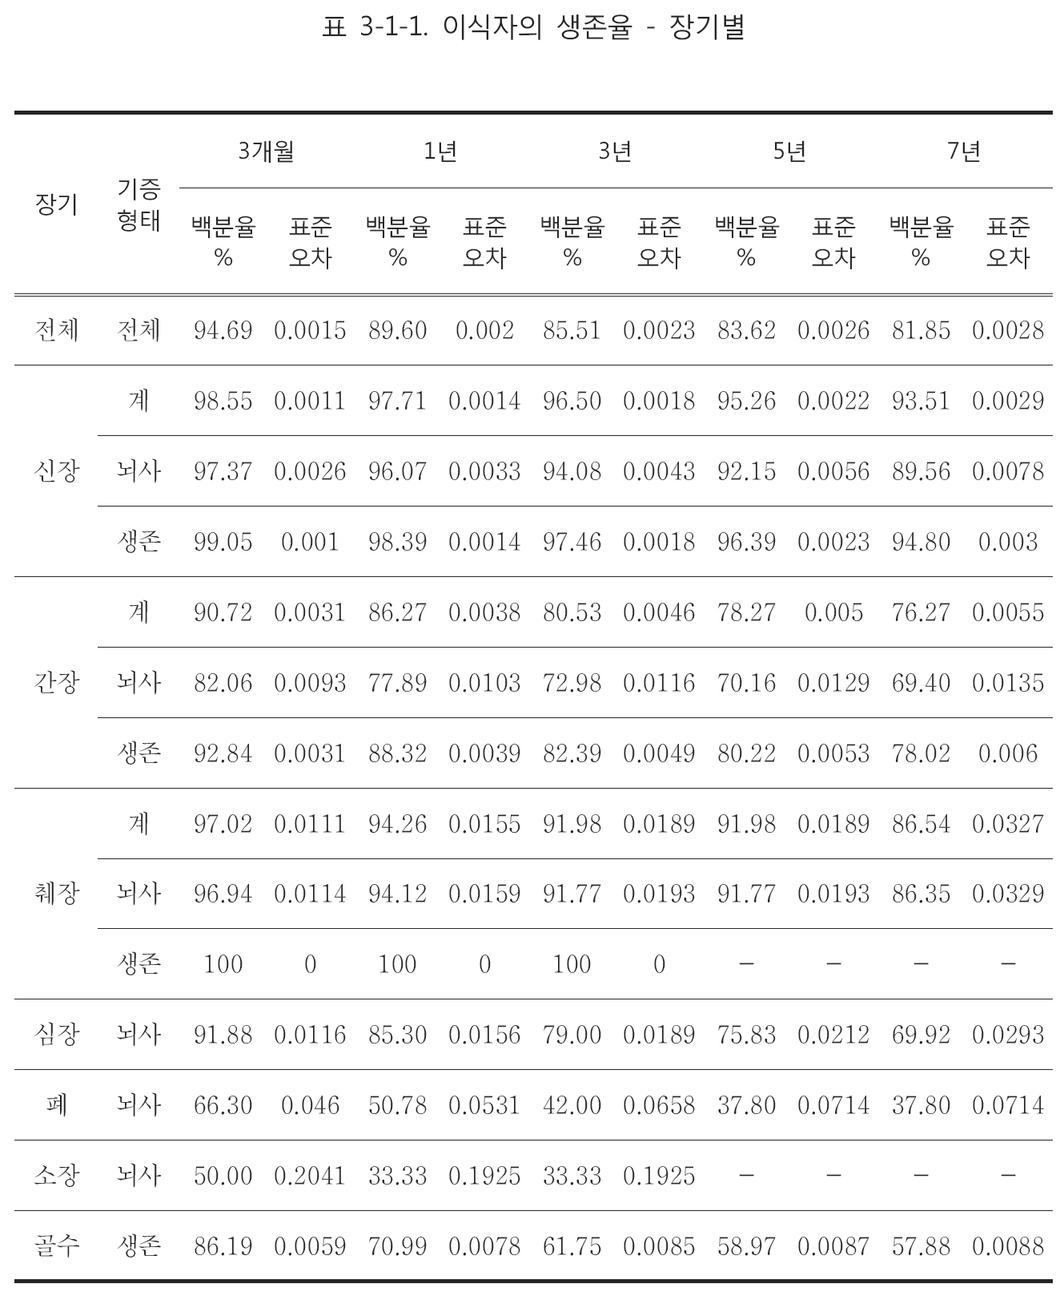

Slide 8
ADULT LUNG TRANSPLANTS
Kaplan-Meier Survival by Era
(Transplants: January 1988 - June 2010)
1988-95 vs. 1996-2003: p < 0.0001
1988-95 vs. 2004-6/2010: p <0.0001
1996-2003 vs. 2004-6/2010: p <0.0001
ISHLT
2012
J Heart Lung Transplant. 2012 Oct; 31(10): 1045-1095
Notes:
Survival was calculated using the Kaplan-Meier method, which incorporates information from all transplants for whom any follow-up has been provided. Since many patients are still alive and some patients have been lost to follow-up, the survival rates are estimates rather than exact rates because the time of death is not known for all patients.
The half-life is the estimated time point at which 50% of all of the recipients have died. The conditional half-life is the estimated time point at which 50% of the recipients who survive to at least 1 year have died. Because the decline in survival is greatest during the first year following transplantation, the conditional survival provides a more realistic expectation of survival time for recipients who survive the early post-transplant period.
Survival rates were compared using the log-rank test statistic. No adjustments were made for multiple comparisons.

Slide 9
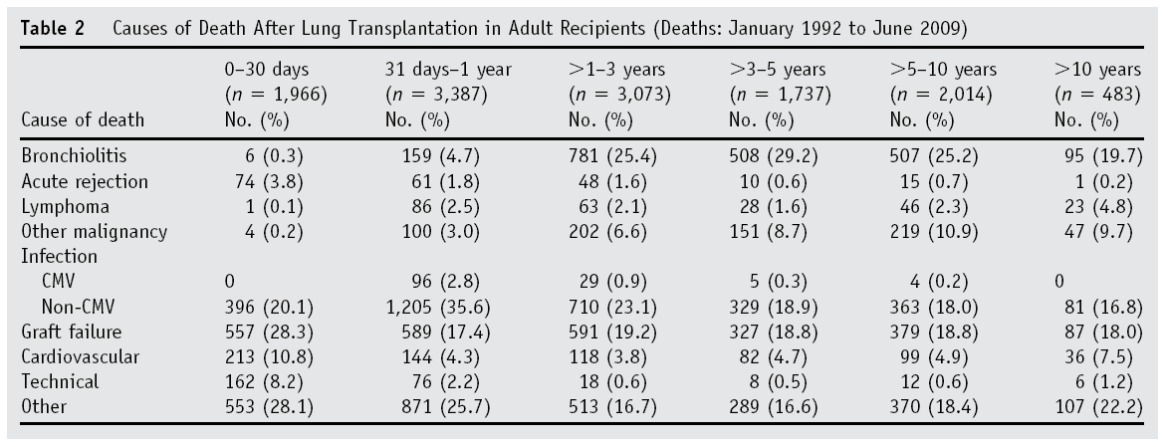
Cause of death

Slide 10
Grading system for primary graft dysfunction
Primary Graft Dysfunction (PGD) : 2005 ISHLT
  PGD grade 0
    PaO₂/FiO₂ > 300 and no pulmonary edema (on CXR)
  PGD grade 1
    PaO₂/FiO₂ > 300 and pulmonary edema
  PGD grade 2
    200 = PaO₂/FiO₂ < 300 and pulmonary edema
  PGD grade 3
    PaO₂/FiO₂ < 200 and pulmonary edema
→ First 48 hrs PDG score 3 : increased short and long term mortality

Slide 11
Quality of life
Improved overall and health-related quality of life after lung transplantation
Over 80% : no activity limitation
Almost 40% : working at least part-time
90% of survivor : satisfied with their decision to have a transplant
But, expensive treatment

Slide 12
Recipient selection

Slide 13
General guideline for recipient selection
ATS and ISHLT
  Appropriate age
    Heart-lung 55yrs, single 65yrs, bilateral 60yrs
  Clinically and physiologically severe disease
  Ineffective or unavailable medical therapy
  Limited life expectancy due to lung disease

Slide 14
  Acceptable nutritional status, usually 80 to 120% of ideal body weight or BMI less than 30 kg/m²
  Satisfactory psychosocial profile and support system
  Adequate financial coverage for the procedure and postoperative care

Slide 15
LUNG TRANSPLANTS
Transplant Recipient Age by Year of Transplant
(Transplants: January 1, 1987 – June 30, 2011)
ISHLT
2012
J Heart Lung Transplant. 2012 Oct; 31(10): 1045-1095

Slide 16
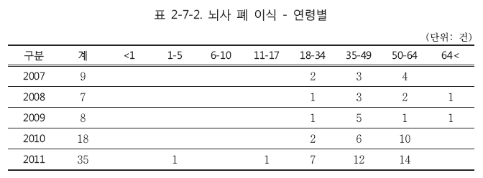

Slide 17
ADULT LUNG TRANSPLANTS
Kaplan-Meier Survival by Age Group
(Transplants: January 1990 - June 2010)
All pair-wise comparisons are significant at p < 0.05
ISHLT
2012
J Heart Lung Transplant. 2012 Oct; 31(10): 1045-1095
Notes:
Survival was calculated using the Kaplan-Meier method, which incorporates information from all transplants for whom any follow-up has been provided. Since many patients are still alive and some patients have been lost to follow-up, the survival rates are estimates rather than exact rates because the time of death is not known for all patients. The half-life is the estimated time point at which 50% of all of the recipients have died.
Survival rates were compared using the log-rank test statistic. No adjustments were made for multiple comparisons.

Slide 18
Lung allocation score
“http://optn.transplant.hrsa.gov/resources/allocationcalculators.asp?index=88”
Post transplant survival (days)
  FVC, PCW pressure, MV, Age, Cr, NYHA, Dx
Waiting list urgency (days)
  FVC, PA sys pressure, O₂ require, Age, BMI, DM, NYHA, 6-min walk distance, MV, Dx, pCO₂
Lung allocation score : 0~100

Slide 19
Contraindication
Uncontrolled or untreatable pulmonary or extrapulmonary infection
Malignancy in the last two years
Significant dysfunction of other vital organs
Significant coronary artery disease or heart disease
Active tobacco smoking

Slide 20
Drug or alcohol dependency
Unresolved psychosocial problems or noncompliance with medical therapy
HIV infection
Ongoing hepatitis B or C viral infection
Absence of a consistent or reliable social support system

Slide 21
Disease specific consideration

Slide 22
Major 4 categories
Nonbronchiectatic obstructive : COPD
Bronchiectasis : Cystic fibrosis
Interstitial : IPF
Pulmonary vascular : Pulmonary hypertension

Slide 23
ADULT LUNG TRANSPLANTS
Major Indications By Year (Number)
ISHLT
2012
J Heart Lung Transplant. 2012 Oct; 31(10): 1045-1095

Slide 24
ADULT LUNG TRANSPLANTS
Kaplan-Meier Survival by Diagnosis
(Transplants: January 1990 - June 2010)
All comparisons with Alpha-1 and CF are statistically significant at < 0.05
COPD vs. IPF: p < 0.0001
ISHLT
2012
J Heart Lung Transplant. 2012 Oct; 31(10): 1045-1095
Notes:
Survival was calculated using the Kaplan-Meier method, which incorporates information from all transplants for whom any follow-up has been provided. Since many patients are still alive and some patients have been lost to follow-up, the survival rates are estimates rather than exact rates because the time of death is not known for all patients. The half-life is the estimated time point at which 50% of all of the recipients have died.
Survival rates were compared using the log-rank test statistic. No adjustments were made for multiple comparisons. Only pair-wise comparisons statistically significant at p ≤ 0.05 are shown on the slide.

Slide 25
COPD
Guideline for transplantation (ISHLT 2006)
  BODE index of 7-10 or at least 1 of following
  Hx of hospitalization for AE associated with acute hypercapnia (PCO₂ ≥ 50mmHg)
  PH or cor pulmonale, or both despite oxygen therapy
  FEV₁ < 20% and either DLCO < 20% or homogenous distribution of emphysema

Slide 26
CF (and other causes of BE)
Guideline for lung transplantation (ISHLT 2006)
  Oxygen-dependent respiratory failure
  Hypercapnia
  Pulmonary hypertension

Slide 27
UIP and NSIP
Guideline for lung transplantation (ISHLT 2006)
  UIP (any one of following)
    DLCO < 35% predicted
    10% ≤ decrement in FVC during 6 months of F/U
    SpO₂ < 88% during 6MWT
    Honeycombing on HRCT (fibrosis score of 2)
  NSIP (any one of following)
    DLCO < 35% predicted
    10% ≤ decrement in FVC or 15% ≤ decrease in DLCO during 6 months of F/U

Slide 28
PAH
Guideline for lung transplantation (ISHLT 2006)
  Persistent NYHA III/IV on maximal medical therapy
  Low (350m) or declining 6MWT
  Failing therapy with intravenous epoprostenol or equivalent
  CI < 2L/min/m²
  RAP > 15mmHg

Slide 29
Ventilator dependence
Invasive mechanical ventilation before transplantation → significant risk factor for mortality after transplantation
Clinically stable patients requiring mechanical ventilation : similar survival
Noninvasive positive pressure ventilation is preferred
ECMO can be used successfully as a bridge to lung transplantation

Slide 30
Nutritional status
Pretransplant obesity → significant risk for mortality : > BMI 30kg/m² → 22% higher
Low BMI : not a risk factor, malnutrition is ominous
ATS guideline : <70% or 130%> of IBW, should gain or lose weight before transplantation

Slide 31
DM
DM is not considered a contraindication
Several studies reported that DM is associated with increased mortality
Significant end-organ disease : relative or absolute contraindication
Blood sugar control : HbA1c < 7%

Slide 32
Previous cardiothoracic surgery
Increase technical difficulty and operative risk
Rarely preclude lung transplantation
Simple pneumothorax treated by closed tube thoracostomy, open lung biopsy, uncomplicated lobectomy : not impediment to transplantation
More complex cases must be individually assessed

Slide 33
Coronary heart disease
17% among lung transplant candidates over the age of 50 → 8% of those required revascularization
Multiple risk factors → consider angiography before transplantation
Coronary artery disease : a relative contraindication
Advanced disease : may be candidate for heart-lung transplantation

Slide 34
Glucocorticoid use
The use of GC before transplantation has not been a risk factor for mortality
Prednisone 0.2 to 0.3 mg/kg per day are safe
High dose for relatively short periods is not considered a contraindication

Slide 35
Chronic infection
Bronchiectasis, especially cystic fibrosis
Initiate antifungal therapy when aspergillus is isolated before (20~50%) or after (50%) transplantation
NTM infection (8%) : attempt to eradicate before transplantation, persistent (+) cultures on Tx are relative contraindication
MDR bacteria : may be associated with worse prognosis
Burkholderia cepacia complex : increased mortality, consider contraindication

Slide 36
Prior malignancy
The risk of cancer recurrence (ex: kidney recipient 22% recur, transplantation within 2 years of cancer treatment 53% recur)
2-year period between cancer treatment and transplantation was advised for most cases
Longer than 2 years : malignant melanoma, breast cancers, colorectal cancers

Slide 37
Allosensitization
Ab to HLA (transfusion, pregnancy, previous transplantation)
Risk of hyperacute rejection
PRA (panel reactive antibodies) : detect anti-HLA antibodies
> 25% PRA → increased risk of death, especially in the early post-operative period
Avoid potential donors with the reactive HLA for the corresponding recipient

Slide 38
Systemic disease
Carefully selected patients with sarcoidosis, LAM, pulmonary LCH, scleroderma
→ Satisfactory results after lung transplantation

Slide 39
References
Uptodate : www.uptodate.com
The International Society for Heart and Lung Transplantation (ISHLT) : www.ishlt.org
질병관리본부 장기이식관리센터 : Annual report of transplant 2011, www.konos.go.kr
Christie JD, et al. The Registry of the International Society for Heart and Lung Transplantation: twenty-seventh official adult lung and heart-lung transplant report-2010. J Heart Lung Transplant 2010.

