Slide 1

In depth review
: Lung function decline in COPD
- SAPALDIA Study
Lung Health Study
Leem Ah Young
Division of Pulmonology,
Department of Internal Medicine,
Institute of Chest Diseases,
Severance hospital, Yonsei University College of Medicine

Slide 2
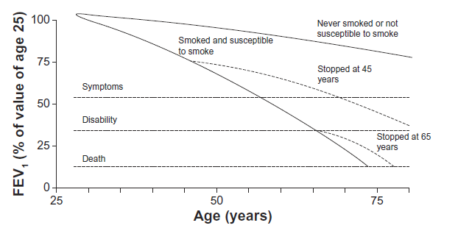
Introduction
Assumptions about lung function decline occurring in COPD have been influenced by the landmark study of Fletcher and Peto
  Measured the FEV₁ every 6 months for an 8-year follow-up period in a cohort of 792 working men

Slide 3
Introduction
  Smoking-related lung functional damage
  Unavoidable progression of the airflow obstruction
  Reduction of the excessive FEV₁ decline after smoking cessation
  The rate of FEV1 decline increased progressively with time in susceptible smokers
  Limitations
    Age between 30 and 59 years only
    Follow-up period was relatively short
    Fletcher C, Peto R. Br Med J. 1977;1(6077):1645–1648

Slide 4
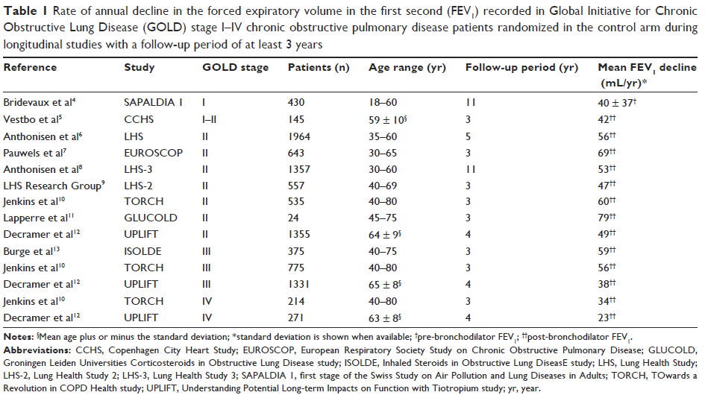
Introduction
Claudio Tantucci et al. International Journal of COPD 2012:7 95–99

Slide 5
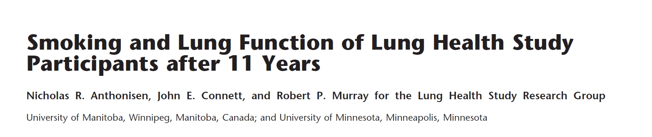
Anthonisen NR et al. Am J Respir Crit Care Med. 2002;166(5):675–679.

Slide 6
Background
Original Lung Health Study (LHS 1)
  Randomized clinical trial of smoking cessation and regular administration of an inhaled bronchodilator (ipratropium bromide)
  In 5,887 middle-aged smokers(35-60yrs) who had airway obstruction
  5-year follow up
  Analysis showed that smoking cessation reduced the rate of decline of lung function whereas inhaled bronchodilator did not

Slide 7
Background
Lung Health Study 3
  Extension of LHS 1
  Reassessment 11 years after their enrollment
  Objectives
    To ascertain whether differences in lung function between randomly assigned treatment groups
    To determine whether the profound impact of smoking cessation on lung function decline noted in LHS 1 persisted or increased

Slide 8
Methods
All LHS 1 participants were deemed eligible for LHS 3
  Healthy smokers, aged 35 to 60 years, presence of airway obstruction
  Asked to return for spirometry and to answer smoking questionnaires
Detailed smoking history, smoking status, spirometry

Slide 9
Methods
Analysis groups
  Usual care (UC) and smoking intervention (SI)
    Usual care
      No intervention
    Smoking intervention
      Smoking cessation program
  Sustained quitters (SQs), Continuing smokers (CSs) and Intermittent quitters (IQs)
    Sustained quitters
      Ex-smokers at each of the follow-up visits
    Continuing smokers
      Reported smoking at all scheduled follow-up visits
    Intermittent quitters
      Smoking at some but not all of their visits

Slide 10
Methods
Statistical analysis
  t-tests, chi-square tests
  analysis of covariance, logistic regression

Slide 11
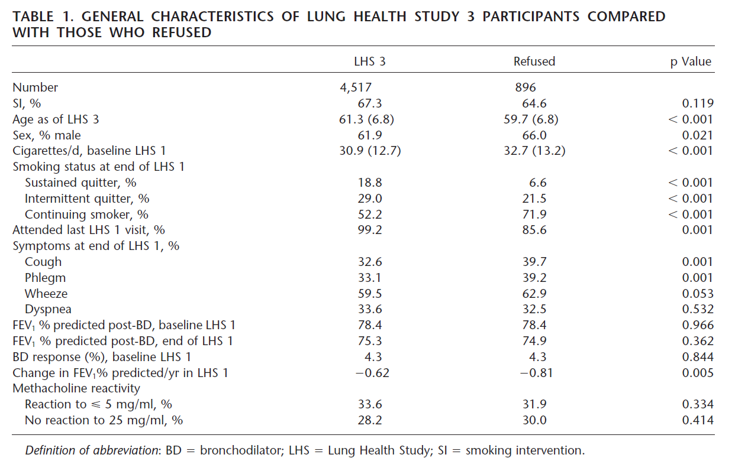
Results
Notes:
5413명이 eligible, 그 중 4517명이 enroll (83.4%)
Enroll 되지 않은 group에 젊은 남성, 흡연자가 많은 경향

Slide 12
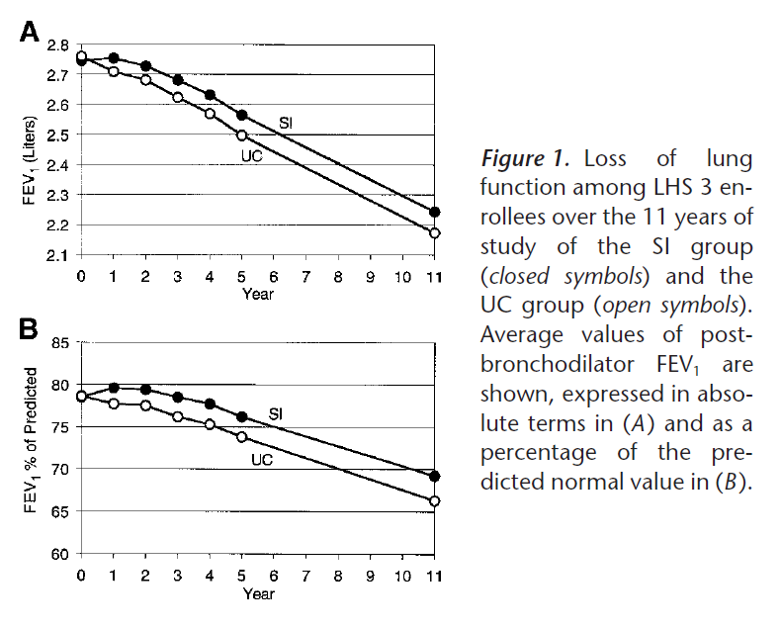
Over the 11 years, FEV1 decline
UC group : 587ml, or 12.3%
SI group : 502ml, or 9.3%
(p=0.001)
Notes:
다음은 treatment group 에 따른 FEV1 실측치 및 predicted value의 감소를 비교한 것
11년간, UC group은 … , SI group 은 … 의 FEV1 감소가 있었고, 이는 유의한 차이

Slide 13
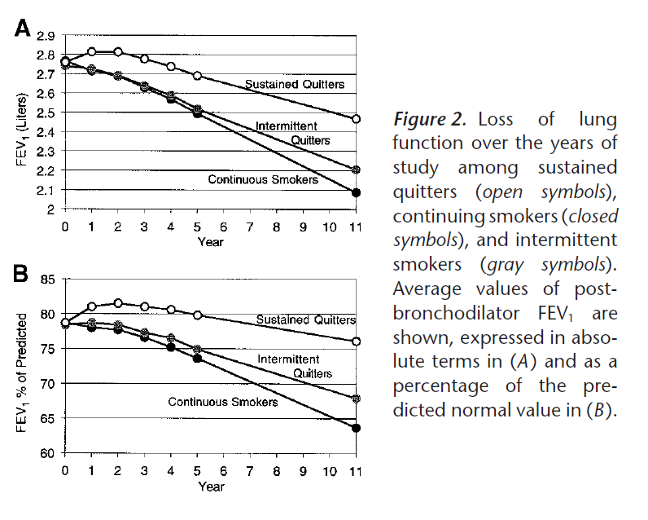
Notes:
다음은 smoking status 에 따라 분류한 각 group 간의 FEV1 실측치 및 predicted value 의 감소를 비교한것
Lung function 감소의 기울기는 sustained quitter group에서 가장 완만하였고, continuous 급격하였으며 intermittent quitter의 경우 중간

Slide 14
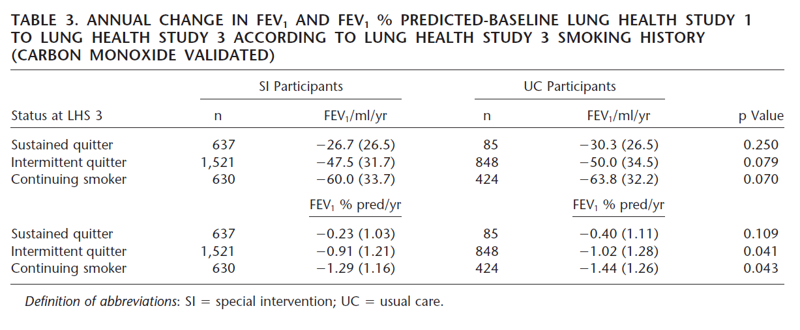
Results
Notes:
다음은 smoking status 에 따른 FEV1 의 감소를 treatment group에 따라 나누어 살펴본 것
각 그룹에서 SI group에서 UC group보다 lung function loss 가 약간 적었으나,

Slide 15
Discussion & Summary
There were significant differences in lung function between randomly assigned treatment groups after 11 years
Differences in lung function between who quit smoking and those who did not increased progressively over 11 years

Slide 16
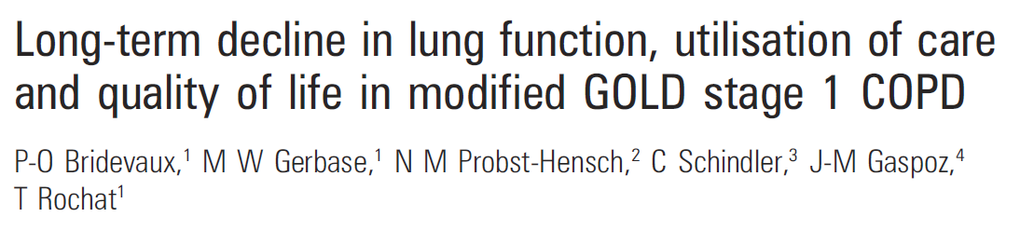
Bridevaux PO et al. Thorax. 2008;63(9):768–774.

Slide 17
Background
Little is known about the long-term outcomes of individuals with mild COPD
Aim of the study
  Compare the long-term decline in FEV₁, respiratory care utilisation and quality of life between individuals with symptomatic and asymptomatic stage 1 COPD

Slide 18
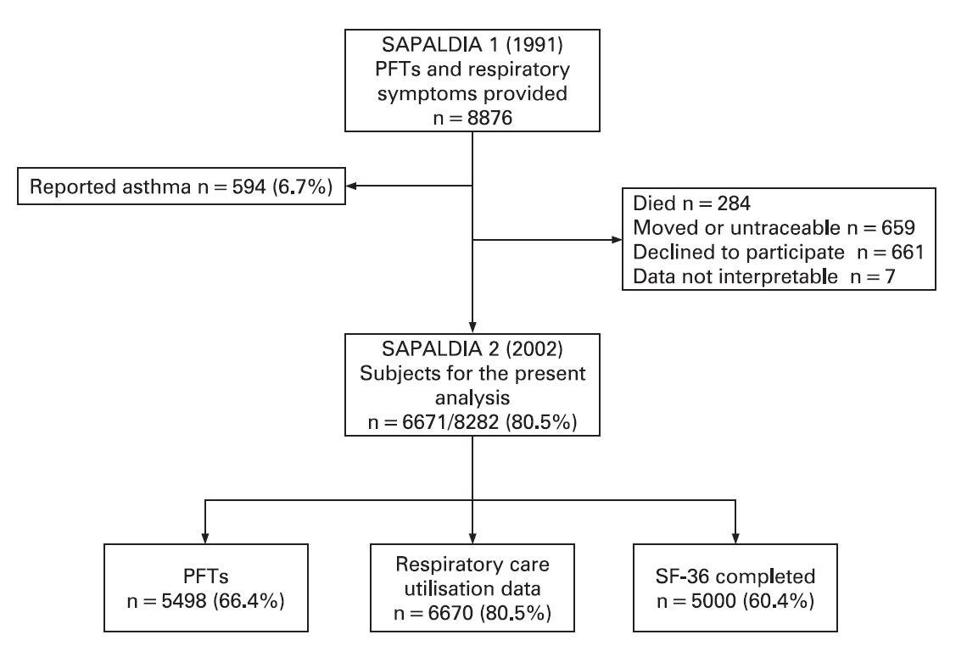
Methods
Study population
  The SAPALDIA cohort (Swiss Study on Air Pollution and Lung Diseases in Adults) (n=9651)
  1991–2002
  Individuals aged 18–60 years
Notes:
SAPALDIA cohort 에서 PFT 와 respiratory symptom 을 확인할 수 있었던 8876 명을 대항으로, asthma 와 사망, 연락되지 않는 환자, loss 된 환자를 제외한 6671명이 f/u study 의 대상이 되었습니다.

Slide 19
Methods
Pulmonary function tests and symptoms assessment
  FEV1/FVC<0.7 and prebronchodilator FEV1≥80% into the stage 1 COPD category
  Respiratory symptoms
    Chronic cough, phlegm or shortness of breath while walking at basline examination
Respiratory care utilisation
  Inhaler use, emergency room visit or hospitalisation due to respiratory problems, ambulatory visit to a chest physician, asthma specialist or primary care provider for respiratory problems

Slide 20
Methods
Quality of life
  Medical Outcomes Study 36-item Short-Form General Health Survey (SF-36)
    Physical component summary, Mental component summary
Covariates
  Nationality, education level, smoking status (never, former, current) and lifetime smoking (packs/year)
  Height, weight and body mass index (BMI)
Statistical analysis
  Mixed linear and logistic regression models

Slide 21
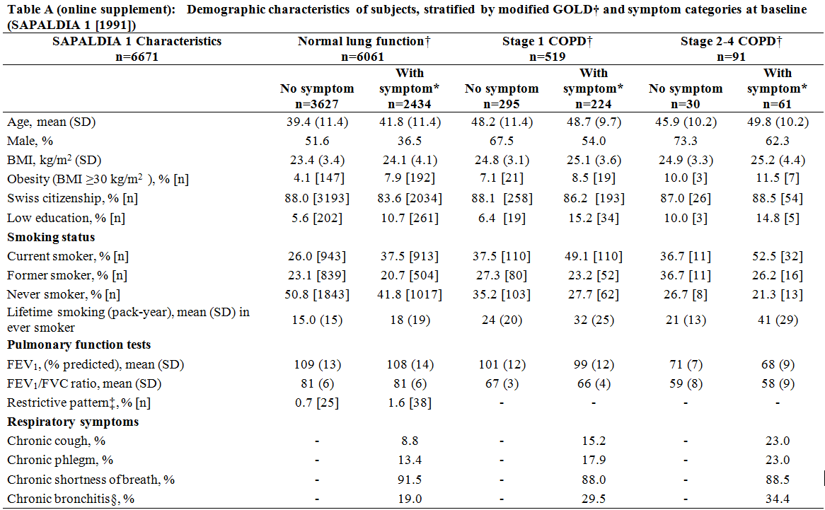
Results
Notes:
다음은 normal lung function group, stage 1 COPD, Stage 2-4 COPD group 간의, baseline demographic characteristics 비교
Stage 1 COPD 에서는 반 이상이 no symptom
COPD group이 normal lung function group에 비하여 고령이고, male, 흡연자 비율이 높았음.

Slide 22
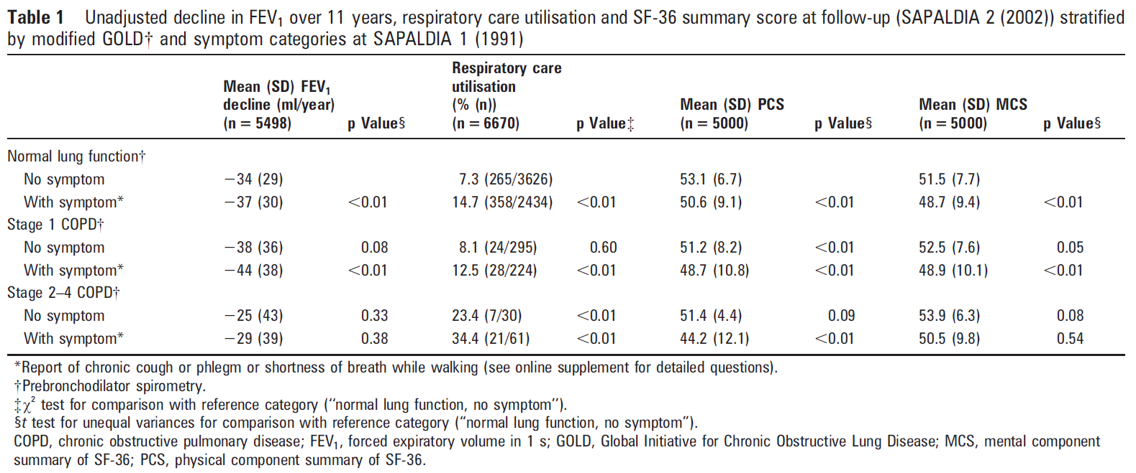
Results
Mean FEV1 decline over 11yrs
Normal lung function : -35 (29) ml/yr (n=4997)
Stage 1 COPD : -40 (37) ml/yr (n=430)
Stage 2-4 COPD : -28 (40) ml/yr (n=71)
(p<0.01)
Notes:
11년간의 FEV1 의 unadjusted decline 을 나타낸 것
Normal lung function 의 No symptom group 을 reference group 으로 하였을 때,
Symotom 있는 normal lung function group, symtom 있는 stage 1 COPD group 의 mean FEV1 decline 이 reference group 과 유의한 차이
Stage 1 COPD 의 no symptom, symptom group 간에는 유의한 차이는 없었음.

Slide 23
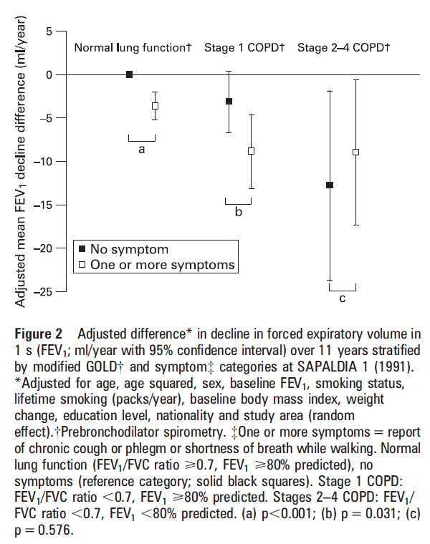
Notes:
다음 그림은 covariate 으로 multivariate analysis 을 했을 시의 adjusted mean annaul decline 을 비교
Normal lung function group 과, Stage 1 COPD group 의 경우 symptom 있는 그룹과 없는 그룹간의 mean FEV1 decline 의 유의한 차이

Slide 24
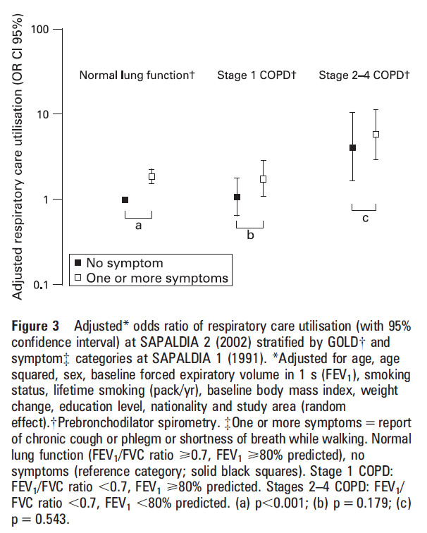
Notes:
다음은 repiratory care utilization 에 대한 multivariate analysis 결과.
Symptom 유무로 비교하였을 때 normal lung function group 의 경우에 symptom 유무에 따라 respiratory care utilization 에 유의한 차이
예상할 수 있는 결과지만 stage 2-4 COPD 의 경우에 유의하게 normal lung function 에 비하여 respiratory care utilization 이 많았음.

Slide 25
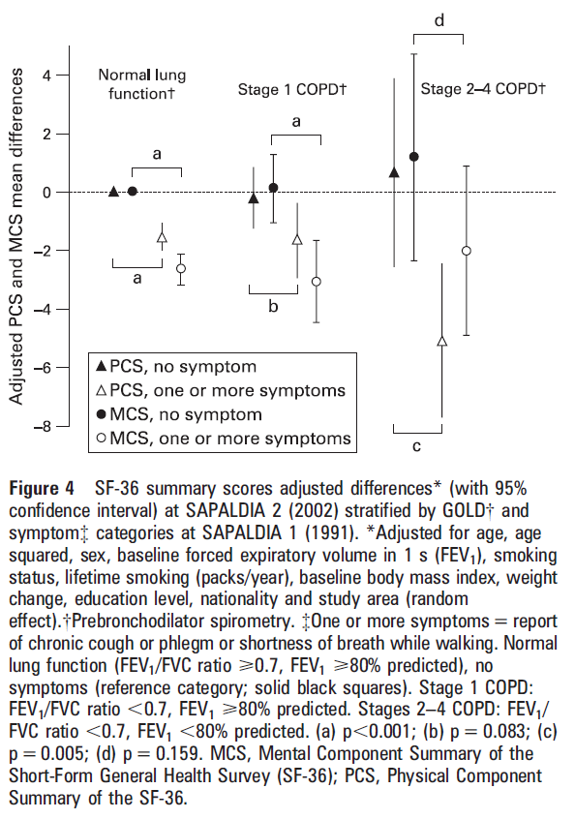
Notes:
다음은 physical component summary score 와 mental component summary score 에 대한 multivariate analysis 결과로
Normal lung function group의 경우 physical component, mental component 모두 symptom 이 없을 때에 비하여 있을 때 유의하게 낮음
Stage 1 COPD 의 경우에는 Physical component score, Stage 2-4 COPD 의 경우 MCS

Slide 26
Discussion & Summary
The presence of respiratory symptoms with stage 1 COPD significantly modified
  Long-term FEV₁ decline
  Respiratory care utilisation patterns
  Health-related quality of life scores
Decline in lung function
  Decline in FEV₁ with stage 1 COPD was statistically different in relation to the absence or presence of respiratory symptoms
    Symptoms might be linked to a remodelling process in the airways and, may represent a prognostic marker of functional impairment

Slide 27
Discussion & Summary
Respiratory care utilisation
  Symptomatic individuals with stage 1 COPD were more likely to report respiratory care utilisation
    Free of respiratory symptoms of stage 1 COPD had similar rates to asymptomatic subjects with normal lung function
      Stage 1 COPD may represent a normal variant of lung function with little potential for developing clinical disease
Quality of life
  Symptomatic subjects with normal lung function, stage 1 or stages 2–4 COPD had lower physical and mental health scores
  Asymptomatic subjects with stage 1 COPD and those with normal lung function had similar quality of life scores
    Deterioration in the health status was possibly due to respiratory symptoms

Slide 28
Study plan
Long term lung function decline (annual)
  안성, 안산 코호트 (8000명)
  PFT
  Normal lung function, COPD
  Risk factor
Incidence and risk factor of COPD
  안성, 안산 코호트 및 KOLD cohort
  Risk factor and ralative risk
    Age, sex, smoking status, socioeconomic status

Slide 29
Reference
[1] Fletcher C, Peto R. The natural history of chronic airflow obstruction. Br Med J. 1977;1(6077):1645–1648.
[2] Bridevaux PO, Gerbase MW, Probst-Hensch NM, Schindler C, Gaspoz JM, Rochat T. Long-term decline in lung function, utilisation of care and quality of life in modified GOLD stage 1 COPD. Thorax. 2008;63(9):768–774.
[3] Anthonisen NR, Connett JE, Kiley JP, et al. Effects of smoking intervention and the use of an inhaled anticholinergic broncodilator on the rate of decline of FEV1: the Lung Health Study. JAMA. 1994;272(19):1497–1505.
[4] Anthonisen NR, Connett JE, Murray RP. Smoking and lung function of Lung Health Study participants after 11 years. Am J Respir Crit Care Med. 2002;166(5):675–679.
[5] Lung Health Study Research Group. Effect of inhaled triamcinolone on the decline in pulmonary function in chronic obstructive pulmonary disease. N Engl J Med. 2000;343(26):1902–1909.

Slide 30


