Slide 1




Lung cancer in interstitial lung disease patients
호흡기내과 R3 김영재
Division of Pulmonology
Department of Internal Medicine
Yonsei University College of Medicine

Slide 2
Index
Case presentation
Interstitial lung disease and lung cancer
Korean data
Cohort study of Interstitial lung disease in Severance

Slide 3
Case presentation

Slide 4
Identification
김ㅇ호
M / 70
5821863

Slide 5
Chief complaint & Present illness
Chief complaint
: Blood tinged sputum x 10 days
Present illness
: 상기 70세 남환은 약 15년 전 DM, dyslipidemia 진단 받고 po medication 중이고, PAOD로 본원 refer 되어 PTA (2010년 8월) 시행 받고 심장내과 f/u 중이며, 호흡기내과적으로는 여의도 성모병원에서 2001년 thoracoscopic wedge biopsy 시행하여 Idiopathic pulmonary fibrosis 진단 받았던 환자로, 내원 10일 전부터의 blood tinged sputum 있어 본원 호흡기내과 내원함.

Slide 6
Past history & V/S
HTN / DM / Tuberculosis / Hepatitis ( - / + / - / - )
흡연력 : Former (2p x 45ys = 90pys, 2년 전 quit)
직업력 : 방송 업계
BP : 154/89mmHg, PR : 59/min, RR : 16/min

Slide 7
ROS & P/Ex
ROS
- Fever / Chill ( - / - )
- Cough / Sputum / Hemoptysis ( + / + / + )
- Dyspnea / DOE / Chest pain ( - / - / - )
P/Ex
- Not so ill looking apperance
- Alert mental status
- Clear breathing sound with crackle on BLLF
- Regular heartbeat without murmur

Slide 8
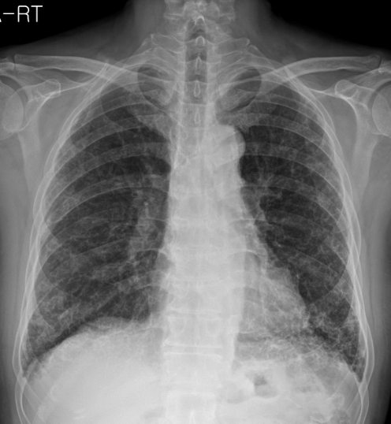
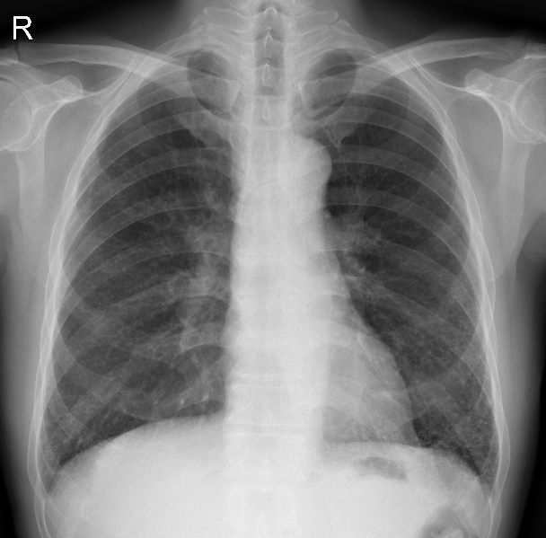
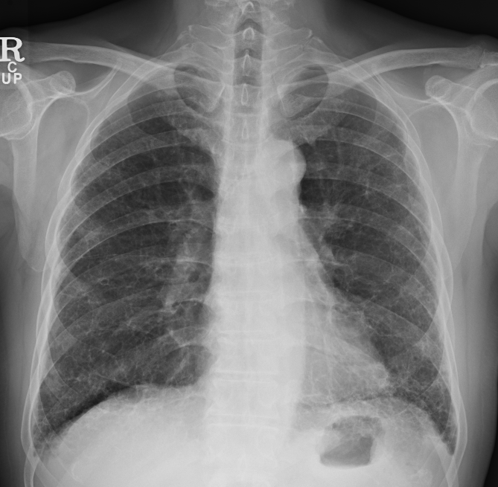
Chest X-ray
< 2012. 12. 6 >
< 2012. 8. 23 >
< 2005. 5. 11 >

Slide 9
Lab & Study
CBC : 9440(49.8%) / 14.6 / 253K
PT (INR) / aPTT : 0.89 / 28.4 sec
BUN / Cr : 27.1 / 1.22 (mg/dL)
OT / PT / T.bil : 17 / 15 / 0.6 (IU/L)
Electrolyte : 138 / 5.4 / 104 (mmol/L)
HbA1c : 7.3 (%)
CRP : 2.82 (mg/L)

Slide 10
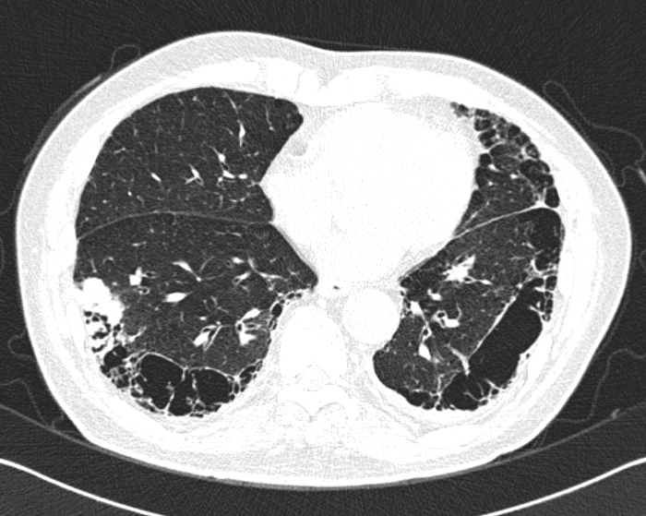
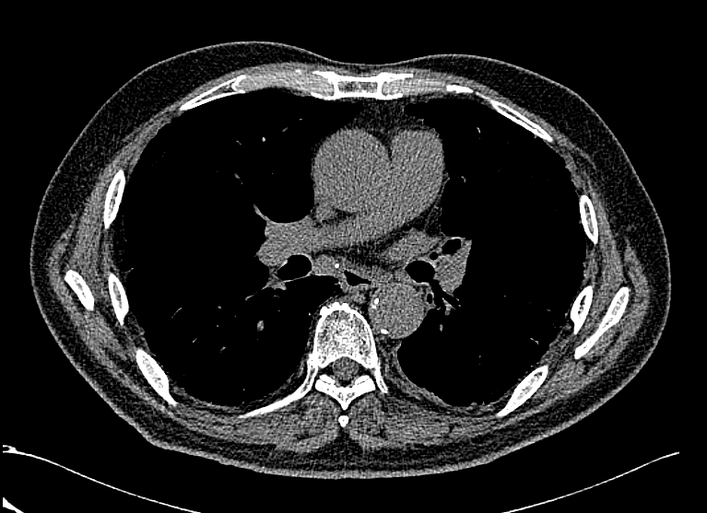
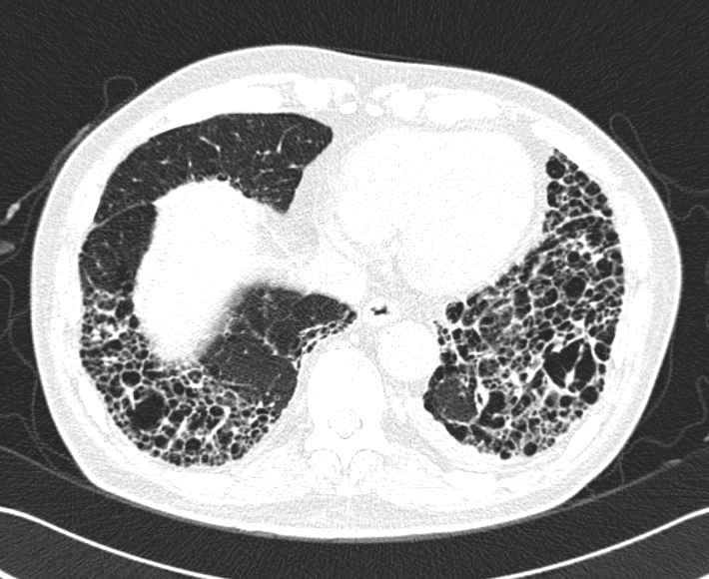
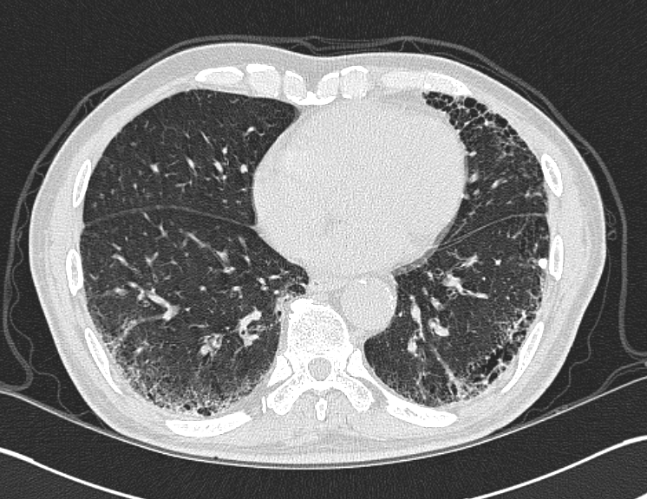
Chest CT (non-contrast)
(2012. 12. 6)

Slide 11
Impression
R/O Lung cancer
Idiopathic pulmonary fibrosis
PAOD
s/p PTA c stent at Lt SFA, PTA at Lt. ATA (2010.8.10)
s/p PTA at Rt.ATA, Peroneal A (2010.8.11)
CAOD (2VD)
Diabetes mellitus
Dyslipidemia

Slide 12
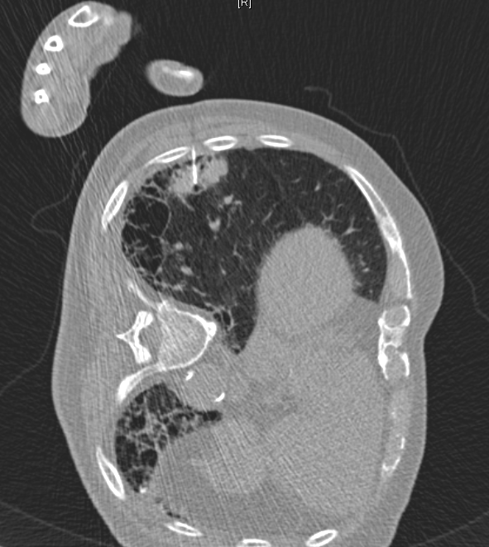
CT guided lung biopsy
(2013. 1. 2)

Slide 13
Tumor marker
& Autoimmune marker
CEA 246.58 (mg/mL)
CYFRA 21-1 6.38 (mg/mL)
ANA IFA 1:40 negative
Anti-DNA Screening 1:10 negative
Anti-Cardiolipin antibody screening Negative
Anti-RNP Negative
Anti-Sm Negative
Anti-SS-A/Ro Negative
Anti-SS-B/La Negative
Anti-Scl 70 Negative
Anti-CCP antibody Negative
P-ANCA, IFA Negative
C-ANCA, IFA Negative
MPO(P-ANCA) Negative
PR3(C-ANCA) Negative

Slide 14
Pathology
Lung Aspirate Liquid Based Cytology
◇ SPECIMEN ADEQUACY
Satisfactory for evaluation
◇ INTERPRETATION/RESULT
Positive for malignancy, adenocarcinoma
[Additional report]
The results of immunocytochemical stain:
- TTF-1 and Napsin A: Positive in tumor cells
- p40: Negative

Slide 15
Final diagnosis
Lung cancer (Adenocarcinoma)
Idiopathic pulmonary fibrosis
PAOD
s/p PTA c stent at Lt SFA, PTA at Lt. ATA (2010.8.10)
s/p PTA at Rt.ATA, Peroneal A (2010.8.11)
CAOD (2VD)
Diabetes mellitus
Dyslipidemia

Slide 16
The epidemiology of interstitial lung disease and its association with lung cancer
< British Journal of Cancer (2004) 91(Suppl 2), S3 – S10 >

Slide 17
Introduction
Interstitial lung disease (ILD) refers to a diverse range of pulmonary fibrotic disorders that affect the alveoli of the lungs.
Approximately two-thirds do not have a known cause (idiopathic), while one-third result from known endogenous or exogenous causes, including environmental/occupational factors, infections, drugs and radiation.

Slide 18
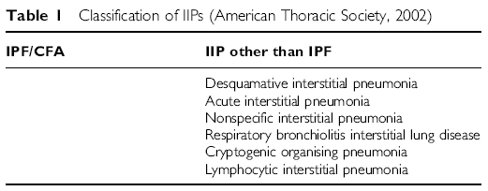
Classification of ILD
IIP (Idiopathic Interstitial Pneumonia)
IPF (Idiopathic Pulmonary Fibrosis) in the USA
= CFA (Cryptogenic Fibrosing Aveolitis) in the U.K.

Slide 19
ILD as a comorbidity of lung cancer
The association between ILD and lung cancer has been recognized since 1952 (Callahan et al, 1952).
Whether ILD precedes lung cancer or vice versa, or if both sequences are common, remains unclear.

Slide 20
Incidence & Prevalence
Idiopathic pulmonary fibrosis patients have a higher incidence of lung cancer than the general population, with relative risks of 7.3 and 14.1 being reported in UK follow-up studies and a similar ratio of 5.3 for prevalence of lung cancer at death in a small Japanese autopsy study

Slide 21
Incidence & Prevalence
The prevalence of lung cancer at the time of IIP diagnosis has been reported in three Japanese patient series studies as 6, 17 and 15%
Among those IIP patients initially free of lung cancer, the approximate cumulative lung cancer incidence over 3–10 years of follow-up ranged from 6 to 15% in Japanese IIP patient series and from 4 to 10% in the UK CFA patient series

Slide 22
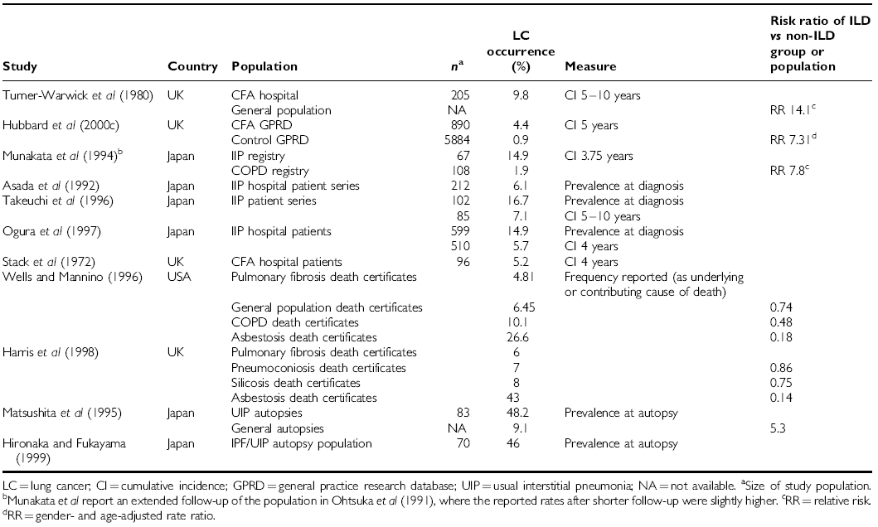
Incidence & Prevalence

Slide 23
Explanation of the association between ILD and lung cancer
Many occupational and environmental exposures have been associated with an increased risk of both ILD and lung cancer and have been investigated as common mechanisms to explain the association
Many studies report that patients with both IPF and lung cancer are generally heavy smokers

Slide 24
Explanation of the association between ILD and lung cancer
An important hypothesis is that the diffuse inflammatory process of IPF may increase lung cancer risk
IPF produces chronic inflammation resulting in the remodeling of the lung and malignancy may be secondary to these chronic inflammatory and fibrotic processes

Slide 25
Explanation of the association between ILD and lung cancer
There have been conflicting reports about the type of lung cancer seen in ILD patients and whether it differs from that seen in the general population
Some authors have reported no difference in the distribution of histological lung cancer types between patients with and without pulmonary fibrosis

Slide 26
Explanation of the association between ILD and lung cancer
Others have reported a distinct anatomical distribution of lung cancer in ILD patients, with most cancers in the peripheral lung
Some authors have also reported a close relationship between the malignancy and honeycombed fibrotic areas

Slide 27
Lung cancer in patients with idiopathic pulmonary fibrosis
J. Park ¹ , D.S. Kim ¹ , T.S. Shim ¹ , C-M. Lim ¹ , Y. Koh ¹ , S.D. Lee ¹ , W.S. Kim ¹ , W.D. Kim ¹ , J.S. Lee ² and K.S. Song ²
< Eur Respir J 2001; 17: 1216–1219 >

Slide 28
Methods
This retrospective study was performed at Asan medical Center in Seoul, Korea, which is a university affiliated tertiary referral centre of 2,000 bed-size. All the patients diagnosed as IPF and lung cancer from May, 1989 to August, 1998 were enrolled in the study

Slide 29
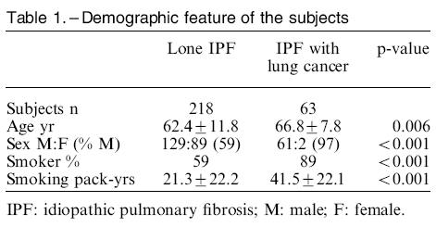
Results

Slide 30
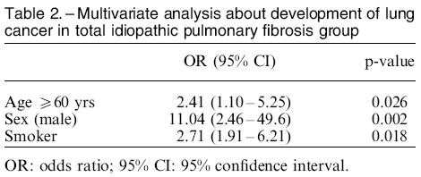
Results

Slide 31
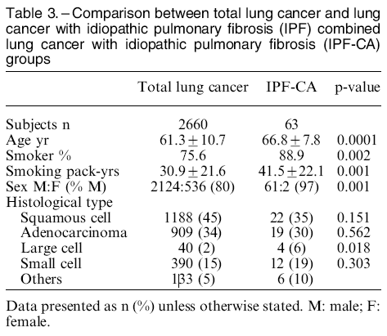
Results

Slide 32
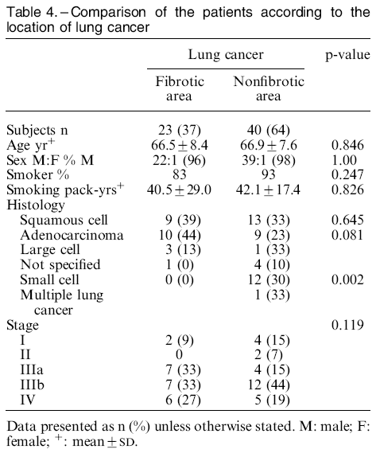
Results

Slide 33
Discussion
The age, percentage of smokers, and the male sex were significantly higher in IPF-CA compared with lone IPF.
The odds ratio of smoking was 2.71 compared to nonsmoking IPF controls.

Slide 34
Discussion
In IPF-CA, 56% of the cancer was located in the periphery of the lung and 52% in the upper lobe.
The majority of the cancers (64%) were found in the nonfibrotic area at chest CT.
The most frequent cell type was squamous cell carcinoma (35%), and there was no significant difference in the cancer cell type between IPF-CA and total lung cancer population.

Slide 35
Discussion
These findings suggest that in combined lung cancer and idiopathic pulmonary fibrosis patients, the features of the lung cancer are similar to the total lung cancer population.

Slide 36
Cohort study of
Interstitial lung disease in Severance

Slide 37
연구 목적
간질성 폐렴에 대한 data base의 체계적 관리 시스템 구축 및 생체 검체 운행을 구축하고 위험인자 예후인자 치료반응인자 및 예측인자 등을 규명하고자 한다. 이러한 시스템은 향후 한국인의 간질성 폐질환에 대한 보다 정확한 이해를 가능하게 할 것이다.

Slide 38
연구 설계 개요
본 연구는 전향적인 코호트 관찰연구로 환자정보 수집은 담당연구간호사 또는 의사가 기록한다.
환자 방문의 종류
- 초기방문(Baseline visit: 등록 당시, 안정상태)
- 정규방문(Regular visit: 안정상태 방문)
- 응급방문(Emergency visit: 급성악화 방문)
각 환자 방문 시마다 임상검사항목 및 관찰항목을 평가하여 기록한다.
환자 동의 하에 피험자로 등록될 시에 수술 검체 및 혈액 채취(10-15ml) 의 혈액을 채취, 저장, 유전자 분리하여 보관한다. 검체는 10년간 보관될 예정이다.

Slide 39
선정 기준
① 만 20세 이상의 성인을 대상으로 함.
② 증상과 무관하게 흉부 X-선 사진상 양측의 망상-미세결절 음영(reticulonodular pattern) 이 있는 경우
③ 증상과 무관하게 흉부 X-선 검사상 정상이나 제한성 호흡장애나 운동 유발성 저산소증이 있는 경우
④ 2002년도 ATS/ERS International multidisplinary consensus에서 제시된 진단 알고리즘에 따라 간질성 폐질환이 진단된 경우
⑤ 임상시험의 취지를 이해하고 본 임상시험에 참여할 것을 자발적으로 동의한 자

Slide 40
연구 방법
평가 항목은 증상, 폐기능, 운동능력, 삶의 질, 장애 그리고 사망으로 일차 평가 지표는 사망이며, 이차 평가 지표는 장애이다. 장애는 폐기능 감소와 운동능력,삶의 질로 평가한다.

