Slide 1
Journal Conference
2012.09.25
내과 R2 한인미

Slide 2
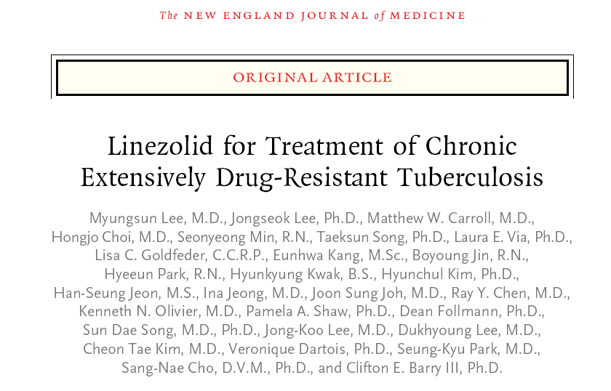

Slide 3
Introduction
Linezolid
-Approved in 2000 for drug-resistant, gram-positive bacterial infections
-A member of the oxazolidinone antibiotic class
-Inhibition of protein synthesis by binding the 23S ribosomal RNA (rRNA) portion of the bacterial 50S ribosomal subunit
-Bacteriostatic activity against Mycobacterium tuberculosis, including multidrug-resistant (MDR) and extensively drug resistant (XDR) strains, with a minimum inhibitory concentration of less than 1 μg per milliliter

Slide 4
Introduction
Backgrounds
-Little tissue-sterilizing ability and a limited role in the treatment of MDR tuberculosis in murine models of tuberculosis
-May be effective in treating MDR and XDR tuberculosis in a number of case reports and retrospective studies
→Discrepancy between preclinical data and clinical observations prompted to undertake a prospective, randomized trial of linezolid in patients with chronic XDR tuberculosis

Slide 5
Methods
From December 2008 through May 2011
Phase 2a, randomized, two-group study at the National Masan Hospital in Changwon and the National Medical Center in Seoul, South Korea
Adults, 20 years of age or older, with chronic XDR pulmonary tuberculosis (positive sputum smear and culture) and with confirmed genotypic or phenotypic resistance to isoniazid, rifampin, kanamycin, ofloxacin, and moxifloxacin or a documented nonresponse to treatment for 6 months or more
Randomly assigned to receive linezolid, at a dose of 600 mg per day, in addition to their existing regimen, either immediately or after a 2-month delay

Slide 6
Methods
The primary end point
-sputum-culture conversion, with data censored at 4 months
-conversion, defined as negative sputum samples on solid (Lowenstein–Jensen) medium for 3 consecutive weeks; culture on liquid medium performed with the use of the MB/BacT automated mycobacterial culture system
Second randomization
-after conversion to negative sputum smears
-stratified either to continue receiving linezolid at a dose of 600 mg per day or to receive a lower dose, 300 mg per day, for an additional 18 months or until therapy was stopped owing to side effects or laboratory abnormalities.

Slide 7
Methods
Adverse event monitoring
-serious neuropathies (e.g., peripheral and optic neuropathies)
-Subjective Peripheral Neuropathy Screen
-Clinical neurologic examinations at baseline and monthly thereafter
-test for visual acuity, contrast sensitivity, and color vision (using Ishihara plates)

Slide 8
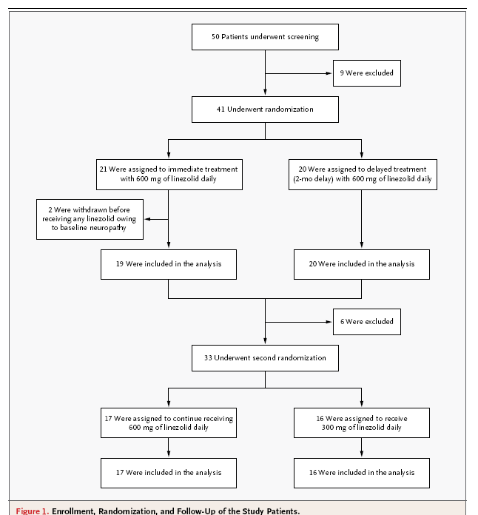

Slide 9
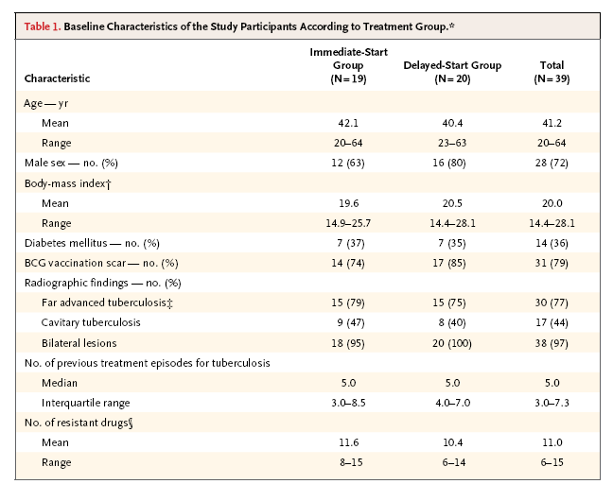
Notes:
the presence of disseminated lesions of slight-to-moderate density exceeding the total volume of one lung
Dense and confluent lesions exceeding one third the volume of one lung
the presence of cavities greater
than 4 cm in diameter.

Slide 10
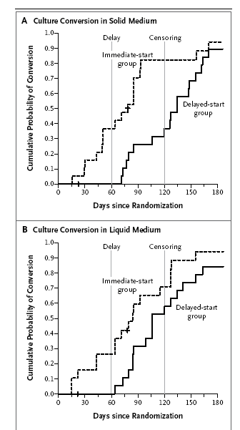
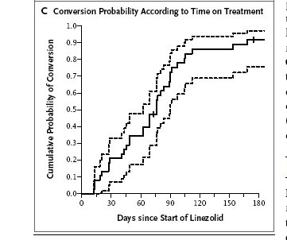
Results
Notes:
15 of the 19 patients (79%) in the immediate-start group and 7 of the 20 (35%) in the delayed-start group (solid medium) (P = 0.001)
12 of the 19 patients (63%) in the immediate-start group and 11 of the 20 (55%) in the delayed-start group (liquid media) (P = 0.07)

Slide 11
Results
Safety
-Of the 38 patients who received linezolid, 33 (87%) had clinically significant adverse events.
-After the second randomization, the group receiving the 600-mg dose was 2.7 times as likely to have an adverse event as the group receiving the 300-mg dose (P = 0.03).
Drug resistance
-Of the four patients who did not have a response to treatment, three (two in the 300-mg group, and one in the 600-mg group) did not have confirmed culture conversion.
-DNA sequencing of these isolates revealed mutations (in association with linezolid resistance from M. smegmatis29 and M. tuberculosis), either in 23S rRNA or in the ribosomal protein L3, in all four patients.

Slide 12
Results
Pharmacokinetics
-Plasma levels of free linezolid were above the measured minimum inhibitory concentration for each isolate during the entire dosing interval in almost all patients taking 600 mg per day.
-No association between the time to culture conversion (measured from the date of the start of treatment with linezolid) and either the peak level (P = 0.93) or the trough level (P = 0.92), measured after at least 2 weeks of linezolid treatment.

Slide 13
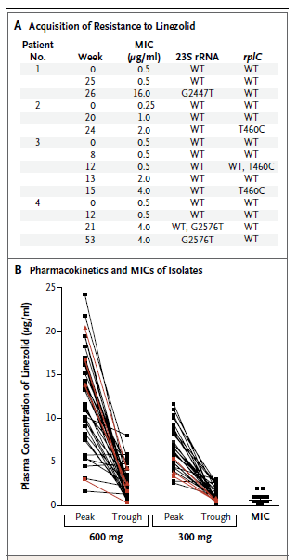
Probability of Event-free Survival over Time.
Resistance to and Pharmacokinetics of Linezolid.

Slide 14
Discussion
The immediate addition of linezolid at a dose of 600 mg per day to the ongoing background treatment regimen had a significant beneficial effect on the time to sputum-culture conversion on solid medium, as compared with the delayed addition of linezolid at the same dose.
34 of the 39 patients (87%) had confirmed culture conversion,
at a median of 76 days.
The incorporation of linezolid into second-line regimens may substantially improve culture-conversion rates.
4 of the 38 patients who received linezolid for 6 months or more (11%) had apparent acquired resistance. This low frequency of acquisition of resistance may be related to the low rate of observed mutation to linezolid resistance in vitro.

Slide 15
Discussion
Adverse events were significantly reduced in patients who subsequently received the reduced dose of 300 mg per day. The pharmacokinetic profile of the 300-mg dose, showed that this dose was sufficient to maintain serum levels above the minimum inhibitory concentration in most patients.
Linezolid shows good pulmonary penetration, and has been
shown to have favorable distribution in infected soft tissue.

Slide 16
Limitations
This study is limited by the small number of patients evaluated, particularly the small number of patients who did not have a response to treatment or in whom resistance developed.
Balancing the long-term risk–benefit ratio of linezolid requires identifying a dose with sufficient potency but less toxicity.

