Slide 1
Lymphangioleiomyomatosis (LAM)
F 용승현

Slide 2
Definition
Lymphangioleiomyomatosis (LAM) is rare multisystem disorder, indolent, progressive growth of smooth muscle cells throughout the lungs, pulmonary blood vessels, lymphatics, and pleurae. It is rare and occurs exclusively in young women.

Slide 3
Epidemiology
Incidence
  Not exactly known, assumed 1 per million, 2~10 per million women worldwide(varies by study)
  Caucasian
  10~15 % of diagnosis are TSC related
  Rarely reported in men, mostly associated with TSC
  Traditionaly known to affect young women (childbearing age, 30-40) but ranging from preadolescence to old age
  No known risk factor

Slide 4
Pathogenesis
2 types of LAM
  TSC related
    Germline mutation in TSC1 or TSC2 gene
  Sporadic
    LAM not associated with tuberous sclerosis complex

Slide 5
Pathogenesis
Primary histopathological abnormality is the proliferation of atypical smooth muscle-like cells (LAM cells)
Tuberin
LAM cell
mTOR unrestricted
Abnormal Lymphangio
genesis
Hamartin

Slide 6
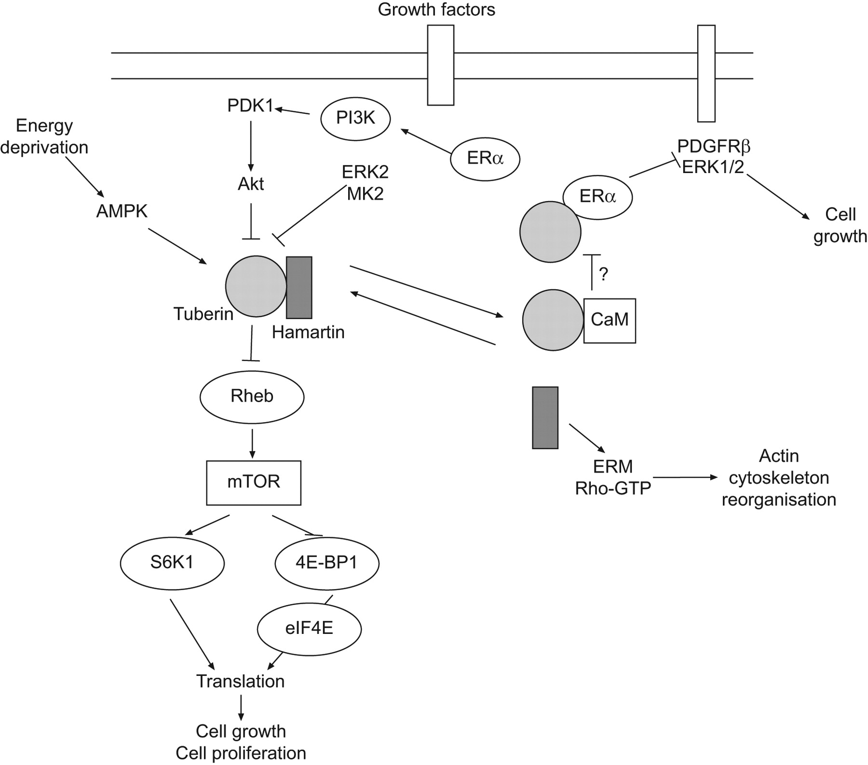
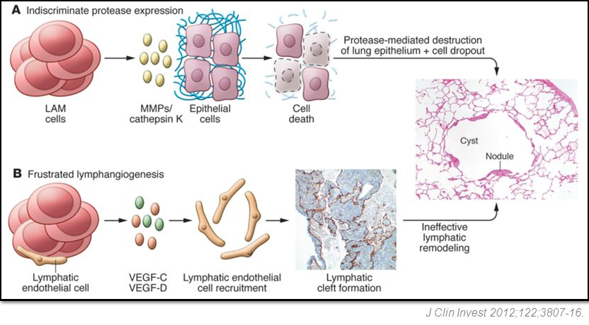

Slide 7
Manifestation
Fatigue (approximately 2/3)
Progressive dyspnea (approximately 2/3)
Spontaneous pneumothorax (approximately 1/3)
Pleural effusion (approximately 1/4)
Organ involvement other to lung
  Lymphangioleiomyomas, lymphadenopathy, Uterine LAM lesions, meningioma
Other
  Chest pain, cough, hemoptysis, chyloptysis, etc

Slide 8
Diagnosis
LAM should be suspected in women with a spontaneous pneumothorax or unexplained dyspnea, especially nonsmoking women of reproductive age
Present with pleural or peritoneal chylous accumulations
Tuberous sclerosis complex (TSC)
Renal angiomyolipoma

Slide 9
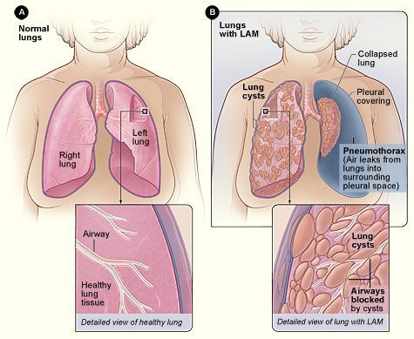

Slide 10
Diagnosis
PFT
  Normal spirometry (30 to 60 percent)
  Obstructive pattern on spirometry (25 to 66 percent)
  Restrictive or mixed obstructive and restrictive pattern on spirometry (less than 1/4)
  Reduced DLCO (60 to 90 percent)
  Approximately 30 percent of patients demonstrate reversible airflow obstruction following an inhaled bronchodilator

Slide 11
Diagnosis
Imaging
  Noncontrast high-resolution computed tomography (HRCT) of the chest should be performed in women with suspected LAM to look for pulmonary cysts characteristic of the disease.
  Noncontrast abdominopelvic CT is indicated to look for the presence of AMLs if cysts are found on chest CT or the patient has abdominal or pelvic symptoms or signs that warrant dedicated abdominal imaging

Slide 12
CT imaging
Cysts – Pulmonary cysts are the hallmark feature of LAM on HRCT chest. Cysts characteristic of LAM are thin-walled, diffuse, round, well-defined, bilateral, and without lobar predominance
Pleural masses or thickening – Macroscopic pleural masses and thickening are not a natural feature of LAM, although microscopic pleural involvement is common
Thoracic lymphatic involvement and pleural effusion – Lymphatic involvement by LAM can cause septal thickening, unilateral or bilateral chylothorax (10 to 20 percent), mediastinal lymphadenopathy (26 percent; hilar adenopathy is unusual), dilated thoracic duct (11 percent), pericardial effusion (6 percent),

Slide 13
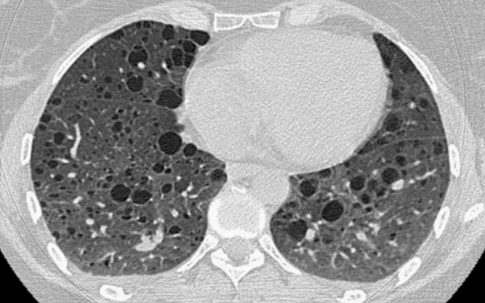
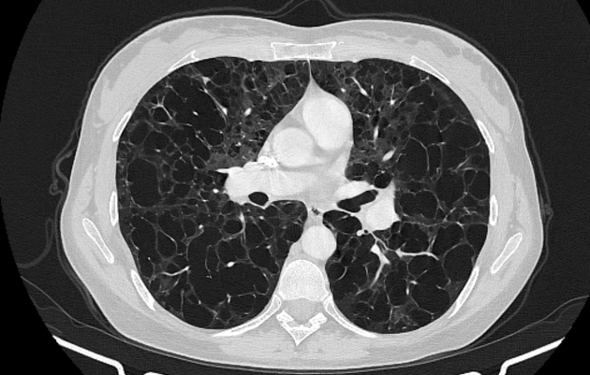
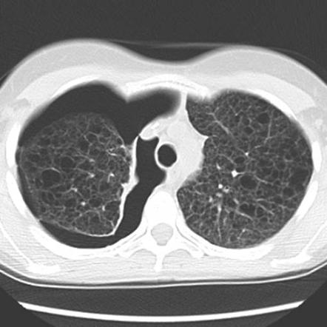
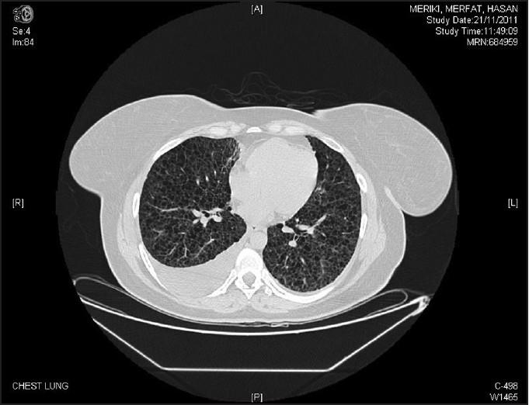

Slide 14
Diagnosis
Laboratory
  Vascular endothelial growth factor-D (VEGF-D) > 800 pg/mL
  alpha-1 antitrypsin (AAT) deficiency and autoantibody testing for rheumatic diseases that can mimic LAM
  Cancer antigen-125 (CA-125) (elevated in 25%), vitamin D binding protein (VDBP)

Slide 15
Diagnosis
Confirmation
  The definitive diagnosis of LAM is made by the identification of LAM cells pathologically or cytologically in lung, lymph node, or body fluid
Differential diagnosis
  Emphysema, pulmonary Langerhans cell histiocytosis (PLCH), lymphocytic interstitial pneumonia (LIP)/follicular bronchiolitis (FB), and Birt-Hogg-Dubé syndrome (BHD)

Slide 16
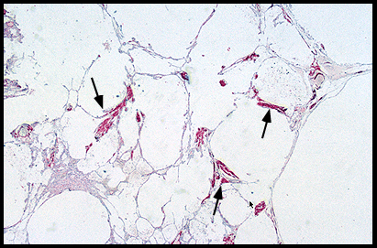
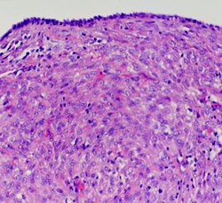

Slide 17
Diagnosis
Other workup
  Pulmonary hypertension (eg, echocardiography)
  Osteoporosis (nuclear bone scanning)
  Tuberous sclerosis complex (TSC) manifestations (retinal exam, central nervous system imaging)
  Cerebral meningioma (eg, brain imaging)

Slide 18
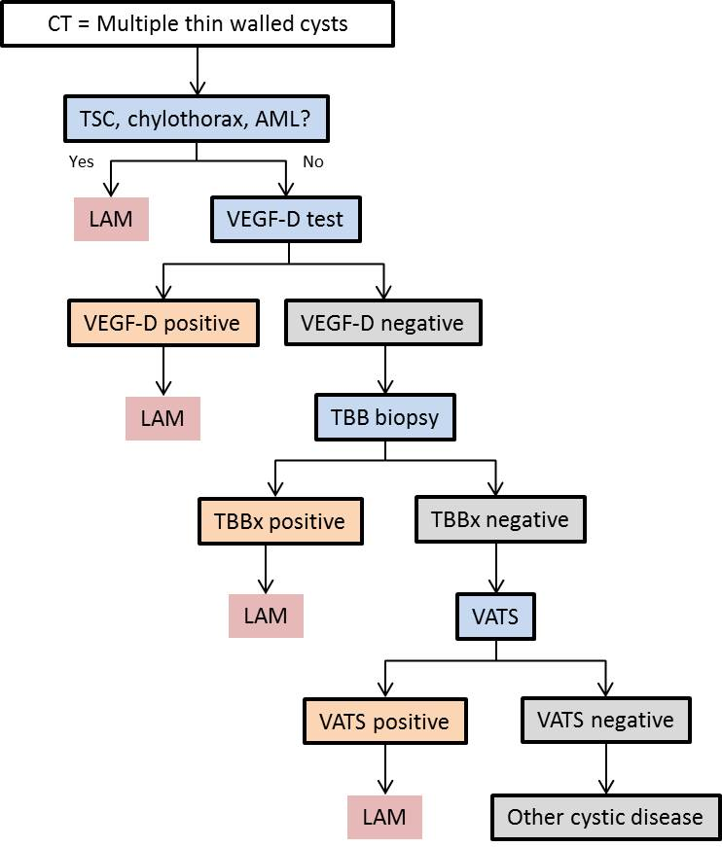

Slide 19
Treatment
The key treatment for parenchymal lung disease due to sporadic LAM is inhibition of the mechanistic target of mTOR
  Sirolimus
  Everorimus
  Clinical Trial
    Interferon-gamma or beta
    Promoters of autophagy (eg, hydroxychloroquine)
    Matrix metalloproteinase inhibitors
    Tyrosine kinase inhibitors
    Statins

Slide 20
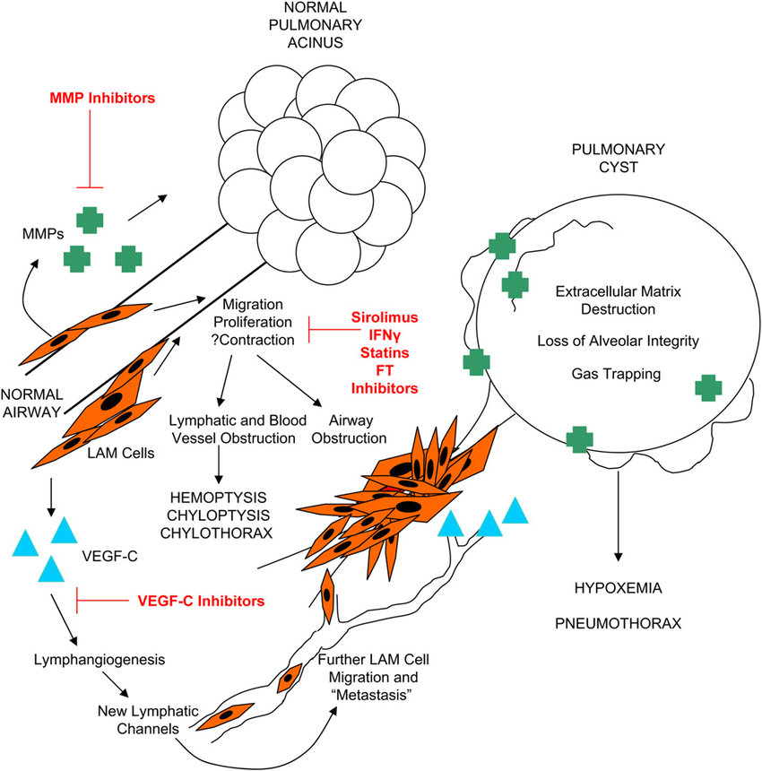
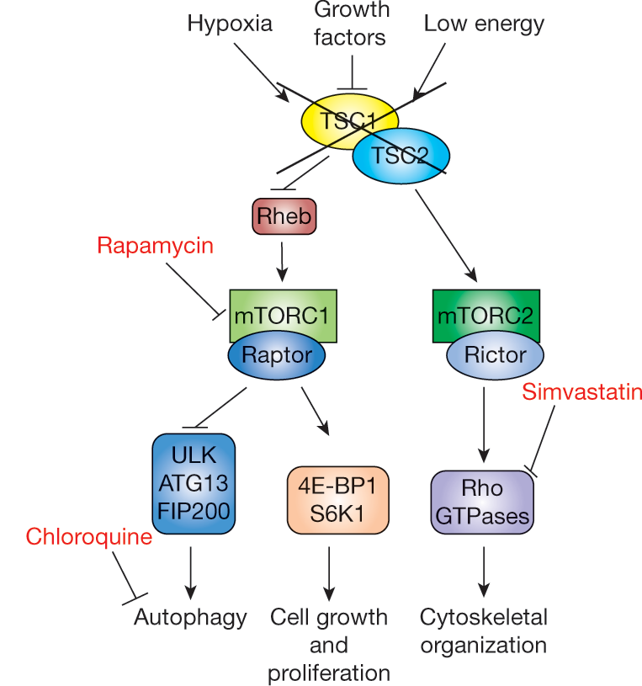

Slide 21
Treatment
Lung transplantation
  Patients with LAM may eventually require lung transplantation because of progressive respiratory failure
  Selection criteria, lung transplantation type, and outcomes are similar to those for other chronic lung diseases
  The presence of a renal AML, other complications of LAM, prior pleurodesis, or TSC are not contraindications to lung transplantation
  Post-transplant – Sirolimus and everolimus should not be used in the post-transplant period until wound healing is complete
  Recommended regimen : optimized for prevention of rejection without routine use of sirolimus or everolimus for prevention of recurrence

Slide 22
Treatment
Supportive care
  Avoidance of cigarette smoking
  Administration of influenza and pneumococcal vaccines
  Supplemental oxygen
  Exercise and pulmonary rehabilitation
  Nutritional support
  Psychosocial support

Slide 23
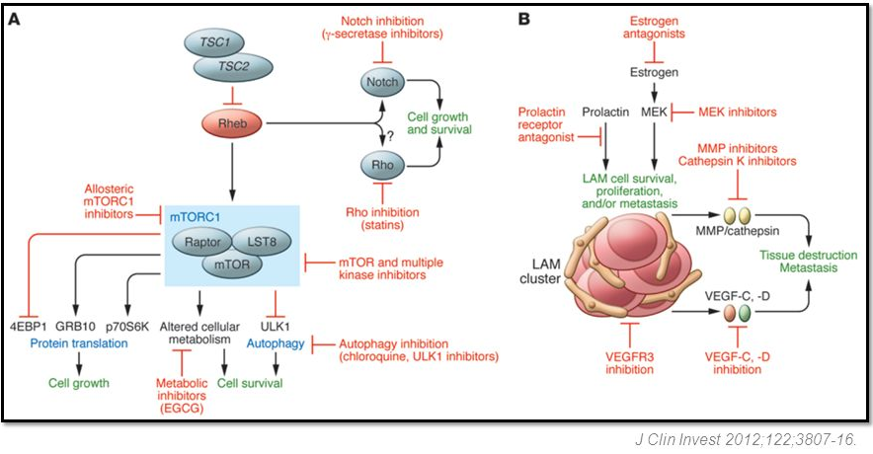

Slide 24
Prognosis
Lung function decline
  ranges from 40 to 120 mL/year (off therapy)
Mortality
  Median survival for patients with LAM was 8 to 10 years from diagnosis (Up to 29 year transplant free survival)
  Effect of sirolimus on survival or time to transplant is unknown

Slide 25
Reference
Sporadic lymphangioleiomyomatosis: Epidemiology and pathogenesis, Francis X McCormack et al, uptodate
Sporadic lymphangioleiomyomatosis: Clinical presentation and diagnostic evaluation, Francis X McCormack et al, uptodate
Sporadic lymphangioleiomyomatosis: Treatment and prognosis, Francis X McCormack et al, uptodate
Kalassian KG, Doyle R, Kao P, et al. Lymphangioleiomyomatosis: new insights. Am J Respir Crit Care Med 1997; 155:1183.
Sullivan EJ. Lymphangioleiomyomatosis: a review. Chest 1998; 114:1689.
Corrin B, Liebow AA, Friedman PJ. Pulmonary lymphangiomyomatosis. A review. Am J Pathol 1975; 79:348.

