Slide 1
NOX 4 in lung transplantation
Lab meeting
2016-9-27
호흡기내과
김송이

Slide 2
NOX, NADPH Oxidase
Evolutionarily conserved family
NOX 1-5
Catalyze the reduction of molecular oxygen (O2) to superoxide (O2⁻) or hydrogen peroxide (H₂O₂) _{(NOX 4)}
  Superoxide : primary product of the enzymatic reaction → H₂O₂
Antioxid Redox Signal. 2014 Jun 10;20(17):2838-53

Slide 3
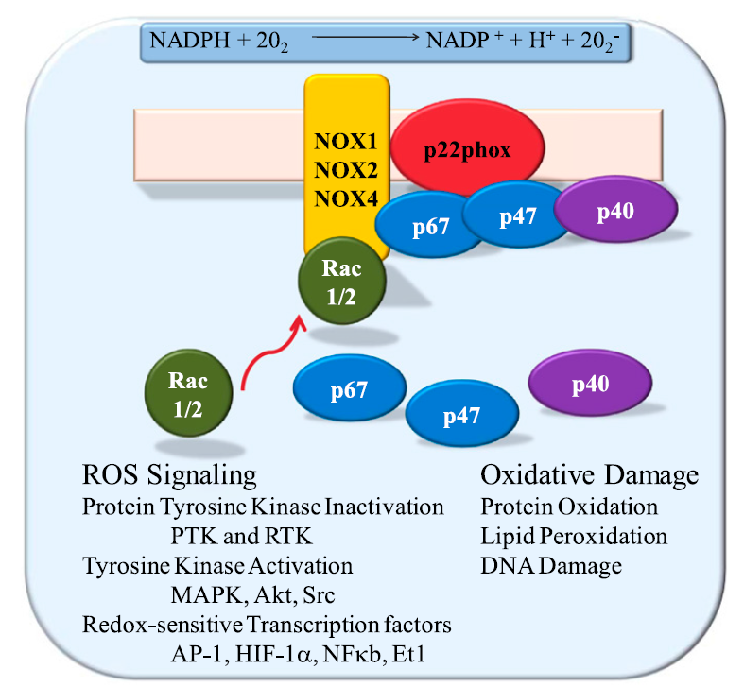
NOX4 : constitutively active
Regulated by expression/post translational modification
Activation:
membrane
Inactivation: cytosol
Am J Respir Cell Mol Biol 2012;47:129-139
Notes:
Figure 1. Schematic of reduced nicotinamide adenine dinucleotide
phosphate (NADPH) oxidase (NOX)–mediated free radical production,
domain structure, and putative molecular functions. Akt, protein kinase
B; AP-1, activated protein-1; Et1, endothelin-1; HIF-1a, hypoxia-inducible
factor 1-a; MAPK, mitogen-activated protein kinase; PTK, protein
tyrosine kinase; Rac, Ras-related C3 botulinum toxin substrate; ROS, reactive
oxygen species; RTK, receptor tyrosine kinase.
# p22phox: regulatory subunit
# p67,47, 40 phox 가 inactivation 시 cytolsol 에 있다가 activaiton 이 membrane 으로 이동
O2- : superoxide
H2O2: hydrogen peroxide
Rac :” Ras-related C3 botulinum toxin substrate

Slide 4
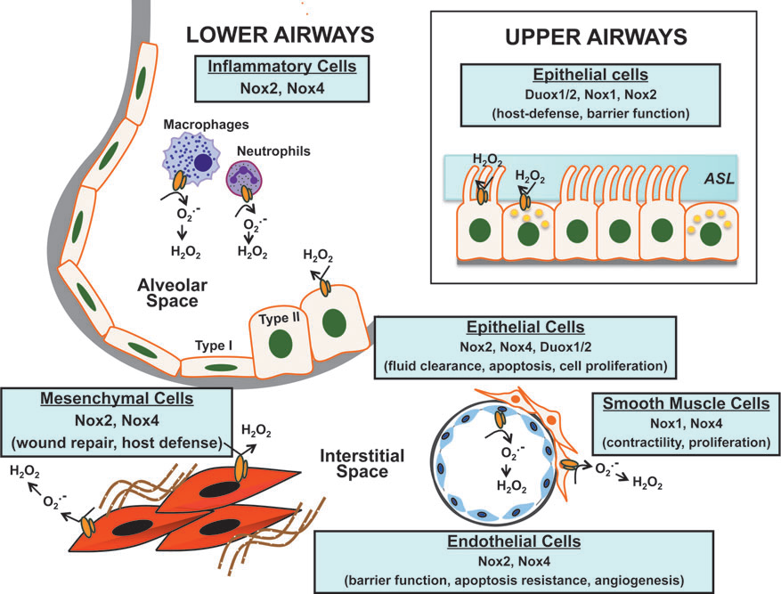
Antioxid Redox Signal. 2014 Jun 10;20(17):2838-53
Notes:
FIG. 2. Cellular localization of Nox enzymes in the lung. Nox/Duox isoforms are expressed in specific lung cells, where
they mediate diverse functions in both normal physiologic and/or pathologic states. The catalytic subunits of Nox enzymes
are schematically represented by an orange ‘‘duplex.’’ Refer to text for related references and details. ASL, airway surface
liquid; Duox, dual oxidase. To see this illustration in color, the reader is referred to the web version of this article at
www.liebertpub.com/ars

Slide 5
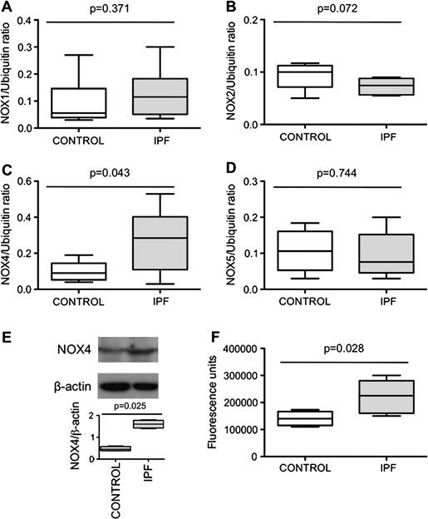
NOX in IPF
IPF N=8
Control N=9
Fibroblast
IPF pt fibroblasts
mRNA / WB/ ROS production
(H2-DC FH-DA oxidation)
Thorax 2010;65:733-738
Notes:
Figure 1 (AeD) NOX1, 2, 4 and 5 mRNA expression in lung fibroblasts
from patients with idiopathic pulmonary fibrosis (IPF) compared with
controls expressed as the ratio to ubiquitin mRNA levels. Data are
presented as a box and whisker plot with median, IQR and minimum and
maximum values. (E) Typical western blot and quantification of NOX4
protein expression (67 kDa) in lung fibroblasts from patients with IPF
and controls. NOX4 is expressed as the ratio to b-actin expression. Data
are presented as a box and whisker plot with median, IQR and minimum
and maximum values. (F) Reactive oxygen species production by IPF
and control fibroblasts assessed by measurement of H2-DCFH-DA (2,7-
dichlorofluorescein diacetate) oxidation. The values, expressed as
arbitrary fluorescence units, are presented as a box and whisker plot
with median, IQR and minimum and maximum values.

Slide 6
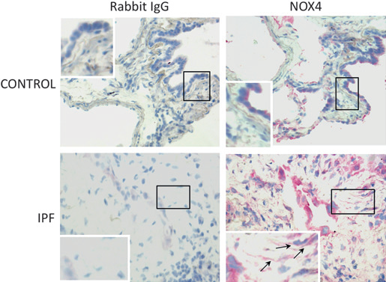
Bronchial , alveolar epithelial cells
Hyperplastic alveolar cells, fibroblasts
Thorax 2010;65:733-738
Notes:
Figure 2 Detection of immunoreactive NOX4 in the lung. Immunohistochemistry
shows that bronchial and alveolar epithelial cells express
NOX4 in the normal lung. In idiopathic pulmonary fibrosis (IPF) lung
samples, hyperplastic alveolar cells and fibroblasts (arrows) are strongly
labelled. The control antibody always gave a negative signal.

Slide 7
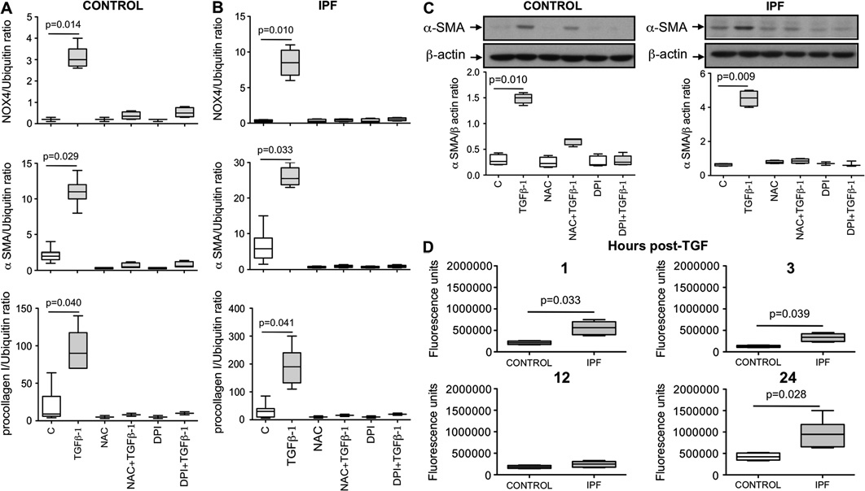
Notes:
(A and B) Effect of transforming growth factor b1 (TGFb1) in the presence or in the absence of N-acetylcysteine (NAC, 1 mM) or
diphenylene iodonium (DPI, 10 mm) on NOX4, a-smooth muscle actin (a-SMA) and procollagen I (a1) mRNA expression in lung fibroblasts from
controls and patients with idiopathic pulmonary fibrosis (IPF). Data are presented as a box and whisker plot with median, IQR and minimum and
maximum values. (C) Typical western blot and quantification of a-SMA protein expression in lung fibroblasts after TGFb1 incubation in the presence or
in the absence of NAC (1 mM) or DPI (10 mm). a-SMA is expressed as the ratio to b-actin expression. Data are presented as a box and whisker plot
with median, IQR and minimum and maximum values. (D) TGFb1 stimulates reactive oxygen species (ROS) production in human lung fibroblasts.
Control and IPF fibroblasts were stimulated with TGFb1 for 1e24 h and ROS production was assessed by measurement of H2-DCFH-DA (2,7-
dichlorofluorescein diacetate) oxidation. The four figures show production by the two groups of cells at 1, 3, 12 and 24 h post-TGFb1, respectively.
Values are presented as a box and whisker plot with median, IQR and minimum and maximum values.
# DPI : TGF beta induced alph SMA , procollagen I mRNA expression 저해

Slide 8
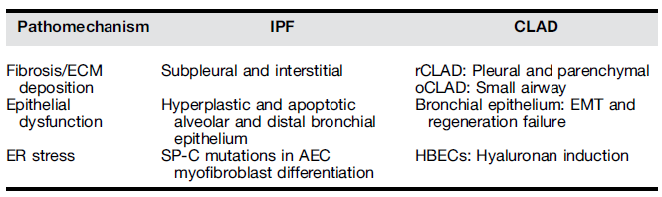
CLAD Chrnic lung allograft dysfunction vs. IPF
Ann Am Thorac Soc 2015;12: Suppl 1: S34-41
Notes:
SP-C : surface protein C
AECs: alveolar epithelial cells
Sporadic IPF bx → UPR (Unfolded protein response) activation in AECs lining areas of fibrotic remodeling
현재까지 CLAD 시작에 있어서 ER stress 연관있다는 명확한 증거가 있지는 않지만
Ischemia-reperfusion injury , acute rejection episode 는 이식받은 장기에 ER stress 를 induce 할수 있다고 알려져 있기는 하다.
BOS 환자의 bronchila epithelial 중 40% 에서 ER stress 가 관찰되기는 한다.

Slide 9

Notes:
(A and B) Effect of transforming growth factor b1 (TGFb1) in the presence or in the absence of N-acetylcysteine (NAC, 1 mM) or
diphenylene iodonium (DPI, 10 mm) on NOX4, a-smooth muscle actin (a-SMA) and procollagen I (a1) mRNA expression in lung fibroblasts from
controls and patients with idiopathic pulmonary fibrosis (IPF). Data are presented as a box and whisker plot with median, IQR and minimum and
maximum values. (C) Typical western blot and quantification of a-SMA protein expression in lung fibroblasts after TGFb1 incubation in the presence or
in the absence of NAC (1 mM) or DPI (10 mm). a-SMA is expressed as the ratio to b-actin expression. Data are presented as a box and whisker plot
with median, IQR and minimum and maximum values. (D) TGFb1 stimulates reactive oxygen species (ROS) production in human lung fibroblasts.
Control and IPF fibroblasts were stimulated with TGFb1 for 1e24 h and ROS production was assessed by measurement of H2-DCFH-DA (2,7-
dichlorofluorescein diacetate) oxidation. The four figures show production by the two groups of cells at 1, 3, 12 and 24 h post-TGFb1, respectively.
Values are presented as a box and whisker plot with median, IQR and minimum and maximum values.

Slide 10
Hypothesis
NOX4 expression in donor -lung tissue before lung transplantation is associated with development of CLAD
NOX4 expression in BAL sample is associated with development of CLAD

Slide 11
현재 임상검체
Serial BAL sample
  모두 일정치는 않음 (1-3, 3-6, 3-6-12, 6-12…)
  26 명
Donor lung tissue
  49 명

Slide 12
Methods
NOX4 expression in donor -lung tissue before lung transplantation
  NOX4 staining (IHC)
  NOX4 WB
NOX4 expression in BAL sample
  NOX4 mRNA level : serial change
Clinical manifestations: CLAD (BOS0p)

Slide 13
In the future
Murine model ..?
  CLAD murine model
  KO mouse

