Slide 1
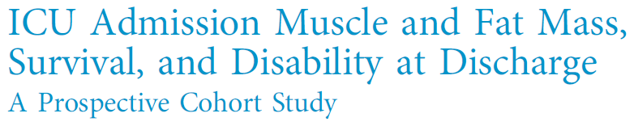

Journal Presentation
R2 이영채
Severance Hospital
Yonsei University, College of Medicine

Slide 2
01
Background and Aims
Skeletal muscle dysfunction after ICU stay
  Mortality
  Ventilator weaning failure
  ICU Readmission
Weight gain after discharge?
  Primarily d/t fat gain, not lean body mass
  Baseline skeletal muscle = influenced by nutritional status
Muscle, Fat mass & outcomes
  Muscle – Pectoralis muscle area (PMA) according to Chest CT scan
  Fat mass – subcutaneous adipose tissue (SAT) area at T7-T8 body

Slide 3
02
Patients & Methods
Prospective, single-center, observational study
  MICU of Albany Medical Center (New York)
  Enrollment between 2015.11-2017.2
Requirements
  Age > 18yrs, MICU admission, Chest CT within 24hrs of admission
Exclusion Criteria
  Primary NM pathology
  Acute Illness
  Chronic Illness : life expectancy < 6 months

Slide 4
02
Patients & Methods
Endpoints
  Primary – 6 month survival
  Secondary – hospital survival, disabilaty at discharge, ICU-free days (D28)
Disability at discharge
  In hospital death
  Discharged to facility, home with assistance
  Discharged independantly
  Odd ratios used, analyzed by logistic regression
  PMA & SAT compared among three groups : ANOVA & Tukey test

Slide 5
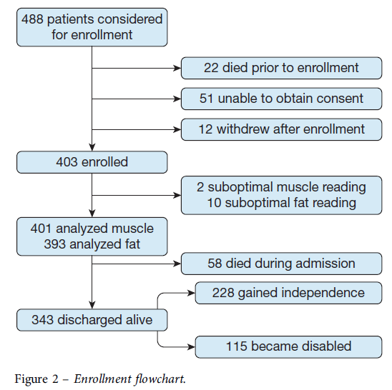
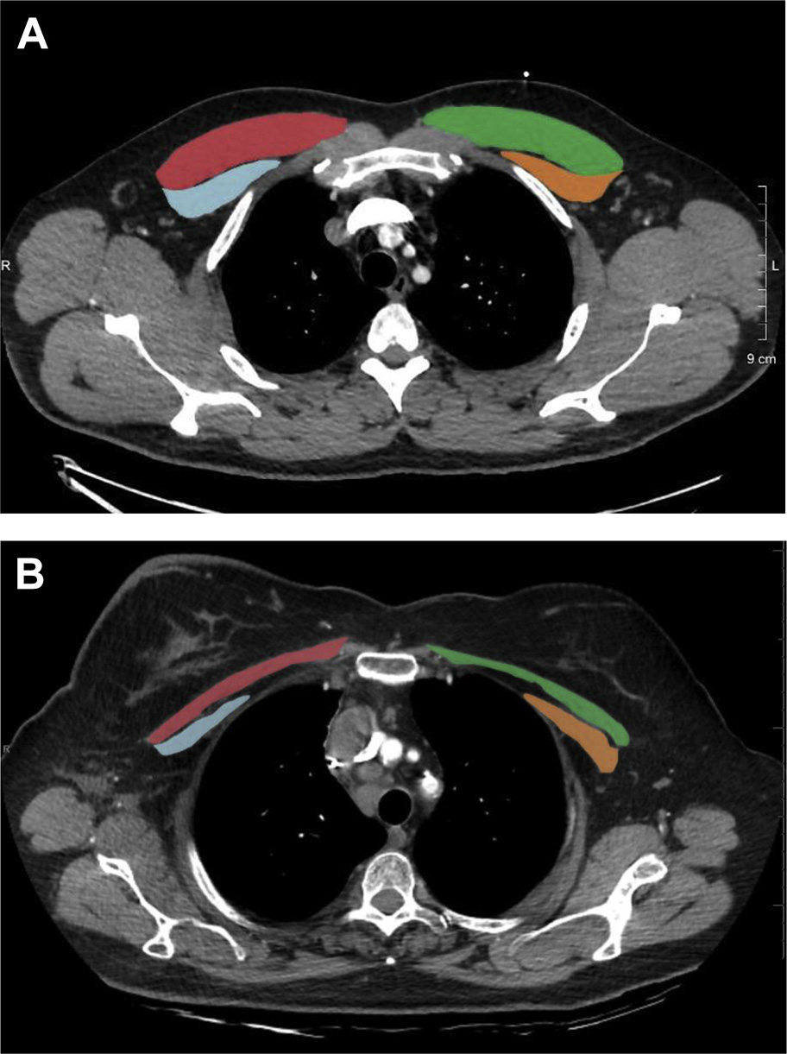
02
Patients & Methods

Slide 6
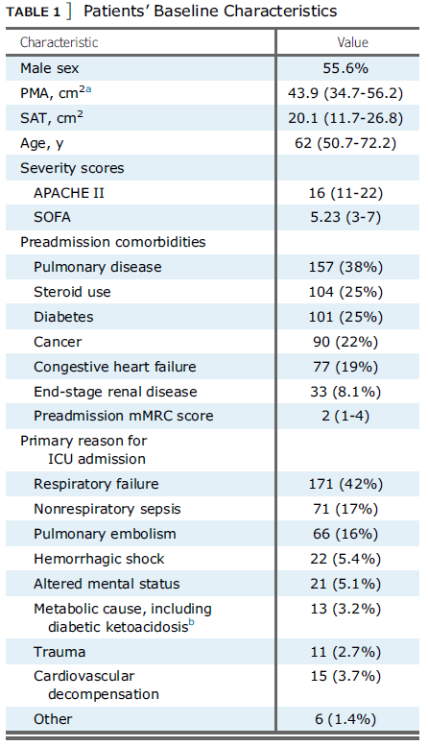
03
Results

Slide 7
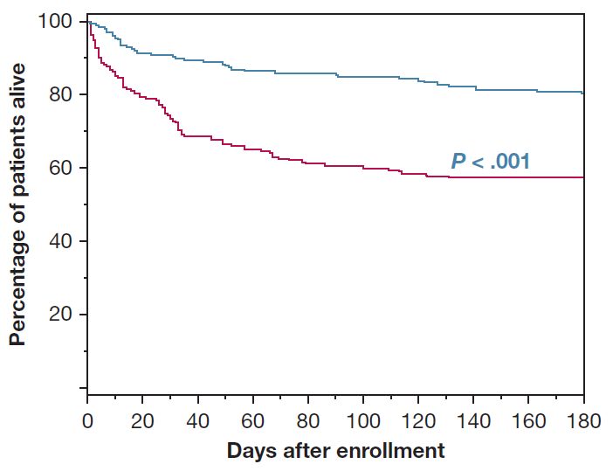
03
Results
PMA & survival
Using Kaplan-Meier plotting
Significantly associated with odds of survival

Slide 8
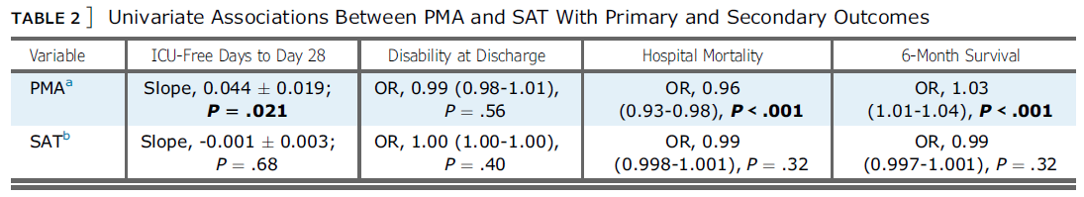
03
Results
PMA, SMT & 2ndary outcomes

Slide 9
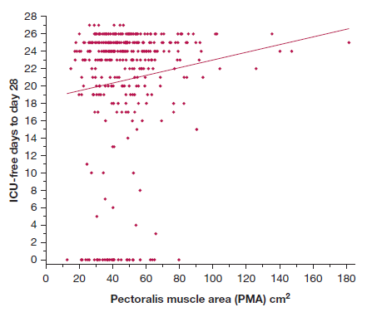
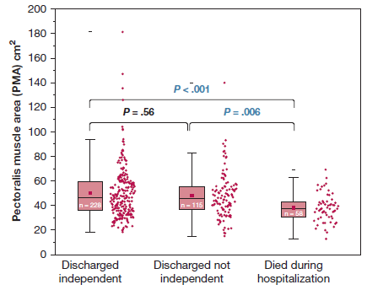
03
Results
PMA & 2ndary outcomes

Slide 10
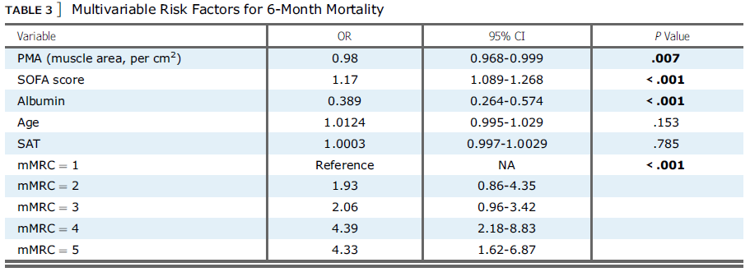
03
Results
PMA & Primary outcome : after correction of other variables

Slide 11
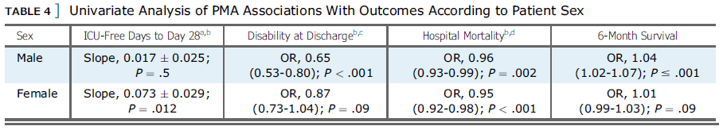
03
Results
PMA & Primary, 2ndary outcomes : for each patient sex

Slide 12
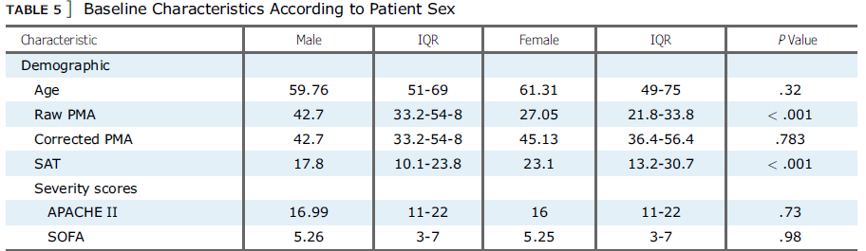
03
Results
PMA & Primary, 2ndary outcomes : for each patient sex

Slide 13
04
Discussion
PMA association
  Higher 6-mon hospital suvival, more ICU-free days
  Influential even after adjusting other variables
  Marker for prehospitalization frailty
Other results..
  Different results between different sexes : no obvious cause found
  No mechanisms of muscle wasting presented in this study
  Other studies : Female > Male concerning muscle stem cell activity

Slide 14
04
Discussion
Acknowledgements
  1st large prospective study : skeletal muscle mass vs survival
  Previous retrospective study : Lumbar muscle mass in elderly patients
  1st to explore fat mass : no correlation found
Limitations
  Single center study
  Distribution of diseases : not generalied & even compared to other ICUs
  Chest CT : selection bias
  PMA & SAT measurement : Validation problems

