Slide 1
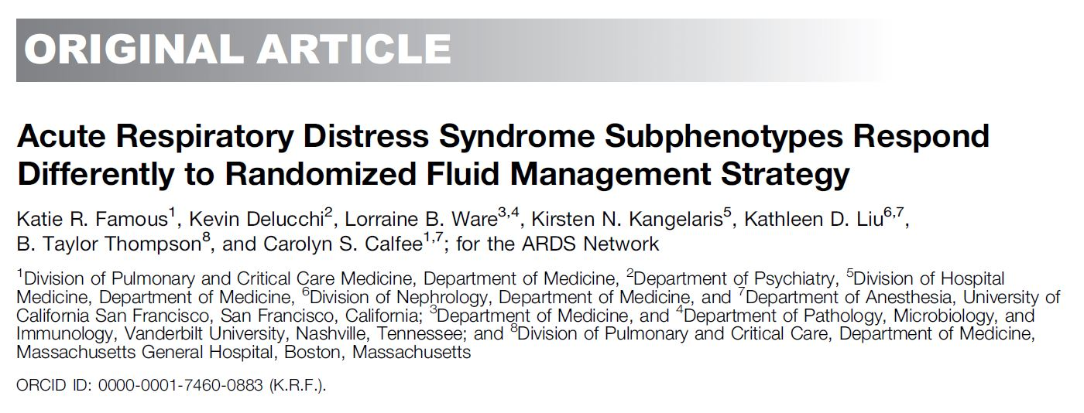
호흡기내과 R3 전호수

Slide 2
Background
ARDS : acute respiratory distress syndrome
- clinical condition characterized by disruption of the
alveolar–capillary barrier with the formation of
noncardiogenic, protein-rich pulmonary edema
Treatment is limited to supportive care, such as low tidal-volume mechanical ventilation

Slide 3
Background
ARMA and ALVEOLI (Assessment of Low tidal Volume and elevated End expiratory volume to Obviate Lung Injury)
Two distinct ARDS subphenotypes
- Subphenotype 2 was associated with increased levels of
inflammatory biomarkers, acidosis, and shock
ALVEOLI trial, higher positive end-expiratory pressure was beneficial in one subphenotype and harmful in the other

Slide 4
Background
A third, more recent independent cohort, the NHLBI ARDS Network’s FACTT (Fluid and Catheter Treatment Trial)
hypothesized a priori that subphenotype 2 would have higher mortality and fewer ventilator-free days in response to a liberal fluid strategy

Slide 5
Method
FACTT enrolled 1,000 patients with ARDS between 2000 and 2005
ARDS criteria within 48 hours before enrollment
Two-by-Two factorial design; conservative versus liberal fluid
management, pulmonary artery versus central venous catheter
subphenotype classification, clinical outcomes (60-d mortality,
90-d mortality, and ventilator-free days)

Slide 6
Method
Ten plasma biomarkers
- IL-6, IL-8, surfactant protein D, and von Willebrand factor, intercellular adhesion molecule-1, protein C, soluble tumor necrosis factor receptor-1[sTNFr1], plasminogen activator inhibitor 1
- angiopoietin-2 (Ang-2) and the receptor for advanced glycation end-products (RAGE)

Slide 7
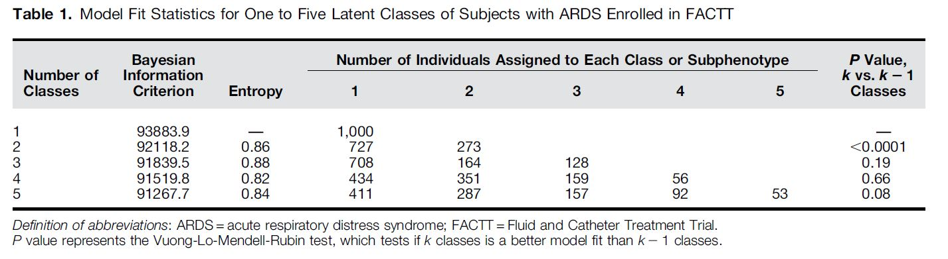
Results
A Two-Class Model Best Describes the Patients with ARDS Enrolled in FACTT
Notes:
morphologic similarities between the tissue forms of several fungal genera, and the frequent presence of sparse or atypical
fungal elements

Slide 8
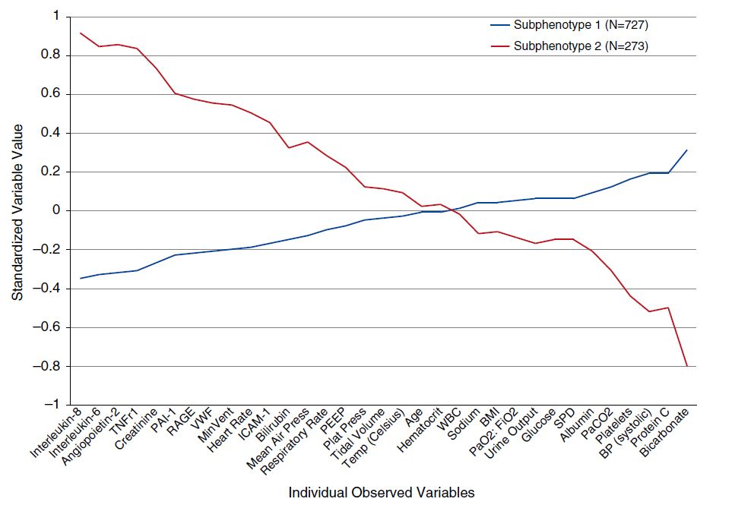
Notes:
morphologic similarities between the tissue forms of several fungal genera, and the frequent presence of sparse or atypical
fungal elements

Slide 9
Subphenotype 2
higher levels of IL-8, IL-6, and sTNFr1, but lower serum bicarbonate and protein C, higher plasma levels of Ang-2 and RAGE
no significant difference in sex distribution
More frequently required vasopressors

Slide 10
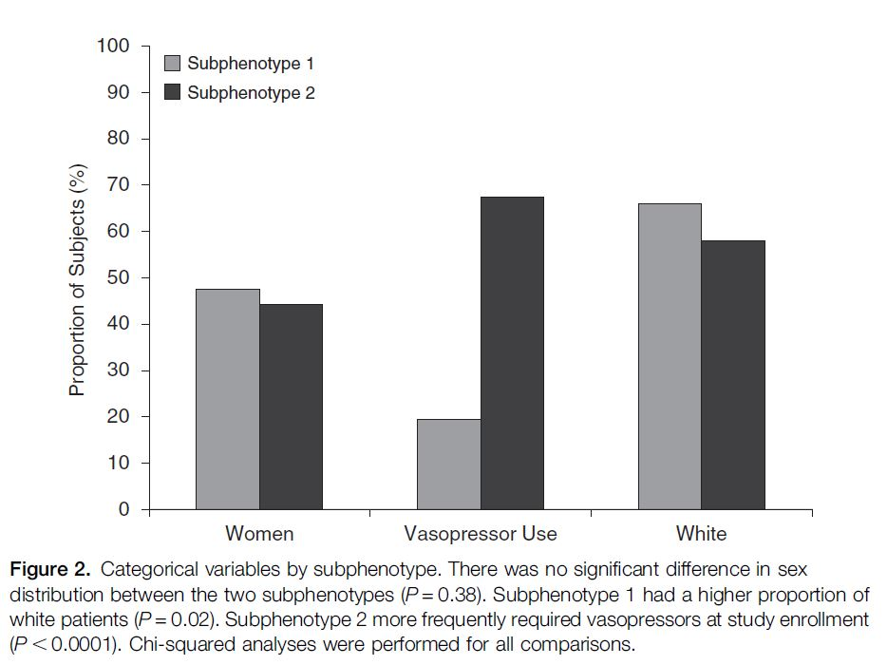
Notes:
morphologic similarities between the tissue forms of several fungal genera, and the frequent presence of sparse or atypical
fungal elements

Slide 11
* Primary ARDS risk factor
Sepsis were equally likely to be assigned to either subphenotype(49% subphenotype 1; 51% subphenotype 2)
Trauma, aspiration, or pneumonia were more likely to be assigned to subphenotype 1
Higher central venous pressure (12.7 vs. 11.7 mmHg; P = 0.005) lower central venous oxygen saturation (71.4 vs. 73.5%; P = 0.04) in subphenotype 2

Slide 12
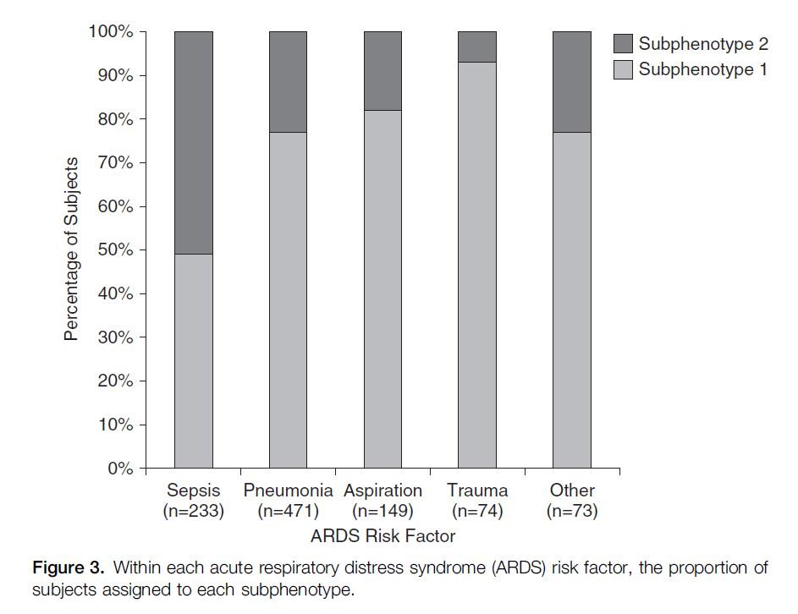
Notes:
morphologic similarities between the tissue forms of several fungal genera, and the frequent presence of sparse or atypical
fungal elements

Slide 13
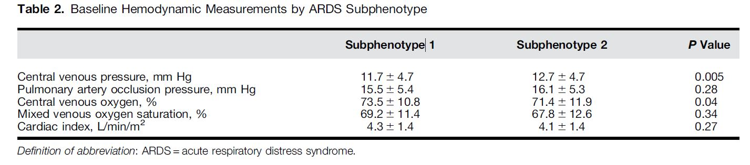
Notes:
morphologic similarities between the tissue forms of several fungal genera, and the frequent presence of sparse or atypical
fungal elements

Slide 14
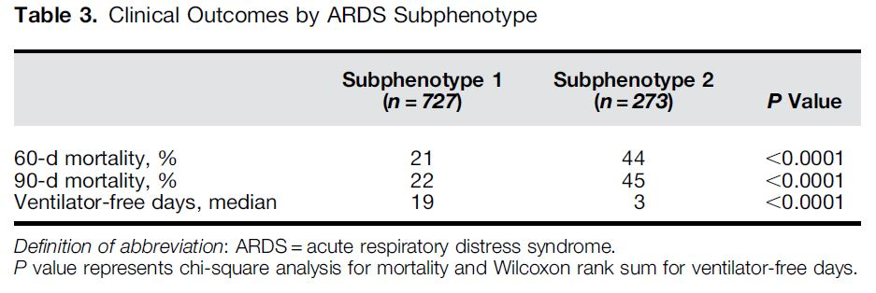
Notes:
morphologic similarities between the tissue forms of several fungal genera, and the frequent presence of sparse or atypical
fungal elements

Slide 15
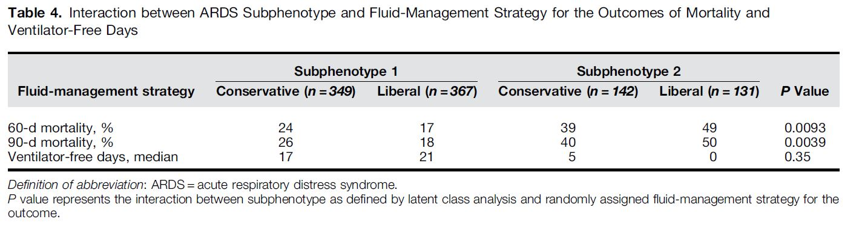

Slide 16
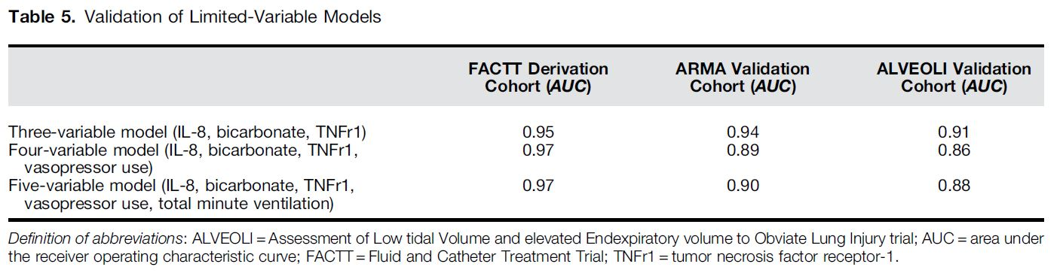
A Three-Variable Model

Slide 17
Discussion
Conservative strategy was associated with improved mortality in subphenotype 2 but had the opposite effect in subphenotype 1.
A three-variable model that incorporates IL-8, serum bicarbonate, and TNFr1 identifies ARDS subphenotypes with better accuracy than a model that only incorporates clinically available variables

Slide 18
Discussion
Ang-2 and RAGE
Ang-2 : biomarker and mediator of endothelial cell injury
RAGE : a marker of lung epithelial cell injury and
Inflammation
Ang-2 and RAGE levels were higher in subjects assigned to subphenotype 2, suggesting a higher degree of baseline
endothelial and lung epithelial cell injury in these patients

Slide 19
Discussion
Heterogeneity of treatment effects of fluid-management strategy in ARDS
higher Ang-2 levels in subphenotype 2
-> more endothelial permeability and predilection for extravascular fluid accumulation

Slide 20
Discussion
Ventilator-free days
-> interaction between subphenotype and fluid-strategy
on mortality may be driven by the extrapulmonary
manifestations of the patient’s underlying illness
not a clinically meaningful difference in baseline central venous pressure or cardiac index

Slide 21
Limitation
Secondary analysis, requires prospective validation before definitive conclusions
it remains unknown if these subphenotypes exist outside RCTs in a more diverse population of critically ill patients
determine if these subphenotypes remain stable later in the course of ARDS
Limitation of a three variable model

Slide 22
감사합니다.

