Slide 1
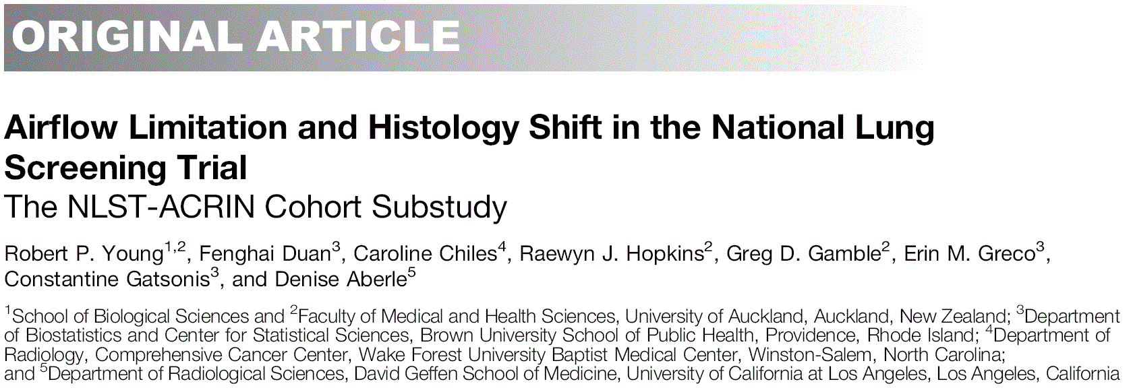
호흡기내과 R2 강신찬

Slide 2
Rationale
CT screening arm of the National Lung Screening Trial (NLST)
: 20% reduction in lung cancer deaths
->Yearly CT screening for lung cancer is now widely recommended
Concerns about the potential harms and overdiagnosis
(radiation exposure, unnecessary invasive workup)
(Identification and treatment of cancers that would not otherwise have caused death)
->Overdiagnosis is estimated to account for 18% of lung cancers identified during screening
->Long volume-doubling time of lung cancer is central feature of overdiagnosis
Notes:
COPD(defined as prebronchodilator airflow limitation)

Slide 3
Rationale
Excess cancers in screening group
: mostly Adenocarcinoma or bronchoalveolar subgroup
->Histologic shift
(significant excess of these “early-stage” adenocarcinoma)
->masquerading as a Stage shift (increase in early-stage cancers)
Single-arm CT studies
:CANNOT exclude overdiagnosis, or directly correlate stage shift with survival benefit
“Are there any biomarkers or patient characteristics that are associated
with overdiagnosis in lung cancer screening?”
In Screening participants, those who has normal lung function
: a twofold greater prevalence of lung cancer with a long VDT than those who has COPD
Notes:
Feature of CT screening

Slide 4
Rationale
Examined the effect of Airflow limitation (COPD) at baseline on
>lung cancer prevalence
>Incidence
>histology shift
>clinical stage

Slide 5
Methods
NLST-ACRIN cohort
: including 18,714 participants with spirometry testing
COPD was defined by the presence of airflow
Prebronchodilator spirometry (FEV1/FVC,0.70)
COPD severity (FEV1% predicted) according to GOLD criteria grades 1–4

Slide 6
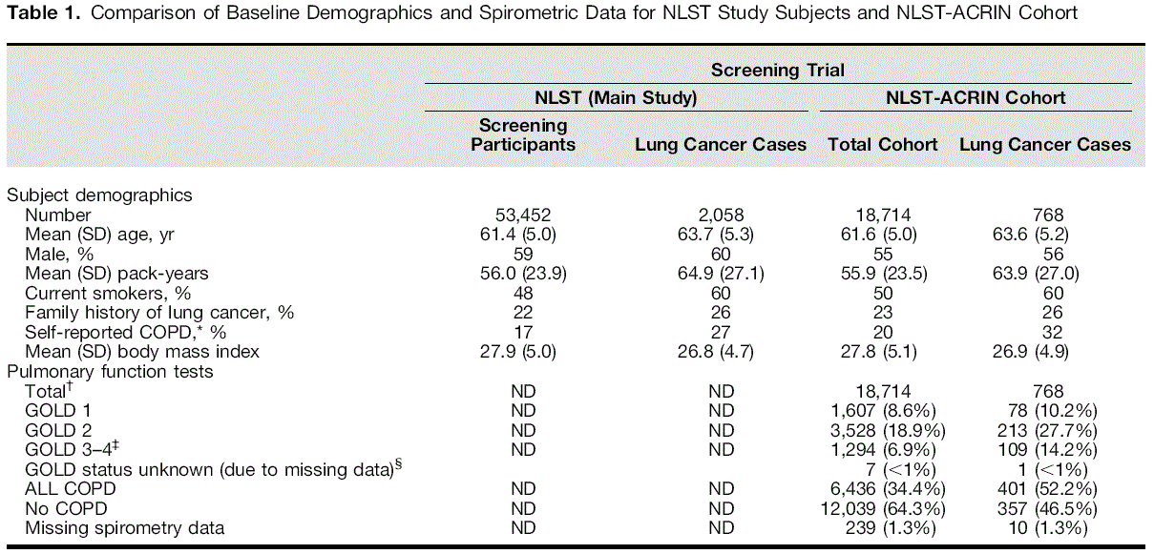
Results

Slide 7
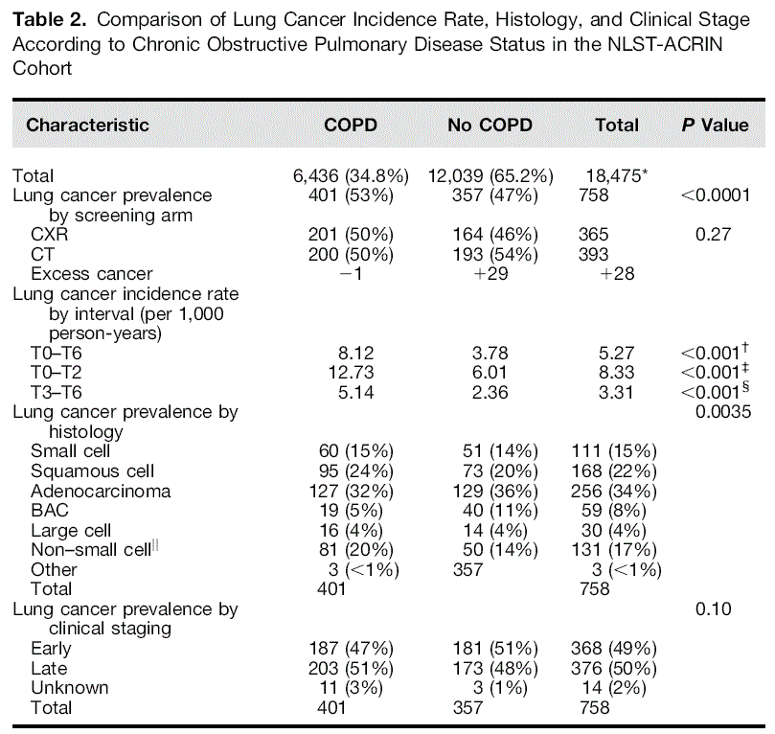
Results : Histology

Slide 8
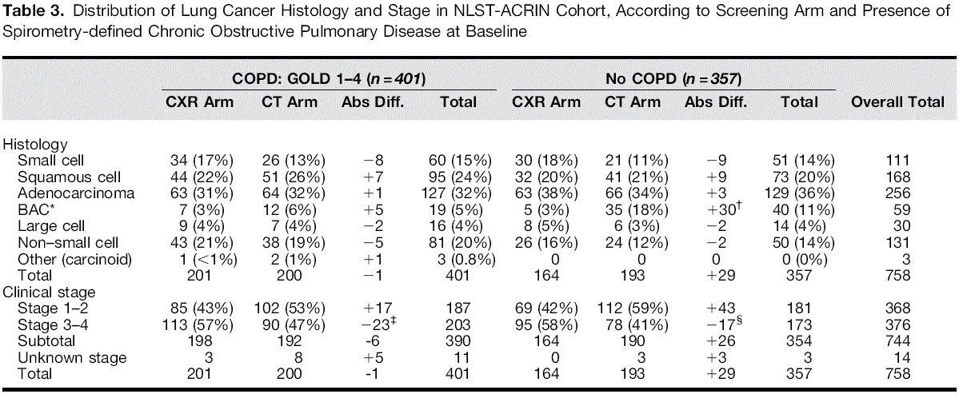
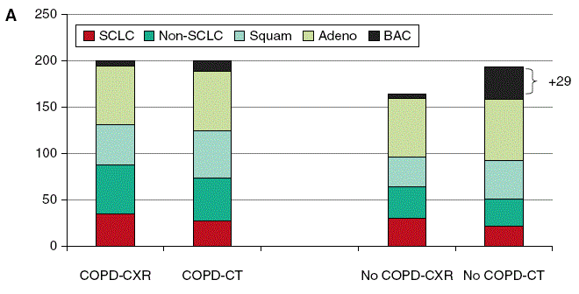
Results : Histology
Notes:
COPD가 있는 group은 histolodic shifting이 적다

Slide 9
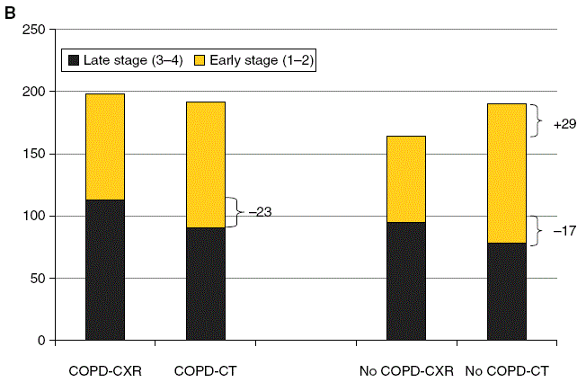
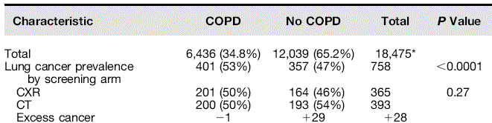
Results : Stage
Notes:
COPD가 있는 group은 early cancer 진단이 더 잘된다
COPD가 없는 group도 그런거 같지만 BAC group을 빼면 Excess cancer빼면 통계적으로 유의하지 않다.
최근 무증상의 환자에게 가슴 부위의 전산화 단층촬영(CT)을 실시하여 폐암을 조기에 발견하고자 하는 연구들이 활발히 진행되었는데, 이 때 '간유리 음영'이라고 불리는 작은 병변들을 조사해 본 결과 선암인 경우가 많았다. 이들은 우리가 알고 있던 일반적인 폐암보다 상당히 느리게 진행하여, 심지어 환자가 정상 수명을 사는 동안 아무 해를 끼치지 않는 경우도 있었다.

Slide 10
Disscussion
Significant differences in lung cancer incidence and histology
according to COPD status
The annual lung cancer incidence, regardless of screening interval,
was twofold greater in participants with COPD
In those patients with lung cancer with COPD at baseline,
there were no excess cancers in comparing the CT and CXR arms,
with comparable histology and a nearly significant stage shift
in favor of early-stage cancer over late-stage cancer
In those lung cancers found in screening subjects with no COPD
: Excess attributed entirely to early-stage cancers of the BAC-related subgroup
When these were excluded,
the stage shift favoring early-stage over late stage cancers
was no longer significant

Slide 11
Disscussion
This suggests that identifying lung cancer by CT screening in smokers with COPD
may result in more cancers per person screened while minimizing overdiagnosis
It has been suggested that CT screening identifies a distinct type of
“adenocarcinoma” with more indolent behavior, represented by either BAC or slow-growing adenocarcinoma
This also suggests that COPD appears to be associated
with more aggressive forms of CT-detected lung cancer, concordant with
findings from other screening studies
“What biomarkers or strategies are available that might help
minimize overdiagnosis and maximize the stage shift during screening?”

Slide 12
Conclusion
The presence of COPD identifies smokers at greatest risk of lung cancer
and that it is associated with an increased lung cancer incidence rate in CT screening
COPD is also associated with more aggressive cancers and significantly less (or minimal) overdiagnosis
the routine use of screening spirometry in asymptomatic smokers at risk of lung cancer
either in general, or specifically
as part of assessing the harm-to-benefit ratio of CT screening
Overdiagnosis is a significant issue in CT screening for lung cancer
and is found exclusively in those with normal lung function at lower risk.
Lung cancer risk assessment requires the inclusion of variables underlying COPD risk, and that such an approach may help to better optimize the benefit-to-harm ratio of CT screening

