Slide 1

Open Forum Infect Dis. 2019 Jan 17;6

Slide 2
Introduction
Gold standard : AFB Microbiological culture (2-6wks)
clinicians usually start anti-TB therapy with..
  AFB smear, MTB PCR, Xpert TB/RIF, and radiographic features
Clinical manifestations and Radiologic features are affected by the host immune response to MTB and difficult to diagnose with Atypical symptoms and radiologic findings
▶ Delayed diagnosis & treatment, Transmission
Evaluate the clinical characteristics and radiologic findings of immunocompromised patients who received delayed diagnosis and treatment of pauci-bacillary pulmonary TB
Notes:
in an intermediate–TB burden country

Slide 3
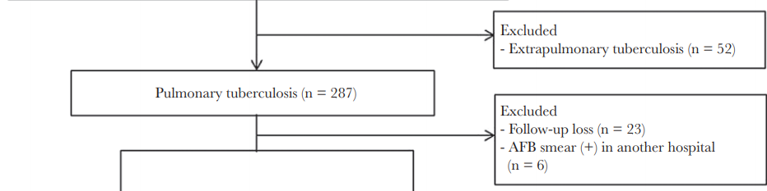
Methods
Study Population AMC, intermediate–TB burden country
Retrospective 2012.1-2016.12, Age >18yrs
Pauci-bacillary pulmonary TBc AFB smear (-) Culture (+)
Missed TB who started anti-TB therapy after positive mycobacterial culture results were obtained
Notes:
(annual TB incidence in 2016, 63.2 per 100 000 population)
we wished to focus on the clinical features and chest computed tomography (CT) findings
Exclusion : extrapulmonary TB, not followed up after 1st sputum AFB, transferred from other

Slide 4
Methods
Immunocompromised
  HIV infection, Malignancy, Liver cirrhosis, Chronic renal failure, Transplantation status, Receipt of immunosuppressivetreatment
Diagnostic delay interval from mycobacterial test to initiation of anti-TB therapy
Period of antibiotics exposure to be between 4 weeks before the date of mycobacterial tests
CT Evaluation Two independent experienced radiologists
  centrilobular nodules with/without tree-in bud appearance,bronchial wall thickening (or bronchiolar), macronodule, mass, airspace consolidation, ground-glass opacity, miliary nodules, lymphadenopathy, pleural effusion, previous TB sequelae
Statistical Analysis
Notes:
Centrilobular nodules were defined as small dot-like opacities in the center of a normal secondary pulmonary lobule.
Tree-in-bud appearance was defined as clustered 2–4-mm nodular and linear branching centrilobular opacities with a lobular or segmented distribution.
A macronodule was defined as a focal opacity with a diameter of >1 cm and ≤3 cm,
a mass was defined as an opacity >3 cm in diameter.
Consolidation was defined as any exudate or other product of disease that replaced alveolar air, rendering the lung solid.
Miliary nodules were defined as profuse, tiny, discrete, rounded pulmonary opacities
variables with P ≤ .20 in the final multivariate model

Slide 5
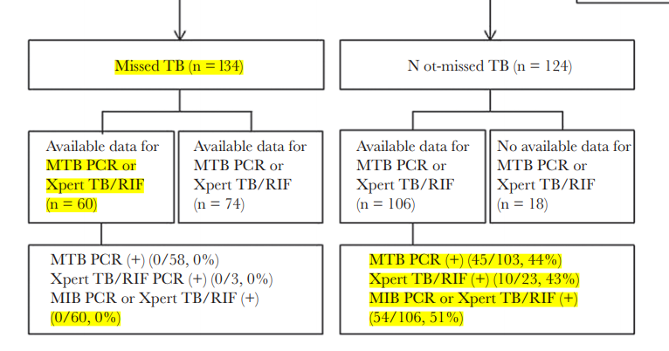
Results
Initial clinical symptoms such as cough or sputum and weight loss, were similar in the 2 groups
Diagnostic delay was also significantly longer in the missed TB group
Patients in the missed TB group were also older
Positive IGRA results were significantly lower in the missed TB group than in the not-missed TB group
Solid tumors and receipt of cytotoxic chemotherapy within 1 month were more common in the missed TB group.
Notes:
In addition, 13 (10%) of 134 patients in the missed TB group and 23 (19%) of 124 patients in the not-missed TB group underwent IFN-gamma releasing assay (IGRA), respectively (P = .04). Positive IGRA results were significantly lower in the missed TB group than in the not-missed TB group

Slide 6
Results
Long-term FQ use was significantly higher in the missed TB group than in the not-missed TB group whereas carbapenem was significantly lower in the missed TB group than in the not-missed TB group
There was NO statistically significant difference between the groups in terms of other underlying diseases or conditions, and all-cause 30-day mortality was similar
Notes:
In addition, 13 (10%) of 134 patients in the missed TB group and 23 (19%) of 124 patients in the not-missed TB group underwent IFN-gamma releasing assay (IGRA), respectively (P = .04). Positive IGRA results were significantly lower in the missed TB group than in the not-missed TB group

Slide 7
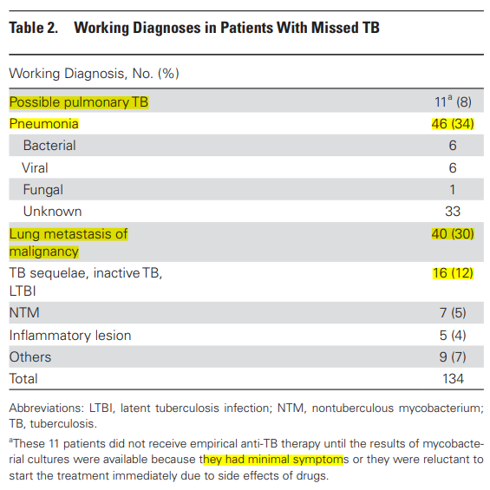
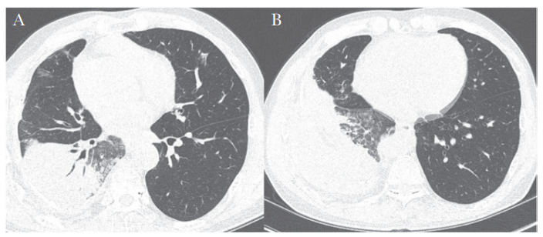
Results
Working Diagnoses in the Missed TB Group
  1) pneumonia (46 patients, 34%)
  2) lung metastasis of malignancy (40 patients, 30%)
M/58, underlying liver cirrhosis and hepatocellular carcinoma
Notes:
A missed case of active pulmonary tuberculosis in a 58-year-old man with underlying liver cirrhosis and hepatocellular carcinoma.
A, High-resolution computed tomography (CT) scan showing lobar consolidation with air-bronchogram and surrounding ground-glass opacities.
Several patchy ground-glass opacities are evident in the right middle lobe and left upper lobe. B,
Scan showing several ill-defined nodules in the right lower lobe.
The CT findings were interpreted as nonspecific pneumonia, and the possibility of tuberculosis was neglected
due to the lower lobe location and the main findings showing a consolidation with an air-bronchogram rather than discrete centrilobular nodules.

Slide 8
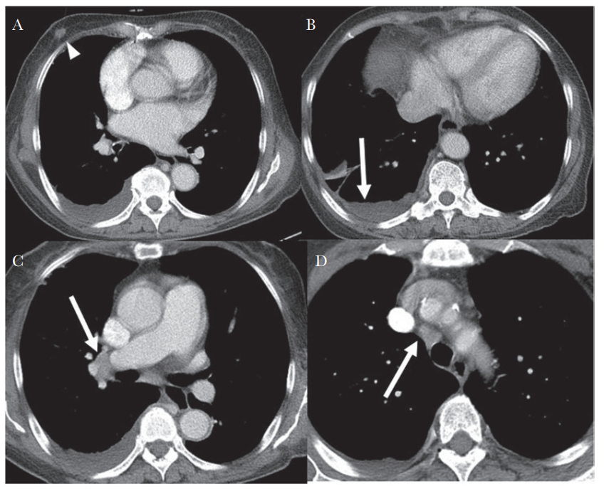
Results
F/67, primary myelofibrosis, recently diagnosed breast cancer
Notes:
A missed case of active pulmonary tuberculosis in a 68-year-old woman with primary myelofibrosis and recently diagnosed breast cancer.
A, Contrast-enhanced chest computed tomography (CT) shows moderate right pleural effusion. The 1.3-cm nodule in the right breast was identified as breast cancer (arrowhead).
B, There is mild enhancing smooth pleural thickening.
C, D, Several borderline-to-enlarged right interlobar, hilar, and paratracheal lymph nodes are also visible.
The CT findings were interpreted as malignant pleural effusion and possible metastatic lymph nodes.

Slide 9
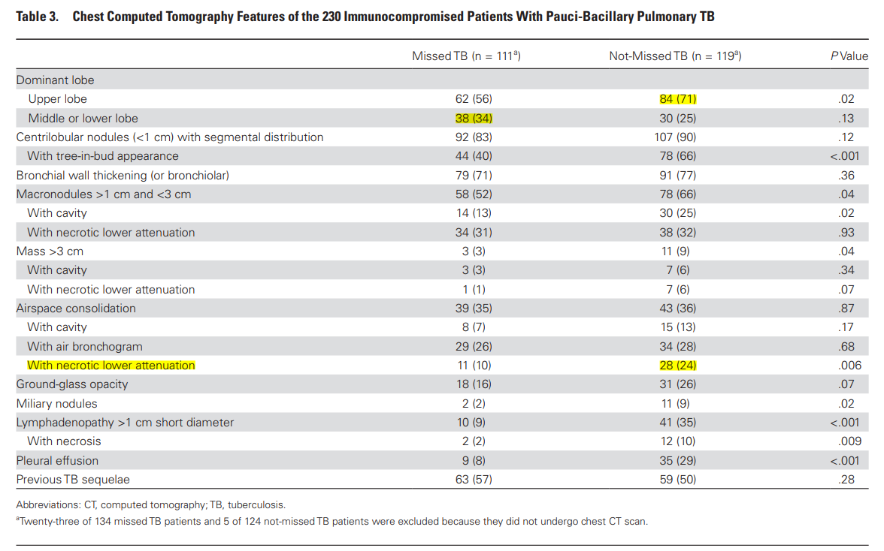
Results
Less frequent CT features in missed Tb group
  dominant affected lobes of the lung is upper lobe
  Centrilobular nodules with tree-in-bud appearance
  macronodules (>1 cm and <3 cm) with / without cavities
  Masses
  airspace consolidations with necrotic lower attenuations
  miliary nodules
  lymphadenopathy with and without necrosis
  pleural effusion
Notes:
230/ 258 of immunocompromised patients with pauci-bacillary pulmonary TB underwent chest CT scan at the time of symptom or sign onset.

Slide 10
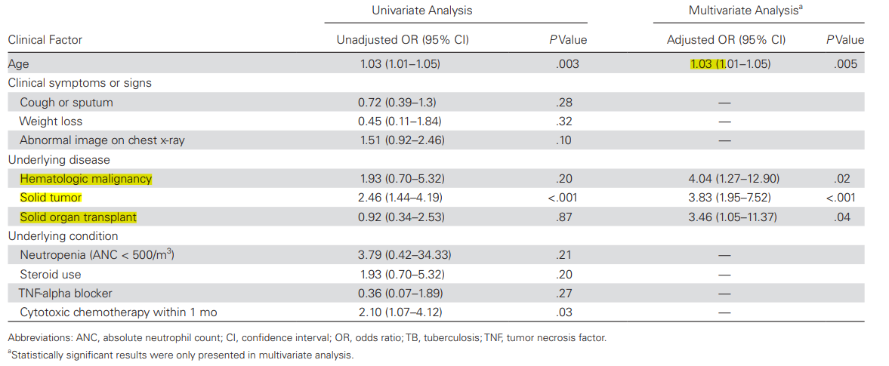
Results
Risk Factors Associated With Missed TB old age, solid tumor, and cytotoxic chemotherapy within 1 month
Notes:
were independently associated with missed TB in multivariate analysis

Slide 11
Discussion
Previous studies generally analyzed the diagnostic and treatment delays associated with pulmonary TB from the aspect of socioeconomic and health care systems
Transmission of TB to other patients during the period of diagnostic delay
Long-delayed diagnosis and treatment of pulmonary TB increase the severity of TB and the number of deaths
Notes:
We found that old age, solid organ transplants, and solid and hematologic malignancies were associated with missed TB, and that missed TB did not display typical CT findings of pulmonary TB.

Slide 12
Discussion
Positive results of rapid molecular tests were only obtained in the not-missed TB group. The sensitivity of these tests in this study was lower than that previously reported
  → Early diagnosis of paucibacillary pulmonary TB relies heavily on CT findings. But findings in missed TB patients were less typical for pulmonary TB
Further studies are needed of the possibility that the pathophysiology of extremely low pauci-bacillary TB in immunocompromised patients

Slide 13
Limitation
Retrospectively performed in a single large tertiary referral center, there could be a patient selection bias
We could not separate diagnostic delay into patient delay and health care system delay
Rapid molecular tests were not performed in over half of the missed TB patients, so there could be some unmeasured bias that skews the performance of such tests in these patients
Only 1 patient with HIV was included in study population
We did not investigate other treatment outcomes, such as the time lag to isolate patients after admission to hospitals and additional exposure burden due to the delay of appropriate isolation.
Notes:
(2014.8, ie, suspected multidrug-resistant TB, life-threatening TB, and exposure to multidrug-resistant TB patients)

Slide 14
Conclusion
Diagnosis and treatment of pauci-bacillary TB can be delayed until available mycobacterial culture results in about half of immunocompromised patients,
  especially in the elderly and those with solid organ transplants or hematologic or solid malignancies.
Clinicians diagnose patients as having pneumonia or other malignancies of the lung, they need to consider the possibility of TB one more time.
Routine evaluation for active TB with rapid molecular tests is needed in immunocompromised patients.
  Additional rapid diagnostic tests to rule out pauci-bacillary TB are urgently needed.

