Slide 1


Near-Apneic Ventilation Decreases Lung Injury and Fibroproliferation in an Acute Respiratory Distress Syndrome Model with Extracorporeal Membrane Oxygenation
AJRCCM, 2019.03
CHANG, Shihwan
Resident 4th Year
Division of Pulmonology
Department of Internal Medicine,
Severance Hospital

Slide 2
Introduction
Extramembraneous membrane oxygenation (ECMO)
  Used more often to treat patients with Acute respiratory distress syndrome (ARDS) and refractory hypoxemia
  In addition to improving oxygenation, ECMO enables lung protective ventilation.
Lung protective ventilation in ARDS patients
  One study incorporated low-frequency ventilation methods in ARDS patients, with RR < 5 bpm, PEEP 15~25 cm H₂O, PIP < 35~45 cm H₂O.
  Recommendations for lung rest during ECMO have evolved toward lower driving pressure, but still promoting lower RRs.
  Although most physicians support the rationale for such recommendations, approaches to mechanical ventilation during ECMO for ARDS vary widely.
  In severe ARDS, conventional lung protective ventilation (V_{T} of 6 mL/kg) may still pose an excessive mechanical load, causing further lung injury.
Hypothesis
  in severe acute lung injury, the use of near-apneic ventilation (very low levels of V_{T}, driving pressure, RR) may prevent further lung damage by minimizing energy transfer to lungs.

Slide 3
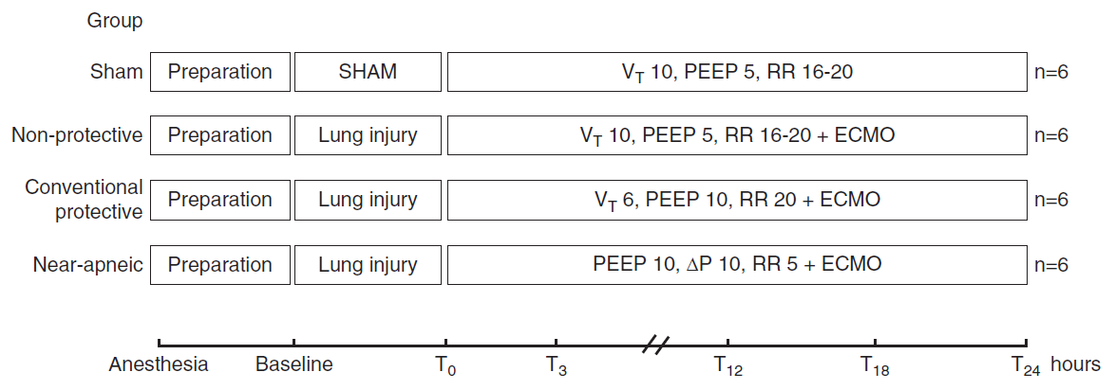
Methods (1)
FiO2 remained at 1.0
Sacrifice
Baseline settings : V_{T} 10mL/kg, RR 16-18 bpm, I/E ratio 1:2, PEEP 5 cm H₂O. FiO₂ 1.0
Lung Injury : repeated lung lavage (0.9% NS, 30 mL/kg) until PaO₂/FiO₂ < 250 mmHg
  → Injurious ventilation (pressure control, PEEP 0 cm H₂O, IP 40 cm H₂O, RR 10 bpm, I/E ratio 1:1)
(Experiment groups) After T₀ measurements were done, ECMO was started (Blood flow > 60 mL/kg/min, Sweep gas flow titrated to PaCO₂ 40 ± 10 mmHg.
(Sham group) No lung injury nor ECMO.
Notes:
1안

Slide 4
Methods (2)
FiO2 remained at 1.0
Sacrifice
Respiratory and hemodynamic data at T0, T3, T12, T18, T24
Quantifications of Fibroproliferative Response
Histology (Semiquantitative score, 0 ~ 3) : Lung H&E, α-Smooth muscle actins (SMA), procollagen-3 IHC.
Real-time PCR for mRNA : α-SMA, collagens I & III, TGF-β1
Zymography : MMP-2, MMP-9
ELISA : TGF-β1
Notes:
1안

Slide 5
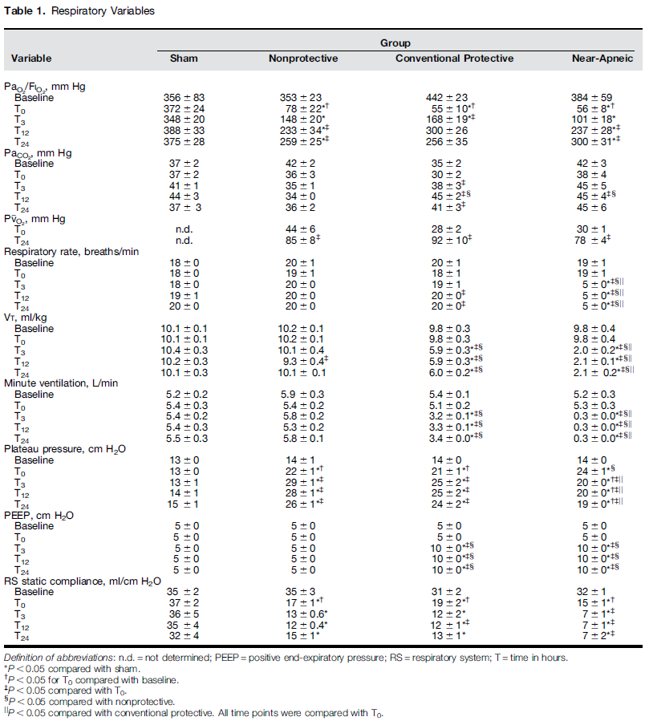
Results : Table 1.
sd
Notes:
1안

Slide 6
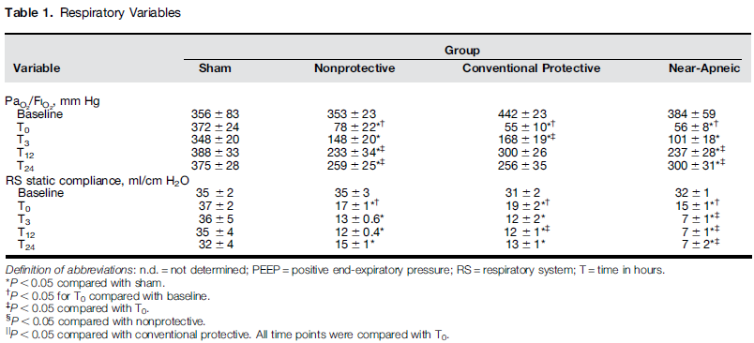
Results : Table 1.
Severe hypoxemia and decreased lung compliances in all experimental groups.
Hypoxemia improved after ECMO.
Lung compliance remained low until sacrifice.
Notes:
1안

Slide 7
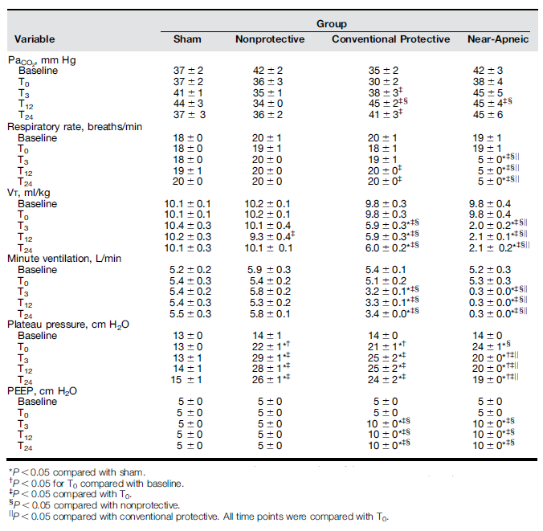
Results : Table 1.
Minute ventilation decreased in conventional protective (30-40%) and near-apneic (10-20 times) groups.
PaCO₂ was relatively unaffected by the differences in minute ventilation, due to changes in ECMO sweep gas flow.
Other ECMO parameters were similar among groups. (Table E1.)
Notes:
1안

Slide 8
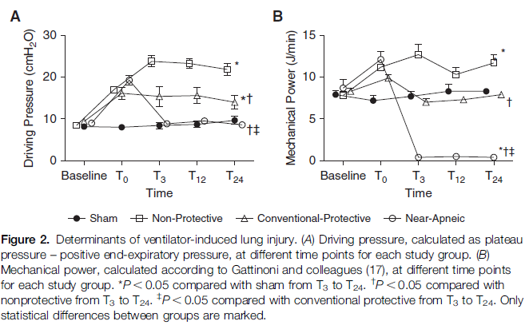

Results : Figure 2.
Driving pressure : nonprotective > conventional protective > near-apneic (≒ Sham)
  Driving pressure = (Plateau pressure) – (PEEP)
Mechanical power : nonprotective > conventional protective (≒ Sham) > near apneic
Notes:
1안

Slide 9
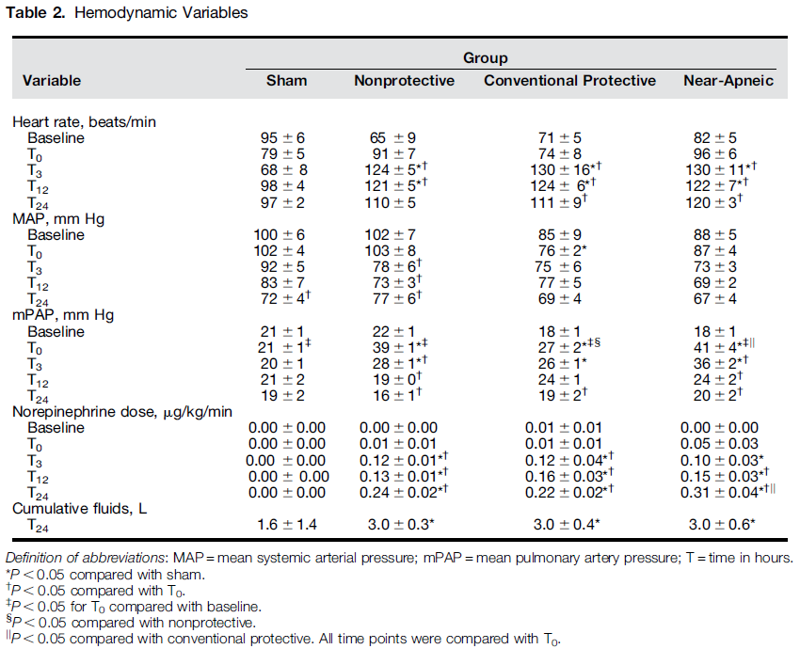
Results : Table 2.
Pulmonary hypertension at T₀ for all experimental groups. Improvement was observed during the study period.
Because of hypotension refractory to hydration, inotropics was required in all experimental groups, with no significant difference.
Mild renal/liver dysfunction in nonprotective group, as indicated by an increase in Cr and AST levels (Table E2.)
Notes:
1안

Slide 10
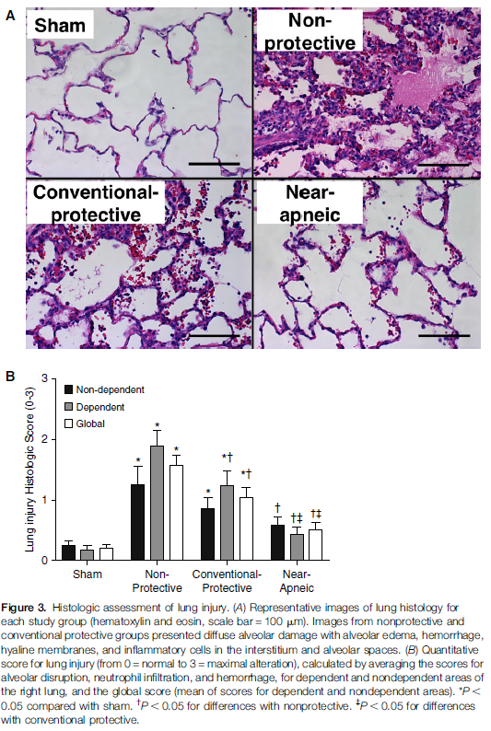
Results : Figure 3.
Severity of injury was lowest in the near-apneic group : less alveolar disruption, neutrophil infiltration, and hemorrhage.
Notes:
1안

Slide 11
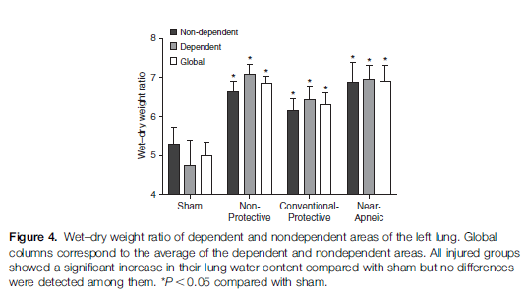
Results : Figure 4.
Notes:
1안

Slide 12
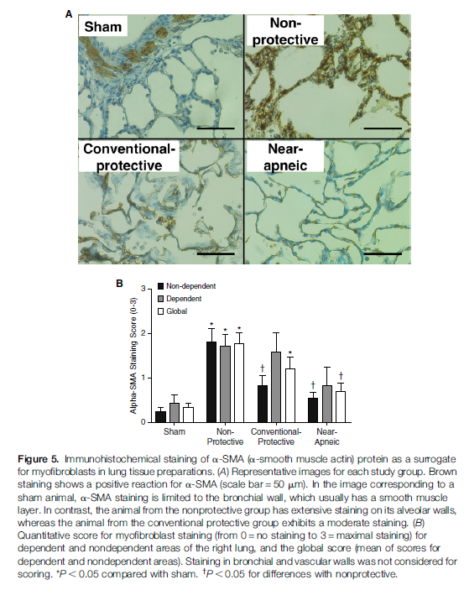
Results : Figure 5.
Immunohistochemistry staining ↑ for α-SMA in nonprotective and conventional protective groups, but not in the near-apneic group.
Procollagen III and TGF-β1 were increased only in the nonprotective group. (Figure E2, E3.)
Notes:
1안

Slide 13
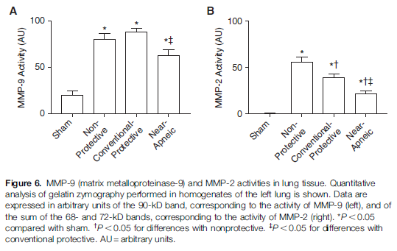
Results : Figure 6.
MMP-2 and -9 activities higher in three injured groups, but near-apneic group was significantly lower than other two groups.
Notes:
1안

Slide 14
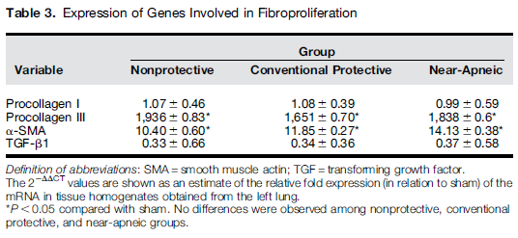
Results : Table 3.
α-SMA and procollagen III expression ↑ for all experimental groups. (Not procollagen I and TGF-β1)
A positive correlation of histologic injury, myofibroblast and procollagen III scores with both driving pressure and mechanical power. (Figure E4.)
Notes:
1안

Slide 15
Discussion
In a model of severe ARDS supported with ECMO, 24 hours of nonprotective ventilation induces severe lung injury and an early fibroproliferative response.
This response is more consistently prevented by applying near-apneic ventilation than by just providing conventional protective ventilation.
In addition to conventional protective and near-apneic groups, nonprotective ventilatory strategy serves as a positive control to confirm that the model was sensitive top the influence of the ventilatory strategy.
This design reproduces the clinical context of ECMO in ARDS patients.
Notes:
1안

Slide 16
Discussion
Near-apneic ventilation significantly decreased histologic lung injury compared with both the nonprotective and the conventional protective ventilatory strategies.
  Associated with marked differences in driving pressures and mechanical power.
  Driving pressures 40~60%↓ → Mechanical power 10 times ↓.
  This suggests that mechanical power may be an important factor in the progression of lung damage during severe ARDS.
  It is difficult to clarify the relative contribution of lower RR versus lower V_{T}.
Increased early fibroproliferative responses, observed in this study, were modulated by the ventilatory strategy applied. Near-apneic ventilation exhibits least alterations.
  Myofibroblasts and procollagen III in alveolar walls / TGF-β1 level ↑ / Collagen III, α-SMA expression ↑ / MMP-2 and -9 activity ↑
  Several studies implicate VILI in the etiology of ARDS-associated fibrosis.
  Pathologic extracellular matrix formation (myofibroblast apoptosis ↓ + procollagen III synthesis ↑) have been described in the presence of abnormally high mechanotransduction.
  Although early fibroproliferative response could be abnormal fibroproliferation that may result in fibrosis, it also may represent a normal repair process to lung injury.
Notes:
1안

Slide 17
Discussion
Limitations
  Pigs as animal models : may differ from human ARDS pathophysiology
  Fixed FiO₂ 1.0 : although not a covariate in this study, this should not be a part of lung rest strategy in ECMO patients.
  Different strategies applied differed in multiple ventilatory parameters; The relative contribution of each parameter to the results is uncertain.
Notes:
1안

Slide 18

Thank you for your attention!
Notes:
의과대학 1-A

Slide 19
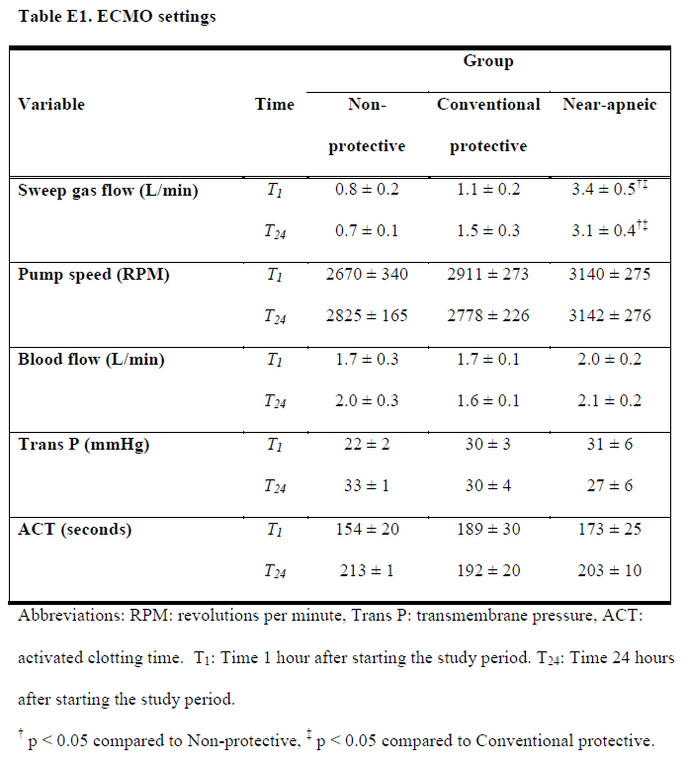
Results : Table E1.
PaCO₂ was relatively unaffected by the differences in minute ventilation, due to changes in ECMO sweep gas flow.
Notes:
1안

Slide 20
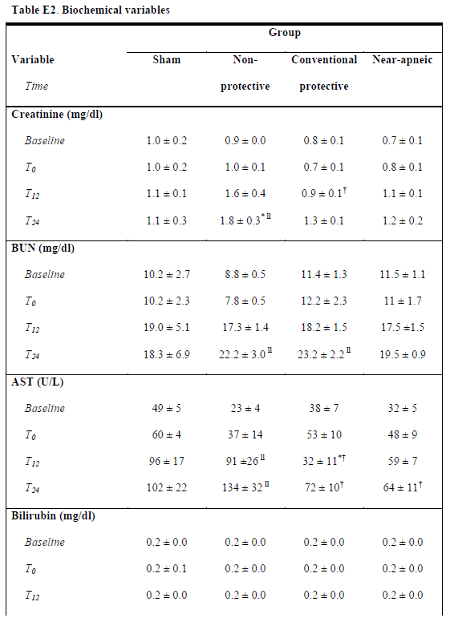
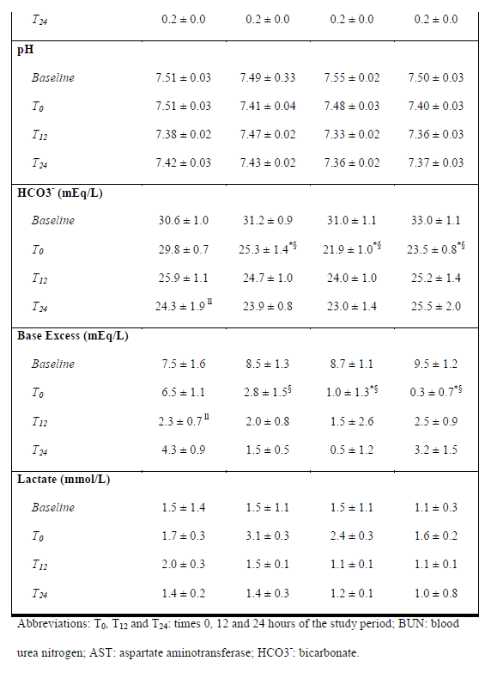
Results : Table E2.
Pulmonary hypertension at T0 for all experimental groups. Improvement was observed during the study period.
Because of hypotension refractory to hydration, inotropics was required in all experimental groups, with no significant difference.
Mild renal/liver dysfunction in nonprotective group, as indicated by an increase in Cr and AST levels (Supplement 2.)
Notes:
1안

Slide 21
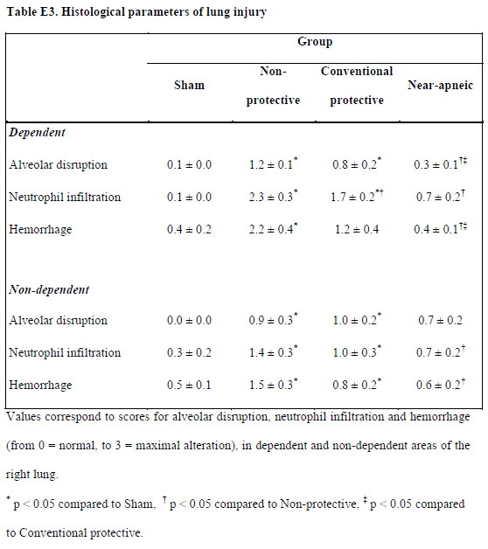
Results : Table E3.
Notes:
1안

Slide 22
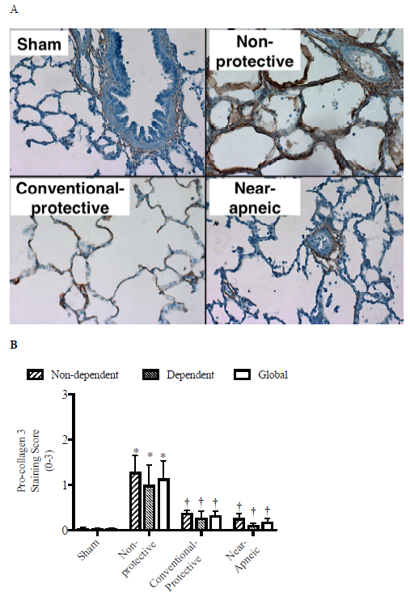
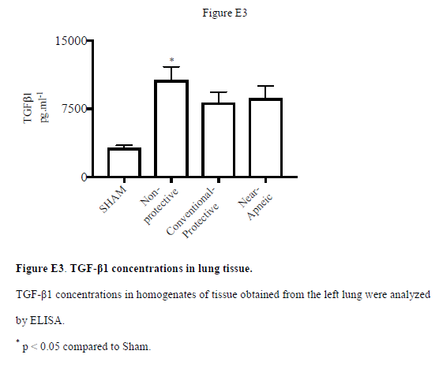
Results : Figure E2 (Procollagen III), E3 (TGF-β1)
Notes:
1안

Slide 23
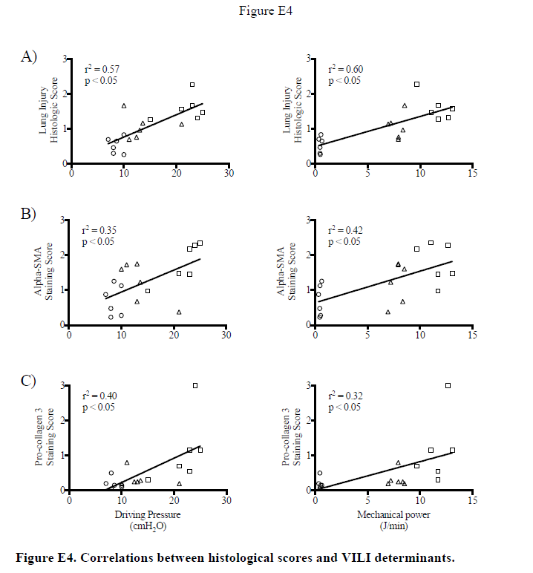
Results : Figure E4.
Notes:
1안

