Slide 1
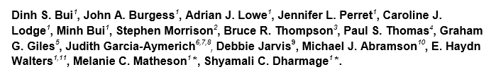
Childhood lung function predicts adult COPD and Asthma-COPD overlap syndrome (ACOS)
R4 고희병

Slide 2
Introduction
It is possible that lower lung function in early life is related to both COPD and ACOS in adult life, but to date, no study has directly investigated this association.
We aimed to investigate associations between childhood lung function and current asthma, COPD and ACOS, and to estimate the prevalence of these conditions in early middle-age.

Slide 3
Method
Tasmanian Longitudinal Health Study (TAHS)
8,583 Tasmanian children born in 1961 and attending school in Tasmania were studied with surveys and pre-bronchodilator (BD) spirometry.
The 1389 participants with postbronchodilator (BD) spirometry comprise the sample for this analysis.

Slide 4
Definition
Asthma
: positive response to survey plus any asthma symptom or asthma medication use in the last 12 months
COPD
: spirometrically defined as a post-BD FEV1/FVC<lower limit of normal (LLN)
ACOS
: defined as the coexistence of both COPD and current asthma.

Slide 5
Statistical Analysis
Characteristics were compared across four groups ; unaffected, asthma alone, COPD alone and ACOS
: Chi-squared tests , ANOVA
Associations between childhood lung function parameters at 7 years and asthma, COPD, ACOS at 45 years
: Multinomial regression
adjusted for childhood lung infections, childhood asthma, maternal smoking, paternal smoking during childhood and childhood socio-economic status

Slide 6
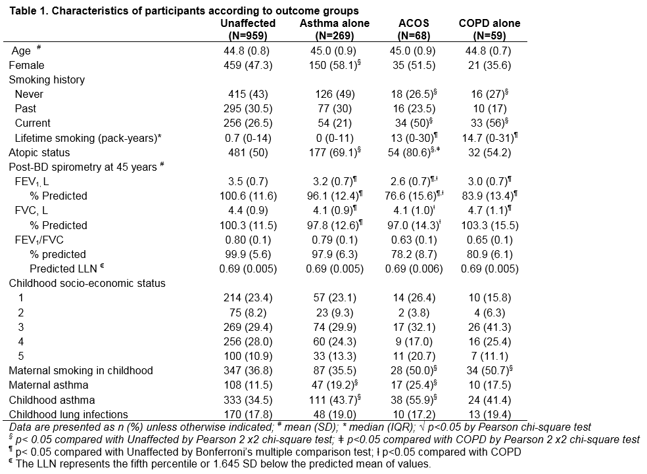

Slide 7
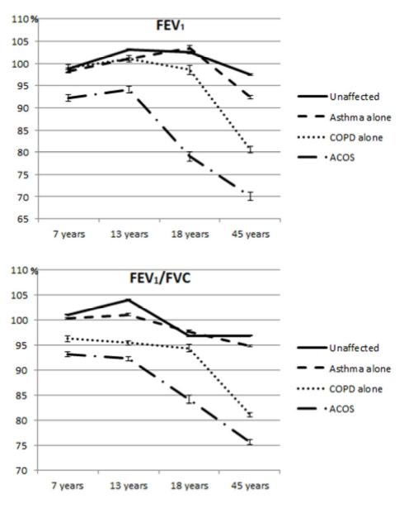
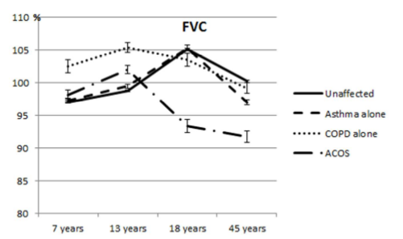

Slide 8
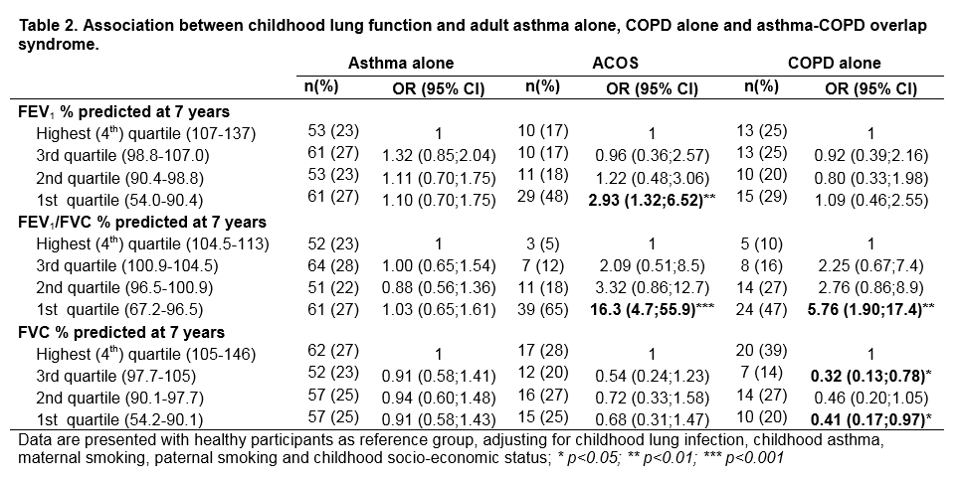

Slide 9
Discussion
Definition of COPD was solely based on spirometry.
Reweighted prevalence of ACOS and COPD alone to be 2.9% and 4.1% respectively at 45 years of age.
ACOS among COPD patients : 41%
Reweighted prevalence of ACOS is higher than the probability of having both asthma and COPD
: ACOS is not just the coexistence of asthma and COPD by chance alone.

Slide 10
Discussion
ACOS; persistently lower FEV1 and FEV1/FVC from childhood.
: Poorer childhood lung function tracked to early adult life, impaired maximally attained lung function, leads to poorer lung function in middle age, even when lung function decline is not accelerated.
Who developed COPD by middle age had persistently lower FEV1/FVC overtime from childhood.

Slide 11
Discussion
This study highlights that low childhood lung function is a risk factor for COPD (and ACOS) independent of smoking.
Effect of lower childhood lung function on subsequent COPD to be greater in never-smokers than ever-smokers but a test for interaction between childhood lung function and smoking was not statistically significant.
Small sample size might have limited the statistical power.

Slide 12
Strength & Limitation
One of the world’s longest-running prospective cohort studies.
The use of post-BD spirometry to define COPD at age 45 years.
Relatively small sample sizes for the ACOS and COPD alone groups.
Did not have post-BD spirometry at 7 years
Large variation in lung function values in the lowest quartiles of FEV1 and FEV1/FVC

Slide 13
Conclusion
Lowest quartile for lung function at age 7 may have long-term consequences for the development of COPD and ACOS by middle age.
Screening of lung function in school age children may identify a high risk group that could be targeted for intervention.
Further research is needed to understand possible modifiers of these associations and develop interventions for children with impaired lung function.

Slide 14
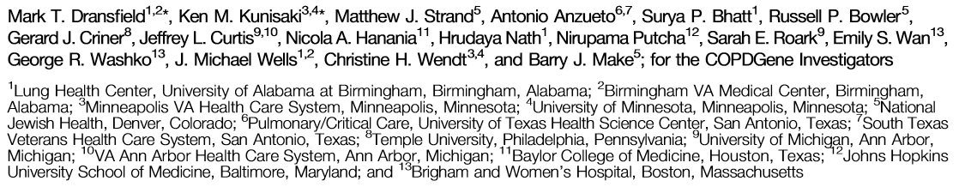
Acute Exacerbations and Lung Function Loss in Smokers with and without Chronic Obstructive Pulmonary Disease

Slide 15
Introduction
Acute exacerbations of COPD increase the risk of death and drive healthcare costs, but whether they accelerate loss of lung function remains controversial.
Whether exacerbations in subjects with mild COPD or similar acute respiratory events in smokers without airﬂow obstruction affect lung function decline is unknown.
To determine the association between acute exacerbations of COPD (and acute respiratory events in smokers without COPD) and the change in lung function over 5years of follow-up.

Slide 16
Study population
The COPDGene study.
  2,000 subjects who returned for a second visit approximately 5 years after their initial visit.
  861 subjects who were more than 1 year late for their return visit.

Slide 17
Definition
GOLD stage 0
  ; current and former smokers without COPD
PRISm ; Preserved ratio impared spirometry
  ; current and former smokers with reduced FEV1 <80% predicted but normal FEV1/FVC ratio(>70%)
Exacerbations ; required use of either antibiotics or systemic steroids
Severe exacerbations ; need for hospitalization

Slide 18
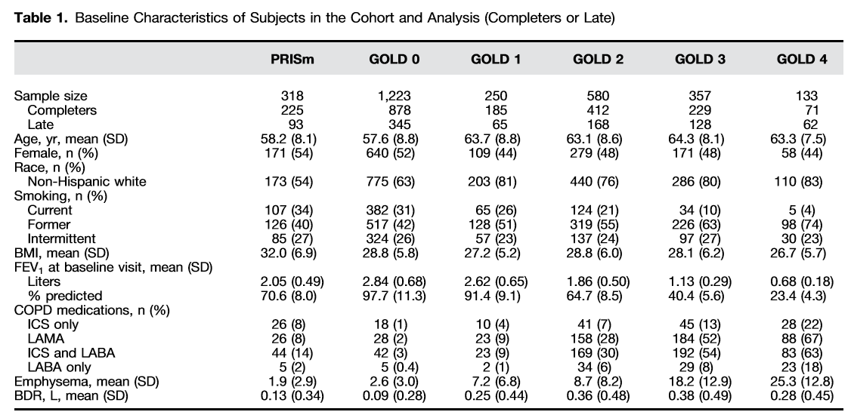

Slide 19
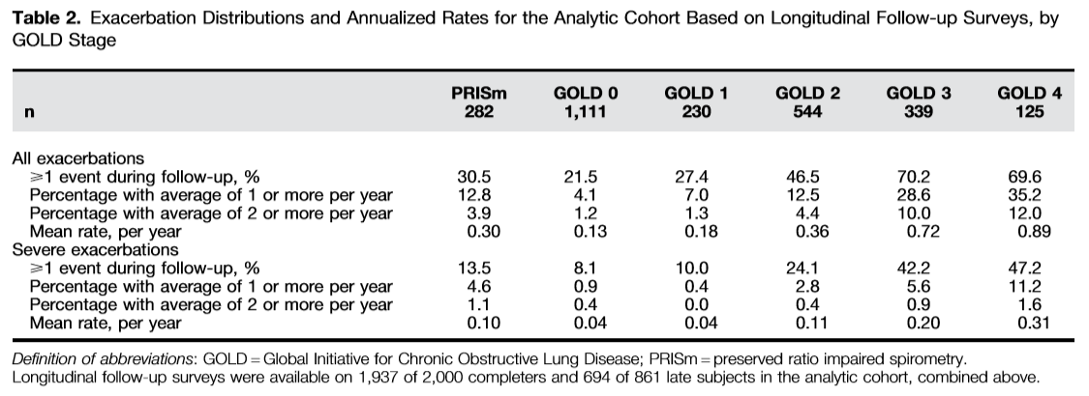
Notes:
Both the proportion of subjects who suffered any event and the annualized rates increased with worsening lung function

Slide 20
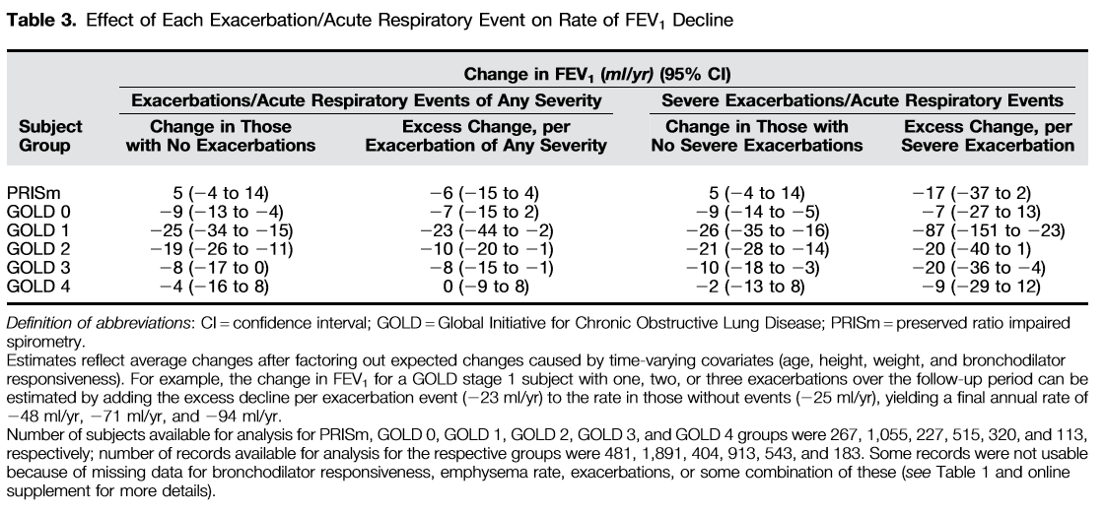

Slide 21
Discussion & conclusion
Large multicenter sample, longitudinal study deign, use of standardized post-BD spirometry, large number of GOLD stage 0, and PRISm subject.
Cannot assign causality between exacerbation and loss of lung function
Spirometry at only two time points, 5 years apart.
Did not collect data about how exacerbations were treated
This study support the hypothesis that acute exacerbations contribute to COPD progression, particularly in those with disease that is initially mild.
  : possibility that preventing exacerbations in this subpopulation could reduce the risk of developing severe COPD

