Slide 1
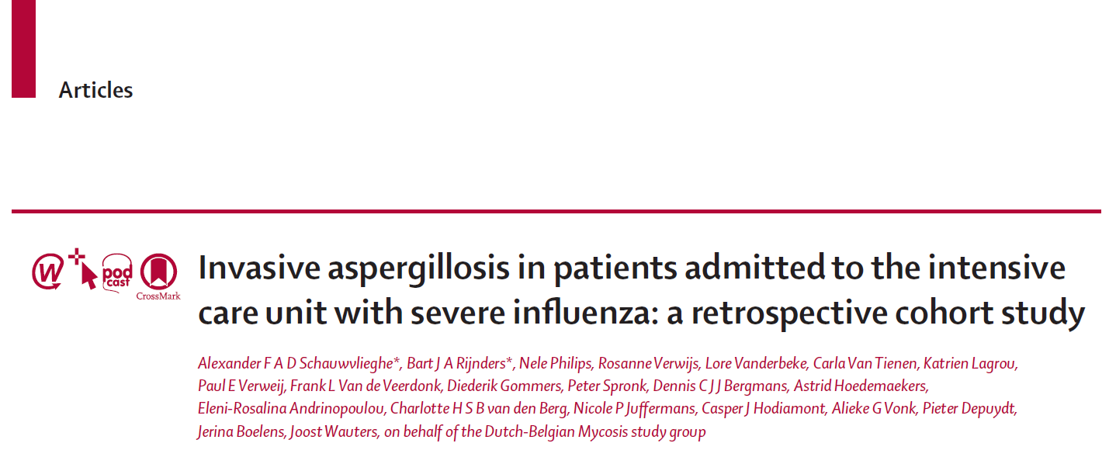
발표자: R2 황윤아

Slide 2
Introduction
Invasive pulmonary aspergillosis
  typically occurs in a severely immunocompromised host
  isolation of Aspergillus species in the immunocompetent host is mostly considered colonisation
  The 6-week mortality : 20–30%

Slide 3
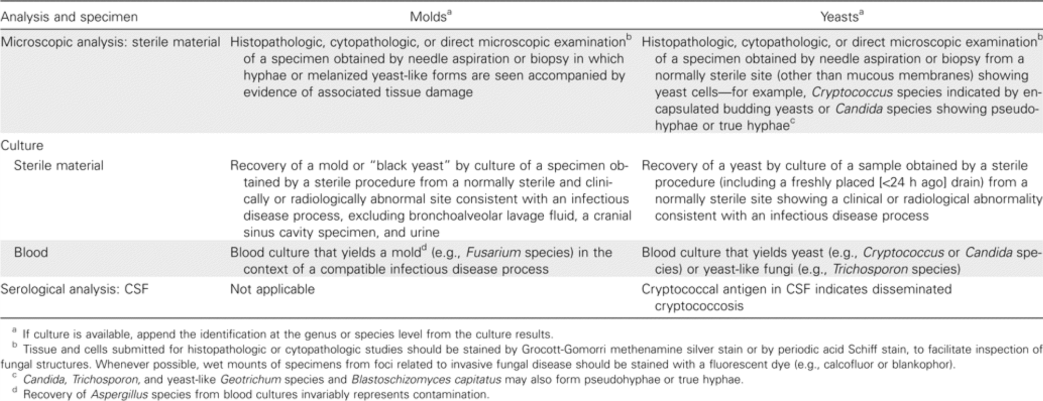
EORTC/MSG criteria for invasive fungal disease
From: Revised Definitions of Invasive Fungal Disease from the European Organization for Research and Treatment of Cancer/Invasive Fungal Infections Cooperative Group and the National Institute of Allergy and Infectious Diseases Mycoses Study Group (EORTC/MSG) Consensus Group
Clin Infect Dis. 2008;46(12):1813-1821. doi:10.1086/588660
Clin Infect Dis | © 2008 by the Infectious Diseases Society of America

Slide 4
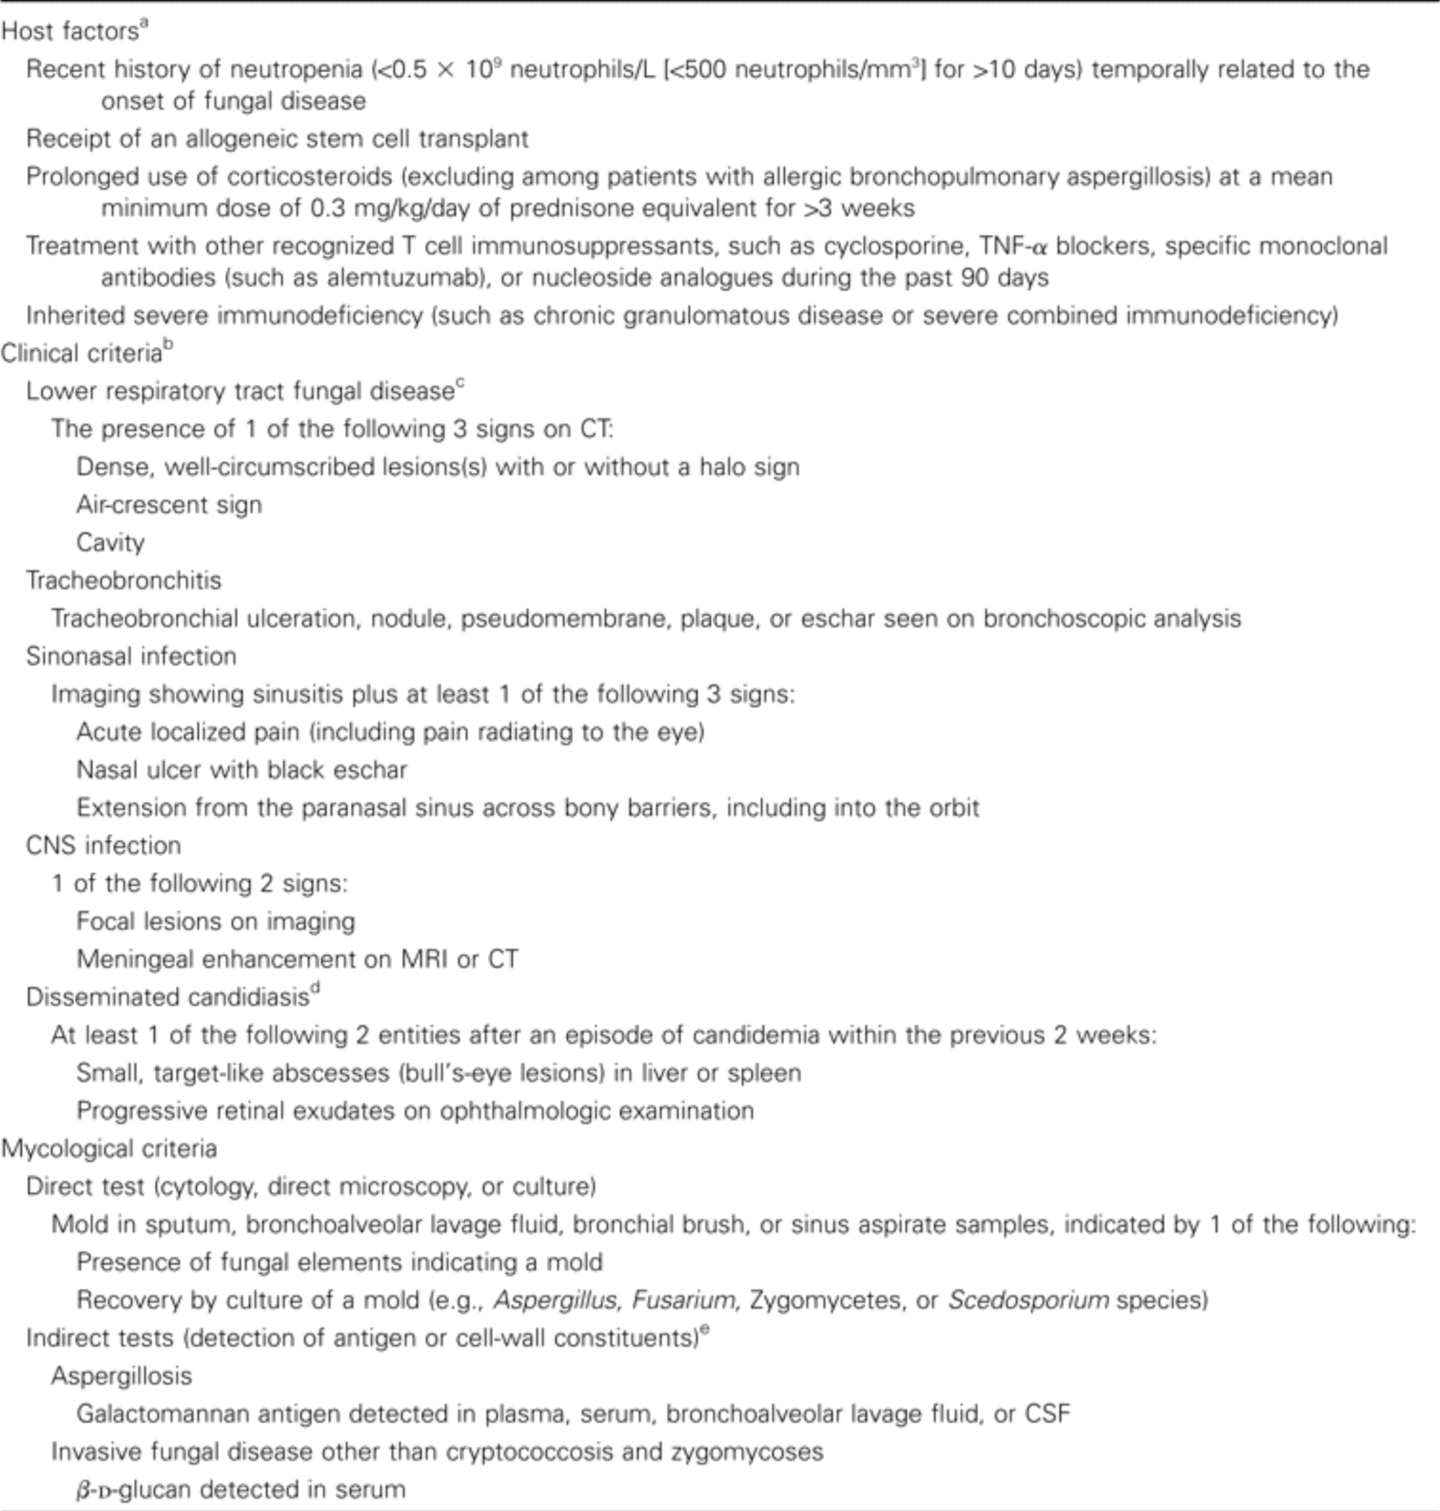


Slide 5
AspICU Algorithm
To distinguish invasive pulmonary aspergillosis from Aspergillus colonisation in patients who are critically ill.
Proven invasive pulmonary aspergillosis
  Identical to EORTC/MSG criteria
Putative invasive pulmonary aspergillosis
  Aspergillosis-positive lower resp. tract specimen culture
  Compatible signs and symptoms
  Abnormal medical imaging
  Host risk factor or Semiquantitative Asp-positive Culture in BAL
Aspergillosis colonization
From: A Clinical Algorithm to Diagnose Invasive Pulmonary Aspergillosis in Critically Ill Patients
American Journal of Respiratory and Critical Care Medicine. 2012;186(1). doi:10.1164/rccm.201111-1978OC

Slide 6
Introduction
Influenza
  common viral respiratory tract infection
  intensive care admission might be needed
    bacterial superinfection
    severe acute respiratory distress syndrome (ARDS)
Influenza-associated aspergillosis
  several small case series in the past 5–10 years.
  65% of the reported cases did not have classic host factors for invasive pulmonary aspergillosis as defined by EORTC/MSG
  Two observation studies: suggest that influenza infection that requires ICU admission is a risk factor for invasive pulmonary aspergillosis
Notes:
In 2012, Wauters and colleagues reported an incidence of 23% of proven or probable invasive pulmonary aspergillosis in 44 patients with H1N1 influenza in two consecutive influenza seasons (2009–11). Remarkably, 44% of patients with invasive pulmonary aspergillosis did not have any of the classical EORTC/MSG host factors.
A Dutch study13 described 23 (16%) of 144 patients with invasive pulmonary aspergillosis who were admitted to the ICU with influenza during the 2015–16 influenza season.

Slide 7
Aim
To describe the epidemiology and outcome of invasive pulmonary aspergillosis in patients admitted to the ICU over seven consecutive influenza seasons
To assess whether influenza was independently associated with invasive pulmonary aspergillosis

Slide 8
Method
A retrospective multicentre cohort study
  Seven tertiary care ICUs (two in Belgium and five in The Netherlands)
  During influenza season from 2009.01.01 to 2016.06.30

Slide 9
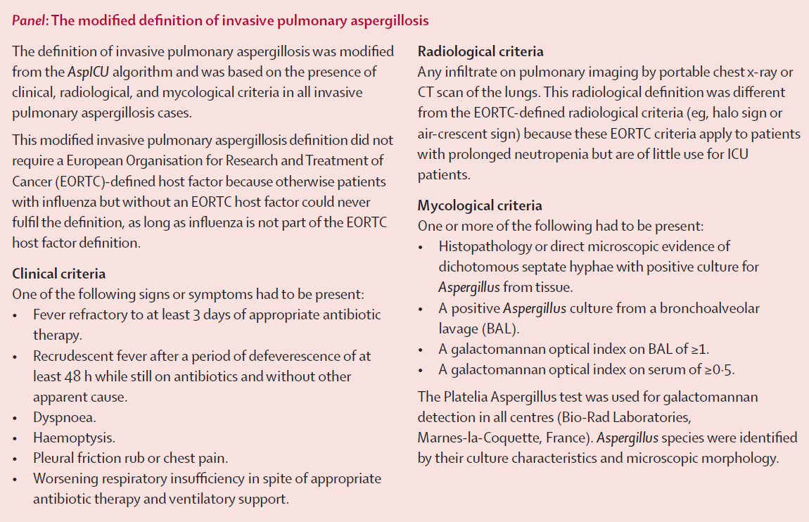
Definition of invasive pulmonary aspergillosis

Slide 10
Method
Patient groups
  Those with severe influenza confirmed by RT-PCR
  Those with severe community-acquired pneumonia without influenza that were not immunocompromised
  Inclusion
    Older than 18 years
    Admission to ICU with acute respiratory failure
  Exclusion
    Admitted to ICU due to other than respiratory failure
    Insufficient available information
    History of invasive pulmonary aspergillosis
    Hospital-acquired pneumonia
    A negative or unavailable bronchoalveolar lavage (BAL) culture or galactomannan test.

Slide 11
Result

Slide 12
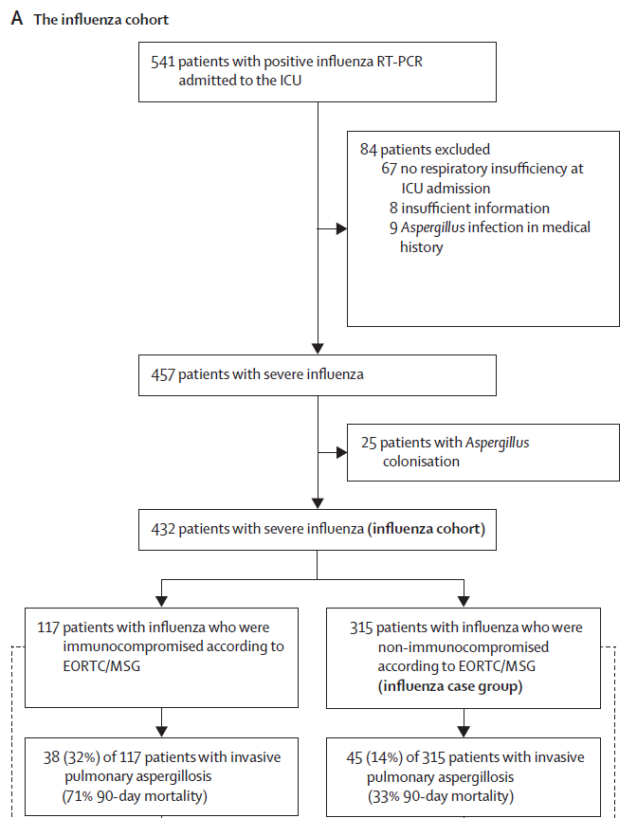

Slide 13
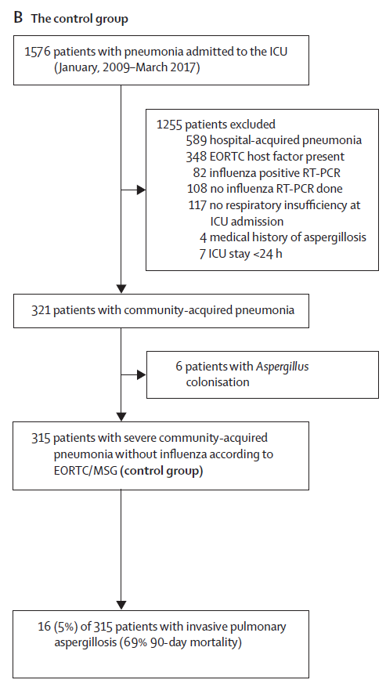

Slide 14
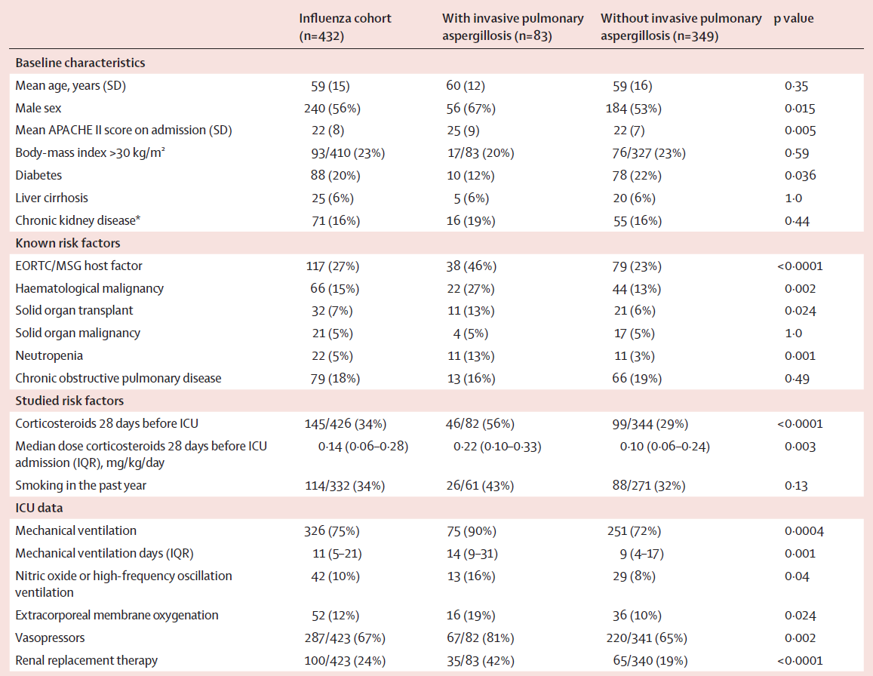

Slide 15
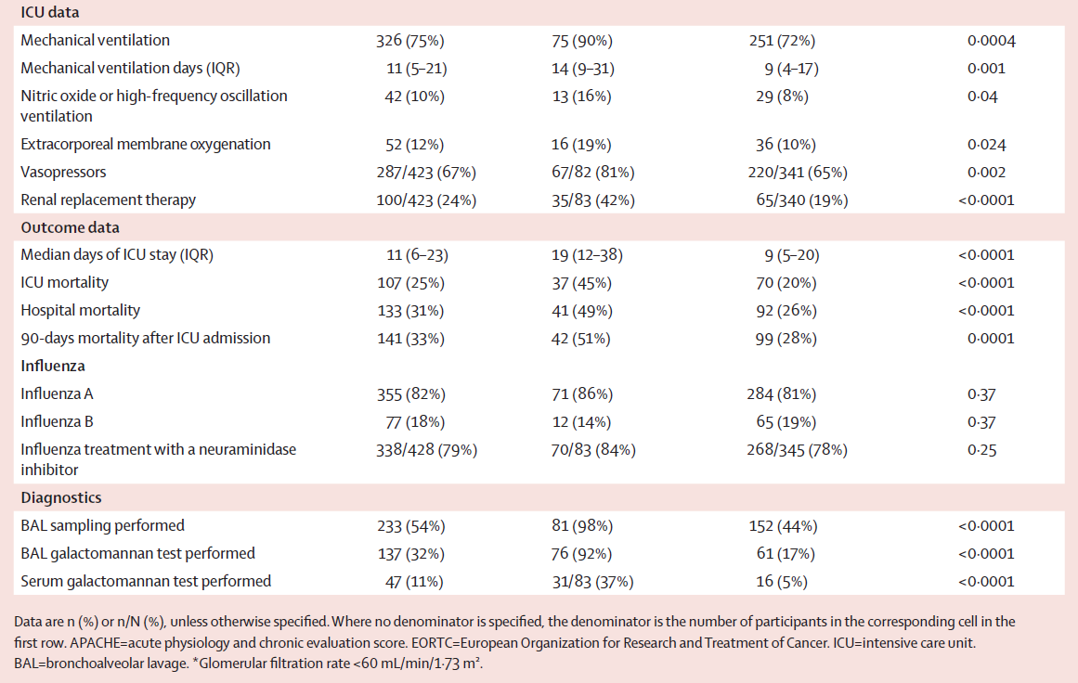

Slide 16
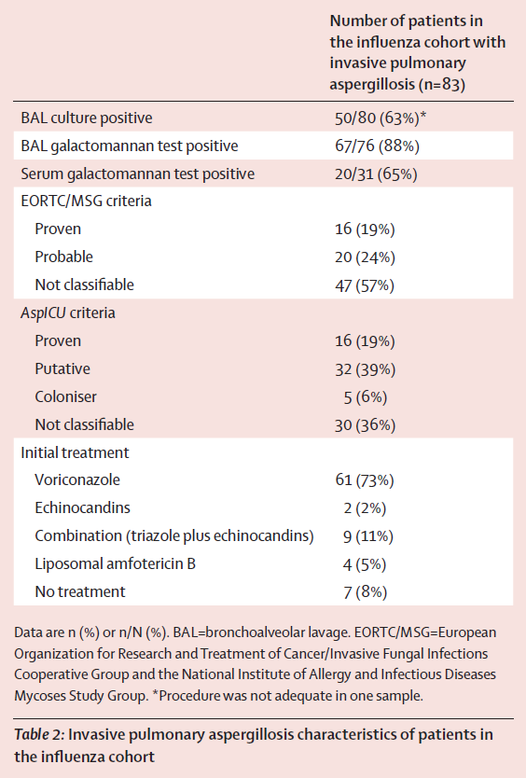
In the influenza cohort, 83 patients
The proportion of patients with invasive pulmonary aspergillosis varied per centre (6%–26%).
median of 3 days (IQR 0–7) after ICU admission
Aspergillus fumigatus
No clear association between the prevalence of invasive pulmonary aspergillosis and the influenza subtypes

Slide 17
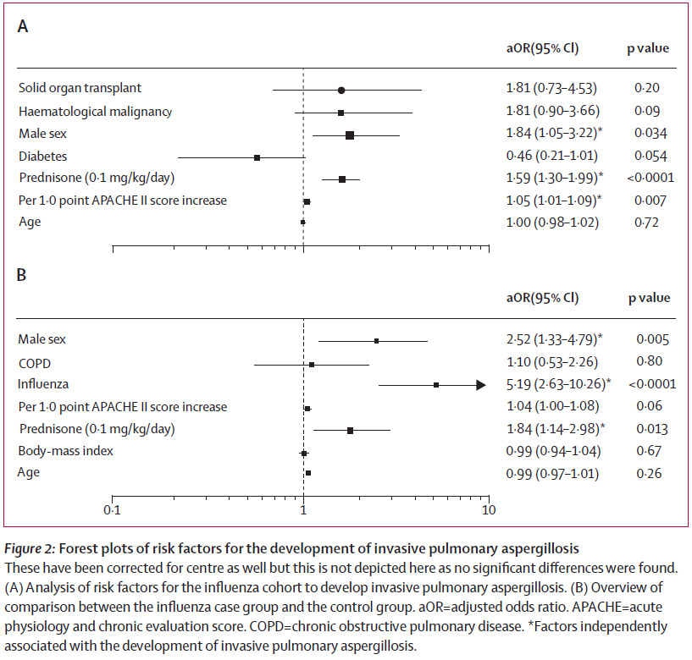

Slide 18
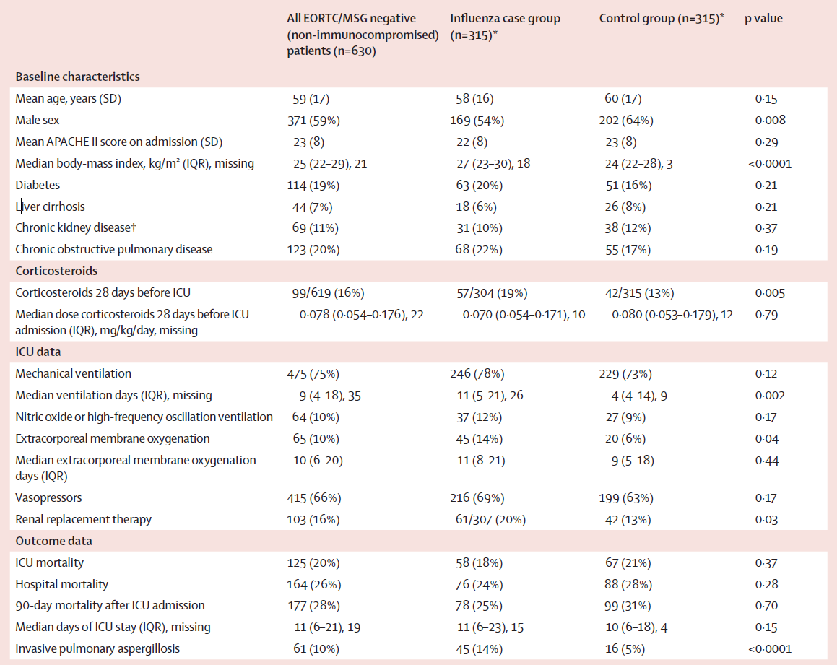

Slide 19
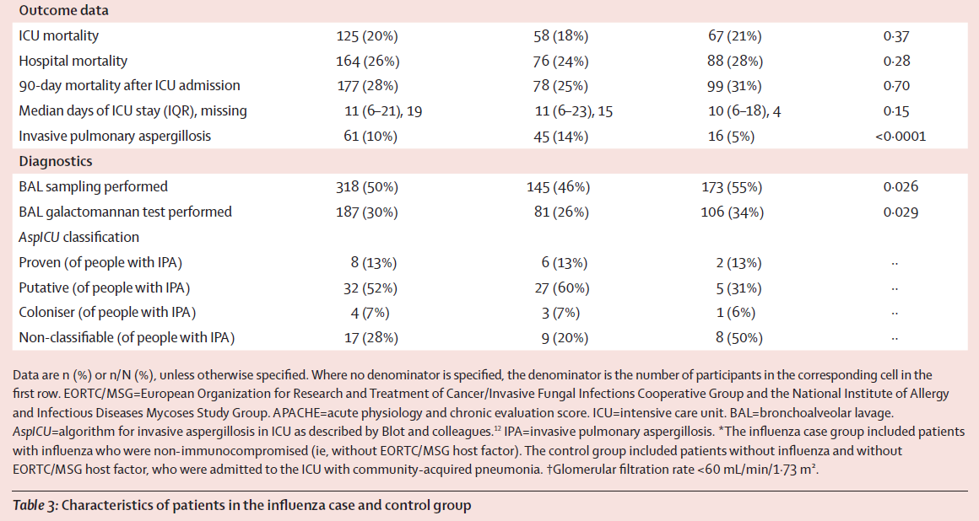

Slide 20
Discussion
The largest ever done on the incidence, risk factors, and outcome of invasive pulmonary aspergillosis in patients with influenza in the ICU
Mortality in patients with influenza associated invasive pulmonary aspergillosis in the ICU was 45%
  accordance with the 47% mortality described in earlier
  somewhat lower than described in cohorts over the past 10 years
Overall incidence : 5%
  Previous literatures: 1% to 6·9%

Slide 21
Discussion
Only some of patients with invasive pulmonary aspergillosis fulfilled one of diagnostic criteria, as defined by the EORTC/MSG or AspICU algorithm
  Nonspecific radiology: classic radiological features only occur in 5%
  Autopsy series indicated that strict interpretation of the host factors for invasive fungal disease contributes to missed diagnosis of invasive pulmonary aspergillosis.
OD cutoff above which a BAL galactomannan test
  a cutoff threshold of 1·0
Angioinvasion is often present in patients with influenza and invasive pulmonary aspergillosis
  17 (61%) of these 28 patients were positive

Slide 22
Discussion
Could not confirm that delayed initiation of antifungal therapy was associated with a fatal outcome
Influenza infection is an independent risk factor for invasive pulmonary aspergillosis
  increased the risk of invasive pulmonary aspergillosis from 5% to 14%
  Mechanism: not yet clear
    Respiratory epithelium damage and mucociliary clearance dysfunction
    influenza-induced ARDS and hypoxia
No association between invasive pulmonary aspergillosis and the influenza subtypes

Slide 23
Discussion
Extrapolation to other respiratroy viruses influenza remains to be seen
Limitation
  Confounding factors cannot be ruled out
  Standardised diagnostic approach towards invasive pulmonary aspergillosis was not used
  Underestimation of actual incidence of invasive pumoanary aspergillosis
  All but one of the seven centres were tertiary care academic ICUs
  Limited set of the control group

Slide 24
Conclusion
In patients with influenza admitted to the ICU, the incidence of invasive pulmonary aspergillosis was high, as was the mortality.
Influenza was independently associated with invasive pulmonary aspergillosis
Future works
  An aggressive diagnostic approach
  The value of antifungal prophylaxis

