Slide 1
Mechanical ventilation after lung transplantation
In depth review
호흡기내과 강사 이수환

Slide 2
Lung transplantation
Treatment option for end-stage lung disease
Median survival is only 5.5 years
Primary graft dysfunction (PGD) is the most common postoperative complication (~25%)
J Heart Lung Transplant, 30 (2011), pp. 1104–1122
J Heart Lung Transplant 2007;26:1004–11.
Am J Respir Crit Care Med 2005;171:1312-6

Slide 3
Primary graft dysfunction
Within 72 h following lung transplantation
Ischemia–reperfusion injury
Pulmonary edema and diffuse alveolar damage
Impaired lung function
Higher risk of developing bronchiolitis obliterans syndrome (BOS)
Am J Transplant 2007;7(11):2573-8.

Slide 4
PGD is a form of ischemia–reperfusion injury
  Grade 1 — PaO₂/FiO₂ ratio > 300 mmHg accompanied by chest infiltrates on x-ray
  Grade 2 — PaO₂/FiO₂ ratio 200–300 mmHg accompanied by chest infiltrates on x-ray
  Grade 3 — PaO₂/FiO₂ ratio < 200 mmHg accompanied by chest infiltrates on x-ray
Semin Respir Crit Care Med, 31 (2010), pp. 161–171
J Heart Lung Transplant, 24 (2005), pp. 1454–1459

Slide 5
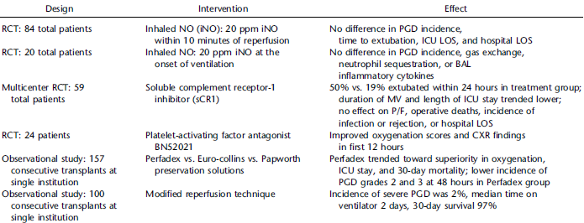
Prevention of PGD
Am J Respir Crit Care Med 2003;167:1483–1489.
J Heart Lung Transplant 2007;26:1199–1205.
Chest 1999;116:46S.
J Heart Lung Transplant 2001;20:358–363.
Ann Thorac Surg 2006;82:1842–1848.
J Thorac Cardiovasc Surg 2006;131:218–223

Slide 6
Management of PGD
Treatment of established PGD largely remains supportive
Treatment strategies are similar to those for patients with ARDS
J Heart Lung Transplant 2005;24:1489–1500.

Slide 7
Management of ARDS
Treated with mechanical ventilation
Low tidal volumes
Positive end expiratory pressure (PEEP)
Plateau pressure (< 30 cmH2O)
High-frequency oscillatory ventilation
ECMO
N Engl J Med, 338 (1998), pp. 347–354
N Engl J Med, 342 (2000), pp. 1301–1308
N Engl J Med, 351 (2004), pp. 327–336
JAMA, 299 (2008), pp. 646–655
JAMA, 303 (2010), pp. 865–873
Am J Respir Crit Care Med, 166 (2002), pp. 1510–1514
Curr Opin Crit Care, 18 (2012), pp. 70–79

Slide 8
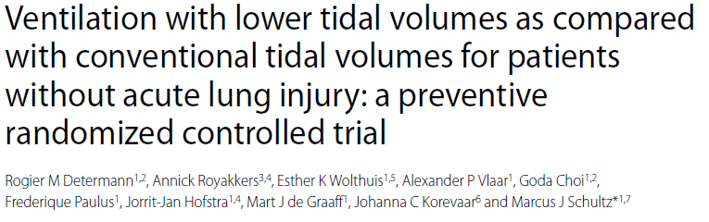
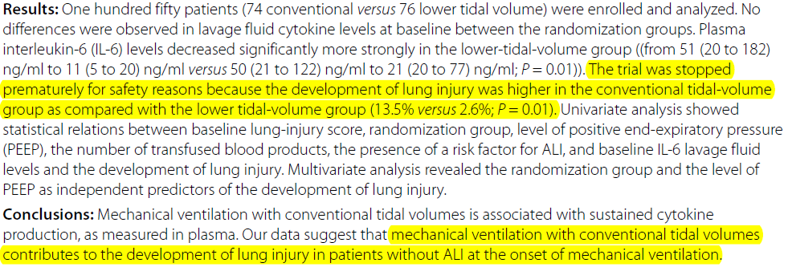
Crit Care 2010;14(1):R1.

Slide 9
There are no international practice guidelines or consensus statements for the perioperative management of lung transplantation, and anesthetic management is not currently standardized
Transplant Rev 2013;27:30–5.

Slide 10
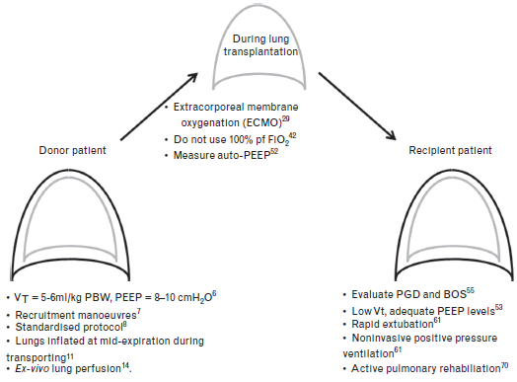
Eur J Anaesthesiol 2015;32(12):828-36.

Slide 11
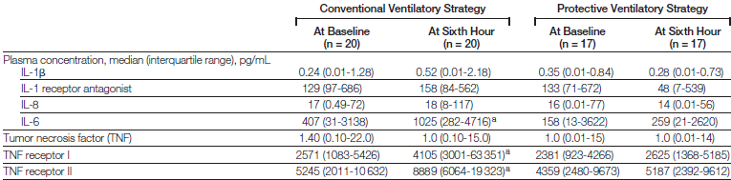
Ventilating the donor lungs and preoperative care
Ventilation with a VT of 5 to 6 ml /kg and PEEP of 8 to 10cmH2O (RCT)
Jama 2010;304(23):2620-7.
Notes:
Multicenter randomized controlled trial of patients with beating hearts who were potential organ donors conducted at 12 European intensive care units from September 2004 to May 2009 in the Protective Ventilatory Strategy in Potential Lung Donors Study. Interventions Potential donors were randomized to the conventional ventilatory strategy (with tidal volumes of 10-12 mL/kg of predicted body weight, positive end-expiratory pressure [PEEP] of 3-5 cm H(2)O, apnea tests performed by disconnecting the ventilator, and open circuit for airway suction) or the protective ventilatory strategy (with tidal volumes of 6-8 mL/kg of predicted body weight, PEEP of 8-10 cm H(2)O, apnea tests performed by using continuous positive airway pressure, and closed circuit for airway suction).

Slide 12
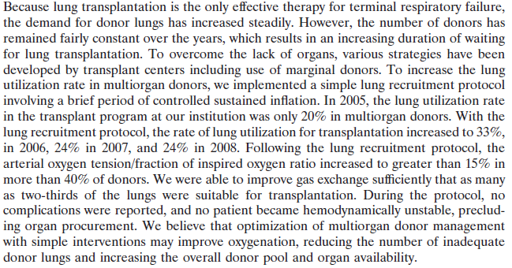

Ventilating the donor lungs and preoperative care
Recruitment protocol for organ donors →improve the rate of lung utilization
Transplant Proc 2009;41(8):3284-9.
Notes:
Lung Recruitment Protocol
Optimize ventilator settings (tidal volume, rate, pressure)
Baseline blood gas obtained with Fio2 100%; PEEP, 5 cm H2O
Initiate recruitment maneuver
30 seconds of sustained inflation at 30 cm H2O
Hemodynamics closely monitored to prevent hypotension or decreased organ perfusion
2 minutes of normal ventilation
30 seconds of sustained inflation at 30 cm H2O
1 hour of normal ventilation, Fio2 40%; PEEP, 10 cm H2O; peak pressure <30 mm Hg
Blood gas postrecruitment is obtained with Fio2 100%; PEEP, 5 cm H2O for 20 minutes
After blood gases are assessed, Fio2 is decreased to <50%

Slide 13
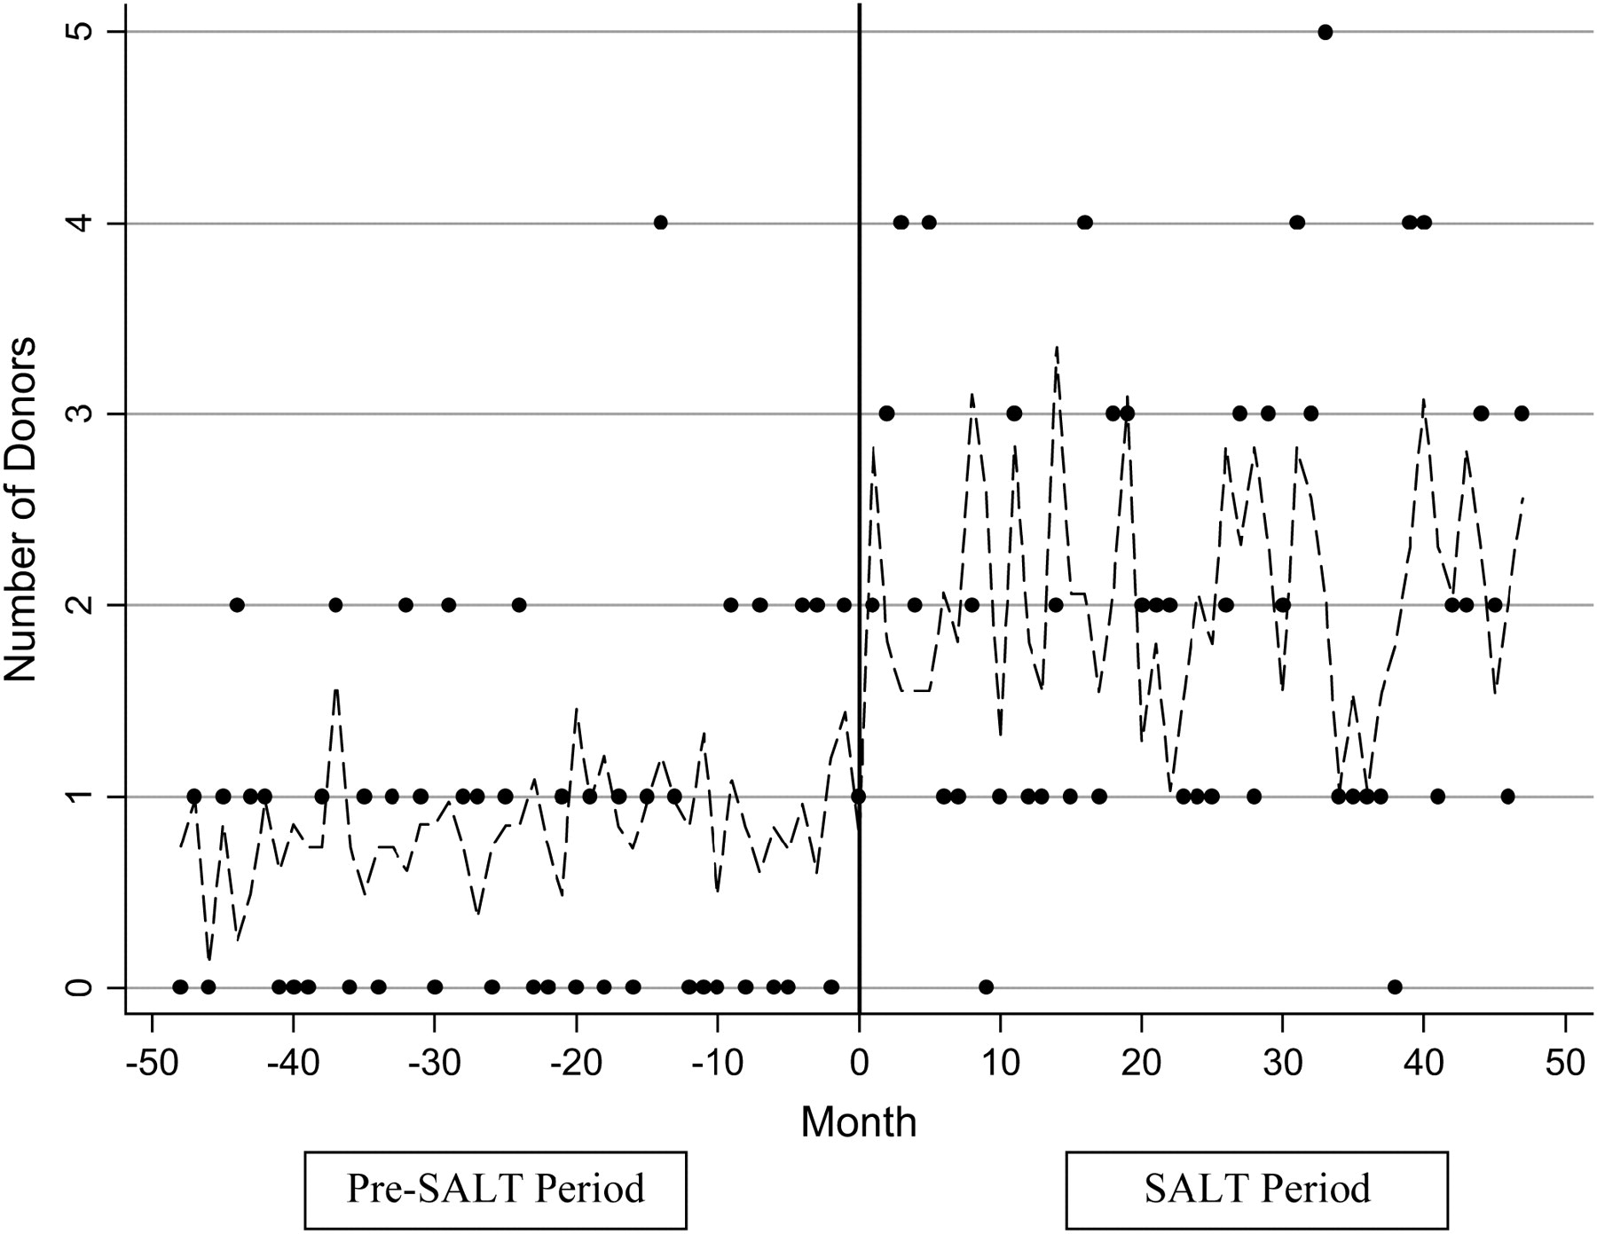
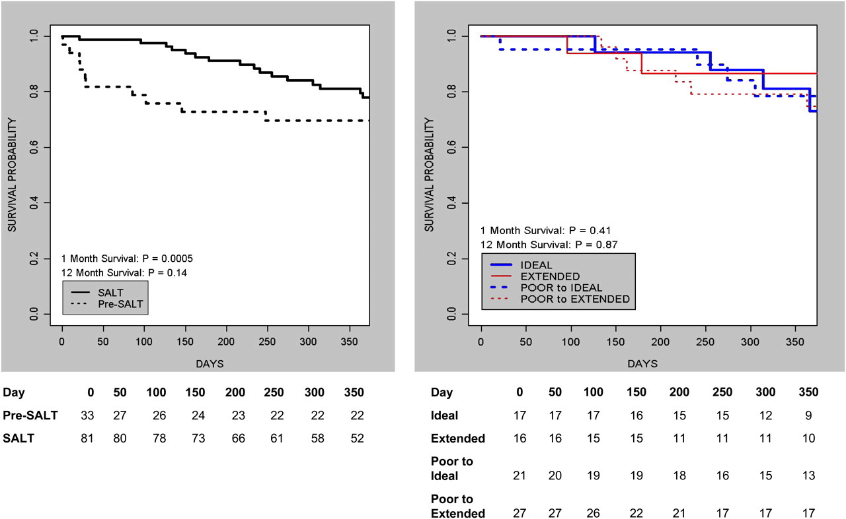
Ventilating the donor lungs
and preoperative care
lung donor–management protocol → increase in the number of lung donors and transplant procedures
Am J Respir Crit Care Med 2006;174(6):710-6.
Notes:
recruitment manoeuvres during pressure- controlled ventilation,
an inspiratory pressure of 25cmH2O followed by 15cmH2O of PEEP for 2 h (PaO2/FiO2 ratio should be higher than 300 and maintained
for 30 min to be considered successful) and then
switched to volume-control ventilation.
figure1. There was a clear and statistically significant (p = 0.037) increase in the number of actual lung donors during the SALT period. Dotted lines represent the predicted values from the fitted generalized estimating equation model. Solid circles represent the observed number of donors from whom lungs were procured.
Figure2. 114 lung transplantation procedures were performed at our institution, with a minimum follow-up of 1 yr. There was no significant difference in the underlying diagnosis of the recipients. The rate of bilateral lung transplantation increased from 19% during the pre-SALT period to 37% during the SALT period (p = 0.02). The 30-d survival rate (81% pre-SALT; 99% SALT; p = 0.005) and the 1-yr survival rate (76% pre-SALT; 85% SALT; p = 0.14) improved after implementation of the SALT protocol. No significant differences were found during the SALT period in 30-d and 1-yr survival rates between recipients of lungs from the donor groups (ideal, extended, poor to ideal, and poor to extended;

Slide 14
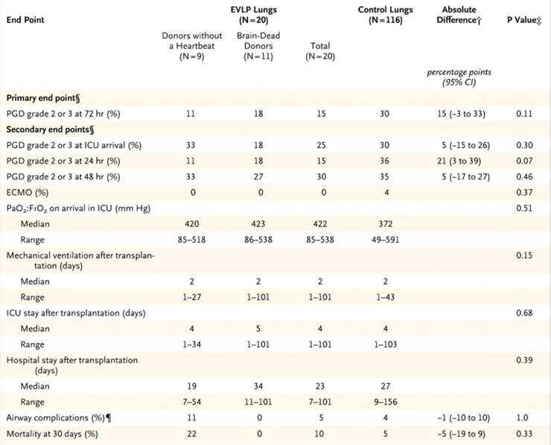
Ventilating the donor lungs and preoperative care
Ex Vivo Lung Perfusion
Transplantation of high-risk donor lungs that were physiologically stable during 4 hours of ex vivo perfusion led to results similar to those obtained with conventionally selected lungs
N Engl J Med 2011;364(15):1431-40
Notes:
High-risk donor lungs were defined by specific criteria,
including pulmonary edema and
a ratio of the partial pressure of arterial oxygen to the fraction of inspired oxygen (PO₂:FIO₂) less than 300 mm Hg.
Lungs with acceptable function were subsequently transplanted.

Slide 15
Intraoperative mechanical ventilation
ECMO →stabilize hemodynamic variables and prevent ‘first lung syndrome’ (hyperperfusion of the first implanted lung during implantation of the second lung)
Do not use 1.0 FiO2
Measure auto-PEEP
J Thorac Cardiovasc Surg 2002;124(6):1137-44
J Thorac Cardiovasc Surg 2005;130(5):1440
Am J Respir Crit Care Med 2011;184(7):756-62.
Notes:
Reperfusion 시 1.o 이 lung ventilation의 악형향, 2시간 이후에 1.0 는 비슷한 결과
Auto-positive end-expiratory pressure (auto-PEEP; AP) and dynamic hyperinflation (DH) may affect hemodynamics, predispose to barotrauma, increase work of breathing, cause dyspnea, disrupt patient-ventilator synchrony, confuse monitoring of hemodynamics and respiratory system mechanics, and interfere with the effectiveness of pressure-regulated ventilation. Although basic knowledge regarding the clinical physiology and management of AP during mechanical ventilation has evolved impressively over the 30 years since DH and AP were first brought to clinical attention, novel and clinically relevant characteristics of this complex phenomenon continue to be described. This discussion reviews some of the more important aspects of AP that bear on the care of the ventilated patient with critical illness

Slide 16
Postoperative mechanical ventilation
Evaluate PGD and BOS → early intensive care of lung
Low Vt (<6ml/kg PBW), adequate PEEP levels (low to moderate)
Rapid extubation & Noninvasive positive pressure ventilation
Active pulmonary rehabilitation
Am J Respir Crit Care Med 184(7): 756-762.
Curr Opin Anaesthesiol 25(2): 170-174.
Transplant Proc 44(7): 2016-2021.
J Heart Lung Transplant 31(9): 934-941.

Slide 17
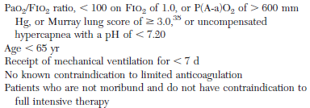
Postoperative mechanical ventilation
ECMO
1.0 FiO2 with PIP 40cmH2O and continued deterioration – PEEP 12-15cmH2O
PIP 35 cmH2O or 0.6 FiO2
Ann Thorac Surg 2004; 78:1230–1235.
Chest 2008; 134:179–184.
J Thorac Cardiovasc Surg 2000; 120:20–26

Slide 18

Method:
  Electronic survey
  Medical and surgical directors
  US LTx programs (N=111) & Members of the pulmonary council of international society for heart and lung trasnsplantation (N=470)
Total 149 individuals from 18 countries responded
Ann Am Thorac Soc 2014;11(4):546-53.

Slide 19
Ann Am Thorac Soc 2014;11(4):546-53.
Notes:
The most common modes of ventilation were pressure assist/control (37%) and volume assist/control (35%).
Tidal volumes were most often determined by recipient characteristics.
Donor characteristics were rarely considered (35%) and were infrequently known by the team managing the ventilator (42%)
A majority of respondents selected 6 ml/kg recipient predicted body weight (58%), fewer selected 10ml/kg (21%), and none selected 15 ml/kg.
A majority preferred limiting the fraction of inspired oxygen rather than positive end-expiratory pressure (PEEP)
The median plateau pressure limit perceived as a threshold triggering reduction in tidal volume was 30 cm H2O

Slide 20
A large percentage of respondents (65%) answered that they did not consider donor characteristics such as height, sex, PBW, or predicted lung size when setting the ventilator.
Ann Am Thorac Soc 2014;11(4):546-53.

Slide 21
For lung →
Protective ventilation, should ventilator settings be based on donor or recipients characteristics ?

Slide 22
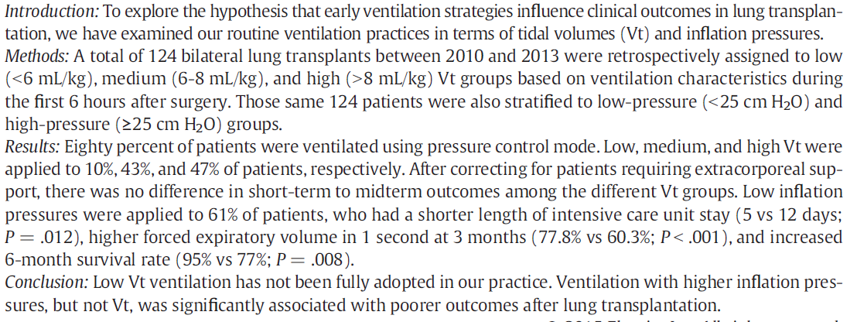
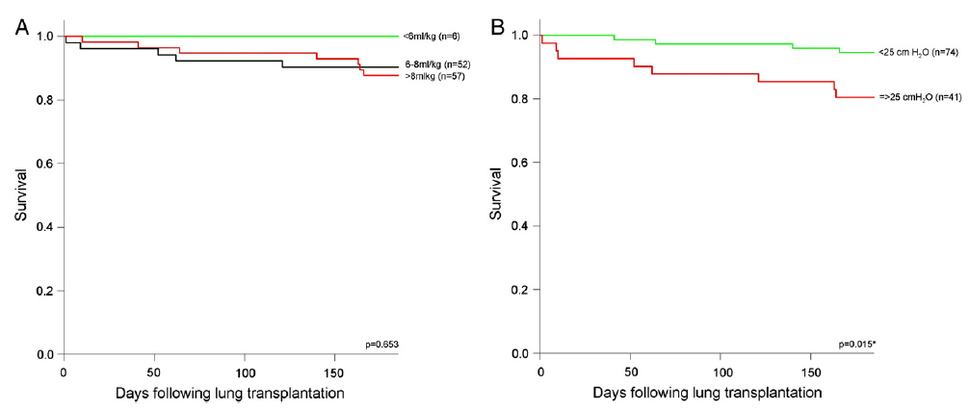
Crit Care 2016;31(1):110-8.

Slide 23
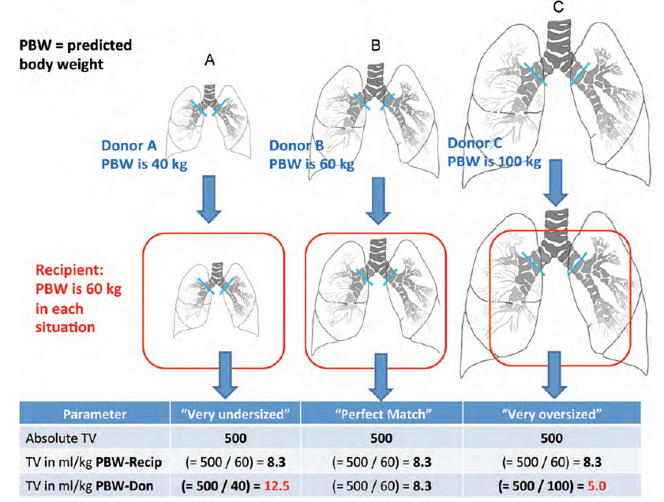
The effect of lung-size mismatch on mechanical ventilation tidal volumes after bilateral lung transplantation
Interact Cardiovasc Thorac Surg 2013;16(3):275-81.

Slide 24
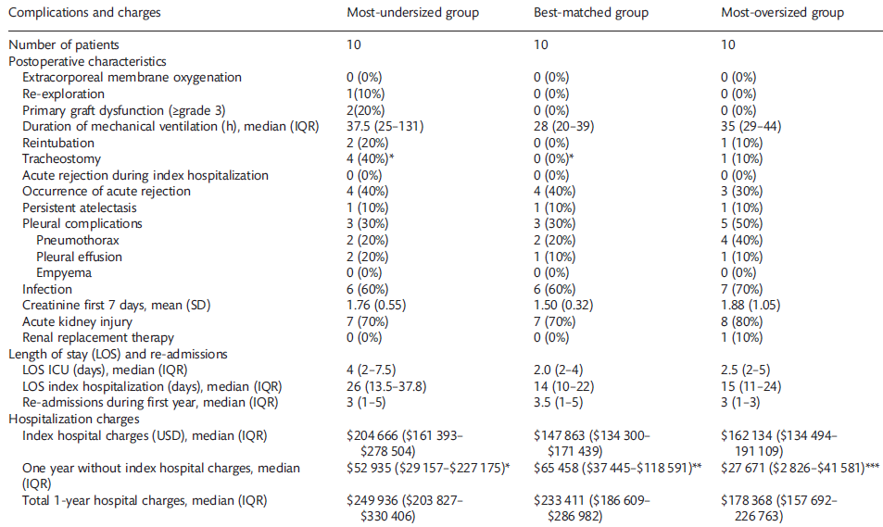
Interact Cardiovasc Thorac Surg 2013;16(3):275-81.

Slide 25
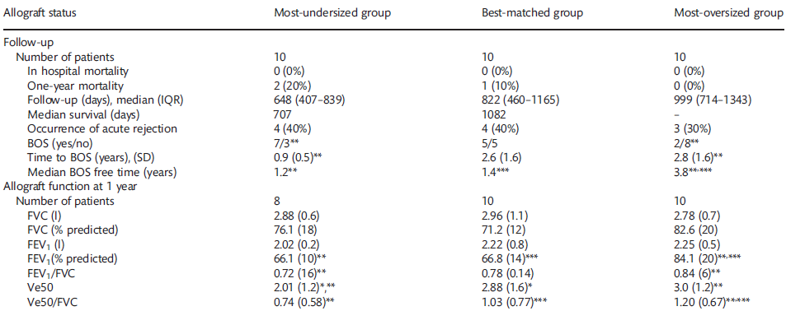
Lungs smaller than the recipient size were ventilated with a VT greater than that predicted for donor weight, which could induce volutrauma. Nevertheless, in
comparison with patients who received adequately sized lungs, there was no significant difference in in-hospital or 1-year mortality.
Interact Cardiovasc Thorac Surg 2013;16(3):275-81.

Slide 26
MECHANICAL VENTILATION FOR THE LUNG TRANSPLANT RECIPIENT.
Mechanical ventilation (MV) is an important aspect in the intraoperative and early postoperative management of lung transplant (LTx)-recipients. There are no randomized-controlled trials of LTx-recipient MV strategies; however there are LTx center experiences and international survey studies reported. The main early complication of LTx is primary graft dysfunction (PGD), which is similar to the adult respiratory distress syndrome (ARDS). We aim to summarize information pertinent to LTx-MV, as well as PGD, ARDS, and intraoperative MV and to synthesize these available data into recommendations. Based on the available evidence, we recommend lung-protective MV with low-tidal-volumes (≤6 mL/kg predicted body weight [PBW]) and positive end-expiratory pressure for the LTx-recipient. In our opinion, the MV strategy should be based on donor characteristics (donor PBW as a parameter of actual allograft size), rather than based on recipient characteristics; however this donor-characteristics-based protective MV is based on indirect evidence and requires validation in prospective clinical studies.
Curr Pulmonol Rep 4(2): 88-96.

Slide 27
본원 data 정리
(from 2010-01-22 to 2014-03-21)
Variables | Over or best match | Under match | P-value
Subject number, N (%) | 38 | 23
Age, years (median, IQR) | 49.5(38.7-62.3) | 55(49.5-60) | 0.337
Sex, N (%) |  |  | <0.001
Men | 34 (89.5) | 11 (47.8)
Women | 4 (10.5) | 12 (52.2)
BMI, kg/m2 ( median, IQR) | 19.9 (17.1-23) | 20.5 (19.0-22.9) | 0.352
LT type, N (%)
Bilateral | 34 | 21
Unilateral | 4 | 2
Ever smoker, N (%) | 12 (31.3) | 8 (34.8) | 0.796
Post op Vt/kg | 5.3(4.8-5.6) | 6.7(6.4-7.3) | <0.001
PGD, N (%) | 36 (94.7) | 20 (87.0) | 0.356
PGD0,1 vs PGD 2,3 , N(%) | 21 (55.3) | 11 (47.8 ) | 0.573
PGD 0,1,2 vs PGD 3, N(%) | 11 (28.9) | 5 (21.7) | 0.535
30 days survivals, N (%) | 33 (86.8) | 18 (78.3) | 0.481
90 days survivals, N (%) | 30 (78.9) | 16 (69.6) | 0.410

Slide 28
Variables | Post Vt ≤6ml/kg | Post Vt >6ml/kg | P-value
Subject number, N (%) | 36 | 25
Age, years (median, IQR) | 49(38.3-62.8) | 55(49.5-59.0) | 0.252
Sex, N (%) |  |  | 0.008
Men | 15(41.7) | 19(76)
Women | 21(58.3) | 6(24)
BMI, kg/m2 ( median, IQR) | 20.3(16.9-23.0) | 20.4(18.6-22.9) | 0.687
LT type, N (%)
Bilateral
Unilateral
Ever smoker, N (%) | 11(30.6) | 9(36) | 0.656
Post op Vt/kg | 5.2(4.8-5.9) | 6.8(4.8-7.3) | <0.001
PGD, N (%) | 35(97.2) | 21(84) | 0.149
PGD0,1 vs PGD 2,3 , N(%) | 20(55.6) | 12(48) | 0.561
PGD 0,1,2 vs PGD 3, N(%) | 11(68.8) | 5(20) | 0.357
30 days survivals, N (%) | 31(86.1) | 20(80) | 0.727
90 days survivals, N (%) | 28(77.8) | 18(72) | 0.606

