Slide 1


In depth review
: ILD & Lung transplantation
F2. 송명진

Slide 2
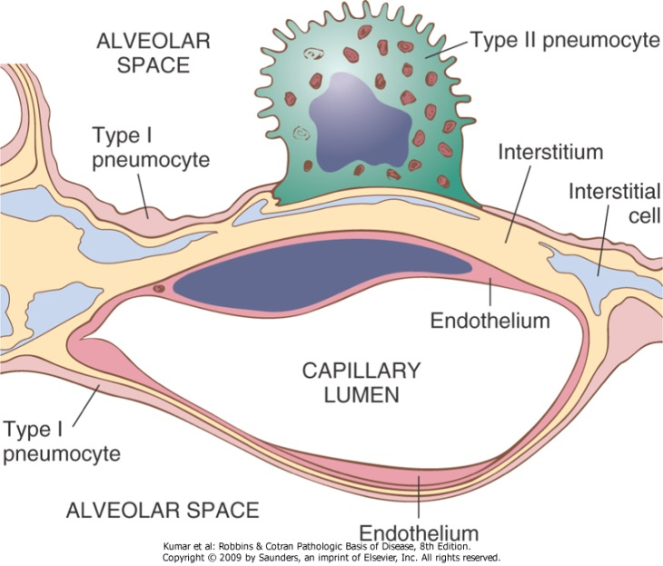
Interstitial lung disease?
Interstitium : space between the epithelial and endothelial basement membranes
heterogeneous group of non-neoplastic, non infectious disorders where the primary site of injury is interstitium
affect not only the interstitium, but also the airspaces, peripheral airways, and vessels along with their respective epithelial and endothelial linings.

Slide 3
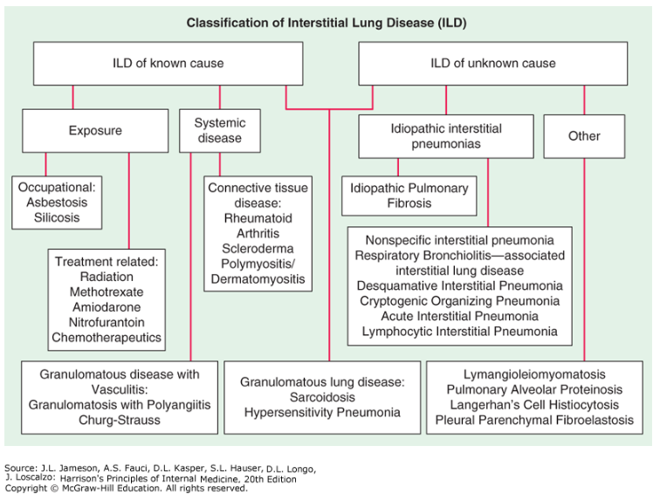
Classification
Harrison 20th
ATS/ERS, AJRCCM 2013

Slide 4
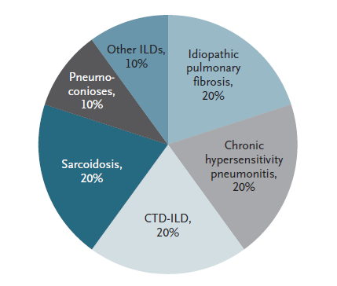
Estimated Relative Distribution of ILD
These estimates are likely to be heavily influenced by regional variation in referral patterns and the true underlying prevalence of each disease (which is unknown).
NEJM 2018;378:1811-23

Slide 5
Contents
IPF
  Revised diagnosis guideline - 2018
  Pharmacologic treatment
  Acute exacerbation
Sarcoidosis
Hypersensitivity pneumonitis
Lung transplantation

Slide 6
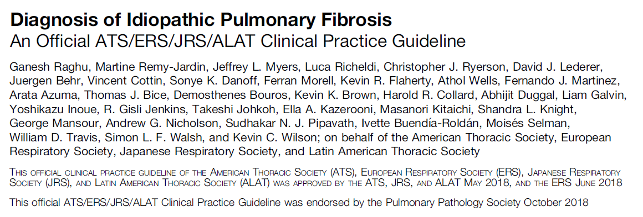
Diagnosis of Idiopathic Pulmonary Fibrosis

Slide 7
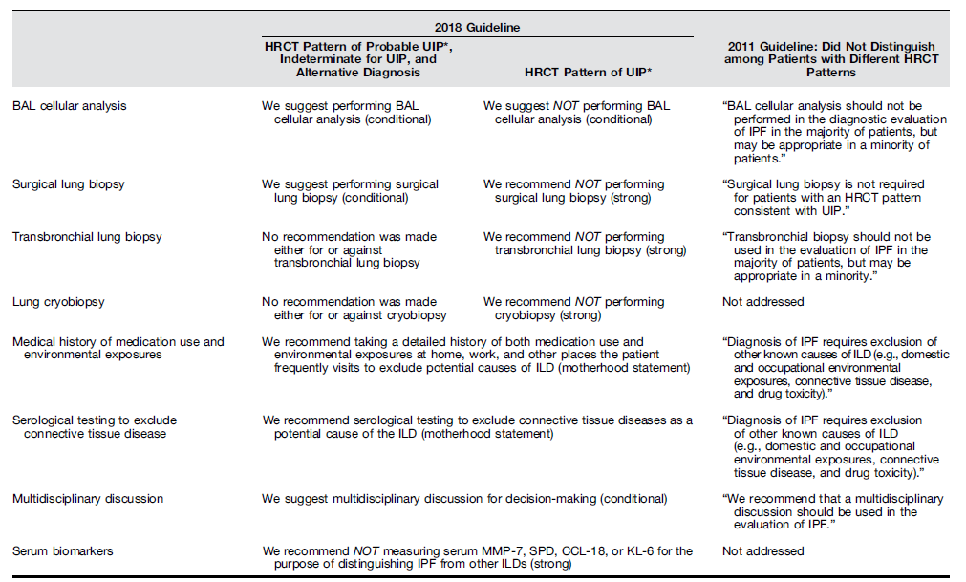
Comparison of ATS/ERS/JRS/ALAT Recommendations for the Diagnosis of IPF in the 2011 and 2018 Guidelines

Slide 8
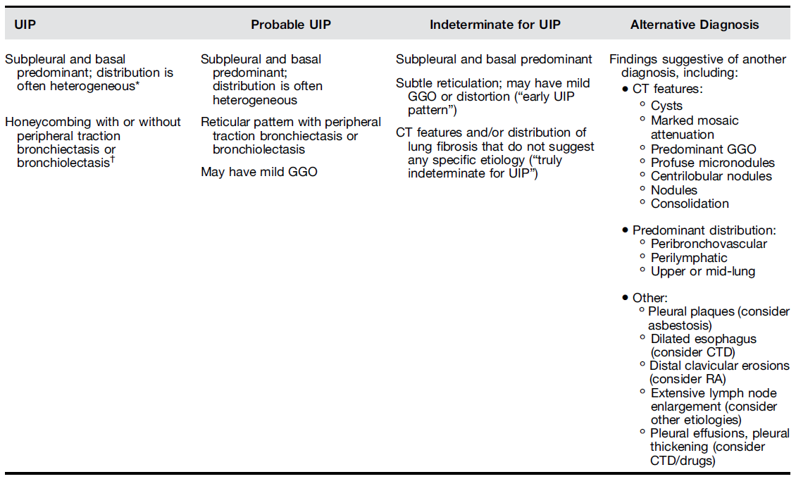
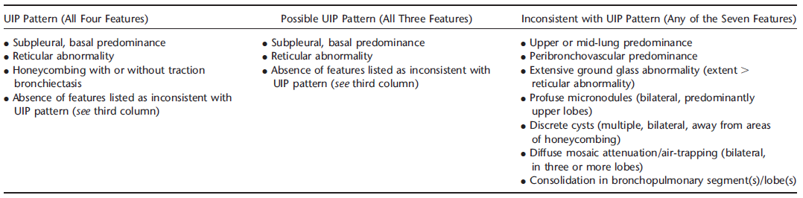
HRCT criteria for UIP
2018
90-100% pathologic UIP
2011

Slide 9
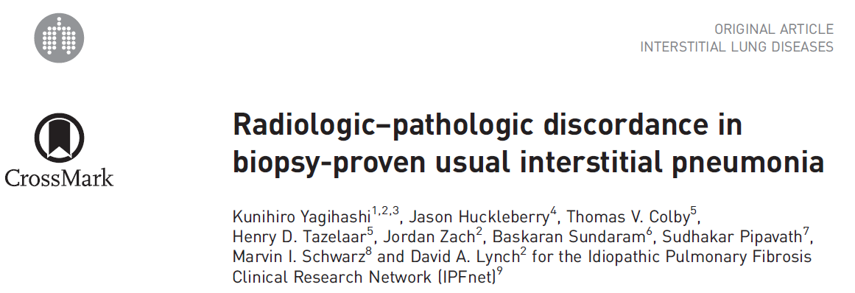
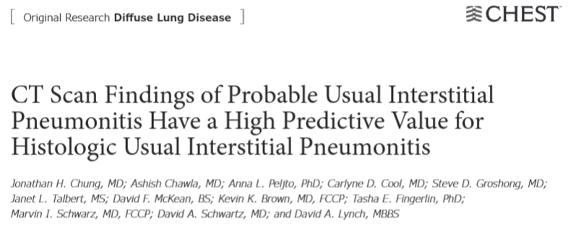
94.7% of “inconsistent with UIP” demonstrated histological UIP.
Possible → Probable vs indeterminate
Pathologic UIP 82.4% vs 52.4%
Eur Respir J 2016; 47: 1189–1197
CHEST 2015 147:450-459

Slide 10
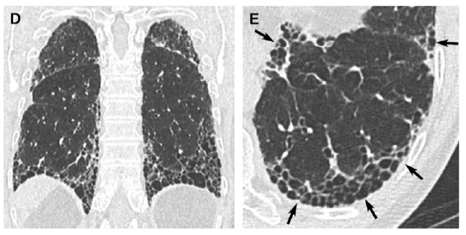
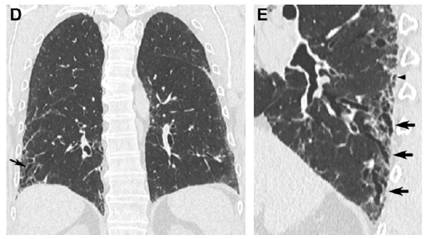
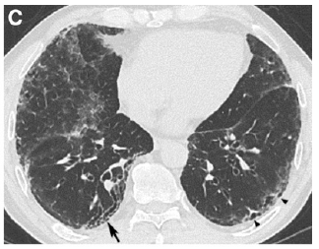
HRCT criteria for UIP
UIP
Probable UIP

Slide 11
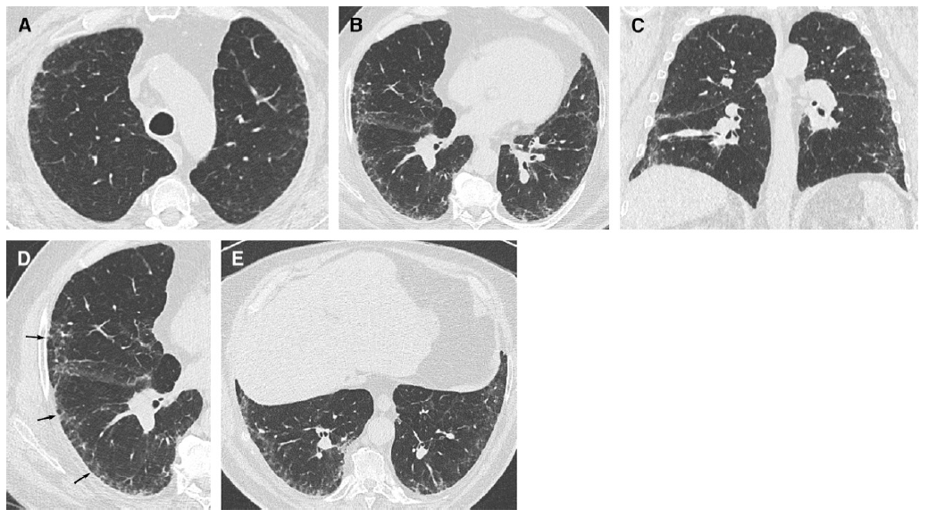
HRCT criteria for UIP
Indeterminate for UIP

Slide 12
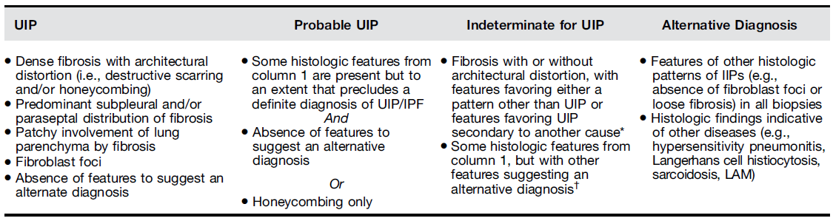
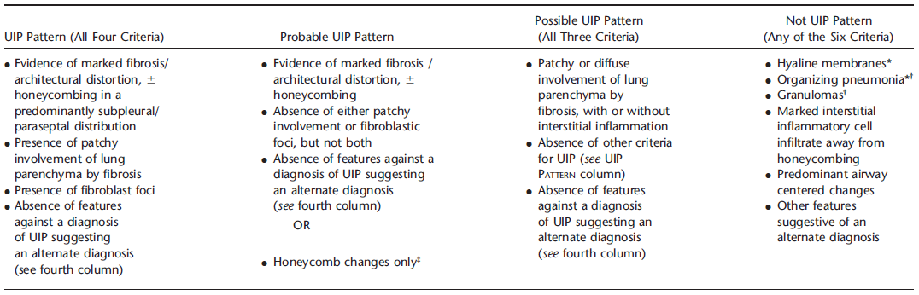
Histopathological criteria for UIP
2018
2011

Slide 13
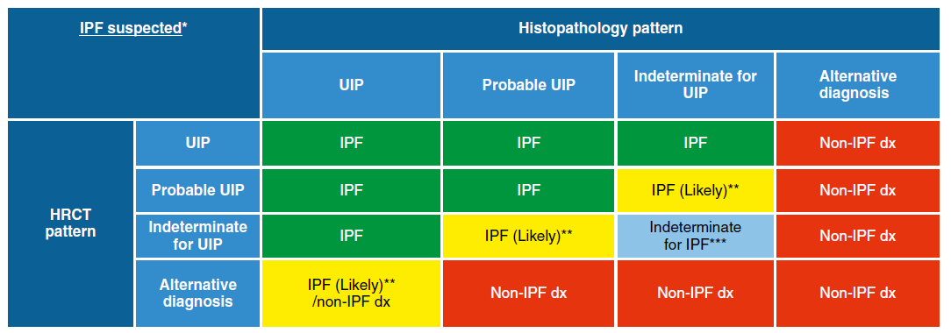
**IPF is the likely diagnosis when any of the following features are present:
Moderate-to-severe traction bronchiectasis/bronchiolectasis (defined as mild traction bronchiectasis/bronchiolectasis in four or more lobes including the lingual as a lobe, or moderate to severe traction bronchiectasis in two or more lobes) in a man over age 50 years or in a woman over age 60 years
Extensive (>30%) reticulation on HRCT and an age > 70 years
Increased neutrophils and/or absence of lymphocytosis in BAL fluid
Multidisciplinary discussion reaches a confident diagnosis of IPF.
*“Clinically suspected of having IPF”
  unexplained symptomatic or asymptomatic patterns of bilateral pulmonary fibrosis on a chest radiograph or chest computed tomography, bibasilar inspiratory crackles, and age greater than 60 years.
  Middle-aged adults [>40 yr and <60 yr], especially patients with risks for familial pulmonary fibrosis, can rarely present with the otherwise same clinical scenario as the typical patient older than 60 years.

Slide 14
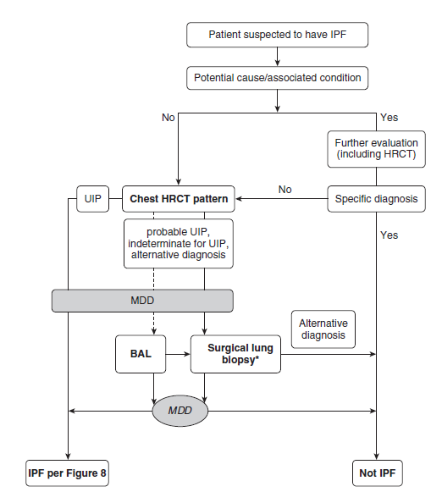
Diagnostic algorithm

Slide 15
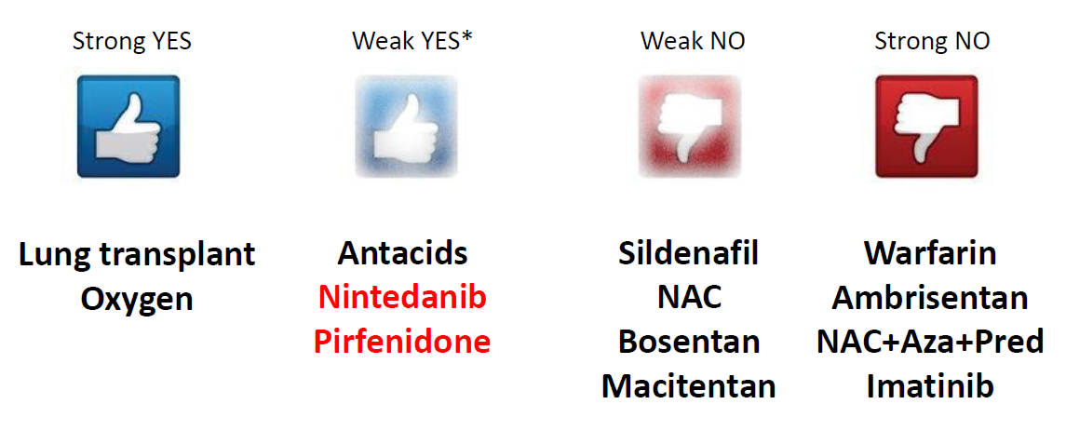
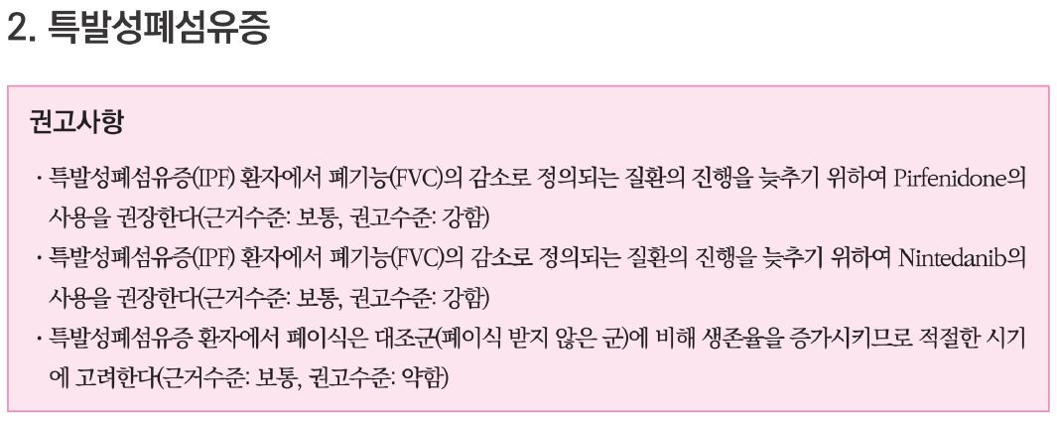
Pharmacologic management
2015 ATS/ERS/JRS/ALAT Clinical Practice Guideline: Treatment of IPF
2018 간질성 폐질환 임상진료지침 KATRD

Slide 16
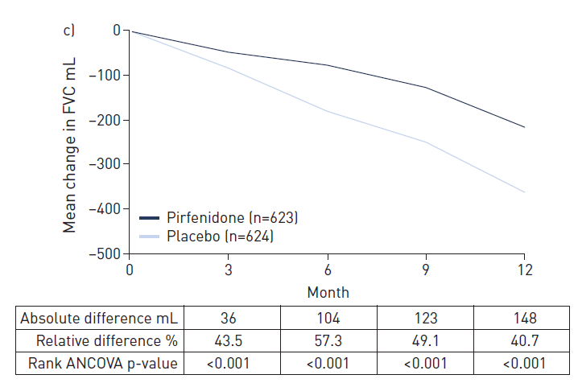
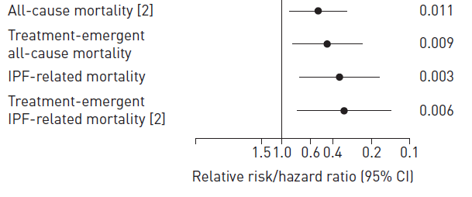
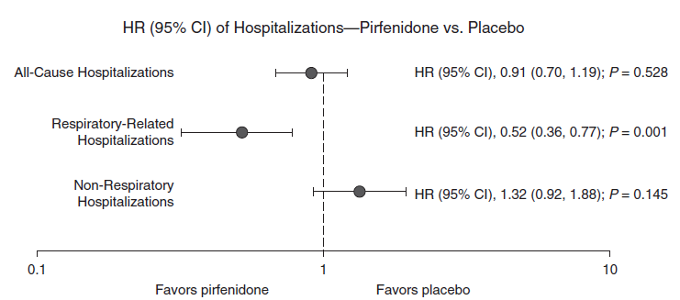
Pirfenidone
FVC decline
Survival
Hospitalization
Eur Respir J 2016; 47: 243–253
Am J Repir Crit Care Med 2017;196:756

Slide 17
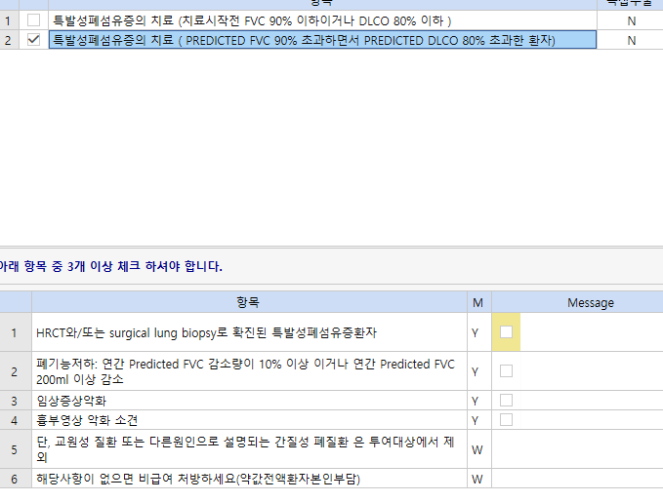
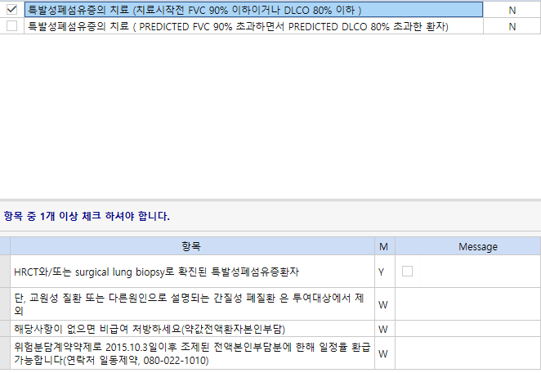
Pirespa 보험기준 확대

Slide 18
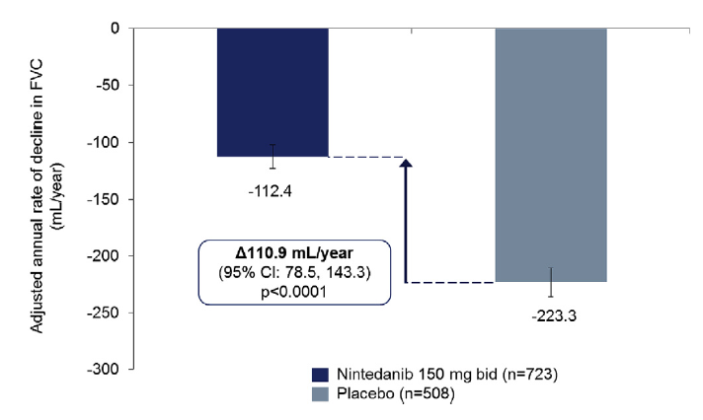
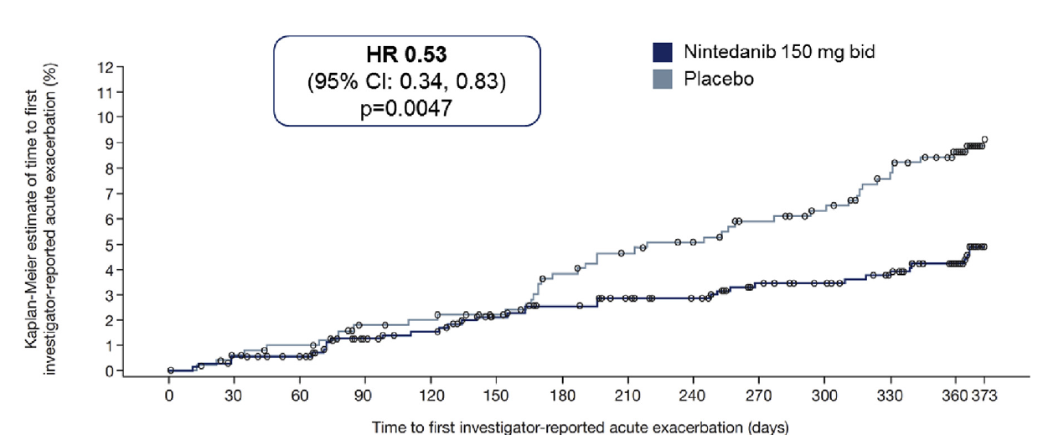
Nintendanib
FVC decline
Survival
 | Nintedanib 150 mg bid (n=723) | Placebo (n=508)
On-treatment mortality
On-treatment deaths, n (%) | 25 (3.5) | 34 (6.7)
p-value | 0.0274
Acute exacerbation
47.0%

Slide 19
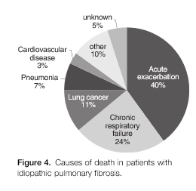
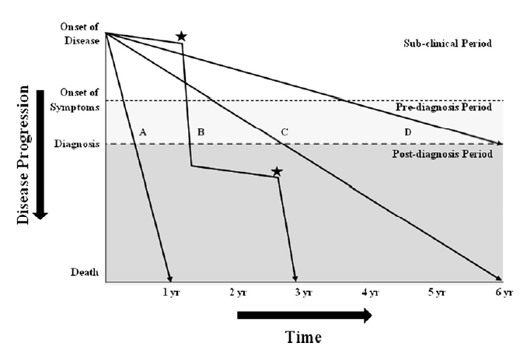
Cause of death
Natural course
AJRCCM 2014 Oct 1;190(7):773-9.
AJRCCM 2011 183: 431–440

Slide 20
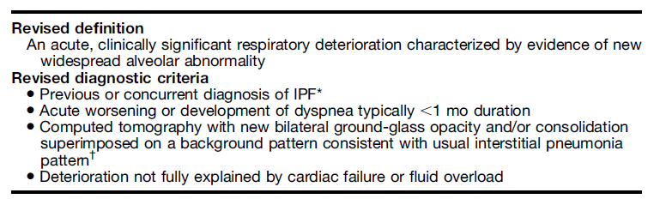
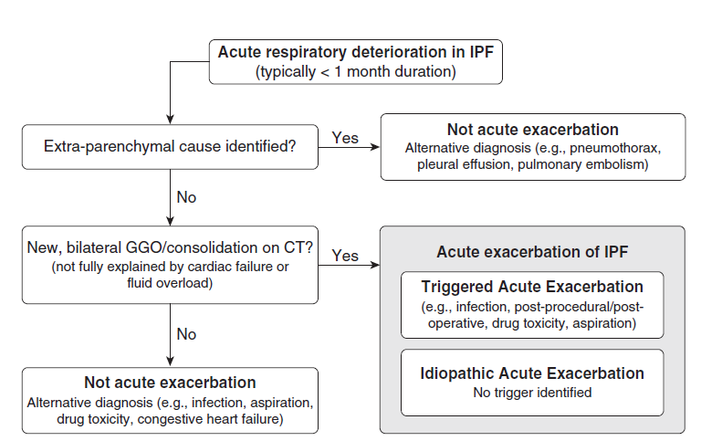
Acute exacerbation
1 – and 3- year incidence of 14.2 % and 20.7% in Korean cohort
AJRCCM 194:265–275 2016

Slide 21
Management
no proven, effective therapies for acute exacerbation of IPF
supportive care and unproven interventions….
high-dose corticosteroids : no controlled trials ….
Mechanical ventilation : weak recommendation against the use. In-hospital mortality 90%..
Cyclophosphamide, Cyclosporine, Polymyxin-B immobilized fiber column hemoperfusion, Rituximab, plasma exchange and intravenous immunoglobulin, Tacrolimus, Thrombomodulin
AJRCCM 2011 183: 431–440
AJRCCM 194:265–275 2016

Slide 22
Pulmonary sarcoidosis
granulomatous disease involving multiple organ systems (primarily the lungs and the lymphatic system) of unknown cause
Epidemiology in Korea
  The average annual age-adjusted prevalence between 2003 and 2015 was 3.4 per 100,000 population.
  The prevalence of sarcoidosis was higher in females than in males (4.2 vs. 2.6 per 100,000 population, respectively), and highest between the ages of 50 and 69 years.
  approximately one-tenth of that in European or American populations.
  The mean annual age-adjusted mortality rate was 13.1 per 1000 sarcoidosis patients, which was approximately twice that of the general population.
causes of death : chronic respiratory disease (20.3%), cardiovascular disease (16.7%), and infectious disease (11.0%)
several studies suggest a link between sarcoidosis and increased risk of malignancy (overall cancer standardised incidence ratios 1.3)
Park, J.E., Respiratory Medicine (2018)
Eur Respir J 2016; 48: 1700–09.
Eur Respir J 2015; 45: 269–72

Slide 23
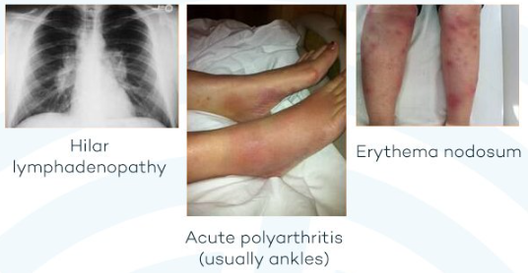
Diagnosis
clinical and radiological data are supported by the presence of non-caseating granulomas in a biopsy specimen, and if alternative causes of granulomatous inflammation are ruled out.
Clinical diagnosis of Sarcoidosis
  Lofgren’s syndrome(Hilar lymphadenopathy, acute polyarthritis, erythema nodosum) or Heerfordt’s syndrome (Uveitis, patorid gland swelling, fever and facial nerve palsy in some cases)
  or with an asymptomatic bilateral hilar lymphadenopathy
  careful follow-up is needed
In the remaining cases, should be confirmed histologically.
Lancet Respir Med 2018;6: 389–402
Notes:
Angiotensin-converting enzyme (ACE) is an integral membrane bound protein that is strongly expressed in many endothelial cells, especially the capillary endothelial cells of the lung. It plays a pivotal role in the renin–angiotensin system to maintain the normal blood pressure and electrolyte balance by converting angiotensin I to angiotensin II and degrade bradykinin [5].
The first report of elevation of serum ACE levels among patients with active sarcoidosis appeared in 1975 [6]. Subsequent studies reported elevated ACE levels in other granulomatous pulmonary diseases such as histoplasmosis, silicosis, and tuberculosis [7, 8]. The increased level is thought to be secondary to increased ACE expression by the epithelioid cells present in the granulomas [9].
The utility of ACE levels for the diagnosis of sarcoidosis has been investigated in several studies [6, 10, 11, 12, 13, 14, 15, 16]. Most of these used sarcoidosis cohorts from tertiary care centers, which might not represent the true spectrum of sarcoidosis. The current study was conducted using a population-based cohort of patients with sarcoidosis to evaluate the sensitivity and specificity of ACE levels.

Slide 24
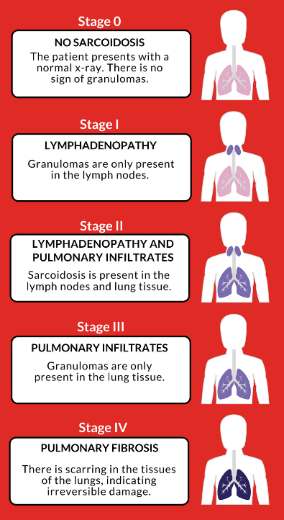
Scadding stage
Scadding stage correlates poorly with patient-reported disease severity, pulmonary function tests, and need for treatment for individual patients
just categorization.
Lancet Respir Med 2018;6: 389–402

Slide 25
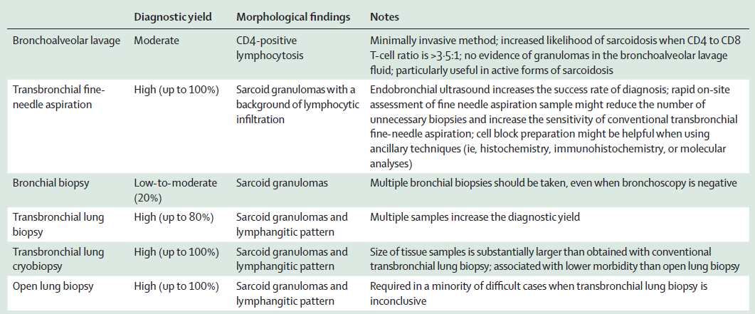
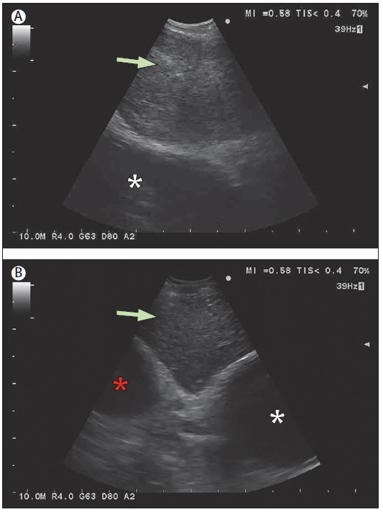
Diagnostic yield and sampling technique
BAL : CD4-positive T-helper 1 lymphocytic alveolitis is an immunological feature of sarcoidosis, but about 10–15% of cases have a normal cell count. 50–60% of patients have an increased ratio of CD4-positive to CD8-positive cells (>3.5:1) on bronchoalveolar lavage.
EBUS : LN node density in B-mode, Heterogenous in infection, Homogenous in sarcoidosis.
Bronchial biopsy : The diagnostic yield is high (>70%) when visible abnormalities at bronchoscopy are present (eg, cobblestone appearance of the mucosa)
Lancet Respir Med 2018; 6: 389–402

Slide 26
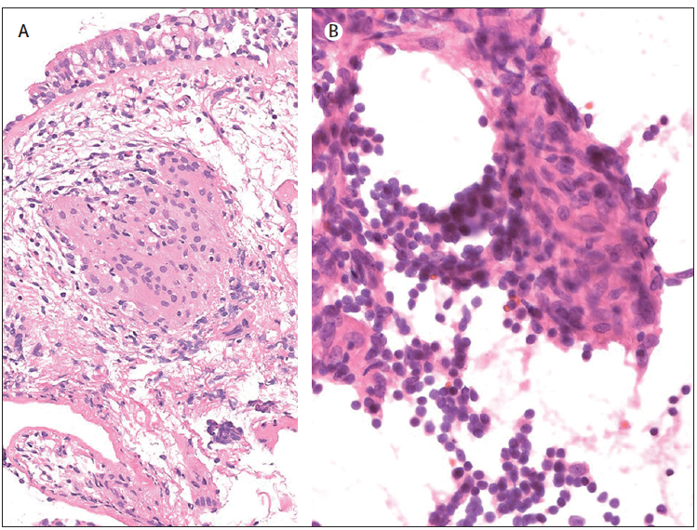
Pathology
coalescing, tightly clustered, non-necrotising granulomas.
In the lung, they are preferentially located along the lymphatic routes of the pleura, interlobular septa, and bronchovascular bundles
Lancet Respir Med 2018;6: 389–402

Slide 27
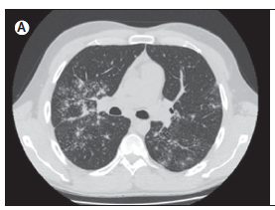
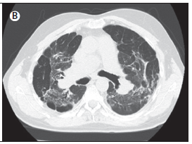
Imaging
Symetrical lymphadenopathy : more than 2/3 of patients.
Pulmonary opacities (ie, nodules and reticulation) with a middle and upper lobe predilection : 20–50% of patients.
Pulmonary fibrosis : 20–25% of sarcoidosis patients. linear opacities radiating laterally from the hilum, architectural distortion (fissural and proximal bronchovascular bundle displacement), and honeycombing
Lancet Respir Med 2018;6: 389–402

Slide 28
Pulmonary manifestation
Dry cough, dyspnea, and chest discomfort : 30–50% of patients
restrictive ventilatory defect or airflow obstruction , isolated reduction in DLCO is also moderately frequent
Lancet Respir Med 2018;6: 389–402

Slide 29
Major complications of end-stage pulmonary disease
Pulmonary hypertension : prevalence ranging between 5% and 79%
  most commonly complicates advanced pulmonary disease
  granulomatous inflammation of the pulmonary vessels, extrinsic compression of the pulmonary arteries by enlarged mediastinal or hilar lymph nodes, and left ventricular dysfunction
Chronic pulmonary aspergillosis : estimated to be present in 3–12% of advanced pulmonary sarcoidosis cases
Lancet Respir Med 2018;6: 389–402

Slide 30
Treatment
indications for treatment : life threatening and organ-threatening disease and unacceptably impaired quality of life.
  1) worsening respiratory symptoms, particularly dyspnea
  2) severe pulmonary function impairment or substantial functional deterioration (≥10% reduction in FVC or ≥15% reduction in DLCO from baseline values)
  3) major radiographical progression (ie, development of cavities or honeycomb changes, or substantial worsening of interstitial abnormalities).
Corticosteroid usually continued for 9–12 months
antimetabolites and cytotoxic drugs (ie, methotrexate, azathioprine, leflunomide, and mycophenolate mofetil)
monoclonal anti-TNFα antibody infliximab
Lung transplanation : 2.5% of all indications for lung transplantation, with long-term outcomes equivalent to those of other indications. - J Heart Lung Transplant 2013; 32: 965–78.

Slide 31
Hypersensitivity pneumonitis
In a genetically predisposed individual, HP is a consequence of an immune mediated reaction caused by recurrent exposure to overt or occult inducing environmental agents—HP inducers
Incidence, 0.3 up to 0.9 per 100,000 individuals (Europe)
nearly half of patients with new-onset ILD in one study, with other reported incidence ranging from 18 to 30%
importance of a clinical suspicion of HP diagnoses in patients manifesting ILD!
challenging for clinicians to distinguish cHP from IPF
This exposure can occur at home, in the workplace, related to hobbies, or sometimes indirectly, in another environment frequently visited by the patient
It is likely that a mixture of antigens, rather than a single antigen.
Despite thorough investigations, the search for the occult HP inducer is reported as unsuccessful in up to 60% of cases
AJRCCM 2017;196:680-689
AJRCCM 2018;197, 1036–1044

Slide 32
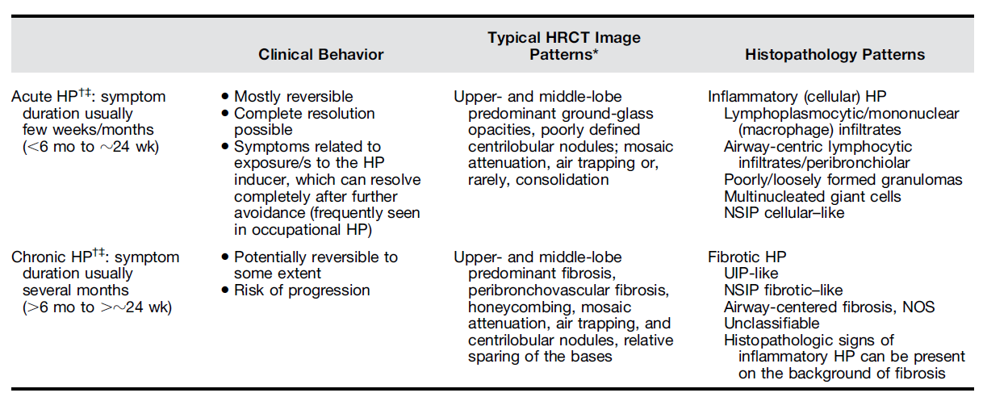
Acute vs Chronic
chronic progressive group, the median survival has been shown to be only 7 years
AJRCCM 2017;196:680-689

Slide 33
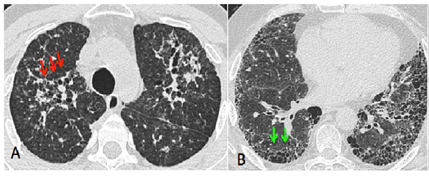
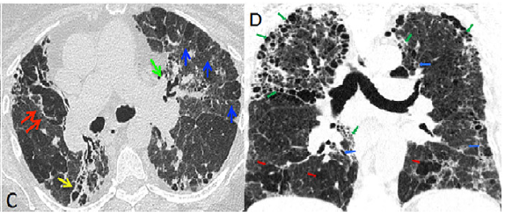
HRCT
A) peribronchovascular reticulation and GGO containing traction bronchiectasis
B) subpleural honeycombing, reticulation, and traction bronchiectasis (typical UIP pattern)
→ bird keeper and also had a marked lymphocytosis on BALF
C) peribronchovascular fibrosis, parenchymal mosaicism
D) upper lobe involvement and reticulation with traction bronchiectasis, honeycombing ,mosaic attenuation
AJRCCM 2017;196:680-689

Slide 34
Diagnosis of HP
history, seeking to identify exposures, physical examination
HRCT
BAL : predominantly lymphocytic pattern
Lung biopsy
Serum specific IgG : not diagnostic of HP, merely reflects the exposure and sensitization to the specific antigen by the patient
  1. Find a relationship between exposure and the disease and/or associate exposure with the disease.
  2. Screen for potential inducers where an inducer has not been identified, but where clinical and imaging data are compatible with HP.
  3. Decrease probability of feather or fungus etiology of ILD if negative.
Specific inhalation challenge (SIC) test : direct challenge with inhalation to confirm an etiology
  not standardized/validated
  requires experienced personnel and laboratories
AJRCCM 2017;196:680-689

Slide 35
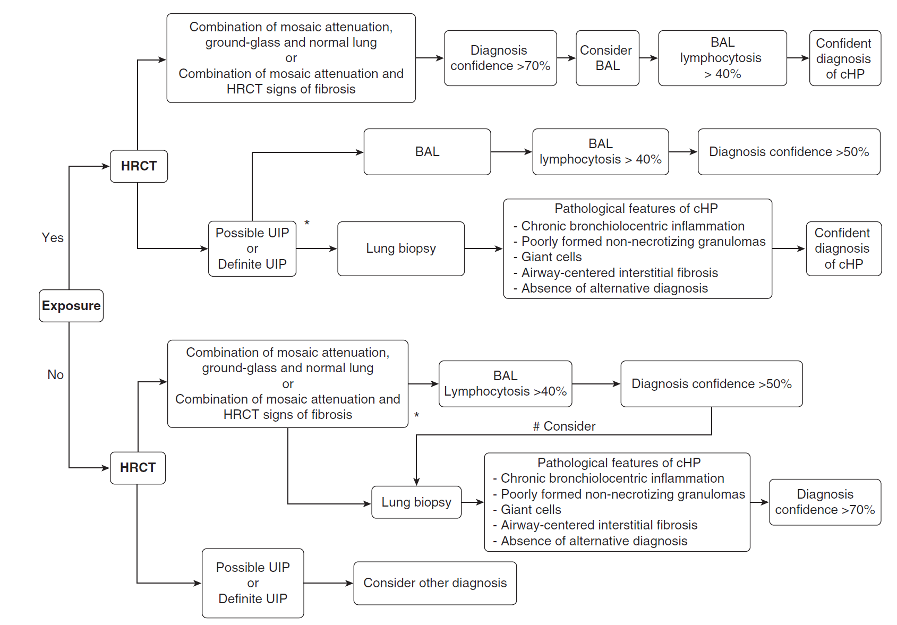
Diagnosis of HP
AJRCC 2018;197, 1036–1044

Slide 36
Treatment of HP
Exposure Avoidance
Corticosteroids : starting at 0.5 mg/kg (ideal body weight) for a few days and slow tapering to the lowest possible dose over several months to a year or longer
Immune-modulating agents : azathioprine and mycophenolate mofetil was associated with an improvement of gas exchange and reduction of prednisone, which supports the use of these drugs in the treatment of chronic progressive HP
Lung Transplantation
AJRCCM 2017;196:680-689

Slide 37
Number of Lung transplantation - Korea
KONOS

Slide 38
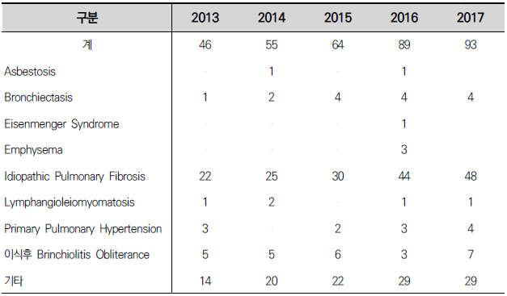
Indication of Lung transplantation -Korea
KONOS

Slide 39
General candidacy considerations
Lung transplantation should be considered for adults with chronic, end-stage lung disease who meet all the following general criteria:
1. High(> 50%) risk of death from lung disease within 2 years if lung transplantation is not performed.
2. High(>80%) likelihood of surviving at least 90 days after lung transplantation.
3. High(>80%) likelihood of 5-year post-transplant survival from a general medical perspective provided that there is adequate graft function.
ISHLT 2015;34:1-15

Slide 40
Absolute contraindications
recent history of malignancy.
Untreatable signiﬁcant dysfunction of another major organ system (e.g., heart, liver, kidney, or brain) unless combined organ transplantation can be performed.
Uncorrected atherosclerotic disease with suspected end-organ ischemia
Acute medical instability (e.g., acute sepsis, myocardial infarction, and liver failure)
Uncorrectable bleeding diathesis.
Poorly controlled chronic infection with highly virulent and/or resistant microbes.
active Mycobacterium tuberculosis infection.
Signiﬁcant chest wall or spinal deformity
Class II or III obesity (BMI > 35.0 kg/m2).
Severely limited functional status with poor rehabilitation potential.
non-adherence to medical therapy
Psychiatric or psychologic conditions
Absence of an adequate or reliable social support system
Substance abuse or dependence
ISHLT 2015;34:1-15

Slide 41
Relative contraindications
Age > 65 years in association with low physiologic
Age > 75 years
Class I obesity (BMI 30.0–34.9 kg/m2), particularly central obesity.
Progressive or severe malnutrition.
Severe, symptomatic osteoporosis.
Extensive prior chest surgery with lung resection.
Colonization or infection with highly resistant or highly virulent bacteria, fungi, and certain strains of mycobacteria therapy. (Burkholderia cenocepacia, Burkholderia gladioli, and multi-drug–resistant Mycobacterium abscessus )
Diabetes mellitus, systemic hypertension, epilepsy, central venous obstruction, peptic ulcer disease, or gastroesophageal reflux, should be optimally treated before transplantation.
ISHLT 2015;34:1-15

Slide 42
Interstitial lung disease
Timing of referral:
Abnormal lung function: FVC < 80% predicted or DLCO < 40% predicted.
Any dyspnea or functional limitation attributable to lung disease.
Any oxygen requirement, even if only during exertion.
For inﬂammatory ILD, failure to improve dyspnea, oxygen requirement, and/or lung function after a clinically indicated trial of medical therapy.
Timing of listing:
Decline in FVC ≥10% during 6 months of follow-up
Decline in DLCO ≥15% during 6 months of follow-up.
Desaturation to < 88% or distance < 250 m on 6-minute- walk test or 450 m decline in 6-minute-walk distance over a 6-month period.
Pulmonary hypertension on right heart catheterization or 2-d echocardiography.
Hospitalization because of respiratory decline, pneumothorax, or acute exacerbation.
ISHLT 2015;34:1-15

Slide 43
우리나라 이식 대기자 등록
2019.03
이식대기자 249명
응급도2
등록시점 30일 이내의 검사결과로 등록할 수 있으며 180일마다 연장할 수 있다. 검사결과는 처음등록 시점검사결과만으로 연장이 가능하다.
1) FEV1 〈 25 %
2) 산소 없이 측정한 ABGA PaO2〈 60 mmHg
3) 평균 우심방 혈압이 10 -15 mmHg인 경우
4) 평균 폐동맥압력이 55 -65 mmHg인 경우
5) Cardiac index 〈 2-2.5L/min/m2인 경우
6) ABGA 70mmHg≦PCO2<80mmHg인 경우
7) DLCO<30%인 경우
응급도 3
응급도 0과 1,2에서 동일 응급도로 연장하지 않은 경우 현재의 환자 상태 해당 응급도로 변경한다.
1) 단독 폐이식이 필요한 경우
2) 폐기종,폐고혈압 ,DILD
3) 폐기능검사에서 노력호기량 <30 %
4) 호흡부전증으로 3번 이상 입원한 경우
응급도4
응급도가 0,1,2,3에 해당되지 않는 모든 대기자
응급도0
-입원한 환자로 다음 한가지 이상 해당 하여야 한다. (8일이내 재등록)
1) 호흡부전증으로 인공호흡기
2) 체외막형 심폐기를 가동중인 환자
응급도 1
(60일마다 재등록하며 검사결과는 검사시점과 상관없이 인정한다)
1) 산소 투여 없이 측정한 동맥혈 가스 검사상 PaO2〈 55mmHg
2) 평균 폐동맥혈압 〉65mmHg, 또는 평균 우심방 혈압 〉15mmHg
3) Cardiac index 〈 2L/min/m² 인 경우
4) ABGA PCO2≧ 80mmHg인 경우
5) 입원 환자중 highflow nasal cannula 30L FiO2≧0.6로 2주 이상 유지중인 경우(유지 중 에만 인정)

Slide 44
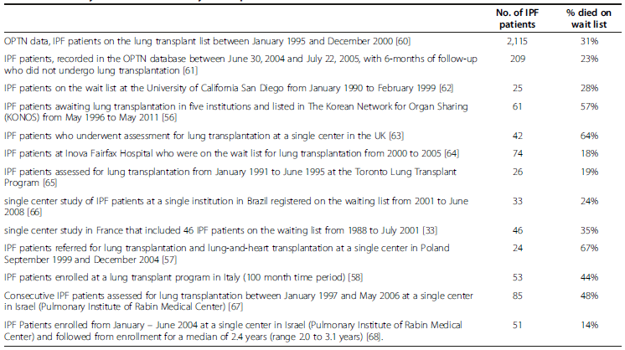
Pre-transplant mortality rate among adult patients wait-listed for a lung transplantation
14% ~ 64%...
BMC pulmonary medicine 2014;14:139

Slide 45
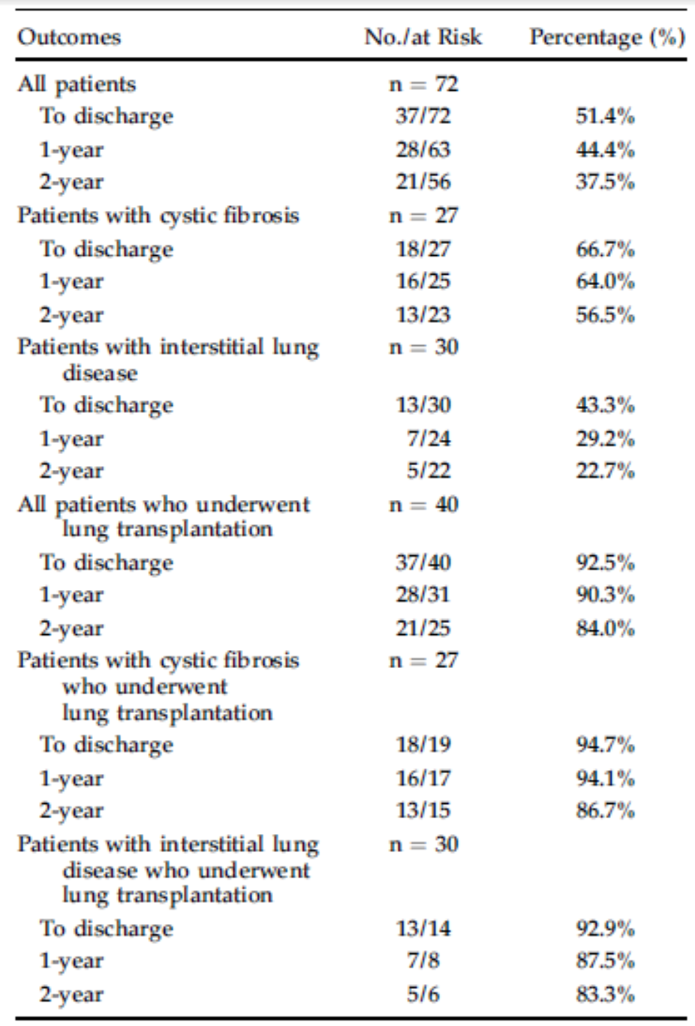
ECMO as a bridge to lung transplantation
72 patients
January 1, 2007 - July 10, 2016
40 patients -> LTx / 32 patients -> delisted or died
50 patients (69.4%) ambulated during ECMO
32 underwent lung T could ambulate
8 underwent lung T but did not ambulate; all these underwent ECMO for 6 days or less and performed bedside physical therapy.
favorable survival in patients receiving ECMO as a bridge to lung transplantation
high rates of physical therapy and avoidance of mechanical ventilation
Ann Thorac Surg 2017;104:412–9

Slide 46
Mechanical bridges to transplant
ECLS recommended:
  Young age.
  Absence of multiple-organ dysfunction.
  Good potential for rehabilitation.
ECLS not recommended:
  Septic shock.
  Multi-organ dysfunction.
  Severe arterial occlusive disease.
  Heparin-induced thrombocytopenia.
  Prior prolonged mechanical ventilation.
  Advanced age.
  Obesity.
Mechanical ventilation … : ventilator- induced lung injury and ventilator-associated pneumonia, decontioning due to prolonged sedation
ISHLT 2015;34:1-15

Slide 47

Notes:
의과대학 1-A

