Slide 1
Bronchopleural Fistula & Bronchoscopic treatment
호흡기내과
임상연구조교수(F2)
윤성환

Slide 2
Contents
Bronchopleural fistula review
Bronchoscopic intervention to Bronchopleural fistula

Slide 3
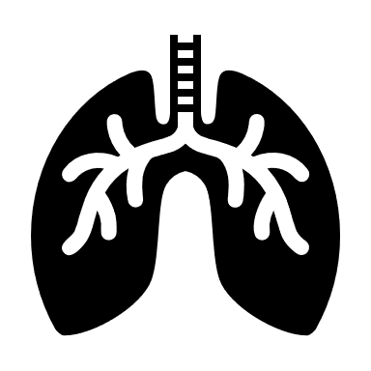
Bronchopleural fistula
Bronchopleural fistula(BPF)
Leakage of inspired air from the airways into the pleural spaces for more than 24~48hrs.
Incidence
4.5~20% after Pneumonectomy, 0.5% after Lobectomy(Cerfolio et al)
4.4% after lung resection, NSCLC patients(Sirbu et al)
0.5%(Lobectomy), 2.2%(Bilobectomy), 3%(Pneumonectomy) [Pforr A et al)
→ Recently, 1~4% 정도로 생각됨(Surgical procedure, method 발달)

Slide 4
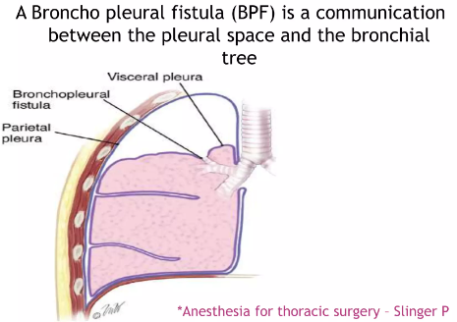

Slide 5
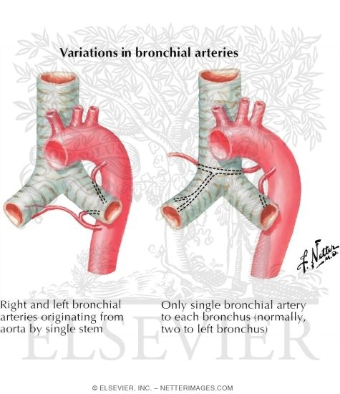
Etiology
Lung resection
Rt. Sided surgery
Pneumonectomy
Chemo and radiation therapy
Diabetes mellitus
Heavy-smoker
Chronic obstructive lung disease
Low nutritional status or poor wound healing
Residual tumor at bronchial margin
A large diameter bronchial stump(>25mm)
Extensive lymph node dissection
Older age(>60 years)
Male
Prolonged post-operative mechanical ventilation
Bronchial closure technique(Manual versus Stapled) → Controversial

Slide 6
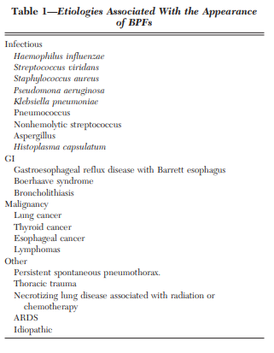
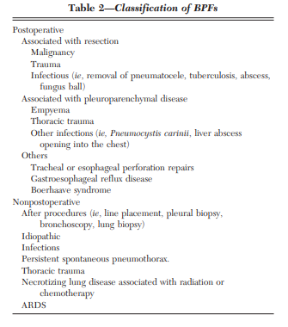
Etiology

Slide 7
Clinical feature
Multiple range of disease entity & Onset concept
From acute symptoms[Tension pneumothorax] to Subacute symptom[Empyema]
Early Onset vs Late Onset> - Paper에 따라 Variable
1) Cut off 2wks
Within 2wks related to lung resection
After 2wks related to other cause(Infection, Empyema, Malignancy..)
2) Varoli et el : Early(1~7days) Intermediate(8~30days), Late(Over 30days)
3) Algar et el : Early(Within one month), Late(Over one month)
Variable Sx could be reported.
Disease onset doesn’t have precise guideline..

Slide 8
Diagnosis
Clinical Sx + Image finding[Chest X-ray or Chest CT] + Bronchoscopic finding → Combination diagnosis
Clinical setting : Non-specific Laboratory finding, Wide range of Symptom
Infection related Symptom ~ Pneumothorax, Empyema
Image finding
- Chest Image : failure of the postpneumonectomy space to fill with fluid(takes 1~4 months after surgery) or Decreasing air-fluid level over time(>1.5~2cm)
Without lung resection[Malignant BPF] : Cavitating mass, Air-fluid level
Bronchoscopy : Critical for diagnosis and localization
→ Large BPF : Visual check / Small & Distal : Balloon method or Methylene blue

Slide 9

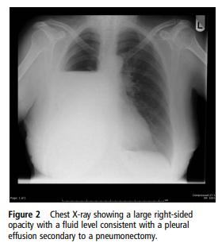
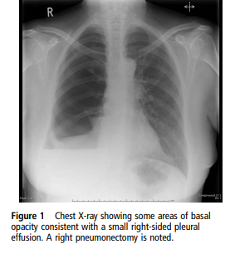
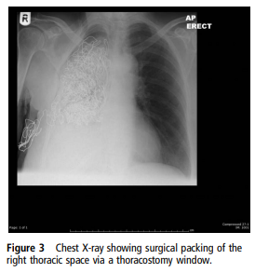
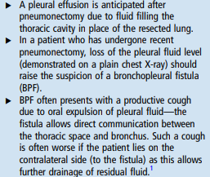
Serial Chest X-ray could detect Post pneumonectomy related BPF

Slide 10
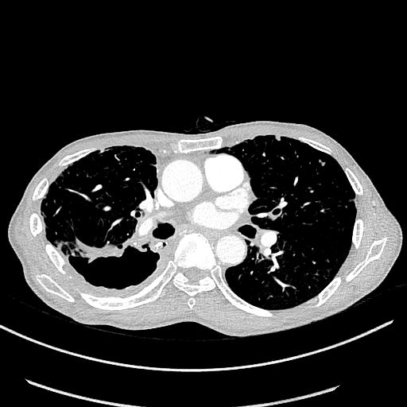
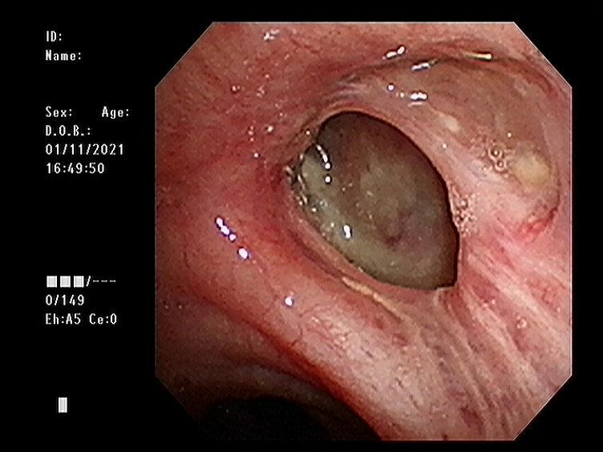
Chest CT
Bronchoscopy
Bronchopleural fistula
Pleural space

Slide 11
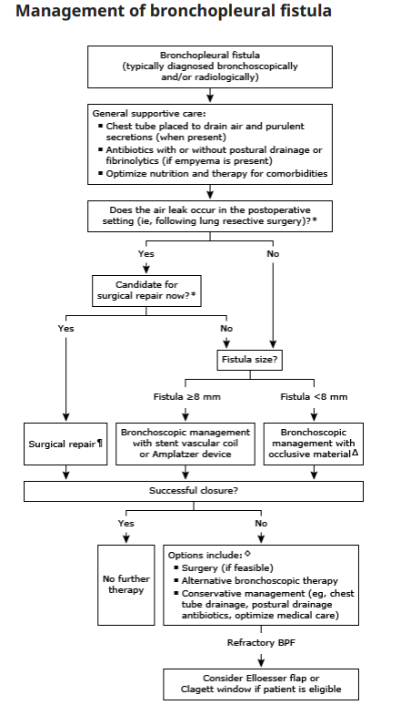
Treatment - No Consensus or Guideline
Conservative manage 이후
Operable status 여부에 따라
Surgical repair
Bronchoscopic repair

Slide 12
Surgical repair(Curative)>
→ Should be assessed medically for ““Surgical fit or Stump site condition””
(1) Early period BPF(Within 2wks) : If patient fit for surgery → Surgical repair.
(Bronchial stump is not diseased & Post-op chest tube is expected)
Dehiscence : Early vs Late [2wks cut off]
Early : Tend to be more amendable to immediate repair
Late : Technically challenging(Tissue quality, Matured fistula tract, pleural contamination, Scarring
Surgical repair(VATS or Thoracotomy) : Revision stump, Debridement of necrotic tissure & Suture reclosure of the bronchial stump with vascularized flap tissue(Omentum, Muscle)

Slide 13
2) Later in the postoperative period(over 2wks) : Generally indicated surgery, but need to be delayed (Treat complicating empyema or improved their physical strength, Nutritional status)
Some case, Bronchoscopic therapy is done for briding for surgery
Thoracoscopic debridement and stump revision
Open window thoracotomy(OWT, The Eloesser flap or Clagrett procedure)
Adequate drainage, Antibiotics use, Obliteration of the empyema cavity, Nutrition status is related to duration of OWT
OWT can be paired with V.A.C : Improved wound care & healing
Bronchoscopic intervention : Non-operable condition, Non-lung resection patients
→ 뒤에 Review에서 자세히 소개

Slide 14
Prognosis
Prognosis may be determined by the underlying illness or morbid state that prevents surgery.
Reported mortality
Postpneumonectomy empyema : 60~80% 환자에서 BPF(+), 21~71% Mortality, related Aspiration pneumonia, Acute respiratory distress syndrome.

Slide 15
Bronchoscopic intervention to BPF

Slide 16
When we consider bronchoscopic intervention at BPF?
Surgical option is the first consideration but,
Infection, Malignancy → Difficult stump site healing
Poor general condition → Non-operable status
Bridging therapy for curative surgery
Small size or Delayed onset

Slide 17
Size related Classification
Uptodate [8mm cut off]
1) Large(>8mm)
Silicon and covered metallic stent
Angiographic coil with occlusive material
Amplatzer device(ASD, PFO Occluder)
2) Small(<8mm)
Occlusive material : Methyl-2-cyanoacrylate, N-butyl-cyanoacrylate, Albumin-glutaraldehyde tissue adhesive, Polyvinyl alcohol sponge, Fibrin glu
Sclerosant : Ethanol, Polidocanol, Tetracycline(Doxycyline) followed autologous bleed
Ablative therapy : Argon plasma coagulation & Nd:YAG
Endobronchial valve
Amplatzer vascular plugging device

Slide 18
Occlusion[Device, Material or Glue] vs Injection material
1) Injection
Polidocanol
Tetracycline or Doxycyline followed by autologous blood patch
Ethanol
2) Injection and occlusion combined concept
Fibrin glue
3) Occlusion - Device
EWS(Endobronchial Watanabe Spigot)
Endobronchial valve
Amplatzer ASD & PFO Occluder
Amplatzer vascular plug for embolization

Slide 19
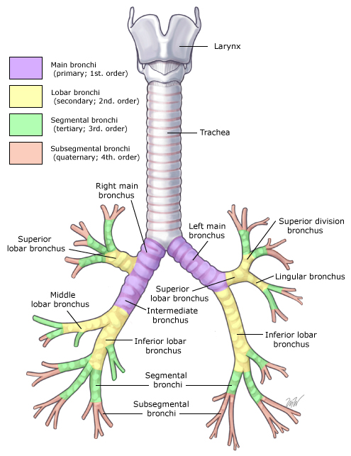
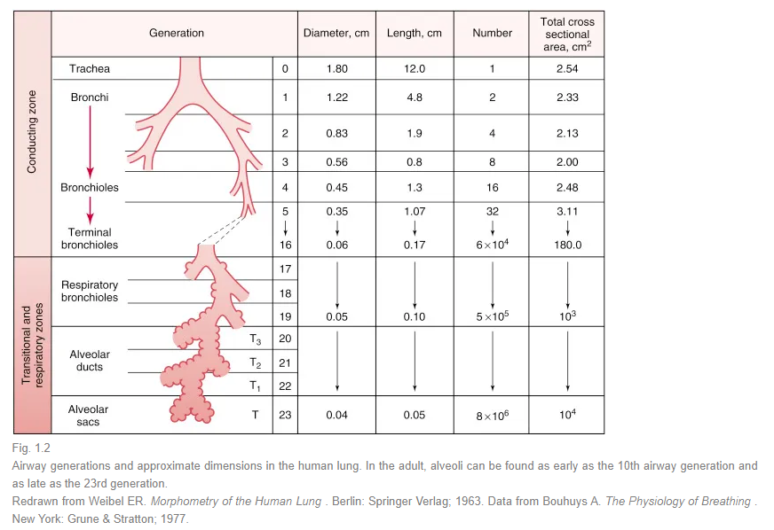
Anatomy
Large BPF
Small BPF
8mm sized, (Lobar bronhchus)
4~6mm sized, (Segmental bronhchus)
Uptodate

Slide 20
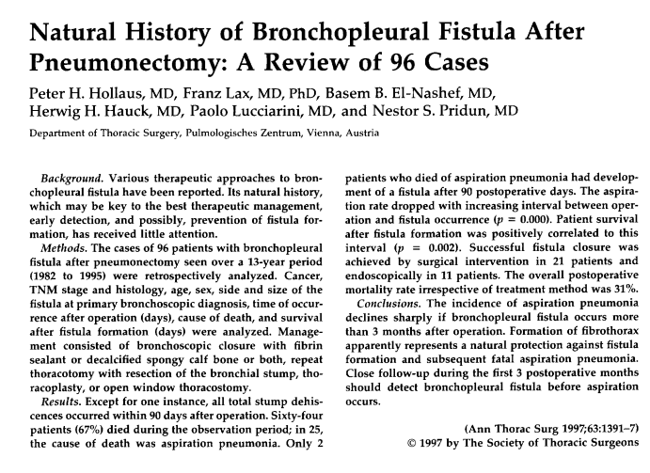
1) 1982.01~1995.06 Pneumonectomy patients
- Total 797 patients, 96 BPF developed (96/797) ➔ 12% Incidence
[Malignancy 93, Destroyed lung 2, Pulmonary atresia 1]
2) Fistula onset [Cut off 3months]
- Within 3month 76, Over 3months 20 ➔ 79% Within 3months
[Within 3month Subgroup → 0~14days 28, 15~90days 48]
3) Treatment option
- Thoracic drainage – 11 Case(Treat 1)
- Surgical repair – 49 Case(Treat 27)
- Bronchoscopic treatment(Treat 11) → Low Succecssful rate.
4) Mortality
- 64 Patients died during observation period → 64/96 = 66.6%
[Aspiration pneumonia 25 > Tumor recurrence 19 > Heart failure 7
> Empyema & sepsis 4 > Cachexia 2 > PTE = Cerebral hemorrahge 1, Unknwon cause 5 → Not reported.]
5) Result
- m/c cause of Death post-pneumonectomy BPF : Aspiration pneumonia
- BPF Onset within 3months showed more mortality(p=0.002)

Slide 21
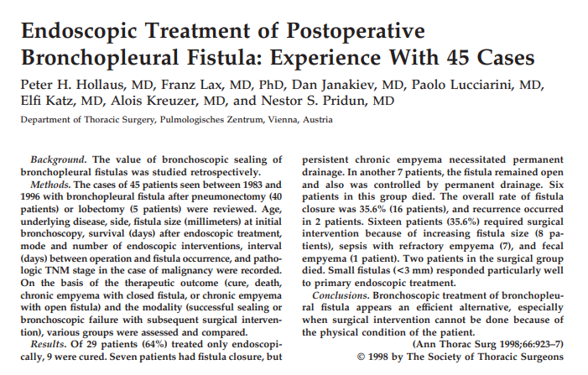
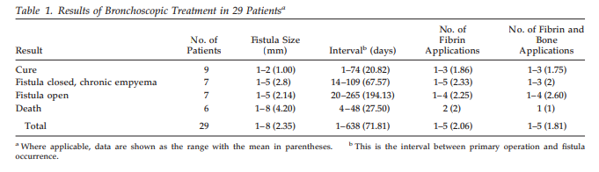
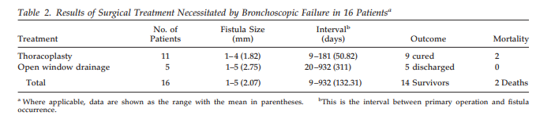
All method : Under G.A with Rigid Bronchoscopy
Pretreatment : Fistula channel was de-epithelialization
Visible & Under 3mm sized : Fibrin sealant(Tissucol; Immuno, Vienna, Austria) → Intraluminal or Submucosal injection
3mm~8mm sized : Fibrin + Spongy calf bone
Over 8mm : Unsuitable Endoscopic treatment

Slide 22
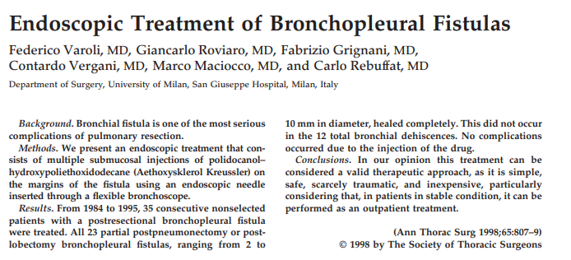
- Median healing time 5.5wks[2~8wks]
- 23/35 Successful rate : 65.7%
- No critical complication
Method
- Bronchoscopic treatment one or more session(Carried out once every week)
- Submucosal injection[Polidocanol-hydroxypoliethoxidodecane]
- Multiple injection until the ensuing swelling → The best mechanical reduction of fistula
- No more than 4~5mg
- Expectatation effect : Intense inflammation within 2days → After 6~7days reactive proliferation
→ Repeated procedure, until a whitish fibrous tissue seals the fistula

Slide 23
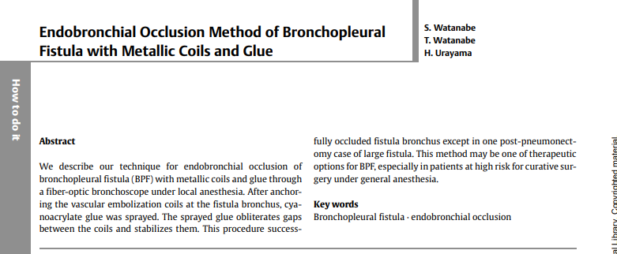
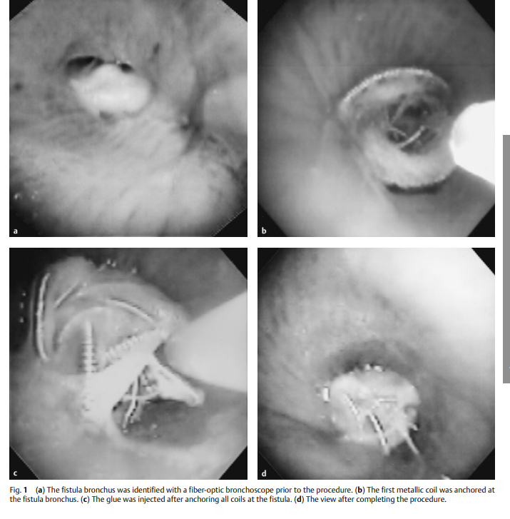
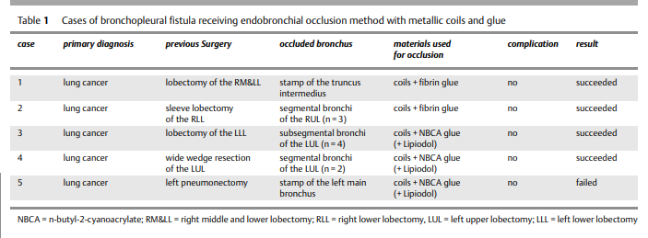


Slide 24
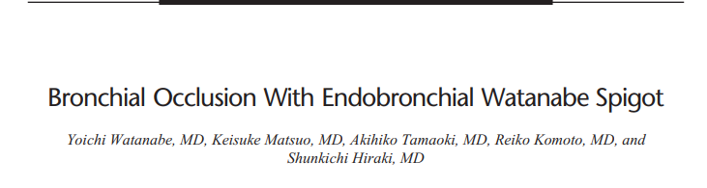
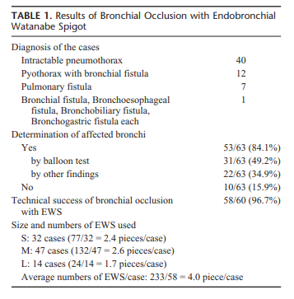
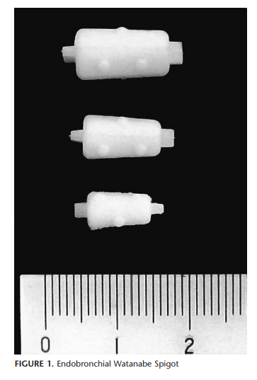
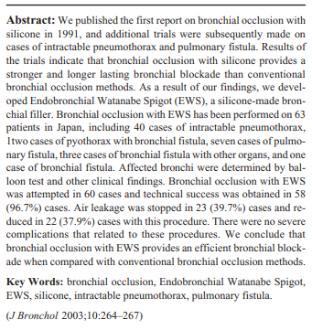
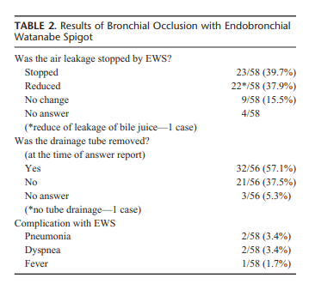
Silicon-made bronchial filter(Novatech, Grassee, France)
EWS-S, M, L (5, 6, 7mm sized)

Slide 25
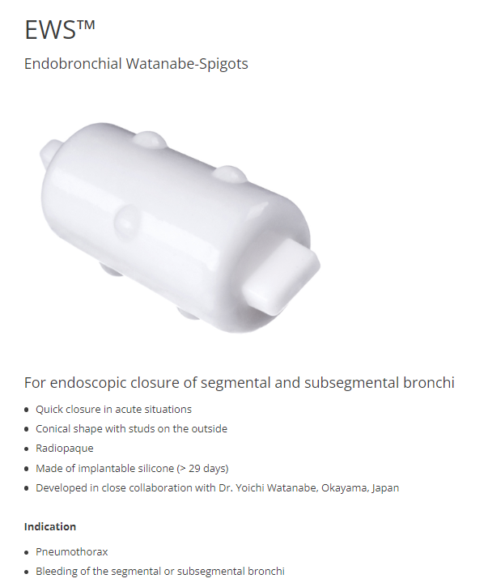
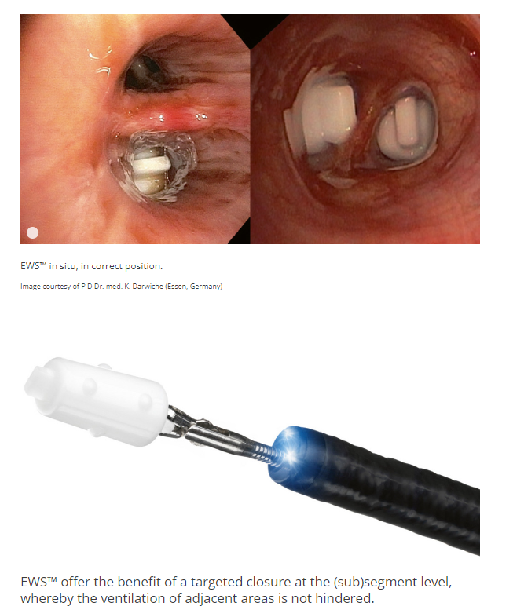
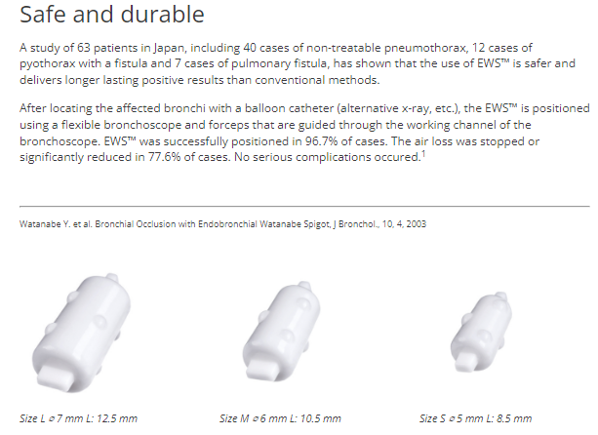
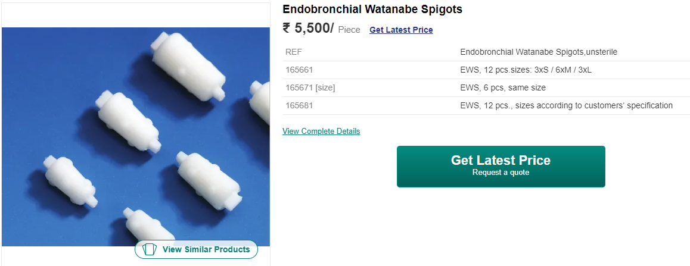

Slide 26
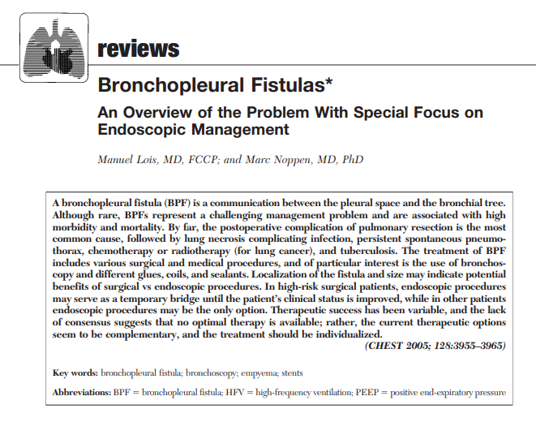
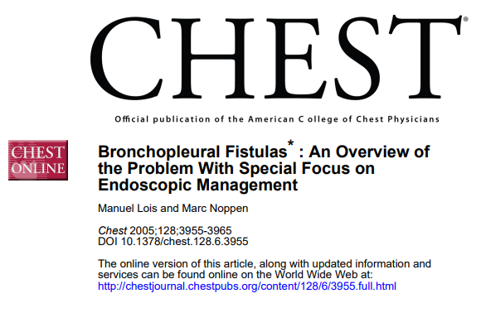
2005 Chest Overview → Bronchoscopic treatment
Ethanol, Polyethylene glycol, Cyanoacrylate glue, Fibrin glue, Blood clot with antibiotics(TC, DC),
Albumin-glutaraldehyde tissue adhesive, Cellulose, Gel foam, Coil, Balloon catheter occlusion, Silver nitrate, Calf bone, Stent……
Non-superiority among the brochoscopic methods…. But….

Slide 27
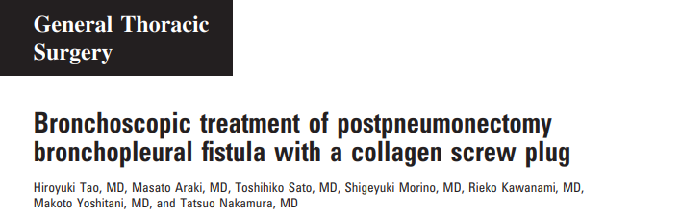
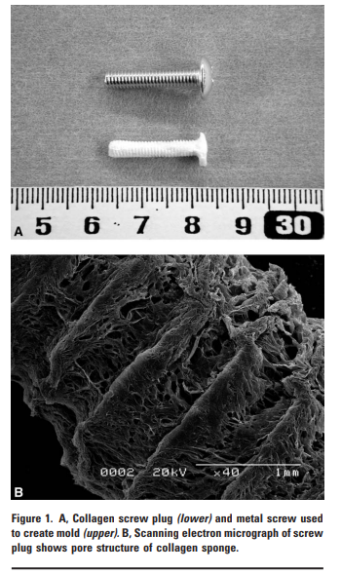
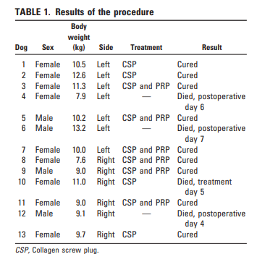
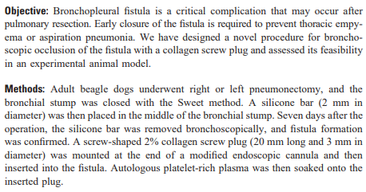
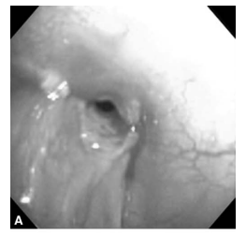
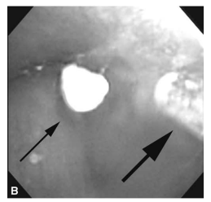
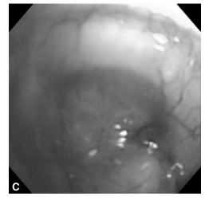


Slide 28
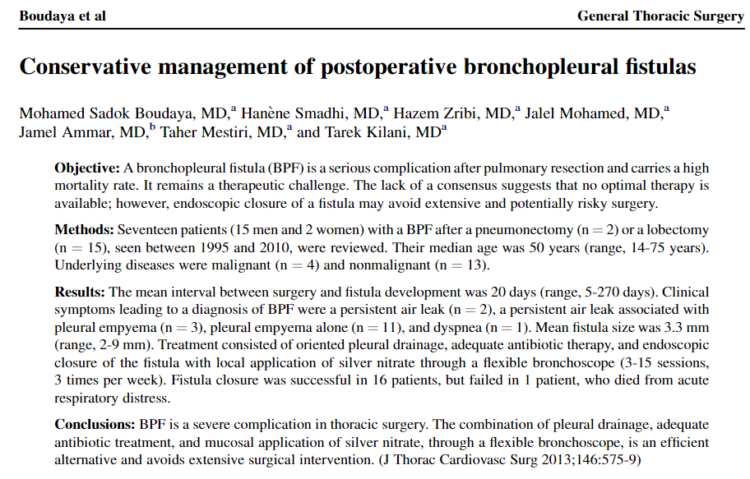
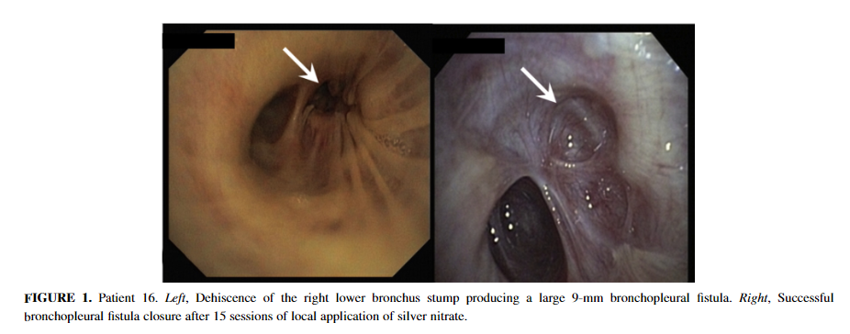
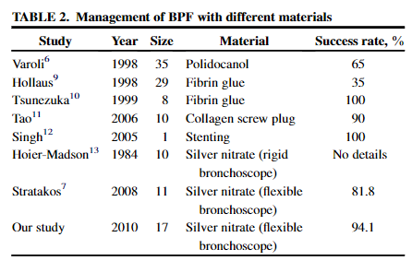

Slide 29
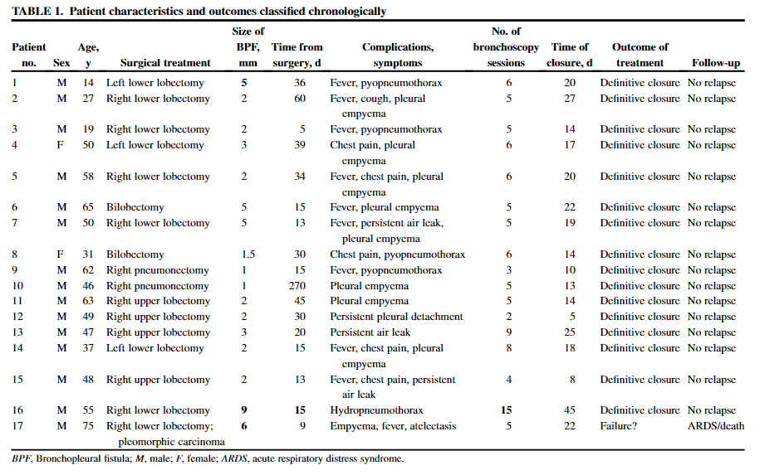
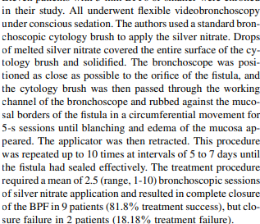

Slide 30
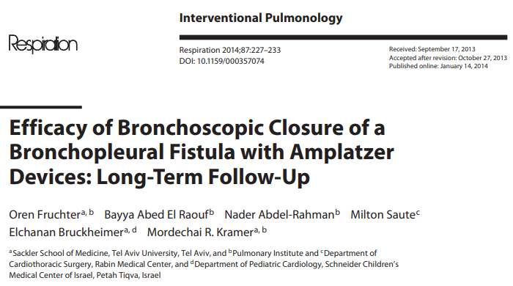
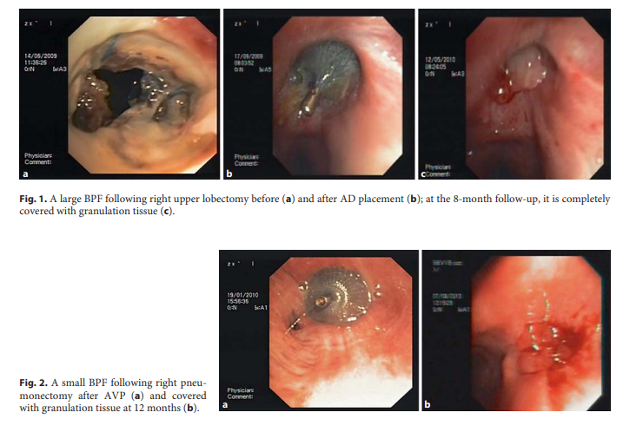
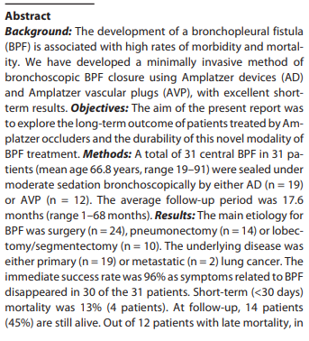
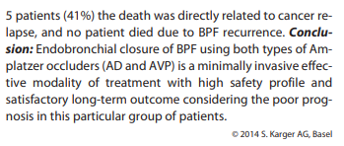

Slide 31
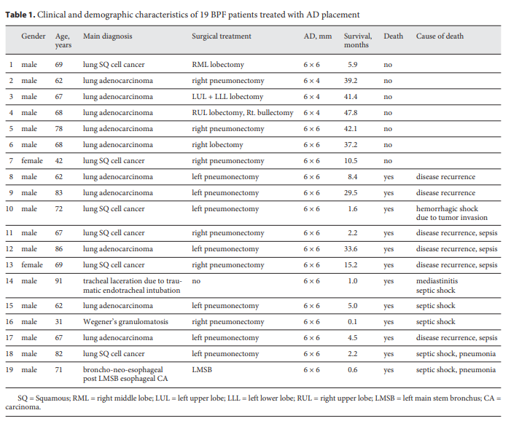


Slide 32





Slide 33




Slide 34





Slide 35






Slide 36





Slide 37


Width : 4~8.5mm
Length<10mm
Short Neck & Sub-subsegmental BPF의 Closure의 Benefit.

Slide 38




Slide 39


Procedure method
- Under general anesthesia or Under conscious sedation
- 5,6,7mm sized Valve use
- Fogarty balloon으로 Air leak 확인
- FOB Working channel>2.6mm(Olympus T-190)
- Total procedure time 10~15mins

Slide 40




- Mean age 54yrs(28-86yrs old)
- 2017.8 ~ 2020.10 BPF Treatment using EBV
Single center study(Shanghai Tongji)
- Sedation : General Anesthesia
➔ Succinylcholine, Sufentanil, Propofol
- Mechanical ventilation and Laryngeal mask
- BF1TQ290 FOB(Olympus)
- Chartis system + Ballon catheter for BPF Localization
- Zephyr endobronchial valve used(2nd-generation device, silicone 'duck bill’ attached to a nitinol skeleton)

Slide 41



Successful rate 73.1%(19/26)

Slide 42






Slide 43



Slide 44





Slide 45
Consideration?
- Early onset → Surgical repair consider
- Cost & Effectiveness
- Reproducibility
- Safety
- Hospital utilization
- Technical learning curve
Summary of Bronchopleural fistula Endoscopic Tx
Poor general condition
Non-post lung resection BPF
(Infection, Cancer related)
Delayed onset
Bridging therapy for curative Op
(Not suitable immediate Op)
Unsuitable surgical repair
Large size
At least over 8mm
Small size
Mostly, Under 8mm
Amplatzer Device(PFO, ASD, Vascular Plug Type II(Consider)
Vascular coiling + Fibrin agent
Silicone & Covered stent
<Occulsion device> 5~8mm favor
Amplatzer vascular plug
Endobronchial valve
EWS(Endoscopic Watanabe spigot)
<Injection material> - Under 5mm, Favor
Silver nitrate
Fibrin glue
Polidocanol
Autologous blood patch with TC or DC
Cost
EBV : $2,750
Amplatzer : $800[국내 70만원 정도]
EWS : $60/Piece

Slide 46



Figure Review
4~6mm sized, (Segmental bronhchus)
Small BPF Closure method
<Occulsion device> : 5~8mm favor
- Amplatzer vascular plug
- Endobronchial valve
- EWS(Endoscopic Watanabe spigot)
<Injection material> : Under 5mm favor
- Silver nitrate
- Fibrin glue
- Polidocanol
Autologous blood patch with Abx
Other method[Sclerosant, Laser ablation…]
8mm sized, (Lobar bronhchus)
Large BPF Closure method
- Amplatzer PFO, ASD Occluder
- Vascular coiling + Fibrin agent
- Silicone & Covered stent

