Slide 1




Prevention for complication of glucocorticoid use
Kim Young jae
Division of Pulmonology
Department of Internal Medicine
Yonsei University College of Medicine

Slide 2
Introduction
Glucocorticoids are important in the treatment of many inflammatory, allergic, immunologic, and malignant disorders, and the toxicity of glucocorticoids is one of the commonest causes of iatrogenic illness associated with chronic inflammatory disease.

Slide 3
Introduction
Glucocorticoid toxicity is generally related to both the average dose and cumulative duration of use, although, for most toxicities, a “threshold” dose or duration has not been established
Da Silva JA, Jacobs JW, Kirwan JR, et al. Safety of low dose glucocorticoid treatment in rheumatoid arthritis: published evidence and prospective trial data. Ann Rheum Dis 2006; 65:285.

Slide 4
Introduction
Controversy exists over the relative safety of “low-dose” glucocorticoid use (less than or equal to 10 mg/day of prednisone or equivalent) in chronic conditions such as rheumatoid arthritis
Saag KG, Koehnke R, Caldwell JR, et al. Low dose long-term corticosteroid therapy in rheumatoid arthritis: an analysis of serious adverse events. Am J Med 1994; 96:115.

Slide 5
Introduction
Several large retrospective reviews have shown that long-term glucocorticoid use, even in low doses, is a significant independent predictor of numerous serious adverse effect and that risk is both dose and time
McDougall R, Sibley J, Haga M, Russell A. Outcome in patients with rheumatoid arthritis receiving prednisone compared to matched controls. J Rheumatol 1994; 21:1207.

Slide 6
Introduction
Other analyses note a paucity of evidence documenting toxicity from the use of very low doses of glucocorticoids (eg, prednisone <5 mg/day), such as those sometimes used for the treatment of rheumatoid arthritis
Da Silva JA, Jacobs JW, Kirwan JR, et al. Safety of low dose glucocorticoid treatment in rheumatoid arthritis: published evidence and prospective trial data. Ann Rheum Dis 2006; 65:285.

Slide 7
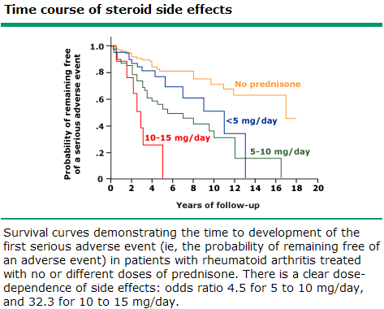
Introduction
Data from Saag, KG, Koehnke, R, Caldwell, JR, et al. Am J Med 1994; 96:115.

Slide 8
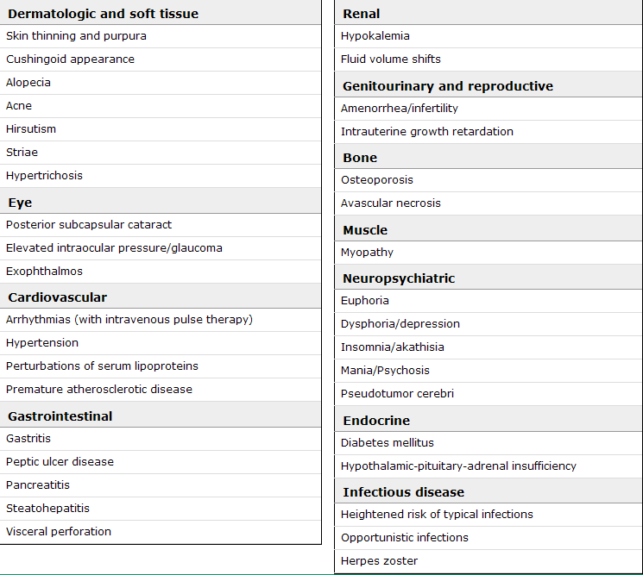

Slide 9
Contents
1. Peptic ulcer disease (PUD)
2. Pneumocystis pneumonia (PCP)
3. Osteoporosis

Slide 10
Peptic ulcer disease (PUD)

Slide 11
Peptic ulcer disease (PUD)
Glucocorticoids independently increase the risk for a number of adverse gastrointestinal (GI) events, such as gastritis, ulcer formation, and GI bleeding.
However, the risk of peptic ulcer disease due to glucocorticoids alone is low, rises significantly when they are used in combination with nonsteroidal antiinflammatory drugs (NSAIDs), and is also lower than the risk with NSAIDs alone
Messer J, Reitman D, Sacks HS, et al. Association of adrenocorticosteroid therapy and peptic-ulcer disease.
N Engl J Med 1983; 309:21.

Slide 12
Peptic ulcer disease (PUD)
The estimated relative risks of glucocorticoids alone vary from 1.1 (not significant) to 1.5 (marginally significant)
Messer J, Reitman D, Sacks HS, et al. Association of adrenocorticosteroid therapy and peptic-ulcer disease. N Engl J Med 1983; 309:21.
Piper JM, Ray WA, Daugherty JR, Griffin MR. Corticosteroid use and peptic ulcer disease: role of nonsteroidal anti-inflammatory drugs. Ann Intern Med 1991; 114:735.

Slide 13
Peptic ulcer disease (PUD)
They suggest NOT using prophylaxis against gastrointestinal bleeding in patients taking glucocorticoids alone.
By contrast, patients taking glucocorticoids in combination with aspirin or other NSAIDs may require prophylaxis.

Slide 14
Peptic ulcer disease (PUD)
Glucocorticoid use is associated with a nearly twofold increased risk of a gastrointestinal AE among patients also taking NSAIDs when compared with those who use NSAIDs alone
The use of NSAIDs and glucocorticoids is associated with a fourfold increased risk of a gastrointestinal AE compared with nonuse of either drug
Gabriel SE, Jaakkimainen L, Bombardier C. Risk for serious gastrointestinal complications related to use of nonsteroidal anti-inflammatory drugs. A meta-analysis. Ann Intern Med 1991; 115:787.
Piper JM, Ray WA, Daugherty JR, Griffin MR. Corticosteroid use and peptic ulcer disease: role of nonsteroidal anti-inflammatory drugs. Ann Intern Med 1991; 114:735.

Slide 15
Peptic ulcer disease (PUD)
“American Society of Health System Pharmacists (ASHP)”
- The guidelines recommend stress ulcer prophylaxis for ICU patients with any of the following characteristics
Coagulopathy
Mechanical ventilation for more than 48 hours
History of GI ulceration or bleeding with the past year
Two or more minor risk factors
: sepsis, an ICU stay >1 week, occult GI bleeding for ≥6 days, or glucocorticoid therapy (more than 250 mg hydrocortisone or the equivalent)

Slide 16
Peptic ulcer disease (PUD)
Pharmacologic agents
- Proton pump inhibitors
- H2 blockers
- Sucralfate
- Antacids
- Prostanoids

Slide 17
Pneumocystis pneumonia (PCP)

Slide 18
Pneumocystis pneumonia (PCP)
Pneumocystis pneumonia (PCP) is a potentially life-threatening infection that occurs in immunocompromised individuals.
Guidelines have been published for the use of PCP prophylaxis among patients with cancer, including hematopoietic stem cell transplant (HCT) recipients
National Comprehensive Cancer Network (NCCN) Clinical Practice Guidelines in Oncology. Prevention and treatment of cancer-related infections. Version 1.2012.

Slide 19
Pneumocystis pneumonia (PCP)
Although there are no published guidelines for the use of PCP prophylaxis among solid organ transplant recipients, it is standard practice to administer prophylaxis in this population.
There are no published guidelines for PCP prophylaxis among patients with rheumatologic diseases receiving immunosuppressive drugs, but some advocate its use in such patients when they are receiving high-dose immunosuppressive therapy
Ognibene FP, Shelhamer JH, Hoffman GS, et al. Pneumocystis carinii pneumonia: a major complication of immunosuppressive therapy in patients with Wegener's granulomatosis. Am J Respir Crit Care Med 1995; 151:795.
Suryaprasad A, Stone JH. When is it safe to stop Pneumocystis jiroveci pneumonia prophylaxis? Insights from three cases complicating autoimmune diseases. Arthritis Rheum 2008; 59:1034.

Slide 20
Pneumocystis pneumonia (PCP)
Patients receiving a glucocorticoid dose equivalent to ≥20 mg of prednisone daily for one month or longer who also have another cause of immunocompromise (eg, certain hematologic malignancies or a second immunosuppressive drug, particularly a cytotoxic agent)
Huang L, Morris A, Limper AH, et al. An Official ATS Workshop Summary: Recent advances and future directions in pneumocystis pneumonia (PCP). Proc Am Thorac Soc 2006; 3:655.
Sepkowitz KA, Brown AE, Armstrong D. Pneumocystis carinii pneumonia without acquired immunodeficiency syndrome. More patients, same risk. Arch Intern Med 1995; 155:1125.
Thomas CF Jr, Limper AH. Pneumocystis pneumonia. N Engl J Med 2004; 350:2487.

Slide 21
Pneumocystis pneumonia (PCP)
Pharmacologic agents
- Trimethoprim-sulfamethoxazole
- Atovaquone
- Dapsone
- Aerosolized or intravenous pentamidine
- Clindamycin plus primaquine
- Sulfadoxine plus pyrimethamine

Slide 22
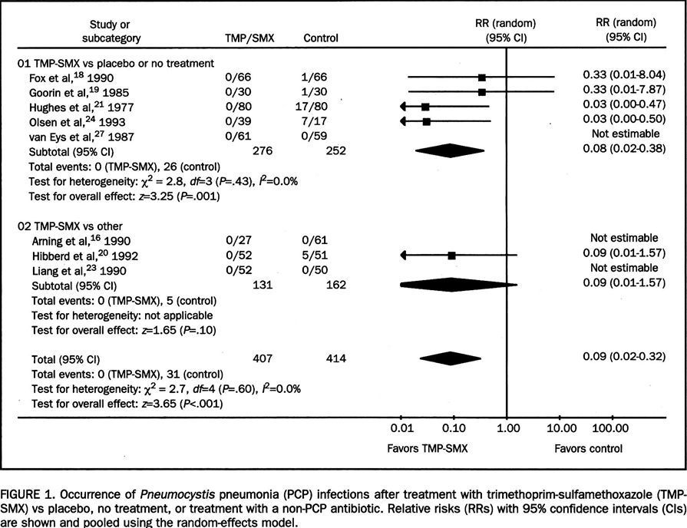
Pneumocystis pneumonia (PCP)
Green H, Paul M, Vidal L, Leibovici L. Prophylaxis of Pneumocystis pneumonia in immunocompromised non-HIV-infected patients: systematic review and meta-analysis of randomized controlled trials. Mayo Clin Proc 2007; 82:1052.

Slide 23
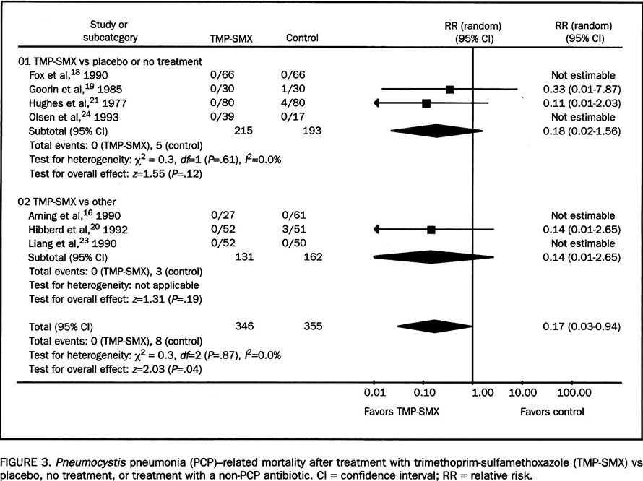
Pneumocystis pneumonia (PCP)
Green H, Paul M, Vidal L, Leibovici L. Prophylaxis of Pneumocystis pneumonia in immunocompromised non-HIV-infected patients: systematic review and meta-analysis of randomized controlled trials. Mayo Clin Proc 2007; 82:1052.

Slide 24
Pneumocystis pneumonia (PCP)
Trimethoprim-sulfamethoxazole (TMP-SMX) is the recommended first-line agent for PCP prophylaxis based upon its proven efficacy
It may be given as one double-strength tablet daily or three times per week or as one single-strength tablet daily.
- Double-strength tablet : TMP 160mg / SMX 800mg
- Single-strength tablet : TMP 80mg / SMX 400mg (본원)

Slide 25
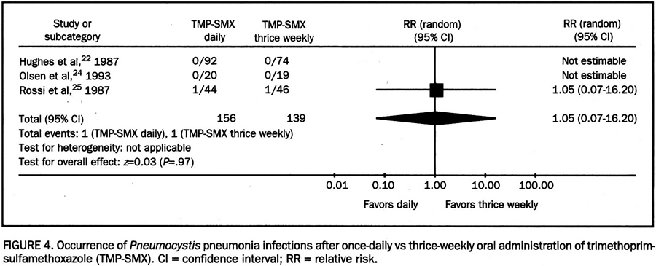
Pneumocystis pneumonia (PCP)

Slide 26
Osteoporosis

Slide 27
Osteoporosis
Glucocorticoid therapy is associated with an appreciable risk of bone loss, which is most pronounced in the first few months of use.
The increased risk of fracture has been reported with doses of prednisone or its equivalent as low as 2.5 to 7.5 mg daily
van Staa TP, Leufkens HG, Cooper C. The epidemiology of corticosteroid-induced osteoporosis: a meta-analysis. Osteoporos Int 2002; 13:777.

Slide 28
Osteoporosis
In an attempt to minimize bone loss, certain general principles should be followed in all patients receiving all doses of glucocorticoids for a duration of ≥3 months
Heffernan MP, Saag KG, Robinson JK, Callen JP. Prevention of osteoporosis associated with chronic glucocorticoid therapy. JAMA 2006; 295:1300.
Grossman JM, Gordon R, Ranganath VK, et al. American College of Rheumatology 2010 recommendations for the prevention and treatment of glucocorticoid-induced osteoporosis. Arthritis Care Res (Hoboken) 2010; 62:1515.

Slide 29
Osteoporosis
For all patients receiving any dose of chronic glucocorticoid therapy or initiating glucocorticoids with an anticipated duration of ≥3 months, we recommend calcium and vitamin D supplementation. Most individuals require 1200 mg of elemental calcium daily, total diet plus supplement, and 800 IU of vitamin D daily.
- DiCAmax 1T : Ca 500mg / Vit D 1000IU
- Hardcal 1T : Ca 600mg / Vit D 400IU
- Calteo 40 1T : Ca 158mg / Vit D 400IU

Slide 30
Osteoporosis
For men ≥50 years or postmenopausal women
& T-score ≤-2.5 (Osteoporosis)
→ Pharmacologic therapy
(any dose of glucocorticoids for any duration)
For men ≥50 years or postmenopausal women
& T-score -2.5 ~ -1.0 (Osteopenia)
→ Risk assessment by FRAX calculation

Slide 31
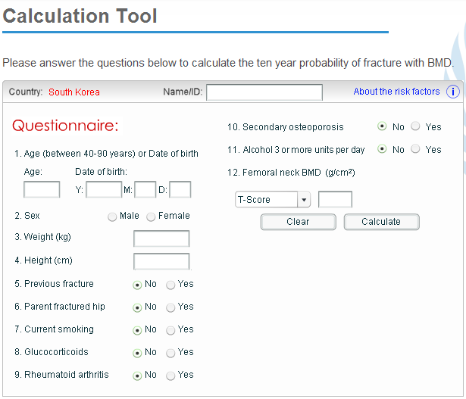
Osteoporosis
FRAX (http://www.shef.ac.uk/FRAX)

Slide 32
Osteoporosis
For men ≥50 years or postmenopausal women
& T-score -2.5 ~ -1.0 (Osteopenia)
→ High risk : Pharmacologic therapy
(any dose of glucocorticoids for any duration)
→ Low risk : Pharmacologic therapy
(≥7.5 mg/day of prednisone or its equivalent for an anticipated duration of ≥3 months)

Slide 33
Osteoporosis
For premenopausal women or men <50 years
& Fragility fracture
→ Pharmacologic therapy
(≥7.5 mg/day of prednisone or its equivalent for an anticipated duration of ≥3 months)

Slide 34
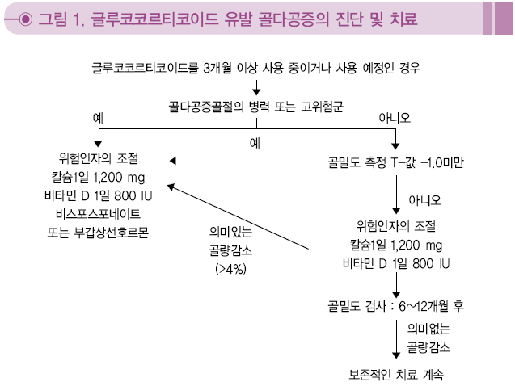
Osteoporosis
골다공증 진단 및 치료 지침 2011. KSBMR

Slide 35
Osteoporosis
Pharmacologic agents
- Bisphosphonates
- Parathyroid hormone
- Hormone replacement
- Calcitonin
- Denosumab

Slide 36
Take home message
Peptic ulcer disease (PUD)
- Glucocorticoid alone ?
- In combination with NSAIDs ?
- High dose steroid ? (ex. more than 250 mg hydrocortisone or the equivalent)

Slide 37
Take home message
Pneumocystis pneumonia (PCP)
- Solid organ transplant recipients ?
- Steroid ? (Equivalent to ≥20 mg of prednisone daily for one month or longer)
- Choice ? (TMP-SMX : Septrin 2T #1 ?)

Slide 38
Take home message
Osteoporosis
- Age, menopause, fracture risk
- Steroid ? (any dose of glucocorticoids for any duration / ≥7.5 mg/day of prednisone or its equivalent for an anticipated duration of ≥3 months)
- Calcium, Vitamin D, Pharmacologic therapy

