Slide 1

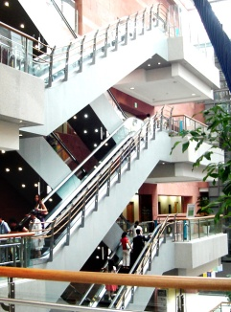


Cytomegalovirus infection in lung transplant recipients
Sang Kook Lee
Division of Pulmonology
Department of Internal Medicine
Yonsei University College of Medicine

Slide 2
Contents
1. CMV (Cytomegalovirus)?
2. CMV and lung transplantation
3. Manifestations of CMV
infection in lung transplant recipients
4. Diagnosis
5. Treatment
6. Prevention

Slide 3
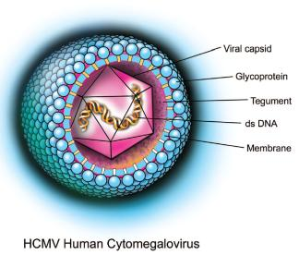
1. CMV (Cytomegalovirus)
β-herpesvirus
Double-strand DNA, four species of mRNA, a protein capsid, lipoprotein envelope
Replicates in the cell nucleus
In breast milk, saliva, feces, urine

Slide 4
40 ~ 100% seroprevalence rates of the adult population
Increases with age
Once infected, an individual generally carries CMV for life
The infection usually remains silent

Slide 5
2. CMV and lung transplantation
2 most common infection among lung transplant recipients (1 -> bacterial pneumonia)
Associated with acute and chronic rejection

Slide 6
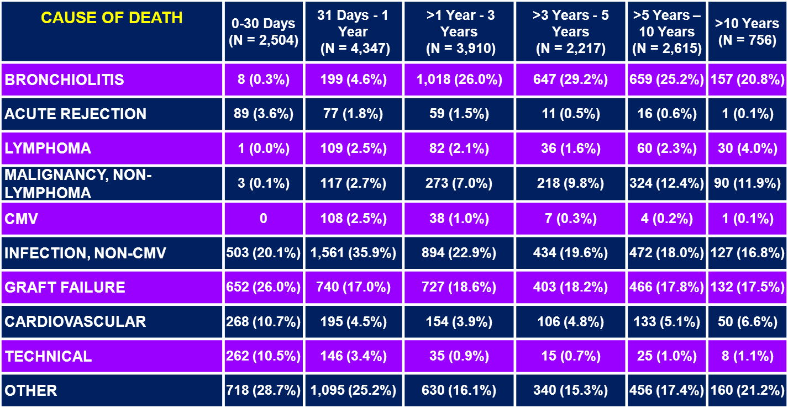

ADULT LUNG TRANSPLANT RECIPIENTS
Cause of Death (Deaths: January 1992 – June 2011)
ISHLT
J Heart Lung Transplant. 2012 Oct; 31(10): 1045-1095
2012

Slide 7
CMV infection following transplantation
  By transmission with the donor organ from a CMV-seropositive donor
  By transfusion of blood products from a CMV-seropositive blood donor
  By reactivation of latent infection in a seropositive recipient
  By close physical contact with a CMV-infected individual

Slide 8
3. Manifestations
CMV disease typically occurs during the first 3 months
CMV syndrome (without end-organ involvement) : fever, malaise, weakness, myalgias, arthralgias
Tissue invasive disease : pneumonitis, hepatitis, gastroenteritis, colitis
-> easily confused with acute rejection (timing of
presentation)
Indirect effects : associated with chronic rejection (bronchiolitis obliterans syndrome)
Notes:
CMV infection은 2주 이내에는 거의 발생하지 않음. 대략 40~55일경에 처음 evnent가 발생함.

Slide 9
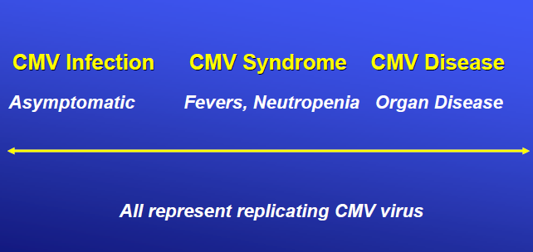
CMV Spectrum

Slide 10
4. Diagnosis
Serology : CMV IgG (false positive IgM reduce specificity of screening)
CMV replication assays
  CMV quantitative PCR : blood, BAL, tissue
  CMV pp65 antigenemia : possible, if neutrophil count > 1000/microL
  Not possible to define cutoff values
Notes:
CMV pp65 antigenemia - detection of CMV proteins in peripheral blood polymorphonuclear leukocytes
using tagged monoclonal antibodies specific to the CMV pp65 lower matrix protein

Slide 11
Culture : BAL culture used to help diagnose (not always correlate with disease)
Histopathology
  Fiberoptic bronchoscopy with transbronchial lung biopy : safe, reliable
  Characteristic inclusion bodies
  Patients suspected of invasive disease (pneumonitis) should undergo bronchoscopy

Slide 12
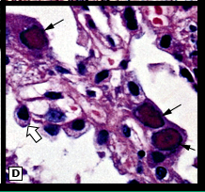

Slide 13
5. Treatment
IV ganciclovir, oral valganciclovir
Acyclovir, valacyclovir, famciclovir, oral ganciclovir shoud not be used.
CMV viremia
  Asymptomatic : should treat
  Not standardized cutoffs
  Continue until the viral load becomes undetectable (1~2/week)
Notes:
Valganciclovir : Prodrug
Asymptomatic CMV viremia라 할지라도, invasive disease 와 CMV 의 indirect effect를 막기 위해서 치료가 필요.

Slide 14
Non-severe disease
  Oral valganciclovir (900mg twice/d)
  IV ganciclovir (5mg/kg twice/d)
Severe disease, CMV pneumonitis, children
  IV ganciclovir (5mg/kg twice/d)
  IV Cytomegalovirus Immune Globulin (Cytogam®)
Notes:
Severe 의 기준 : considered life-threatening by the investigator
CMV immune globulin은 data 가 부족.

Slide 15
Treatment duration
  Resolution of viremia, > 2 weeks
  Proven with 2 consecutive negative CMV viral load assays
  Secondary suppression : oral valganciclovir 900mg once / d -> 1 ~ 3 months

Slide 16
Ganciclovir resistance
  Risk factors : prolonged antiviral use, active CMV replication, lack of prior CMV immunity (CMV D+/R-), inadequate antiviral drug delivery
  However, viral load may rise following initiation of therapy in some patients
  UL97 phsphotransferase mutation, UL54 DNA polymerase mutations
  Foscarnet, cidofovir, leflunomide, ACI246

Slide 17
6. Prevention
54 ~ 92% develop in patients without prophylaxis
CMV D+/R- : highest risk
Pre-transplant serologic test : CMV IgG
(false positive IgM reduce specificity of
screening)

Slide 18
CMV replication assays
  CMV viral load test (PCR, hybrid capture assay)
  CMV pp65 antigenemia
  Preemptive approach : weekly monitoring during 3 months

Slide 19
Universal Prophylaxis VS Preemptive treatment
Universal Prophylaxis : recipients at high risk (all but CMV D-/R-)
Preemptive treatment : monitoring frequently, start treatment when viral replication reach a threshold
few studies have directly compared universal prophylaxis to preemptive therapy
Notes:
2010 International Consensus Guidelines on the Management of Cytomegalovirus in Solid Organ Transplantation에서는 universal prophylaxis를 지지함.
In 2 separate trials, Khoury et al (n=98 kidney transplant) and Reischig et al (n=70 kidney transplant) randomized to preemptive therapy vs prophylaxis ‒ Equally effective in preventing CMV disease
Kliem et al: randomized 148 renal transplant patients to preemptive therapy (IV ganciclovir) vs prophylaxis (3 months oral ganciclovir) ‒ Long-term graft survival at 4-years posttransplant was significantly
improved in the prophylaxis group

Slide 20
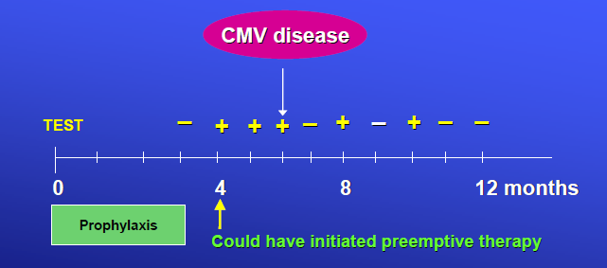

Slide 21
Universal Prophylaxis
Ganciclovir
  Inhibit viral replication, but not eradicate latent infection
  IV 5mg/kg once/d (dose adjustment for renal insufficiency)
  S/E : hematologic suppression

Slide 22
Valganciclovir
  Ganciclovir prodrug
  Oral 900mg once/d (dose adjustment for renal insufficiency)
  S/E : hematologic suppression
Duration : 3 ~ 6m (CMV D+/R- : at least 6m)

Slide 23
Preemptive therapy
Monitored frequently with CMV replication assays
Advantage
  Decrease costs, drug toxicity, catheter-related complications, and drug-resistant strains
Not used commonly d/t limited data and high risk of CMV infection (lung transplantation)
Preemptive approach can be used after the end of prophylaxis.

Slide 24
CMV immune globulin
  Used in combination with an antiviral agent for prophylaxis
  High risk (DMV D+/R-)
  Never use alone for CMV prophylaxis

Slide 25
Blood products : CMV D-/R- recipients should receive only CMV-negative or leukoreduced blood products
Vaccination : none available for clinical use

Slide 26
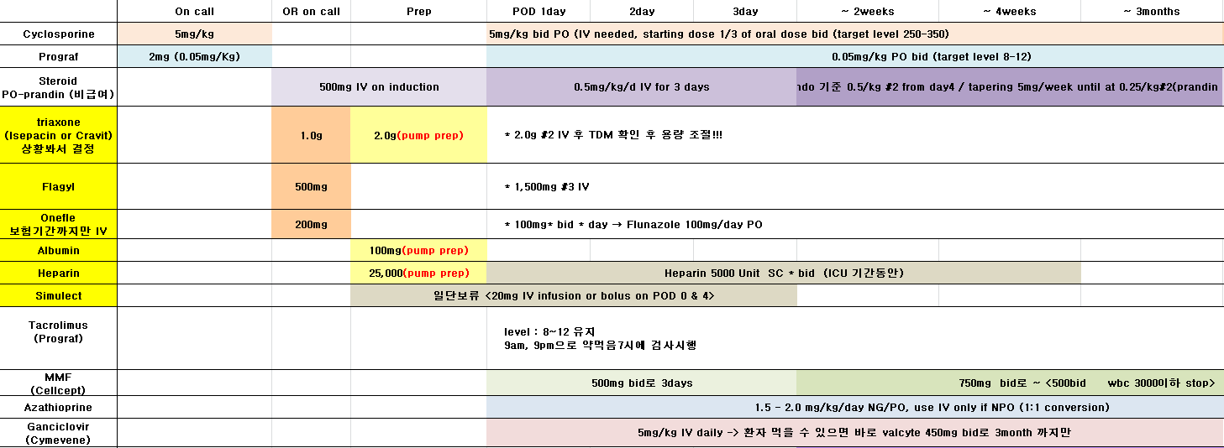

Slide 27
Summary
1. CMV (Cytomegalovirus)?
-> β-herpesvirus, In breast milk, saliva,
feces, urine
2. CMV and lung transplantation
-> 2 most common infection, associated
with acute and chronic rejection
3. Manifestations
-> CMV infection, syndrome, disease

Slide 28
4. Diagnosis
-> Serology, CMV replication assays,
culture, histopathology
5. Treatment
  -> IV ganciclovir(5mg/kg twice/d),
  oral valganciclovir (900mg twice/d)
6. Prevention
  -> Universal Prophylaxis, IV ganciclovir(5mg/kg
  once/d), oral valganciclovir (900mg once/d)

Slide 29
Thank you for listening

