Slide 1
High-Flow Nasal Cannula Therapy
2018.4.12 Indepth Review
R4 기민서

Slide 2
Contents
Introduction
Mechanism of action
Clinical implications
Future research

Slide 3
Introduction
Supplemental O2 is an FIO2 > 21% and is a drug.
Conventional oxygen therapy
- low-flow systems : Nasal cannulae or Simple, Non-rebreather, Partial rebreather masks
- high-flow systems : Venturi masks
do not deliver a reliable fraction of inspired oxygen
poorly tolerated for prolonged periods due to inadequate warming and humidification of inspired gas

Slide 4
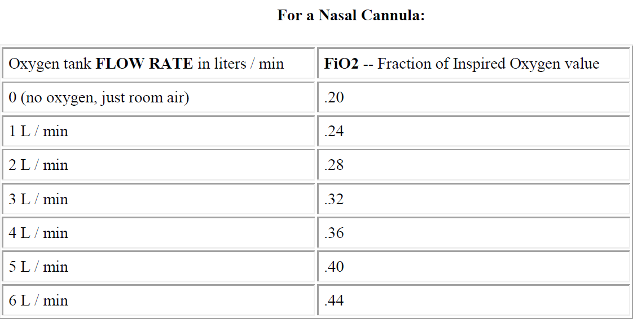

Slide 5
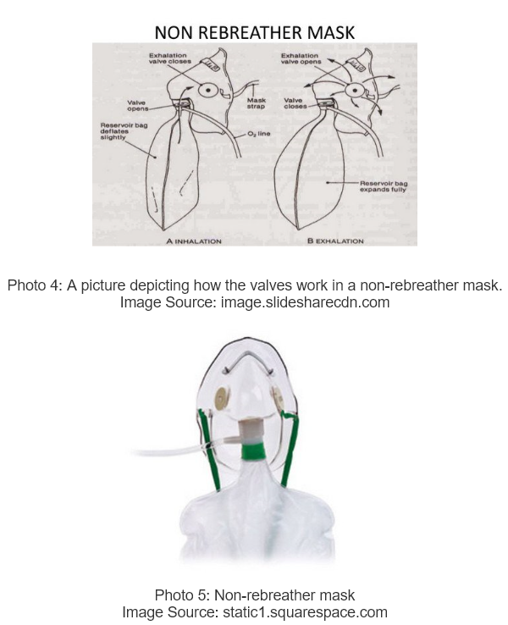
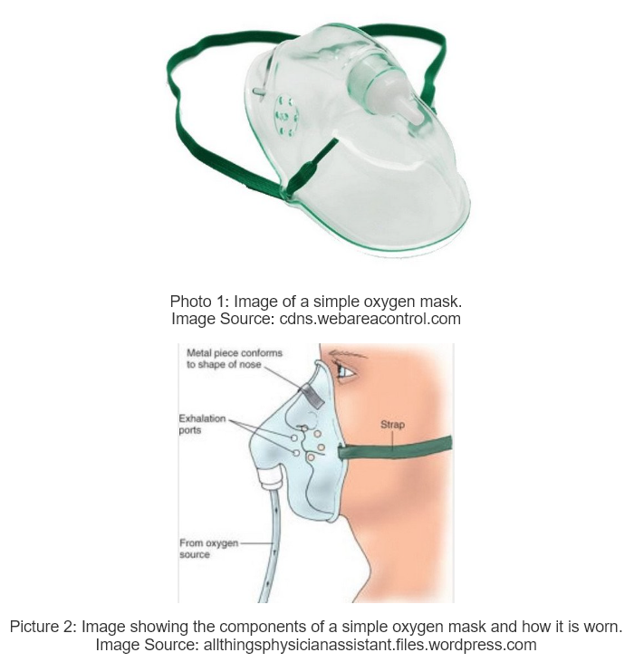
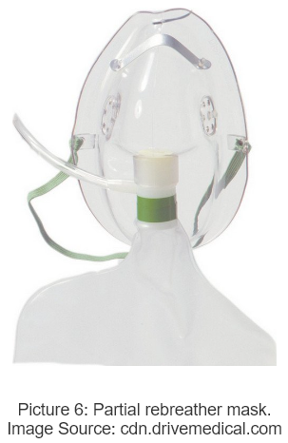
 | simple mask | non-rebreather mask | partial rebreather mask
Flow rate | 5-10 L/min | 12-15 L/min | 5-15 L/min
estimated FiO2 | 25-50% | 80-100% | 40-70%

Slide 6
High-flow nasal cannula therapy (HFNC)
Heated and humidified oxygen/air mixtures at flow rates that match or exceed the patient’s inspiratory flow rate
→ reducing entrainment of room air and dilution of administered oxygen
→ more stable and higher FiO2 than those of standard oxygen delivery systems
A natural extension of its use in neonates and children

Slide 7
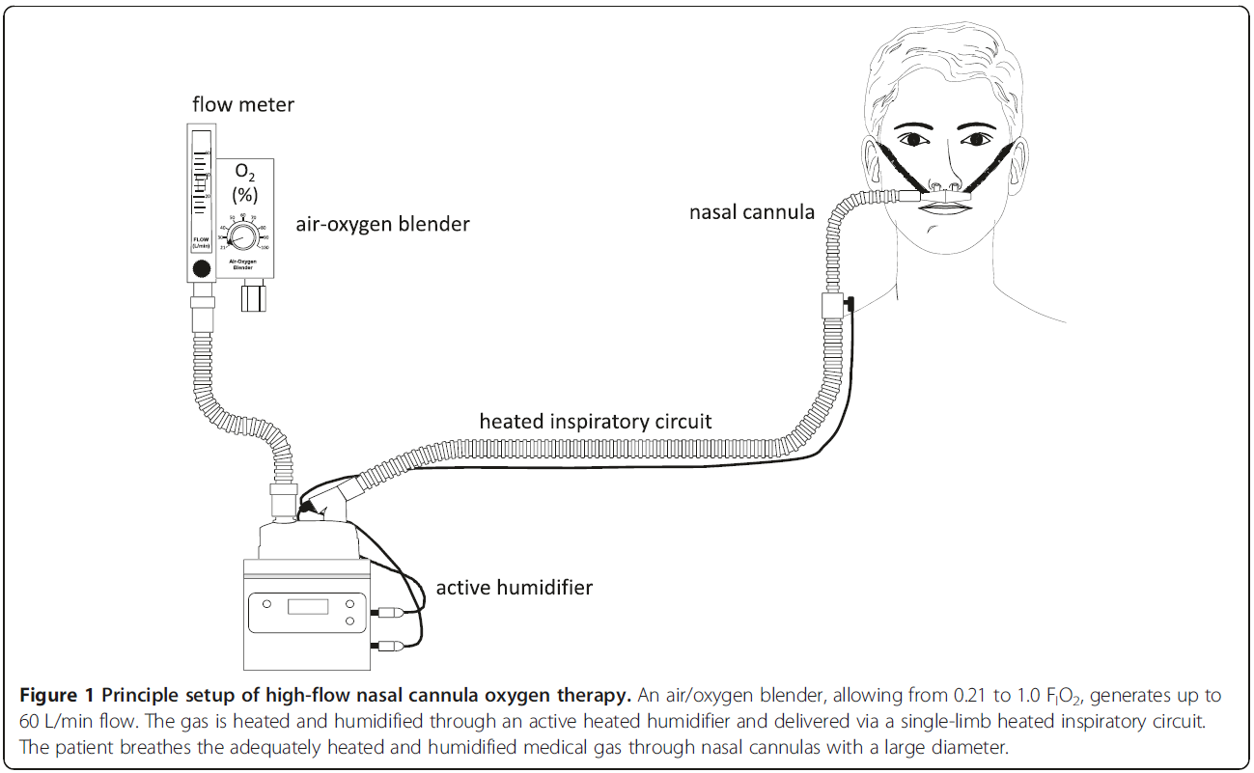
Mechanisms of action
Nishimura Journal of Intensive Care (2015) 3:15

Slide 8
Physiological effect
1. Fraction of inspired oxygen
2. Anatomical dead space washout
3. PEEP effect
4. Humidification

Slide 9
① Fraction of Inspired Oxygen
Physiologically, inspiratory flow is not constant, and VT (inspiratory flow) varies breath-by-breath.
Even with quiet breathing, the inspiratory flow rate at the nares of an adult usually exceeds 12L/min, and can exceed 30L/min for someone with mild respiratory distress.
→ Actual FIO2 during low-flow oxygen delivery is generally much lower than predicted by equipment algorithms

Slide 10
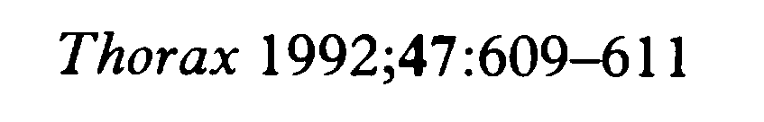
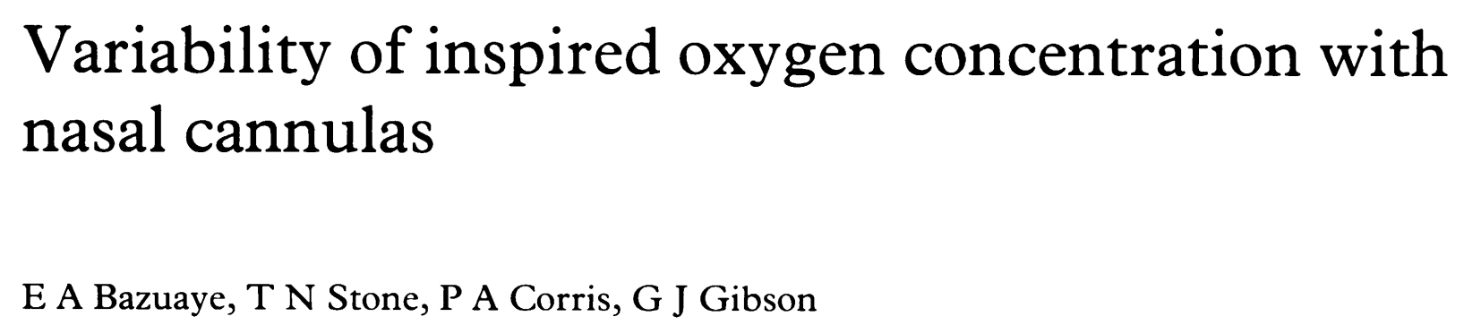
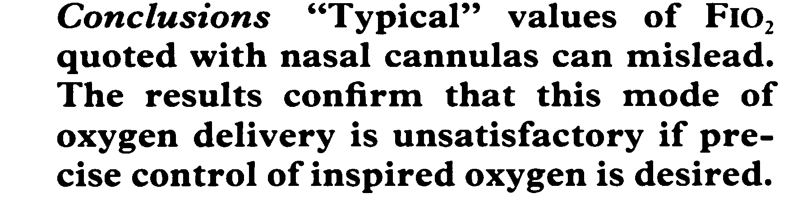

Slide 11
Calculation of FiO2
FiO2 (Fraction of inspired oxygen, 흡입산소분율)
산소 농도의 심한 변화는 흡기와 호기 주기에 따라 일어나며, 언제 어디서 측정하는 것이 가장 낫다는 것은 정해지지 않았다. 기관에서 추출하는 것이 현재는 기술적으로 정확해졌으나 임상적으로는 이러한 침습적인 방법을 일반적으로 사용하기에는 어려움이 따른다. 이러한 이유로 흡입 산소의 농도 분율을 임상적인 산소 흡입 농도의 기준으로 삼는다.
산소요법이 적절한가에 대한 궁극적인 판단은 동맥혈 가스분석과 임상적인 관찰에 의하므로 산소투여에 있어 중요한 점은 그 투여 농도가 지속적이고 조절이 가능하여야 한다.
산소요법. 강정완. 대한치과마취과학회지：2008; 8: 10～15

Slide 12
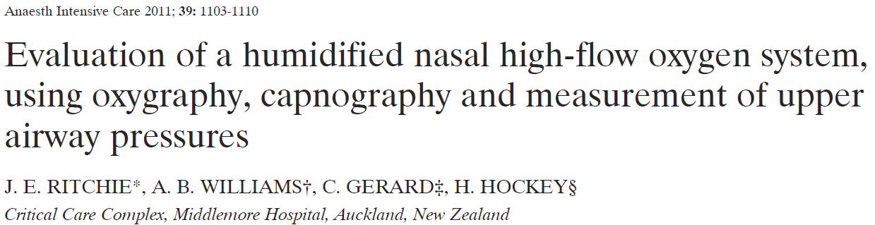
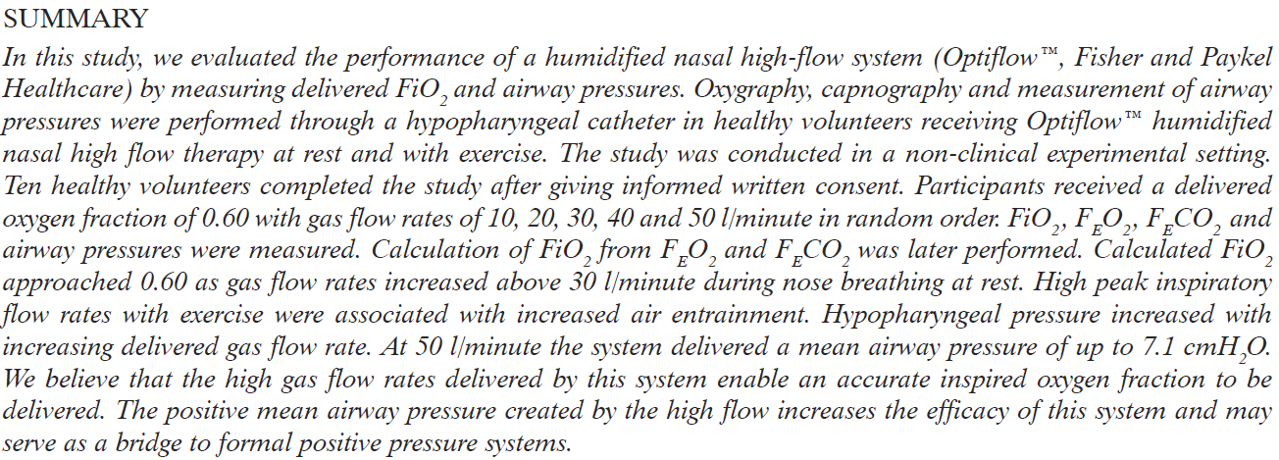

Slide 13
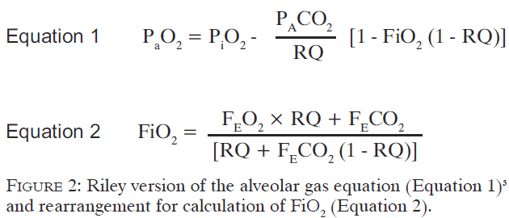
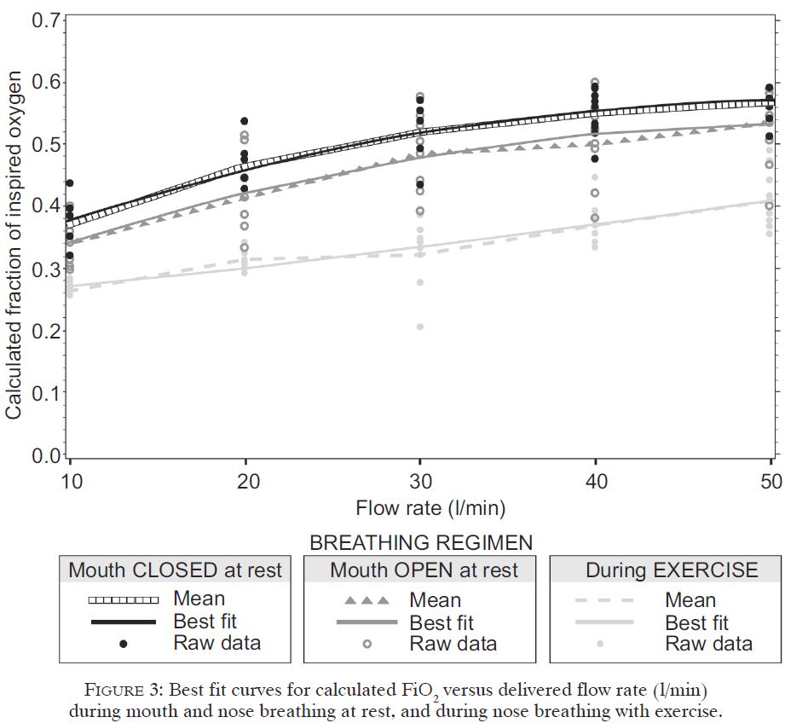
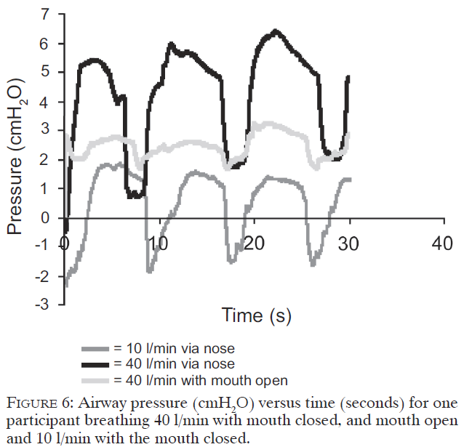

Slide 14
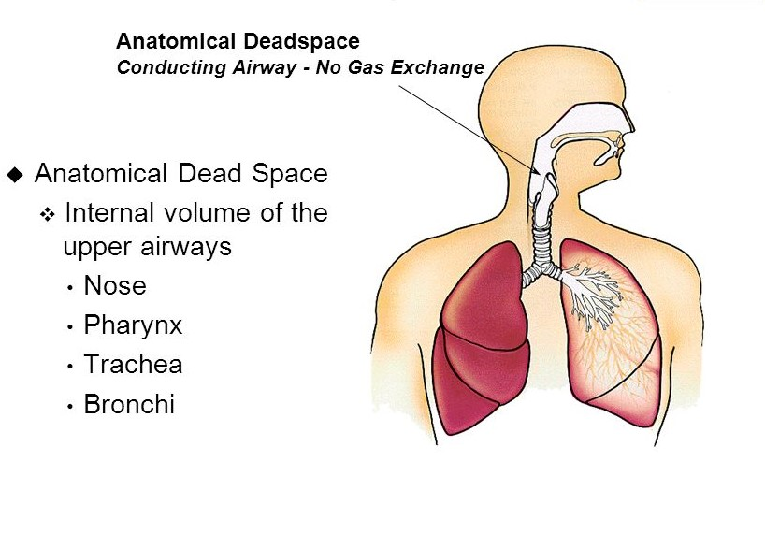
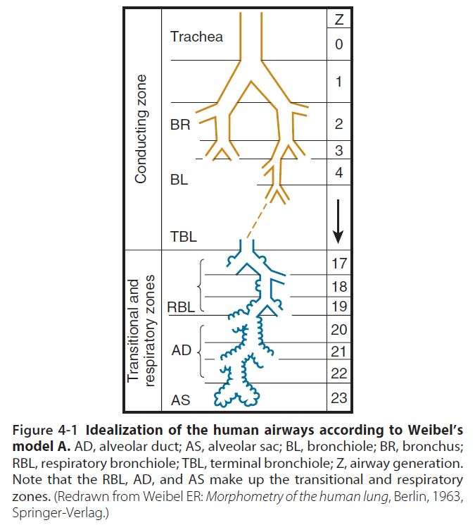
② Anatomical dead space washout
High flow washes out CO2 in anatomical dead space.

Slide 15
In a lung-injured-animal model, PaCO2 decreased as HFNC flow increased, and greater escape of gas more effectively decreased PaCO2.

Slide 16
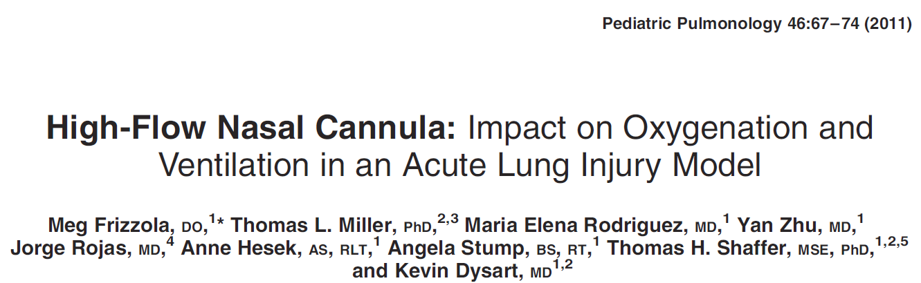
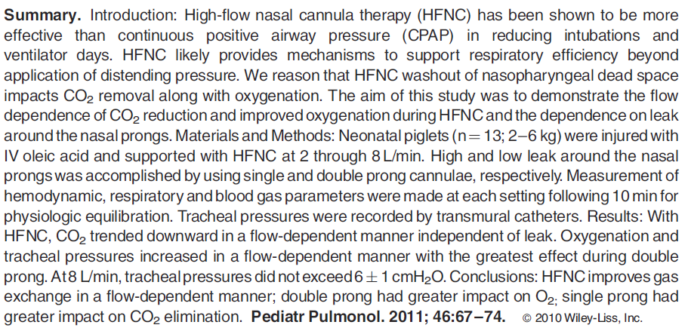

Slide 17
③ PEEP effect
Although HFNC is an open system, high flow from the nasal cannula prevails against some of the resistance of expiratory flow and increases airway pressure.

Slide 18
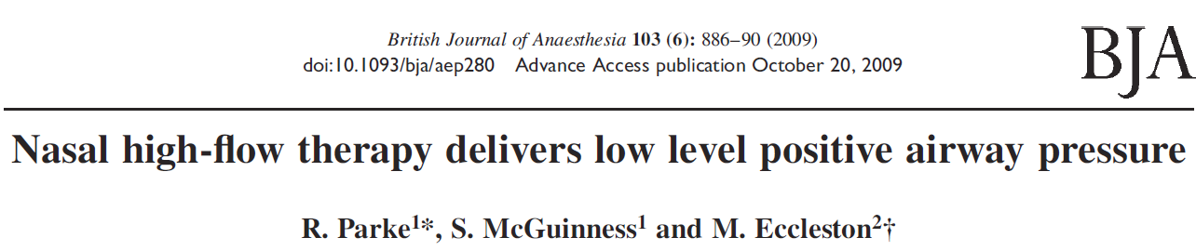
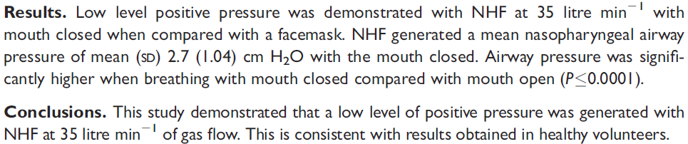
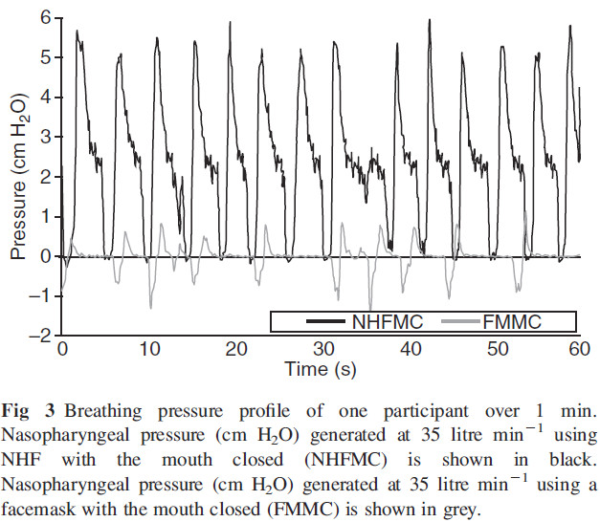

Slide 19
For every 10 L/min increase in gas flow, the mean airway pressure increases by 0.69 cmH2O in the mouth-closed position and by 0.35 cmH2O in the mouth-open position.
It results in recruitment of the atelectatic areas and thus increase of end-expiratory lung volume (EELV) by ∼25%
Parke RL, Eccleston ML, McGuinness SP. The effects of flow on airway pressure during nasal high-flow oxygen therapy. Respir Care 2011; 56: 1151–1155.
Corley A, Caruana LR, Barnett AG, et al. Oxygen delivery through high-flow nasal cannulae increase end-expiratory lung volume and reduce respiratory rate in post-cardiac surgical patients. Br J Anaesth 2011; 107:998–1004.

Slide 20
④ Humidification
Conventional oxygen devices delivering dry and unwarmed gas are associated with mask discomfort, nasal dryness, oral dryness, eye irritation, nasal and eye trauma, gastric distension, and aspiration
It is well known that cold air induces bronchoconstriction

Slide 21
Conditioning of the gas
→ minimizes airway constriction
→ reduces the work of breathing
→ improves mucociliary function
→ facilitates clearance of secretions
→ less atelectasis, resulting in a good ventilation/perfusion ratio and better oxygenation.
→ particularly important for patients with secretion problems, such as those with COPD.

Slide 22
While bubble humidifiers deliver poor levels of humidity and are associated with significant discomfort, a heated humidifier was associated with a decrease of dryness

Slide 23
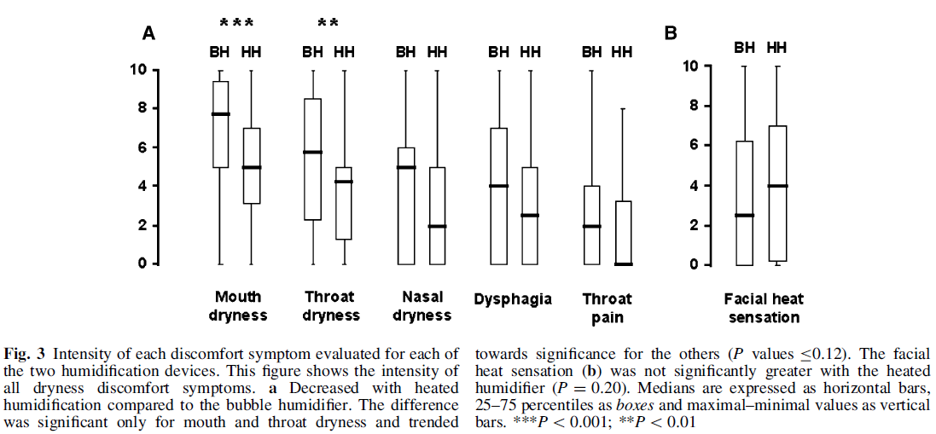
A randomized cross-over study in critically ill patients during a 3-day period

Slide 24
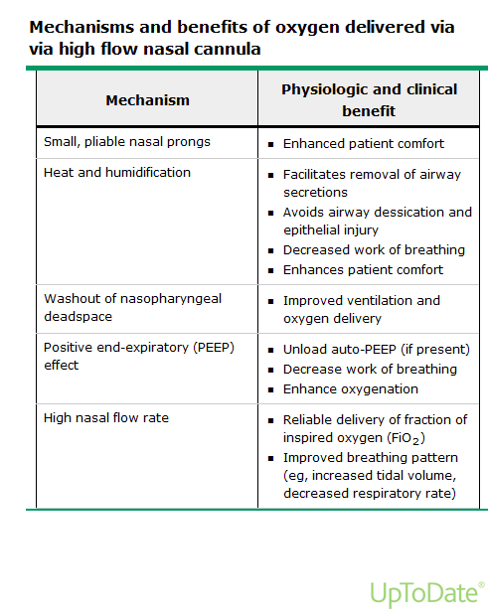

Slide 25
Clinical implications
Acute hypoxaemic respiratory failure
Post-extubation in the ICU
Post-extubation following surgery
Pre- and peri-oxygenation during intubation
Acute hypoxaemic respiratory failure in immunocompromised patients
HFNC in other clinical conditions
- COPD, HF, during the bronchoscopy

Slide 26
① Acute hypoxaemic respiratory failure
- Benefit

Slide 27
Multicenter, open-label, randomized controlled trial
310 patients included in the analysis
- Primary outcome : % of pts intubated at day 28
- Secondary outcomes : all-cause mortality in and at 90 days, ventilator-free
days at day 28

Slide 30
① Acute hypoxaemic respiratory failure
- No benefit
→ a post hoc analysis : fewer participants in the NHF group required mechanical ventilation either in the emergency department or within 24 h of leaving the emergency department

Slide 31
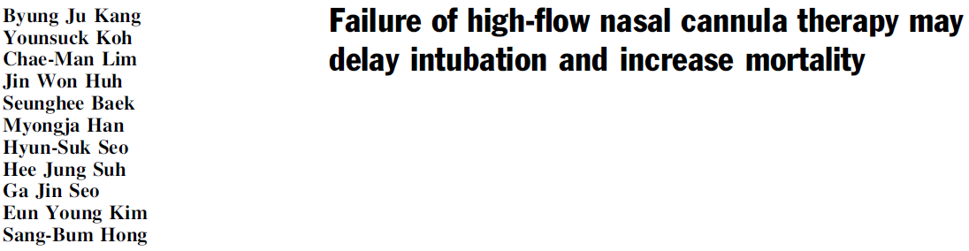
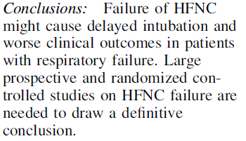
Retrospective observational study
175 enrolled pts. who failed HFNC and then required intubation
Jan. 2013 ~ Mar 2014

Slide 32
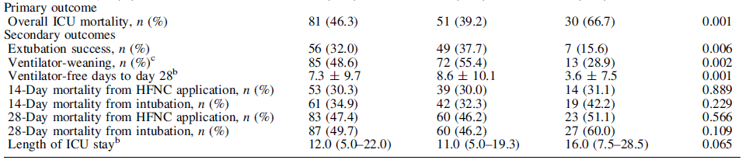
→ early intubation (i.e., within 48 h of starting HFNC) is associated with
lower overall ICU mortality than late intubation
→ may be because prolonged intubation delay in patients with uncontrolled disease can induce respiratory muscle fatigue and cardiac dysfunction, which in turn lead to poor hospital outcomes.
→ Similarly with late NIV failure.. (Moretti M et al. Thorax 55:819–825)

Slide 33
② Post-extubation in the ICU
- Benefit

Slide 34
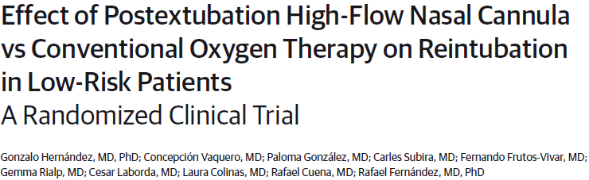
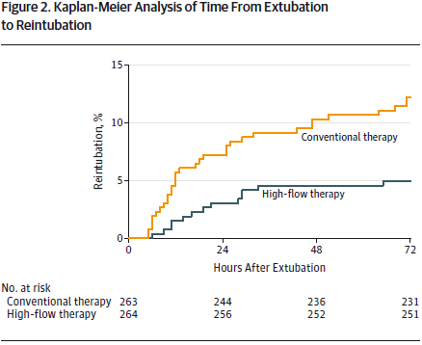
Multicenter randomized clinical trial
Sep. 2012 ~ Oct. 2014 in 7 ICUs in Spain
527 adult critical patients at low risk for reintubation
Low risk for reintubation :
- < 65yrs
- APACHE II < 12 on day of extubation
- BMI < 30
- Adequate secretions management
- Simple weaning
- 0 or 1 comorbidity
- Absence of HF, COPD (mod to severe), airway patency problems, prolonged mechanical ventilation
→ Among extubated patients at low risk for reintubation, the use of high-flow nasal cannula oxygen compared with conventional oxygen therapy reduced the risk of reintubation within 72 hours.

Slide 35
② Post-extubation in the ICU
- No benefit

Slide 36
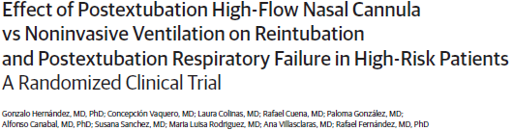
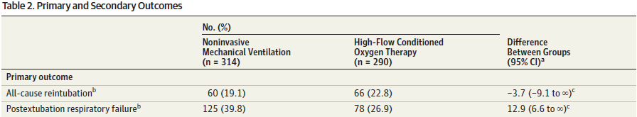
Multicenter randomized clinical trial
September 2012-October 2014 in 3 ICUs in Spain
604 adult critical patients at high risk for reintubation
High risks for reintubation :
- > 65yrs
- APACHE II > 12 on day of extubation
- BMI < 30
- Inadequate secretions management
- difficult or prolonged weaning
- >1 comorbidity
HF
COPD (mod to severe), airway patency problems, prolonged mechanical ventilation
→ Among high-risk adults who have undergone extubation, high-flow conditioned oxygen therapy was not inferior to NIV for preventing reintubation and postextubation respiratory failure.

Slide 37
③ Post-extubation following surgery
- Benefit

Slide 38
③ Post-extubation following surgery
- No benefit

Slide 39
④ Pre- and peri-oxygenation during intubation
Endotracheal intubation in the ICU is one of the highest risk procedures, resulting in complications up to 40% or cases.
Pre-existing hypoxaemia and haemodynamic instability of ICU patients are the main reasons for insufficient pre-oxygenation and severe desaturations during laryngoscopy, throughout which pre-oxygenation is interrupted, even for a short period
NHF (60 L/min) VS non-rebreathing bag reservoir face mask (15 L/min) for pre- and peri-oxygenation during the intubation procedure : nonrandomised prospective study
→ HFNC significantly improved preoxygenation and reduced prevalence of severe hypoxemia compared with nonrebreathing bag reservoir facemask.
Miguel-Montanes R, Hajage D, Messika J, et al. Use of high-flow nasal cannula oxygen therapy to prevent
desaturation during tracheal intubation of intensive care patients with mild-to-moderate hypoxemia. Crit Care
Med 2015; 43: 574–583.)

Slide 40
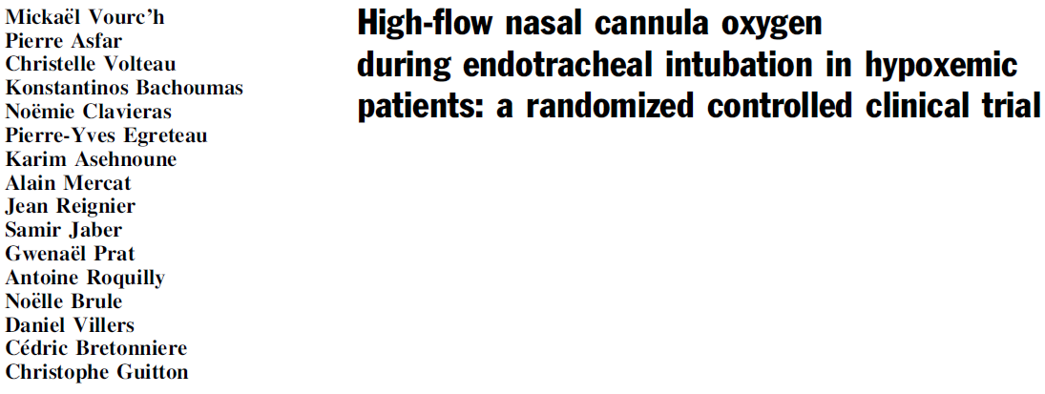
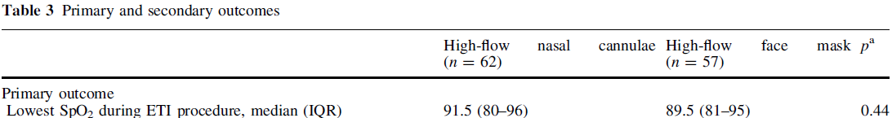
Multicenter, randomized, open-labelled, controlled PREOXYFLOW
trial in six French ICUs
119 patients (HFNC n = 62; HFFM n = 57)
Primary outcome : the lowest saturation throughout intubation procedure
→ Compared to HFFM, HFNC as a preoxygenation device did not reduce the lowest level of desaturation.

Slide 41
⑤ Acute hypoxaemic respiratory failure in immunocompromised patients
- Benefit

Slide 42
⑤ Acute hypoxaemic respiratory failure in immunocompromised patients
- No benefit

Slide 43
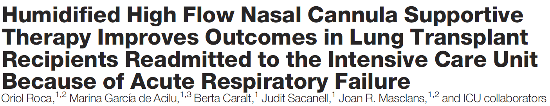
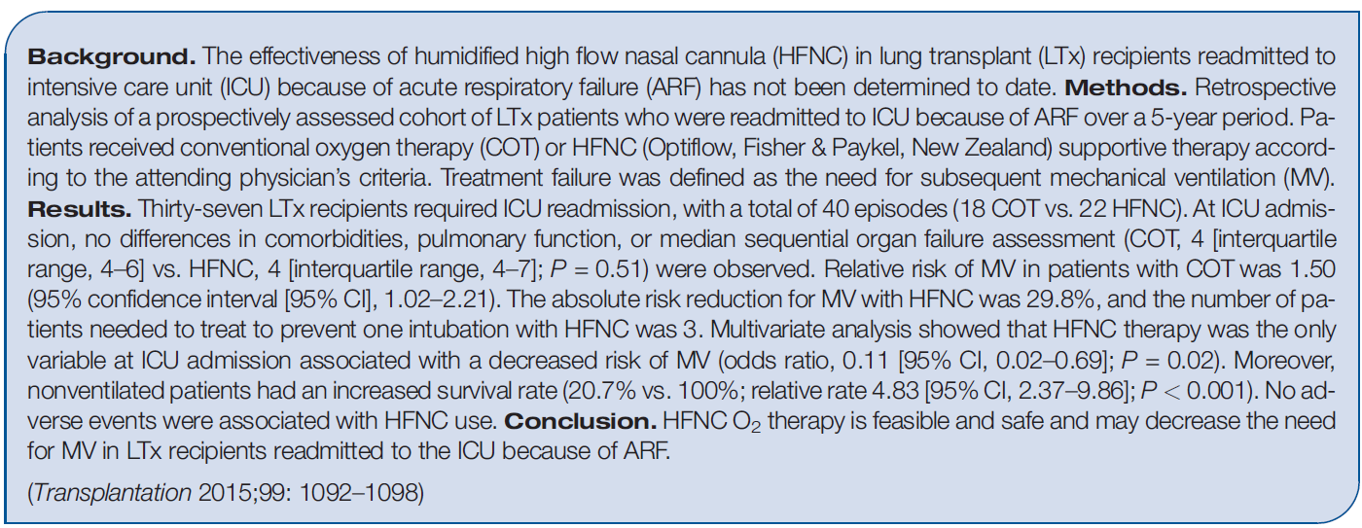
Retrospective analysis of a prospectively assessed cohort of LTx patients
37 LTx recipients required readmission to the ICU, with a total of 40 episodes

Slide 44
⑥ HFNC in other clinical conditions
COPD
IPF
Heart failure
during bronchoscopy

Slide 45
HFNC in COPD
Stable COPD pts with chronic respiratory failure could benefit from NHF application through a reduction of anatomical dead space, improvement inmucociliary clearance in conducting airways and passive elevation in end-expiratory pressure.

Slide 46
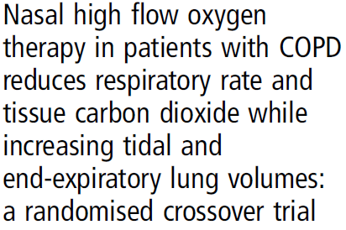
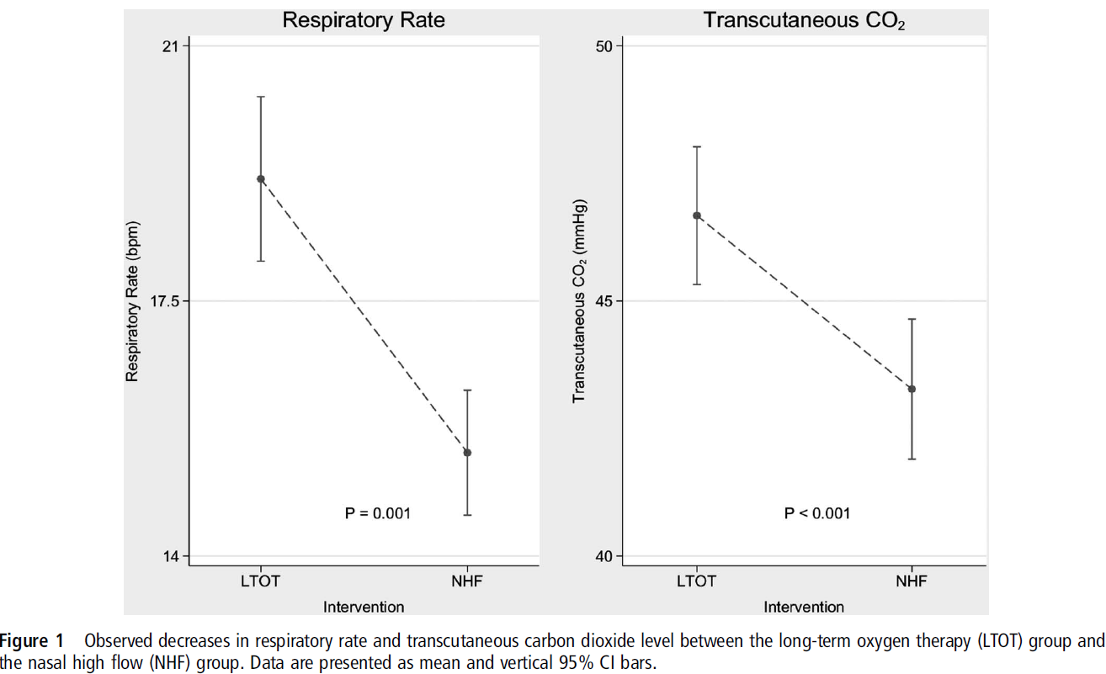
√ Randomised crossover study
√ Assessing short-term physiological responses to NHF therapy in 30 males chronically treated with LTOT
√ LTOT (2–4 L/min via NC) vs NHF at 30 L/min
NHF decreased TcCO2, I:E ratio and RR, with a concurrent increase in EELV and Vt compared with LTOT

Slide 47
Hypercapnic Respiratory Failure
Since NIV is used currently as a treatment option in patients with COPD and chronic hypercapnia, it seems that NHF could be used instead of NIV in the least tolerant and compliant patients, or in association with NIV, to reduce mask-related side-effects

Slide 48
HFNC in IPF
In IPF, in which prognosis is extremely poor after mechanical ventilation, HFNC appears to be an alternative modality for treating patients with hypoxemia who do not require immediate intubation, providing better oxygenation, dyspnea relief and comfort.
New perspectives for the use of high-flow nasal oxygen
Rev Port Pneumol. 2016;22(6):368

Slide 50
HFNC in HF
NHF application in patients with decompensated heart failure improved the intensity of dyspnoea, respiratory rate and oxygenation indices
→ more randomised trials are needed in order to compare NHF versus NIV in the intubation rates and mortality of patients with decompensated heart failure.
Carratalá Perales JM, Llorens P, Brouzet B, et al. High-flow therapy via nasal cannula in acute heart failure. Rev
Esp Cardiol 2011; 64: 723–725.

Slide 51
HFNC during Bronchoscopy
High flow rates (50–60 L/min) protect patients from hypoxaemia during bronchoscopy with remarkable tolerance and minimal variations in SpO2.
Mask를 적용하면서 검사하기 어려운 경우 : Bronchoscopy, Endoscopy..

Slide 52
Algorithm for clinical use
Ischaki E, Pantazopoulos I, Zakynthinos S. Nasal high flow therapy: a novel treatment rather than a more expensive oxygen device. Eur Respir Rev 2017; 26: 170028

Slide 53
Ischaki E, Pantazopoulos I, Zakynthinos S. Nasal high flow therapy: a novel treatment rather than a more expensive oxygen device. Eur Respir Rev 2017; 26: 170028

Slide 54
Titration of HFNC
The proposed initial flow rate differs between the studies
→ initial maximum flow rate values (60 L/min) to rapidly relieve dyspnoea and avoid the occurrence of muscle fatigue
Flow rate could be adjusted downwards by 5–10 L/min per 1–2 h if none of the negative prognostic factors are present.
If targets of arterial oxygen saturation measured by pulse oximetry (SpO2) and respiratory rate are not achieved, while the flow rate is <60 L/min, increase of flow rate by 5–10 L/min is preferred to raising FiO2
→ higher flow rates reduce entrainment of room air during inspiration and increase the airway pressure linearly, thus recruiting more alveolar units.
Ischaki E, Pantazopoulos I, Zakynthinos S. Nasal high flow therapy: a novel treatment rather than a more expensive oxygen device. Eur Respir Rev 2017; 26: 170028

Slide 55
Titration of HFNC
If SpO2 remains low, then an increase of FiO2 is required
Temperature can be set at 37°C or lower (31–34°C), based on the patient’s comfort
It is necessary to monitor closely the patient under NHF to avoid undesired respiratory and cardiac complications with a maximum time frame of 48 h.
→ If the patient does not improve within 48 h, NHF treatment should be considered to have failed and we should proceed to intubation and invasive mechanical ventilation as soon as possible.
Ischaki E, Pantazopoulos I, Zakynthinos S. Nasal high flow therapy: a novel treatment rather than a more expensive oxygen device. Eur Respir Rev 2017; 26: 170028

Slide 56
Titration of HFNC
If the patient’s clinical and gasometric parameters gradually improve, then FiO2 should first be lowered to 40–50%, proceeding with a stepped decrease in flow rate of 5–10 L/min.
When the patient is stable for 1–2 h with FiO2 40% and flow rate <15 L/min, NHF should be stopped and a Venturi mask or nasal oxygen could be started.
Ischaki E, Pantazopoulos I, Zakynthinos S. Nasal high flow therapy: a novel treatment rather than a more expensive oxygen device. Eur Respir Rev 2017; 26: 170028

Slide 57

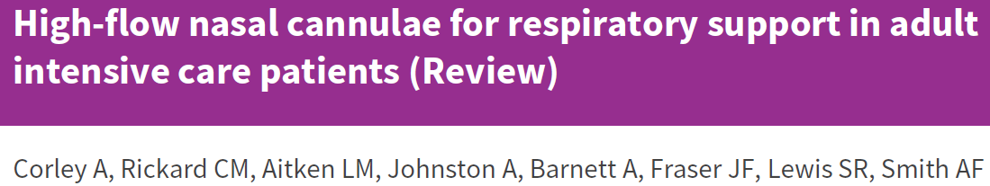
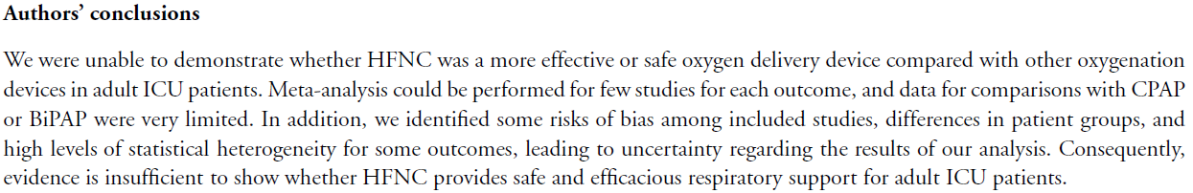

Slide 58
Future research
Specific randomised clinical trials are needed to make recommendations for each separate cause.
Different NHF initial settings, titration and weaning approaches could potentially be required in each separate disease, given the different pathophysiological underlying mechanisms.
In case of hypercapnic ARF, controlled trials are needed to clarify the role of NHF and whether it could be used instead of and/or during breaks in NIV.
The haemodynamic effects of NHF should be studied in detail, such as NHF effects on cardiac output, heart pressures and pulmonary vascular resistance.

Slide 59
HFNC in Severance
기간 : 2013.10 ~ 2018.3
HFNC 적용된 환자수 : 2237명

Slide 60
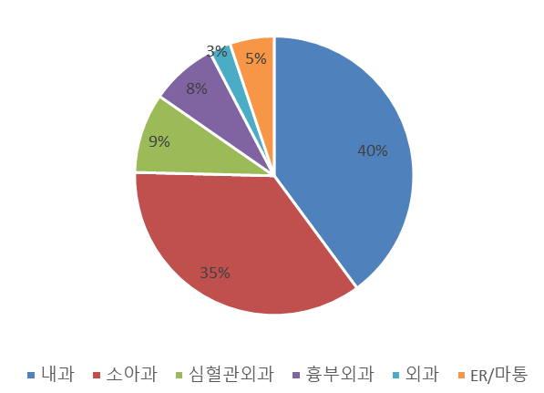
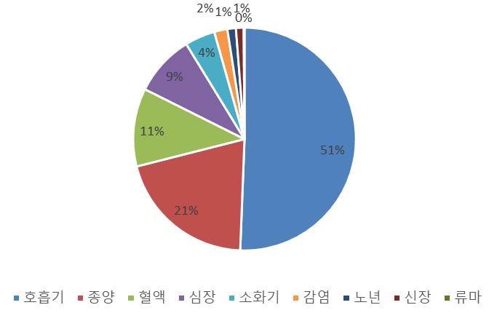

Slide 61
감사합니다

