Slide 1




Heterogeneity of EGFR mutations in advanced NSCLC
호흡기내과 강사
박선철

Slide 2
Introduction
Personalized medicine is a promising approach that can improve treatment outcomes in patients with advanced non-small cell lung cancer (NSCLC)
The discovery of driver oncogenes

Slide 3
Introduction
Activating mutations in the epidermal growth factor receptor (EGFR)
EGFR tyrosine kinase inhibitors (TKIs)

Slide 4
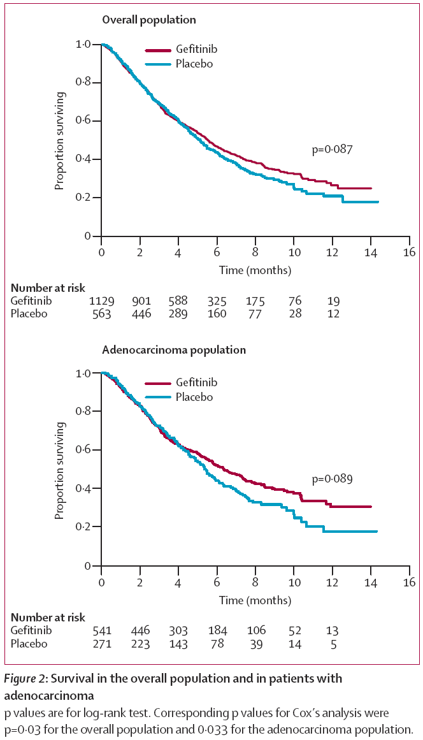
Thatcher N , Lancet 2005

Slide 5
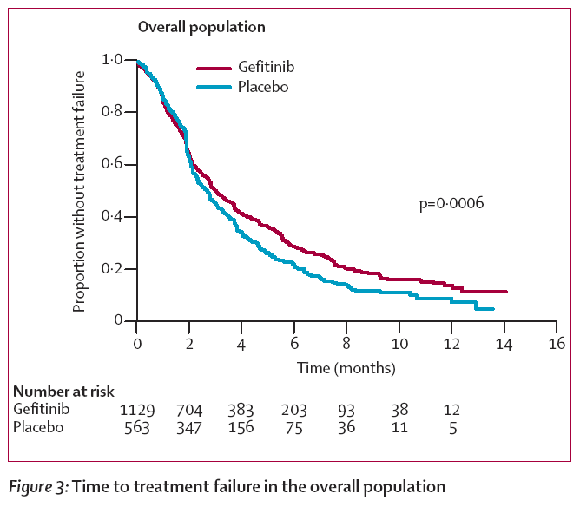
Thatcher N , Lancet 2005

Slide 6
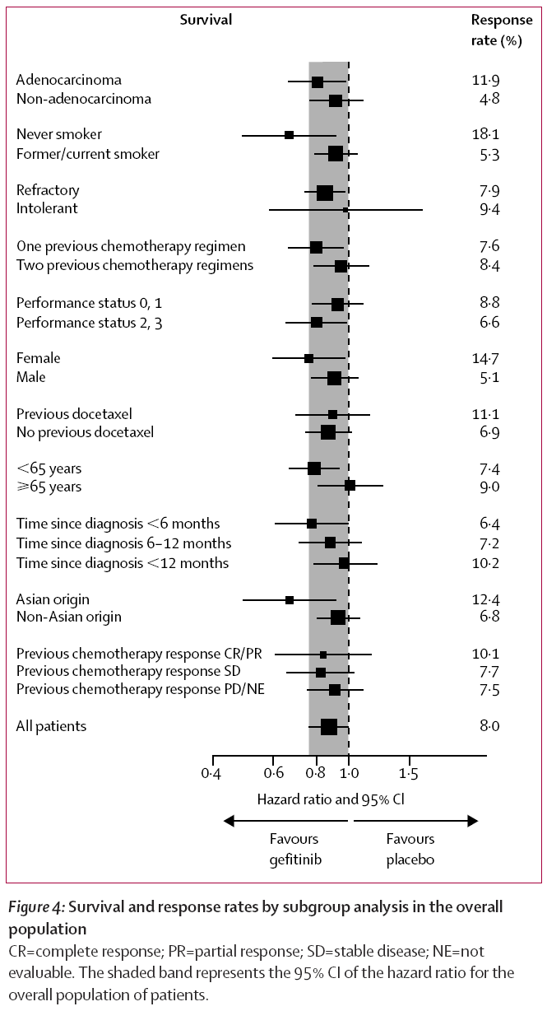
Thatcher N , Lancet 2005

Slide 7
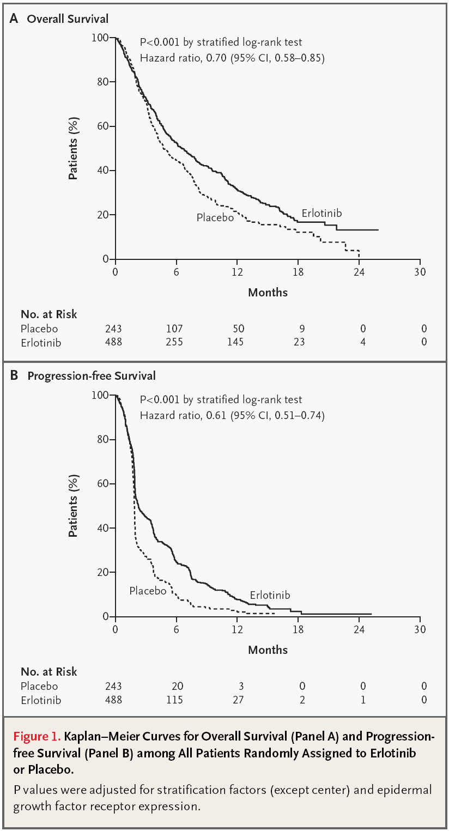
Shepherd FA, NEJM 2005

Slide 8
Introduction
EGFR-activating mutation (never-smoker, female, adenocarcinoma, Asian)
Better response to EGFR-TKIs
However,
The efficacy of EGFR-TKIs is not consistent for every patients

Slide 9
EGFR heterogeneity
Advanced NSCLC with EGFR mutations
Mixed response to EGFR-TKIs
Tumor heterogeneity between the primary lung tumors and their metastases

Slide 10
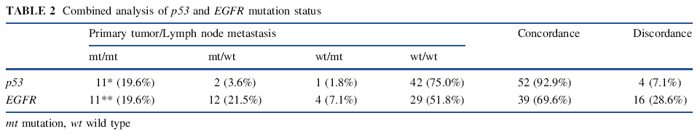
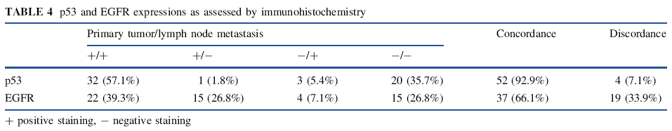
Chang, Ann Surg Oncol 2011

Slide 11
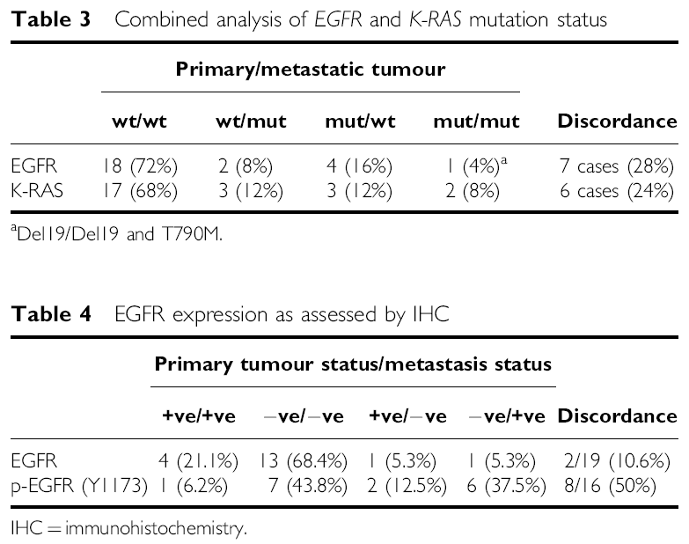
Kalikaki A, Br J Cancer 2008

Slide 12
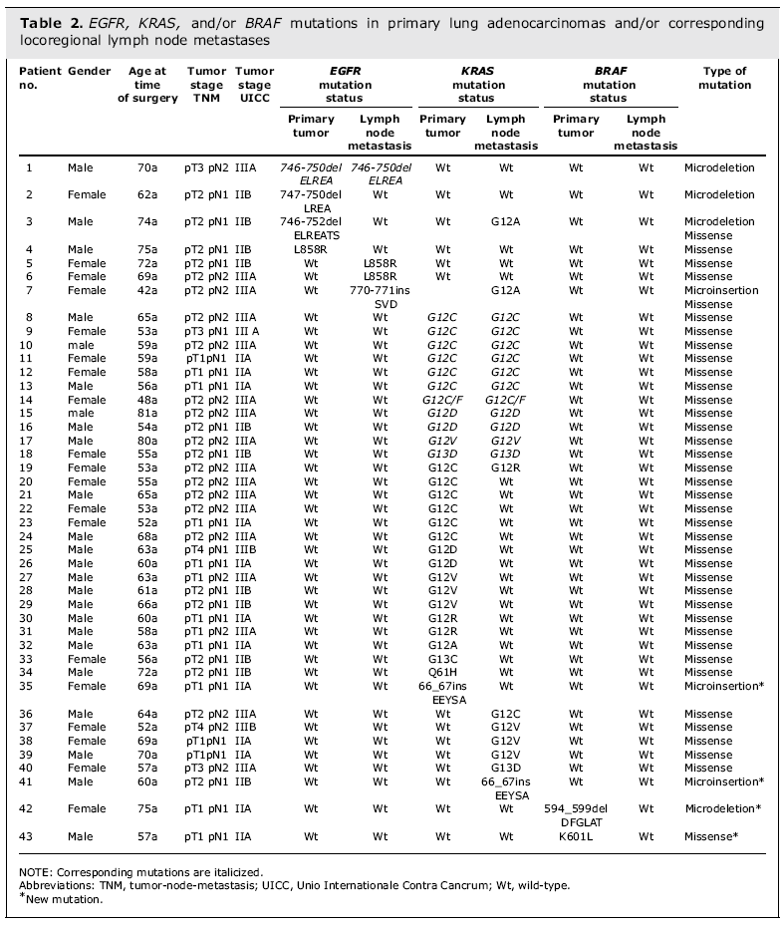
Schmid K, Clin Cancer Res 2009

Slide 13
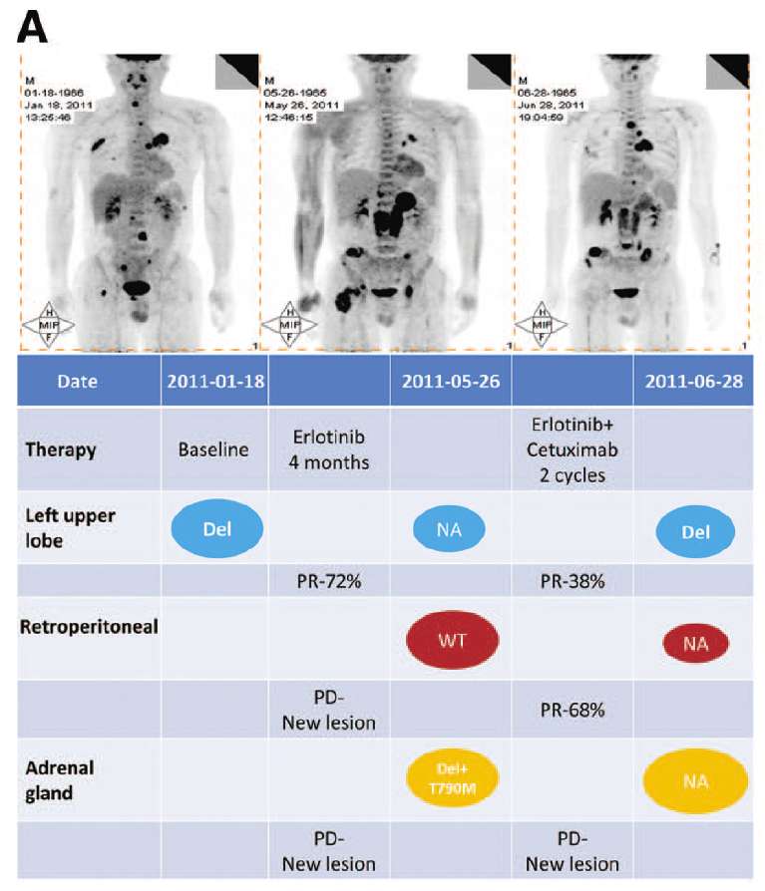
Chen et al, Oncologist 2012

Slide 14
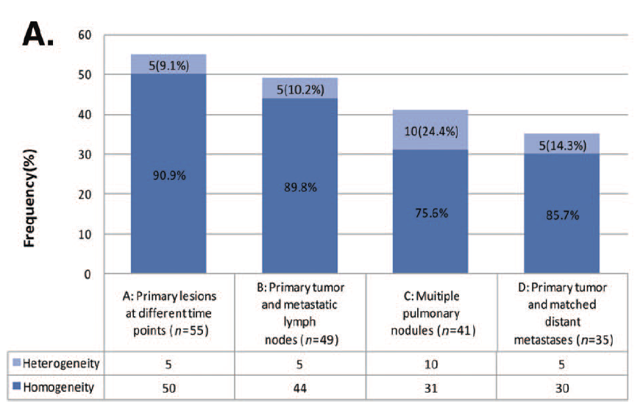
Chen et al, Oncologist 2012

Slide 15
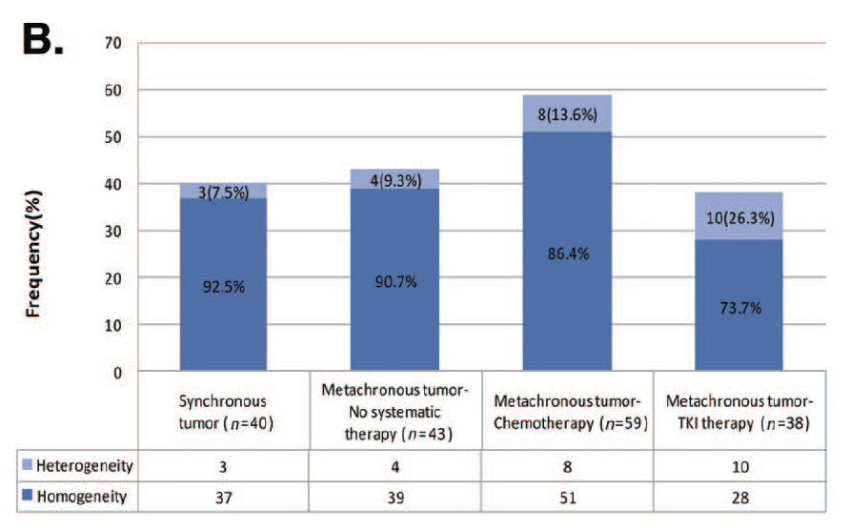
Chen et al, Oncologist 2012

Slide 16
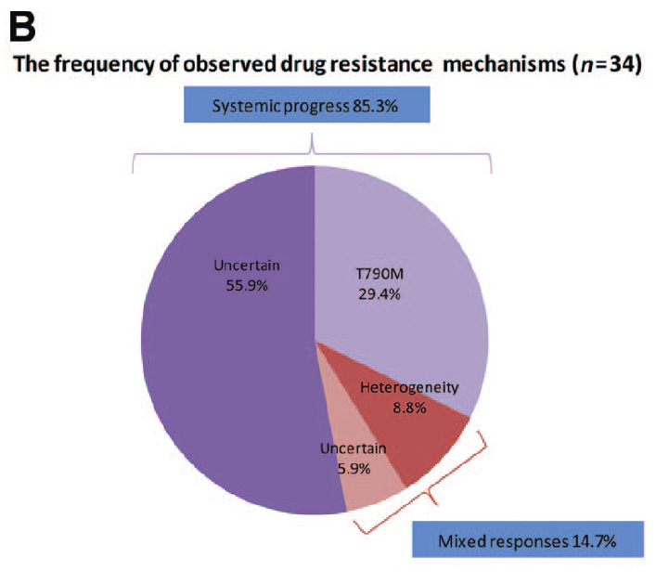
Chen et al, Oncologist 2012

Slide 17
Intratumor heterogeneity
Intratumor heterogeneity of EGFR mutations
Genetic heterogeneity within a single tumor tissue
Contribute to resistance to anticancer drugs

Slide 18
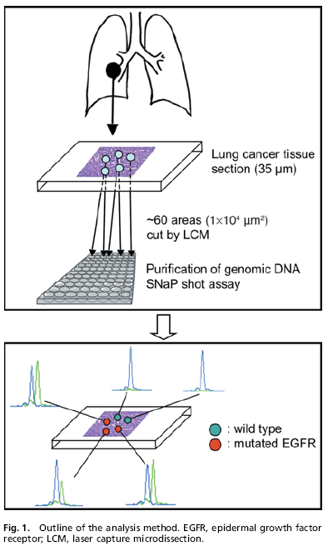
Kazuya T, Cancer Sci 2008

Slide 19
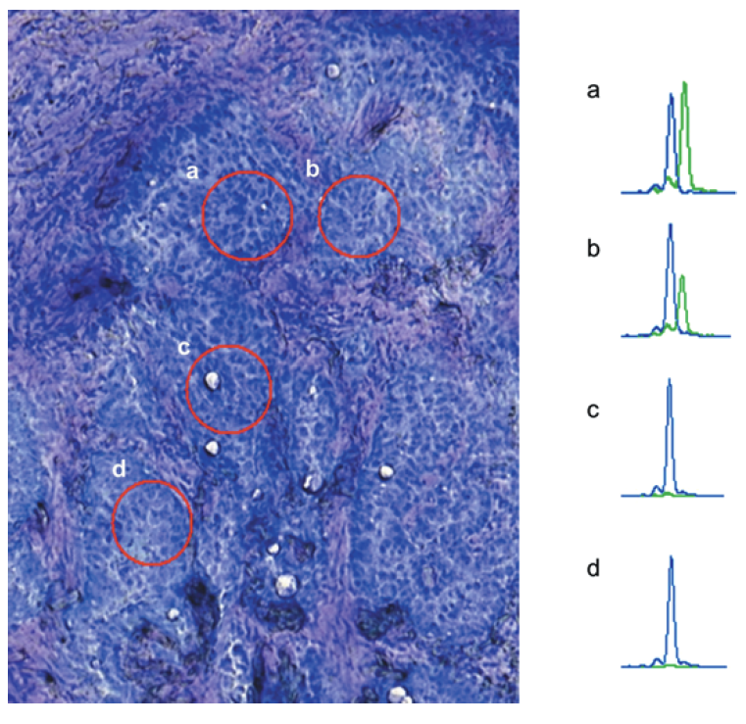
Kazuya T, Cancer Sci 2008

Slide 20
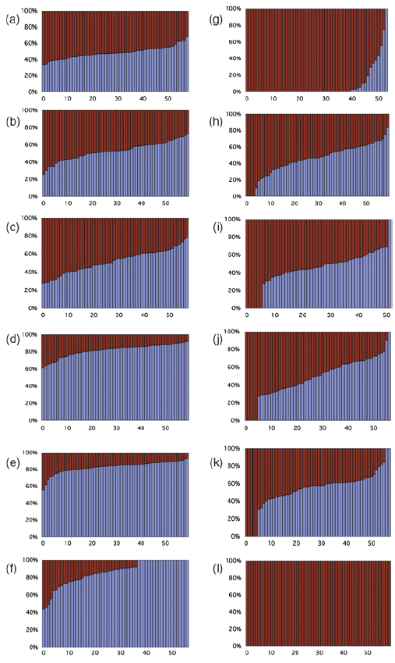
Mutated genes
Non-mutated genes
Kazuya T, Cancer Sci 2008

Slide 21
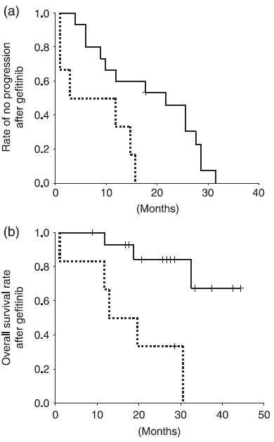
Kazuya T, Cancer Sci 2008

Slide 22
Abundance of EGFR mutations
Quantification of EGFR mutations
Predict the extent of benefit from EGFR-TKIs
High abundance of EGFR mutations
Benefit more from EGFR-TKIs

Slide 23
Abundance of EGFR mutations
Direct DNA sequencing : (detecting >10% frequency)
Scorpion amplification refractory mutation system (ARMS) : (detecting >1% frequency)
Seq (+) ARMS (+) | Group H
Seq (-) ARMS (+) | Group L
Seq (-) ARMS (-) | Group W

Slide 24
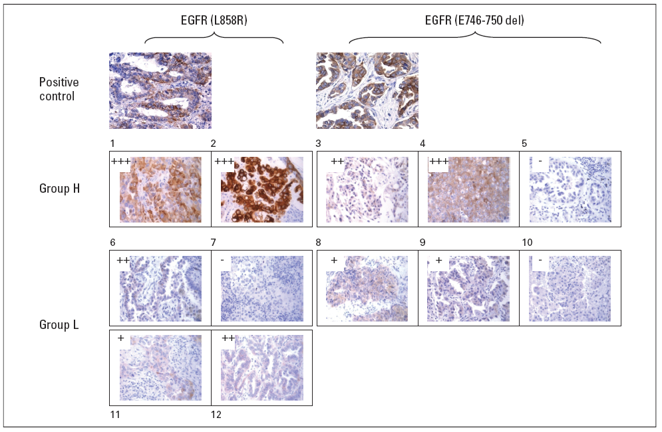
Zhou et al, JCO 2011

Slide 25
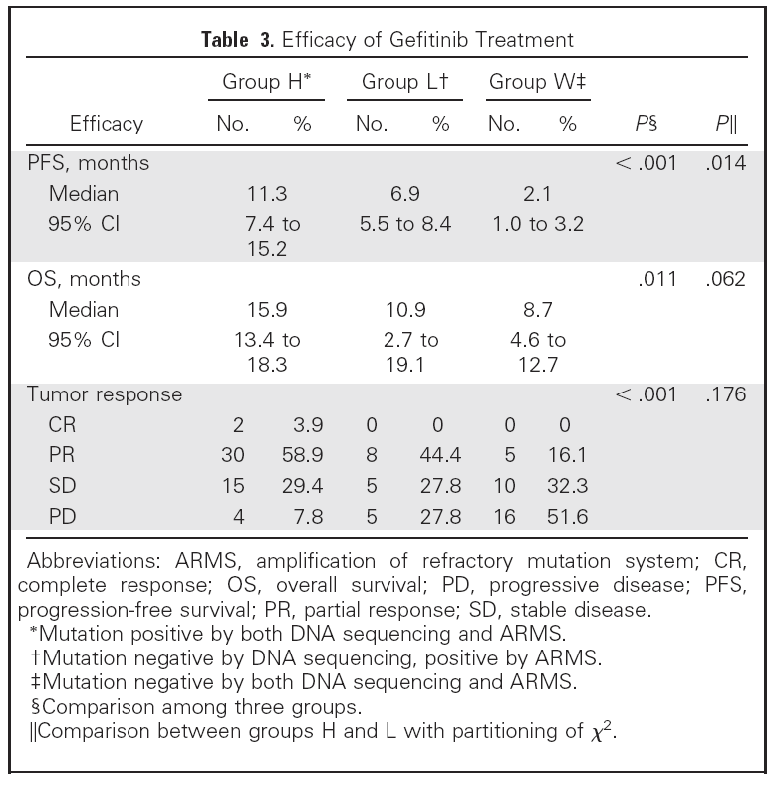
Zhou et al, JCO 2011

Slide 26
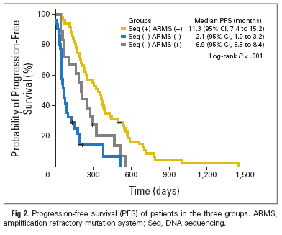
H
L
W
Zhou et al, JCO 2011

Slide 27
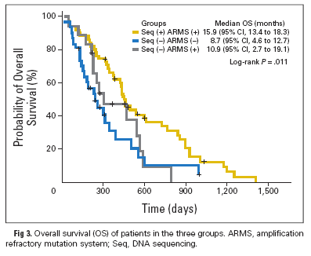
H
L
W
Zhou et al, JCO 2011

Slide 28
T790M mutation
T790M mutation : EGFR-TKIs resistance
Acquired TKI resistance : > 50% T790M
Unclear whether and how T790M is induced by EGFR-TKI therapy

Slide 29
Pretreatment T790M mutation
Pretreatment EGFR T790M mutation
Conventional direct sequencing methods → Sensitivity ?
Highly sensitivity matrix-assisted laser desorption ionization-time of flight mass spectrometry (MALDI-TOF MS)

Slide 30
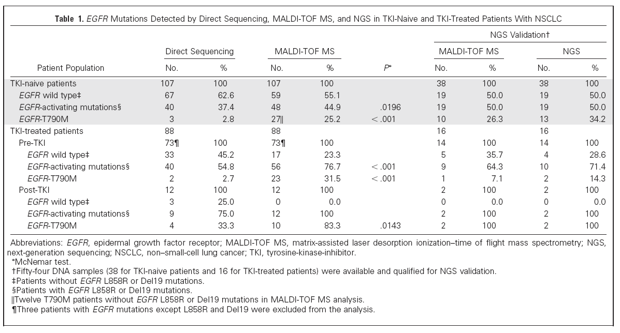
Su et al, JCO 2012

Slide 31
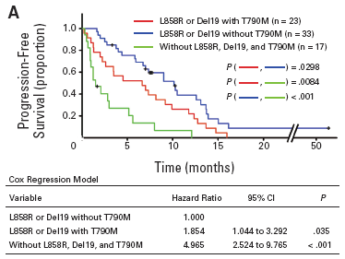
Su et al, JCO 2012

Slide 32
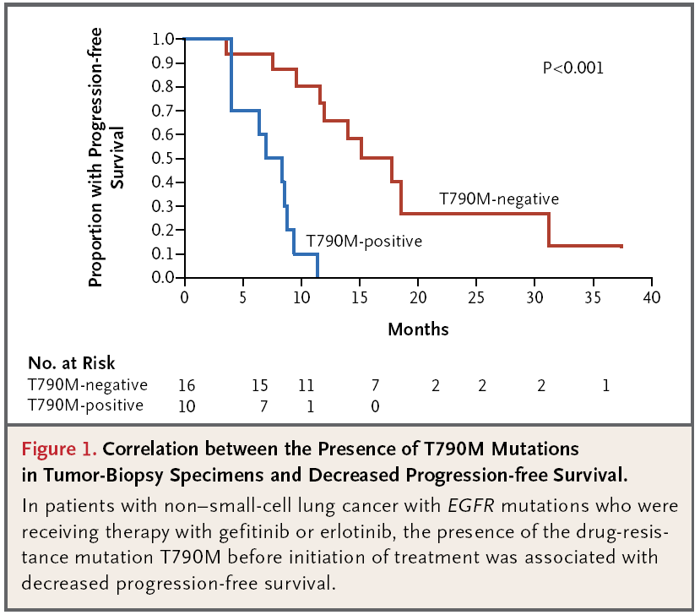
Maheswaran S, NEJM 2008

Slide 33
Optimization of TKIs dosing
Targeted therapeutic options for T790M-harboring NSCLCs are limited
Second generation EGFR-TKIs : HKI-272 (neratinib), BIBW-2992 (afatinib)
Optimization of TKIs dosing

Slide 34
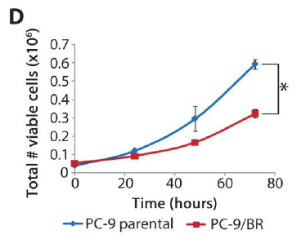
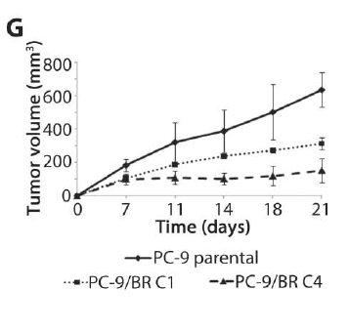
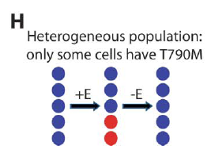
TKI sensitive
TKI resistant
Drug sensitive and drug resistant cells
→ Differential growth kinetics
Chmielecki et al, Sci Transl Med 2011

Slide 35
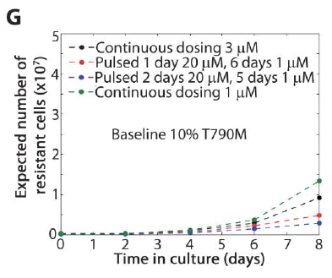
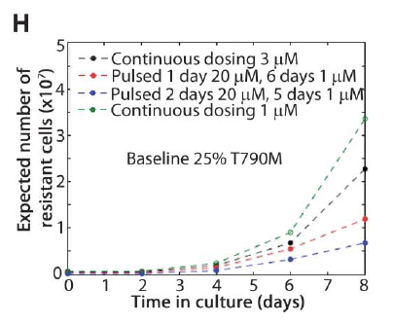
Chmielecki et al, Sci Transl Med 2011

Slide 36
Summary
EGFR mutations in patients with advanced NSCLC
  Heterogeneity between primary tumors and metastases
  Intratumor heterogeneity
  Abundance of mutations
  Pretreatment T790M mutation
  Optimization of treatment
  ...

Slide 37
Summary
Heterogeneity of EGFR mutations
→ Consider combined modality strategies
→ Personalized treatment
→ Can improve outcomes in patients with advanced NSCLC

