Slide 1

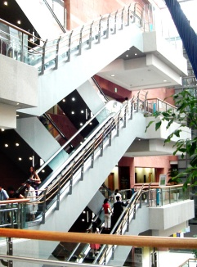
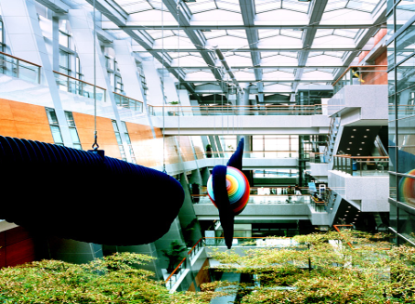

Avian influenza
Kim Young
Division of Pulmonology
Department of Internal Medicine
Yonsei University College of Medicine

Slide 2
조류독감
1) 닭이나 오리와 같은 가금류나 야생 조류에서 발생하는 일종의 동물 전염병.
병원성에 따라 고병원성, 약병원성, 비병원성으로 구분하며, 그 중에서 H5N1은
고병원성으로서, 가축전염병 예방법상 제1종 가축전염병으로 분류.
2) 고병원성 조류인플루엔자(Highly pathogenic avian influenza : HPAI) 의 정의
① 4-8주령의 SPF닭(SPF: Specific Pathogen Free특정질병부재) 에 분리주를 정맥으로 접종하여 10일 이내에 8마리중 6마리 이상 (75%)의 폐사
② 1마리 이상(12.5%) 5마리 이하(52.5%)의 닭을 죽이고, 혈청형이 H5나 H7이 아닐 경우에는 세포접종시 세포변성(CPE)을 보임
③ 혈청형이 H5혹은H7일 경우에는 세포접종시 CPE을 보이고 H항원의 분절부위(cleavage site)의 아미노산 배열이 HPAI의 특성을 가지고 있을 경우
일반적으로 조류독감은 종간벽(species-specific)이 있어서 사람에게 감염되지
않는다고 알려져 있으나 사람에게 감염된 사례가 계속 보고되고 있으며 감염경
로는 주로 바이러스에 감염된 가금류와 그 배설물로 오염된 물체와의 직접적인
접촉이 원인인 것으로 판단된다.

Slide 3
조류독감
3) AI 바이러스의 생존력과 잠복기
-4℃ 온도에서 분변내에서는 최소 35일간, 계사오염 먼지에서는 2주간 생존.
-오염된 물에서는 22℃에서는 4일간, 0℃에서는 30일간 생존.
-오염된 가금육에서는 70 ℃ 30분, 75 ℃ 5분간 열처리시 사멸함.
-잠복기는 3-14일이나 안전기간을 포함하면 21일.
4) 가금류에서의 주요 증상
호흡기증상, 산란율저하와 폐사
-산란율 감소는 1-2주 사이에 40%∼50%정도까지 감소하거나 산란정지.
-산란율 감소때는 무각 또는 연각란이 관찰되며 이외에 활력 저하, 사료섭취 감소와 쇠약, 육수나 벼슬에 청색증, 머리와 안면부에 부종, 그리고 깃털을 세우고 한곳에 모이는 행동이 관찰됨.
-폐사율은 매우 다양하여, 질병이 있는지 모를 정도로 폐사가 없는 경우부터
높은 폐사율을 보이는 계군까지 있으며, 산란전에 감염된 닭에서는 임상증상이 관찰되지 않는 예가 많음.
-백색산란계나 육용종계는 갈색산란계보다 평균폐사율이 더 높다.

Slide 4
조류독감
5) 전파 경로 : 농장간 전파는 주로 오염된 먼지, 물, 분변 또는 사람의 의복이나 신발, 차량, 기구 및 장비, 달걀등에 묻어 일어날 수 있으며 달걀속에 감염된 난계대 전염은 이루어지지 않는다.
닭고기, 오리고기를 먹을 경우 : 조류독감 발생농장 뿐 아니라 발생진원지로 파악되는 3km 이내의 닭이나 오리, 달걀은 전부 폐기 조치되고, 3-10km사이의 조류 및 그 생산물에 대해서도 이동통제를 실시하기 때문에 일반국민이 오염원과 접촉할 가능성은 거의 없고, 충분한 가열조리를 할 경우 음식에 의해서는 감염되지 않는다(조류 독감 바이러스는 75 ℃ 이상에서 5분 이상 가열할 경우 사멸됨).
6) 질병관리본부의 조치내용
-차단방역 ( 외부인, 외부차량의 출입을 통제, 장비와 기구 등을 세척 소독) 과 발생초기에 적극적인 살처분.
-인체감염 예방을 위한 목적으로 발생농장 종사자, 살처분관계자를 대상으로 항바이러스제제 투여, 개인보호구 제공, 예방 수칙 교육 홍보 실시.
-환자발생시의 조기 발견을 위하여 발생지역을 중심으로 환자감시체계 운영 및 인체 감염 여부를 진단하기 위한 실험실체계 운영.

Slide 5
조류독감
6) 질병관리본부의 조치내용
환자 감시
운영 시기 : 조류독감 발생지역 시, 군, 구
감시 시기 : 조류독감 발생인지일로부터 종료시까지
감시 대상 : 조류독감 위험요인에 폭로된 인플루엔자 의사환자, 급성호흡부전증 환자, 원인불명의 지역사회 획득 폐렴 환자, 호흡기감염으로 사망한 환자.
인플루엔자 의사환자 : 38 ℃ 이상의 발열이 있으면서 기침, 인후통, 전신근육통, 또는 호흡곤란과 같은 호흡기증상이 있는 환자.
조류독감 위험요인 : 발병전 7일 이내에 오리, 닭 사육농장(감염여부에 상관없이)에 폭로된 경우, 오리, 닭 사육농장 종사자, 사료 배급자, 수의사, 도계 관계자, 생닭이나 생오리 판매자, 야생조류 사냥 또는 접촉자 등.
발병전 7일 이내에 가금류에서 조류독감 유행이 발생한 국가를 여행한 경우.

Slide 6
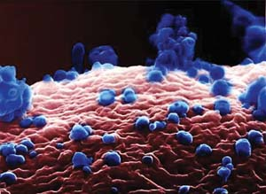
Human infection with Avian influenza

Slide 7
Introduction
There have been five influenza pandemics during the past 100 years, and each has been caused by the novel virus. In the 1957 and 1968 pandemics, the new viruses contained components of previous human, as well as avian, influenza viruses. The emergence of a novel H1N1 human-swine-avian reassortant virus in 2009 in North America started a new pandemic.

Slide 8
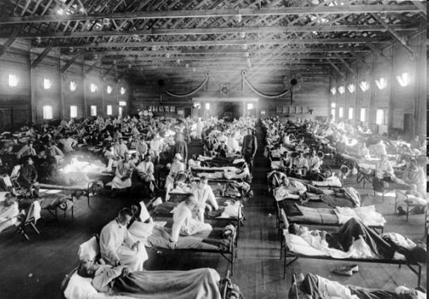
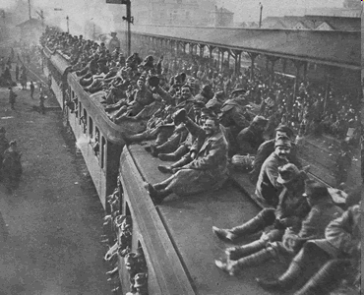
Introduction
1918 “Spanish Influenza” Pandemic
Infected 1/3 of the world’s population. (estimated 500 million people)
Caused approximately 50 million deaths.

Slide 9
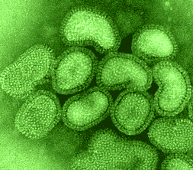
Influenza virus

Slide 10
Classification
Influenza virus : RNA virus
Family:
ORTHOMYXOVIRIDAE
Genus:
Influenza virus
Influenza C virus
Types:
Type A
Type B
Type C
Notes:
IPF 의 진단 기준에는 이렇게 major criteria 로 ILD 를 일으킬수 있는 다른 원인들
CTD 와 같은 을 r/o 한 뒤에야 IPF 를 진단 할수 있다고 정의내리고 있습니다.

Slide 11
The virus nomenclature
For example: A / Beijing / 32 / 92 (H3N2)
A virus type, here A
Beijing place where the strain was isolated
32 strain number
92 year of first isolation
H3N2 subtypes H3 and N2 virus type

Slide 12
Influenza subgroups
Influenza A
  highly infective
  infects many species
  causes widespread epidemics
Influenza B
  found only in humans
  capable of producing severe disease
  causes regional epidemics
Influenza C
  causes mild disease
  humans are natural hosts, but isolates also found in pigs
  does not cause epidemics

Slide 13

Structure: segmented and enveloped viruses
Influenza virus : Single-strand RNA virus : Basic types of influenza .
RNA core : 8 gene segments surrounded by a coat of 10(A) or 11(B) proteins.
Nucleocapsid
Nucleoprotein (NP)-RNA (7 or 8 segments)
Internal
antigens
Matrix protein (M)
Lipid bilayer
Haemaglutinin (HA)
Surface
antigens
Neuraminidase (NA)
80 to 120 nm
Notes:
IPF 의 진단 기준에는 이렇게 major criteria 로 ILD 를 일으킬수 있는 다른 원인들
CTD 와 같은 을 r/o 한 뒤에야 IPF 를 진단 할수 있다고 정의내리고 있습니다.

Slide 14
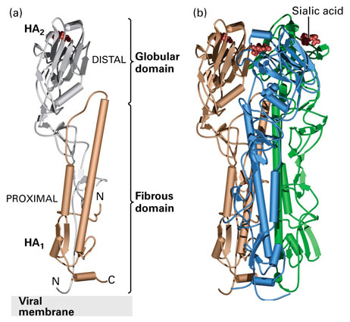
Surface glycoproteins
Hemagglutinin
  H or HA.
  responsible for pathogenicity of the virus.
  allows virus to adhere to infected cells.
  main determinant of immunity.
Neuraminidase
  N or NA.
  allows release of newly formed viruses from the host cells.
  main determinant of disease severity.
HA1
HA2

Slide 15
Influenza A virus
Influenza A viruses- 16 HA types
9 NA types
Species affected - humans, pigs, horses, birds,
marine mammals
Humans- 3 HA types (H1, H2, H3)
3 NA types (N1, N2, N8)
Birds - all HA types
all NA types

Slide 16
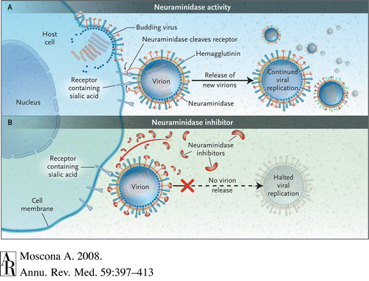
Notes:
CTD 에서 lung involvement 는 흔하며, morbidity와 survival 단축에 영향을 미칩니다. I
CTD-ILD 는 aggressive 하게 progression 하는 IPF 와 달리 limited, stable 해서 치료를 요하지 않는 비율이
높기는 하나, 어떤 CTD_ILD 는 severe 하게 progression 하기 때문에 즉각적인 치료를 필요로 할수 있습니다.
그렇기 때문에 CTD-ILD 와 IPF 를 감별하는 것이 중요한데,
CTD-ILD 라 하더라도 lung involvement 가 먼저 오는 경우에는 ILD 인지 CTD_ILD 인지 구별하기가 어렵다.

Slide 17
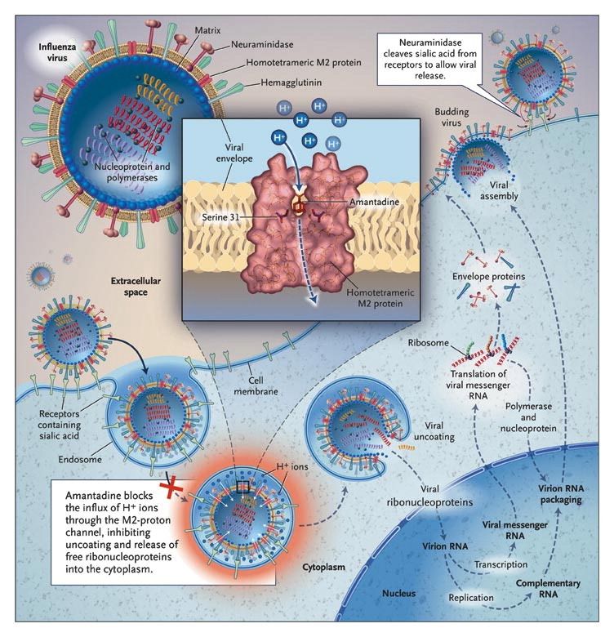
Notes:
Mechanism of Action of and Development of Resistance to M2 Inhibitors. In the absence of amantadine, the proton channel mediates an influx of H⁺ ions into the infecting virion early in the viral replication cycle, which facilitates the dissociation of the ribonucleoproteins from the virion interior and allows them to be released into the cytoplasm and transported into the cell nucleus. In highly pathogenic avian viruses (H5 and H7), the M2-proton channel protects the hemagglutinin from acid-induced inactivation in the trans-Golgi network during transport to the cell surface. In the presence of amantadine, the channel is blocked and replication is inhibited. The serine at position 31 lies partially in the protein–protein interface and partially in the channel (see inset). Replacement of serine by a larger asparagine leads to the loss of amantadine binding and the restoration of channel function. Depending on the particular amino acid, other mutations at position 26, 27, 30, or 34 may inhibit amantadine binding or allow binding without the loss of ion-channel function. Inset courtesy of Rupert Russell, Phillip Spearpoint, and Alan Hay, National Institute for Medical Research, London.

Slide 18
Antigenic variation
Antigenic drift : 복제과정 중 spontaneous
mutation에 의해 유발되며, 기존의 (preexisting) 면역
반응에 의해 억제되지 않음. (influenza epidemic).
Antigenic shift : HA와 NA 단백질의 아미노산 배열이 변하는 것. 사람과 동물 influenza virus간의 재조합 (recombination)이나 재분류 (reassortment)에 의해 생성되며 이러한 변화는 HA와 NA serotype이 완전히 새로운 형으로 전환되기 때문에 보다 큰 규모의 독감을 유발할 수 있다 (influenza pandemic).
Notes:
독감바이러스의 항원성의 변화 즉 새로운 형(type)의 발생은 기존의 HA와 NA의 변화로 나타나며, 새로운 독감 전염병 발생
의 원인이 된다.

Slide 19
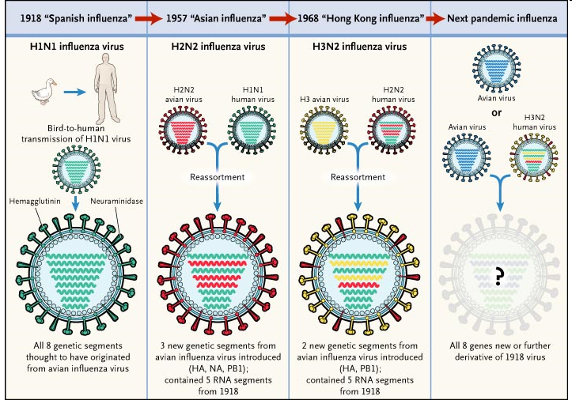
Mechanism Pandemic Influenza Originates
There have been five influenza pandemics during the past 100 years,
Notes:
IPF 의 진단 기준에는 이렇게 major criteria 로 ILD 를 일으킬수 있는 다른 원인들
CTD 와 같은 을 r/o 한 뒤에야 IPF 를 진단 할수 있다고 정의내리고 있습니다.

Slide 20
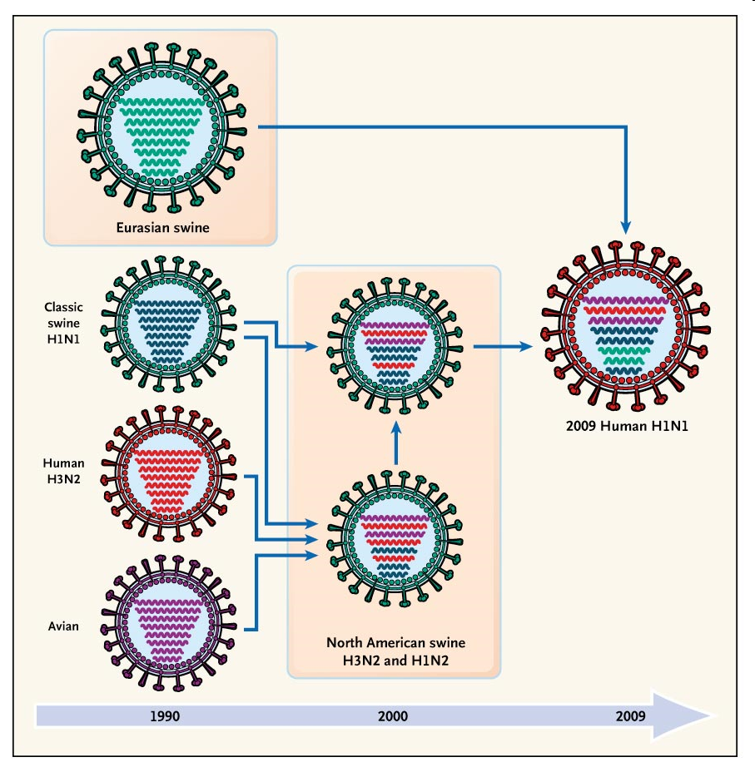
History of Reassortment Events in the Evolution of the 2009 Influenza A (H1N1) Virus
NEJM published at www.nejm.org on May 27, 2009 (10.1056/NEJMp0904572
Notes:
CTD 에서 lung involvement 는 흔하며, morbidity와 survival 단축에 영향을 미칩니다. I
CTD-ILD 는 aggressive 하게 progression 하는 IPF 와 달리 limited, stable 해서 치료를 요하지 않는 비율이
높기는 하나, 어떤 CTD_ILD 는 severe 하게 progression 하기 때문에 즉각적인 치료를 필요로 할수 있습니다.
그렇기 때문에 CTD-ILD 와 IPF 를 감별하는 것이 중요한데,
CTD-ILD 라 하더라도 lung involvement 가 먼저 오는 경우에는 ILD 인지 CTD_ILD 인지 구별하기가 어렵다.

Slide 21
Avian influenza H5N1
Highly pathogenic avian H5N1 influenza is endemic among bird in Eurasia.
Sporadic transmission to humans raises concern that the H5N1 may mutate or combine with genetic material from coinfecting human influenza viruses to generate a novel strain sustained human-to-human transmission with pandemic potential ,estimates of potential global mortality are as high as 62 million deaths.

Slide 22
Epidemiology
Migratory birds are capable of spreading avian influenza .
WHO confirmed Human H5N1 infections in Thailand, Vietnam, Indonesia, China, Turkey, Egypt, Nigeria, Iraq, Pakistan.
Since 2003, more than 590 human cases have been reported to the WHO with a case-fatality rate (CFR) of approximately 60%.

Slide 23
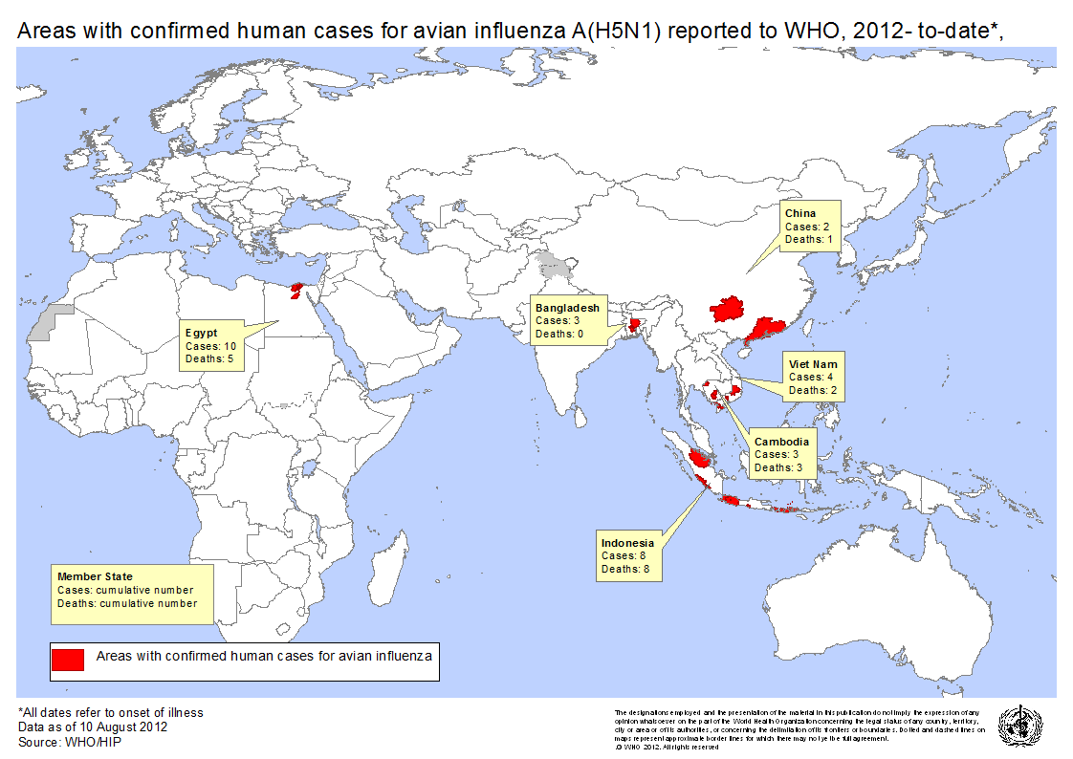

Slide 24
Transmission
Exposure to sick or dead poultry in the week before illness is the most common risk factor for human H5N1 infection .
Human-to-human — Limited person-to-person transmission of H5N1 virus infection has been suggested by cases of avian influenza within families.

Slide 25
Transmission
Infectious virus and viral RNA have been isolated in blood, CSF, and feces.
Whether feces or blood could transmit
avian influenza is unknown.
Mother-to-fetus transmission. autopsy studies demonstrated H5N1 virus genomic sequences and antigens in the placenta and viral sequences in the fetus.

Slide 26
Pathogenesis
Fatal H5N1 infection had unusually high serum concentrations of various cytokines and chemokines.(Cyclooxygenase-2,TNF-alpha)
The severity of human H5N1 infections may be related to the induction of excessive host proinflammatory responses that exacerbate tissue injury and contribute to pathogenesis .
Notes:
, were also elevated in epithelial cells exposed to secretory factors from H5N1-infected macrophages.

Slide 27
Pathogenesis
Tissue tropism - Human influenza viruses preferentially bind to host cells via HA by attaching to α 2-6 sialyl glycan receptors.
Epithelial cells of the human upper respiratory tract has α 2-6 galactose receptors.

Slide 28
Pathogenesis
Avian influenza viruses prefer sialic acid molecules containing α 2-3 galactose receptors of the respiratory tracts of birds.
Human respiratory tract particularly in alveoli and distal airways & human GI tract have α 2-3 galactose receptors .

Slide 29
Pathogenesis
Human nasopharyngeal, adenoid, and tonsillar tissues and tracheal epithelial cells can be infected with H5N1 viruses despite absence of α 2-3 galactose receptors.
suggesting that other binding sites can mediate viral entry .

Slide 30
Clinical manifestations
Incubation period — Following exposure to infected poultry, the incubation period for human H5N1 infection is 7days or less, and is often 2-5 days .
In clusters of human-to-human transmission, the incubation period is typically 3-5 days, but was 8-9 days in one cluster.

Slide 31
Clinical manifestations
Fever , cough , headache, myalgia,
sore throat, rhinorrhea, conjunctivitis.
Dyspnea , bilateral pulmonary infiltrates , pulmonary hemorrhage, pneumothorax.
Multiorgan failure with renal dysfunction and cardiac compromise.
Lymphopenia , AST, ALT elevation.
Diarrhea, mucosal bleedig.

Slide 32
Radiographic findings
Diffuse, multifocal, patchy infiltrates, interstitial infiltrates,and segmental or lobular consolidation .
Pleural effusions are usually not seen .
Progression to respiratory failure is associated with diffuse bilateral ground-glass infiltrates .

Slide 33
Pathology
Pathologic studies in H5N1 avian influenza are primarily obtained at autopsy.
Severe pulmonary injury with diffuse alveolar damage, alveolar hemorrhage, hyaline-membrane formation, lymphocytic infiltration into the interstitium, and the presence of reactive fibroblasts.
BM has demonstrated reactive histiocytosis with hemophagocytosis.

Slide 34
Diagnosis
A patient who meets the following criteria should be tested for H5N1 influenza virus :
Illness that requires hospitalization or is fatal.
BT ≥38ºC in the past 24 hrs
Radiographically confirmed pneumonia, ARDS, or other severe respiratory illness.
At least one of the following potential exposures within 7 days of symptoms onset.

Slide 35
Diagnosis
Hx. of travel to a country where H5N1 avian influenza has been documented in poultry, wild birds, and/or humans and had at least one of the following potential exposures during travel (a list of H5N1-affected countries, see the WHO web site.)
Direct contact with well-appearing, sick, or dead poultry or wild birds.

Slide 36
Diagnosis
Direct contact with surfaces with poultry feces or poultry parts containing H5N1 avian influenza virus.
Consumption of raw or incompletely cooked poultry or poultry products.
Close contact (about 6 feet) with a confirmed H5N1 infected animal other than poultry or wild birds (eg, cat or dog).
Visit to a market where live poultry are sold.

Slide 37
Diagnosis
Close contact (about 6 feet) with a person who was hospitalized or died with a severe unexplained respiratory illness.
Close contact (about 6 feet) with an ill person who under investigation for possible H5N1 infection.
Close contact (about 6 feet) with an ill person with confirmed H5N1 infection.

Slide 38
Diagnosis
Direct contact with samples (animal or human) suspected of containing H5N1 avian influenza virus in a laboratory or other setting.
Work with live H5N1 avian influenza virus in a laboratory.
Testing for H5N1 infection should also be considered on a case-by-case suspicious but does not meet the criteria listed above.

Slide 39
Diagnosis
Diagnosis of H5N1 can be made by one or more of the following tests.
Real-time (RT-PCR) assay H5N1 RNA.
Virus culture.
A fourfold rise in H5-specific Ab in paired serum samples.

Slide 40
Treatment
M2 ion channel inhibitors -amantadine and rimantadine.
Neuraminidase inhibitors -oseltamivir and zanamivir.
H5N1 viruses isolated in Thailand and Vietnam have resistance to amantadine and rimantadine . However, these viruses are susceptible to the neuraminidase inhibitors.

Slide 41
Treatment
The use of oseltamivir was associated with a significant reduction in mortality (hazard ratio 0.51, 95% CI 0.34-0.77) .
The mortality benefit was greatest when treatment was started within the first
2 days following symptom onset, but some
benefit persisted for up to 6 to 8 days
following symptom onset.

Slide 42
Treatment
Experimental regimens;
H5-specific monoclonal antibodies.
Nanobodies that target H5N1 hemagglutinin; nanobodies are single-domain immunoglobulins.
IV neuraminidase inhibitor, such as peramivir or zanamivir, but neither agent has been approved for the treatment of H5N1 influenza by the US FDA.

Slide 43
Treatment
Optimal dose and duration are unknown.
Oseltamivir -uncomplicated disease at a dose of 75 mg twice daily for 5days.
Pneumonia or worsening on the lower dose should be given 150 mg twice daily for 10 days.
Oseltamivir should be administered early. but should be initiated even in late. (because viral replication is more prolonged than seasonal influenza.)

Slide 44
Treatment
High-dose glucocorticoids have not been shown to be beneficial and can result in serious harm in influenza A (H5N1) virus-infected patients, including secondary infection .
Thus, glucocorticoids should only be considered in patients with septic shock and suspected adrenal insufficiency requiring vasopressors.

Slide 45
Treatment
Antibiotic chemoprophylaxis should not be used, although patients with pneumonia should be treated initially according to published guidelines until a diagnosis is established .
Studies in ferrets found zanamivir reduced viral titers of oseltamivir sensitive and resistant virus.

Slide 46
Prevention
Postexposure prophylaxis :
The WHO recommends that household
contacts of patients with avian influenza(H5N1) should receive postexposure prophylaxis with 75 mg of oseltamivir once daily for 7 to 10 days.

Slide 47
Prevention
The Centers for Disease Control and Prevention has not recommended that the general public avoid travel to any particular area with documented cases of avian influenza.
Travelers can check the latest bulletins on the CDC website (www.cdc.gov/travel) prior to departure.

Slide 48
Prevention
Vaccination: non-adjuvanted subvirion H5N1 influenza vaccine was approved by the United States FDA in April 2007 .
An oil-in-water emulsion-adjuvanted subvirion H5N1 vaccine was approved for pre-pandemic use by the European Union in 2008

Slide 49
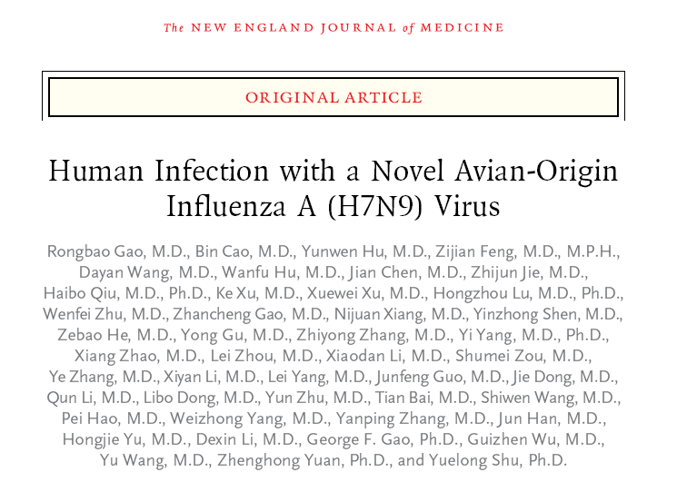

Notes:
그러나 CTD related ILD 또한 NSIP, UIP, OP, LIP ,DAD 와 같은 다양한 특징들을 나타낼수 있기 때문에
조직학적, 영상의학적 소견들만으로는 CTD-ILD 와 IPF 를 감별하기가 쉽지 않습니다.

Slide 50
Background
Infection of poultry with influenza A subtype H7 viruses occurs worldwide.
In March 2013, three urban residents of Shanghai or Anhui, China, presented with
rapidly progressing lower respiratory tract
infections and were found to be infected
with a novel reassortant avian-origin influenza A
(H7N9) virus, this subtype to humans in Asia
has not been observed previously.
Notes:
CTD- lung involvement 에서 폐기능 저하를 일으키는 기전은 크게 4가지로 나눌수 있는데
먼저 interstitial -> 주로 R 패턴과 FVC, FEV1 및 DLCO 의 감소
Lung volume 은 normal 이거나, CT 상 ILD 의 extent에 비해 DLCO 가 낮은 경우에는 pul. Vascular
Disease 가능성을 염두해두고 pul HTN evaluation 을 해야 한다.
3) 또한 R. m involve 할 경우 Extrapul patter의 R 을 보일수 있으며
4) 역시 ILD 하나만으로는 설명되지 않는 airway change 가 있을 때는 특히 RA –ILD 에서 그러하듯 smoking related emphysema 도 있을 수 있음을 생각해야 한다.

Slide 51
Methods
Throat-swab specimens obtained from three
adult Chinese patients were sent to Shanghai
Public Health Clinical Center, the Shanghai
Centers for Disease Control and Prevention
(CDC), and the Anhui CDC.
After preliminary detection, the samples were sent to the Chinese National Influenza Center (CNIC) on March 25, 2013.
Notes:
CTD- lung involvement 에서 폐기능 저하를 일으키는 기전은 크게 4가지로 나눌수 있는데
먼저 interstitial -> 주로 R 패턴과 FVC, FEV1 및 DLCO 의 감소
Lung volume 은 normal 이거나, CT 상 ILD 의 extent에 비해 DLCO 가 낮은 경우에는 pul. Vascular
Disease 가능성을 염두해두고 pul HTN evaluation 을 해야 한다.
3) 또한 R. m involve 할 경우 Extrapul patter의 R 을 보일수 있으며
4) 역시 ILD 하나만으로는 설명되지 않는 airway change 가 있을 때는 특히 RA –ILD 에서 그러하듯 smoking related emphysema 도 있을 수 있음을 생각해야 한다.

Slide 52
Methods
Respiratory specimens were tested for influenza and other respiratory viruses by means of RT-PCR assays.
Seasonal influenza viruses (H1, H3, B).
H5N1, severe acute respiratory syndrome coronavirus (SARS-CoV).
H1 to H16 and N1 to N9 subtypes were performed to verify the viral subtypes.

Slide 53
Methods
Full genome sequences of the viruses were deposited in the Global Initiative on Sharing Avian Influenza Data (GISAID) database .
Phylogenetic trees were constructed. (neighbor-joining method with the use of MEGA software, ver.5.05.)
Estimate the viral gene relationship with selected influenza A virus strains obtained from Gen Bank.

Slide 54
Methods
A standardized surveillance reporting form
was used to collect epidemiologic and clinical
data, demographic characteristics; underlying medical conditions; history of seasonal influenza vaccination; recent exposures to swine,
poultry, or other animals; recent visits to a live
animal market; clinical signs and symptoms; chest radiographic findings; laboratory testing including diagnostic testing for influenza and other respiratory viruses; antiviral treatment; clinical complications; and outcomes.
Notes:
CTD- lung involvement 에서 폐기능 저하를 일으키는 기전은 크게 4가지로 나눌수 있는데
먼저 interstitial -> 주로 R 패턴과 FVC, FEV1 및 DLCO 의 감소
Lung volume 은 normal 이거나, CT 상 ILD 의 extent에 비해 DLCO 가 낮은 경우에는 pul. Vascular
Disease 가능성을 염두해두고 pul HTN evaluation 을 해야 한다.
3) 또한 R. m involve 할 경우 Extrapul patter의 R 을 보일수 있으며
4) 역시 ILD 하나만으로는 설명되지 않는 airway change 가 있을 때는 특히 RA –ILD 에서 그러하듯 smoking related emphysema 도 있을 수 있음을 생각해야 한다.

Slide 55
Clinical Features and Outcomes of the Patients
Two of the patients had a history of recent exposure to poultry.
Fever and cough and dyspnea were the most common symptoms.
The WBC was normal or slightly decreased. Elevated levels of aspartate aminotransferase, CK, LDH . Chest radiography revealed bilateral ground-glass opacities and consolidation.
Complications included ARDS and multiorgan failure. All three patients died.
Notes:
CTD- lung involvement 에서 폐기능 저하를 일으키는 기전은 크게 4가지로 나눌수 있는데
먼저 interstitial -> 주로 R 패턴과 FVC, FEV1 및 DLCO 의 감소
Lung volume 은 normal 이거나, CT 상 ILD 의 extent에 비해 DLCO 가 낮은 경우에는 pul. Vascular
Disease 가능성을 염두해두고 pul HTN evaluation 을 해야 한다.
3) 또한 R. m involve 할 경우 Extrapul patter의 R 을 보일수 있으며
4) 역시 ILD 하나만으로는 설명되지 않는 airway change 가 있을 때는 특히 RA –ILD 에서 그러하듯 smoking related emphysema 도 있을 수 있음을 생각해야 한다.

Slide 56
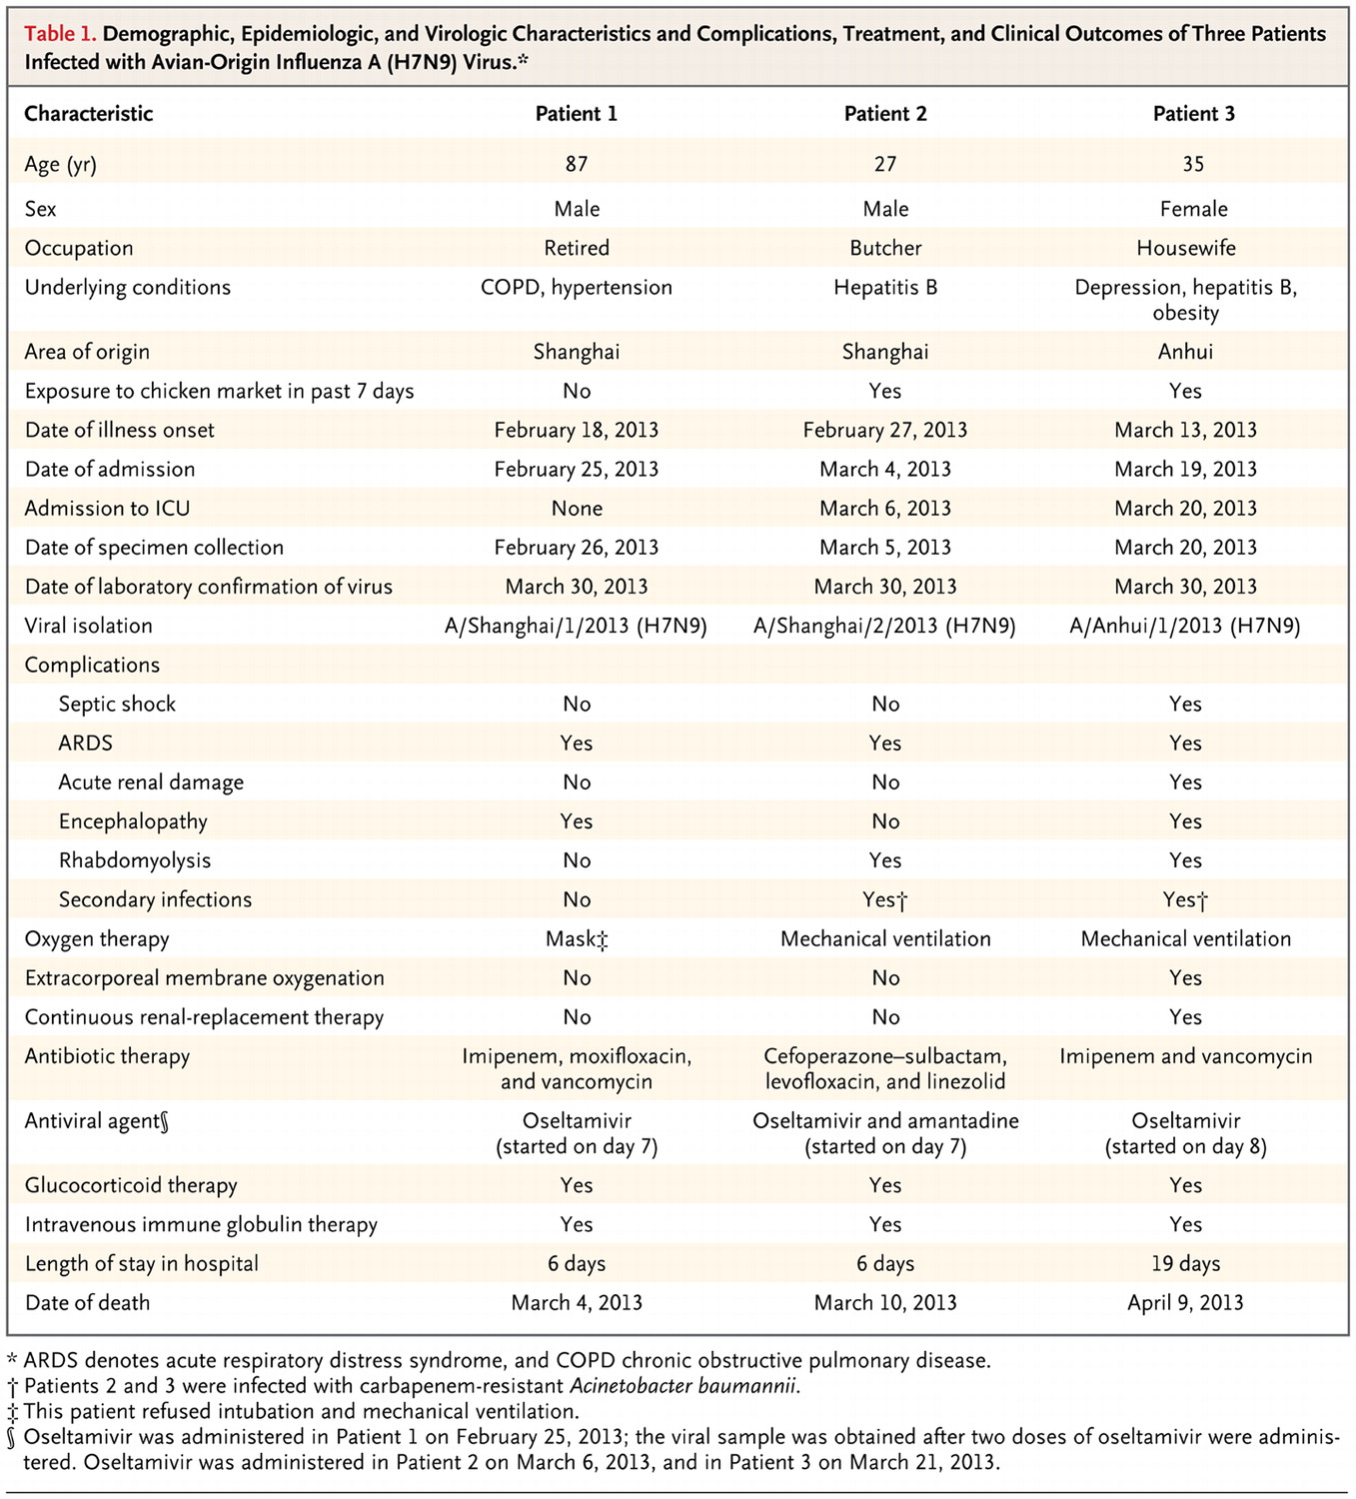
Demographic, Epidemiologic, and Virologic Characteristics and Complications, Treatment, and Clinical Outcomes of Three Patients Infected with Avian-Origin Influenza A (H7N9) Virus.

Slide 57
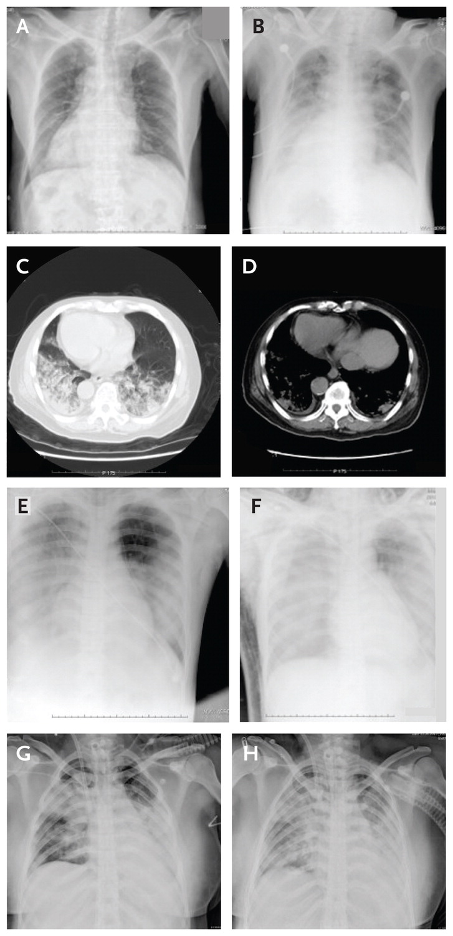
Figure 3. Chest Radiographs.
A chest radiograph (patient’s heart is on the right side) of Patient 1 is shown in Panels A and B . Mild ground glass
opacity was observed on day 6 (Panel A). Bilateral ground-glass opacity and consolidation were clearly seen on day 9 (Panel B). A computed tomographic
scan of the chest of Patient 1, obtained on day 7 (the day of admission), is shown in Panels C and D. Substantial
bilateral ground-glass opacity and consolidation can be seen. Chest radiographs of Patient 2, obtained
on day 7 and day 13 after the onset of illness are shown in Panels E and F, respectively. Bilateral ground glass
opacity and consolidation can be seen on day 7,and white lungs on day 13. Chest radiographs of Patient 3
on day 7 and day 13 after the onset of illness are shown in Panels G and H. Bilateral ground-glass opacity
and consolidation can be seen on both day 7 and day 13
Notes:
Figure 3. Chest Radiographs. A chest radiograph (patient's heart is on the right side) of Patient 1 is shown in Panels A and B . Mild ground-glass opacity was observed on day 6 (Panel A). Bilateral ground-glass opacity and consolidation were clearly seen on day 9 (Panel B). A computed tomographic scan of the chest of Patient 1, obtained on day 7 (the day of admission), is shown in Panels C and D. Substantial bilateral ground-glass opacity and consolidation can be seen. Chest radiographs of Patient 2, obtained on day 7 and day 13 after the onset of illness are shown in Panels E and F, respectively. Bilateral ground-glass opacity and consolidation can be seen on day 7, and white lungs on day 13. Chest radiographs of Patient 3 on day 7 and day 13 after the onset of illness are shown in Panels G and H. Bilateral ground-glass opacity and consolidation can be seen on both day 7 and day 13.

Slide 58
Results
By means of real-time RT-PCR, viral isolation, and full genome sequencing, that all three patients were infected with a novel avian origin influenza A (H7N9) virus was confirmed.
Influenza viruses A/Shanghai/1/2013 (H7N9), A/Shanghai/2/2013 (H7N9), A/Anhui/1/2013(H7N9) were isolated from Patients 1, 2, 3,respectively.
Notes:
CTD- lung involvement 에서 폐기능 저하를 일으키는 기전은 크게 4가지로 나눌수 있는데
먼저 interstitial -> 주로 R 패턴과 FVC, FEV1 및 DLCO 의 감소
Lung volume 은 normal 이거나, CT 상 ILD 의 extent에 비해 DLCO 가 낮은 경우에는 pul. Vascular
Disease 가능성을 염두해두고 pul HTN evaluation 을 해야 한다.
3) 또한 R. m involve 할 경우 Extrapul patter의 R 을 보일수 있으며
4) 역시 ILD 하나만으로는 설명되지 않는 airway change 가 있을 때는 특히 RA –ILD 에서 그러하듯 smoking related emphysema 도 있을 수 있음을 생각해야 한다.

Slide 59
Results
The gene encoding hemagglutinin (HA) shared the highest identity with A/duck/Zhejiang/12/2011 (H7N3, subtype ZJ12).
The gene encoding neuraminidase (NA) protein was most closely related to A/wildbird/ Korea/A14/2011(H7N9, subtype KO14).
All six internal genes shared the highest similarity with A/brambling/Beijing/16/2012-like viruses (H9N2)

Slide 60
Results
Substitution Q226L at the 210-loop in the HA gene was found in both the A/Anhui/1/2013 and A/Shanghai/2/2013. bind strongly to α-2,6 human-receptors.
The M2 protein contained the S31N substitution, indicating resistance to
Amantadine.
89V and E627K in PB2 and 42S in NS1 increasing mammalian adaptation.

Slide 61
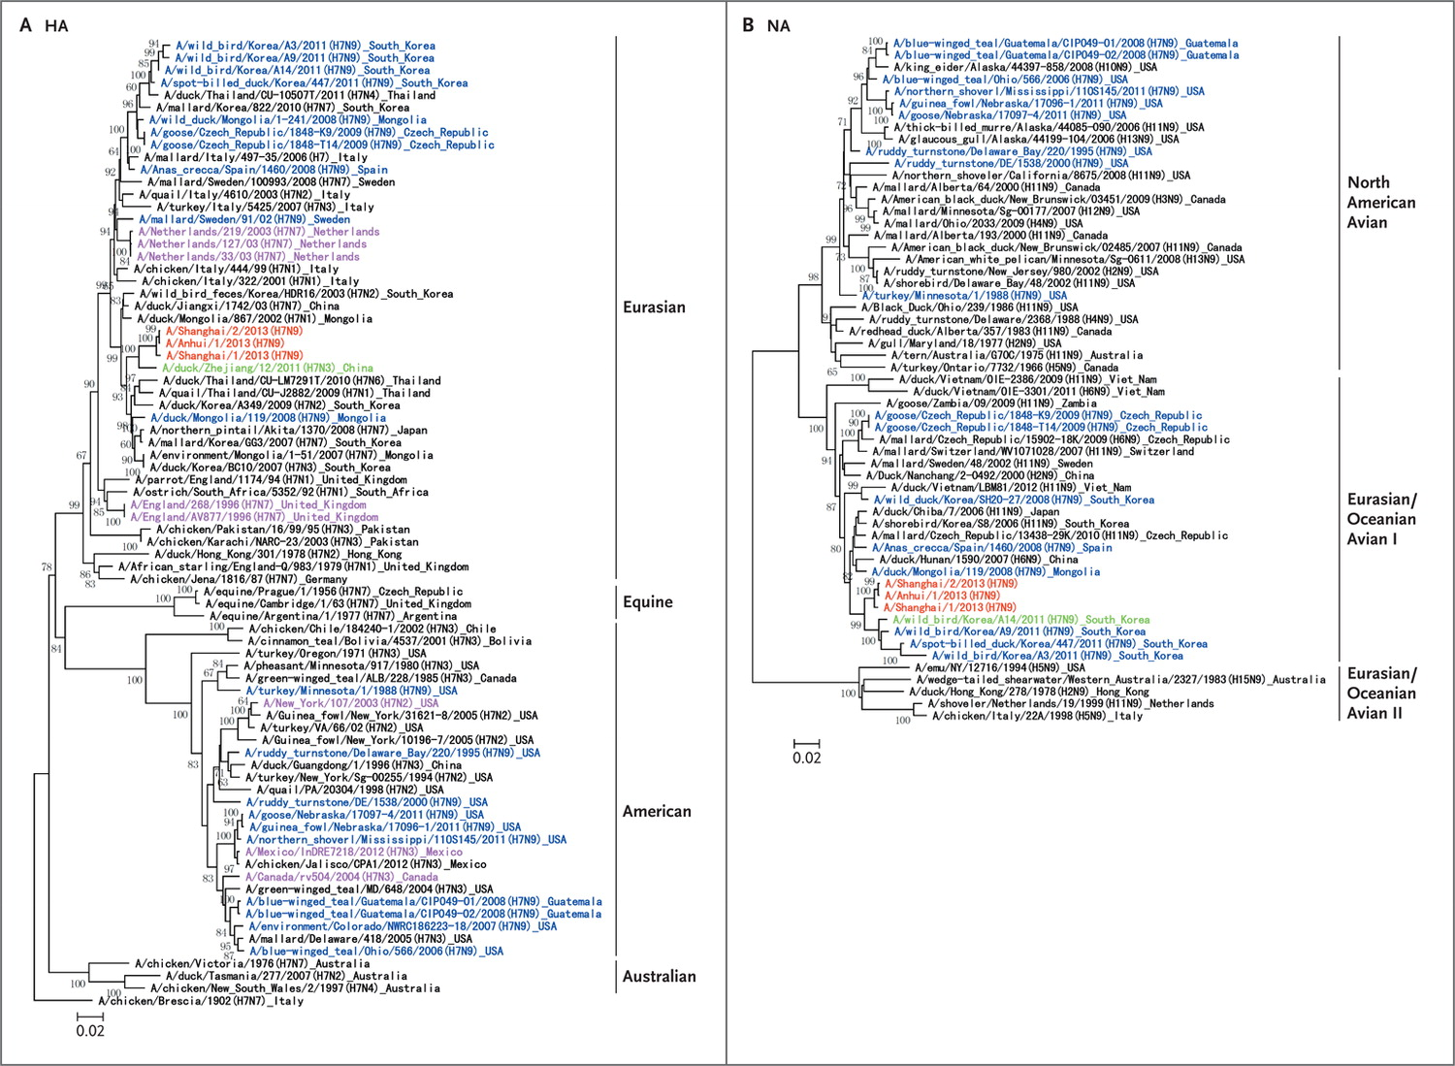
Phylogenetic Trees of Genes of H7N9 Influenza A Viruses.
Notes:
Figure 1. Phylogenetic Trees of Genes of H7N9 Influenza A Viruses. Shown are phylogenetic trees of full-length hemagglutinin (HA; Panel A) and neuraminidase (NA; Panel B) genes of H7N9 influenza A viruses. The trees were generated by means of the distance-based neighbor-joining method with the use of MEGA software, version 5.05. The reliability of the trees was assessed by means of bootstrap analysis with 1000 replications. Horizontal distances are proportional to the genetic distance. The novel reassortant H7N9 viruses are shown in red. The viruses in green presented the highest similarity with the novel H7N9 viruses. Other H7N9 and human H7 subtype are shown in blue and pink, respectively. Phylogenetic trees of the other six genes are included in the Supplementary Appendix.

Slide 62
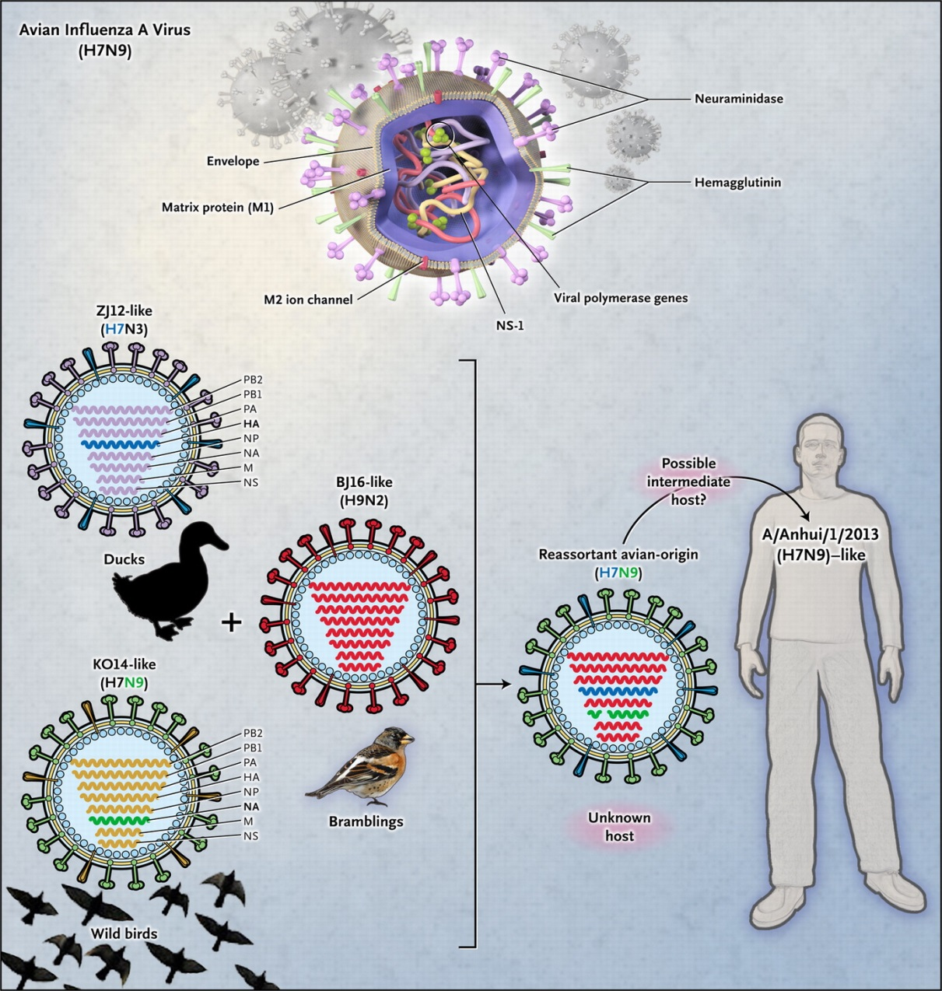
Hypothetical Host and Lineage Origins of the Gene Segments of the Novel Reassortant Human
Influenza A (H7N9) Viruses.
Notes:
Figure 2. Hypothetical Host and Lineage Origins of the Gene Segments of the Novel Reassortant Human Influenza A (H7N9) Viruses. The colors of the gene segments in the ovals indicate their origin. BJ16 denotes A/brambling/Beijing/16/2012, KO14 A/wild bird/Korea/A14/2011, and ZJ12 A/duck/Zhejiang/12/2011.

Slide 63
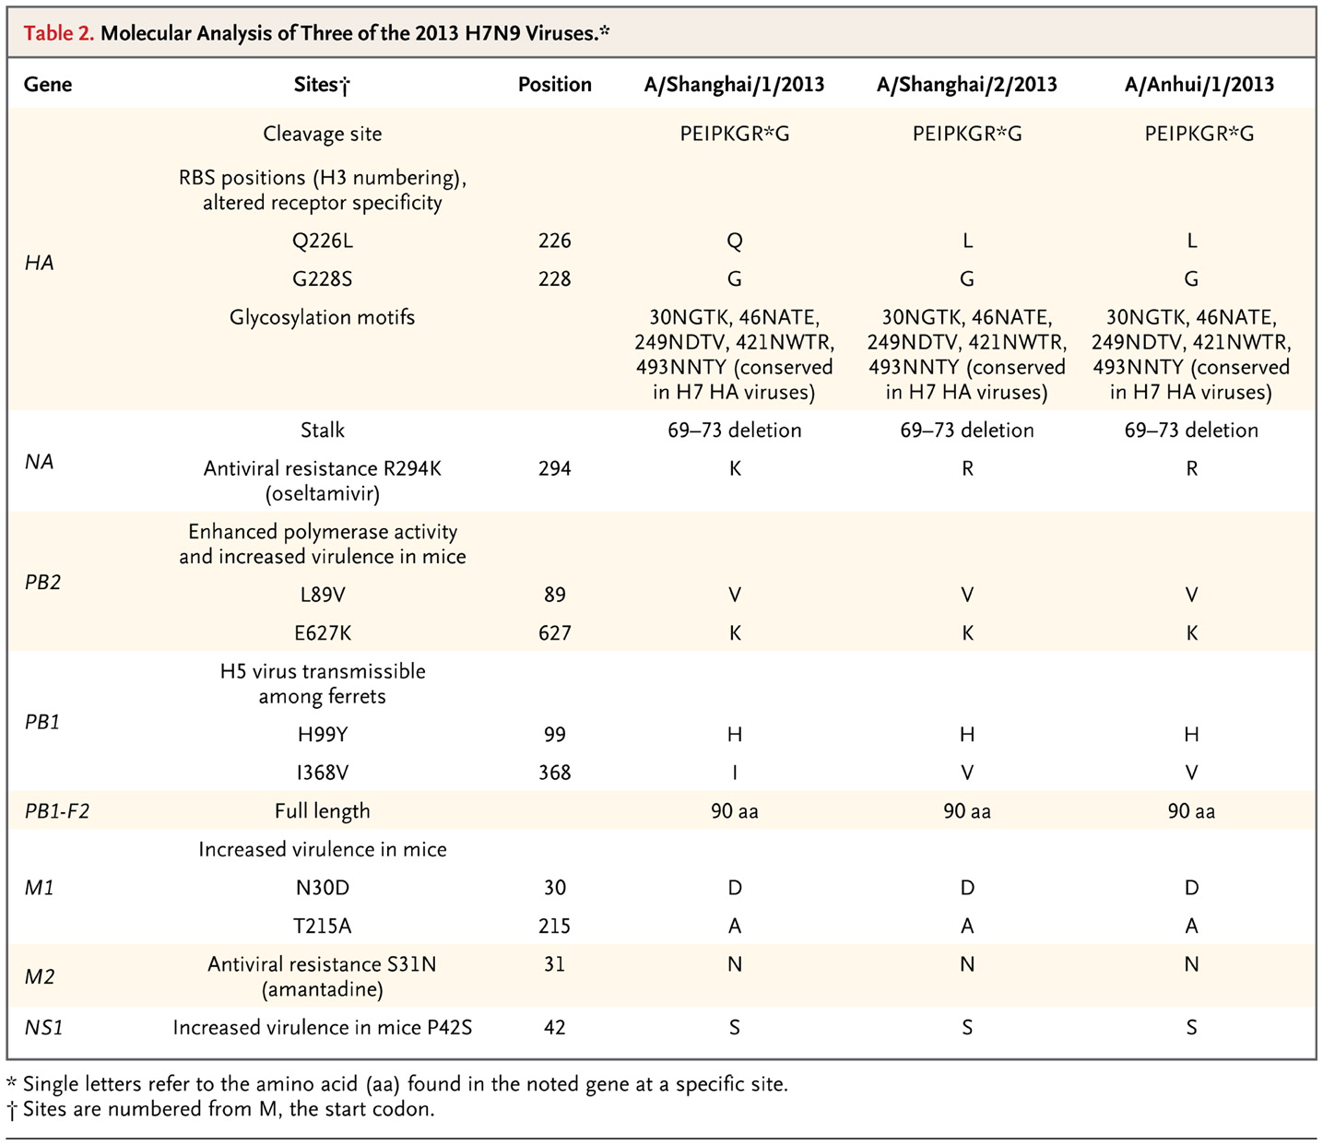
Molecular Analysis of Three of the 2013 H7N9 Viruses.

Slide 64
Discussion
The human H7N9 viruses are the product of reassortment of viruses that are of avian-origin only.
There are no data to suggest that this reassortment occurred in a mammalian host.
The similarity of the human viruses to avian viruses may be stronger support for direct avian transmission of this virus.

Slide 65
Discussion
Q226L in the HA protein was expected to bind strongly to α-2,6 human-like receptors.
A laboratory-produced Q226L mutation at the 210-loop of HA has been shown to change the receptor binding of avian origin might increase the ability of the virus to be transmitted by air .
(Airborne transmission of influenza A/H5N1 virus
between ferrets. Science 2012;336:1534-41)

Slide 66
Discussion
Gln226Leu and Gly186Val in human virus H7 (increased affinity for α-2,6- sialic acid )
PB2 Asp701Asn mutation (mammalian adaptation).
Ser31Asn mutation, adamantane resistance, was noted in viral M2.
(Human infections with the emerging avian influenza A H7N9 virus from wet market poultry: clinical analysis and characterisation of viral genome. Lancet, Early Online Publication, 25 April 2013)

Slide 67
Discussion
Updated information and the specific sequences of the novel H7N9 virus are
available on the website of the World Health
Organization (www.who.int/influenza/gisrs_
laboratory/a_h7n9/en/).

Slide 68
Conclusions
Severe avian influenza A (H7N9) infections
characterized by high fever and ARDS
may pose a serious human health risk
and the potential threat to the human
population.
An understanding of the source and mode of transmission of these infections, further surveillance, and appropriate counter measures are urgently required.

Slide 69
Take Home Messages
Most patients with avian influenza give a history of recent exposure to dead or ill poultry. Thus, a comprehensive travel and epidemiologic history is critical in the identification of suspected cases.
Oseltamivir should be administered early.
An understanding of these infections and further study for appropriate treatment & prevention required.

Slide 70
Reference
1.Human Infection with a Novel Avian-Origin Influenza A (H7N9) Virus
Rongbao Gao, M.D., Bin Cao, M.D., Yunwen Hu, M.D., Zijian Feng, M.D., M.P.H.,etc N Engl J Med 2013.DOI: 10.1056/NEJMoa1304459
2.Herfst S, Schrauwen EJ, Linster M, et al. Airborne transmission of influenza A/H5N1 virus between ferrets. Science 2012;336:1534-41.
3.Human infections with the emerging avian influenza A H7N9 virus from wet market poultry: clinical analysis and characterisation of viral genome. Lancet, Early Online Publication, 25 April 2013
4.World Health Organization. Cumulative number of confirmed human cases for avian influenza A(H5N1) reported to WHO, 2003-2013. http://www.who.int/influenza/human_animal_interface/EN_GIP_20130215CumulativeNumberH5N1cases.pdf (Accessed on February 20, 2013).

