Slide 1
Steroid therapy in Sepsis
- is it beneficial?
- as a bolus or as an infusion?
F. 최지수

Slide 2
Cortisol metabolism and Function in critical illness
The HPA axis is activated, diurnal variation is lost.
Reduced cortisol breakdown → hypercortisolemia
Renal dysfunction → prolong the half-life of circulating cortisol
Reduced both cortisol binding globulin (CBG) and albumin
Inflammatory cytokines
: glucocorticoid receptor affinity ↑, disable glucocorticoid inactivation, peripheral conversion of precursors to cortisol ↑
Notes:
which bind >90 percent of circulating cortisol under normal circumstances,

Slide 3
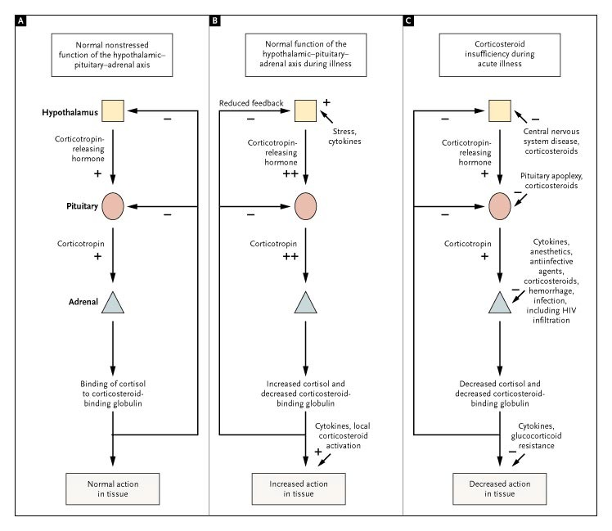
Critical Illness-Related Corticosteroid Insufficiency (CIRCI)
Activity of the Hypothalamic–Pituitary–Adrenal Axis under Normal Conditions (Panel A), during an Appropriate Response to Stress (Panel B), and during an Inappropriate Response to Critical Illness (Panel C).
Cooper MS, Stewart PM: Corticosteroid insufficiency in acutely ill patients. N Engl J Med 2003, 348:727-734.

Slide 4
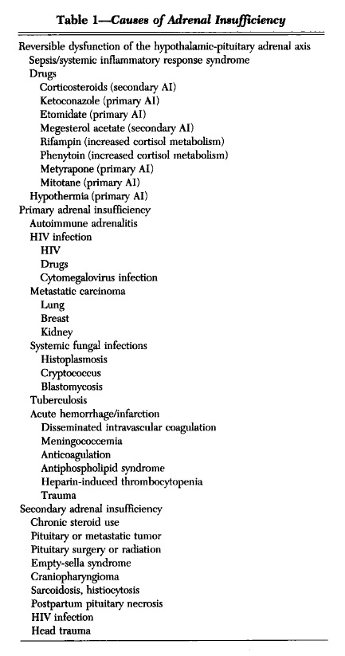
Critical Illness-Related Corticosteroid Insufficiency (CIRCI)
Marik PE: Critical illness-related corticosteroid insufficiency. Chest 2009, 135:181-193.

Slide 5
Steroid therapy for patients with septic shock
We suggest against using IV hydrocortisone (HC) to treat septic shock patients if adequate fluid resuscitation and vasopressor therapy are able to restore hemodynamic stability.
If this is not achievable, we suggest IV hydrocortisone at a dose of 200 mg per day (weak recommendation, low quality of evidence).
Rhodes A, Evans LE, Alhazzani W, Levy MM, Antonelli M, Ferrer R, Kumar A, Sevransky JE, Sprung CL, Nunnally ME, et al: Surviving Sepsis Campaign: International Guidelines for Management of Sepsis and Septic Shock: 2016. Intensive Care Med 2017, 43:304-377.

Slide 6
Steroid therapy for patients with septic shock
Low-dose corticosteroid replacement therapy in septic shock
: associated with improved BP & shorter duration of vasopressor use
: not associated with an improvement in all cause 28-day mortality rate
Since adrenal insufficiency appears to be common in patients with septic shock, treatment should be initiated at the time of diagnostic testing and can be stopped if results do not indicate the presence of adrenal insufficiency.
Patel GP, Balk RA: Systemic steroids in severe sepsis and septic shock. Am J Respir Crit Care Med 2012, 185:133-139.
Cooper MS, Stewart PM: Corticosteroid insufficiency in acutely ill patients. N Engl J Med 2003, 348:727-734.

Slide 7
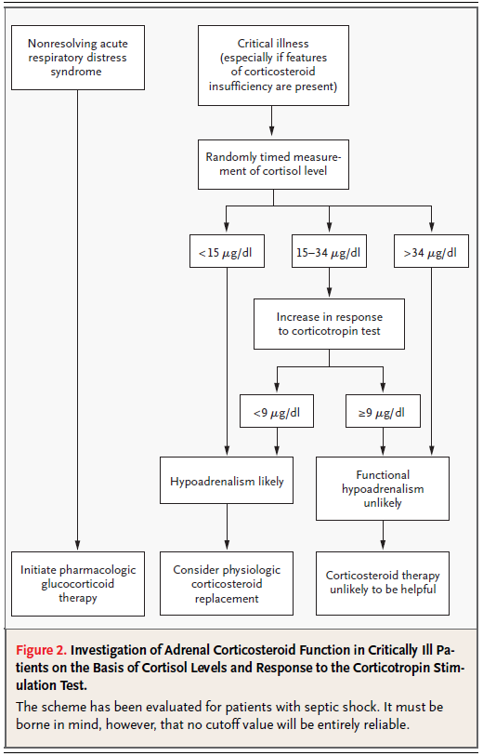
Steroid therapy for patients with septic shock
Cooper MS, Stewart PM: Corticosteroid insufficiency in acutely ill patients. N Engl J Med 2003, 348:727-734.

Slide 8
The prior clinical trials…
1960s
HC (n=96) vs placebo (n=98)
As an adjunctive strategy for patients with severe sepsis and septic shock
→ No significant survival difference between the treatment and control groups
Ivan L. Bennett, Maxwell Finland, Morton Hamburger, Edward H. Kass, Mark Lepper. The effectiveness of Hydrocortisone in the Management of Severe Infections. JAMA. 1963, 462-465.
Notes:
16세 미만 환자도 포함, hydrocortisone 2일 동안 IV 300mg, 250mg then 4일 동안 oral로 tapering

Slide 9
The prior clinical trials…
1970s
30mg/kg of methylprednisolone (MPS) (n=43) vs
3mg/kg of dexamethasone (DMP) (n=43) vs placebo (n=86)
→ Mortality rate: 11.6% in MPS and 9.3% in DMP,
and 38.4% in placebo
→ Complication: no significant difference between the
steroid-treated and the nonsteroid treated patients.
Schumer W: Steroids in the treatment of clinical septic shock. Ann Surg 1976, 184:333-341.
Notes:
Single dose

Slide 10
The prior clinical trials…
1980s
30mg/kg IV MPS (n=21) vs 6mg/kg IV DMP (n=22) vs placebo (n= 16)
→ more rapid shock reversal
but no survival benefit beyond 10 days of follow up
30mg/kg IV MPS, followed by 5mg/kg (n=112) vs placebo (n=111)
→ does not reduce mortality significantly in patients with systemic
sepsis, and therefore should not be used as adjunctive therapy.
Schumer W: Steroids in the treatment of clinical septic shock. Ann Surg 1976, 184:333-341.
Veterans Administration Systemic Sepsis Cooperative Study Group. Effect of high-dose glucocorticoid therapy on mortality in patients with clinical signs of systemic sepsis. N Engl J Med 317(11): 659-665.
Notes:
1. Single dose (shock 발생 후 평균 17시간에 치료)
2. Shock 발생 후 평균 2.8 시간 이내, 처음 kg 당 30mg MPS 후 시간 당 kg 당 5mg infusion 9시간 동안

Slide 11
The prior clinical trials…
1980s
- In 381 patients, 30 mg/kg IV infusion for 4 hours MPS vs placebo
→ No significant differences in the reversal of shock
or overall mortality.
→ Patients treated with MPS, significantly more deaths
(related to secondary infection)
- 30 mg/kg for 4 doses q6hrs MPS (n=38) vs placebo (mannitol) (n=37)
→ neither prevents parenchymal lung injury nor improves mortality
when given early to patients with septic shock
Bone RC, Fisher CJ, Jr., Clemmer TP, Slotman GJ, Metz CA, Balk RA. A controlled clinical trial of high-dose methylprednisolone in the treatment of severe sepsis and septic shock. N Engl J Med. 1987;317(11):653-8.
Luce JM, Montgomery AB, Marks JD, Turner J, Metz CA, Murray JF. Ineffectiveness of high-dose methylprednisolone in preventing parenchymal lung injury and improving mortality in patients with septic shock. Am Rev Respir Dis. 1988;138(1):62-8.
Notes:
진단 후 2시간 이내 시작하여 4시간 infusion

Slide 12
The prior clinical trials…
Supra-physiological doses of steroids were recognized as having no benefit and considered potentially harmful.

Slide 13
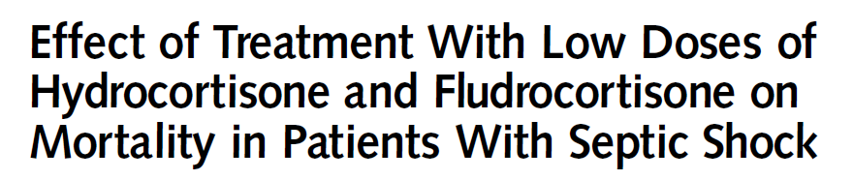
Placebo-controlled, randomized, double-blind, multi-center study
HC 50mg q6hrs + Fludrocortisone(FC) 50mcg q24hrs (7d) (n=150)
vs placebo (n=149)
229 nonresponders (114vs115), 70 responder (36vs34) of high dose ACTH test
In nonresponders, significant difference in
- 28-day mortality, ICU mortality, hospital mortality, 1-Year mortality
- vasopressor therapy was withdrawn within 28 days
In responders: no significant difference between groups
Adverse events (superinfection/GI bleeding/psychiatric disorders related to steroids, arrhythmia/MI/limb or cerebral ischemia related to vasopressors, related to ICU procedure, others) rates were similar in the 2 groups.
Annane D, Sebille V, Charpentier C, Bollaert PE, Francois B, Korach JM, Capellier G, Cohen Y, Azoulay E, Troche G, et al: Effect of treatment with low doses of hydrocortisone and fludrocortisone on mortality in patients with septic shock. Jama 2002, 288:862-871.
Notes:
Primary end poit: 28day mortality

Slide 14
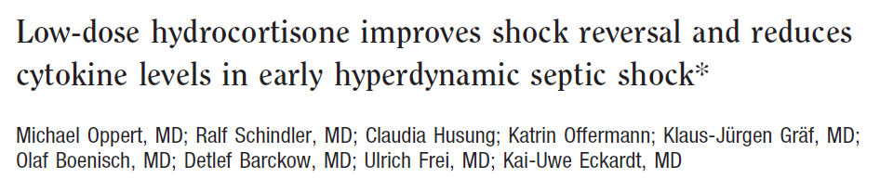
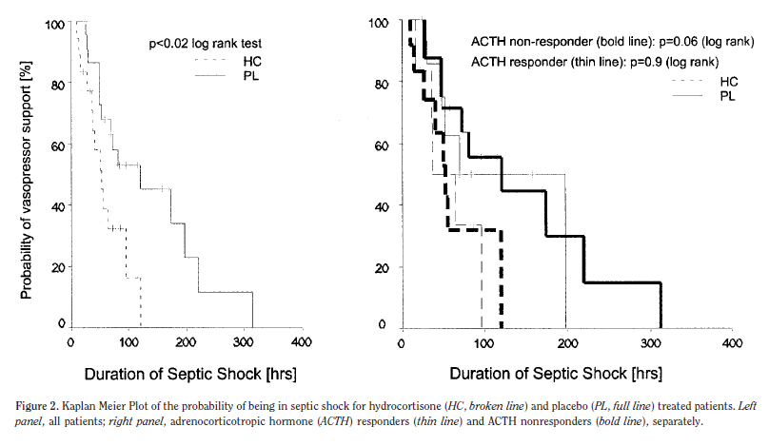
Prospective, randomized, double-blind, single-center study
HC 50mg bolus → infusion of 0.18 mg/kg/hr (n=18) vs placebo (n=23)
26 nonresponders (12vs14), 15 responder (6vs9) of high dose ACTH test
Time to vasopressor withdrawal: median 53hrs (35–96) in HC vs 120hrs
(48–197) in placebo; p .02, log rank test)
Mortality: 39% in HC vs 48% in placebo, p .6; log rank test)
Adverse events were not more frequent in the treatment group.
Oppert M, Schindler R, Husung C, Offermann K, Graf KJ, Boenisch O, Barckow D, Frei U, Eckardt KU: Low-dose hydrocortisone improves shock reversal and reduces cytokine levels in early hyperdynamic septic shock. Crit Care Med 2005, 33:2457-2464.
Notes:
Shock 에서 회복후에는 0.06mg/kg/hr
이후 천천히 tapering

Slide 15
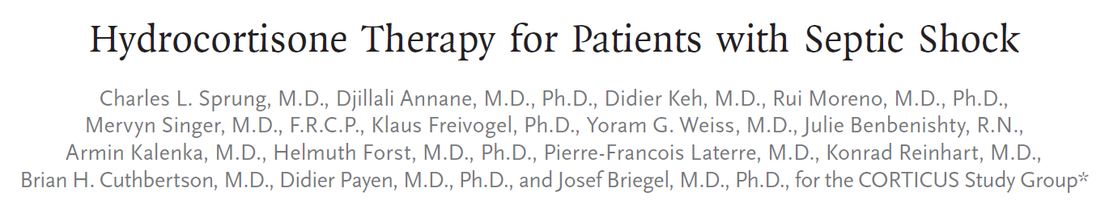
multicenter, randomized, double-blind, placebo-controlled trial
HC 50mg q6hrs (5d) (n=251) vs placebo (n=248)
233 nonresponders (125vs108), 254 responder (118vs136) of high dose ACTH test
In nonresponders, responders, and all study patients:
- no significant difference in 28-day mortality, ICU mortality, hospital mortality,
1-Year mortality, and length of stay-days in ICU and hospital
In all study patients, shorter time duration of time to reversal of shock
Adverse events, including superinfection, hyperglycemia, and hypernatremia, rates increased incidence in steroid-treated group.
Sprung CL, Annane D, Keh D, Moreno R, Singer M, Freivogel K, Weiss YG, Benbenishty J, Kalenka A, Forst H, et al: Hydrocortisone therapy for patients with septic shock. N Engl J Med 2008, 358:111-124.
Notes:
5일 이후 3일 간격으로 절반씩 tapering

Slide 16
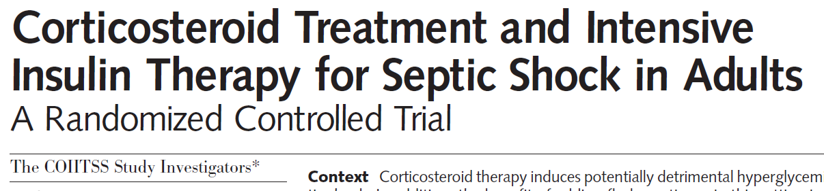
multicenter, 2 X 2 factorial, randomized trial
HC 50mg q6hrs + FC 50mcg q24hrs (7d) + continuous insulin infusion (n=129)
HC 50mg q6hrs (7d) + continuous insulin infusion (n=126)
HC 50mg q6hrs + FC 50mcg q24hrs (7d) + conventional insulin therap (n=116)
HC 50mg q6hrs (7d) + conventional insulin therapy (n=138)
Primary outcome: hospital mortality
Secondary outcome: 28-, 90-, 180-day mortality, vasopressor free day,
MV free day, organ-failure free days(SOFA score<8),
ICU and hospital length of stay
-> No significant differences between HC + FC and HC
Superinfection(UTI) increased in HC + FC than HC
Annane D, Cariou A, Maxime V, Azoulay E, D'Honneur G, Timsit JF, Cohen Y, Wolf M, Fartoukh M, Adrie C, et al: Corticosteroid treatment and intensive insulin therapy for septic shock in adults: a randomized controlled trial. Jama 2010, 303:341-348.

Slide 17
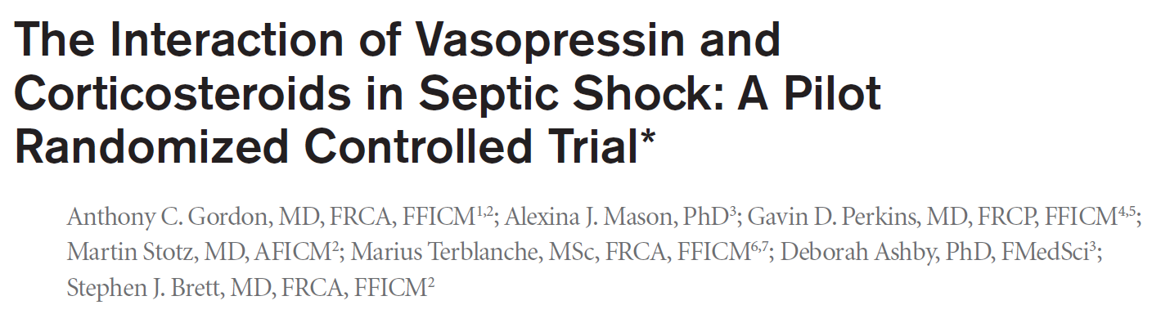
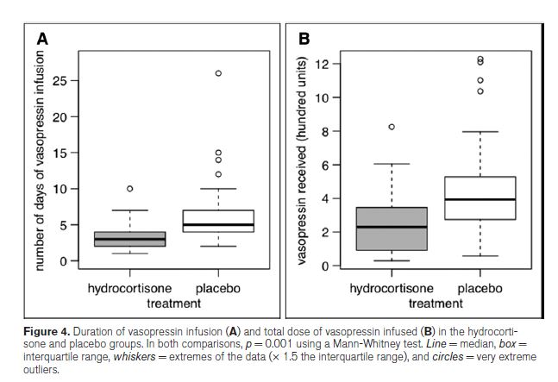
multicenter, Prospective open-label randomized controlled pilot trial
HC 50mg q6hrs + vasopressin (5d) (n=31) vs placebo (n=30)
Primary outcome: the difference in plasma vasopressin concentration
Secondary outcome: vasopressin requirements, 28-day mortality,
ICU and hospital mortality, the onset of new organ failure,
organ-failure free days in 28-day
HC treated group required
- shorter duration of vasopressin therapy
- required a lower total dose of vasopressin
no differences in mortality rates or organ failure assessments.
Gordon AC, Mason AJ, Perkins GD, Stotz M, Terblanche M, Ashby D, Brett SJ: The interaction of vasopressin and corticosteroids in septic shock: a pilot randomized controlled trial. Crit Care Med 2014, 42:1325-1333.
Notes:
5일 후 3일 간격으로 절반 씩 tapering

Slide 18
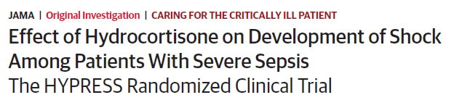
randomised, double-blind, placebo-controlled, multicenter trial
HC 50mg q6hrs (5d) (n=190) vs placebo (n=190)
Primary outcome: the occurrence of septic shock within 14 days
Secondary outcome: time until development of septic shock or death, mortality in the ICU and hospital, vital status at 28, 90, 180 days,
duration of stay in the ICU and hospital, organ dysfunctions,
duration of MV and RRT
→ No significant differences between two groups
There were more episodes of hyperglycemia (blood glucose level >150mg/dL).
Secondary infections, weaning failure, muscle weakness, hypernatremia, or other adverse events were not significantly different between treatment groups.
Keh D, Trips E, Marx G, Wirtz SP, Abduljawwad E, Bercker S, Bogatsch H, Briegel J, Engel C, Gerlach H, et al: Effect of Hydrocortisone on Development of Shock Among Patients With Severe Sepsis: The HYPRESS Randomized Clinical Trial. Jama 2016, 316:1775-1785.
Notes:
Septic shock 환자 제외
5일 사용 후 2일 간격으로 절반 씩 11일까지 tapering

Slide 19
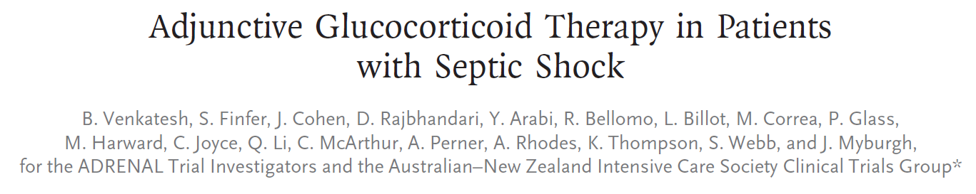
Multicenter, double-blind, parallel-group, randomized controlled trial
HC 200mg per day (Max. 7d) (n=1853) vs placebo (n=1860)
Primary outcome: death from any cause at 90 days after randomization
Secondary outcome: death from any cause at 28 days, the time to the resolution of shock, the recurrence of shock, the length of ICU stay and hospital stay, the frequency and duration of MV and RRT, the incidence of new onset bacteremia or fungemia between 2 and 14 days, the receipt of transfusion in the ICU
Venkatesh B, Finfer S, Cohen J, Rajbhandari D, Arabi Y, Bellomo R, Billot L, Correa M, Glass P, Harward M, et al: Adjunctive Glucocorticoid Therapy in Patients with Septic Shock. N Engl J Med 2018, 378:797-808.
Notes:
Ventilation group 에서 시작

Slide 20
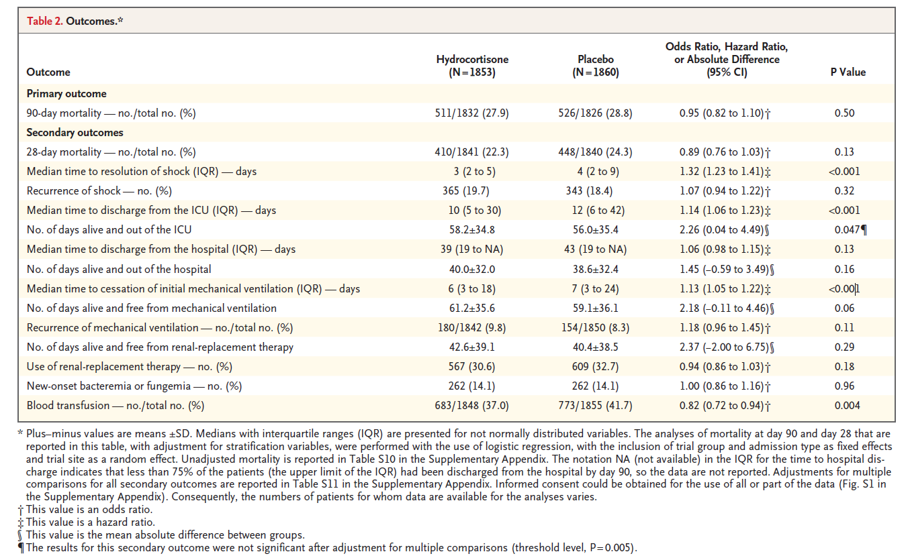
Venkatesh B, Finfer S, Cohen J, Rajbhandari D, Arabi Y, Bellomo R, Billot L, Correa M, Glass P, Harward M, et al: Adjunctive Glucocorticoid Therapy in Patients with Septic Shock. N Engl J Med 2018, 378:797-808.

Slide 21
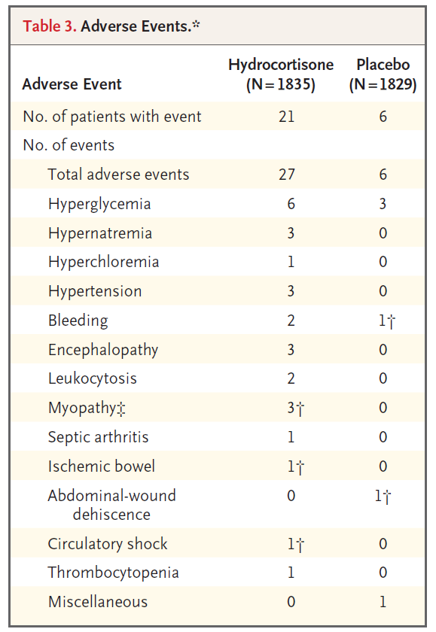
A total of 33 adverse events was reported in the trial population, with a higher percentage. in the hydrocortisone group than in the placebo group (1.1% vs. 0.3%, P = 0.009).
There were 6 serious adverse events,
with 4 occurring in the hydrocortisone group and 2 in the placebo group.
Venkatesh B, Finfer S, Cohen J, Rajbhandari D, Arabi Y, Bellomo R, Billot L, Correa M, Glass P, Harward M, et al: Adjunctive Glucocorticoid Therapy in Patients with Septic Shock. N Engl J Med 2018, 378:797-808.

Slide 22
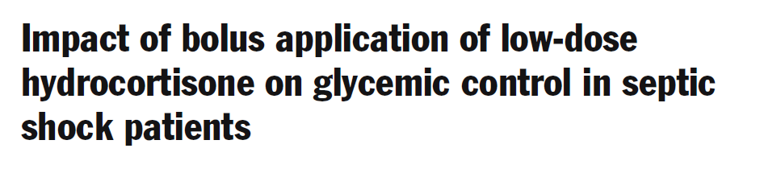
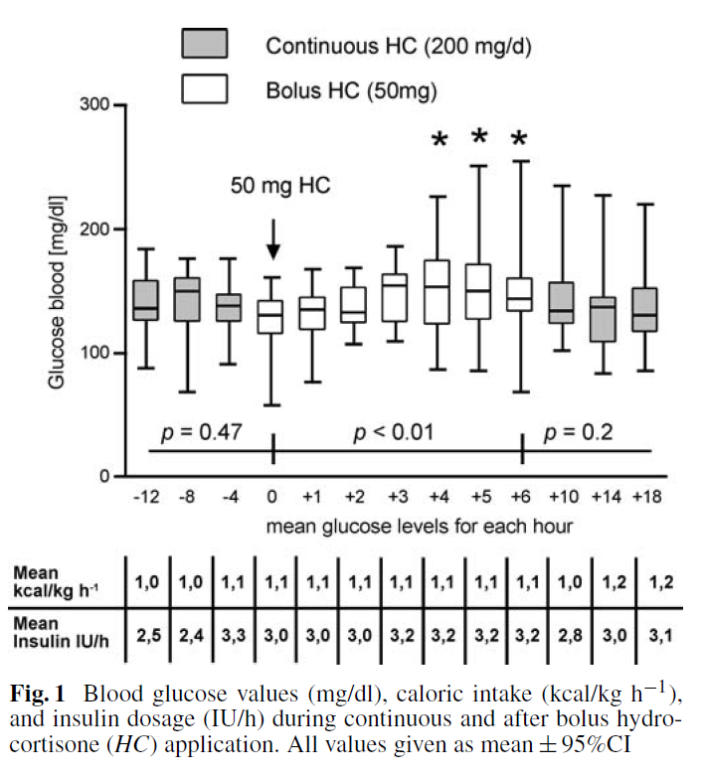
Observational prospective, pilot study.
HC 200mg infusion -> 50mg bolus
After bolus injection of hydrocortisone, blood glucose increased significantly within 6 h with peak levels of 154 mg/dl (range 132–178 mg/dl; p < 0.01).
In terms of glycemic-control strategies, a continuous infusion of hydrocortisone seems to be preferable.
Weber-Carstens S, Deja M, Bercker S, Dimroth A, Ahlers O, Kaisers U, Keh D: Impact of bolus application of low-dose hydrocortisone on glycemic control in septic shock patients. Intensive Care Med 2007, 33:730-733.

Slide 23
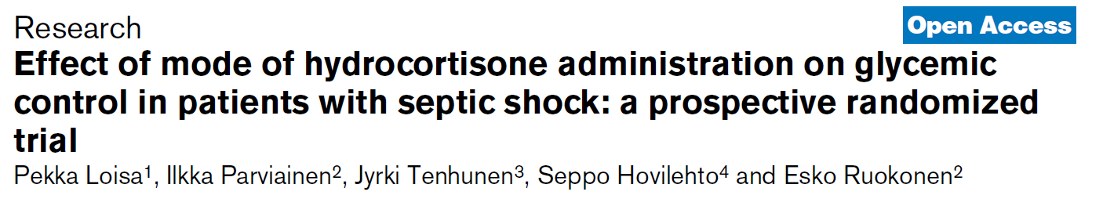
Single center, prospective randomized study
septic shock 48 patients who received HC treatment either by bolus or by continuous infusion with equivalent dose (200 mg/day) during 5 days
The number of hyperglycemic episodes, higher in bolus group
(15.7 ± 8.5 versus 10.5 ± 8.6 episodes per patient, p = 0.039).
The changes in insulin infusion rate to maintain strict normoglycemia, more frequent in the bolus group (4.7 ± 2.2 versus 3.4 ± 1.9 adjustments per patient per day, p = 0.038).
Hypoglycemic episodes were rare in both groups.
No difference was seen in shock reversal.
Loisa P, Parviainen I, Tenhunen J, Hovilehto S, Ruokonen E: Effect of mode of hydrocortisone administration on glycemic control in patients with septic shock: a prospective randomized trial. Crit Care 2007, 11:R21.

Slide 24
Study, Year | Bolus / Infusion | Design | Participants | Intervention | Comparator | Primary Outcomes | Secondary Outcomes
Bollaert 1998 | Bolus | Multi-centre (2) RCT | Adults (n=41) Vasopressor AND ventilator dependent septic shock Classified by response to ST: Responders ≤6mcg/dL Non-responders >6mcg/dL | Hydrocortisone 100mg Every 8hrs Duration: 5 days then tapered over 6 days | Placebo | Shock reversal | 28 days mortality, ICU Mortality, Hospital mortality Improvement in haemodynamics, ICU LoS Hospital LoS, Safety
Briegel 1999 | Infusion | Single-centre RCT | Adults (n=40) Vasopressor AND Ventilator dependent septic shock | Hydrocortisone 100mg loading 0.18mg/kg/hr maintainance Duration: Until shock reversal, then tapered off | Placebo | Shock reversal | 28 day mortality, ICU mortality, Hospital mortality Improvement in haemodynamics, SOFA score at D7, ICU LoS Safety
Chawla 1999 | Bolus | Single-centre RCT | Adults (n=44) Vasopressor dependent shock | Hydrocortisone 100mg Every 8hrs Duration: 3 days then tapered over 4 days | Placebo | Shock reversal | 28 day mortality, Hospital mortality, Improvement in haemodynamics, ICU LoS Safety
Yildiz 2002 | Bolus | Single-centre RCT | Adults (n=40) Sepsis (n=14) Septic shock (n=9) | Prednisolone 5mg@ 0600, 2.5mg@1800 Duration: 10 days | Placebo | 28 days mortality | Hospital mortality, Safety
Annane 2002 | Bolus | Multi-centre (19) RCT | Adults (n=300) Vasopressor AND Ventilator dependent septic shock. Classified by response to ST: Responders >9mcg/dL Non-responders ≤9mcg/dL | Hydrocortisone 50mg Every 6hrs AND Fludrocortisone 50mcg Every 24hrs Duration 7 days | Placebo | 28-Day Mortality in non-responders | 28-Day Mortality in responders, ICU Mortality Hospital Mortality, 1-Year Mortality, Shock Reversal Organ system failure free days, ICU LoS, Hospital LoS Safety Outcomes
Oppert 2005 | Infusion | Single-centre RCT | Adults (n=40) Vasopressor dependent septic shock | Hydrocortisone Load: 50mg, Maint: 0.18mg/kg/hr Duration: until stopping vasopressor 0.06mg/kg/hr for 1 day then reduced by 0.02mg/kg/hr every day | Placebo | Time to stopping vasopressor support | Inflammatory markers, 28 day survival, SOFA score
Rinaldi 2006 | Infusion | Single-centre RCT | Adults (n=40) Sepsis, but no vasopressor | Hydrocortisone 300mg per day Duration: 6days then taper | Standard care | Microalbuminuria: creatinine ratio | Inflammatory markers, Duration of mechanical ventilation, SOFA score

Slide 25
Cicarelli 2007 | Bolus | Single-centre RCT | Adults (n=29) Vasopressor dependent septic shock | Dexamethasone 0.2mg/kg Every 36hrs Duration: 3 doses | Placebo | 28D mortality Duration of vasopressor and MV
Meduri 2007 | Infusion | Multi-centre (5) RCT | Adults (n=91) Early ARDS Sepsis / septic shock (n=61) – only septic shock included Stratified by ST (≤9mcg/dl) | Methylprednisolone Loading: 1mg/kg Maint: 1mg/kg/d D1 – 14 0.5mg/kg/d D15-21 0.25mg/kg/d D22-25 0.125mg/kg D26-28 | Placebo | Improvement in lung injury score | Mechanical ventilation free days, MOD score at D7 28 day mortality, ICU mortality, Hospital mortality ICU LoS, CRP on D7 Safety
Sprung 2008 | Bolus | Multi-centre (52) RCT | Adults (n=499) Septic shock | Hydrocortisone 50mg every 6hrs – 5 days 50mg every 12hrs – 3 days 50mg every day – 3days | Placebo | 28 day mortality in non-responders | 28 day mortality in all ICU mortality, Hospital mortality, 1 year mortality Shock reversal, Organ system failure free days Safety
Hu 2009 | Bolus | Single-centre RCT | Adults (n=77) Septic shock | Hydrocortisone 50mg every 6hrs for 7 days 50mg every 8hrs for 3 days 50mg every 12hrs for 2 days 50mg every 24hrs for 2 days | Unknown | Time on noradrenaline Lactate clearance | ICU Mortality, ICU LoS Shock reversal
Annane 2010 | Bolus | Multi-centre (11) RCT | Adults (n=509) Vasopressor dependent septic shock | Hydrocortisone 50mg Every 6hrs AND Fludrocortisone 50mcg Every 24hrs AND IV Insulin maintaining blood glucose 80 – 110mg/dL Hydrocortisone 50mg Every 6hrs AND IV Insulin maintaining blood glucose 80 – 110mg/dL Hydrocortisone 50mg Every 6hrs AND Fludrocortisone 50mcg Every 24hrs AND Standard blood glucose control Hydrocortisone 50mg Every 6hrs AND standard blood glucose control Duration: 7 day | Each intervention compared with the others – ie no placebo | Hospital Mortality | 28-Day mortality 90-Day mortality 180-day mortality, ICU mortality, Vasopressor free days, Organ-failure free days, ICU LoS, Hospital LoS Safety outcomes
Arabi 2011 | Bolus | Single-centre RCT | Adults (n=75) Liver cirrhosis and septic shock | Hydrocortisone 50mg Every 6hrs Duration: Until shock resolution then tapered by 10mg every 48hrs until stopped | Placebo | 28 day mortality | ICU Mortality, Hospital mortality, Shock reversal Mechanical ventilation free days, RRT free days ICU LoS, Hospital LoS SOFA Score at D7 Adverse events

Slide 26
Sabry 2011 | Infusion | Multi-centre (3) RCT | Adults (n=80) Pneumonia and sepsis | Hydrocortisone Load: 200mg Maint: 12.5mg/h Duration: 7 days | Placebo | Improvement in Pa02:Fi02 ratio | SOFA score D8, Development of delayed septic shock, ICU Mortality rate
Yildiz 2011 | Bolus | Single-centre RCT | Adults (n=55) Sepsis OR septic shock | Prednisolone 10mg@0600 5mg @ 1400 and 2200 | Placebo | 28 day mortality | Reversal of organ failure LoS, Safety
Liu 2012 | Bolus | Single-centre RCT | Adults (n=26) ARDS and sepsis including septic shock | Hydrocortisone 100mg Every 8hrs Duration: 7 days | Placebo | Unclear | 28 Day mortality, Prevalence of shock within 28days SOFA Score, ICU LoS Safety
Gordon 2014 | Bolus | Multi-centre (4) RCT | Adults (n=61) Septic shock treated with vasopressin | Hydrocortisone 50mg Every 6 hours for 5 days Every 13hrs for 3 days Every 24hrs for 3 days | Placebo | Plasma vasopressin concentration | Vasopressin requirements 28 day mortality, ICU mortality, Hospital mortality Organ failure free days until D28, Shock reversal, ICU LoS Hospital LoS, Safety
Keh 2016 | Bolus | Multicenter | Adults (n=380) Severe sepsis Exclusion to septic shock | Hydrocortisone 50mg Every 6 hours for 5days, then half dose per 2days | placebo | Occurrence of septic shock within 14days | Time to septic shock and death, ICU and hospital mortality, vital at 28, 90, 180days, ICU and hospital duration, organ dysfuctions, duration of MV and RRT
Venkatesh 2018 | Infusion | multicenter | Adult (n=3713) on ventilation therapy | Hydrocortisone 200mg per day Maximum 7days | placebo | 90 day mortality | 28 day mortality, time to reversal shock, recurrence of shock, ICU LOS, Hospital LOS, frequency and duration of MV and RRT, new onset bacteremia or fungemia, receipt of transfusion in ICU
Gibbison B, Lopez-Lopez JA, Higgins JP, Miller T, Angelini GD, Lightman SL, Annane D: Corticosteroids in septic shock: a systematic review and network meta-analysis. Crit Care 2017, 21:78.

Slide 27
Thank you for your attention!

