Slide 1

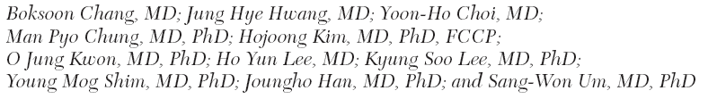

Slide 2
Background
Low-dose CT (LDCT) scanning for lung cancer screening has increased since 1990’s
    The National Lung Cancer Screening Trial in the United States: reduces mortality from lung cancer
Ground-glass opacities (GGOs)
  lesions of homogenous density and with hazy increase in density in the lung field
  not obscure the bronchovascular structure
  0.2% ~ 0.5% of screened populations

Slide 3
Background
Ground-glass opacities (GGOs)
  Benign ~ malignant disease
  Persistent focal GGOs > 3 months
    focal fibrosis, atypical adenomatous hyperplasia, bronchoalveolar carcinoma, and invasive adenocarcinoma
  Frequency of malignancy
    mixed GGO > pure GGO in LDCT screening
  Grow slowly, natural history? Overdiagnosis bias?
The purpose of study
  the natural history of screening-detected pure GGO nodules
  long-term follow-up of > 2 years
  patients with no history of lung cancer or other malignancy

Slide 4
Materials and Methods
Patients
  Retrospectively reviewed (1997.6~2006.10)
  Screening LDCT at the Center for Health Promotion, Samsung Medical Center (Seoul, South Korea)
  Inclusion criteria
    persistent, pure GGO lung nodules
    Followed for > 2 years after the initial LDCT scans
  Exclusion criteria
    transient GGO lung nodules
    diffuse GGO lung lesions and a suspicion of interstitial lung disease
    fibrotic changes or bronchiolitis
    confirmed solid or mixed GGO nodule
    history of previous primary lung cancer or any other malignancy,
    resection of GGO lung nodules within 2 years,
    failure to undergo thin-section chest CT scans ( < 2.5 mm) at the initial LDCT scan or during the follow-up period.

Slide 5
Materials and Methods
CT Screening and Serial Follow-up
  CT scans
    a 64-detector row scanner, unenhanced helical technique
      1-mm section thickness (high-spatial-frequency algorithm)
      1990s : 5-mm-thick reconstructions with single-detector scanner
  GGO with internal solid portion or diameter >10mm
  -> NAB or VATS
  GGO with < 10mm without internal solid portion
  -> 3mo, 6mo, annually CT f/u

Slide 6
Materials and Methods
Radiologic Definition of GGO Nodules
  Tumor shadow disappearance rate (TDR)
    solid (TDR=1), mixed (0 <TDR < 1), pure GGOs (TDR = 0)
  Size change of GGO nodule
    Increased (≥2mm)/unchanged/Decreased (≤2mm)
  Volume doubling time ( Initial –> Final chest CT)
    modified method of the Schwartz formula.
  Peripherally distribution
    located in the lateral two-thirds of the lung parenchyma on transverse CT scans.

Slide 7
Materials and Methods
Surgery and Histopathologic Findings
  Surgical resection
    Growing pure GGO nodules (≥2 mm)
    New development of an internal solid portion.
  Histologic classification of adenocarcinoma
    International Association for the Study of Lung Cancer/American Thoracic Society/European Respiratory Society classification of lung adenocarcinoma

Slide 8
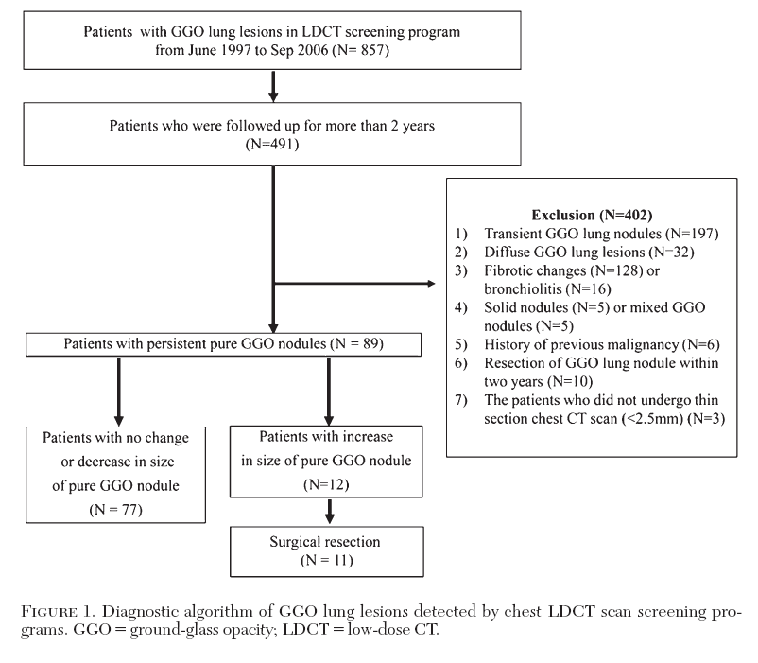
Results

Slide 9
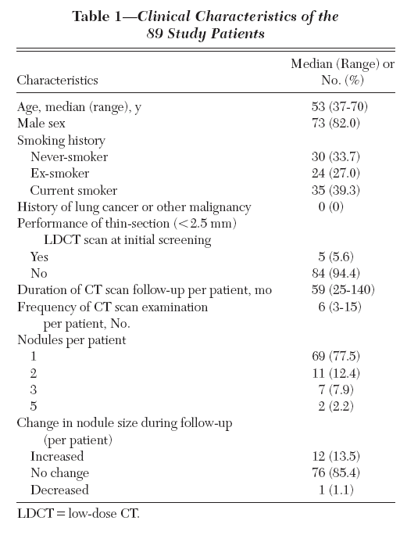
Results

Slide 10
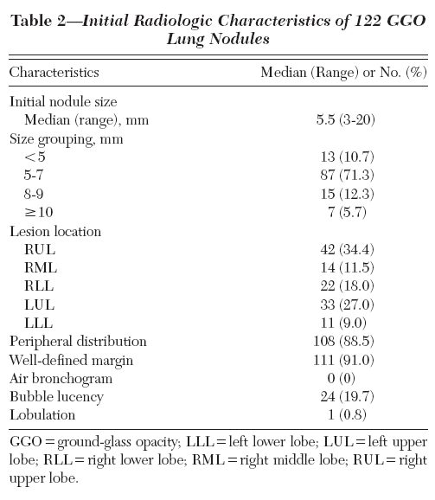
Results

Slide 11
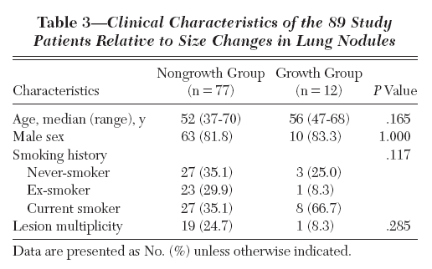
Results

Slide 12
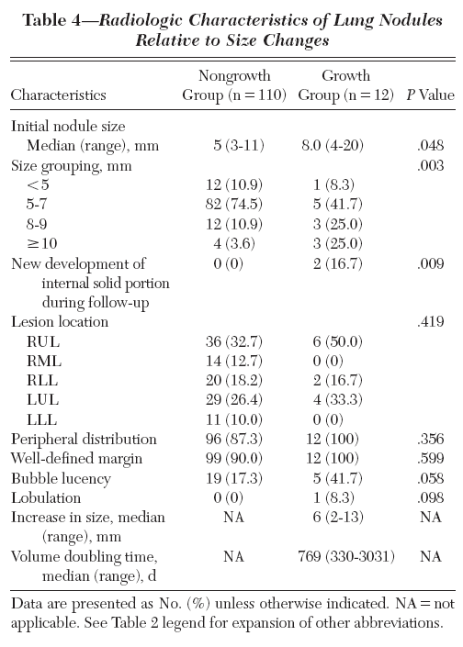
Results

Slide 13
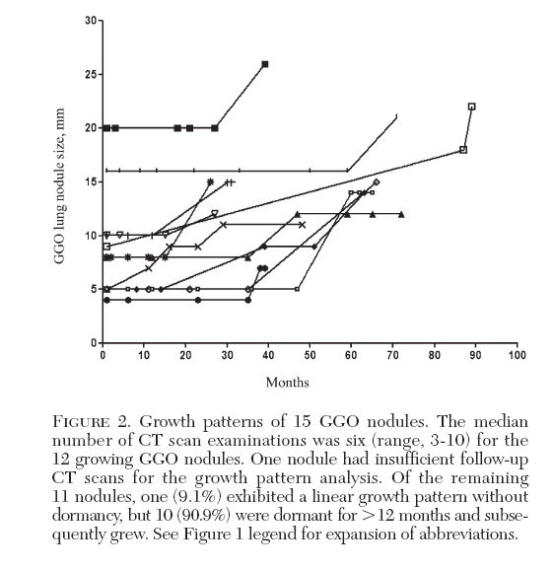
Results

Slide 14
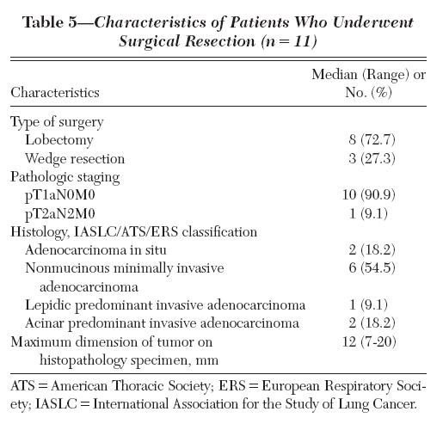
Results

Slide 15
Dicussion
Long-term follow-up data for screening-detected pure GGO
  Previous two study : history of lung cancer
    Risk factor for GGO growth , high malignancy rate
Median volume doubling time: 769days
  Hasegawa et al. : 831days (pure) vs 457days (mixed)
  Five mixed GGOs (excluded) : 60%(growth), 488days
Clinical course of growing pure GGO
  Clinically indolent
    Volume doubling time >400days : 11 of 12 (91.7%)
    Adenoca. in situ or minimally invasive adnoca. (72.7%)
  But, some – invasive carcinoma (27.3%), LN mets (9.1%)

Slide 16
Dicussion
Initial size & new development of a solid portion – associated with nodule growth
  7.7% (<5mm), 5.7%(5-7mm), 20.0%(8-9mm), 42.9% (>10mm)
  Recent guidelines recommend no further follow-up for pure GGO lung nodules < 5 mm
    But growth of 4mm pure GGO nodule,
    Follow-up duration should be extended to 5 or 10 years

Slide 17
Discussion
Limitations
  Heterogeneous follow-up CT scan protocol and duration
  Not all patients undergo tissue confirmation
  Difficulty to evaluate accurate size change and volume doubling time
In conclusion
  90% of the screening-detected pure GGO lung nodules
    not grow during long term follow-up (no history of malignancy)
  Most of growing nodules (9.8%) have an indolent clinical course (11of 12 confirmed as primary lung cancer)
    Strategy of long-term follow-up and selective surgery for growing nodules

