Slide 1
Fungal lung disease
F2 장혜진

Slide 2
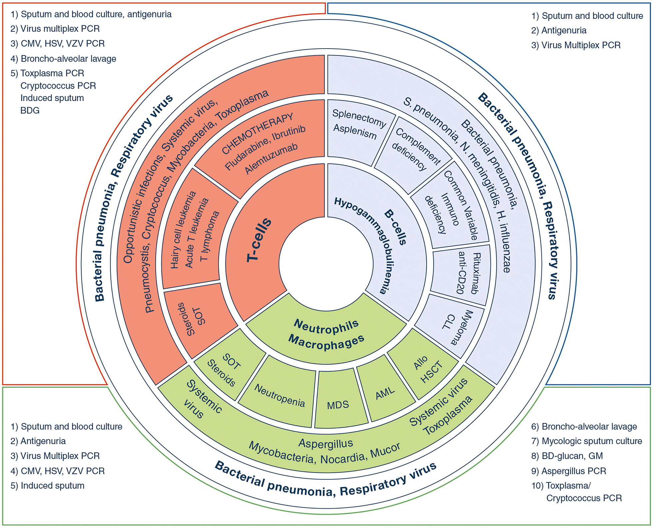
Intensive Care Medicine volume 46, pages298–314(2020)

Slide 3
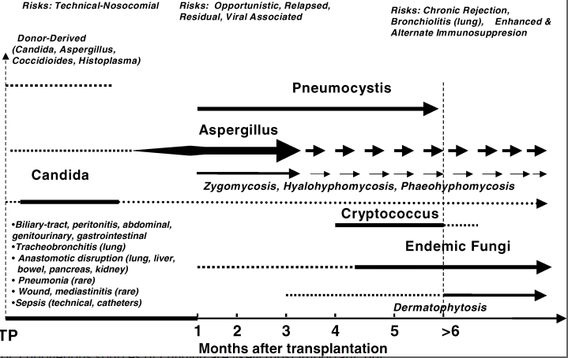
Fungal infections. American Journal of Transplantation, 4: 110-134

Slide 4
Aspergillus
  40.5 cases per 1000 patient-year in lung transplantation, 4.8 cases per 1000 patient-years among all SOT
  6% (3~15%) of lung transplant recipients develop aspergillosis
Cryptococcus
  0.66% in lung transplantation, 0.2% in SOT
Mucormycosis
Other (Pneumocystis, Candida)
J Heart Lung Transplant. 2003;22(3):258.
Transpl Infect Dis. 2002;4(4):195.

Slide 5
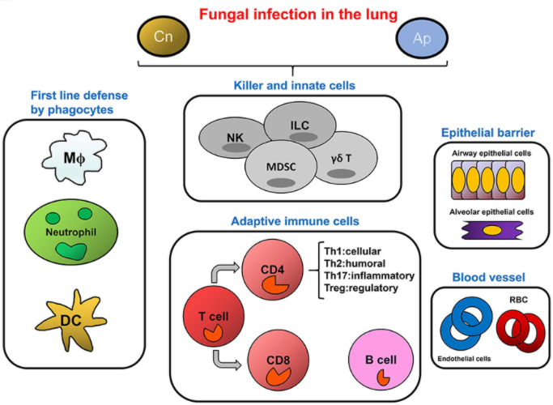
Pathogenic fungal infection in the lung, Front. Immunol., 03 July 2019
Notes:
Figure 3. The Network of cellular defense against fungal infections in the lung. (A) The cell category in host response to infection

Slide 6
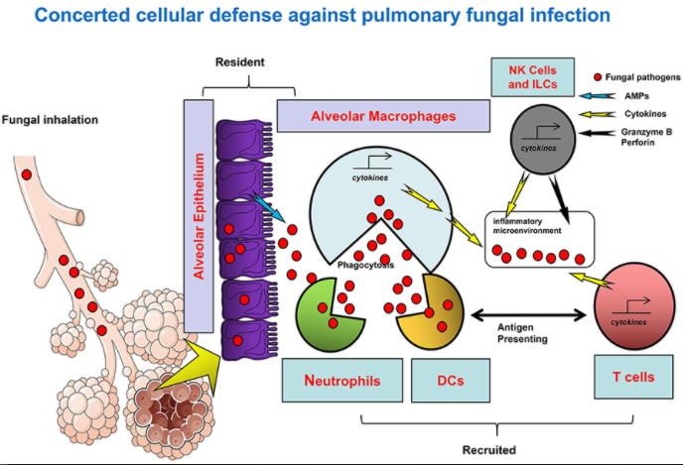
Pathogenic fungal infection in the lung, Front. Immunol., 03 July 2019
Notes:
Among them, granulocytes and monocytes/macrophages as well as DCs are typical myeloid lineages which are the major cellular agents for innate immunity. In the respiratory tract, these cells constitute the first line of defense. Alveolar macrophages are monocytes/macrophages specifically resident in the lung; neutrophils are quickly infiltrated to the sites of inflammation to eradicate the pathogen and to promote tissue repair; pathogens, or antigens bind to DC-SIGN expressing immature DC to gain access to these cells for uptake, meanwhile activating DCs trigger adaptive immunity mediated by the T cells. The direct anti-pathogen effect of NK cells, as a central player of innate immunity, is ascribed to their direct cytotoxicity and cytotoxic cytokine and granule-secreting capacity. In addition, other innate like cells such as ILC and special T cell types such as γδT cells also contribute to the host defense by cytokine secretion or other approaches, with concomitant inducement of MDSC. For adaptive immunity, CD4+ T helper cell immunity is predominant in the pathogen-induced inflammation, IFN-γ produced by active Th1 cells is beneficial for Cryptococcus clearance, and the Th17 cells with IL-17/IL-23 secretion also plays important roles in a pulmonary fungal infection. In contrast, Th2 cells with anti-inflammatory cytokine secretion and Treg cells with immunosuppression activity participate in the host response upon fungal infection usually with negative outcomes. In the microenvironment, secreted cytokines further regulate innate and adaptive cells function through cytokine receptors. Besides multiple immune cells, the epithelial cells at the mucosal barrier also confer a protective activity against the invasive fungi in the respiratory tract. In the lung blood vessel, the roles of endothelial cells and RBC have rarely been reported.

Slide 7
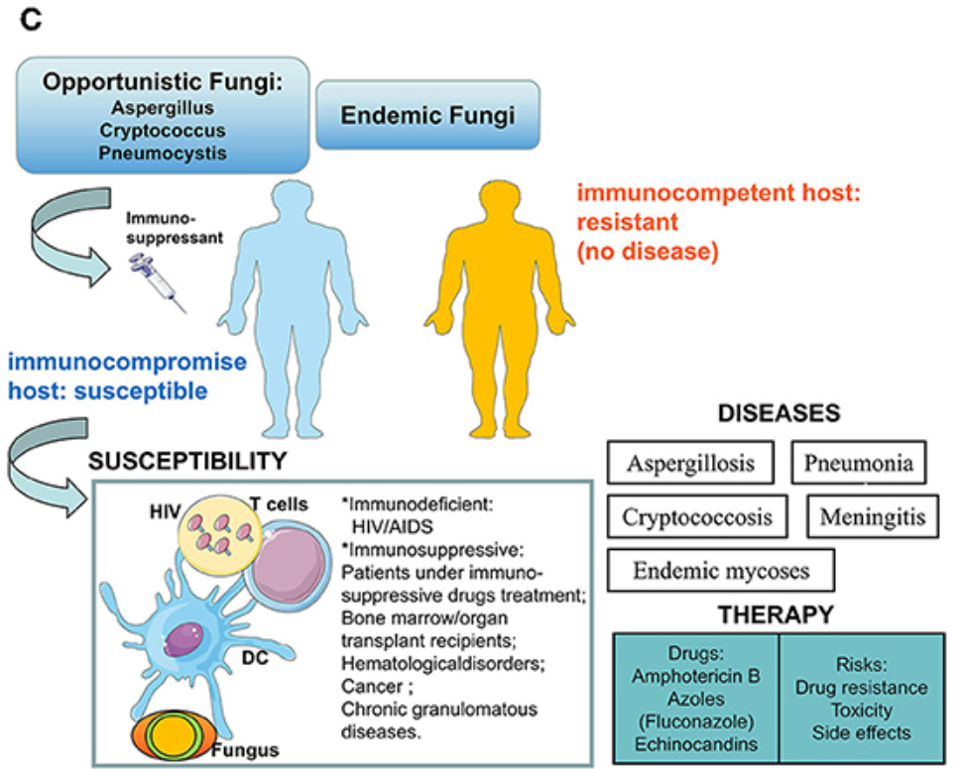
Pathogenic fungal infection in the lung, Front. Immunol., 03 July 2019
Notes:
Summary of fungal infection to human hosts. Opportunistic fungi or endemic fungi infection usually occurs in hosts with a profound immune deficiency involving HIV/AIDS, or immunosuppressed patients involving hematopoietic stem cells (HSCs) or solid organ transplantation, immunosuppressant, or glucocorticosteroid therapy, hematological disorders (leukemia, lymphoma), cancer, and chronic granulomatous diseases. In susceptible hosts, multiple factors participated in this process including HIV, Fungus, immune cells, or even the immunosuppressant and transplanted organs. Infection and subsequent inflammation result in diseases e.g., Mycoses, pneumonia, and meningitis. The current anti-fungal treatments include azoles and Amphotericin B, but potential risks also lead to the ineffectiveness of the drugs.

Slide 8
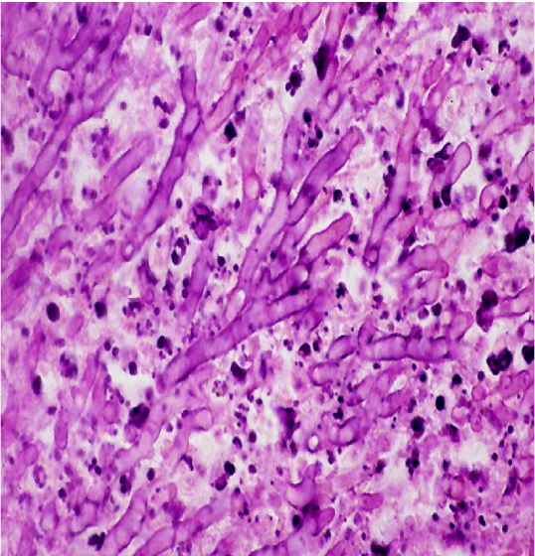
Aspergillosis (mold)
Ubiquitous in the environment
cause a spectrum of clinical syndromes including respiratory colonization, Aspergilloma, Allergic Bronchopulmonary Aspergillosis, and Invasive Pulmonary Aspergillosis (IPA)
Pulmonary involvement -> immunocompromised patients (neutropenia, steroid therapy, immunossupressants 복용)
Cavitary lesion
Blood vessel invasion, thrombosis, infarction

Slide 9
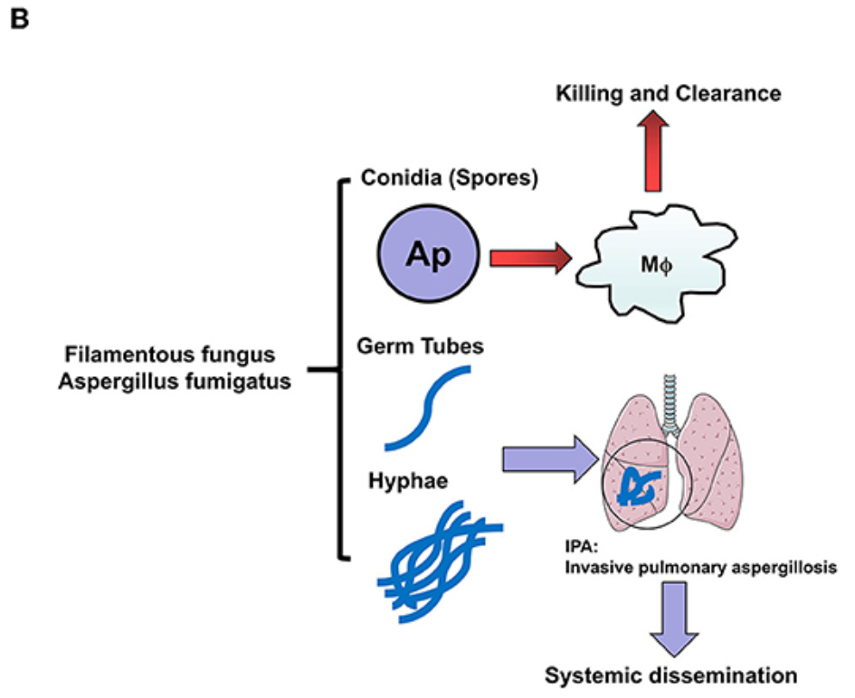
1st line host defense (alveolar macrophage)
Pathogenic fungal infection in the lung, Front. Immunol., 03 July 2019
Notes:
Aspergillus fumigatus in humans: Hyphae are the pathogenicity for IPA. Aspergillus fumigatus are a Filamentous fungus in the lung. Inhaled conidia (spores) could be ingested and killed by the alveolar macrophage constructed first line of host defense, while the escaped conidia grow into mature germ tubes and hyphae, which not only cause Invasive pulmonary aspergillosis (IPA) but also lead to systemic dissemination by invading vessels. This pathological process is more common in patients who lack an effective host defense or hyphal defense.

Slide 10
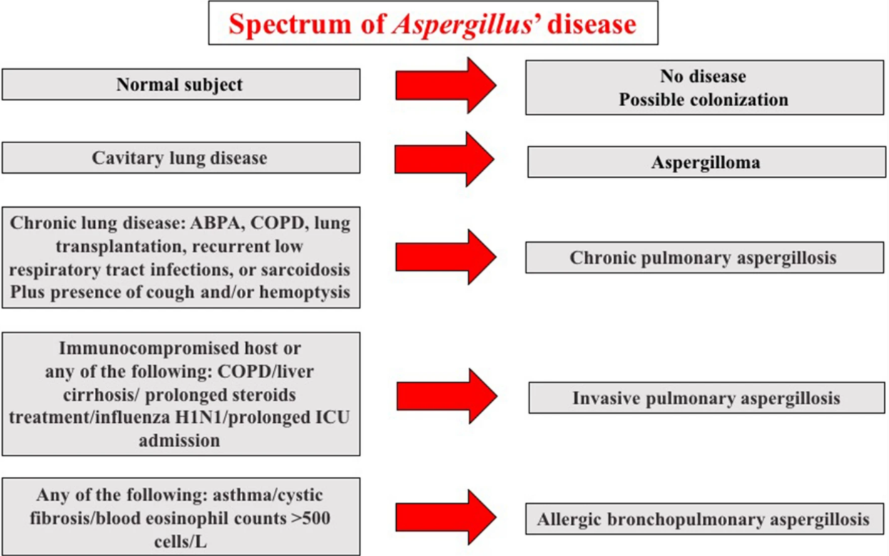
Aspergillosis
Fungal ball in lung
Infectious Diseases and Therapy volume 9, pages511–524(2020)

Slide 11
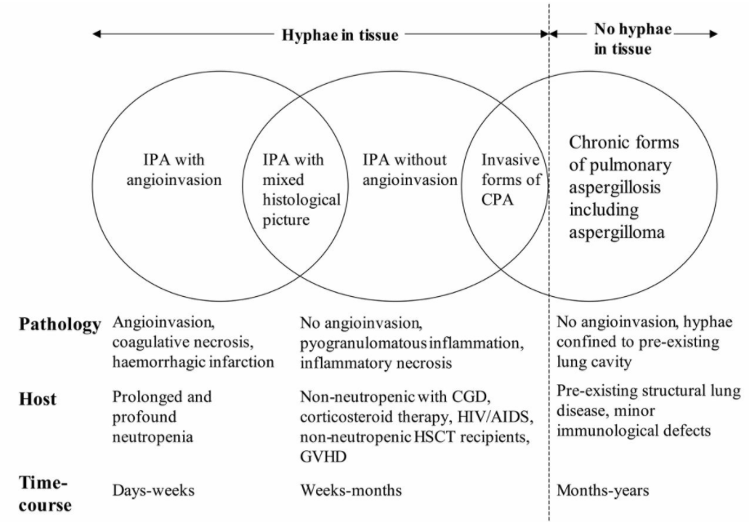
Kosmidis and Denning. Thorax. 2015; 70: 270-277.

Slide 12
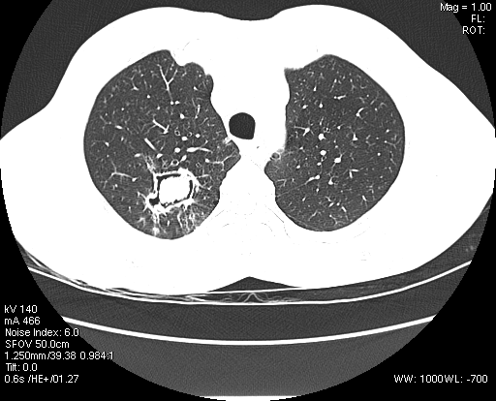
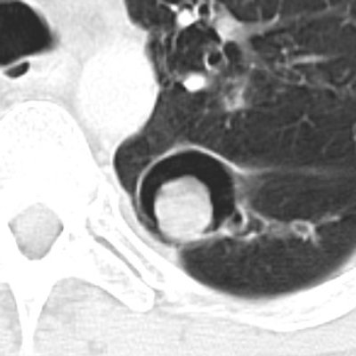
Aspergilloma
: a non-invasive form of pulmonary aspergillosis caused by a fungus ball that characteristically develops itself in a pre-existing cavity of the lung
https://radiopaedia.org/cases/aspergilloma-7
Notes:
a thin walled cavity secondary to tuberculosis , containing a hyperdense soft tissue attenuation with surrounding air lucency characteristic of aspergilloma and air crescent sign . Few fibrotic changes are seen surrounding the cavity . Cavity wall 이 두껍고, pleura 근처에 위치해 있음. 따라서, 어떤 경우에는 pleural thicening이 가장 earlist finding이 되기도 한다.
보통은 asymptomatic 하지만, 가장 흔한 증상은 hemoptysis 이고, 이런 경우 emboli를 고려해봐도 좋고, life threatening 하게 massive hemoptysis 한 경우에는 surgical resection을 하게 됩니다.
tubercular and nontubercular mycobacterial infections are the primary underlying lung conditions predisposing to the formation of aspergilloma
there is a strong recommendation to perform a surgical resection of a simple aspergilloma in symptomatic patients with low surgical risk, if important symptoms are reported and hemoptysis is persistent. Of importance, surgery should also be considered in patients with Aspergillus-localized CPA unresponsive to antifungal therapy

Slide 13
Chronic pulmonary aspergillosis
a local lung invasion mainly observed in patients with chronic pulmonary disease
weight loss to the appearance of chronic productive cough, hemoptysis, and comparison of nodules and cavities at chest imaging (>3 months)
Serum & BAL galactomannan, Aspergillus culture, serum A. fumigatus IgG
Treatment : prevent life-threatening hemoptysis, QOL improve
  PO Itraconazole 200mg bid (1st)
  Voriconazole, Posaconazole (2nd)
  IV amphotericin B, Echinocandin (rapid progression, azole resistant Aspergillus)
  6 month duration of therapy, asymptomatic patients can be reassessed every 3–6 months
Notes:
Symptomatic patients with cavities, aspergilloma, or nodular infiltrates at CT scan should be tested for the presence of serum A. fumigatus IgG; the presence of aspergilloma is associated with positivity of A. fumigatus IgG in serum. Alternatively, the when antibodies are negative, the positive Aspergillus cultures from the lower respiratory tract may support the diagnosis [28]. GM in bronchoalveolar lavage (BAL) showed a good diagnostic performance if compared to serum GM, and appears to be a valuable diagnostic assay [29]. Of interest, the combination of serum GM plus 1,3-beta-D glucan (BDG) could be help physicians to confirm or exclude Aspergillus infection, but their diagnostic values have not been well characterized.
The goal of CPA treatment is to prevent life-threatening hemoptysis and to improve symptoms and the patient’s quality of life. Oral itraconazole, at a dose of 200 mg twice daily, is considered the first-line therapy [22]. Voriconazole and posaconazole are second-line oral therapies [33, 34], and in selected cases the use of short-term courses of intravenous amphotericin B and echinocandins have also been successfully used, especially in patients with rapid progression of the infection, failure of therapy, or azole resistance of Aspergillus strains
A 6-month duration of therapy is recommended, and asymptomatic patients can be reassessed every 3–6 months

Slide 14
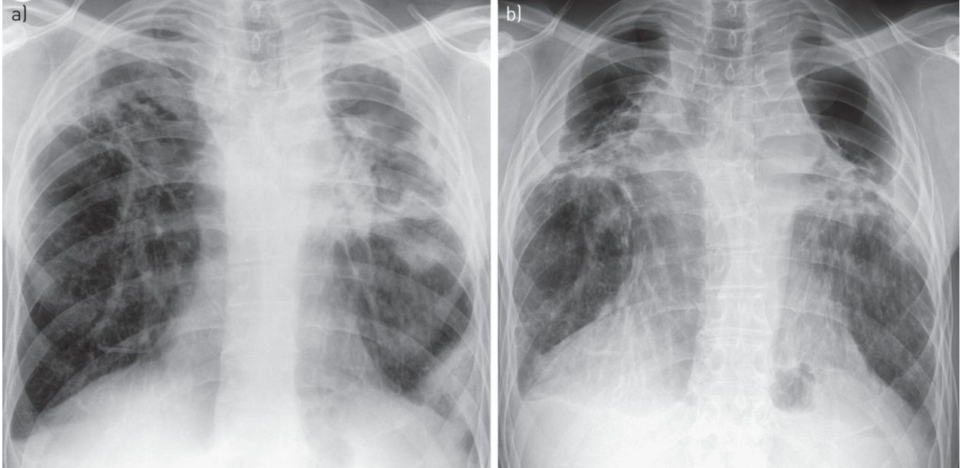
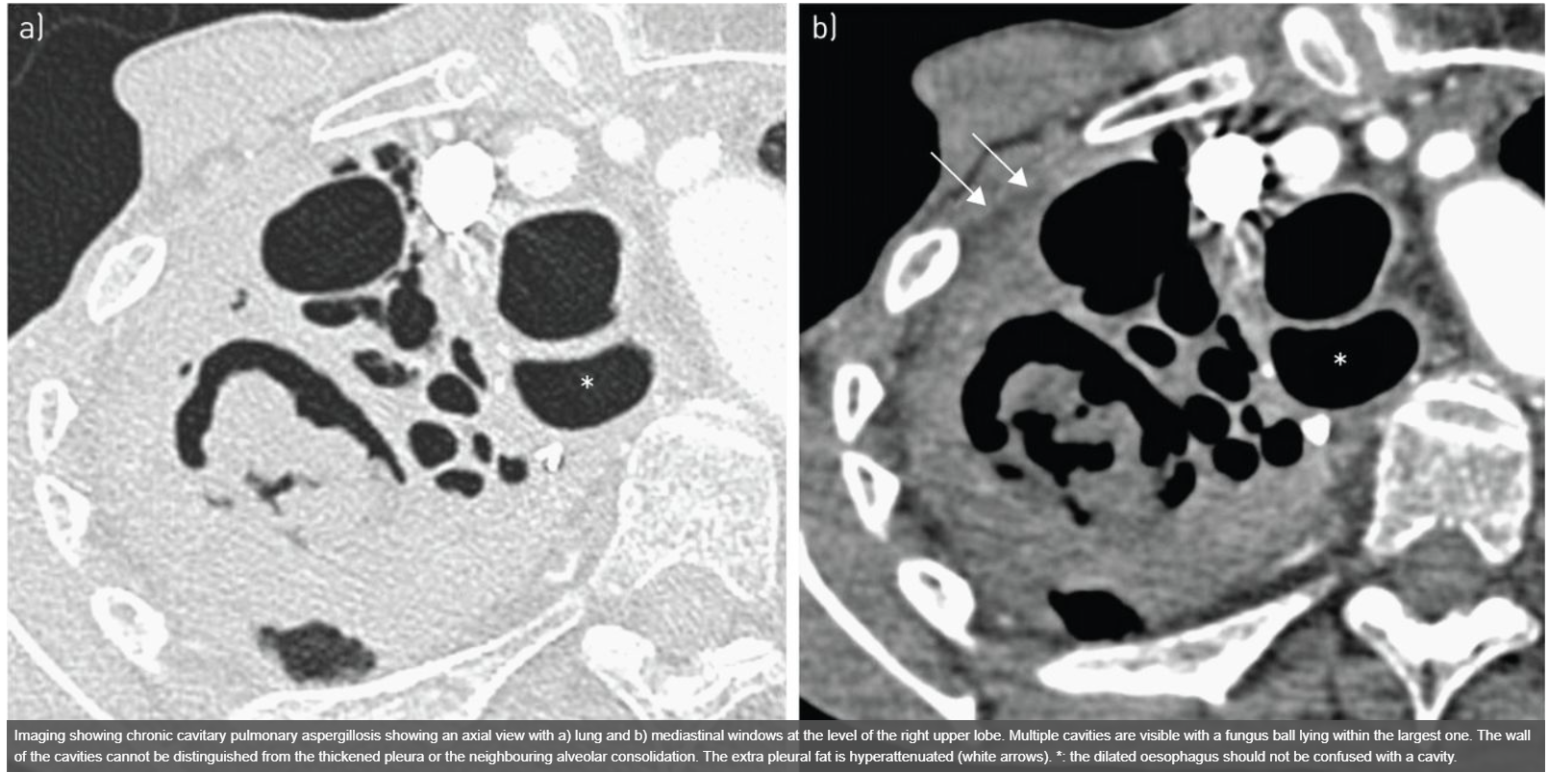
A large cavity with pleural thickening
The right side shows interval development
of a large cavity
European Respiratory Journal 2016 47: 45-68
Notes:
Chronic cavitary pulmonary aspergillosis showing marked progression between a) 2007 and b) 2012. Chest radiographs prior to 2007 (i.e. 1990s) showed “upper lobe fibrosis”, without a firm diagnosis. A large cavity with pleural thickening is visible on the left in both images, with additional small cavities inferiorly in 2012, and contraction of the left upper lobe. The right side shows interval development of a large cavity, with some pleural thickening. Neither cavity contains a fungal ball.

Slide 15
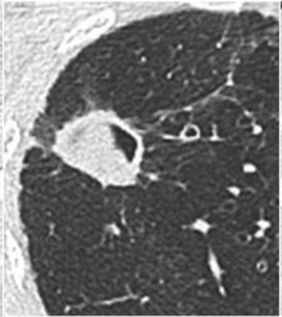
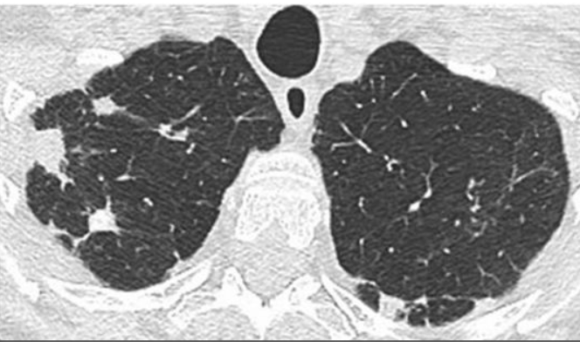
Unusual form of CPA – Aspergillus nodule
European Respiratory Journal 2016 47: 45-68
Notes:
Aspergillus nodule (cavitary화 되어있지 않고, 3cm보다 작은 nodul은 CPA의 unusual form) - malignancy와 비슷
Successive axial views within the lung window showing Aspergillus nodules, of variable size and borders, and a fungus ball filling a cavity with a wall of variable thickness in a patient with pre-existing bronchiectasis and cicatricial atelectasis of the middle lobe.

Slide 16
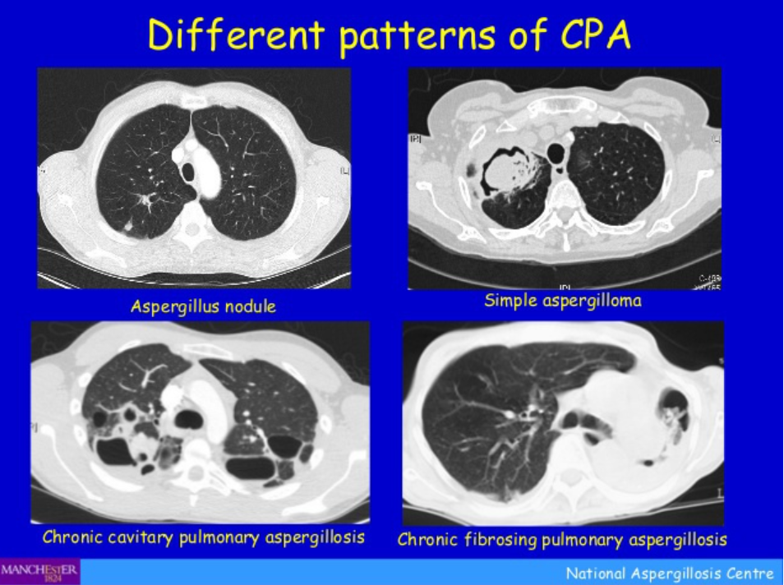

Slide 17
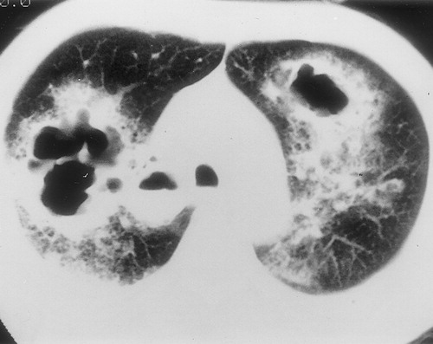
Semi-invasive Aspergillosis
= Subacute invasive aspergillosis
= Chronic necrotizing aspergillosis
Factors associated with this form :
  chronic debilitating illness,
  diabetes mellitus,
  malnutrition,
  alcoholism,
  advanced age,
  prolonged corticosteroid therapy,
  COPD
증상 : Chronic cough, sputum, fever (non-specific), hemoptysis (15%)
영상 : Tissue necrosis, granulomatous inflammation, unilateral or bilateral consolidation과 근접 pleural thickening, multiple nodular area of increased opacity, months ~ years
Serum Aspergillus Ag test, biopsy
RadioGraphicsVol. 21, No. 4
Notes:
Tissue necrosis와 granulomatous inflammatio이 TB reactivatio과 비슷한 양상임. 이런 형태로 aspergillosis가 develop 하게 되는 데에는 만성 질환, DM, malnutrition, alcoholism, old age, steroid 오래 쓴 경우, COPD 등이 있다. Clinical sympto은 chronic cough, sputum, fever 등이 있고, 대부분 non-specific 하며, 15%에서 hemoptysis가 동반된다.
영상 finding 으로는 unilaterao 또는 bilateral segmental area의 consolidation과 근접 pleura의 thickening, cavity는 있거나 없거나 한다.
그리고 multiple nodular area of increased opacity가 있고 수개월에서 수년에 걸쳐 서서히 진행하게 된다.

Slide 18
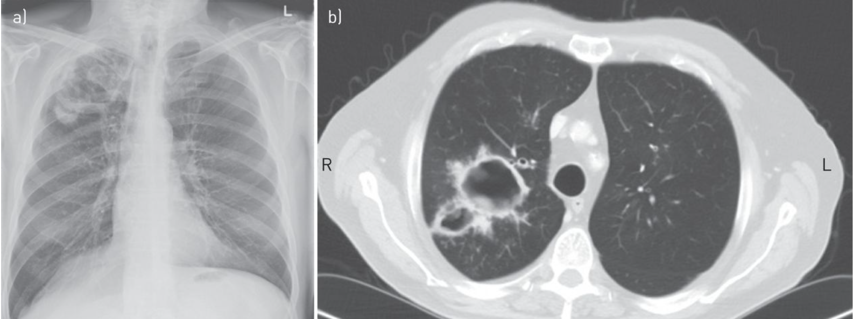
a large irregular right upper-lobe cavitary lesion
a dual cavity with moderately thick walls, an external irregular edge and some material within the cavity
ERJ. 2015 as doi: 10.1183/13993003.00583-2015
Notes:
The chest radiograph shows a large irregular right upper-lobe cavitary lesion that developed with multiple symptoms over 6 weeks during treatment with sorafenib. The patient presented with unresectable hepatocellular carcinoma. b) The computed tomography scan shows a dual cavity with moderately thick walls, an external irregular edge and some material within the cavity on an almost normal lung background.

Slide 19
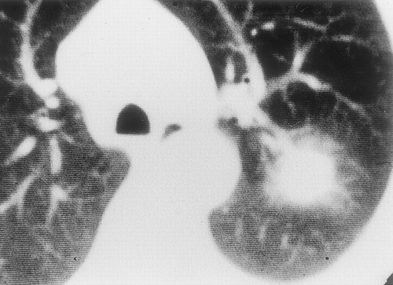
Invasive aspergillosis
a severe acute/subacute disease and can be found not only in severely immunocompromised patients but also in non-neutropenic and/or critically ill patients, and those with chronic obstructive pulmonary disease (COPD) and/or Child–Pugh C liver cirrhosis.
Initially, chest radiograph can be normal
Lung nodules or areas of consolidation can progress rapidly
Halo sign (early)
Air crescent sign (late)
  Crescent-shaped gas collection within pulmonary nodule or consolidation
  Can progress to extensive cavitation and necrosis
the presence of new nodules with ground-glass halo or reversed halo (atoll) sign is strongly suggestive of the diagnosis of angioinvasive aspergillosis,
Treatment
  Voriconazole
  Amphotericin B
RadioGraphicsVol. 21, No. 4
Notes:
a 2-cm nodular lesion with a wide halo of ground-glass attenuation representing adjacent hemorrhage
Halo Sign (early) -> (late) Air-creasent sign
-Mucormycosis
-Tuberculosis
-Bacterial Abscess
-Metastases: Angiosarcoma
the presence of new nodules with ground-glass halo or reversed halo (atoll) sign is strongly suggestive of the diagnosis of angioinvasive aspergillosis,

Slide 20
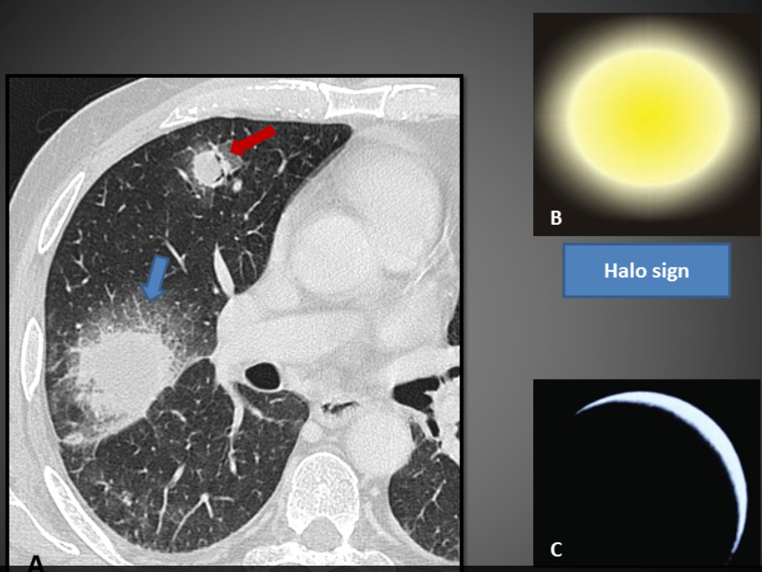
a central fungal nodule surrounded by a rim of hemorrhage and coagulative necrosis.
(A) Radiology, HOSPITAL CLÍNIC DE BARCELONA. (B) (C). Diagn Interv Radiol. 2011 Mar;17(1):18-29. Review.
Notes:
The halo lesion was shown to correspond to a central fungal nodule surrounded by a rim of hemorrhage and coagulative necrosis.
The air-crescent sign (red arrow) is the result of air accumulation between a mass or nodule and normal lung parenchyma. The separated area then fills with air, resulting in the air crescent sign.
These two CT signs are not pathognomonic, but in the setting of neutropenic patients, they are highly suggestive of IPA.

Slide 21
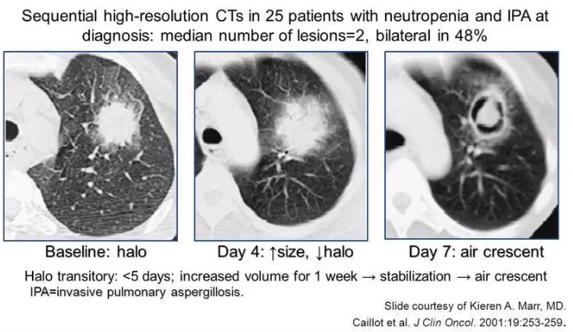
Notes:
Halo Sign (early) -> (late) Air-creasent sign
-Mucormycosis
-Tuberculosis
-Bacterial Abscess
-Metastases: Angiosarcoma
the presence of new nodules with ground-glass halo or reversed halo (atoll) sign is strongly suggestive of the diagnosis of angioinvasive aspergillosis,

Slide 22
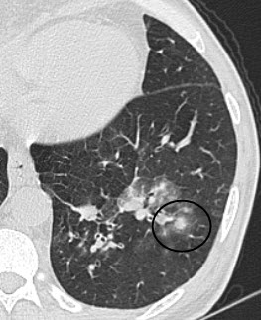
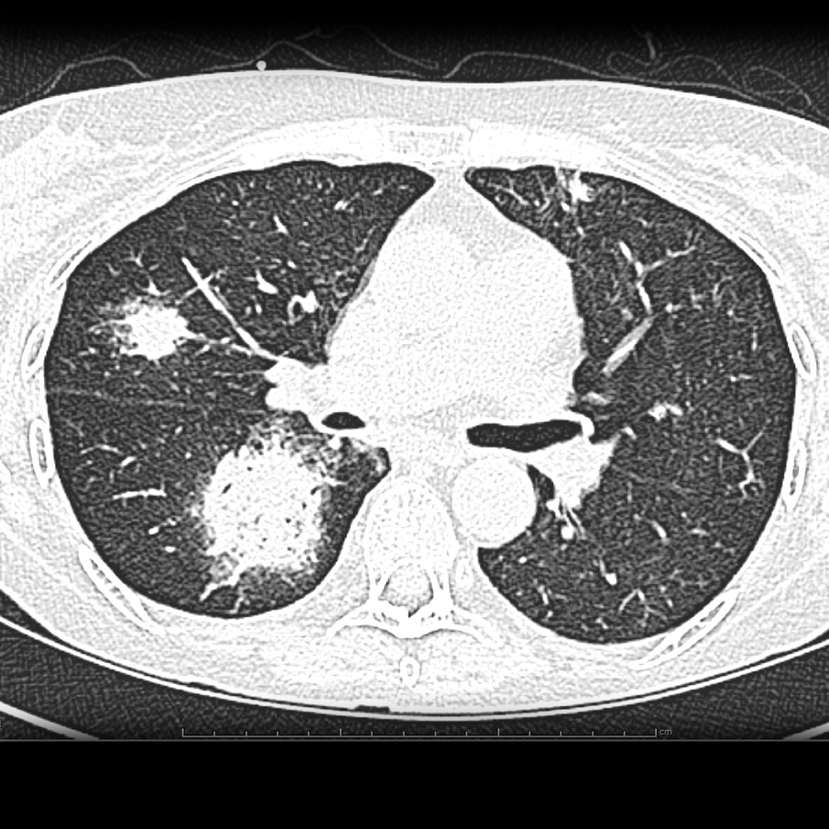
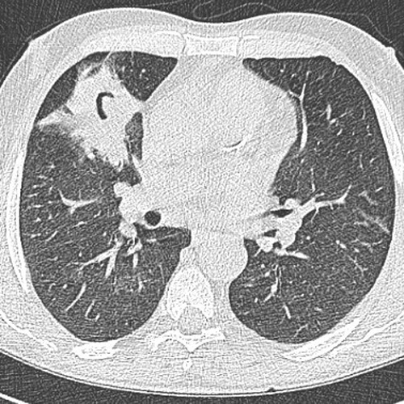
https://radiopaedia.org/articles/angioinvasive-aspergillosis?lang=us
Notes:
3번째 사진은 healing angioinvasive asp (air crescent sign)

Slide 23
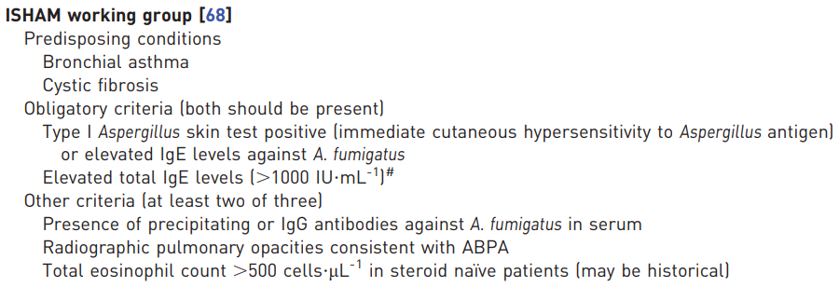
ABPA (Allergic Bronchopulmonary Aspergillosis)
a hypersensitivity reaction of the lung to Aspergillus inhalation, and it is a prerogative of patients with asthma (10%) or cystic fibrosis
The hypersensitivity initially causes bronchospasm and bronchial wall edema, which is IgE-mediated. -> bronchial wall damage with loss of muscle and bronchial wall cartilage
-> resulting in bronchiectasis (typically central bronchiectasis)
Clin Exp Allergy. 2013;43:850–873.
https://radiopaedia.org/articles/allergic-bronchopulmonary-aspergillosis

Slide 24
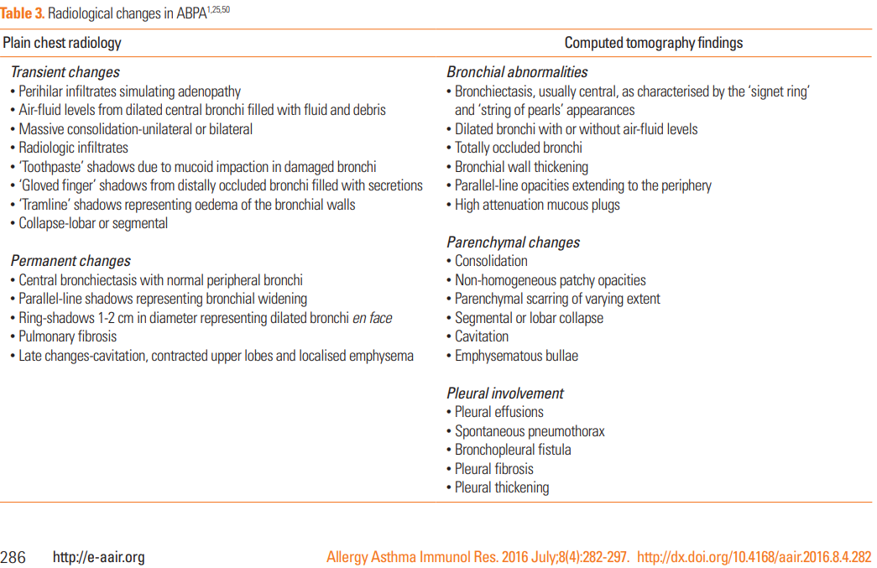

Slide 25
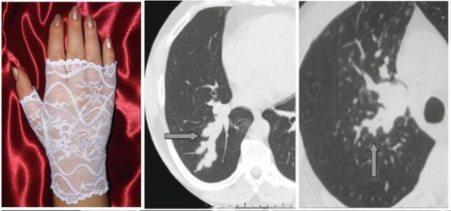
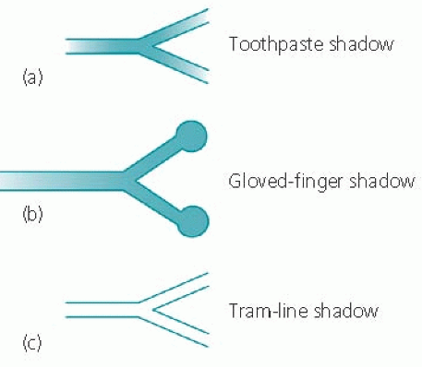
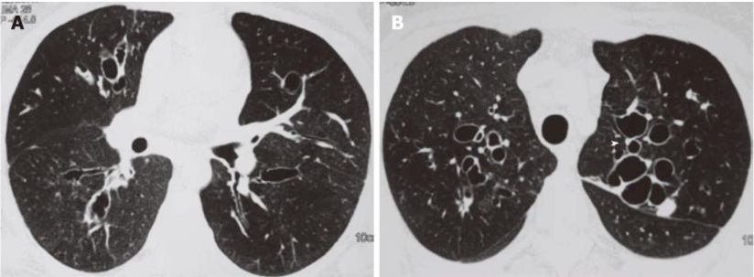
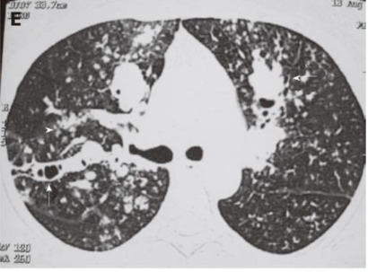
Metaphorical Signs in Computed Tomography of Chest and Abdomen pp 53-53
Principles of Chest X-ray Diagnosis, 4th edn, 1978. Butterworth, London
Central bronchiectasis
Mucus plugging with centrilobular nodules
World J Radiol. Apr 28, 2012; 4(4): 141-150

Slide 26
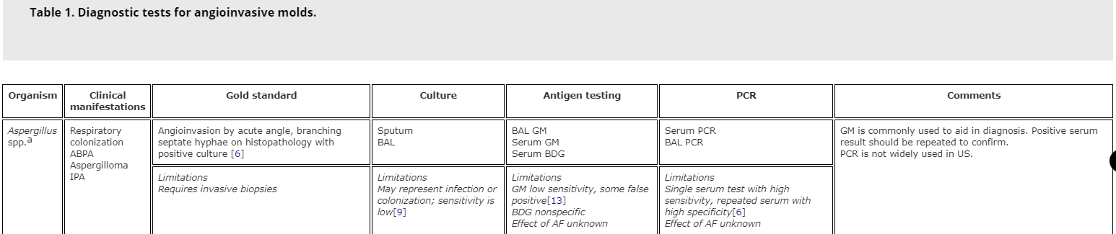
Aspergillosis
Galactomannan and β-1,3-D glucan are cellular wall constituents of Aspergillus spp. that can be detected to aid in the diagnosis of IPA. Replication 할 때 분비되는 물질.
Galactomannan is more specific to Aspergillus spp. than β-1,3-D glucan.
Aspergillus PCR :serum, BAL에서 DNA의 정량을 통해 분석
  Serum PCR : sensitivity of 80.5% and specificity of 78.5%
  BAL PCR : sensitivity of 91% and high specificity 92% for IPA
Am J Respir Crit Care Med. 2019 Sep 1; 200(5): 535–550.
Expert Review of Respiratory Medicine Volume 14, 2020 - Issue 7
Notes:
Galactomannan은 Asper가 replication을 할때 분비되는 것으로 body fluid 검체에서 immunoassay를 통해서 detectio될 수 있습니다.
Serum galactomannan은 severe neutropenia (<500)가장 sensitivity가 높다고 되어 있고,
The sensitivity of serum galactomannan in patients with hematologic malignancy and hematopoietic stem cell transplant is around 71% with a specificity of 89% [13]. The sensitivity is estimated to be around 25% in non-neutropenic patients but may be increased to 88% by utilizing BAL samples to detect galactomannan in such populations
Galactomannan is present in food items such as yogurt, cream cheese, and ice cream, and may be absorbed via the digestive tract in patients with mucositis [14]. Other causes of false-positive galactomannan assay are penicillin antibiotics or colonization/infection with other molds such as Penicillium, Fusarium, or Zygomycetes [15]. Secondary to false-positive results and limited test reproducibility, it is recommended that positive serum galactomannan results be repeated [16]. Moreover, prophylactic antifungals targeting the cell wall such as triazoles may decrease the sensitivity of galactomannan; however, the degree of reduction has not been clearly established.

Slide 27
Aspergillosis
Among the 50 studies that tested serum GM,
  29 used an assay cutoff index of 0.5 : sensitivity 74%, specificity 85%
  7 studies used a cutoff of 1.0 : sensitivity 79%, specificity 88%
  14 studies used a cutoff of 1.5 : sensitivity 59%, specificity 95%
Serum GM이 불명확한 경우 BAL GM recommend (strong rec.)
GM result (-) 이나, IPA 여전히 의심되면 biopsy 와 repeated BAL GM 고려 (conditional rec.)
False positive
  patients undergoing chemotherapy or at risk for gastrointestinal mucositis may have false-positive serum GM assay results due to cross-reactive antigens from other fungi or bacteria that penetrate the intestinal mucosa
  In the past, positive results have also been associated with the use of concomitant b-lactam antibiotics; however, recent studies suggest that the new preparations are less likely to cross-react with the assay
Am J Respir Crit Care Med. 2019 Sep 1; 200(5): 535–550.
Notes:
(semi invasive, ABPA는 포함x)-Q1

Slide 28
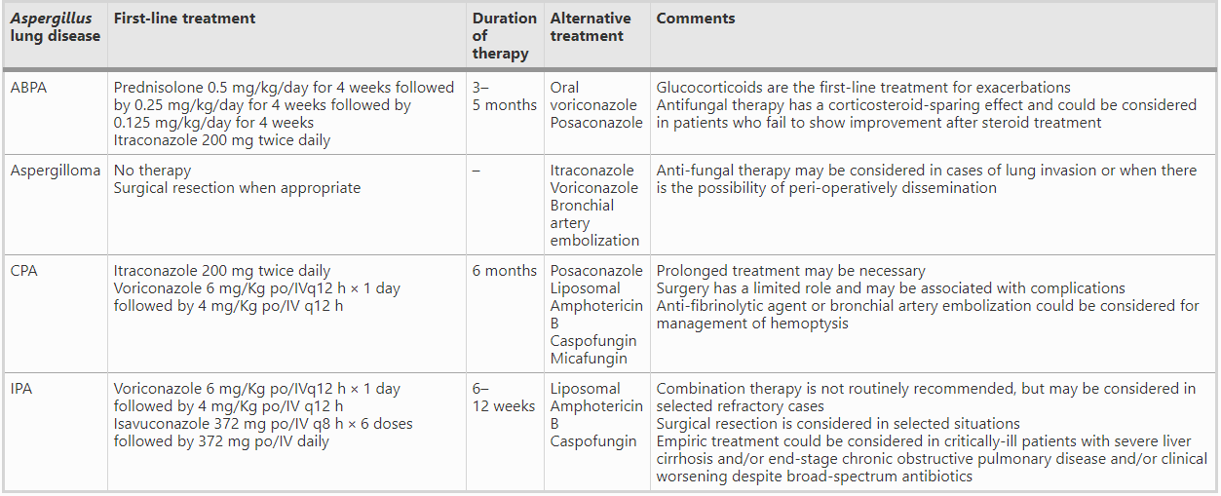
Aspergillosis-Treatment

Slide 29
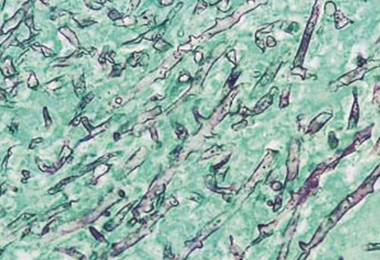
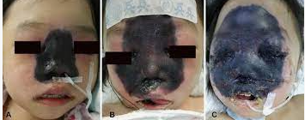
Mucormycosis
infection caused by fungi of the class Zygomycetes
Rhino-orbital-cerebral infections represent the most common site of infection (34%)
followed by skin (22%) and pulmonary (20%)
Risk factors : solid organ transplant and neutropenia are particularly associated with pulmonary Mucormycosis which carries a 51% mortality rate
A high level of suspicion in susceptible patient populations is of paramount importance
증상 : persistent high fever (>38°C), cough, hemoptysis and chest pain
진단 : Identification of organism in tissue (biopsy with culture) !!
  Beta D glucan, galactomannan assay : No useful (not share cell wall component)
  No widely available or FDA approved molecular test for diagnosing Mucor exists.
  More recently, serum PCR to detect free Mucor DNA has been successfully used to aid in diagnosis
치료 : Aggressive surgical debridement of involved tissues ASAP ! + Early antifungal therapy (IV amphotericin B)
J Fungi (Basel). 2019 Mar 20;5(1).

Slide 30
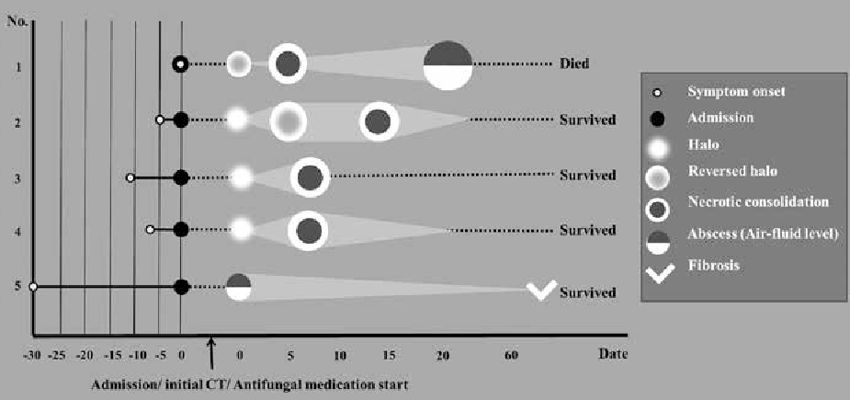
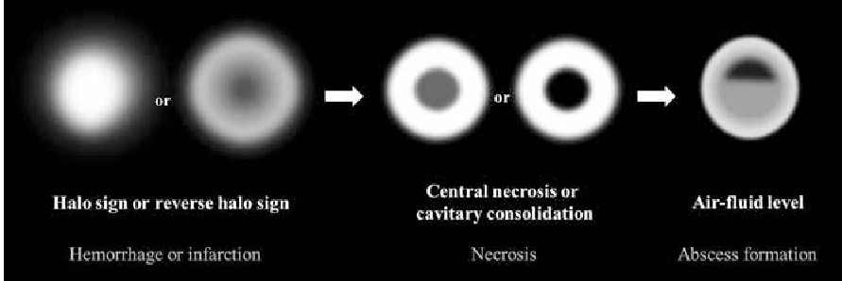
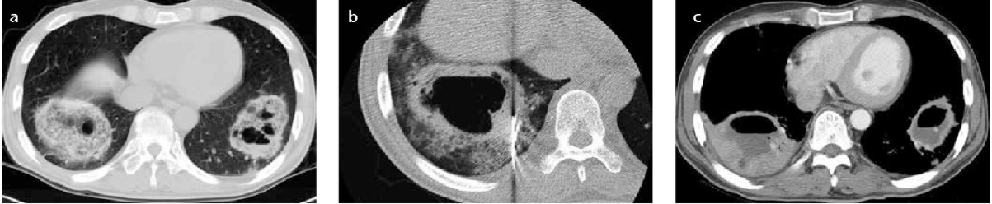
Diagnostic and interventional radiology, 20 1 (2014):42-6

Slide 31
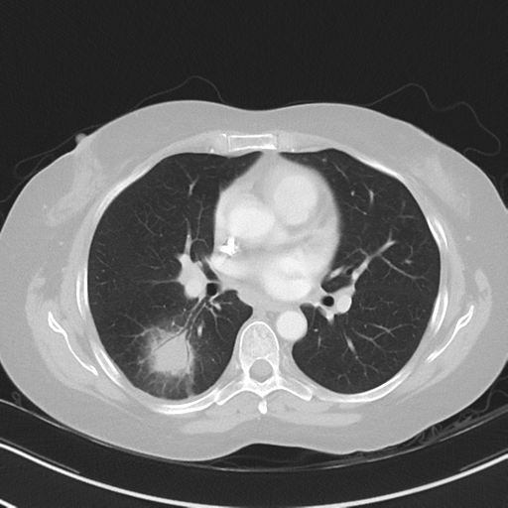
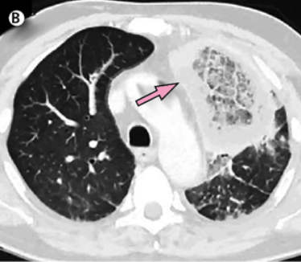
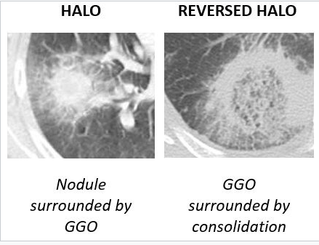
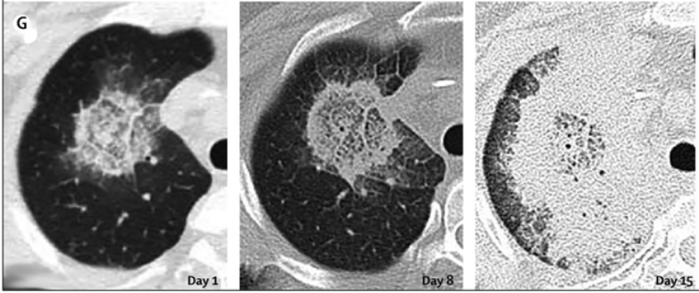
The Lancet Infectious Diseases 19(12), November 2019
Notes:
Imaging features in pulmonary mucormycosis are nonspecific, it can present as a solitary nodule, lobular consolidation as in pneumonia, cavitary lesion or in disseminated form
the peripheral capsule in the reverse halo sign tends to be thicker, which is highly suggestive of mucormycosis.
However, differentiation from other infectious agents cannot be made by imaging.

Slide 32
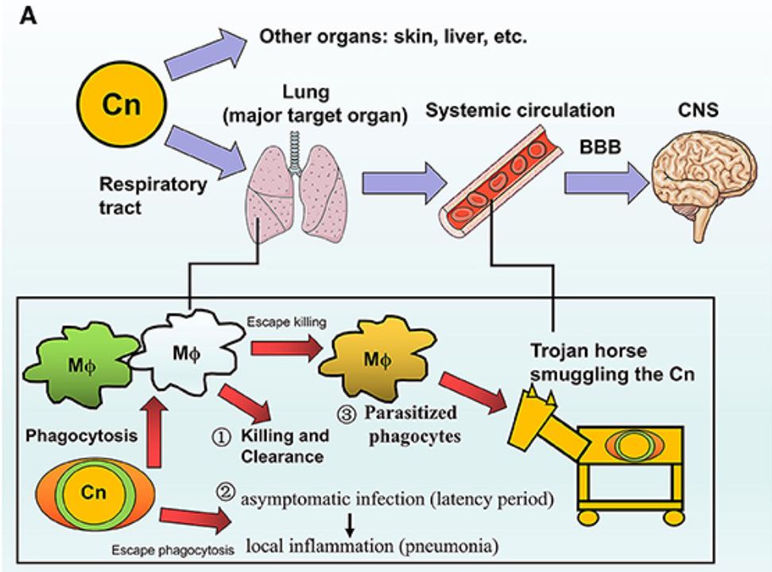
Cryptococcus
Transport the pathologic fungi into the CNA
Pathogenic fungal infection in the lung, Front. Immunol., 03 July 2019
Notes:
Killing and clearance by macrophages after phagocytosis,
The encapsulated fungi are able to escape from phagocytosis and further establish virtual infection after pulmonary colonization, from asymptomatic latency period to local inflammation such as pneumonia,
Part of the phagocytosed fungi could escape from killing and further parasitize the host cells like a Trojan horse which transports the pathogenic fungi into the CNS via circulation. After crossing the BBB, Cn that accumulates in the CNS would result in lethal cryptococcal meningitis especially in susceptible hosts.

Slide 33
Cryptococcus
증상 : fever, cough, chest pain, and dyspnea; (ranging from asymptomatic to respiratory failure)
진단
Culture and Direct Visualization (gold standard)
  Bronchial washing, BAL culture : 83.3%
  Sputum culture : 62.5%
  Biopsy (TBLB, fine needle aspiration, surgical lung biopsy) : 76.9%
  Tissue culture : 72.7%
Cryptococcal antigen (sputum, BAL, serum) : titre ≥1:8.
  BAL : sensitivity 100%, specificity 98%
  Serum : greater than 90% in disseminated case, 83.9% in isolated pulmonary infection
치료 : iv amphotericin B + flucytosine
Chest. 2003 Dec;124(6):2143–2147.
Am Rev Respir Dis. 1992 May;145(5):1226–1229.

Slide 34
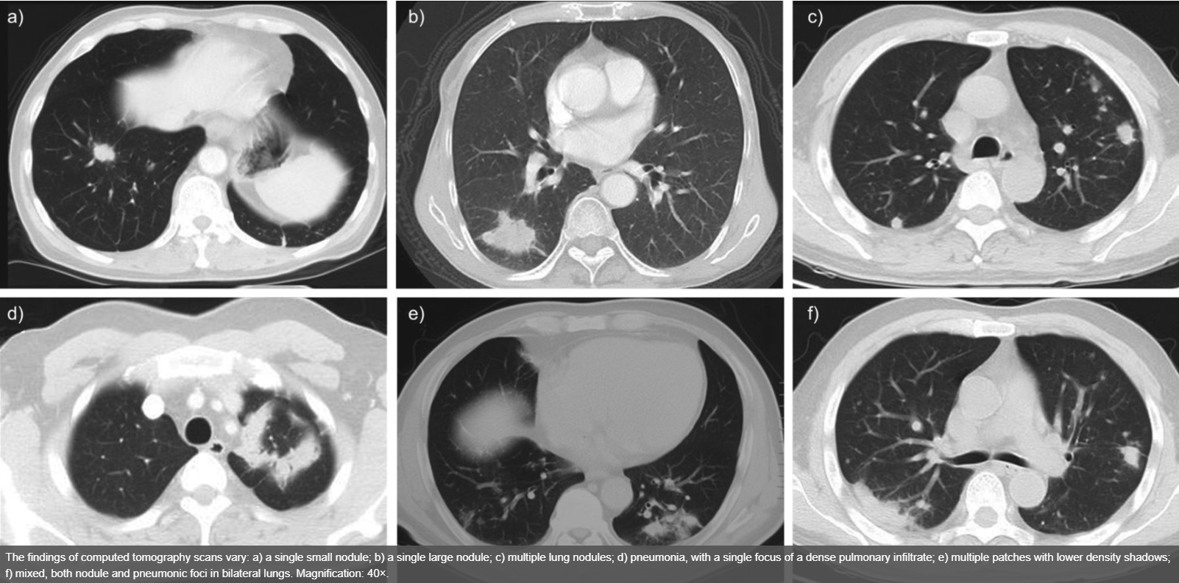
Cryptococcus
Radiographically, pulmonary Cryptococcus infection appears most commonly as nodules
European Respiratory Journal 2012 40: 1191-1200
Notes:
a) a single small nodule; b) a single large nodule; c) multiple lung nodules; d) pneumonia, with a single focus of a dense pulmonary infiltrate; e) multiple patches with lower density shadows; f) mixed, both nodule and pneumonic foci in bilateral lungs.

Slide 35
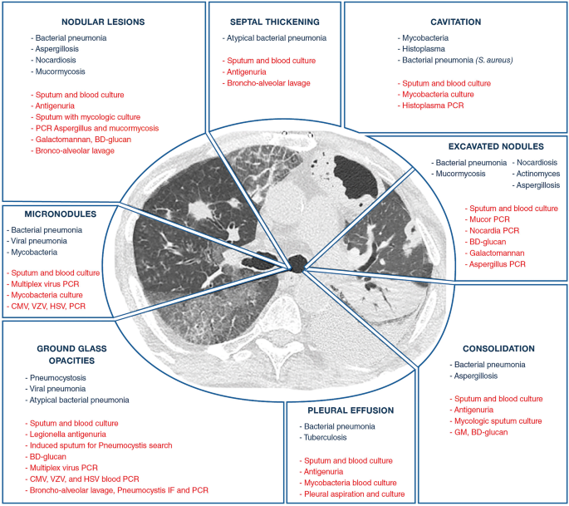
Intensive Care Medicine volume 46, pages298–314(2020)

Slide 36
Thank you.

Slide 37
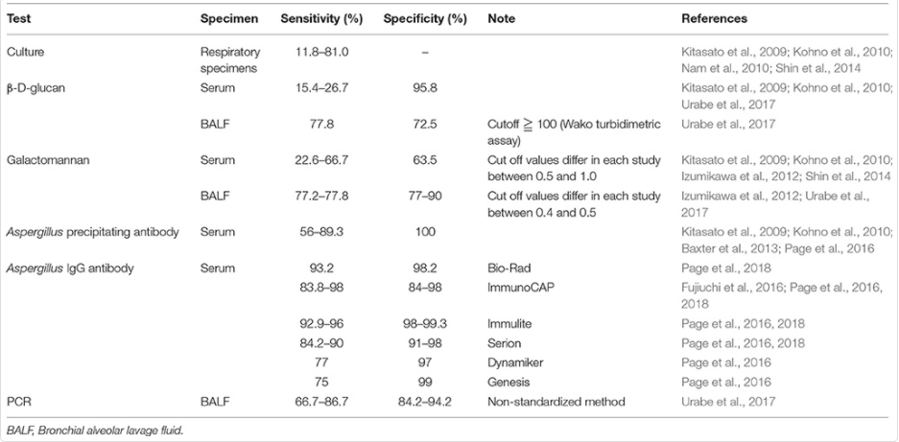

Slide 38
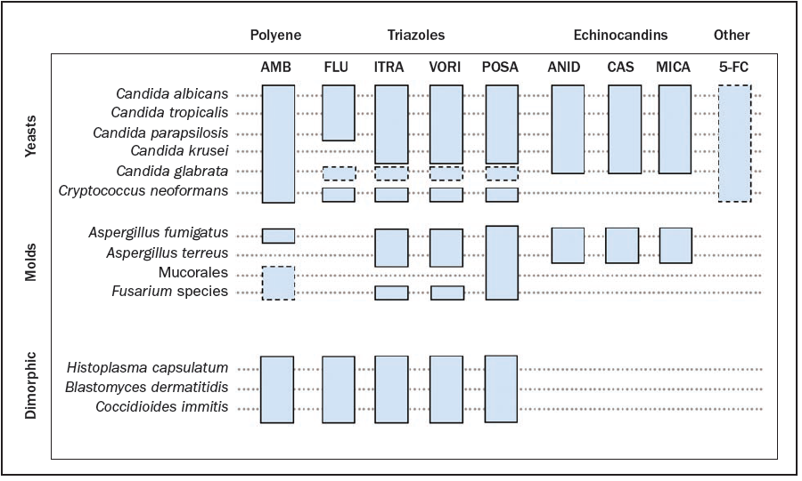
항진균제의 작용범위

