Slide 1

Preparation for bronchoscopy
atropine and lidocaine
Hong Ji Young
Division of Pulmonology,
Department of Internal Medicine,
Institute of Chest Diseases,
Severance hospital, Yonsei University College of Medicine

Slide 2
The use of anticholinergic agents during bronchoscopy
The rationale
  Improve visualization of the tracheobronchial tree through their antisecretory effects
  Prevent reflex bronchoconstriction and vasovagal phenomena
  In case of rigid bronchoscopy,
  atropine premedication became a standard part
  of the procedure.
Chest 1981; 79:512–515
Notes:
In the time of rigid bronchoscopy
to reduce airway secretions caused by irritant gases such as ether and chloroform
to counteract the spasmogenic effects of opioid analgesics and to prevent bradycardia.
Because of effects on bronchial smooth muscle
and salivary and bronchial glands, these agents cause
bronchodilatation and inhibit secretions pro duction
in the nasopharynx/oropharynx and bronchi. The
theoretical beneﬁ ts of prebronchoscopy administration
of these medications include drying of secretions
to allow better examination of the trache obronchial
tree and protection against vasovagal reaction and
bronchospasm.

Slide 3
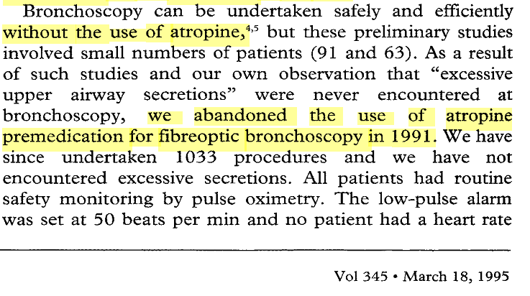
  How about Flexible bronchoscopy ???
  The benefits vs potentially harmful adverse effects

Slide 4
Three randomised controlled trials
(cumulatively studying more than 1300 patients)
→ failed to demonstrate any consistent clinical beneﬁt of anticholinergics for patients
undergoing bronchoscopy

Slide 5
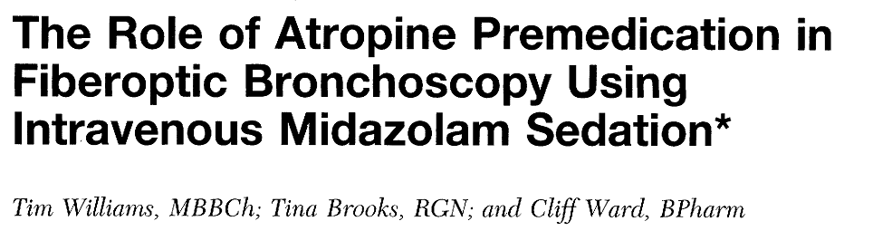
Double-blind study
  IM atropine (0.6 mg) n=50
  saline placebo (1 mL) n=50
  as premedication 30 to 60 minutes before sedation with midazolam

Slide 6
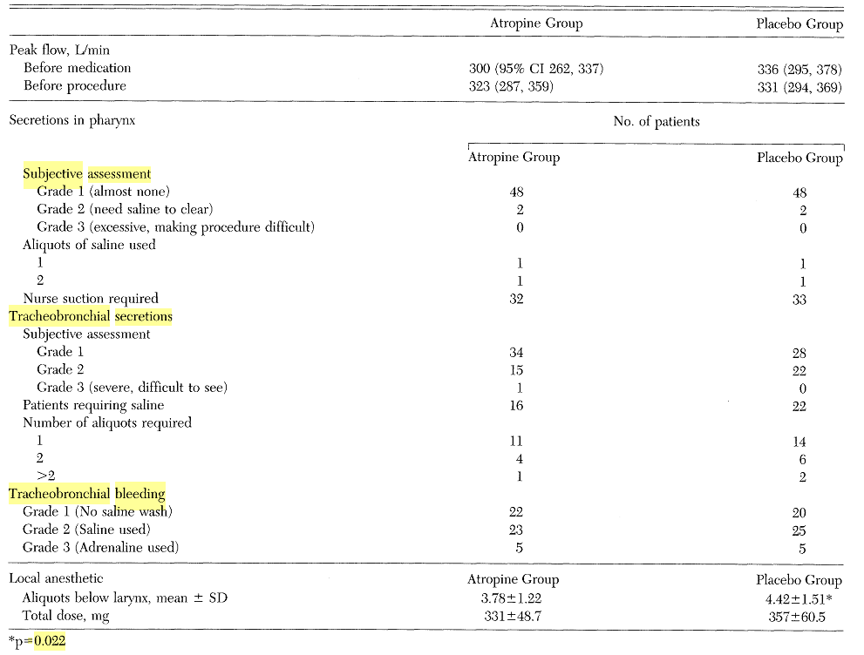
Notes:
There was no significant bronchodilatation after
premedication in either group, nor were there differences in secretions, use of saline, tracheo¬
bronchial bleeding, desaturation, and arrhythmias. More local anesthetic was needed to control
coughing in the placebo group (mean 357 mg vs 331 mg in the atropine group, p=0.02), but this
was not of practical significance.

Slide 7
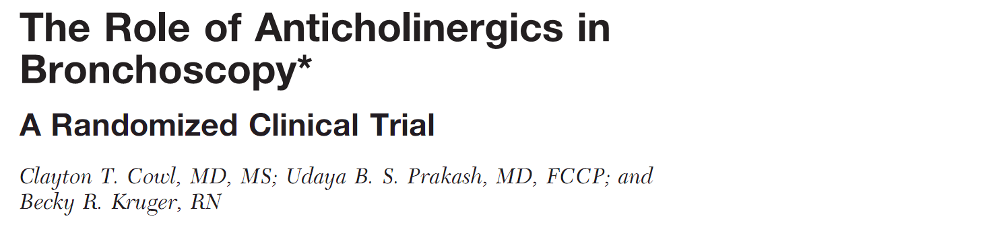
Double-blind, placebo-controlled study
  Atropine (0.01 mg/kg body weight, IM
  Glycopyrrolate (0.005 mg/kg, IM injection)
  Saline solution placebo (approximately 2 mL, IM injection) 15 to 45 min prior to sedation
CHEST 2000; 118:188–192

Slide 8
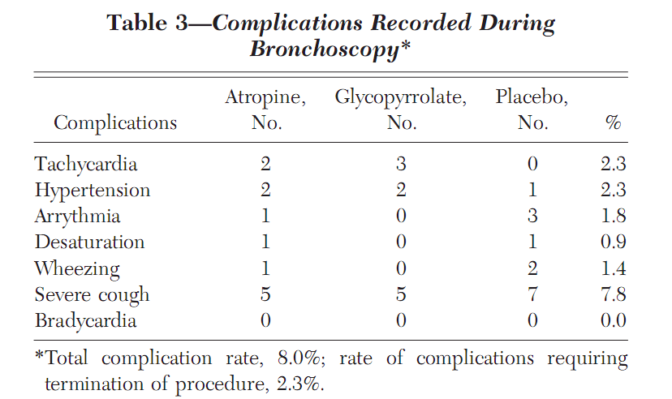
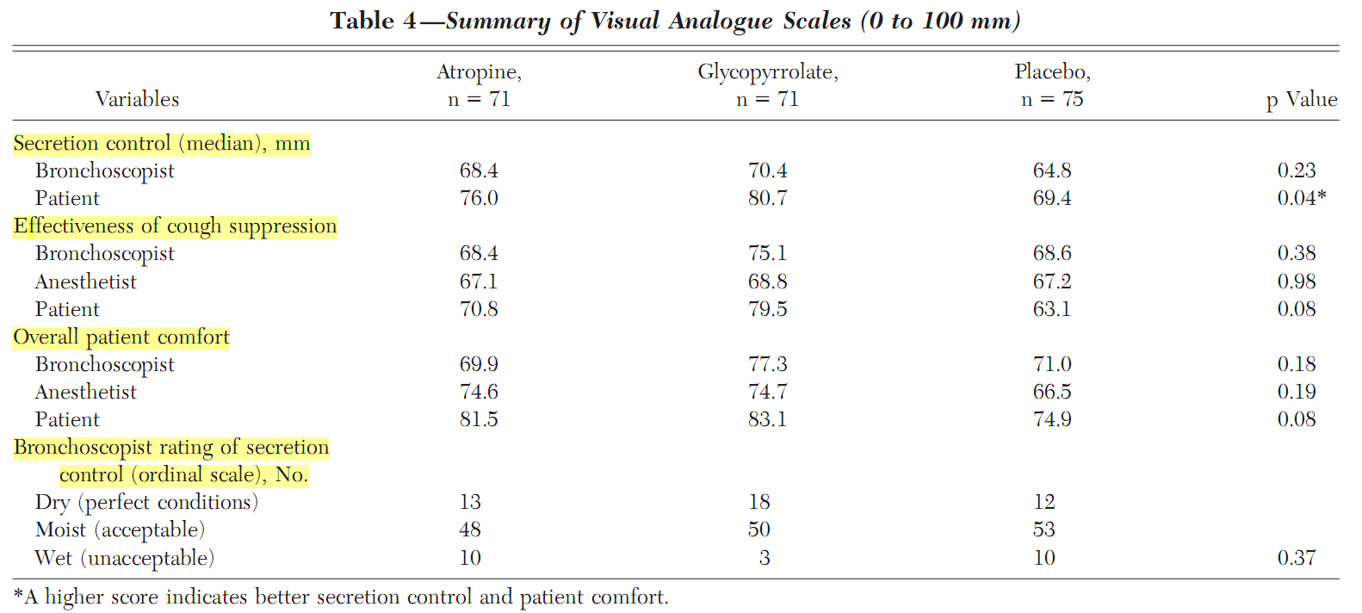

Slide 9
No significant difference in secretion control between atropine and glycopyrrolate when compared to placebo for bronchoscopy outpatients who received IV sedation.
Routine use of these medications be discontinued.

Slide 10
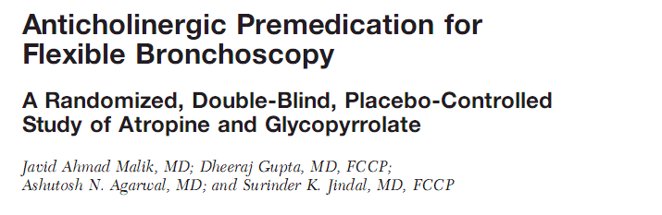
1,000 patients undergoing diagnostic flexible bronchoscopy
Atropine
(0.01 mg/kg)
n=339
Glycopyrrolate (0.005 mg/kg)
n=336
placebo (2 mL of Normal saline)
n = 325
CHEST 2009; 136:347–354

Slide 11
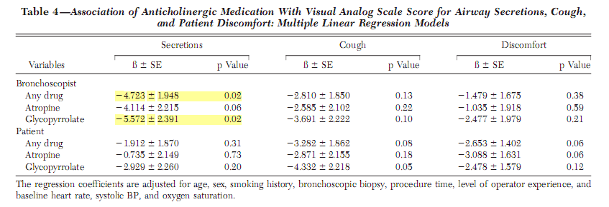
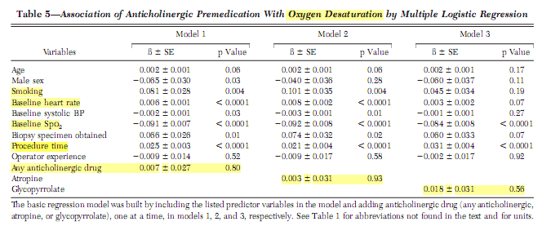

Slide 12
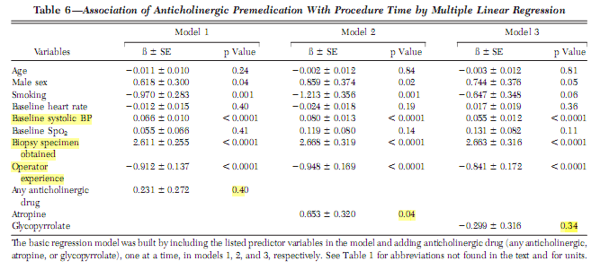

Slide 13
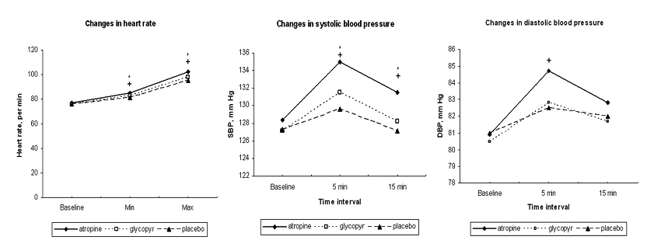
Anticholinergic premedication is not associated with any significant reduction in cough, patient discomfort, oxygen desaturation, or procedure time and is associated with greater hemodynamic fluctuations.

Slide 14
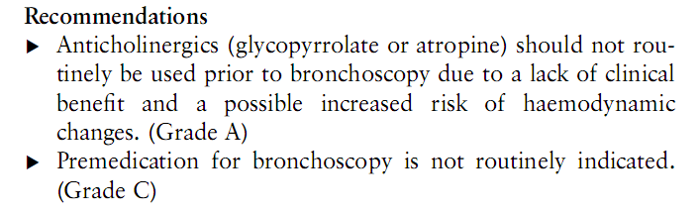
According to BTS guidelines

Slide 15
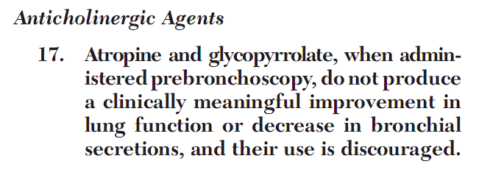
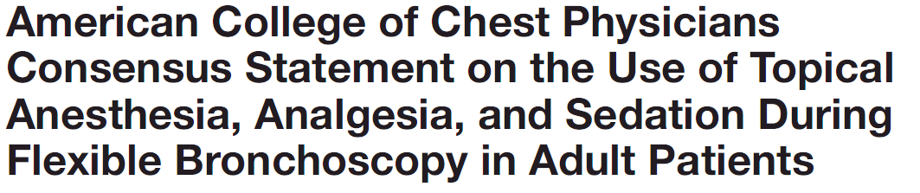
According to ACCP guidelines

Slide 16
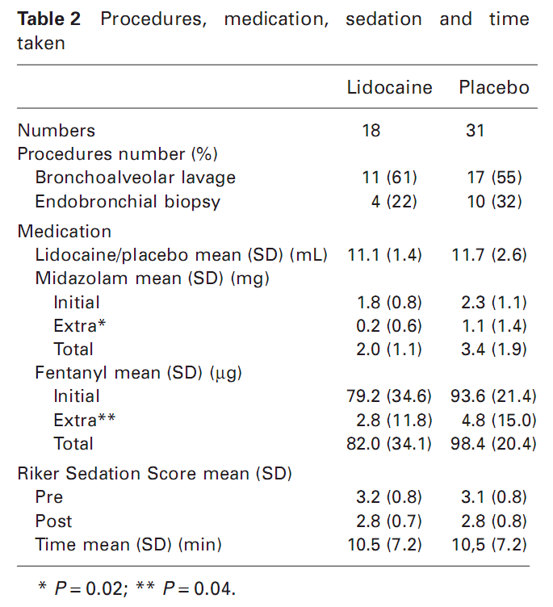
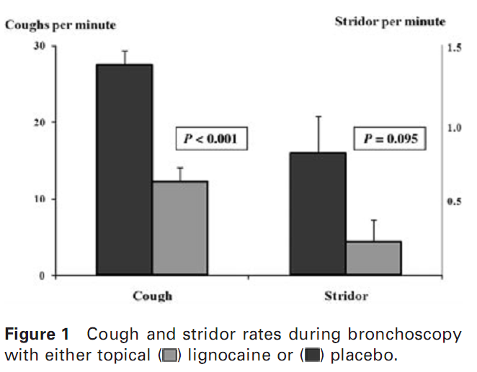
Lignocaine
Topical lidocaine decreases cough frequency and the total dose of sedation required during ﬂexible bronchoscopy
Respirology (2009) 14, 873–876

Slide 17
LOCAL ANAESTHESIA: Lignocaine
Stabilises the neuronal membrane by inhibiting ionic fluxes, thereby preventing the initiation and conduction of action potentials
A variety of preparations
  2% gel (nasal)
  10% spray (nasal and oropharyngeal)
  1–4% solution
    ‘Spray-as-you-go’ via the bronchoscope working channel
    Injection into the trachea through the cricothryoid membrane
    Nebulised; using a dropper in the oropharynx
    Applied to the nasal passages using soaked pledgets

Slide 18
Limited comparative evaluation in administering lidocaine
Decreased cough rate, but similar patient experience, associated with cricothyroid administration
(vs spray-as-you-go)
Respiratory Medicine (1990) 84, 349-350
Bronchoscopic conditions, but not patient assessment, were improved for cricothyroid administration compared with nebulised lidocaine
Anaesthesia, 1990, Volume 45, pages 46-48

Slide 19
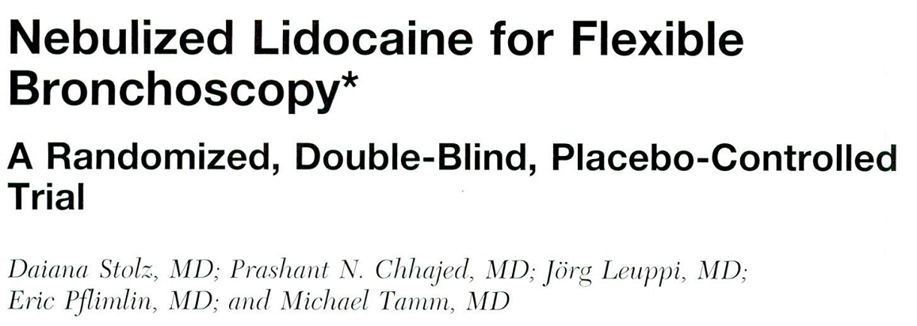
Notes:
15 분 전에 코에 뿌리는 거랑 broncho 하면서 뿌리는 것포함.
\

Slide 20
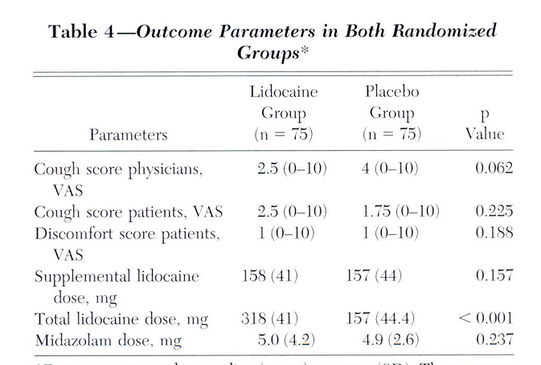

Slide 21
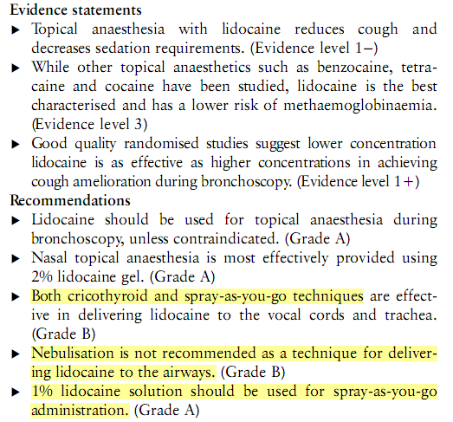
According to BTS guidelines

Slide 22
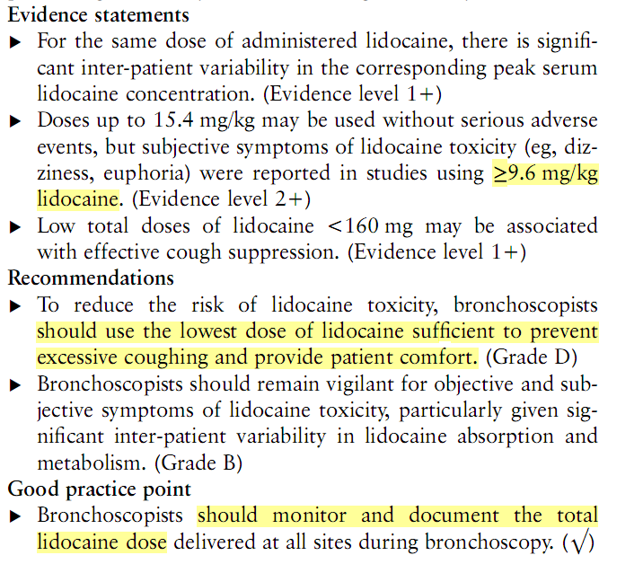

Slide 23
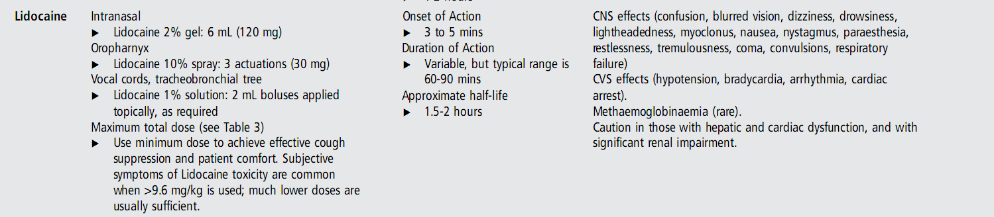
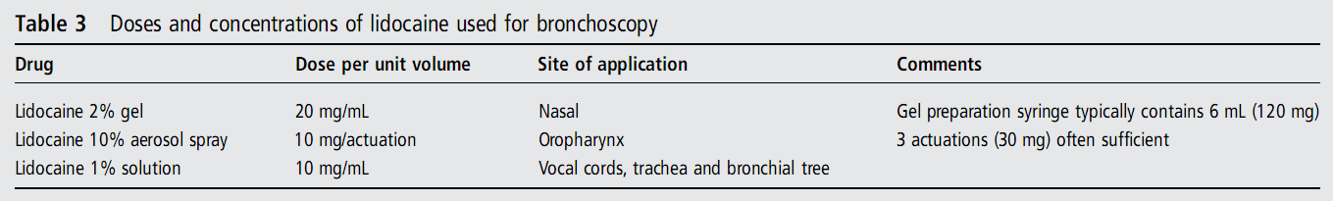
Peak serum concentrations
occur within 20 to 30 min from the beginning
Avoid that serum lidocaine level exceeds
5 mg/L

Slide 24
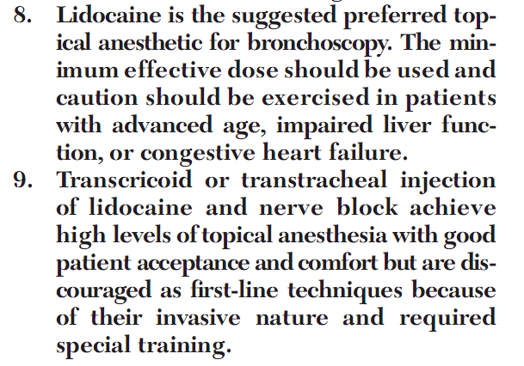
According to ACCP guidelines

Slide 25
Pretreatment for FOB in Severance
검사 전 4시간 이상 금식
사전 투약 atropine 0.5mg IM
국소 마취
  국소마취용 스프레이를 이용하여 구강 설근부 인두부에 10% 리도카인을 집중적으로 분무함
  내시경이 성대를 지나가면 woking channel 을 따라서 2% 리도카인을 반복 사용함.

Slide 26
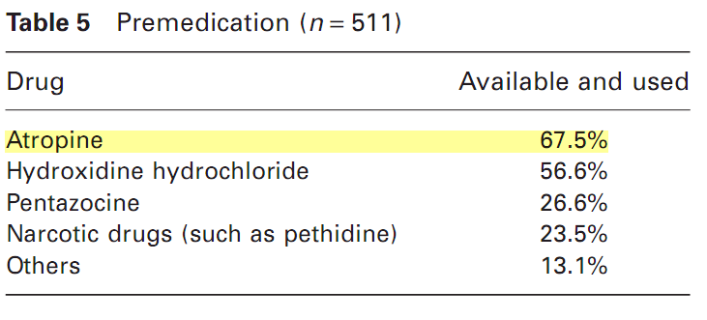
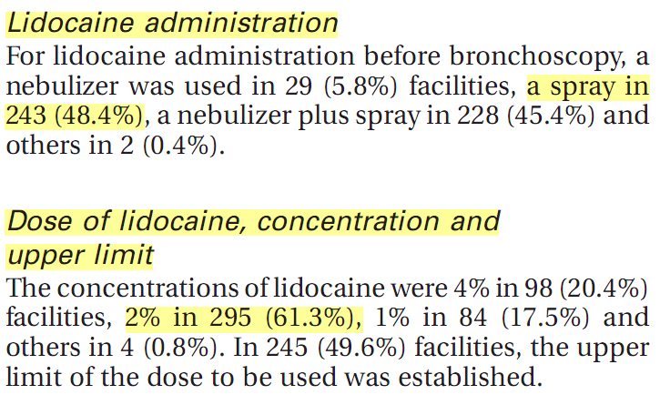
Bronchoscopic practice in Japan 2010

Slide 27
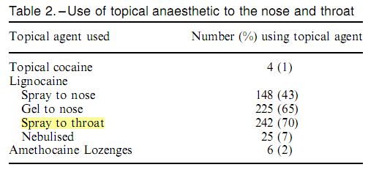
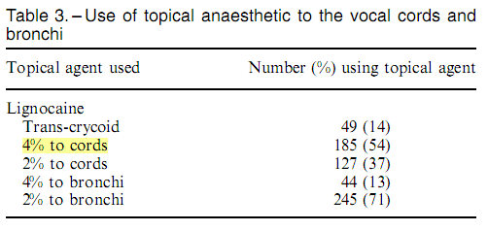
Preparation in England and wales 2003
Atropine
  Sixty-one of 306 consultants
    Only 41 used this routinely
    in patients with asthma (n=5), bradycardias (n=5), history of vasovagal episode (n=1), for unspeciﬁed reasons (n=5) and excess secretions were present (n=4). One operatorroutinely used glycopyrrolate

Slide 28
Pretreatment for FOB in other Hospitals
 | Atropine | Lidocaine
SNH | No use | Spray
SMC | No use | Nebulizer
AMC | No use | Nebulizer
Atropine 중단 및 2% lidocaine 의 농도 조절?

Slide 29


