Slide 1
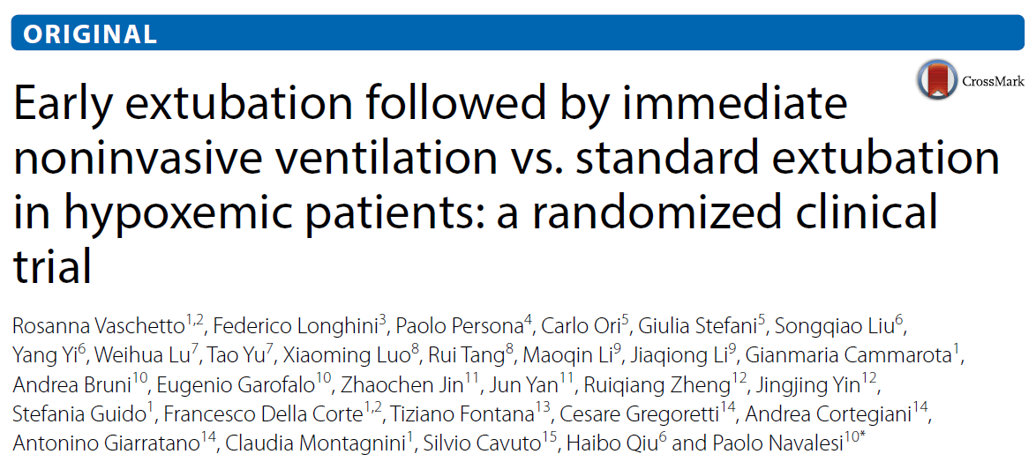

R2 이혁희

Slide 2
Introduction
Patients with acute respiratory failure (ARF) often require invasive mechanical ventilation (i-MV)
  Efficient way to support O2 intake & CO2 wash-out
  Prone to complications & side effects
Noninvasive ventilation (NIV) improves arterial blood gases & reduces the work of breathing in patients with ARF
  Used at an early stage of ARF to prevent the need for i-MV

Slide 3
Introduction
There is much evidence supporting NIV for the treatment of hypercapnic ARF
  COPD
  Cardiogenic pulmonary edema
  ARF following abdominal surgery
However, applying NIV to facilitate the weaning from i-MV in non-hypercapnic hypoxemic ARF has very limited evidence

Slide 4
Introduction
Aim of the study
  To assess whether early extubation followed by immediate NIV application would reduce the duration of i-MV and ICU length of stay (ICU LOS) in patients recovering from hypoxemic ARF

Slide 5
Methods
Trial Design
  Investigator-initiated, Parallel-group, Multicenter RCT
  From 13 Oct. 2013 to 19 Oct. 2016
  In nine ICUs of academic hospitals
    6 in Chinese republic
    3 in Italy

Slide 6
Methods
Patients
  Inclusion criteria
    Age ≥ 18 years
    i-MV ≥ 48 hours
    PSV with a total applied pressure ≤ 25cmH2O & PEEP level 8~13cmH2O
    PF ratio between 200 and 300mmHg with FiO2 ≤ 0.6
    PaCO2 ≤ 50mmHg & pH ≥ 7.35
    RR ≤ 30/min
    Tidal volume < 8ml/kg of IBW
    Core temperature < 38.5˚C
    GCS = 10 (The highest possible value in intubated patients)
    Cough on suctioning & Need for trachea-bronchial suctioning < 2/hr

Slide 7
Methods
Patients
  Exclusion criteria
    Hemodynamic instability (SBP < 90mmHg) or use of vasoactive agents
    : Vasopressin, Epinephrine at any dosage / Dopamine, Dobutamine > 5ug/kg/min
    : Norepinephrine > 0.2ug/kg/min
    Life-threatening arrhythmias or ECG signs of ischemia
    Presence of sepsis
    ARF secondary to neurogenic disorders, status asthmaticus, COPD and cardiogenic pulmonary edema
    Presence of tracheostomy
    Uncontrolled vomiting
    ≥ 2 organ failures
    BMI ≥ 30kg/m2
    History of obstructive sleep apnea (OSA)

Slide 8
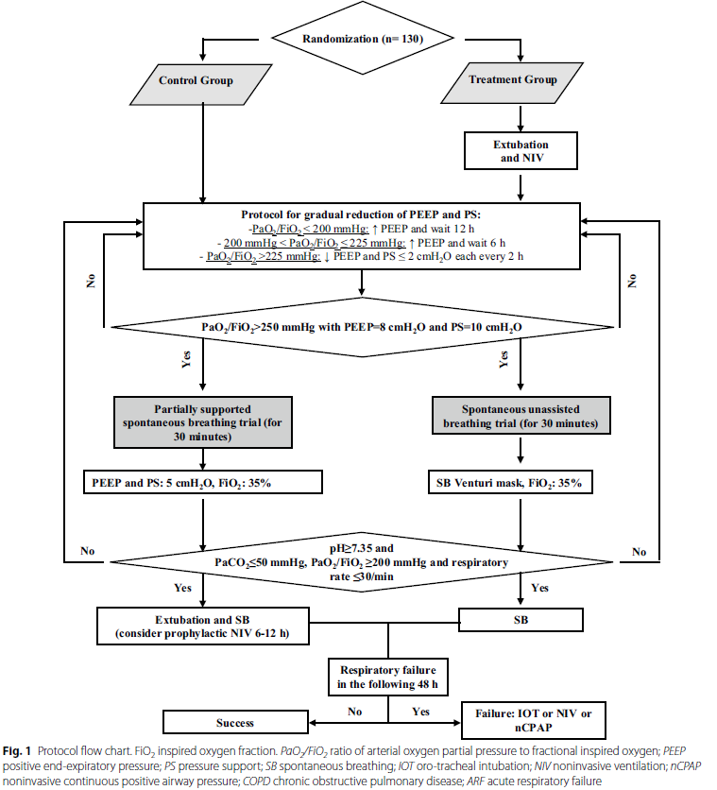
Methods
Protocol

Slide 9
Methods
Protocol
  Definition of treatment failure
    Treatment group : need for nCPAP, NIV or reintubation within 48h after NIV withdrawal
    Control group : need for nCPAP, NIV or reintubation within 48h after extubation

Slide 10
Methods
Study Endpoints
  Co-primary outcomes
    Time spent on i-MV
    ICU LOS
  Secondary outcomes
    Treatment failure
    Occurrence of the severe events
    : Hemorrhage, Sepsis, Stroke, Cardiac event, Renal failure, Pneumothorax, Pul. embolism
    Rate of ventilator-associated pneumonia (VAP) or tracheobronchitis (VAT)
    Tracheostomy
    Rate of patients requiring sedation after study inclusion
    Hospital LOS
    ICU & Hospital mortality

Slide 11
Methods
Statistical analysis
  Sample sizing: 65 patients per group
    Power of 80%
    5% two-sided level of significance
  Primary endpoint variables are analyzed with Mann-Whitney test
    Values were not in normal distribution
  Kaplan-Meier curves were determined in each group and compared using the log-rank test
    Time from intubation to liberation from i-MV
    Time from intubation to liberation from i-MV & NIV

Slide 12
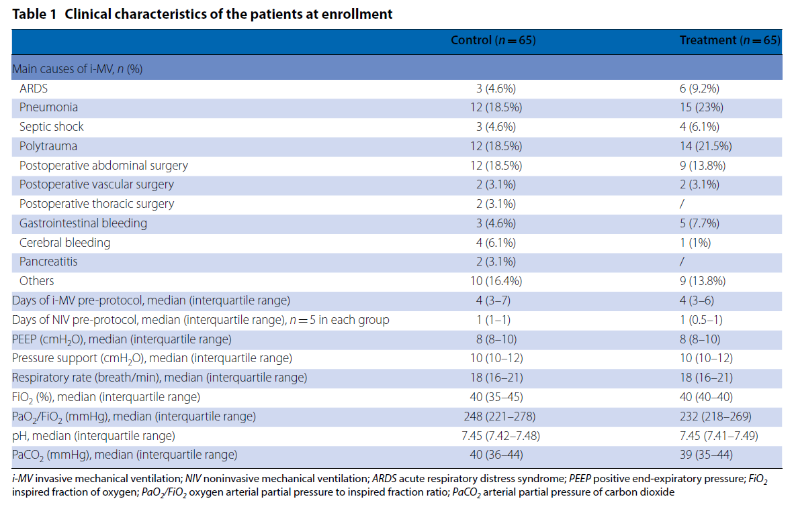
Results

Slide 13
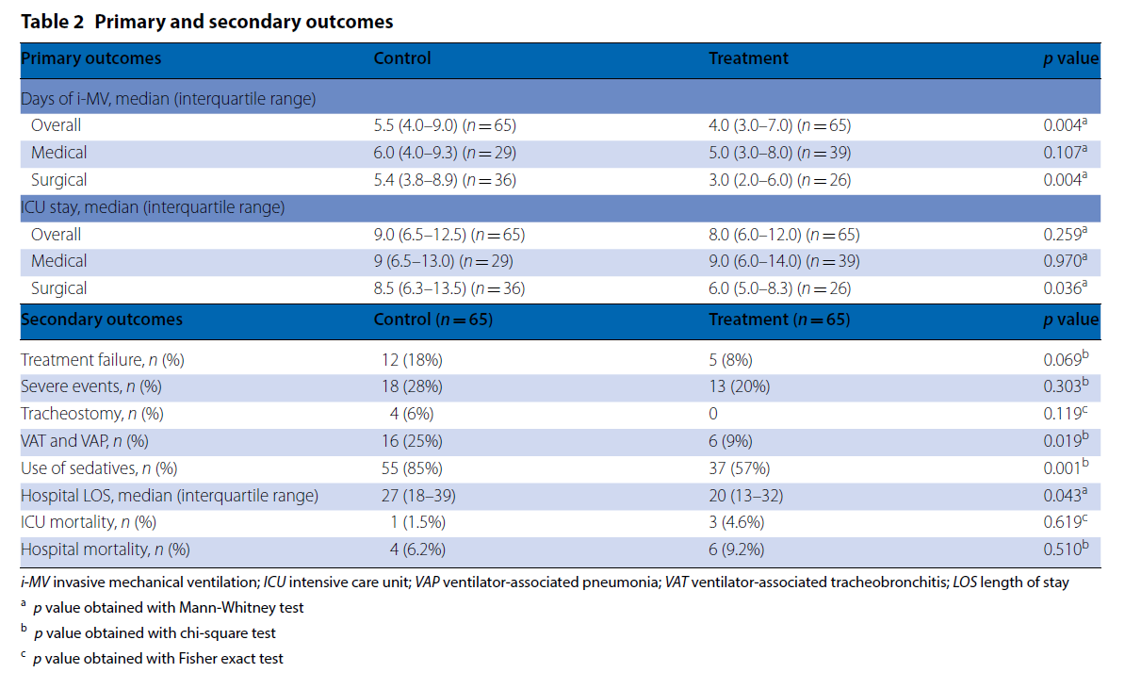
Results
Notes:
Treatment failure
Treatment group : 3 reintubation, 1 NIV, 1 nCPAP
Control group : 7 reintubation, 3 NIV, 2 nCPAP

Slide 14
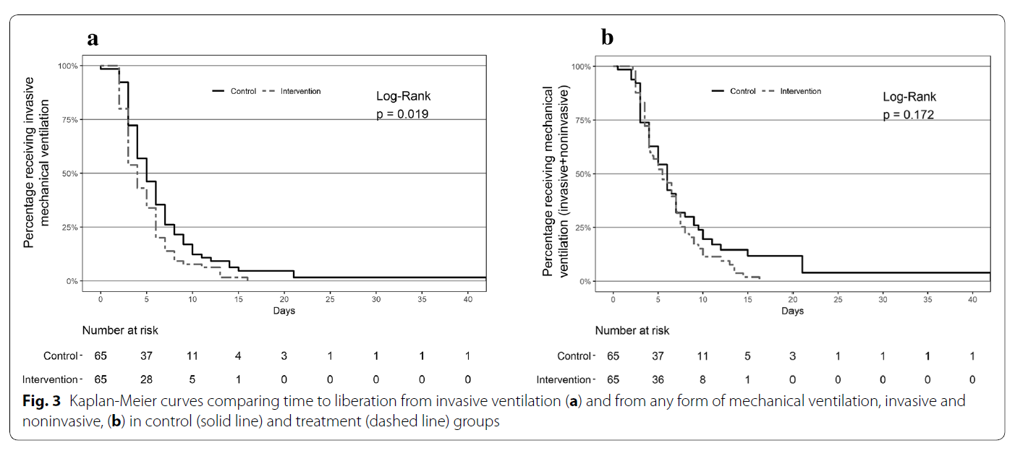
Results
Median time (Intubation ~ Liberation from i-MV)
Treatment group : 4 days (95% CI 3-5 days)
Control group : 5 days (95% CI 4-6 days)
Median time (Intubation ~ Liberation from i-MV & NIV)
Treatment group : 5.5 days (95% CI 4.1-7.0 days)
Control group : 6.0 days (95% CI 5.0-7.0 days)

Slide 15
Discussion
Efficacy of NIV in reducing the duration of i-MV is already proven in patients with acute-on-chronic hypercapnic respiratory failure
  Fewer data is available on NIV for hypoxemia other than cardiogenic pulmonary edema
The result of the study showed that NIV can also be helpful in patients with hypoxemic respiratory failure

Slide 16
Discussion
Limitation
  Highly selected patients with hypoxemic ARF are enrolled
    Limited generalizability
  The use of different interfaces, humidifiers & ventilators
    Limited internal validity
  Unblinded study
    Inevitable bias
  Various SBT techniques
  Accumulating evidence in favor of high-flow nasal cannula for patients with hypoxemic ARF

Slide 17
Conclusion
Use of NIV after early-extubation in patients with hypoxemic non-hypercapnic respiratory failure has some clear benefits
  Shorter duration of i-MV
  Fewer VAPs & VATs
  Fewer sedation
  Shorter hospital LOS
    No difference on ICU LOS, mortality

Slide 18
Further Opinion
Extubation criteria in treatment group is not clearly indicated in the study
Inter-center variability of interface appliance
  Oro-nasal / Full-face mask / Standard helmet / New helmet
  Single use / Rotational use
Tolerance to NIV should have been variable among patients
There was no difference of treatment failure rate between the groups
  Early extubation is not harmful anyway

