Slide 1
Diffuse, Random Pulmonary Metastasis with EGFR mutation in Lung Adenocarcinoma
호흡기내과 R2 이재승

Slide 2
Case 1

Slide 3
8046250 김○숙 F/50
C.C.
Suspicious multiple metastatic nodules of lung with chronic cough
50세 여환으로 고혈압 병력 있었으며, 2014년 10월 경부터 시작하여 약 1개월간 점차 심해진 잔기침을 주소로 local 내원하여 시행한 CXR, chest CT 상 lung cancer 의심된다는 말을 듣고 2015.4월 경 본원 의뢰되었음.
직업: 텔레마케터
Ex-smoker, 20YR x 0.25P = 5 PYRS, 9년 전 quit

Slide 4
Lab findings
CBC 6720(76.1%)/12.3/289k
Ca/P 9.4/2.7
Glucose 103
BUN/Cr 6.6/0.58
T.pro/Alb 7.2/4.4
OT/PT/T.bil 15/9/0.3
e’ 142-4.1-104-27
INR/aPTT 0.91/34.7
CEA/CYFRA 21-1 85.31/15.20
PFT (2015.4.29)
FVC: 2.84 90%, FEV1: 2.25 94%, ratio 79%, BD: 3%, DLCO: 104%

Slide 5
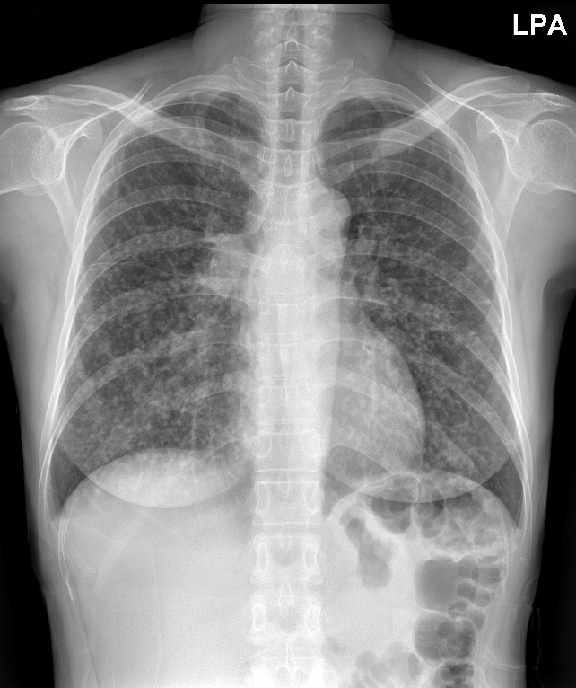
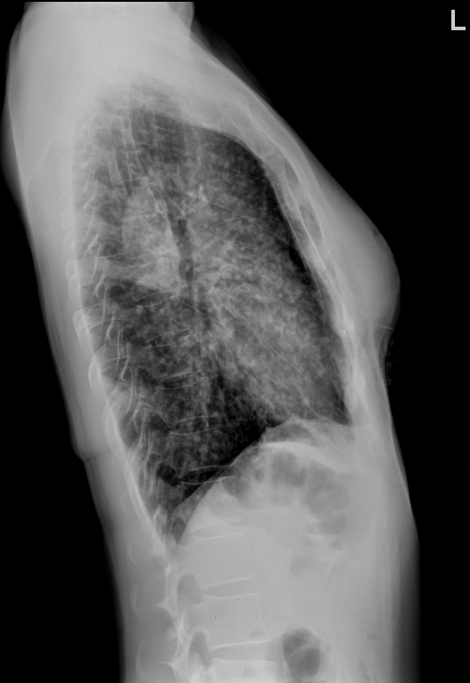
Chest PA, Lat (Lt.) (2015.4.25)

Slide 6
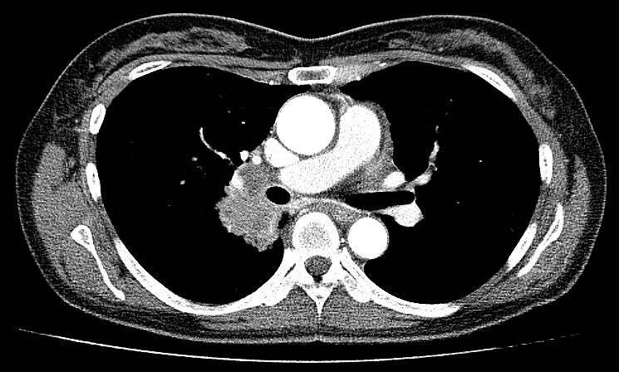
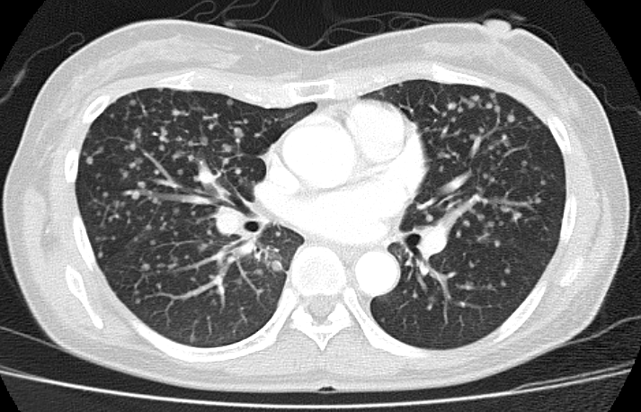
Outside Chest CT (2015.4.25)
3.3cm Rt. hilar mass in RLL superior segment
Hematogenous metastasis with metastatic lymph nodes in Rt. Hilum and Rt. Paratracheal area

Slide 7
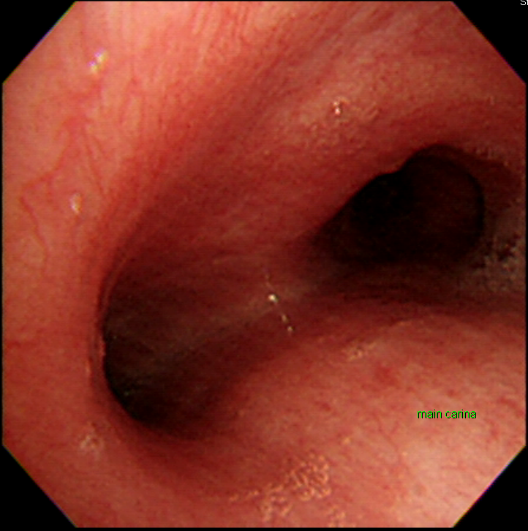
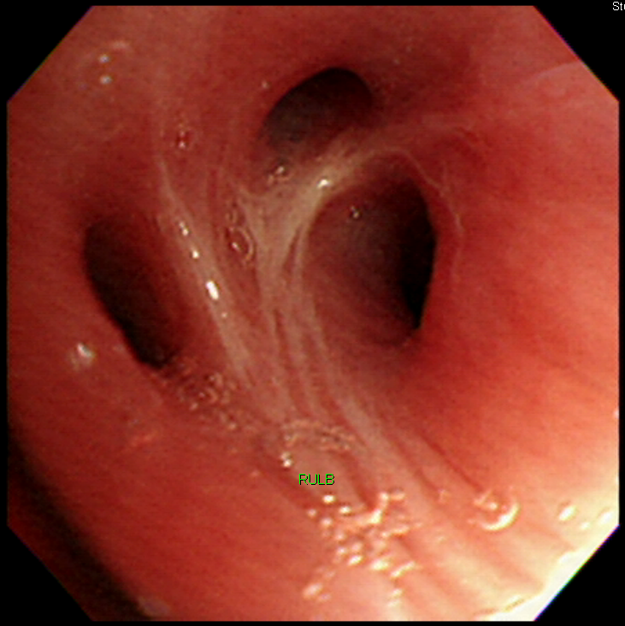
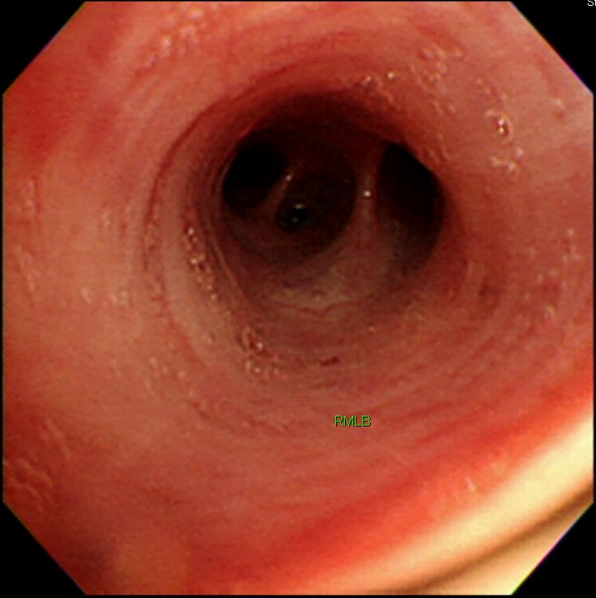
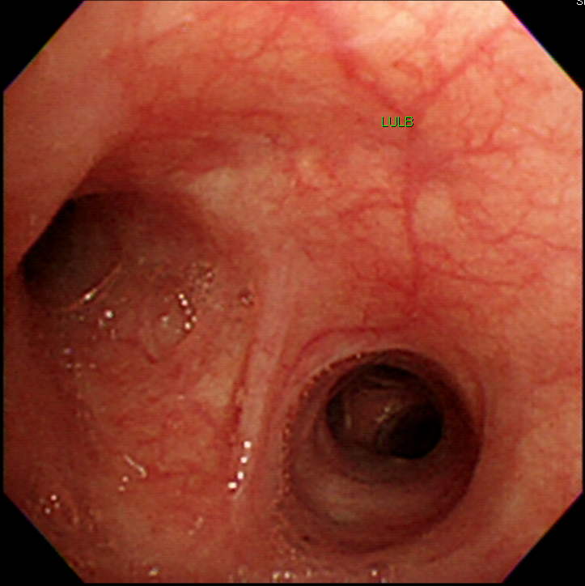
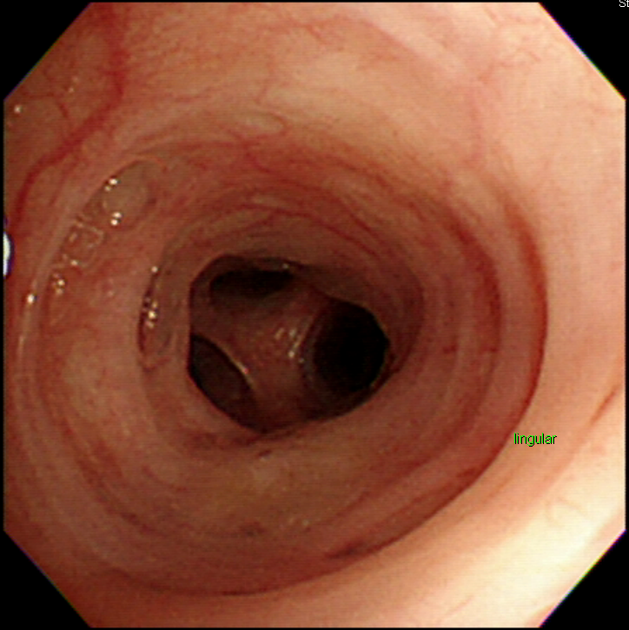
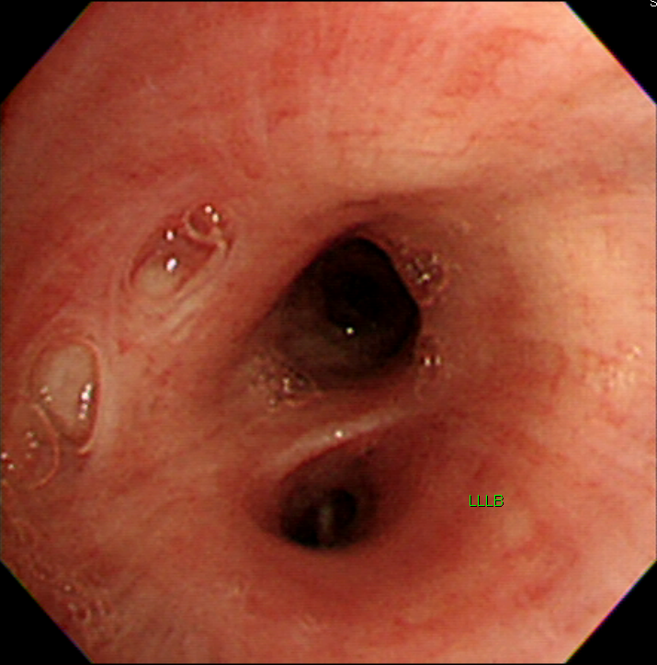
FOB with EBUS-TBNA (2015.4.30)

Slide 8
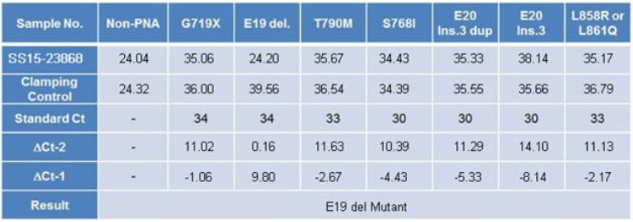
Pathology (2015.5.11)
Rt. Hilar mass: Adenocarcinoma, ALK(-), ROS1(-)
EGFR mutation: E19 del Mutant
ALK rearrangement (-)

Slide 9
Assessment and Plan
# Lung cancer (adenocarcinoma), stage IV, lung to lung metastasis
# Hypertension
Plan
  1st line Iressa start (2015.5.14-)

Slide 10
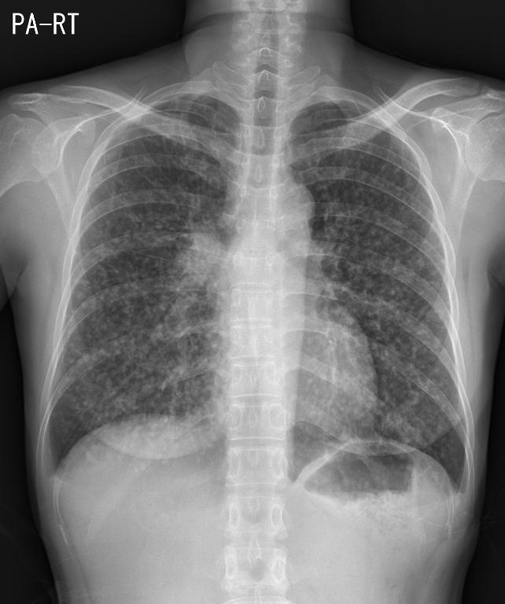
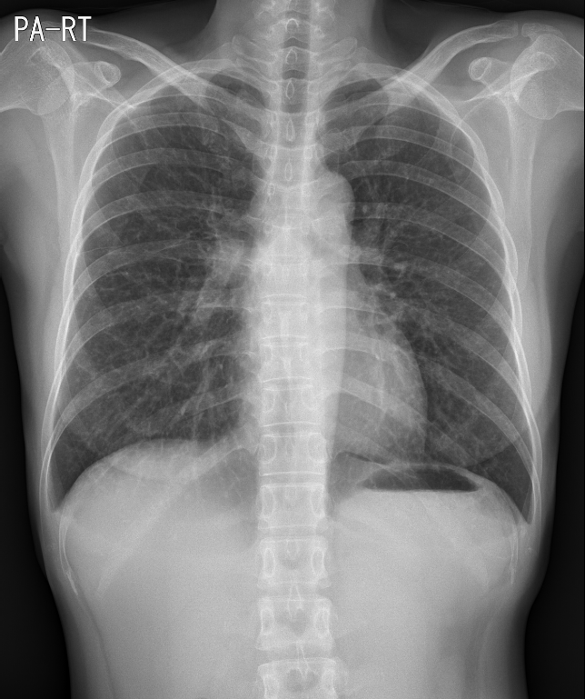
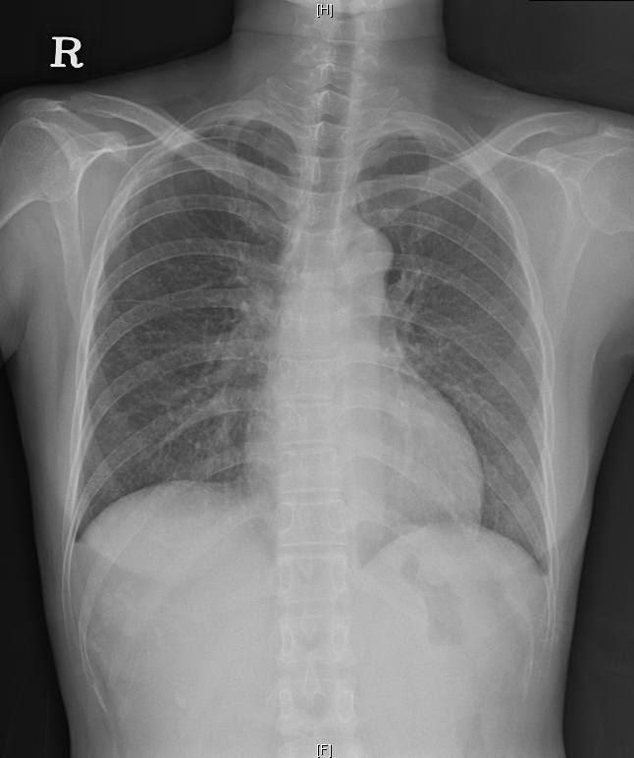
Chest PA Follow Up
2015.5.7
2015.5.7
2015.6.11
2015.8.7

Slide 11
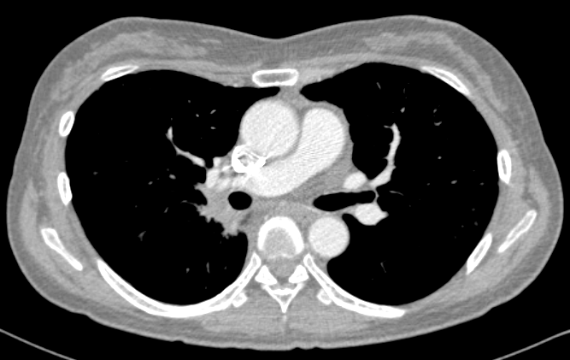
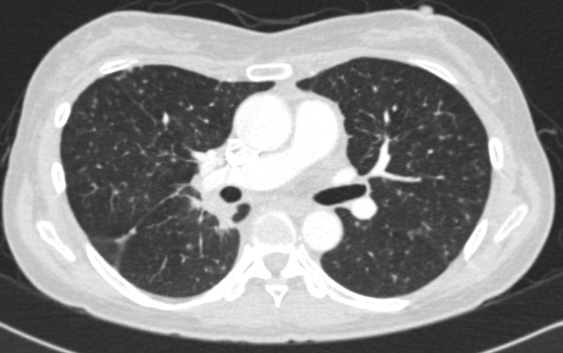
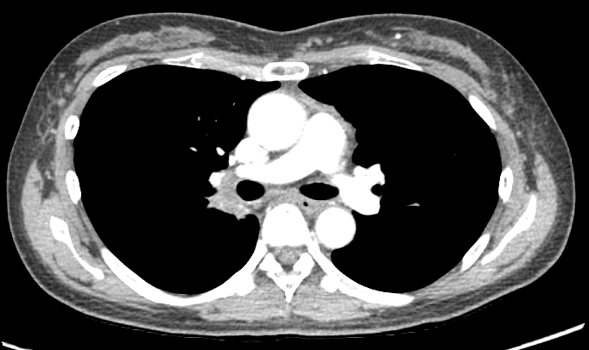
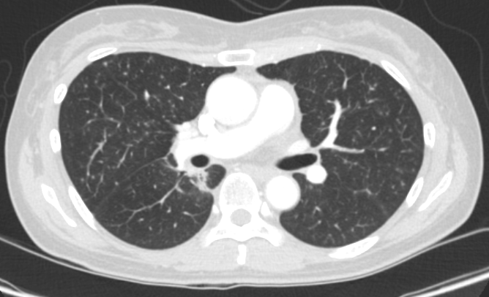
Chest CT f/u (2015.8.7 vs 2015.11.12)

Slide 12
Treatment Response
PR (2015.8.7)
SD (2015.11.12)
Further plan
  Iressa 지속 예정

Slide 13
Case 2

Slide 14
7830664 임○숙 F/56
C.C.
Suspicious multiple metastatic nodules in lung
with 2mo cough, sputum, dyspnea and 3mo weight loss (8kg)
56세 여환, 특이병력 없던 분으로 2014년 1월 경부터 mild cough 있어 local 병원 및 한의원에서 medication 하였으나 호전 없어 2014년 3월 경 서북병원 내원하여 시행한 CXR, chest CT 상 miliary Tbc 의심하 AFB smear 시행하였으나 negative로 multiple lung metastasis 의심하 2014년 3월 14일 본원 응급실로 내원함.
Initial SpO2 94% with nasal O2 3L/min
Nonsmoker

Slide 15
Lab Findings
CBC 9540(86.1%)/13.3/385k
Ca/P 8.5/3.0
Glucose 121
BUN/Cr 98/0.47
T.pro/Alb 6.5/3.7
OT/PT/T.bil 27/12/0.8
e’ 131-3.8-98-20
CEA/CYFRA 21-1 26.95/11.30

Slide 16
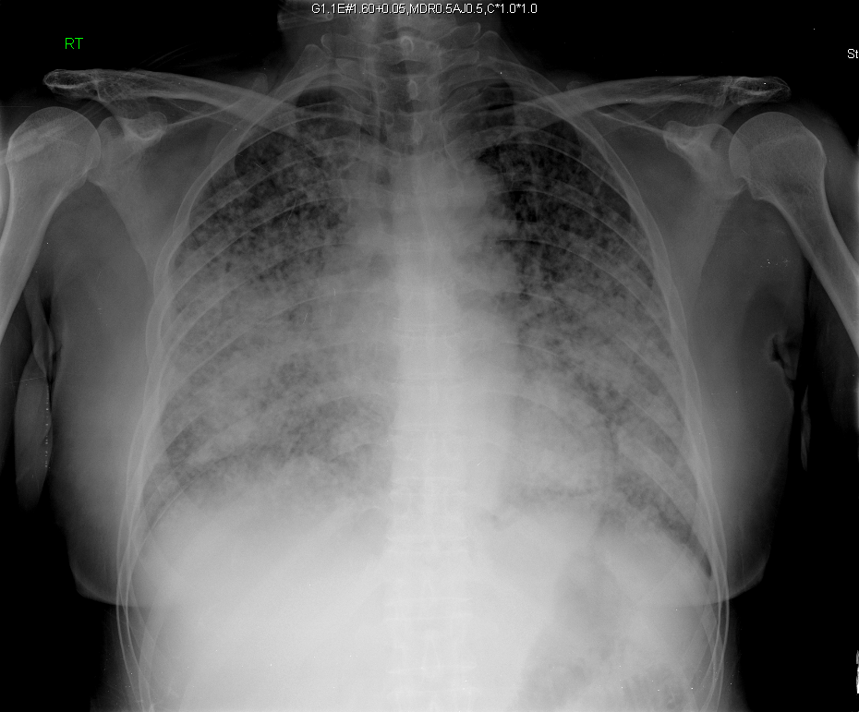
Chest PA (2014.3.17)

Slide 17
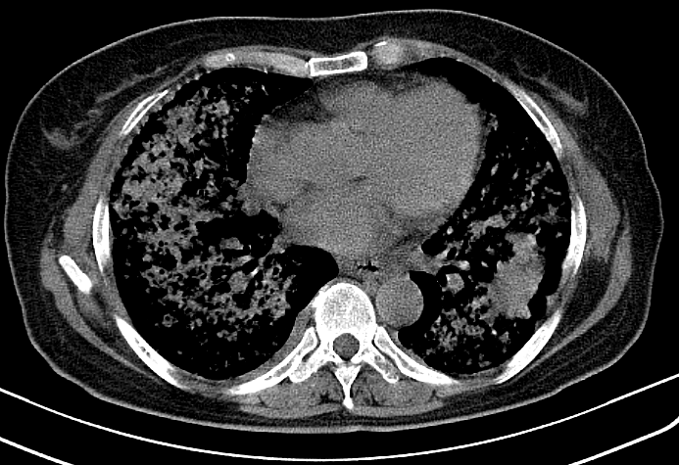
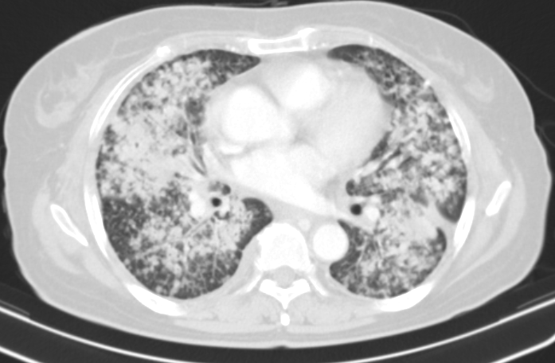
Outside Chest CT (2014.3.13)
Lobulated mass (4cm) in LLL
Lung cancer with extensive lung to lung metastasis, T4 N2/3 M1

Slide 18
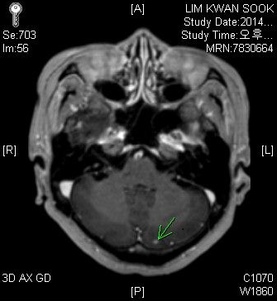
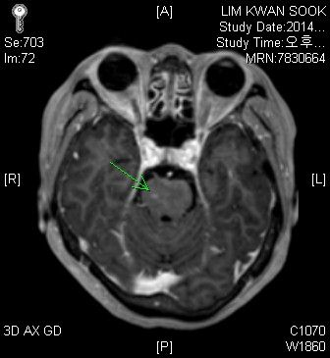
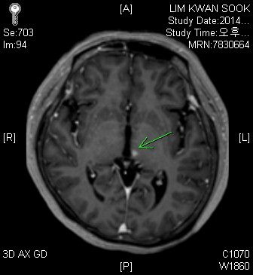
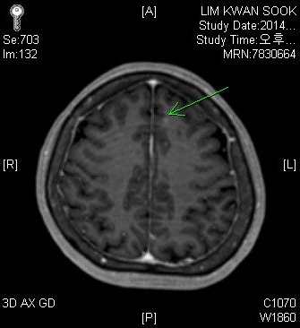
Brain MRI (2014.3.18)
At least four metastatic lesions in the left frontal lobe, left thalamus, right pons and left cerebellar hemisphere.
No other remarkable finding in the brain parenchyma.
Brain metastasis.

Slide 19
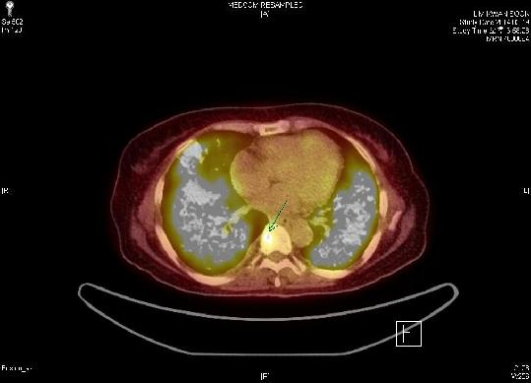
PET-CT (2014.3.19)

Slide 20
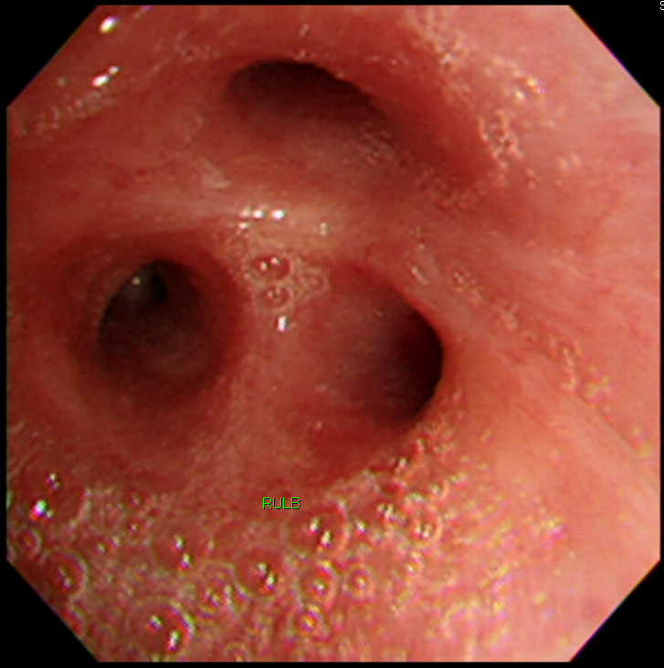
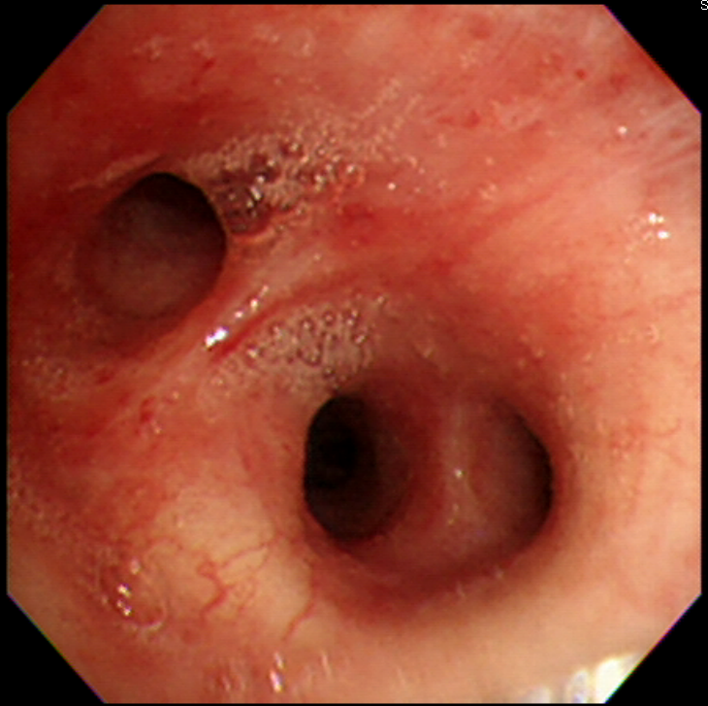
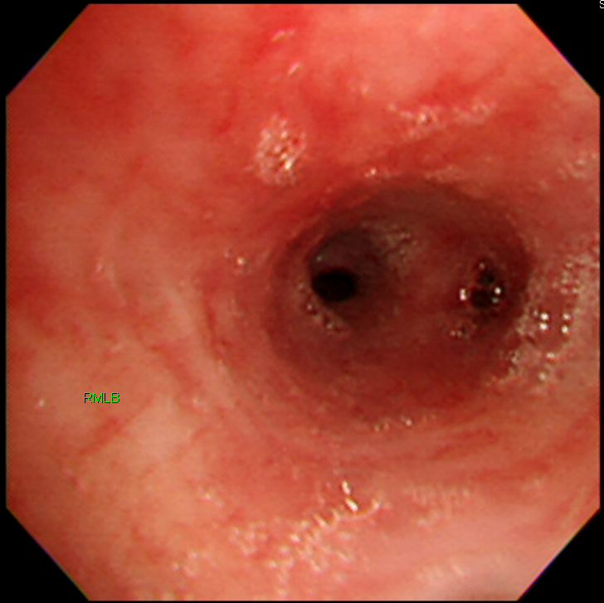
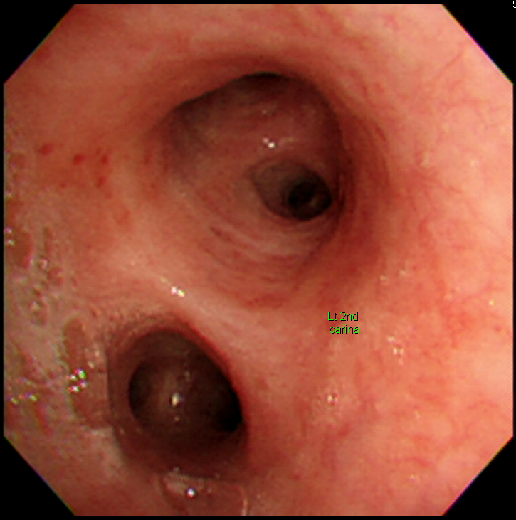
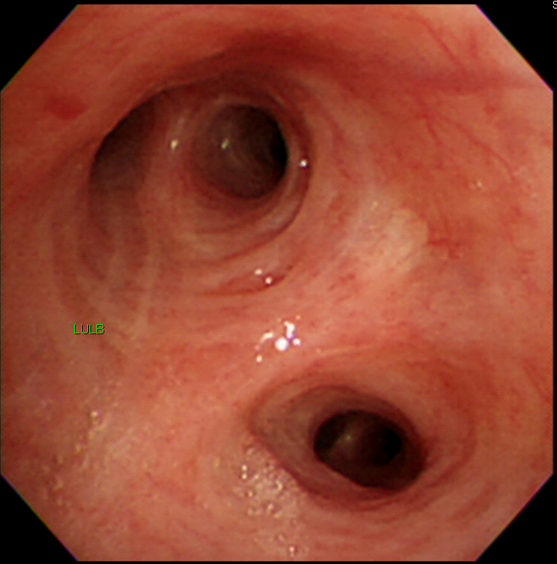
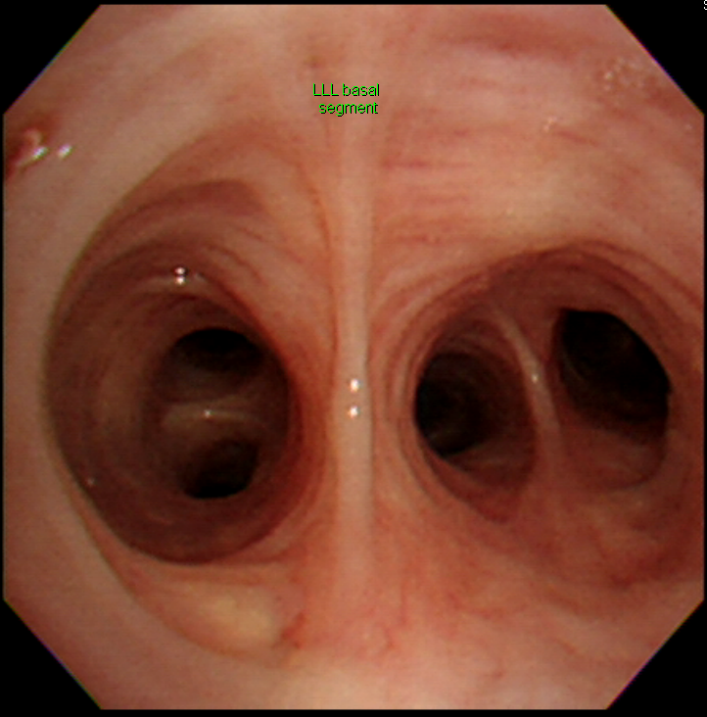
FOB (2014.3.17)

Slide 21
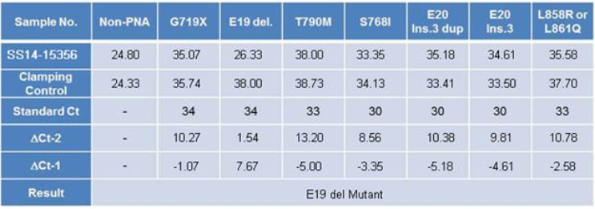
Pathology (2014.3.20)
Rt. LN4R lymph nodes: Metastatic adenocarcinoma
ALK (-), ROS1 (-), KRAS (Wild)
EGFR mutation: E19 del Mutant
Washing cytology (2014.3.19): adenocarcinoma

Slide 22
Assessment and Plan
Lung cancer, LLL, adenocarcinoma, cT4N2/3M1b, stage IV
Brain metastasis
Bone metastasis (T9 vertebral body)
Plan
  1st line Iressa (2014.3.21-)
  Palliative RTx for brain metastasis (2014.3.27-, 3750cGy/15fx)

Slide 23
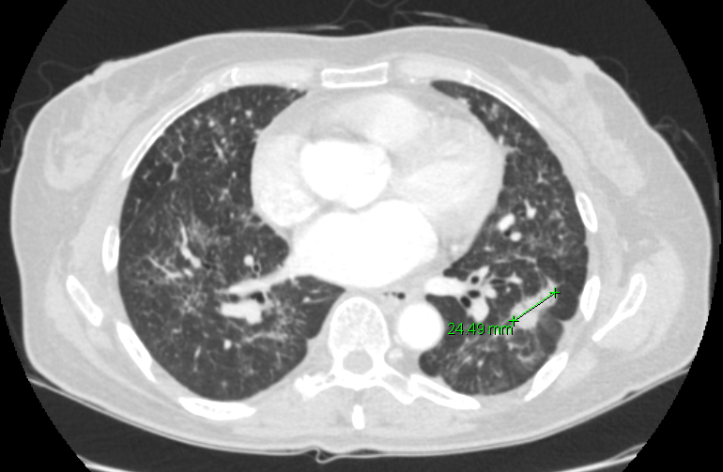
Chest CT f/u (2014.9.11): PR

Slide 24
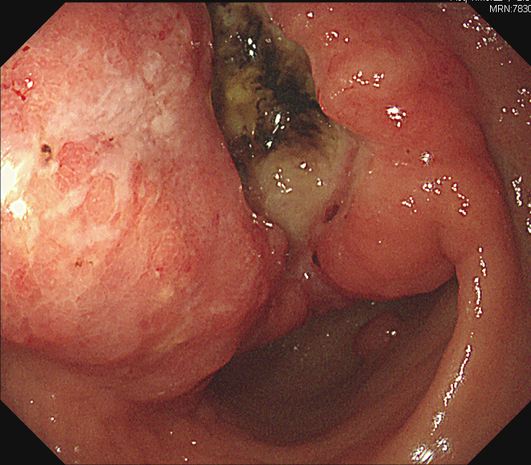
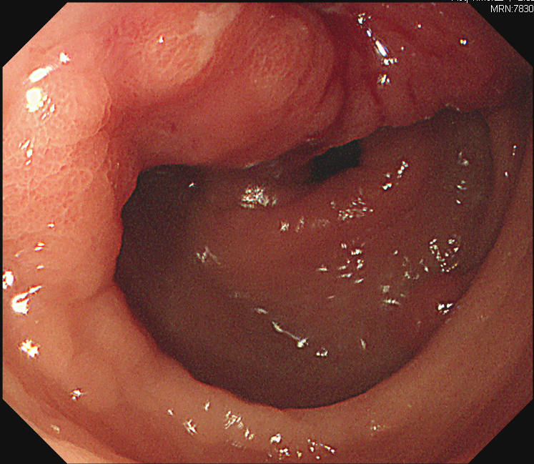
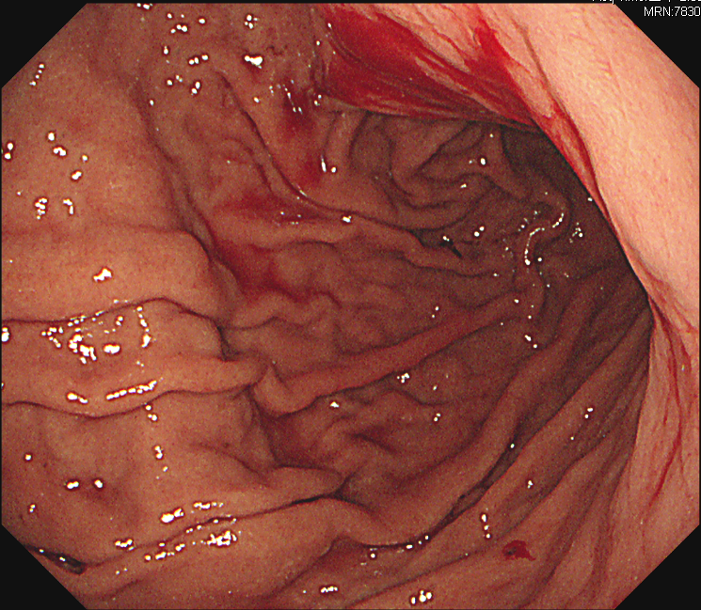
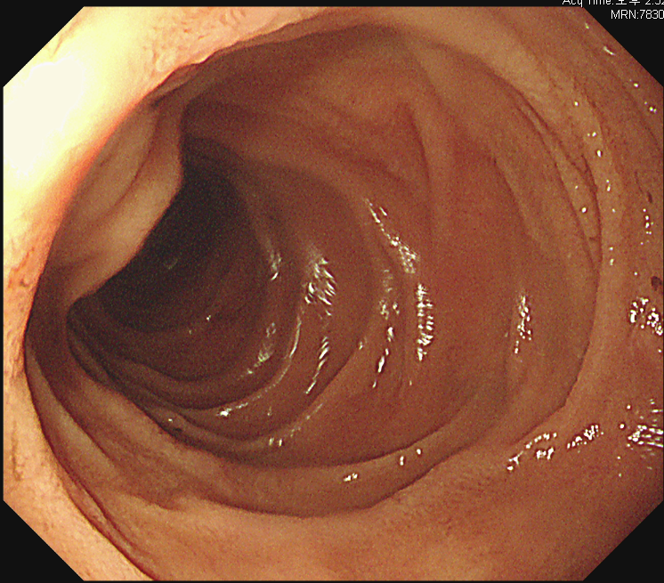
EGD for Anemia (Hb9.2) evaluation

Slide 25
Pathology
Stomach, EGD biopsy
Adenocarcinoma, moderately differentiated, favoring primary
HER2 (-), EGFR (3+), C-met (3+), PTEN loss, P53(-)

Slide 26
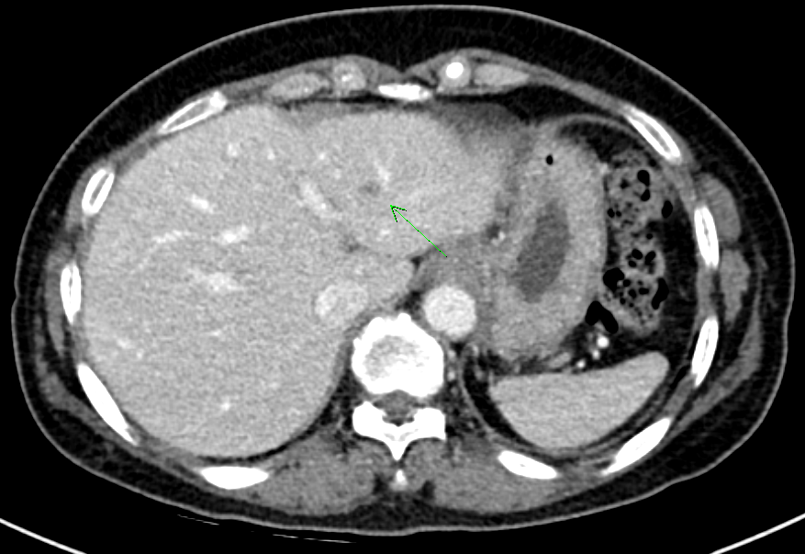
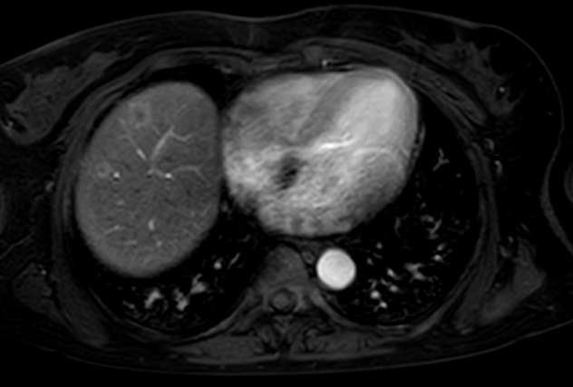
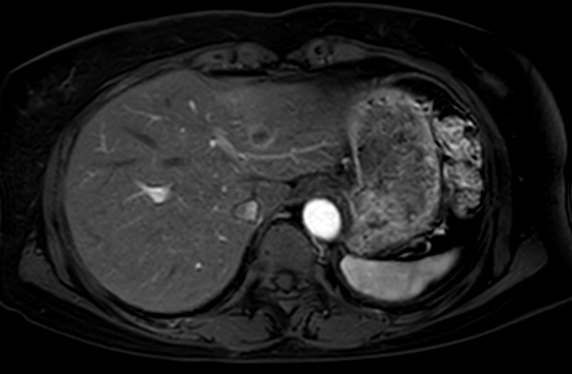
APCT (2015.7.11)
Liver MRI (2015.7.31)

Slide 27
Diagnosis and Plan
NSCLC, adenocarcinoma, cT4N2/3M1b, stage IV
Metastasis to brain and lymph node
  s/p 1st line Iressa CTx (2014.3.21-2015.7.24)
  s/p WBRT (3750cGy, 2014.3.27-4.16)
AGC, adenocarcinoma, moderately differentiated, Borrmann II
Metastasis to liver
Plan)
  FP CTx (2015.8.9-)

