Slide 1

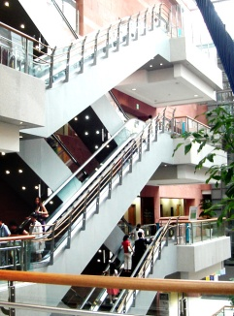


Duodenal Infusion of Donor Feces for Recurrent Clostridium difficile
Els van Nood, Anne Vrieze, Max Nieuwdorp,
Susana Fuentes, Erwin G. Zoetendal,, Willem M. de Vos,
Caroline E. Visser,Ed J. Kuijper,
Joep F.W.M. Bartelsman, Jan G.P. Tijssen,
Peter Speelman., Marcel G.W. Dijkgraaf,
and Josbert J. Keller.
n engl j med on January 16,2013
R3 황의동

Slide 2
Introduction (1)
Not induce a durable response in approximately
15 to 26% of patients.
The estimated efficacy of antibiotic therapy for a first recurrence is 60%.
Mechanisms that have been proposed for recurrence include
  - persistence of spores of C. difficile
  - diminished Ab response to clostridium toxins
  - persistent disturbance with a reduced diversity of
  intestinal microbiota

Slide 3
Introduction (2)
Infusion of feces from healthy donors has been reported as an effective treatment for recurrent C. difficile infection in more than 300 patients.
lack of randomized trials supporting its efficacy and the unappealing nature of the treatment.

Slide 4
Methods (1)
Patients who were at least 18 years of age and who had a life expectancy of at least 3 months.
Exclusion criteria
- Compromised immunity(recent CTx)
- HIV (CD4<240)
- Prednisolone(>60 mg per day)
- Pregnancy, use of antibiotics,ICU

Slide 5
Methods (2)
C. difficile infection was defined as
  diarrhea
  a positive stool test for C. difficile toxin
  relapse of C. difficile infection after at least one course of adequate antibiotic therapy.

Slide 6
Methods (3)
randomly assigned three therapies.
  - initial vancomycin regimen (500 mg orally four times per day for 4 days), followed by bowel lavage and subsequent infusion of a solution of donor feces through a nasoduodenal tube.
  -standard vancomycin regimen.
  (500 mg orally four times per day for14 days)
  -standard vancomycin regimen with bowel lavage

Slide 7
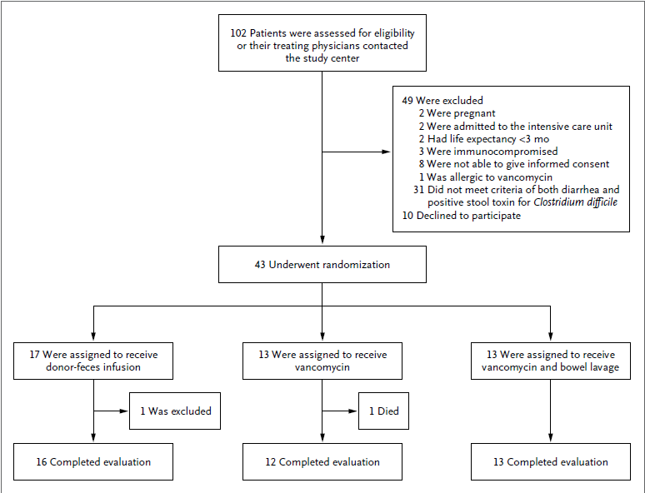
Methods (4)

Slide 8
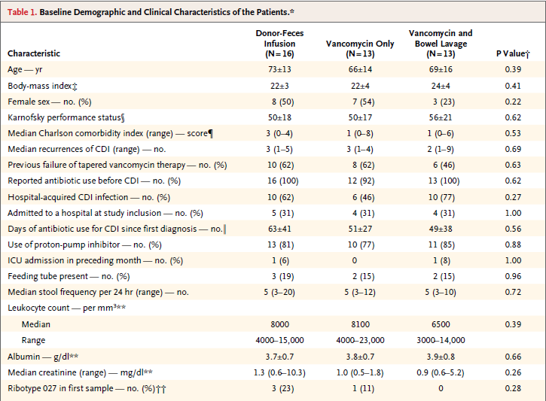
Methods (5)

Slide 9
Methods (6)
Donors (<60 years of age):25 donors
- questionnaire for potentially transmissible disease.
- screened for parasites, C. difficile, enteropathogenic bacteria, HIV, hepatitis…
-A donor pool was created, and screening was repeated every 4 months.

Slide 10
Methods (7)
Feces were collected by the donor on the day of infusion.
Feces were diluted with 500 ml of sterile saline, solution was stirred, and the supernatant strained and poured in a sterile bottle.
Within 6 hours after collection of feces by the donor, the solution was infused through a nasoduodenal tube (2 to 3 minutes per 50 ml)

Slide 11
Outcomes
Primary end point was the resolution of diarrhea associated with C. difficile infection without relapse after 10 weeks
after the initiation of therapy.
Relapse was defined as diarrhea with a positive stool test for C. difficile toxin.

Slide 12
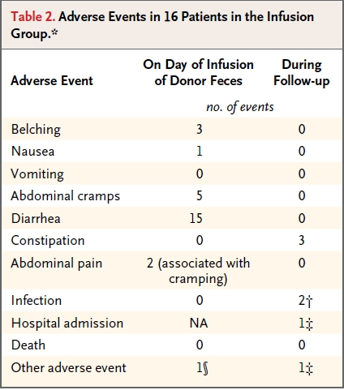

Slide 13
Results (1)
January 2008 through April 2010.
Initially,the inclusion of 40 patients per study group was planned.
most patients in both control groups had a relapse, advised termination of the trial.

Slide 14
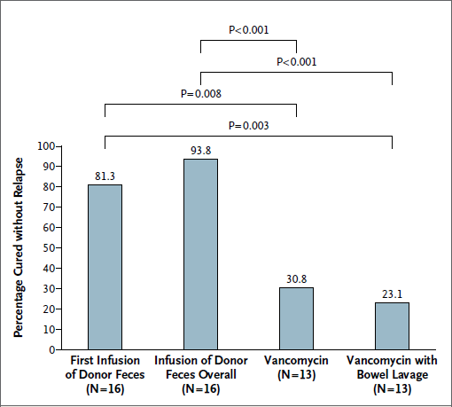
Results (2)
Overall, donor feces cured 15 of 16 patients (94%)
Resolution of infection occurred
  in 4 of 13 patients (31%) in the vancomycin-alone group
  in 3 of 13 patients (23%) in the group receiving vancomycin with bowel lavage.

Slide 15
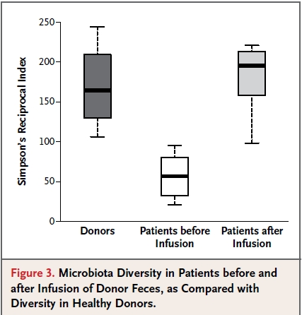
Results (3)

Slide 16
Discussion (1)
Small but open-label, randomized, controlled trial.
study population of mainly elderly patients reflects the population in whom C. difficile infection.
found that the infusion of donor feces is
a potential therapeutic strategy against recurrent C. difficile infection.

Slide 17
Discussion (2)
efficacy of antibiotic therapy decreases
with subsequent recurrences, and it seems reasonable to initiate treatment with donor-feces infusion after the second or third relapse.

Slide 18
Discussion (2)
excluded three groups.
- prolonged immunodeficiency.
- critically ill patients (ICU)
- patients requiring additional antibiotics to treat infections other than C. difficile.

Slide 19
Discussion (3)
Questions remain unanswered.
-optimal protocol for donor-feces infusion is unknown.
-bowel lavage indeed contributes to the efficacy of donor- feces infusion is not known.

Slide 20
Conclusion
In conclusion, in patients with recurrent C. difficile infection, the infusion of donor feces, as compared with vancomycin therapy, resulted in better treatment outcomes.
In particular, patients with multiple relapses of C. difficile infection benefited
from this unconventional approach.

