Slide 1




Drug induced interstitial lung disease
홍지영

Slide 2
Drug induced interstitial lung disease (DILD)
Not uncommon
Many clinical patterns
  from benign infiltrates to life-threatening
  acute respiratory distress syndrome
Definite temporal association between an exposure to the causative agent and the development of respiratory symptoms
Objective improvement after drug withdrawal

Slide 3
Diagnosis
The exclusion of other causes of lung damage(CHF, infection, malignancy)
Occurs after rechallenge- not recommended
Making a timely and accurate diagnosis of DILD is very important.
Laboratory findings and clinical manifestations are nonspecific.
Pulmonary function test
  a pattern of restrictive abnormality, with decreased values of DLCO

Slide 4
Diagnosis
The histological findings
  Nonspecific
    Minocycline: Eosinophilic Pneumonia
    methotrexate (MTX):acute granulomatous ILD
    Nitrofurantoin: the cellular type of NSIP
    Amiodarone and bleomycin: more than one histological pattern
HRCT
  an accuracy of only 45% for predicting the specific histological reaction pattern of DILD
  Suggesting an alternative diagnosis and monitoring treatment responses
Notes:
Sterile granuloma in TNF inhibitor Tx

Slide 5
Diagnosis
Serum marker
  KL-6
    ↑ DAD and CIP but not COP/EP in DILD
  SP-A/SP-D (Surfactant protein)
    Specific markers of pulmonary fibrosis
  ADAM8(a disintegrin and a metalloproteinase 8)
    Drug induced eosinophilic pneumonia
BAL
  HP and COP/EP, may be excluded if BAL cytology is normal
  lymphocytic alveolitis(CD8+↑)
  neutrophil and/or eosinophilic alveolitis
Notes:
In MTX-induced pneu-
monitis, CD4+ cells may also be preferentially increased;
this increase has also been demonstrated with the use of
ampicillin, nitrofurantoin, and sirolimus [20].

Slide 6
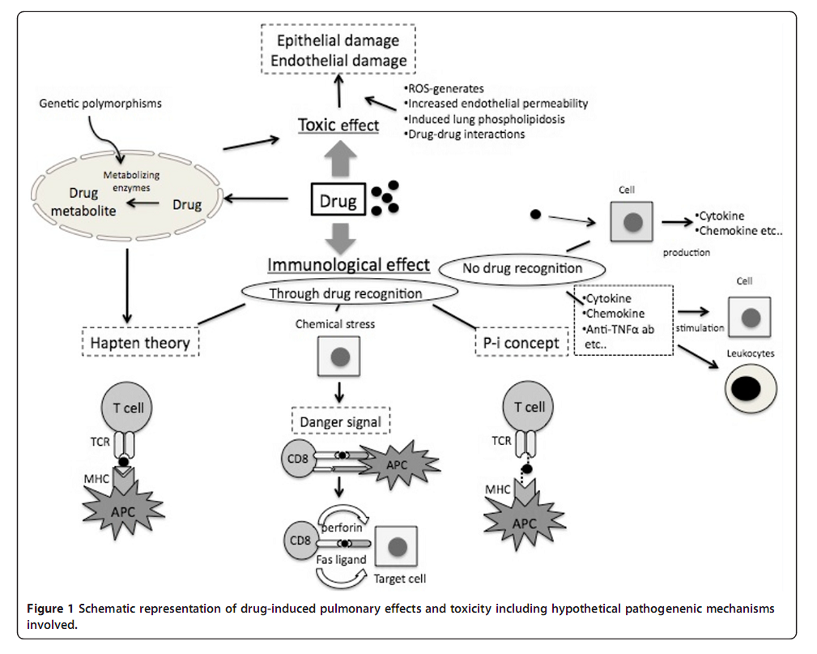
Mechanism
MTX, amiodarone mitomycin C, nitrofurantoin, and bleomycin
gemcitabine
Amiodarone,statin
DLST LMT DPT
Notes:
T cell mediate
그렇다면 어떤 기전으로 아래의 세 기전.

Slide 7
Mechanism
1)Direct, dose-dependent toxicity
  Reactive drug metabolites
  Differences in the capacity of cells to detoxify
    Cell viability after incubating microsomes with PBMCs and the suspected drug
2)Immune-mediated toxicity
  Detect the presence of drug-sensitized T cells.
    Drug-induced lymphocyte stimulation test (DLST)
    The leukocyte migration test(LMT)
    Drug provocation test (DPT) Jpn J Chest Dis 2003, 62:885–891
    do not have a definite role in the diagnosis of DILD.
Notes:
Currently, in vitro drug challenge is not a readily avail-
able or clinically validated diagnostic assay for cytotoxic
lung injury

Slide 8
Host susceptibility in DILD
The human leukocyte antigen (HLA) complex
  Presenting antigens for T cell recognition
  Rheumatoid arthritis (RA) with gold-induced pneumonitis
    HLA-B40 10.5-fold RR compared with no antigens
    Dw1 a 6.2-fold RR compared with no antigens
CYP single nucleotide polymorphisms
  cause variations in drug responses among individuals

Slide 9
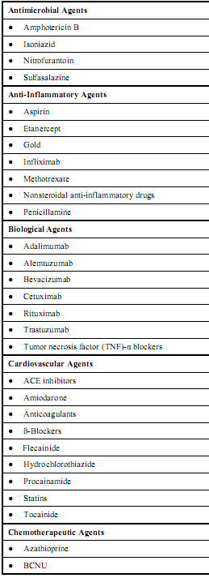
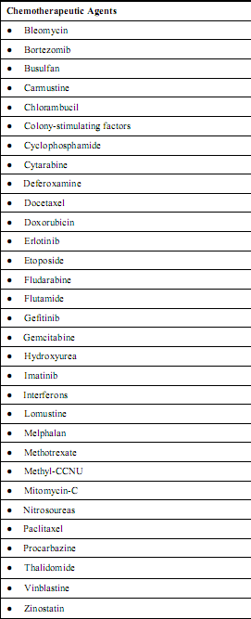
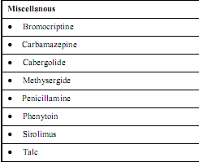
The Open Respiratory Medicine Journal, 2012, 6, 63-74

Slide 10
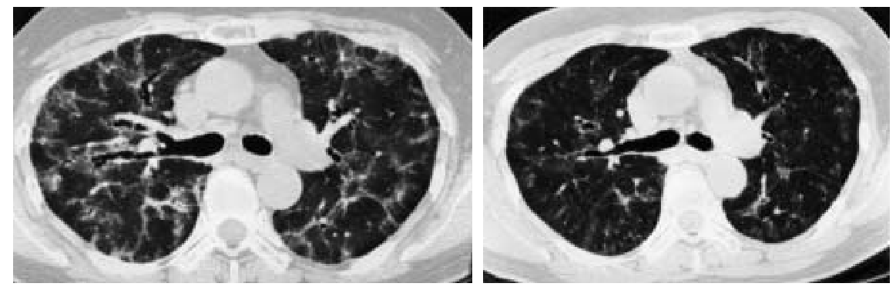
Nitrofurantoin
Chronic ILD/fibrosis ( upper, lack of honeycombing)
Female dominant, uncommon(<1%)
Respiratory symptoms after a year or more
Cessation of nitrofurantoin therapy leads to improvement
alone or in combination with steroid
Path: OS NSIP HP
Mayo Clin Proc. 2005;80(10):1298-1302

Slide 11
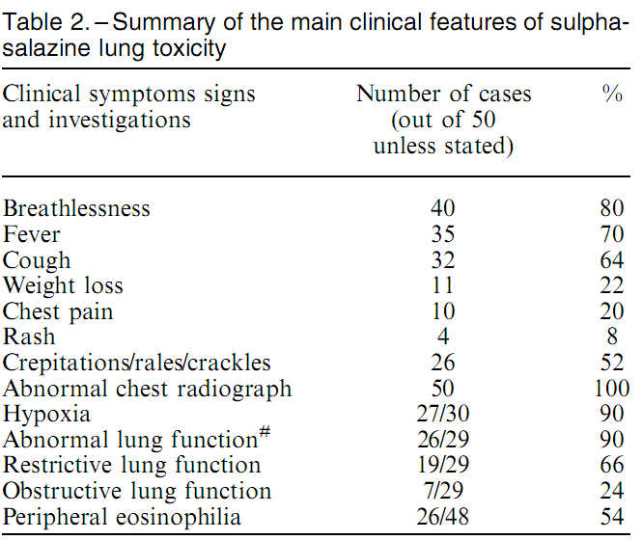
Sulfasalazine
The majority improved within a few weeks of drug withdrawal.
In the three cases where the drug was not withdrawn,
two patients die
Eosinophilic
pneumonitis
Fibrosing alveolitis
Organizing pneumonia
Desquamative interstitial pneumonia (DIP)
a compound of 5-aminosalicylic acid (5-ASA) and sulphapyridine
pulmonary toxicity
remains rare.
Eur Respir J 2002; 19: 756–764
Notes:
The majority of patients with suspected
sulphasalazine-induced lung disease improved within weeks of drug withdrawal and the
need for corticosteroids is debatable.

Slide 12
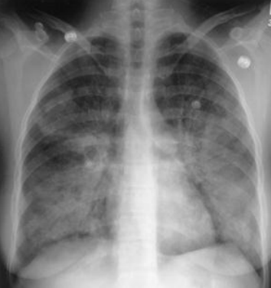
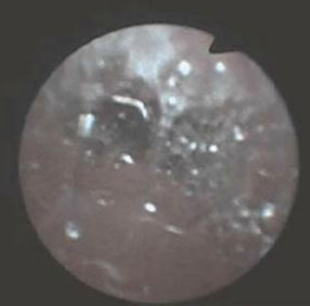
Salicylate
SIPE
Acute and chronic ASA abusers
Consider SIPE in patients with
  Pulmonary edema
  Neurological changes
  Sepsis like features
  Anion-gap metabolic acidosis
  Salicylate>30mg/dL
Management
Serum (>7.5) and urine alkalinization
>100mg/dl: hemodialysis
Glisson 2011 Southern Medical Journal • Volume 104, Number 3

Slide 13
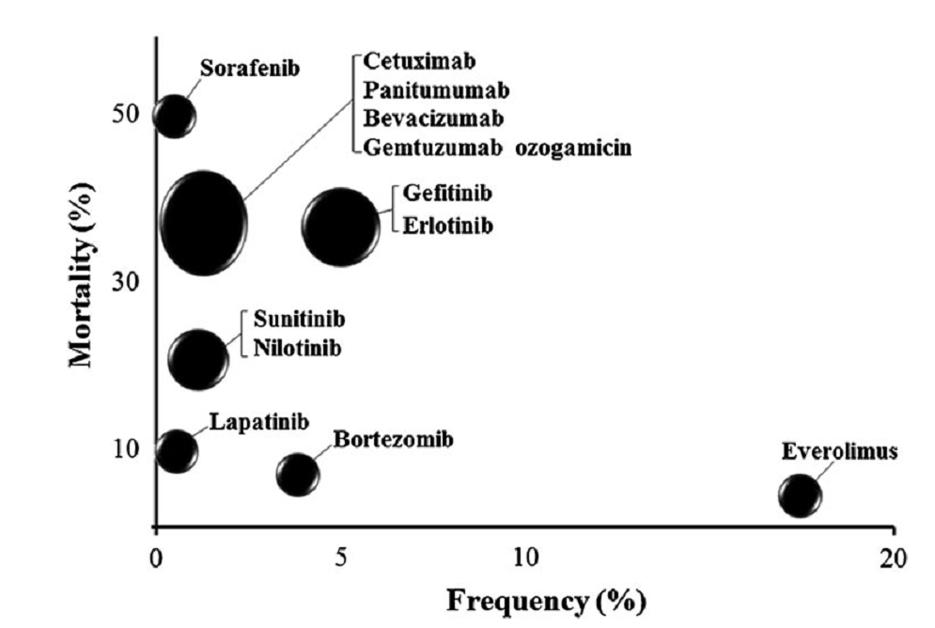
DILD in molecular targeted therapies
Int J Clin Oncol (2012) 17:534–541

Slide 14
Gefitinib
Iressa tablets 250 prospective study
  The frequency: 5.8 %(193/3,322 cases)
  The mortality rate: 38.9 % (75/193 cases)
  ↑the incidence
    (1) a performance status (PS) >2 (HR = 2.15)
    (2) a history of smoking (HR = 1.99)
    (3) interstitial pneumonia at the time of initial administration of the drug (HR = 2.50)
    (4) a history of prior chemotherapy (HR = 1.79)
  Poor prognosis: male, cases with a PS >2
Int J Clin Oncol (2012) 17:534–541

Slide 15
Treatment with gefitinib or other CTx in 3,166 Japanese patients with NSCLC
  Odds ratio (OR) of developing ILD 3.23
  The risk of ILD : high in the first 4 weeks after the start
  The mortality rate from ILD: not significantly different between two groups
Erlotinib
  The frequency: 4.5 % (158/3,488 cases)
  The mortality rate: 34.8 % (55/158 cases)
  ILD developed most often in the first 2 weeks after starting erlotinib therapy
Am J Respir Crit Care Med 177:1348–1357
Notes:
DAD BO COP HP NSIP UIP

Slide 16
mTOR inhibitors (everolimus)
an anticancer drug (AFINITOR) for RCC and PNET
  The frequency: 17.4 % (105/605 cases)
  The mortality rate: 3.8 % (4/105 cases)
Immunosuppressant for the prevention of allograft rejections
  frequency of ILD is lower (0.3%)
  The difference in the dose(10mg/D vs 3mg/D)
  concomitant use of corticosteroid and other immunosuppressants
Notes:
Primitive neuroectodermal tumor

Slide 17
mTOR inhibitors (everolimus)
  ILD without symptoms (grade1)
    Continuing cancer therapy with everolimus is allowed
Symptomatic ILD with severity of grade 2 or 3
  Everolimus should be discontinued
  After the resolution of ILD, everolimus can be administered again

Slide 18
Amiodarone
Overall AE rate 18%
Incidence of amiodarone pulmonary toxicity: 5~13%
Risk group
  High cumulative dose , daily dose>400mg/day
  Duration of therapy> 2months
  Age, pre-exsiting lung disease
  thoracic, non-thoracic surgery
Develop at any time from a few days to more a decade of Tx (increase after a month, peak at 6-12mon)
Symptoms: dyspnea cough malaise

Slide 19
Amiodarone
Direct injury
  Relevant metabolite, desethyl-amiodarone, amphiphilics accumulate in tissues(the lung)
  amiodarone persists in lung for extended periods
An immunologic reaction
  hypersensitivity pneumonitis
  lymphocytic inﬁltration, CD8 T cell lymphocytosis
Recurrences
  Slow release: up to 8 months after amiodarone withdrawal
  Resumption→ recurrence in about two-thirds
Notes:
1–2 months after
beginning corticosteroids, diagnoses other than amioda-
rone-induced pulmonary toxicities should be considere
toxic to lung cells at therapeutic serum concentrations

Slide 20
Amidarone
Steroid
  0.75–1.0 mg/kg prednisolone until improvement
  Treatment of more than 6 months
If improvement fails after 1–2 months after corticosteroids→ consider other DX!!
Amiodarone-induced ﬁbrosis , ARDS
  poorly to treatment with corticosteroid
  PF: Mortality 20-33% in admission cases
  ARDS: Mortality 50%
Notes:
Resumption of amiodarone after a period of drug
holiday is followed by the recurrence of clinical symptoms
and radiographic abnormalities in about two-thirds of
patients within shorter periods of time

Slide 21
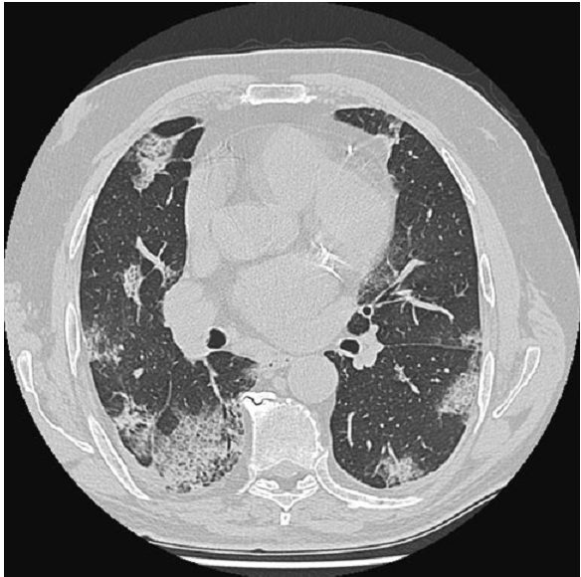
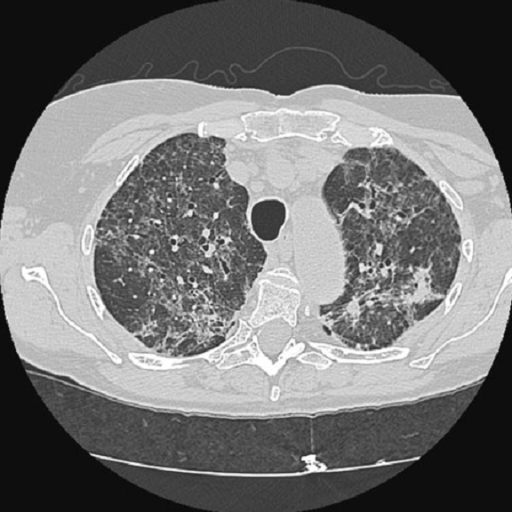
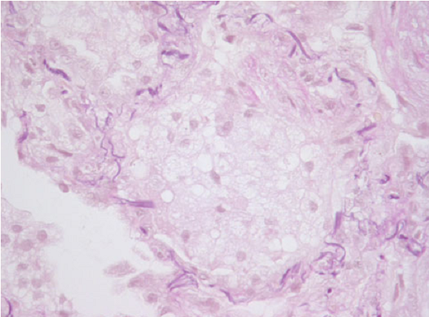
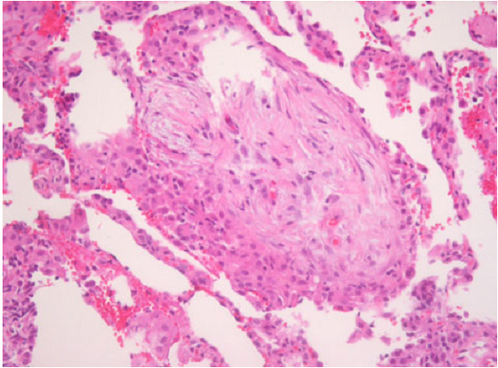
high iodine content : increased attenuation of inﬁltrates
foamy macrophages
septal thickening and foci of organizing
Notes:
patchy
bilateral inﬁltrates
bilateral
diffuse reticulo-nodular opacities
Numerous foamy macrophages in a broncho-alveolar lavage
amiodarone localizes in cell lysosomes and
block the turnover of endogenous phospholipids
The presence of numerous foamy macrophages in the air spaces is a char-
acteristic ﬁnding in many patients exposed to amiodarone
없다면 amiodarine induced lung injury 로 진단하기 어렵다.
Alveolar lung tissue showed interstitial inﬂammation with
septal thickening and foci of organizing
The histopathologic features
of amiodarone-induced ﬁbrosis are those of severe inter-
stitial ﬁbrosis, with thickened alveolar septa, type II cell
hyperplasia and the accumulation of foamy alveolar
macrophages

Slide 22
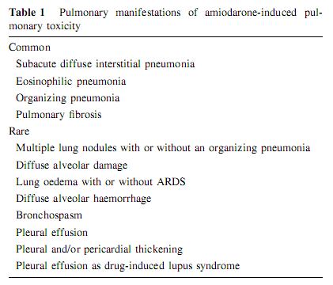
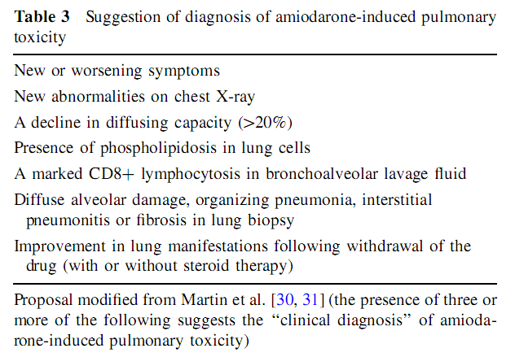

Slide 23
Rituximab(CD20 monoclonal Ab)
Rare but potentially fatal pulmonary toxicity
induce a heterogeneous spectrum of lung disorders
present with dyspnea, fever, and cough, and there is no clear evidence of infection.
Prompt diagnosis and treatment with corticosteroids is essential

Slide 24
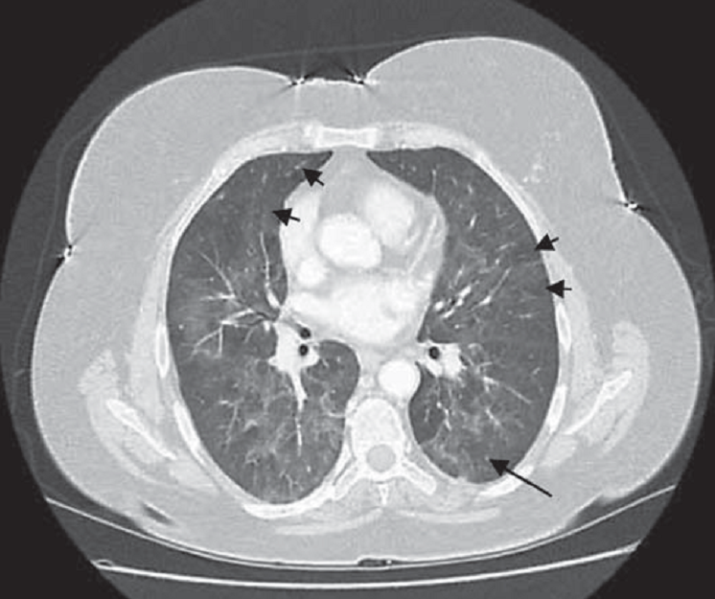
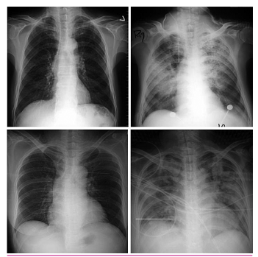
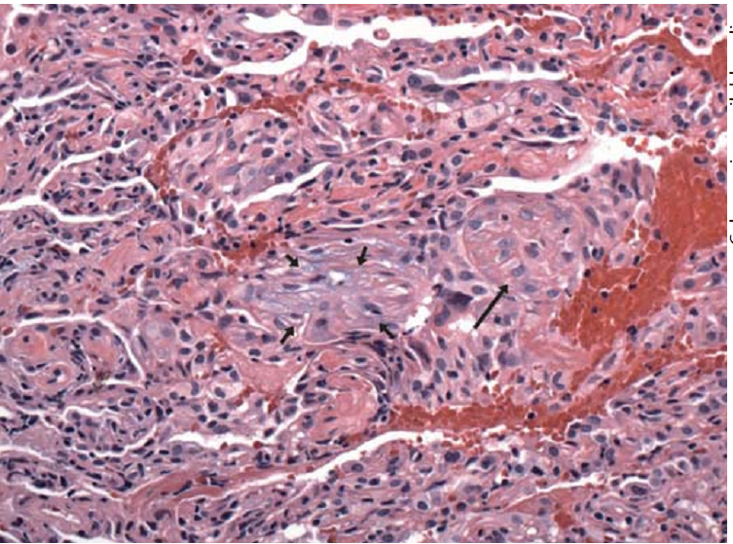
Hyperacute
Subacute
Notes:
granulomas and an inflammatory interstitial infiltrate

Slide 25
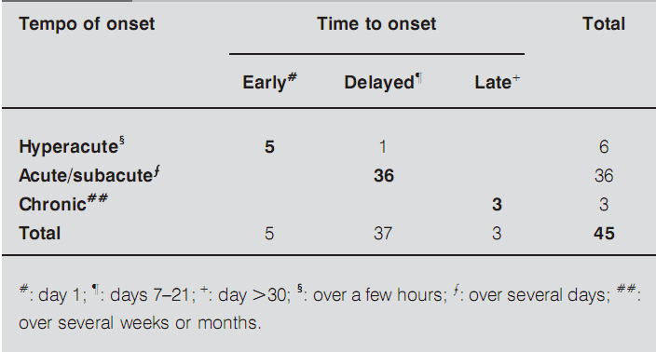
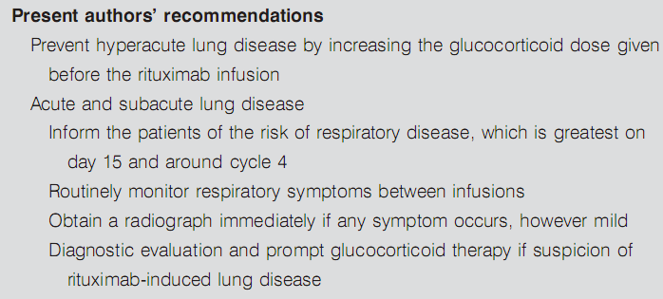
ARDS
Great tumor burden
OP, Hypersensitivity pneumonia
Good response to Steroid
Don’t be overlook!
Toxicity of the drug, (biological half-life is poorly known but probably long)
or immune system restoration
→require histological confirmation
Notes:
Cytokine release tumor lysis syndrome-> rechallenge 에 negatigveFurthermore, instead of the currently recommended methyl-
prednisolone infusion at each rituximab administration, a
longer period of steroid therapy, with tapering of the dose to
avoid a rebound reaction, may be appropriate.

Slide 26
Docetaxel
Type I & IV hypersensitivity reactions to the drug
Incidence 7 to 47%, bilateral infiltration
Risk factors
  The total delivered dose
  Schedule (Weekly schedules > three weekly )
  Especially concurrent Tx with gemcitabine and RTx
Outcome
  Mostly spontaneous resolution
  Grade 3–4 toxicity→ mortality 30%
Routine serial checkup of radiographic studies and pulmonary function test are needed.

Slide 27
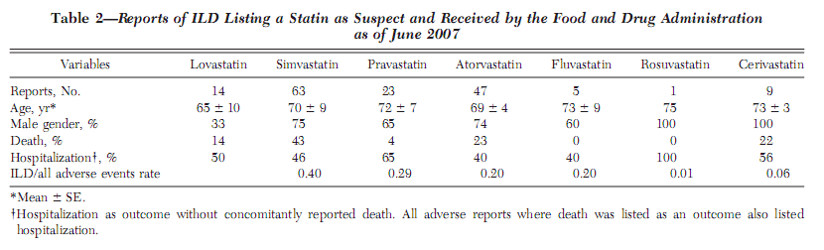
Statin
GGO, bilateral fibrosis
Fibrotic interstitial pneumonia, HP
phospholipid-rich intralysosomal lamellar inclusions in type II pneumocytes
↔ Potential therapuetic use of statin in non-statin induced benefit??
CHEST 2008; 134:824–830

Slide 28
Treatment
Early detection and cessation of treatment with the suspected drug
Education of patients about DILD
The administration of corticosteroids
  OP, EP, and HP patterns are expected to show a good response to corticosteroid
  DAD pattern: usually refractory to corticosteroid therapy and often fatal
The prognosis : related to the degree of the pulmonary fibrosis

Slide 29
Conclusion
DILD
  Heterogeneous group of lung disease
  Preventable
    Earlier diagnosis,
    Aviodance of certain drugs in allergic patient
    Better information to patients
Clinical and generic risk stratification may lead to more accurate prevention of DILD.

