Slide 1
Detection and Early Referral of Patients with Interstitial Lung Abnormalities
Chest (February. 2022)
2022.3.15
R3 홍혜영

Slide 2
Introduction
ILD : Interstitium inflammation & fibrosis
rare, heterogenous
poor outcomes & early mortality
often diagnosed late in their disease course
>> Earlier identification of ILDs & timely initiation of therapies could help improve clinical outcomes of pts. and lead to reduction in morbidity and mortality

Slide 3
Introduction
ILA (Interstitial lung abnormalities)
Abnormalities on chest CT image suggestive on an ILD
Honeycombing, Centrilobular GGO, Reticulation, Traction bronchiectasis
Early stage of ILD
overlapping genetic risk factor, similar physiological decrements,
histopathologic findings, adverse longitudinal outcome
- 2~10% of adults, up to 10% of CT scans in lung cancer screening program
>> Expert-based consensus in ILA
Referral & Follow up procedures
Role of screening in specific populations at high risk of ILD

Slide 4
Materials and Methods
Steering Committee(SC)
: 9 respiratory physicians & thoracic radiologists
Expert panel
- currently practicing clinician trained in pulmonology or thoracic radiology
- >5yrs of clinical experience in diagnosing, treating, or imaging lung disease
- >3yrs of clinical experience with diagnosing and treating ILDs
Surveys
- Anonymized iterative survey
- Survey 1 was reviewed by the SC and then revised set of questions for Survey 2

Slide 5
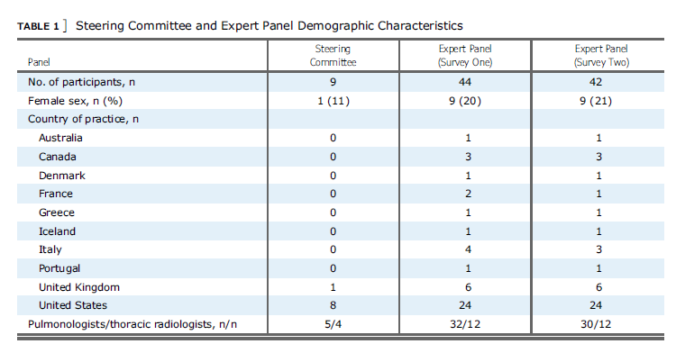
Results
Expert panel Characteristics
-79% had>10yr experience in clinical medicine
-95% practiced at an academic center
-77% saw >100 Pts. with ILD yearly

Slide 6
Results
Survey results
39 Questions achieved consensus agreement
Survey 1
1) Perceptions of significance of ILA
2) Diagnosis & Reporting of ILA
3) Testing of referred asymptomatic Pts.
Survey 2
1) Diagnosis and reporting of incidentally detected ILA
2) Screening early stages of ILD

Slide 7
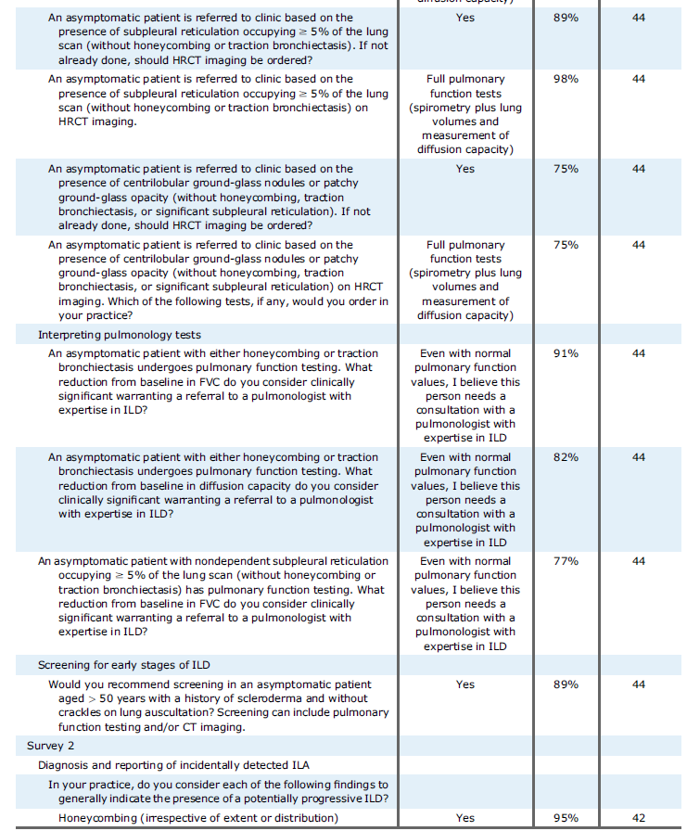
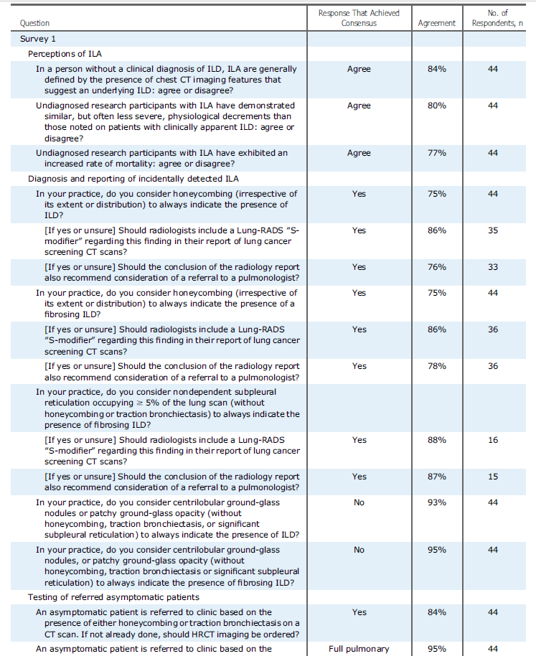
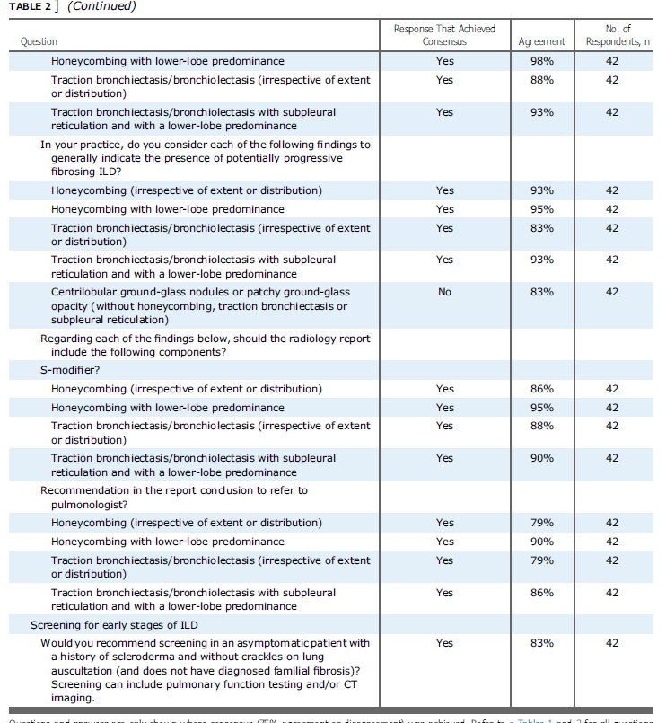

Slide 8
Results
Perceptions of significance of ILA
presence of CT imaging features that suggest an ILD
Diagnosis and reporting of ILA
- Honeycombing always indicated the presence of an underlying ILD
Centrilobular ground-glass nodules or patchy ground-glass opacity
do not always indicate the presence of an underlying ILD
Radiologists should include a Lung-RADS “S-modifier” in lung cancer screening program
* Lung-RADS : to standardize reporting and management recommendation for lung cancer screening
* S-modifier : clinically significant or potentially significant non-cancer finding

Slide 9
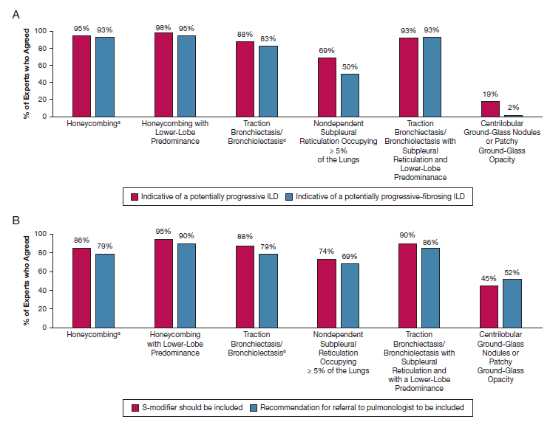
Results
Honeycombing and Traction bronchiectasis or bronchiolectasis indicated potentially progressive ILD
Honeycombing (irrespective of extent or distribution) was believed to indicated the presence of a fibrosing or potentially progressive fibrosing ILD
Nondependent subpleural reticulation occupying > 5% of the CT scan and centrilobular GGO did not achieve consensus
Recommendation the use of Lung-RADS S-modifier
Recommendation for referral to pulmonologists

Slide 10
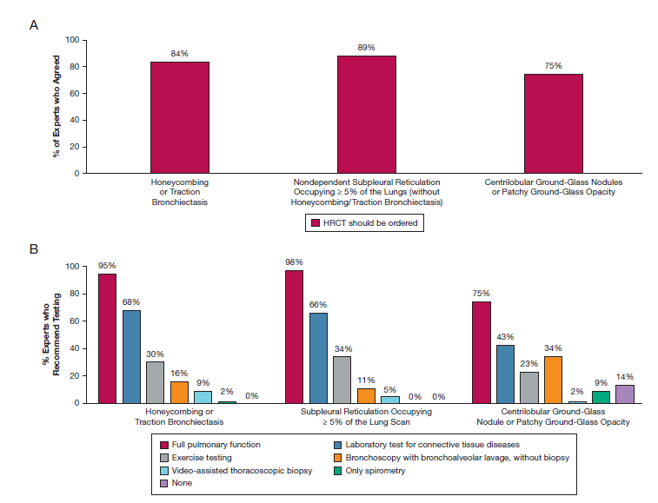
Results
Diagnostic testing in asymptomatic Pts.
1) HRCT
2) PFT+DLCO
>>Even with normal PFT, If honeycombing or traction bronchiectasis was present, Refer to a pulmonologist with expertise in ILD
>>Pts. with these ILA should be followed up within 6 to 12 months

Slide 11
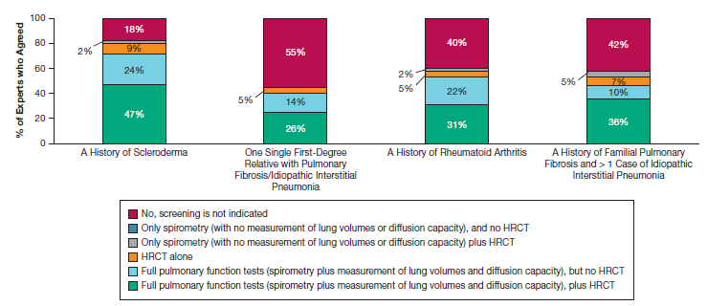
Results
ILA screening in high-risk populations
Asymptomatic Pts. Age>50, Hx. of scleroderma
Undiagnosed but have >1 relative with an idiopathic interstitial pneumonia

Slide 12
Discussion
Presence of ILA with honeycombing or traction bronchiectasis as a clinically significant
Subpleural reticulations have an increased rate of mortality but do not meet consensus
Valuable recommendation for Pts. with ILA
Early identification of ILA could improve outcomes is not yet proven
May increase the burden to physicians
May not be reflective of the broader community

Slide 13
경청해주셔서 감사합니다.

