Slide 1
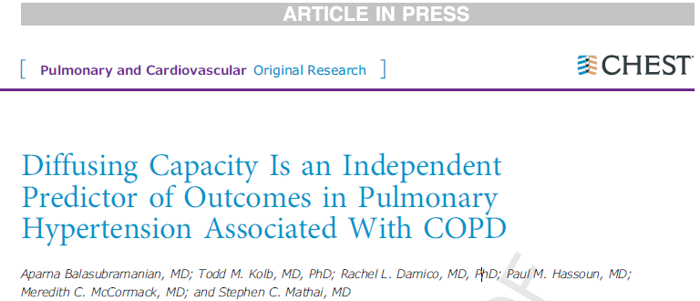
호흡기내과 R3 김나혜
Notes:
2020년 4월 Chest 에 실린 것으로
Pulmonary HTN 과 연관된 COPD 에서 diffusing capacity 가 예후 예측할수 있는 독립적인 지표로
정립될 수 있는 것에 대한 내용을 다룬 article 입니다.

Slide 2
Background
COPD is reported to be the fourth leading cause of death in the United states.
Many patients with COPD experience elevation in pulmonary arterial pressures or pulmonary hypertension (PH).
Patients with COPD who experience pulmonary hypertension (PH) have worse mortality than those with COPD alone.

Slide 3
Background
COPD-PH was thought to develop as severity of airflow obstruction, measured by FEV₁, and subsequent chronic hypoxemia progressed.
However, airflow obstruction increasingly has been noted to be insufficient in the prediction of clinical outcomes in the general population of COPD.
  Hemodynamic measures using right-sided heart catheterization (invasive)
  Diffuse capacity of the lung of carbon monoxide (D_{LCO}) (noninvasive)
In recent COPD cohort study, D_{LCO} is an indicator of disease morbidity .
  This may be particularly relevant for those with COPD-PH.
Notes:
COPD-PH 는 FEV1 으로 측정하는 airflow obstruction 이 심각해 지면서, 결국은 만성적인 hypoxemia 가 진행하면서 발생하는 것으로 알려져 있는데요.
하지만 airflow obstruction 은 일반적인 COPD 인구에서 임상적 예후를 예측하기엔 많이 부족하다고 알려져 있습니다.
정확히 하기 위해서는 right sided heart catheterization 이 있는데 좀더 침습적일 수가 있지만
Diffusing capacity of the lung of carbon monoxide 인 경우는 비침습적이어서
최근 COPD cohor study 에서는 DLCO 롤 질병 사망률을 나타내는 지표로 강조하였으며,
아마도 이것은 COPD-PH 환자에서도 비슷하게 적용될수 있을 것이라고 본 논문에서는 예측해 보았습니다. .

Slide 4
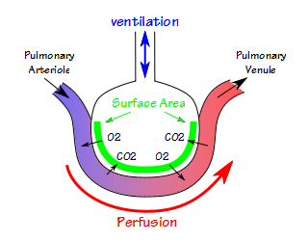
Purpose
To examine D_{LCO} as a predictor of mortality in a cohort of patients with COPD-PH.
  Lower D_{LCO} will predict increased mortality rates in the COPD-PH population independent of airflow obstruction and pulmonary hemodynamics.
Notes:
COPD-OH 환자에서 DLCO 가 사망 예측 인자로 작용할수 있는지에 대해 알아보았고,
Airflow obstruction과 pulmonary hemodynamics 와 독립적으로,
COPD-PH 환자에서 DLCO 가 낮을 수록, mortality rate 은 증가할 것으로 예측하여 가설을 세웠습니다.

Slide 5
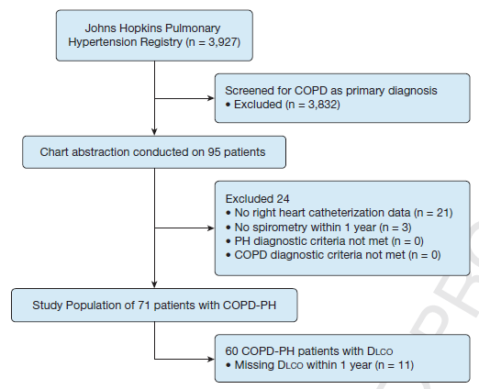
Materials and Methods
Retrospective cohort study
Jan. 2002 ~ Jan. 2018
COPD diagnosis
FEV1/FVC < 0.7
COPD diagnosis
FEV1/FVC < 0.7
PH diagnosis
mPAP > 20mmHg

Slide 6
Materials and Methods
Pulmonary function testing data
  FEV1, FVC, TLC, RV, RV/TLC ratio, D_{LCO}, Gas transfer efficiency, 6MDW (6 minutes walk distance testing)
Right Heart Catheterization data
  Hemodynamic parameters: Right atrial pressure, mPAP, PCWP, CO, CI, PVR, PA Sat %, and arterial oxygen saturation.

Slide 7
Materials and Methods
Statistical Analysis
  Baseline characteristics: mean with SDs
  Baseline clinical, PFT, hemodynamic parameters: t-test or chi-squared tests
  DLCO %: continuous variable
  Unadjusted transplant-free survival by DLCO group: Kaplan-Meir method, long rank test
  Cox proportional hazard methods
  Adjusted transplant-free survival: Cox proportional hazard methods

Slide 8
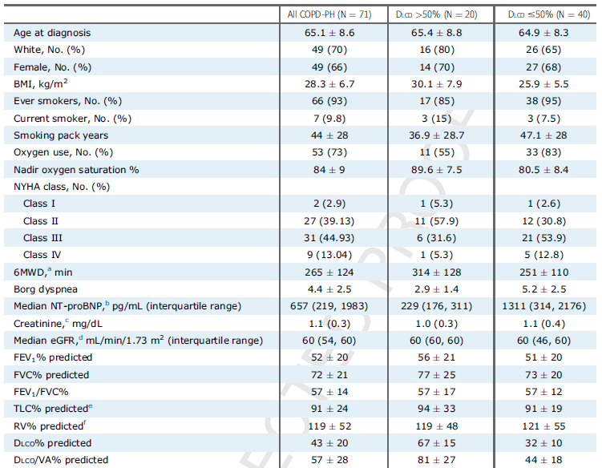
Baseline Characteristics
60% NHYA III/IV
Mod-severe obstruction
Severe gas transfer defects

Slide 10
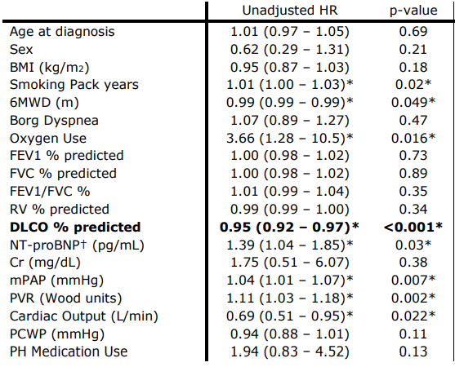
Baseline Characteristics
Pulmonary vascular phenotype: 8 patients (11%)
  Minimal airflow obstruction (FEV₁>60% predicted)
  mPAP ≥ 35 or mPAP ≥25 + CI <2.0
5 out of 8 (7%) pulmonary vascular phenotypes had D_{LCO} <50% predicted

Slide 11
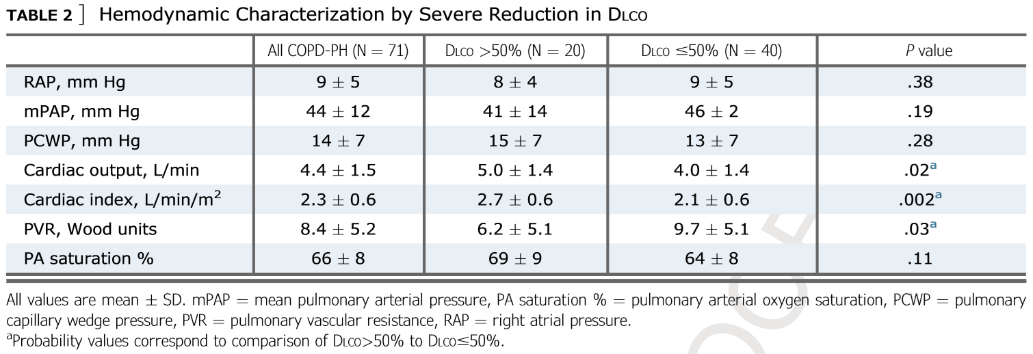
Results
D_{LCO} is associated with PVR.

Slide 12
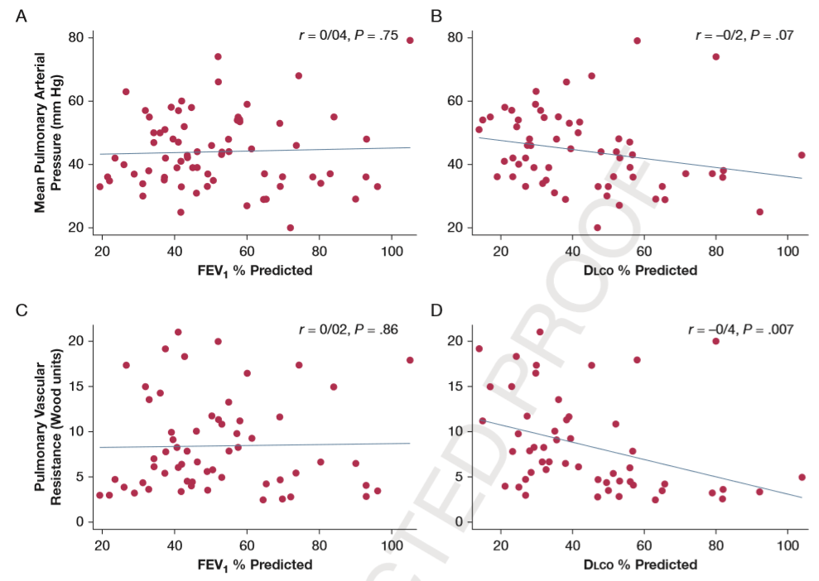
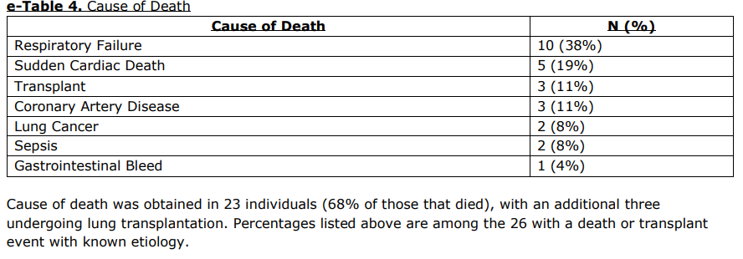
Results
D_{LCO} is associated with PVR.

Slide 13
Results
D_{LCO} is a strong independent predictor of transplant-free survival.
Unadjusted transplant-free survival
  1-year survival: 87%
  3-year survival: 60%
  5-year survival: 51%
34 deaths (48%), 3 transplantations (4%)

Slide 14
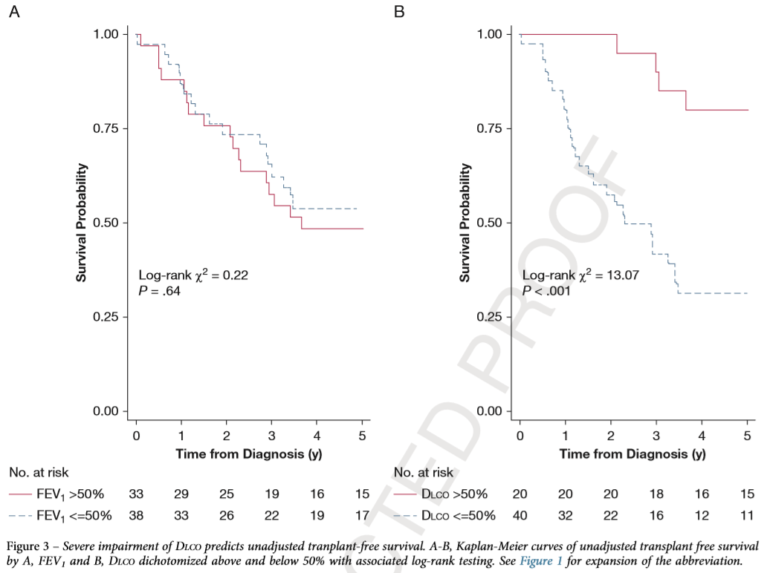
Results
D_{LCO} is a strong independent predictor of transplant-free survival.
D_{LCO}>50%
FEV₁<=50%
FEV₁>50%
D_{LCO}<=50%

Slide 15
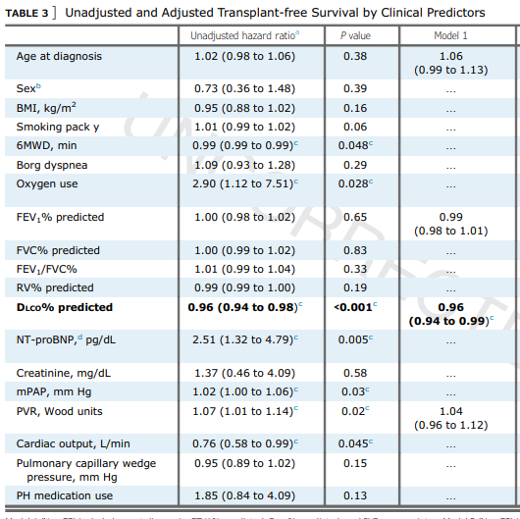
D_{LCO} is the only significant predictor of death.
No other PFT measures were significant.

Slide 16

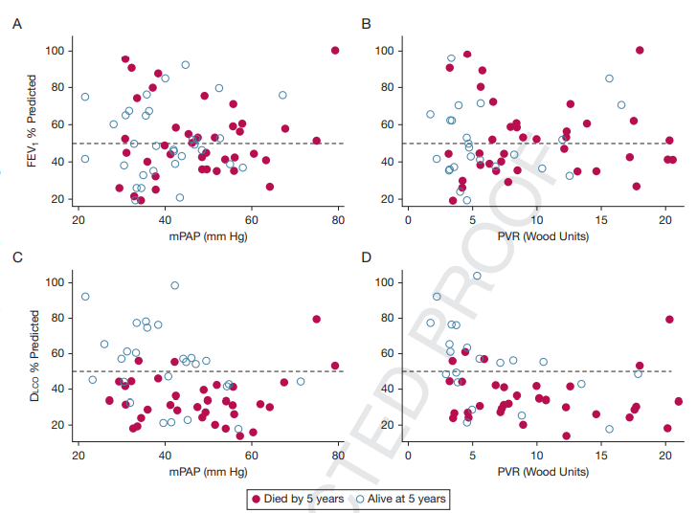
Results
Severe impairment in D_{LCO} is associated with death across a wide range of hemodynamics.
FEV₁>50%
FEV₁< 50%
D_{LCO}>50%
D_{LCO}<50%

Slide 17
Discussion
5-year survival: 51%
  Overall prognosis is poor among this population.
FEV₁ values do not correlate with hemodynamic disease severity nor with mortality rates.
  Airflow obstruction is not the pathophysiologic derangement that drives prognosis.
4% increase in mortality rate for every 1% decrease in D_{LCO}.
  Gas transfer is a strong independent predictor of death.

Slide 18
Discussion
D_{LCO} is correlated with moderately with PVR.
  Relevant to morphologic changes to the pulmonary vasculature.
  (Pulmonary capillary density ↓ → D_{LCO} ↓, PH severity ↑)
  D_{LCO} ∝ Death: early reduction in capillary density
5 out of 8 (7%) COPD vascular phenotype had additionally severe reduction in gas transfer.
  D_{LCO} can be a useful predictor both within and outside of the
  vascular phenotype.
Gas transfer was closely linked to death across a wide range of mPAP and PVR values.
  D_{LCO} is useful even in less severe derangement of dynamic
  metrics.

Slide 19
Limitations
Sample size
Selected from a single center, limiting generalizability to the larger COPD population
No assessment of smoking status at the time of DLCO measurement
No assessment of Hb which can bias DLCO%
Causes of death: no available
Independent of CT scan-defined emphysema

Slide 20
Conclusion
D_{LCO}, a readily available, inexpensive, noninvasive measurement, is a strong independent predictor of death in patients with COPD-PH.
Across a wide range of spirometric and hemo- dynamic parameters, D_{LCO} is consistently
associated with mortality.
∴ D_{LCO} should be considered as a routine,
prognostic measure in clinical practice for
characterization of COPD-PH patients.

Slide 21
Thank You

