Slide 1


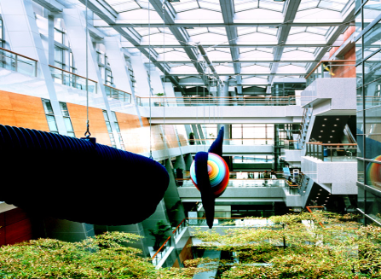

Chylothorax
강 사 이 인 선

Slide 2
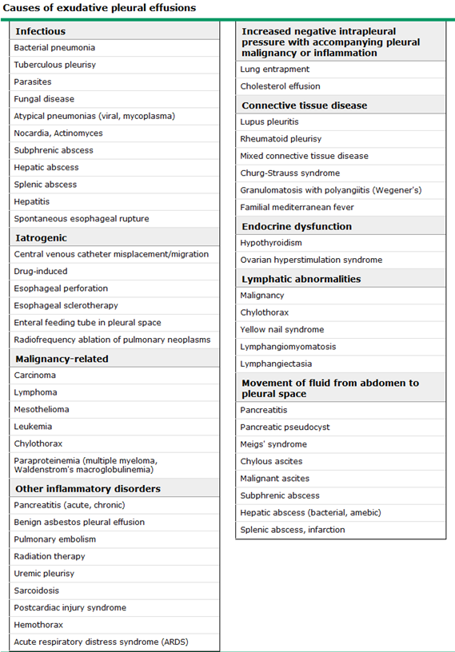

Slide 3
Chylothorax
A chylothorax occurs when lymph fluid accumulates in the pleural space due to disruption or obstruction of the thoracic duct.
Chylothoraces contain a high concentration of triglycerides as chylomicrons.
can be milky, sanguineous, or serous.
→ chylothorax, a cholesterol pleural effusion, or an empyema
DDX>
  Cholesterol effusions (also known as a pseudochylothorax or chyliform effusion) are much less common than chylothoraces and contain a high concentration of cholesterol.
  typically occur in patients with thickened and sometimes calcified pleural surfaces in the setting of chronic pleural inflammation
Notes:
the absence of a milky appearance does not exclude a chylothorax, especially if the patient is malnourished, fasting, or on a low fat diet

Slide 4
Diagnosis
gold standard - chyle leakage by direct visualization or lymphangiography
Chyle composition
lymphatic fluid of intestinal origin, to the bloodstream.
  Cell count : predominance of lymphocytes(usually > 80 % of total nucleated cell count)
  pleural fluid TG> 110 mg/dL (1.24 mmol/L) strongly supports the diagnosis
  < 50 mg/dL excludes a chylothorax with reasonable likelihood,
  50 ~ 110 mg/dL should be followed by lipoprotein analysis of the pleural fluid
  Detection of chylomicrons in the pleural fluid by lipoprotein electrophoresis confirms the presence of a chylothorax.
  The cholesterol level in a chylothorax is generally less than 200 mg/dL (5.18 mmol/L).
Notes:
Fifteen percent (15 percent) of chylothoraces, however, have pleural fluid triglyceride concentrations less than 110 mg/dL and 3 percent have values less than 50 mg/dL [34,38]
A triglyceride level below 110 mg/dL (1.24 mmol/L) should be followed by lipoprotein electrophoresis of the pleural fluid if a chylothorax remains clinically suspected

Slide 5
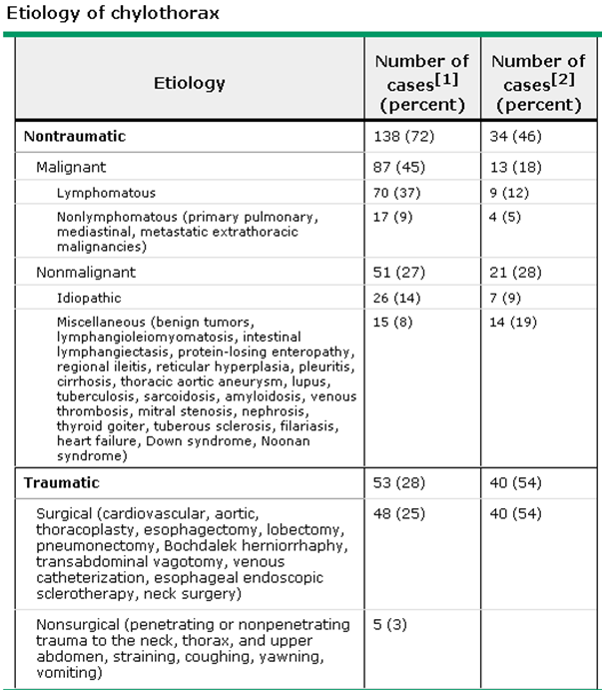

Slide 6
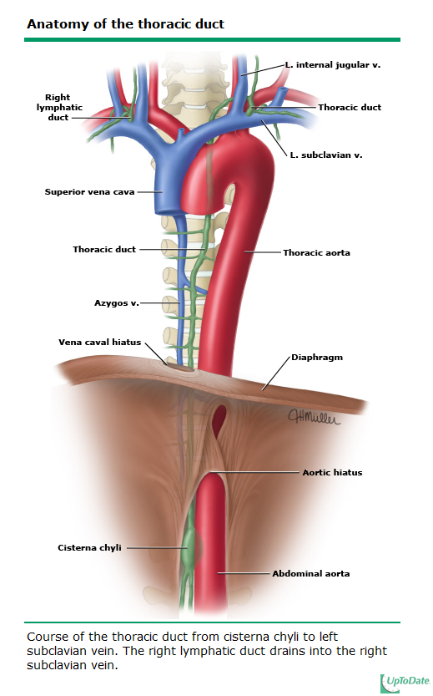
Notes:
가슴림프관팽대 Cisterna chyli

Slide 7
# 3599694 송 O 영 M/69
Pleural fluid analysis (2013.4.9)
Color Mixed bloody
Turbidity Cloudy
RBC 15800
WBC 17950
Polymorphonuclear cells 81
Mononuclear cells 19
Eosinophils 0
Basophils 0
Other 0
SG 1.026
pH 7.4
Total Protein 3300.0
Albumin 2400.0
Amylase 325
Triglyceride 821
Cholesterol 67
LD(LDH) 835
Glucose 164
Hct <1
CEA 0.77
ADA 15.8
Pleural fluid
AFB smear (-)
Mycobacterium cx
: not yet
bacterial cx
: no growth
Sesrum LDH 234
Serum amylase 222 IU/L
lipase 226 IU/L

Slide 8
“Amylase-rich pleural effusion”
pleural fluid amylase > the upper limits of normal for serum amylase or a pleural fluid to serum amylase ratio greater than 1.0,
cause
  Acute pancreatitis
  Chronic pancreatic pleural effusion
  Esophageal rupture
  Malignancy
  Other rare causes :pneumonia, ruptured ectopic pregnancy, hydronephrosis, and cirrhosis
Notes:
Although not routinely tested in pleural fluid samples, amylase measurements can assist in settings wherein pancreatic or esophageal etiologies of an effusion appear possible.
Pancreatic disease is associated with pancreatic isoenzymes, while malignancy and esophageal rupture are characterized by a predominance of salivary isoenzymes [39].

Slide 9
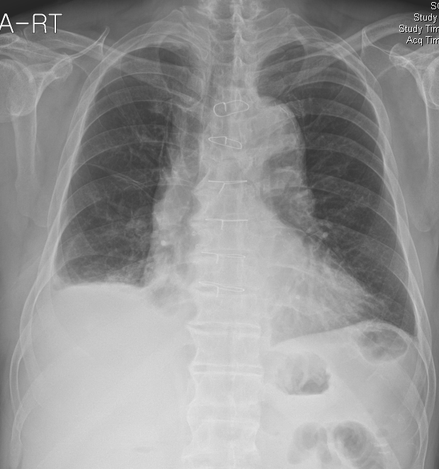
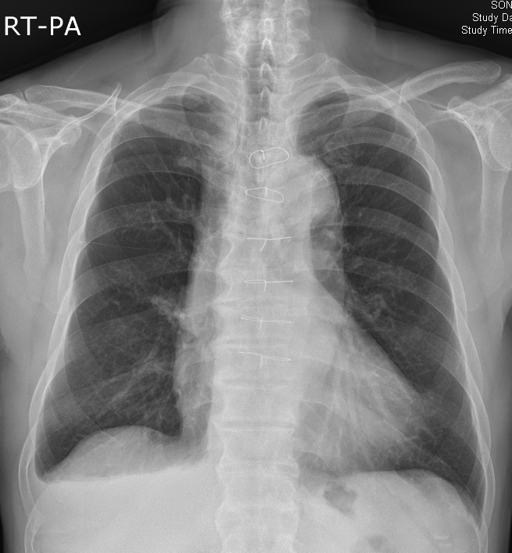
2013-4-15
2013-4-08

Slide 10
Chylous effusions secondary to pancreatitis
M/43 (1984 reported)
Alcohol induced pancreatitis
Serum amylase 1672IU
CXR- Rt pleural effusion
Thoracentesis: pH 6.88 ,WBC 65000(90% poly, 10% monocytes), glc16mg/dL, amylase 6 IU,total protein 2.9mg/dL, TG1100mg/dL, cholesterol 47mg/dL culture : no growth
Ascites: milky fluid
pH 7.11 WBC 90 (10% poly,10% lymphocytes, 80% undetermined) glc 117mg/dL, amylase 400 IU, total protein 2.9mg/dL. Cholesterol 273mg/dL, LDH500 IU

Slide 11
Chylothorax as a rare complication after severe necrotizing pancreatitis and endoscopic pancreatic necrosectomy
M/72 (2013 reported)
Severe necrotizing pancreatitis, multiorgan failure
serum amylase of 2598 U/L , serum triglyceride value of 248 mg/dL
Six sessions of endoscopic pancreatic necrosectomy were performed, during which the retroperitoneal cavity was irrigated with copious amounts of saline solution, and large amounts of turbid fluid were removed along with large pieces of necrotic pancreatic tissue.
Two weeks after the first endoscopic pancreatic necrosectomy,
-> a right pleural effusion.
milky pleural fluid -> chylomicrons was positive

