Slide 1
Chest conference
Oncogene fusion-positive lung adenocarcinoma
2023.10.19
강사 홍혜영

Slide 2
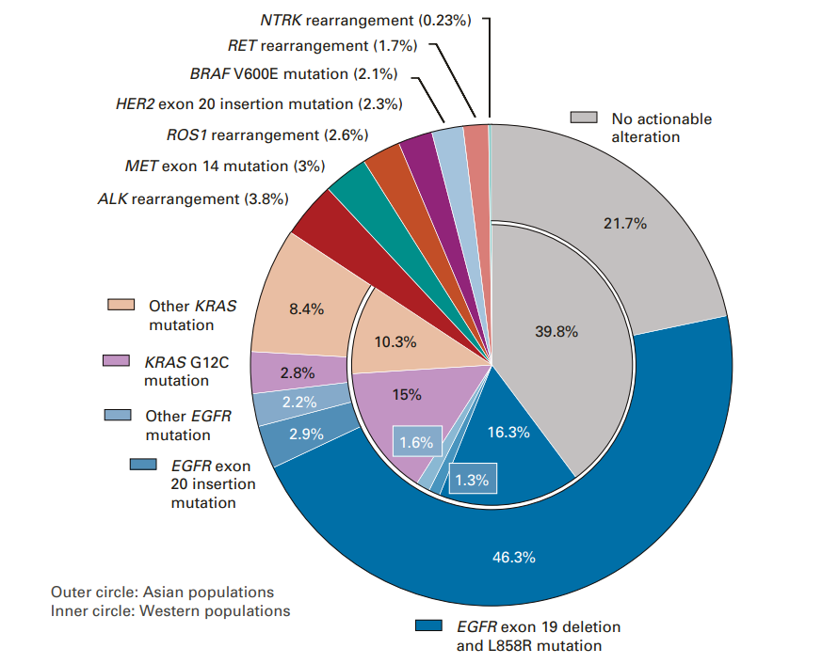
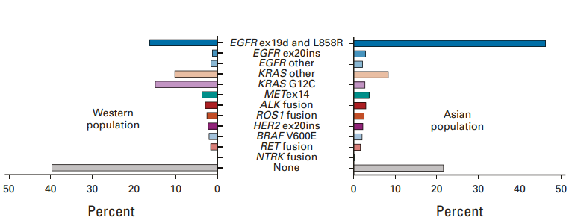
Oncogenic driver mutations in NSCLC
JCO, 2022; 40: 611-625

Slide 3
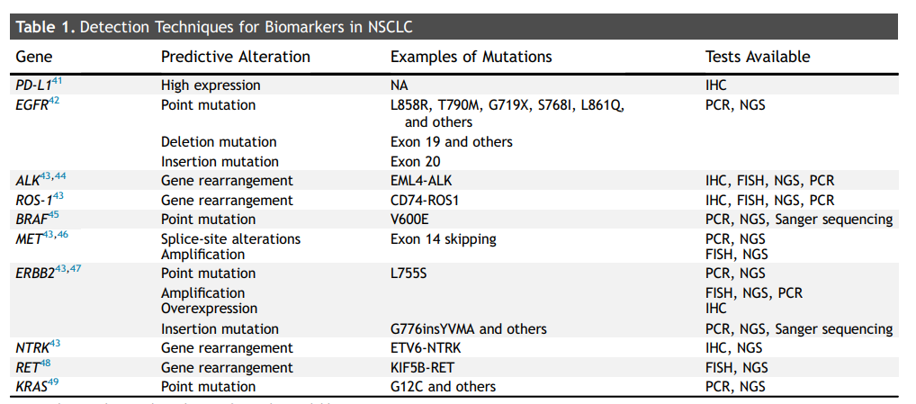
Oncogenic driver mutations in NSCLC
JTO, 2023; 18: 436-446

Slide 4
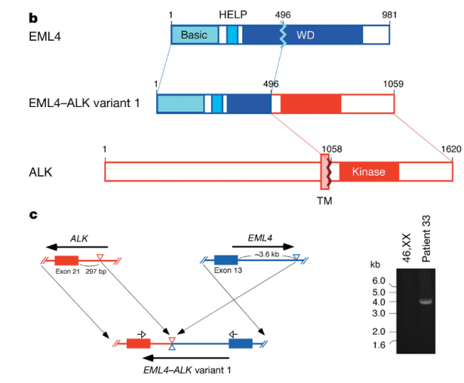
ALK rearrangement
3~5% of NSCLC pts.
Relatively younger (median age: 52)
Minimal (<10PY) to no smoking history
Tumor histology: adenocarcinoma (97%)
Brain metastasis is common
Nature 2007;448:561-6

Slide 5
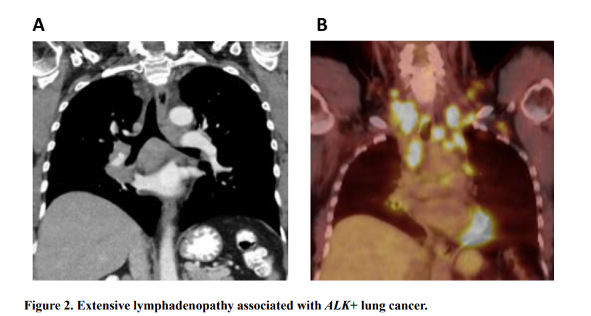
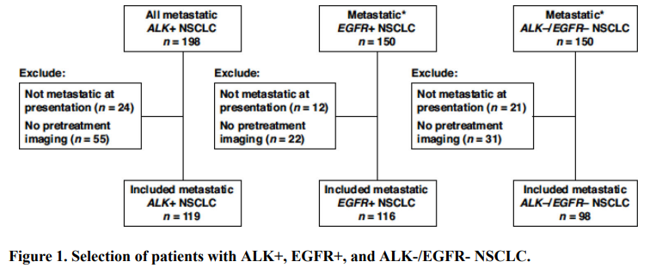
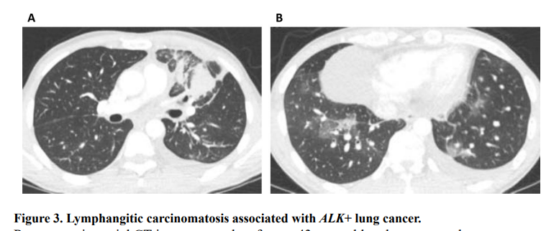
AJR. 2020 April; 214(4): 766–774.

Slide 6
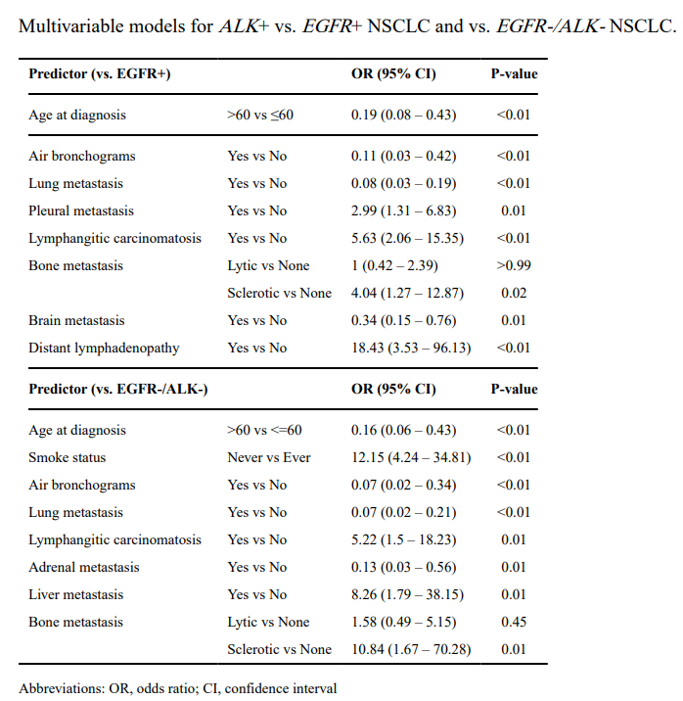
Younger age at diagnosis
Absence of air bronchogram
Presence of lymphangitic carcinomatosis
Pleural meta, sclerotic bone meta
Distant LN meta
AJR. 2020 April; 214(4): 766–774.

Slide 7
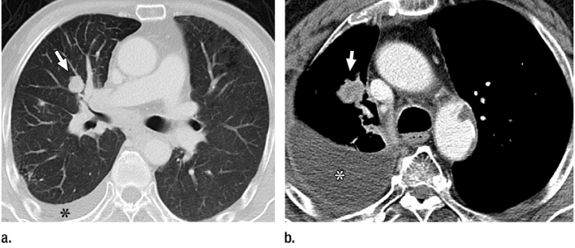
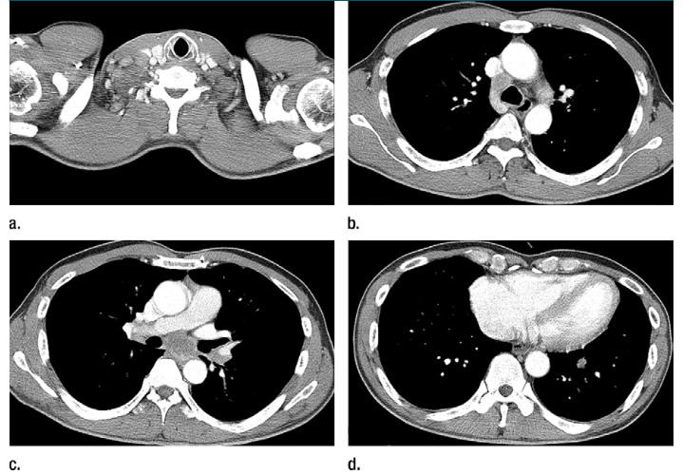
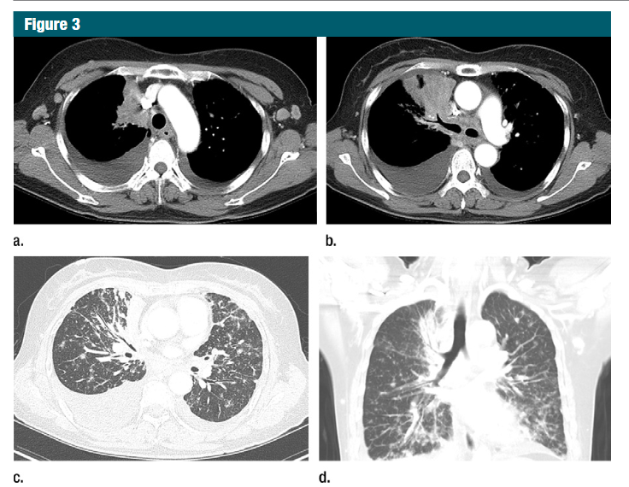
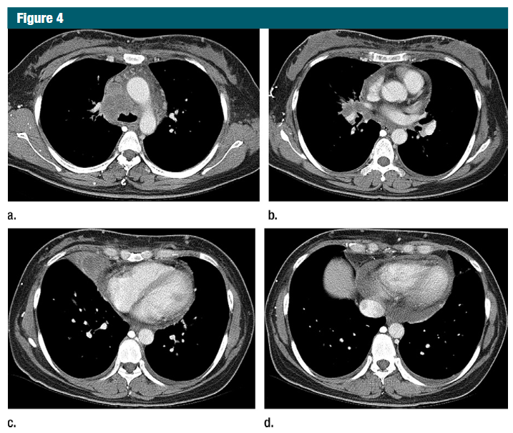
Lobulated margin
N2, N3 involvement
Lymphangitic lung meta
Pleural, Pericardial meta
Radiology. 2015 Apr;275(1):272-9.
Notes:
ALK+ vs EGFR +

Slide 8
Radiologic features of ALK rearranged NSCLC
SR, Meta analysis, 16 studies, 3113 NSCLC Pts. 17% ALK +
  N2 or N3 lymphadenopathy than N0 or N1
    (OR 5.63, 95% CI 2.99-10.61, P<0.01)
  More lymphangitic carcinomatosis
    (OR 3.46, 95% CI 1.47-8.14, P<0.01)
  Less frequent lung meta
    (OR 0.66, 95% CI 0.47-0.93, P=0.02)
  More common pleural effusion, pleural meta
    (OR 1.91, 95% CI 1.24-2.95, p<0.01)
AJR. 2019 November; 213(5): 1059–1072.

Slide 9
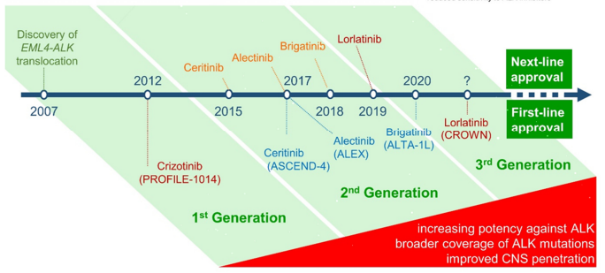
Treatment of ALK rearranged NSCLC
Pharmaceuticals 2021;14:80

Slide 10
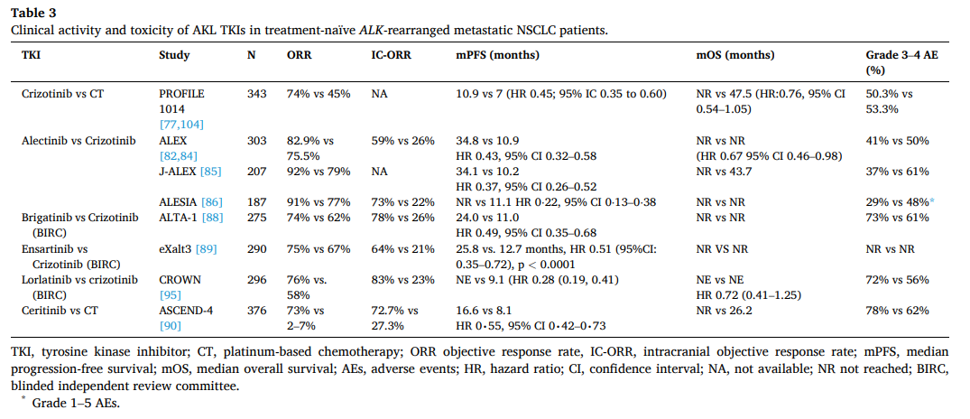
Treatment of ALK rearranged NSCLC
Can Treat Rev 2021;95:102178

Slide 11
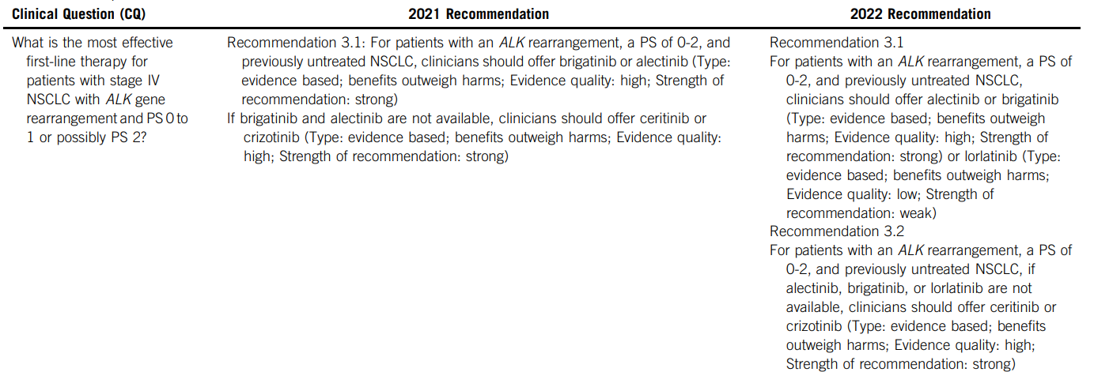
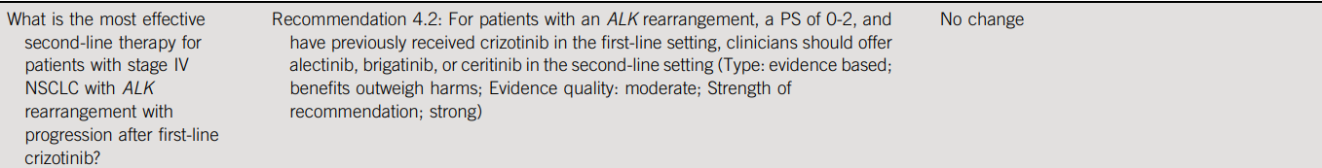
Treatment of ALK rearranged NSCLC
JCO.40:3310-3322.

Slide 12
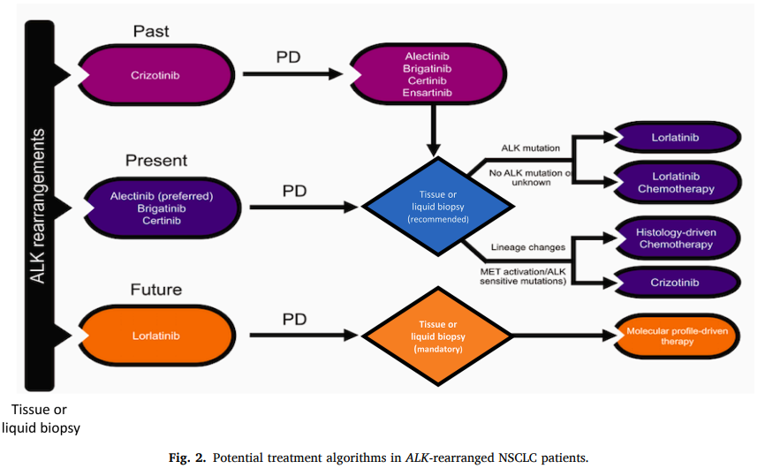
Treatment of ALK rearranged NSCLC
Can Treat Rev 2021;95:102178

Slide 13
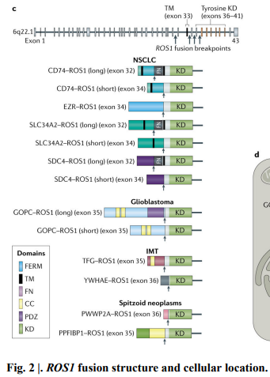
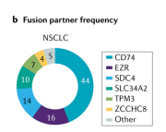
ROS1 rearrangement
1-2% of NSCLC pts.
More frequent younger age, women
Little to no smoking history
Tumor histology : Adenocarcinoma
Advaced stage
Brain metastasis is common
Curr Oncol. 2022 Feb; 29(2): 641–658.
Nat Rev Clin Oncol 2021;18:35-55
Transl Cancer Res. 2020 Jul; 9(7): 4383–4392.

Slide 14
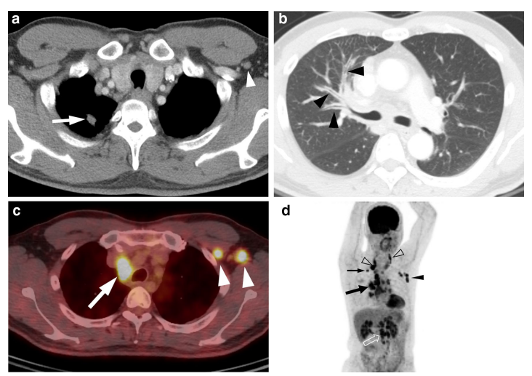
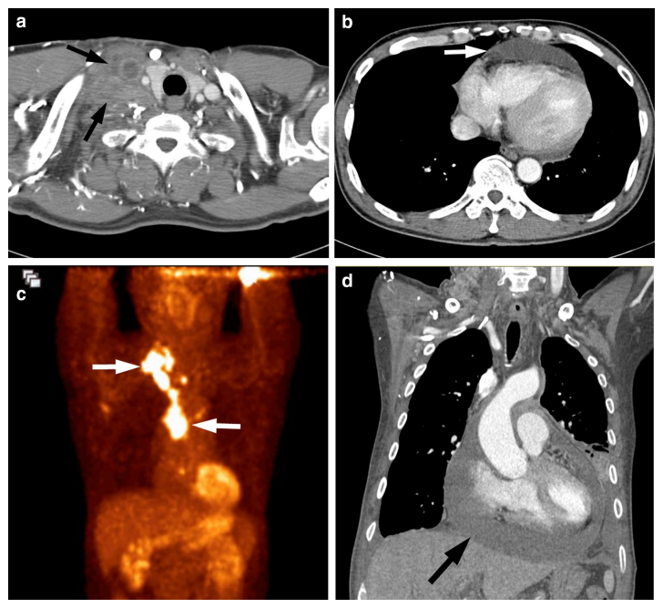
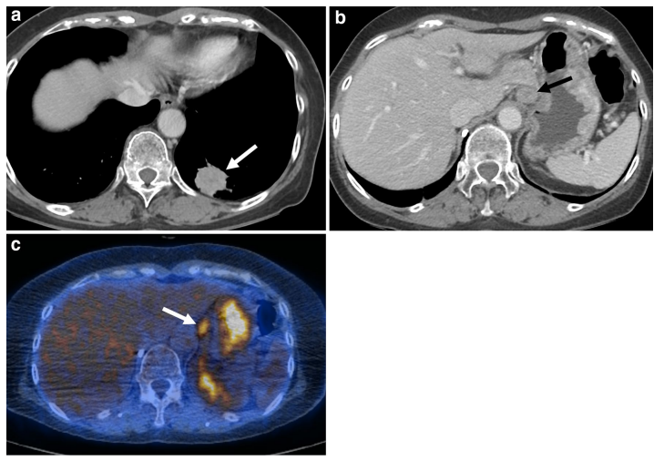
Extensive LN metastasis
Lymphangitic carcinomatosis
Distant LN metastasis
Pericardial effusion
Scientific Reports (2020) 10:16251

Slide 15
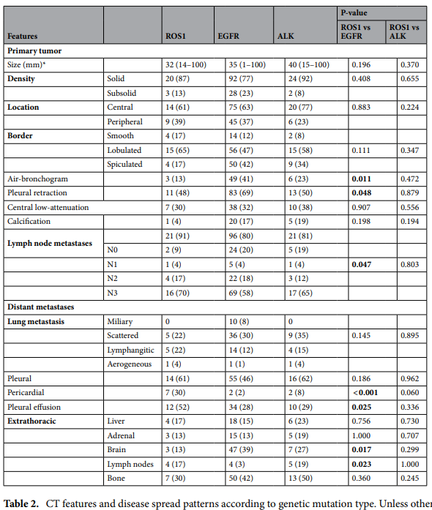
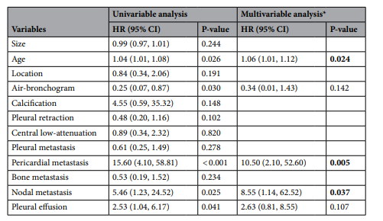
Scientific Reports (2020) 10:16251

Slide 16
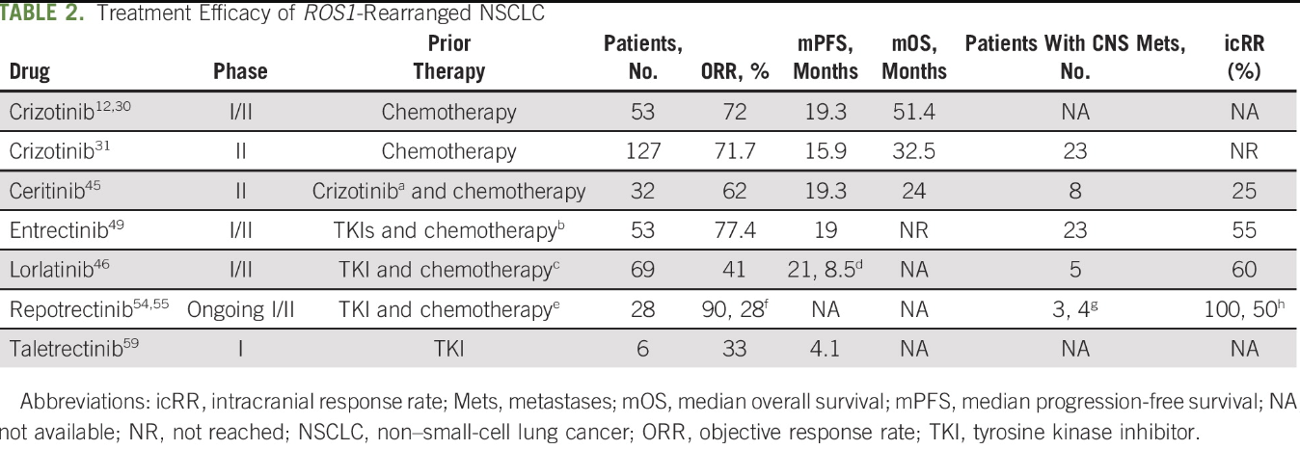
Treatment of ROS1 rearranged NSCLC
JCO Oncol Pract 2020;17:7-14.

Slide 17

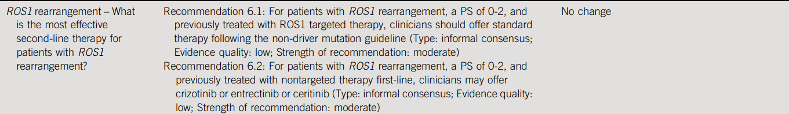
Treatment of ROS1 rearranged NSCLC
JCO.40:3310-3322.

Slide 18
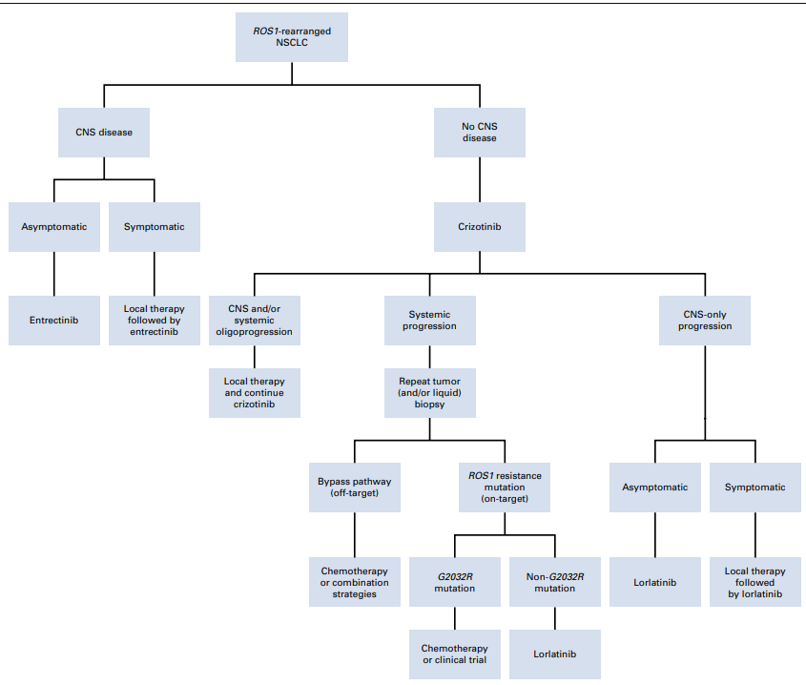
Treatment of ROS1 rearranged NSCLC
JCO Oncol Pract 2020;17:7-14.

Slide 19
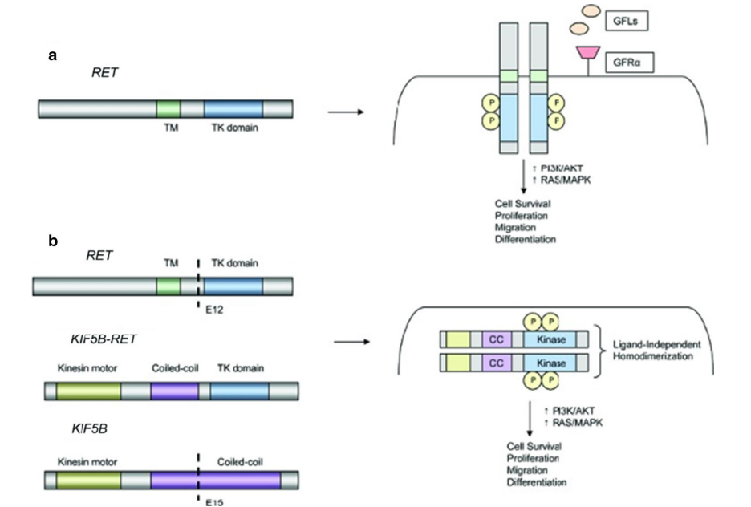
RET rearrangement
1~2% of NSCLC pts. & 10~20% of PTC
Younger age, Never smoker
Tumor histology : Adenocarcinoma
High risk of metastasis to the brain
More advanced stage
Exclusive of EGFR, ALK, KRAS, BRAF
J Hematol Oncol (2021) 14:50

Slide 20
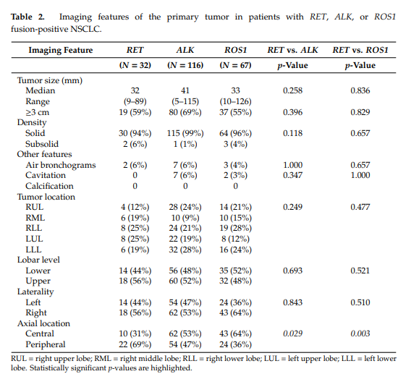
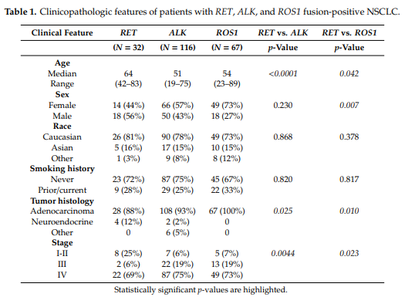
Radiologic features of RET rearranged NSCLC
Cancers 2020, 12, 69

Slide 21
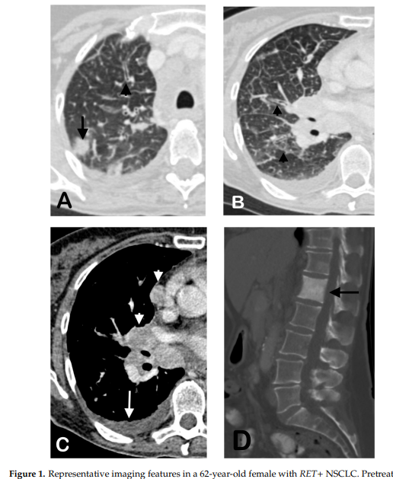
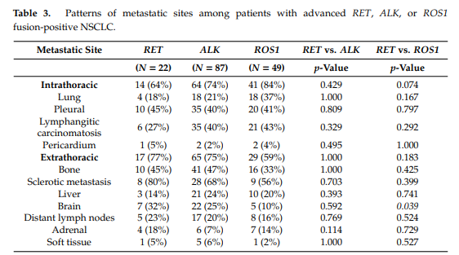
Radiologic features of RET rearranged NSCLC
Cancers 2020, 12, 69

Slide 22
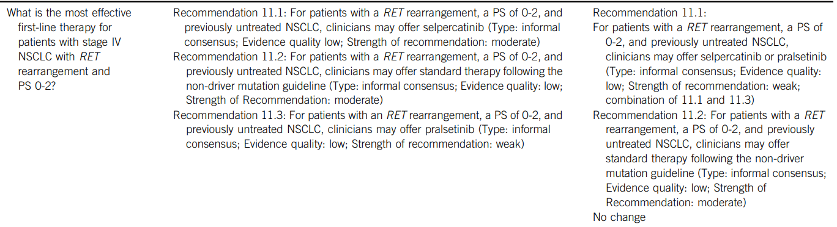
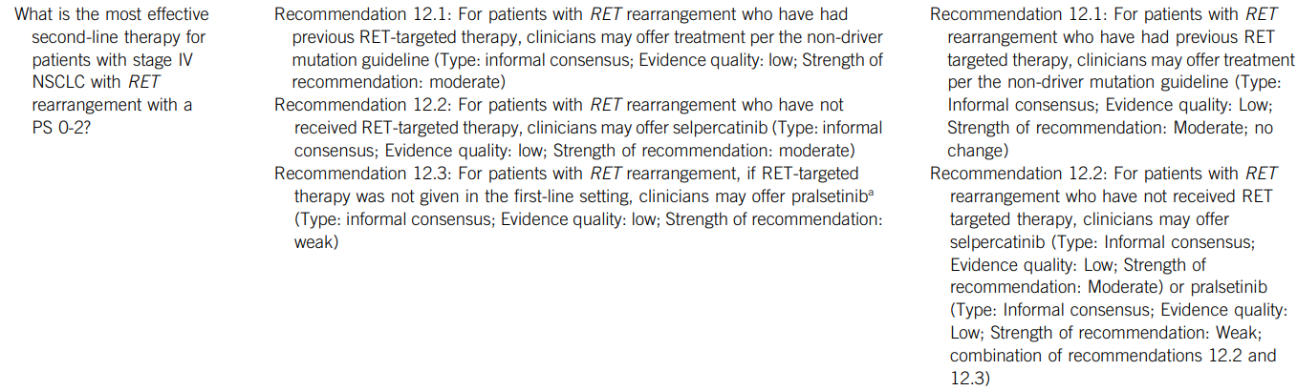
Treatment of RET rearrangement NSCLC
JCO.40:3310-3322.

Slide 23
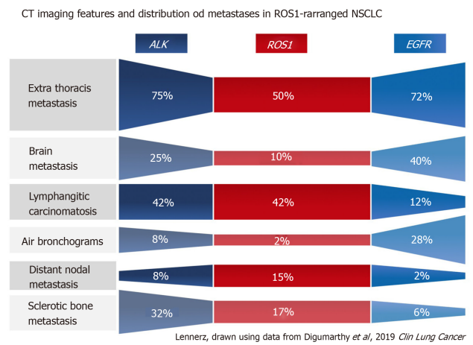
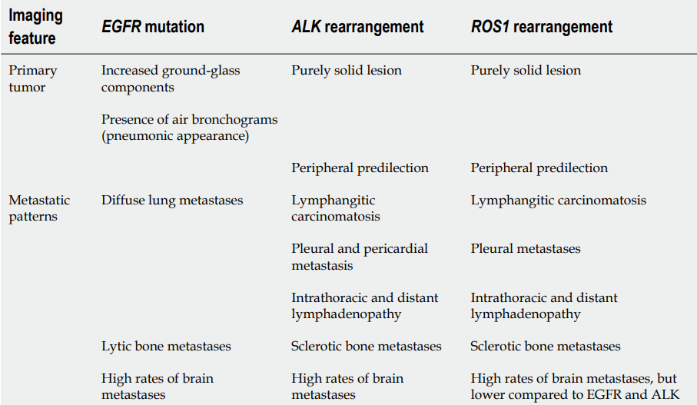
Take home message
Appropriate Molecular Testing
  Identification of oncogenic driver gene mutations (EGFR, ALK, ROS1, BRAF, RET, etc.) is essential for personalized treatment
Radiologic Features
  Radiologic imaging does not replace molecular testing but can support patient management
WJCO 2020 July 24; 11(7): 412-509

Slide 24
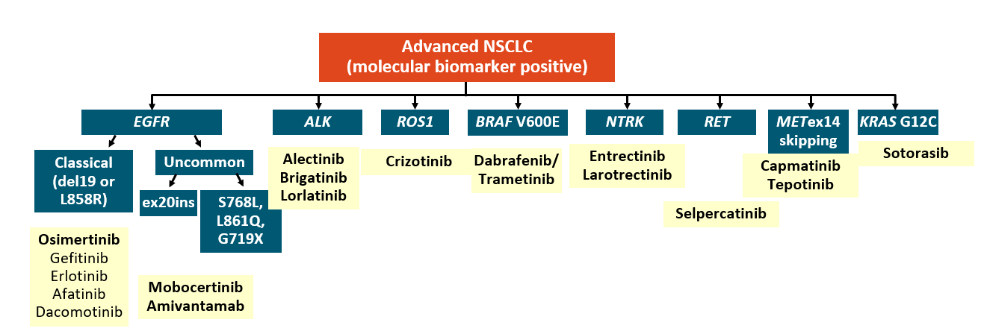
Take home message
Molecular biomarker and treatment

Slide 25
Thank you for your attention !

