Slide 1
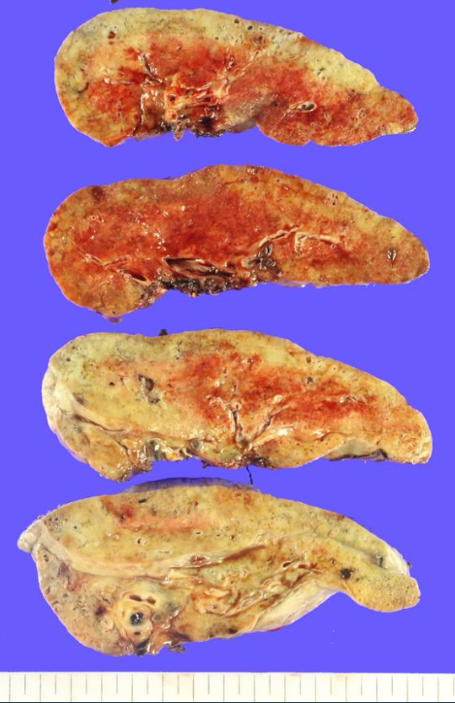
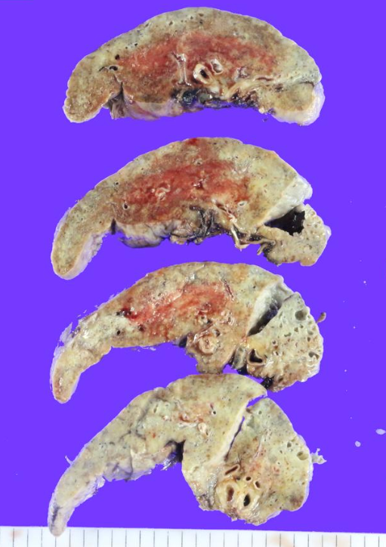
Case 1 김O영SS23-19666
Right
Left

Slide 2
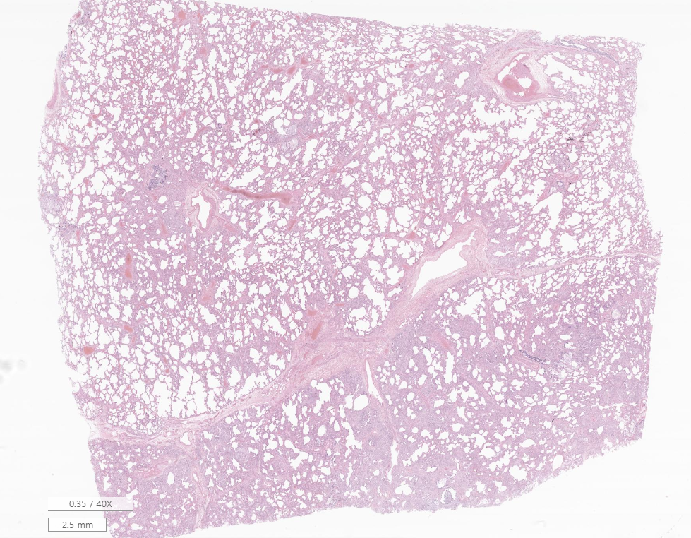
Case 1 김O영SS23-19666

Slide 3
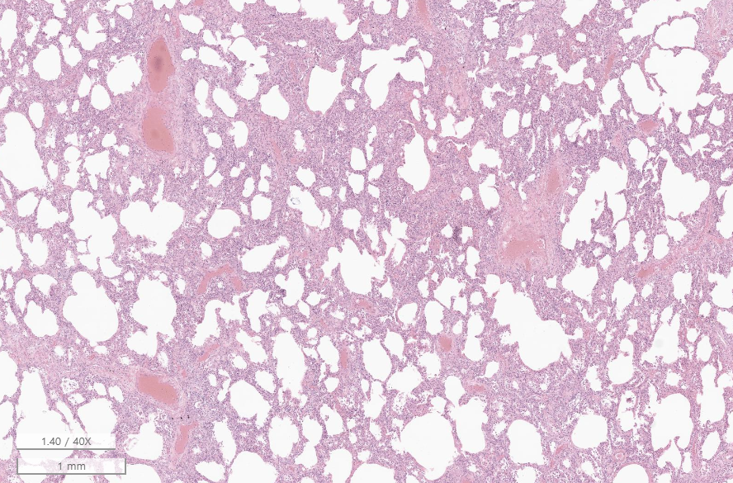
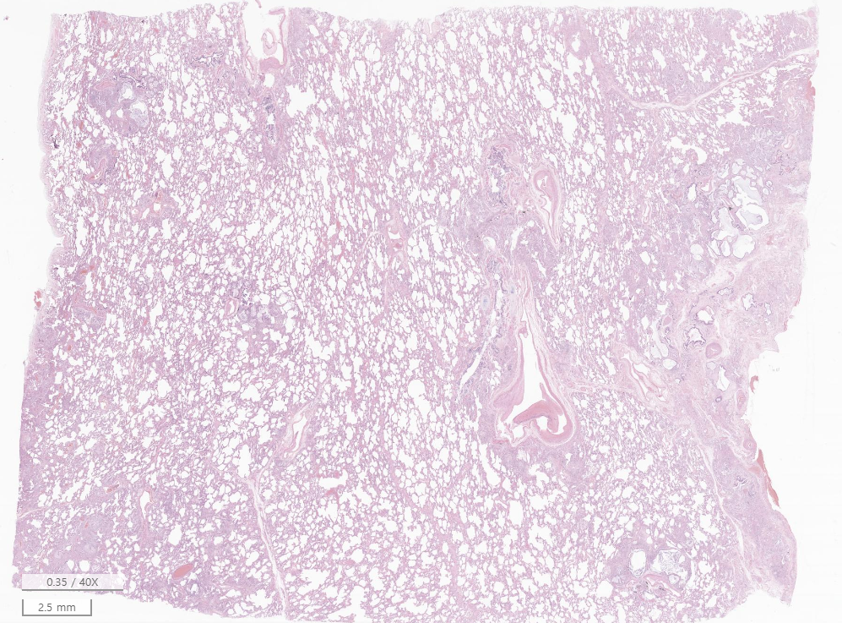
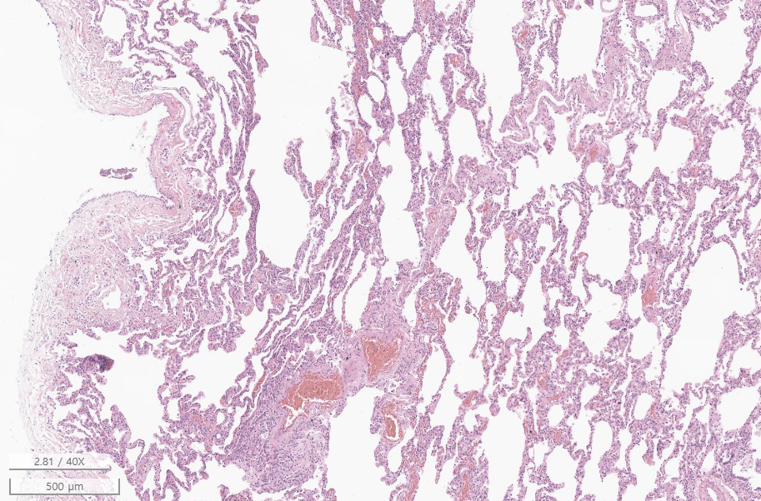

Slide 4
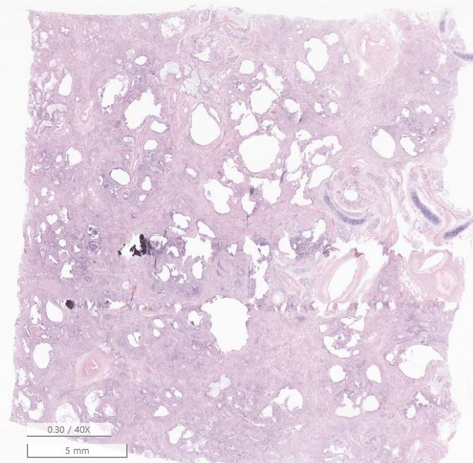
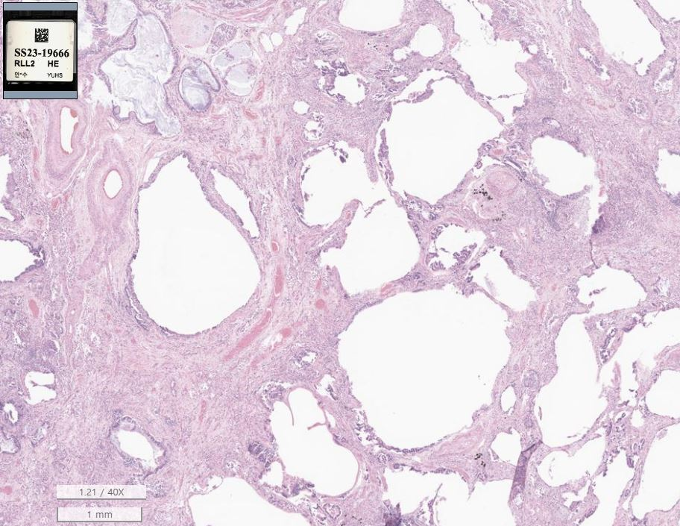

Slide 5
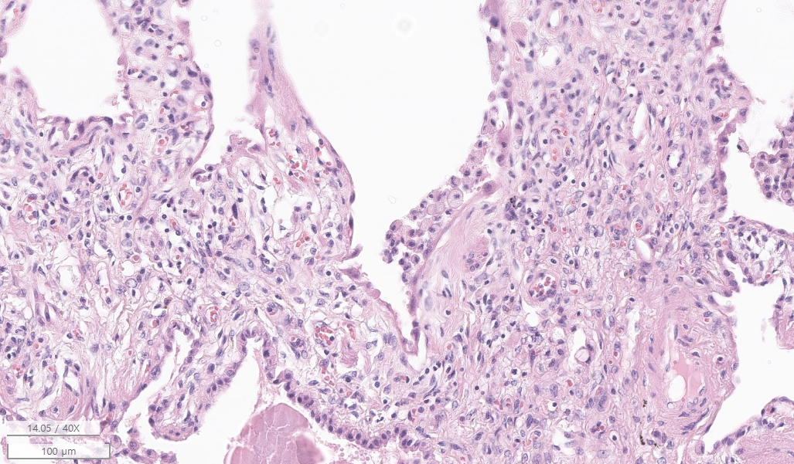

Slide 6
Case 1 김O영SS23-19666
Lung, bilateral, transplantation
Lung, right and left:
Chronic fibrosing interstitial pneumonia, consistent with non-specific interstitial pneumonia, fibrosing type (compatible with connective tissue disease-associated interstitial lung disease in the proper clinical context)
1) Marked fibrosis: Present
2) Honeycombing change: Present
3) Pleural and septal predominancy: Not prominent
4) Patchy involvement of lung parenchyma by fibrosis: Not prominent
5) Fibroblastic foci: Not prominent
6) Airspace enlargement: Present
7) Mild to moderate inflammation: Present
8) Lymphoid follicles / aggregates: Not prominent

Slide 7
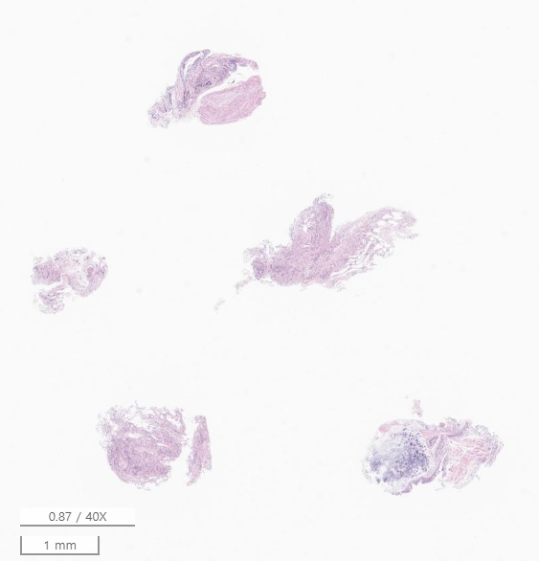
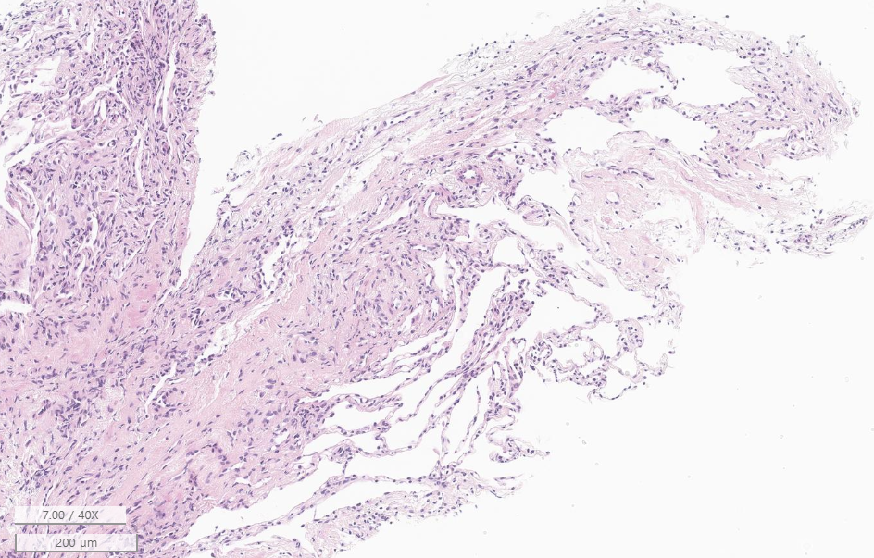
Case 2 조O현 SS22-15079
Lung, right lower lobe, transbronchial lung biopsy
Mild interstitial and intra-alveolar organizing fibrosis with inflammation, focal features of organizing pneumonia

Slide 8
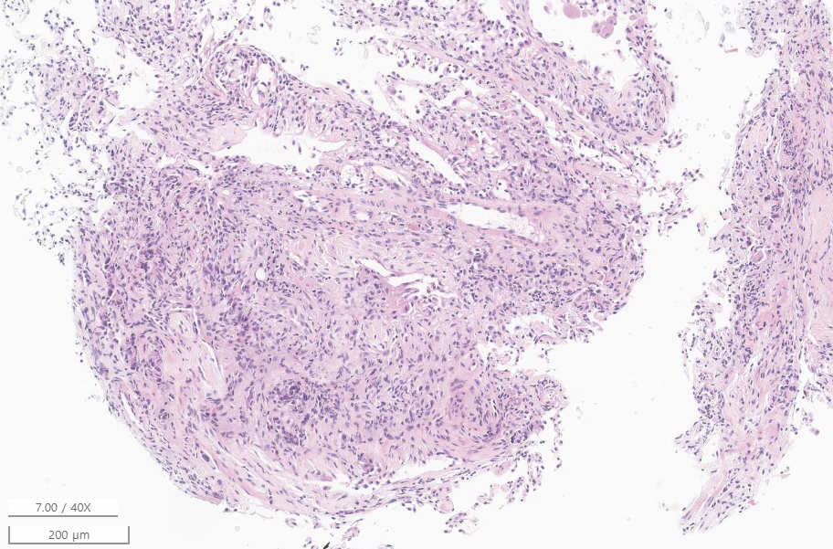
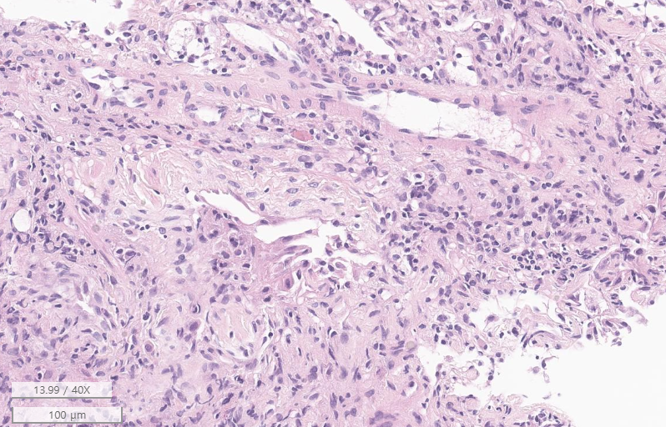

Slide 9
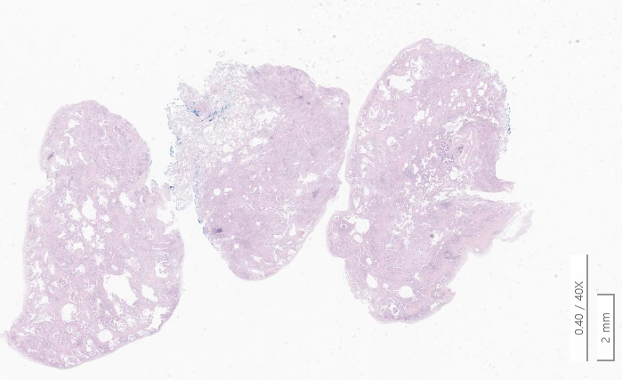
SS22-21060
Lung, left upper and lower lobe, VATS assisted wedge resection
LUL

Slide 10
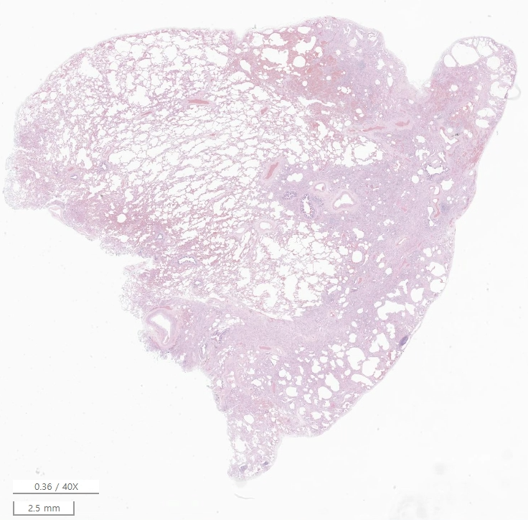
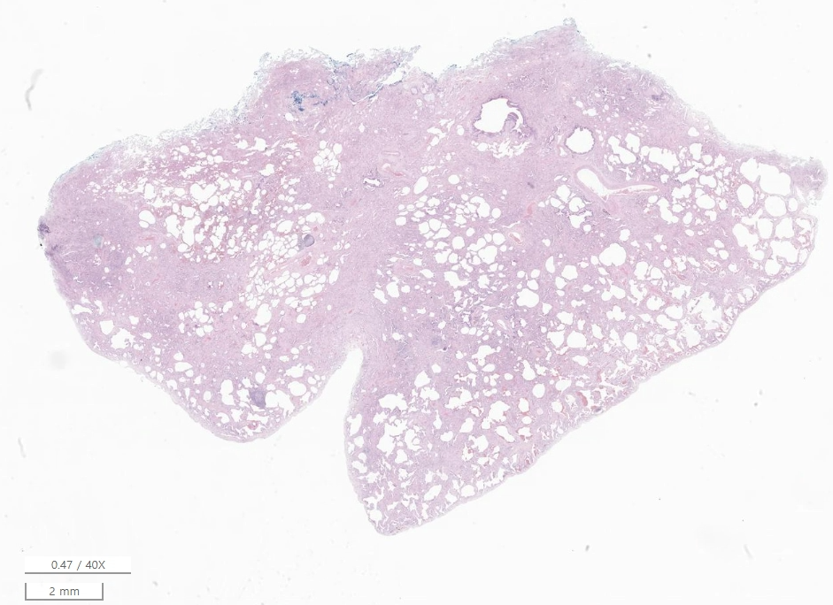
LLL

Slide 11
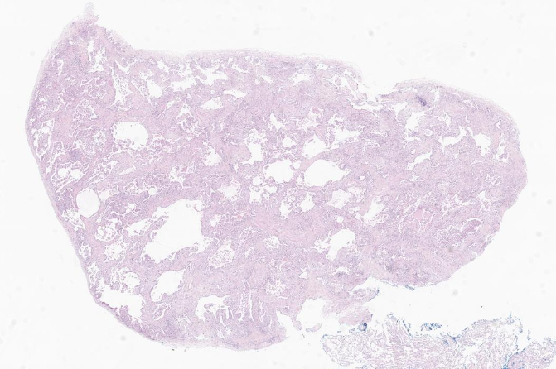
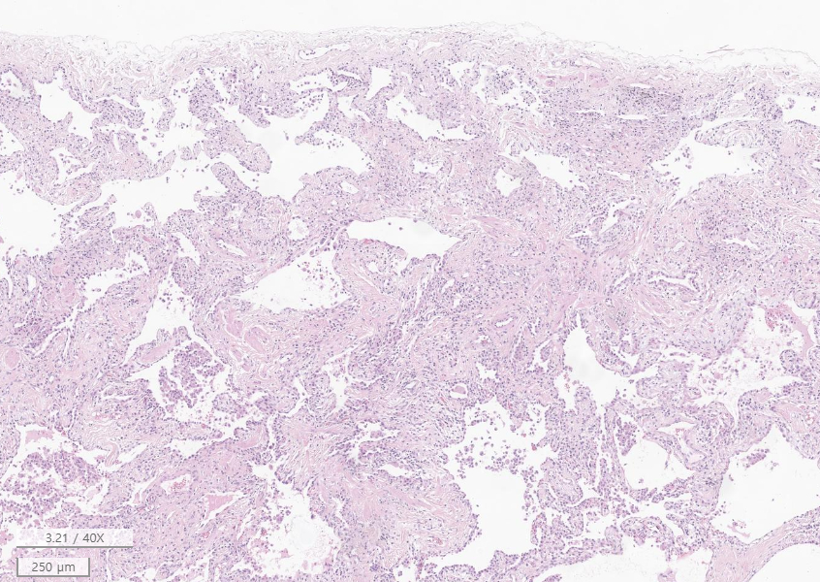

Slide 12
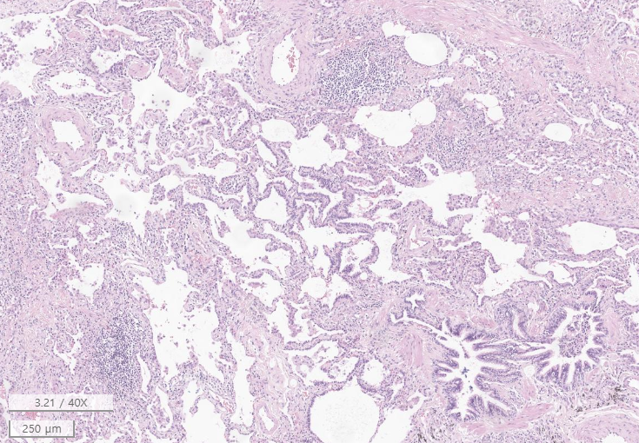
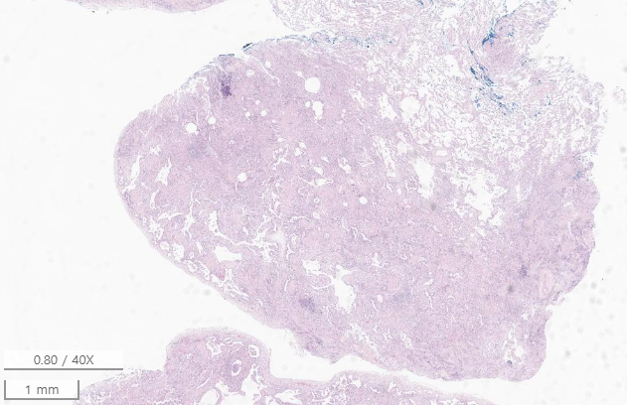
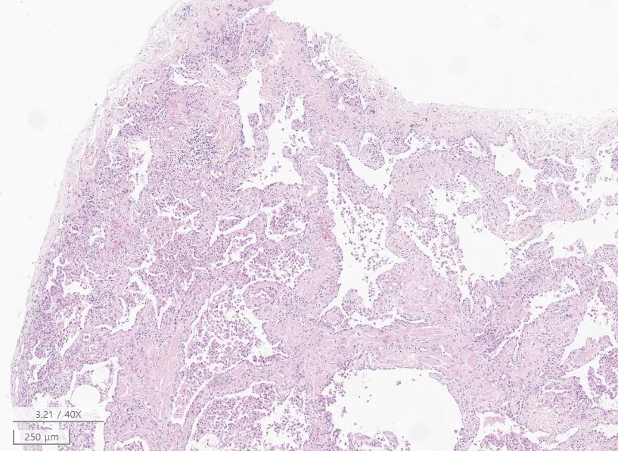

Slide 13
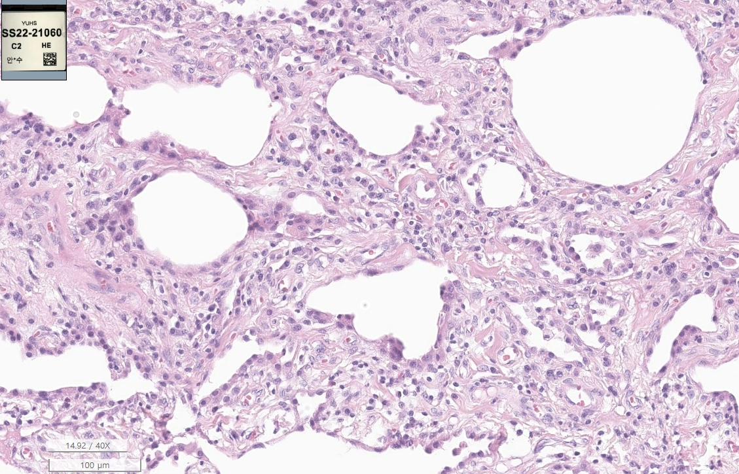

Slide 14
SS22-21060
Lung, left upper and lower lobe, VATS assisted wedge resection
Lung, left upper lobe, left lower lobe, No1 and left lower lobe, No2:
Nonclassifiable interstitial fibrosis, see note
1) Marked fibrosis: Present
2) Honeycombing change: Not prominent
3) Pleural and septal predominancy: Not prominent
4) Patchy involvement of lung parenchyma by fibrosis: Present
5) Fibroblastic foci: Not prominent
6) Airspace enlargement: Present
7) Mild to moderate inflammation: Present
8) Lymphoid follicles / aggregates: Present, mild
Note) 현재 조직만으로는 usual interstitial pneumonia (UIP)의 가능성은 낮아 보입니다. 전반적으로 fibrosing nonspecific interstitial pneumonia (fNSIP)와 유사한 relative uniform chronic interstitial fibrosis가 관찰되고 있으나, diffuse pattern이 아닌 patchwork pattern으로 관찰되고 있어 진단적이지 않습니다. Early lesion of UIP or fNSIP 및 interstitial pneumonia with autoimmune features의 가능성을 완전히 배제 할 수 없으니, clinical correlation/close follow up 하시기 권유드립니다.

